Slide 1

Movies & Shows Comparison
By: Satya Sakuntala NagaSravya Mattapalli, Zack Crowley, Edith Lotterman and Kevin Ybarra

Slide 2

What data did we use?
“Netflix Movies and TV Shows” dataset from Kaggle
Merged with “Netflix Titles” dataset from Kaggle to populate specific information for each movie and TV show
API call from OMDB to fill in all “NAN” values that were not in the “Netflix Titles” merge

Slide 3

Research Approach

Slide 4
What questions did we ask?
What are the most popular genres?
What are the most popular TV Shows and Movies?
Is there a difference in popularity between English vs Non-English Movies and Films?

Slide 5
Final Dataset
Merged the two datasets and performed an API call on OMDB
Deleted rows with null values
Cleaned up countries, runtime, and genre categories
Broke genre down by type and searched for top 6 genre types
Final Dataset
Full Country Name
Columns for drama, comedy, action, family, crime, and romance added
Ratings from PG to Not-Rated
2069 total rows
Shows that had multiple seasons in top 10 were grouped for some analysis

Slide 6
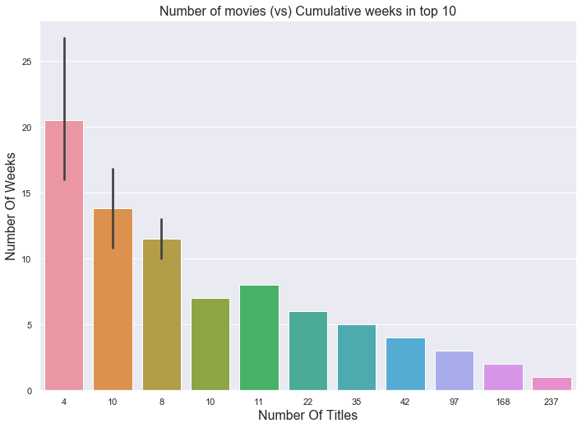
Exploratory Analysis
There are 644 total unique titles that we used for analysis
37% of titles only stay in the top 10 for 1 week
Only 4 titles have remained in the top 10 for more than 20 weeks
1.6% of all titles

Slide 7
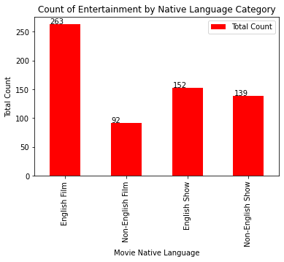
Dataset Overview

Slide 8
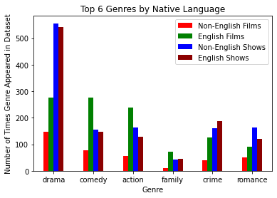
Genre Breakdown

Slide 9
Genre Breakdown

Slide 10
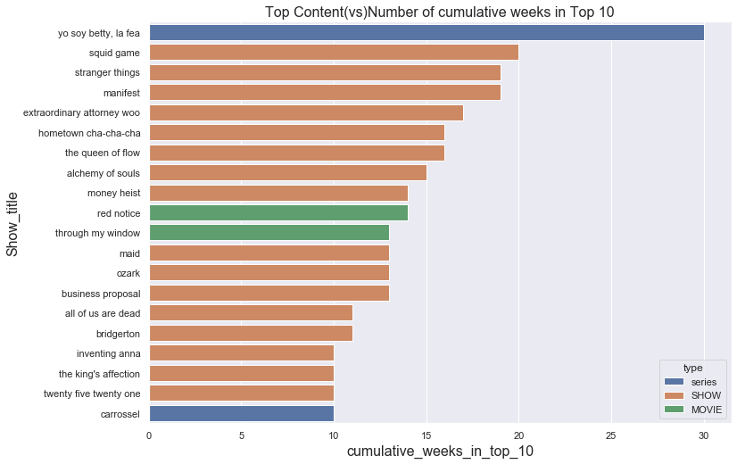

Slide 11
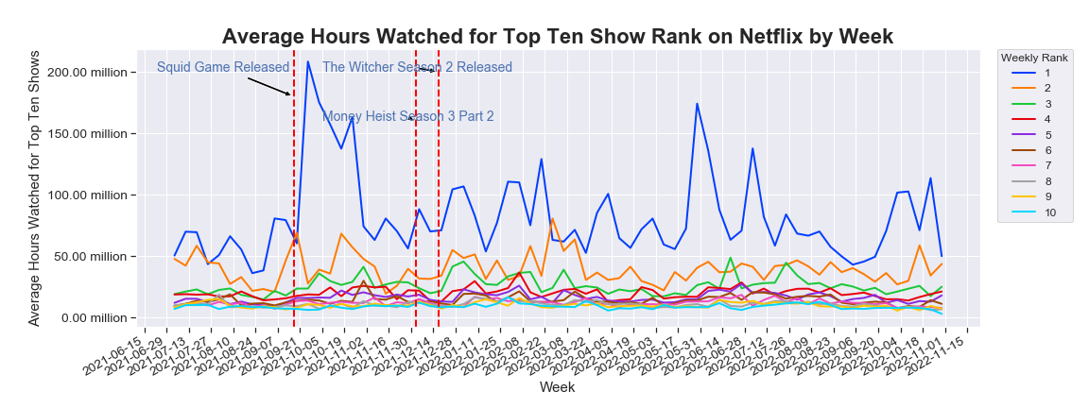
Conclusion

Slide 12
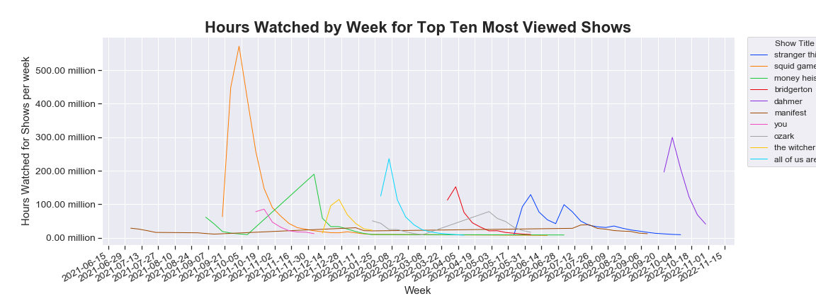
Drivers

Slide 13
Next Steps

