Slide 1

Movies & Shows Comparison
By: Satya Sakuntala NagaSravya Mattapalli, Zack Crowley, Edith Lotterman and Kevin Ybarra

Slide 2


Research Approach
When searching for a good dataset, we wanted to capture a set within the post-COVID era timeframe
The rise in Netflix during COVID period intrigued us and led us to want to dive in further to see what the world was watching post-COVID

Slide 3
What data did we use?
“Netflix Movies and TV Shows” dataset from Kaggle
Merged with “Netflix Titles” dataset from Kaggle to populate specific information for each movie and TV show
API call from OMDB to fill in all “NaN” values that were not in the “Netflix Titles” merge
The data provided captures from the week of 6/15/21 to 11/1/22

Slide 4
What questions did we ask?
What are the most popular genres?
What are the most popular TV Shows and Movies?
Is there a difference in popularity between English vs Non-English Movies and Films?

Slide 5
Final Dataset
Merged the two datasets and performed an API call on OMDB
Deleted rows with null values
Cleaned up countries, runtime, and genre categories
Broke genre down by type and searched for top 6 genre types
Final Dataset
Full Country Name
Columns for drama, comedy, action, family, crime, and romance added
Ratings from PG to Not-Rated
2069 total rows after deletion of NaN
Shows that had multiple seasons in top 10 were grouped for some analysis

Slide 6
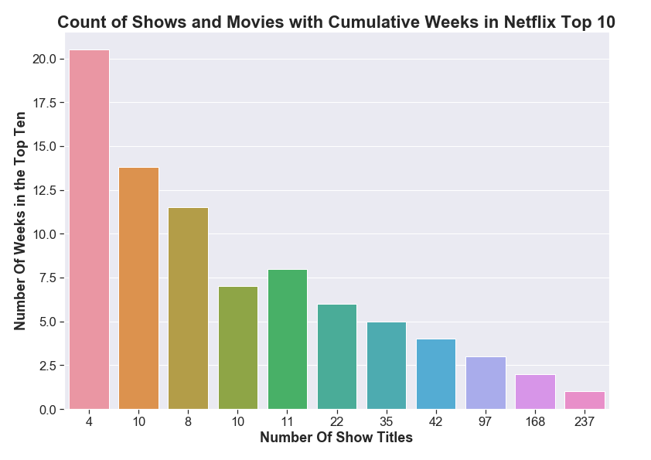
Exploratory Analysis
There are 644 total unique titles that we used for analysis
37% of titles only stay in the top 10 for 1 week
Only 4 titles have remained in the Top 10 for more than 20 weeks
1.6% of all titles

Slide 7
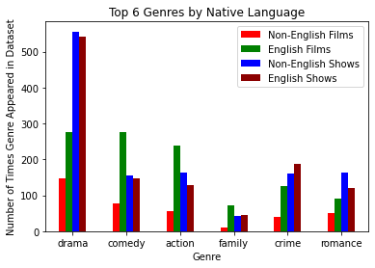
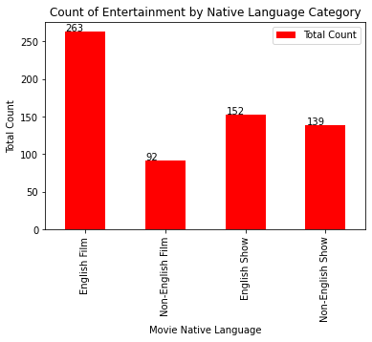
Dataset Overview

Slide 8
Genre Breakdown
Movie Count Chi-Square
TV Show Count Chi-Square
Non-English films vs. English films
Critical Value = 11.07
P Value = 2.8832517822160287e-08
Chi-Squared test output value of 43.53 dictating that these categories are very different
Non-English shows vs. English shows
Critical Value = 11.07
P Value = 0.045170554402416296
Chi-Squared test output value of 11.33 dictating that these categories are different, but not to the severity of films

Slide 9
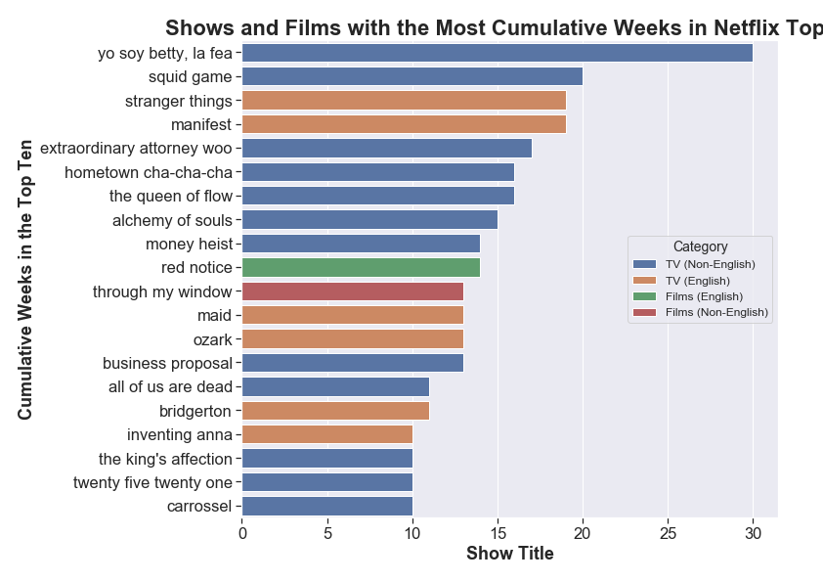
Who created the most impactful content?
From the data provided, the best content is regularly created in the form of TV shows
With only 2 movies making the list, we can assume that movies only create a short impact
TV shows have lasting impacts on viewership and retains viewers

Slide 10
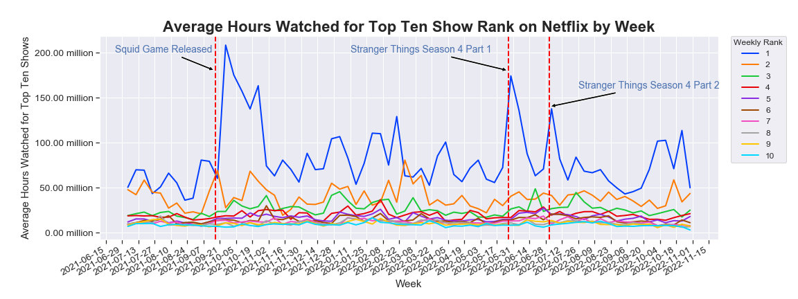
Top 10

Slide 11
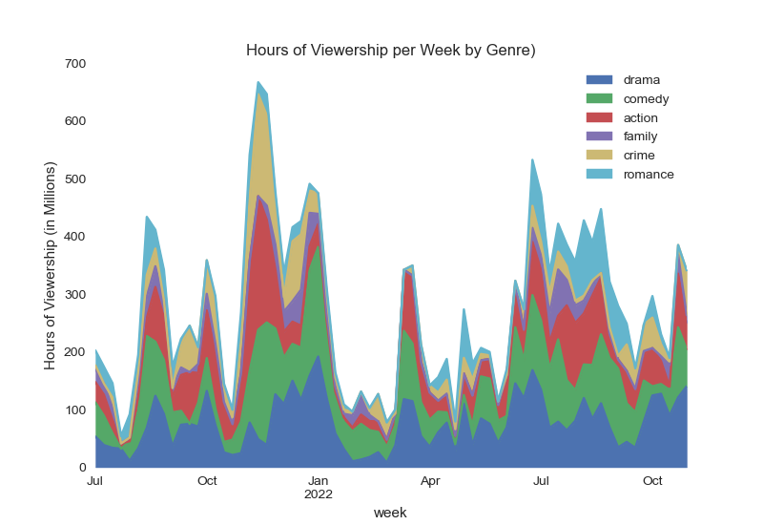
Dataset Overview
The data shown is a compounding line graph
The popularity of movie genres doesn’t seem to change throughout the year and remains consistent
Spikes come from popular releases over this time period

Slide 12
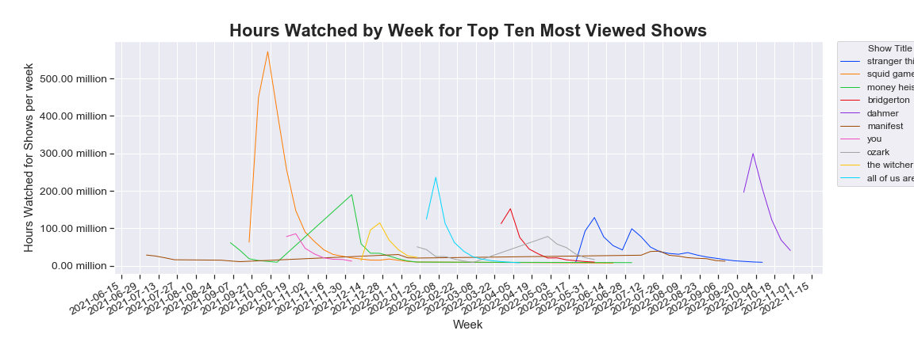
Drivers
The release dates of certain TV shows correlates with spikes in viewership that make up the top 10 TV shows
The show “Manifest” proved to have a lasting effect on viewers due to the longevity of viewer participation
The show “Squid Games” proved to have the greatest impact on viewer participation

Slide 13
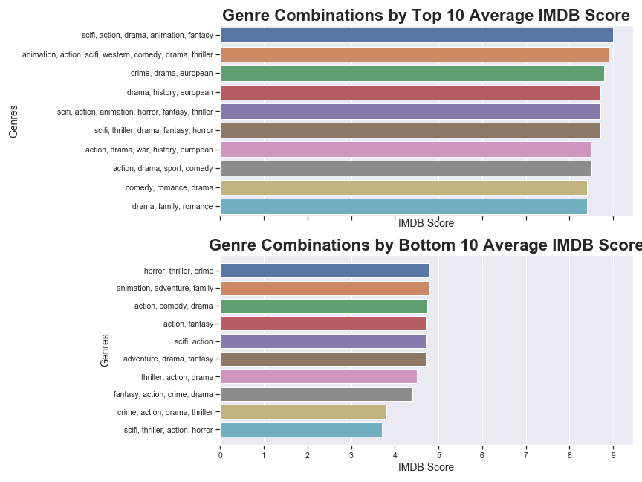
Genre Combinations
Only includes data with over 1,000 votes
From the Top 10 vs Bottom 10 viewership by Genre, we can assume that covering more Genres with net the film a better score
We can also assume that since all but one film covers drama, that drama is a genre that most viewers are searching for

Slide 14
Questions Again
What are the most popular genres?
What are the most impactful TV Shows and Movies?
Is there a difference in popularity between English vs Non-English Movies and Films?

Slide 15
Questions Answered???
The most popular genres are drama, comedy, action, crime, romance and family with drama TV shows being the most popular.
The 2 TV shows that stayed in the Top 10 the longest are “Yo soy Betty, La Fea” and “Squid Games” The 2 Movies that stayed in the Top 10 the longest are “Red Notice” and “Through My Window”
After performing Chi-Square tests, the data indicates that the relationship between Non-English and English movies and TV shows is indeed different

Slide 16
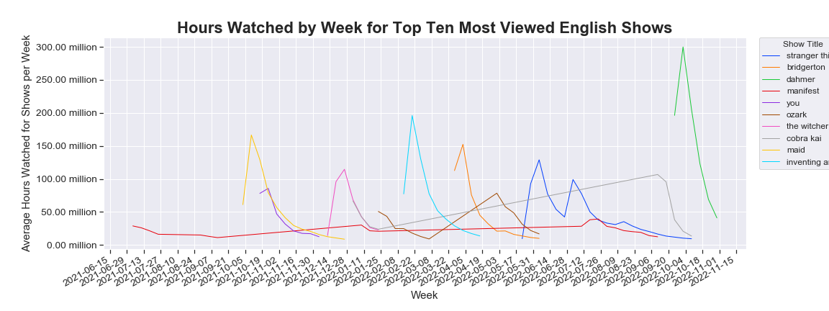
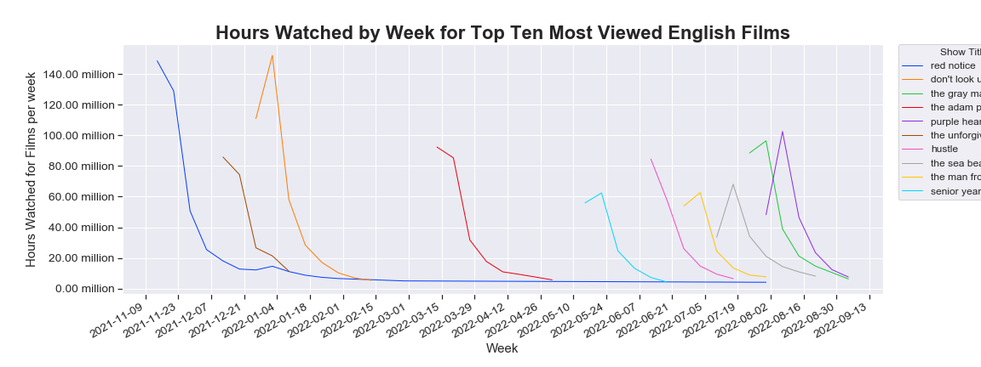
Data for US
Next Steps
How do ratings vary on the number of votes each film or TV show receives?
Are there films or TV Shows that were in the Top 10 before our dataset begin date?
How old were the TV shows or movies that made the Top 10 list on a consistent basis?
If there was another year in the dataset we could see better seasonal trends.

Slide 17
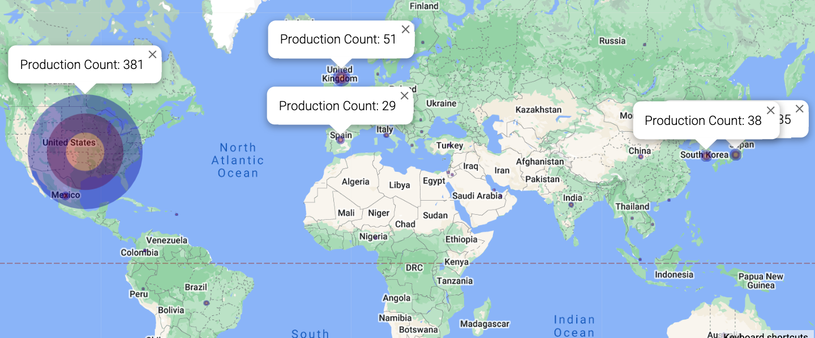
Production by Country

