Slide 1

CODESTREET • BENEFIT-UNDERUTILIZATION ANALYTICS
BenefitIQ
Turning unclaimed card value into measurable, real-time engagement
Team: [Your Team Name] • Karunya Institute of Technology and Sciences

Slide 2
THE PROBLEM
Card members don't know what they're leaving unclaimed
~70%
40%
23%
of rewards cardholders are sitting on some unused cash back, points, or miles
of rewards cardholders redeemed nothing at all in the past year
of cardholders claimed zero rewards over a 12-month period
LendingTree, 2022 survey
LendingTree, 2022 survey
CreditCards.com poll
These figures describe rewards points specifically. Protection & insurance-style benefits — this challenge's focus — have no running balance to remind a cardholder they exist, so real underutilization is likely higher still.
02

Slide 3


THE SOLUTION
Introducing BenefitIQ
See the value you've already paid for.
Detect
Quantify
Act
Reconcile every transaction against the full benefit-entitlement catalog in real time
Price every unclaimed entitlement in real dollars, not a vague “you have perks” flag
Prioritize and deliver the one nudge that matters — explained, timed, and rate-limited
03

Slide 4





HOW IT WORKS
One pipeline, two connected experiences
Ingest
Map
Quantify
Score
Nudge
Transactions +
catalog
Entitlement
matching
Dollar-value
gap
XGBoost
propensity
Right moment,
explained
Card Member Experience → “Value You're Missing” dashboard Business Analyst Experience → Portfolio ROI dashboard
04

Slide 5
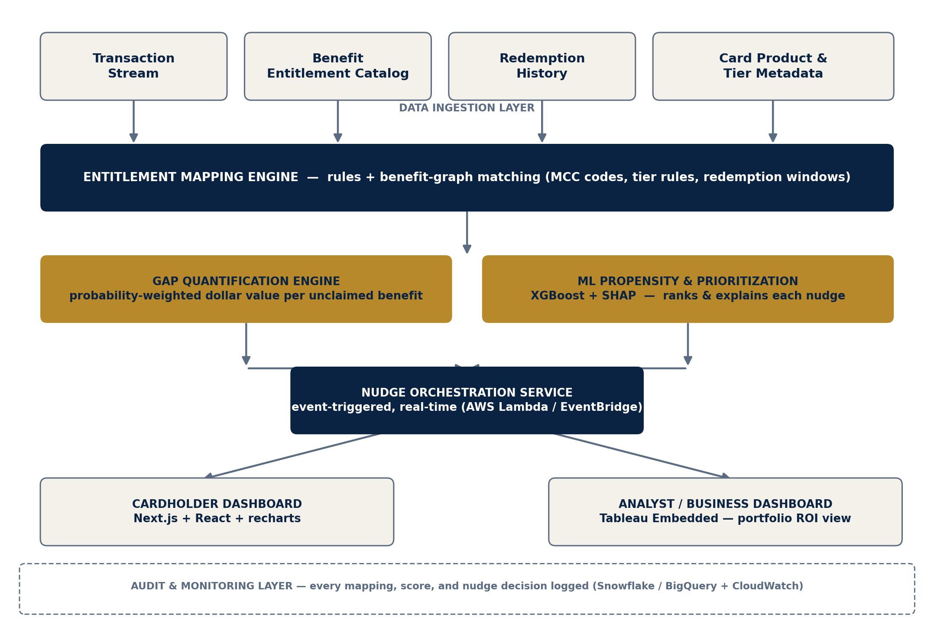
SYSTEM DESIGN
System Architecture — Seven Scalable Layers
05

Slide 6



WHY IT'S DIFFERENT
Built as a decision system, not a reporting tool
Benefit-entitlement graph
Hybrid rules + ML matching
Card benefits live in a structured catalog, not hardcoded rules — onboarding a new product is a config change, not a rebuild.
Eligibility is deterministic and auditable; nudge timing is a learned, adaptive propensity score.
Probability-weighted valuation
Built-in explainability
Every gap is priced from real redemption-value distributions and fires on contextual, event-based triggers.
SHAP attaches a plain-language reason to every nudge — for member trust and compliance audit trails.
06

Slide 7






TECHNOLOGY
Technical Stack — Exactly What This Theme Calls For
Frontend (Member)
Frontend (Analyst)
Backend & APIs
Data Analytics
Machine Learning
Cloud Platform
Data Warehouse
React, Next.js,
Tailwind, shadcn/ui
Tableau Embedded
Analytics
FastAPI (Python),
Node.js gateway
pandas, NumPy
XGBoost, scikit-learn,
SHAP
AWS Lambda,
EventBridge, S3
Snowflake / BigQuery
07

Slide 8
CARD MEMBER EXPERIENCE
“Value You're Missing” — In the App They Already Use
YOUR UNCLAIMED VALUE
Designed for immediate comprehension
$342
Leads with a single dollar figure — the number a member actually cares about
across 4 benefits this year
Travel Delay Insurance
$145
Category breakdown built with recharts, matching production dashboard patterns
Purchase Protection
$98
One-tap claim / activation path for every detected benefit, before it expires
Lounge Access
$65
Extended Warranty
$34
Expiring-soon benefits are visually flagged to create timely, not spammy, urgency
Claim Now →
08

Slide 9
BUSINESS ANALYST EXPERIENCE
The Same Signal, Rolled Up Into a Defensible ROI View
Aggregates unclaimed value by card product, tenure, and geography
Tracks before/after engagement uplift for every nudge campaign
Turns benefit-package design from a guess into a measured decision
Directional target to validate through a live A/B pilot — not a measured result.
09

Slide 10




NUDGE ENGINE
Right Benefit, Right Member, Right Moment
Event-triggered
Decay-based
A flight booking fires a travel-delay-insurance nudge within its relevant window.
Benefits nearing their redemption deadline surface automatically before they expire.
Threshold-based
Propensity-ranked & explained
Accumulated unclaimed value crossing a meaningful figure triggers a summary nudge.
XGBoost ranks who is likely to act; SHAP attaches a reason to every score — no blind broadcasts.
10

Slide 11




RIGOR
Testing & Evaluation Framework
Precision & Recall
AUC-ROC & Calibration
< 2s Latency
Simulated A/B Uplift
Entitlement mapping validated against a labeled synthetic test set
Propensity model scored on both accuracy and calibration quality
End-to-end target from transaction ingestion to nudge decision
Nudged vs. matched control cohort, before any real campaign spend
11

Slide 12






WHY IT HOLDS UP
Built to Scale, Built to Matter
SCALABILITY
BUSINESS IMPACT
Catalog-driven onboarding
Retention
New card products = a config change, not a rebuild
Members who see paid-for value in dollars are less likely to churn at renewal
Horizontally scalable services
Perceived value
Stateless FastAPI containers scale out under peak load
Reinforces AmEx's premium positioning by surfacing its least-visible benefits
Elastic, event-driven core
Product intelligence
Lambda/EventBridge — cost tracks real transaction volume
First dollar-denominated view of which benefits chronically go unused
12

Slide 13


PATH FORWARD
Implementation Roadmap
Round 1 — Now
Round 2 — If Shortlisted
Beyond the Hackathon
Entitlement catalog & synthetic dataset design
Architecture and algorithm design (this deck)
Working mapping + gap engines on synthetic data
XGBoost propensity model + SHAP explanations
Next.js dashboard with a live nudge simulation
Pilot on sandboxed, anonymized real data
Opt-in A/B nudge campaign with real members
Expand catalog across the full AmEx product suite
13

Slide 14
Thank You
BenefitIQ — See the value you've already paid for.
[Team Name] • [team.email@karunya.edu.in] • Karunya Institute of Technology and Sciences

