Slide 1
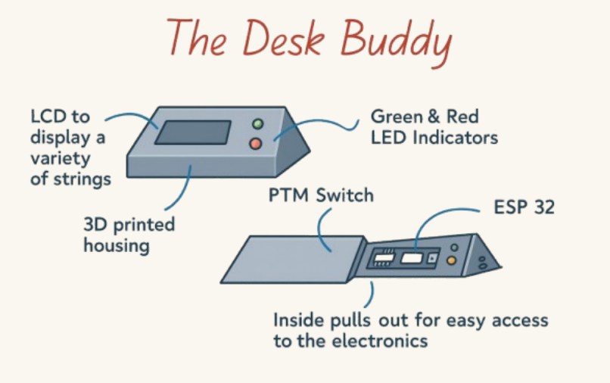
The Desk Buddy
An All-in-One Office Wellness and Productivity Monitoring System
Edmond Wilkinson | G00414989
BEng Software & Electronic Engineering
Supervisor: Paul Lennon | ATU Galway | 2025/26
Notes:
INTRO (30s) Hi, I'm Edmond Wilkinson and this is the Desk Buddy. The idea came from my placement at Fidelity Investments where colleagues were constantly interrupting people who were in meetings, because there was no visible signal. That was the starting point. From there it grew into a full office wellness system: monitoring your environment, posture, and noise all in real time on one dashboard. Let me walk you through what I built.

Slide 2
The Problem
🚨 Constant interruptions
🪑 Prolonged sitting
No signal when a colleague is in a meeting or focused. In open-plan offices there is no way to tell at a glance.
Office workers sit 6–9 hrs/day. Research links this to 50% higher cardiovascular risk without movement breaks.
🔊 Open-plan noise
📐 Poor posture
85% of open-plan workers report inability to concentrate due to noise. Sustained noise above 65 dB degrades cognition.
Forward head posture is the most common work musculoskeletal complaint. It develops slowly and goes unnoticed.
Notes:
THE PROBLEM (45s) Four real problems happening in the same office simultaneously. No availability signal, so people get interrupted constantly. Prolonged sitting is genuinely dangerous — there is solid research linking it to cardiovascular problems. Open-plan offices are loud and noise measurably degrades concentration. And poor posture develops so gradually people don't notice until they already have neck pain. Every one of these has commercial solutions but they are all separate products. Nobody has put them together. That is the gap the Desk Buddy fills.

Slide 3
What I Built
ESP32 Hardware
MediaPipe Pose Worker
DHT22 (temp/humidity) + HC-SR04 (distance). Transmits JSON over USB serial once per second.
Runs at 1.5 FPS on default webcam. Tracks ear + shoulder landmarks. Produces slouch score vs calibrated baseline (in settings).
Python FastAPI Backend
React Frontend Dashboard
Auto-detects ESP32, stores readings in PostgreSQL, streams all data over WebSocket
Live sensor tiles, noise level card, posture card, historical charts. WebSocket updates.
Audio Worker
PostgreSQL + Docker
Captures microphone input, computes RMS dB with smoothing. Classifies noise into 4 configurable bands. (Quiet, Low, Medium, Loud)
Stores all readings, posture events, calibration data.
Notes:
WHAT I BUILT (60s) Six components. Hardware: ESP32 with DHT22 and HC-SR04 transmitting JSON every second. Python FastAPI backend auto-detects the ESP32, stores data in PostgreSQL in Docker, streams everything over WebSocket. An audio worker captures the system microphone, computes RMS decibels with smoothing, classifies into four configurable noise bands. A webcam worker runs MediaPipe Pose at 1.5 FPS tracking ear and shoulder landmarks for a calibrated slouch score. React frontend in the browser updates live. PostgreSQL with composite indexes for fast historical queries.

Slide 4
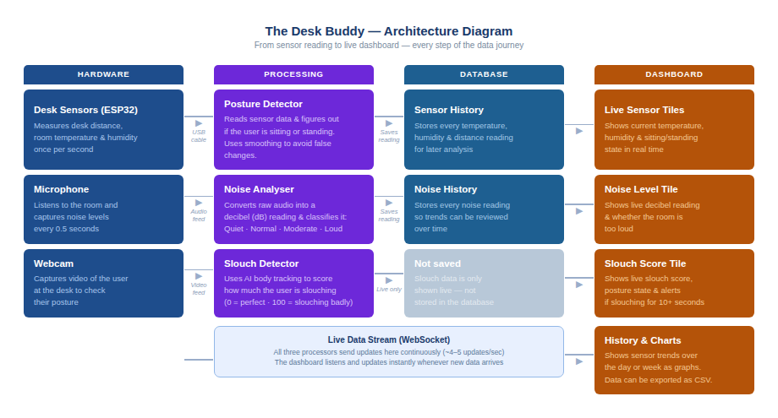
System Architecture
Three independent workers feed one WebSocket stream. React dashboard updates in real time without polling.
Notes:
ARCHITECTURE (45s) Four layers. Hardware on the left: ESP32 sensors, system microphone, webcam. Three processing workers in the middle running concurrently: serial reader, noise analyser, posture worker. They all write to PostgreSQL and push onto the same WebSocket stream. The React dashboard on the right subscribes and renders everything live. The key design decision is that the three workers are completely independent — if the webcam is not available the rest still works. Graceful degradation throughout.

Slide 5
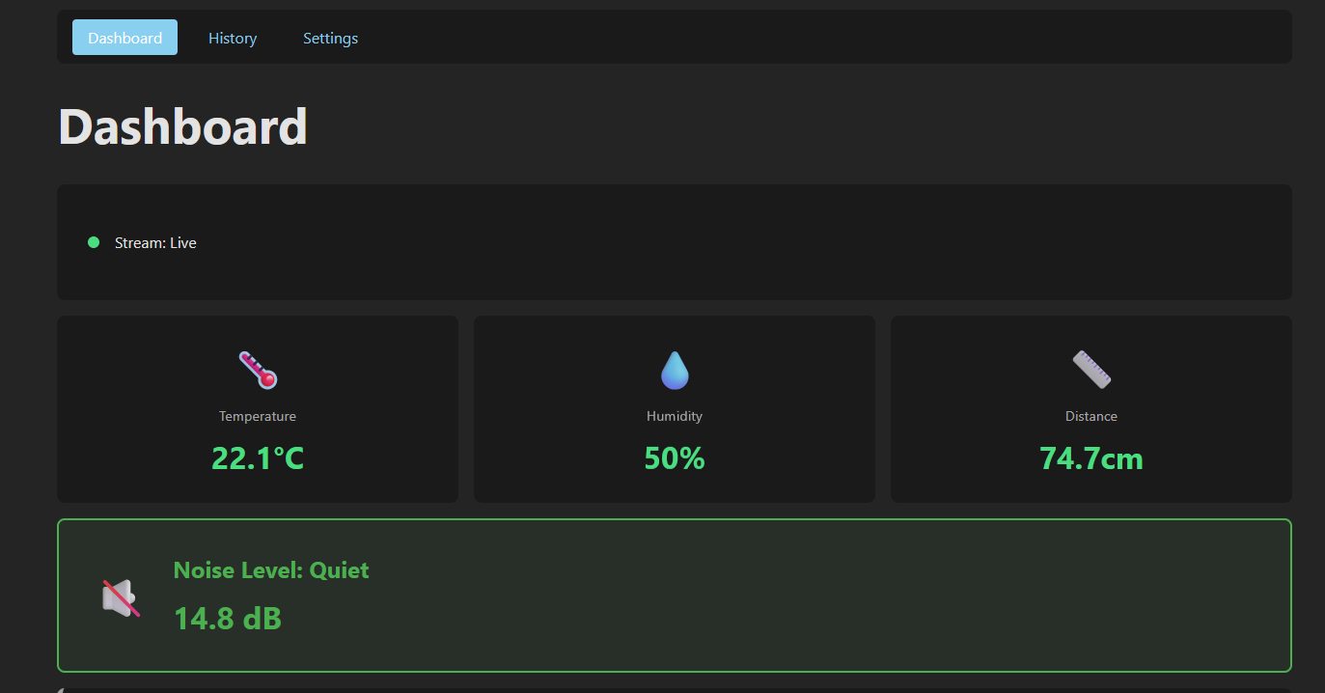
The Live Dashboard
Stream: Live
WebSocket active. UI updates 4-5x/sec from all three workers simultaneously.
Sensor Tiles
22.1°C · 50% humidity · 74.7cm distance — live from ESP32.
Noise: Quiet 14.8 dB
Card colour changes green → blue → orange → red as noise increases through bands.
Posture: SITTING
Distance-based detection. Today's hours shown below. Backend status and ESP32 connection at bottom.
Notes:
LIVE DASHBOARD (45s) This is a screenshot of the real running dashboard. Top: Stream Live green dot means WebSocket is connected. The three sensor tiles show real-time temperature, humidity, and distance from the ESP32. The noise card is green at 14.8 dB — Quiet. If noise goes above 50 dB it turns blue, above 60 orange, above 70 red. The posture card shows SITTING with the current distance reading. Below that are today's accumulated sitting and standing hours. The backend status confirms the server and database are healthy, and the ESP32 connection card shows COM5 with a disconnect button.

Slide 6
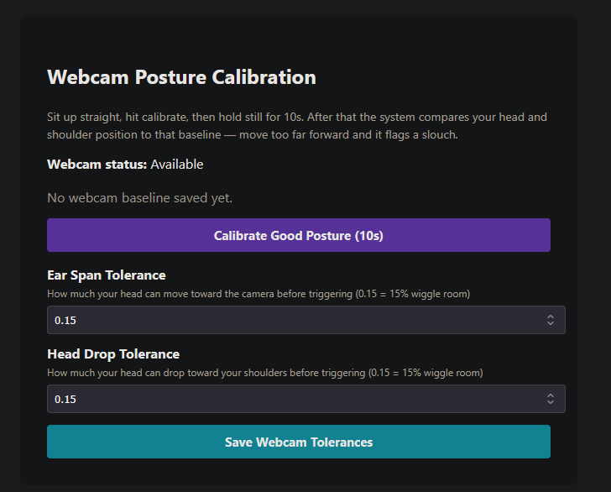
Posture and Noise Detection
Distance-Based Sitting / Standing
MediaPipe Pose Slouch Detection
1
HC-SR04 reads distance (cm)
Tracks: LEFT_EAR, RIGHT_EAR, LEFT_SHOULDER, RIGHT_SHOULDER
Ear span grows → head moves toward camera
Head-shoulder gap shrinks → forward lean
Score 0–100 vs calibrated good-posture baseline
15% tolerance each axis · 1.5s state gate
Browser notification after 30s slouching
2
5-sample rolling average smoothing
3
Hysteresis check (±5cm buffer zone)
4
3-second minimum duration gate (avoid false positives)
5
State confirmed → DB event logged
Quiet
Normal
Moderate
Loud
All noise thresholds configurable per environment
< 50 dB
50–60
60–70
> 70 dB
Notes:
POSTURE AND NOISE (75s) Distance-based detection: HC-SR04 reads every second, 5-sample rolling average removes noise, hysteresis buffer prevents flickering at the boundary, 3-second minimum duration gate means a single errant reading cannot change the state. Clean and reliable. The webcam detection went through three approaches. First plan was ESP32-S3 onboard camera but the board had a hardware fault — overheating and corrupted frames. Second attempt: face bounding box area as a proxy for forward head position, but it was too sensitive to lighting changes and camera auto-exposure. Third approach: MediaPipe Pose with four landmarks. Ear span grows as the head moves forward. Head-shoulder gap shrinks as the head drops. Both compared to a calibrated good-posture baseline with 15% tolerance. State needs to be consistent for 1.5 seconds before it changes. After 30 seconds of sustained slouching the user gets a browser notification. Noise is simpler: RMS amplitude, convert to dB, rolling average smoothing, classify into four configurable bands.

Slide 7
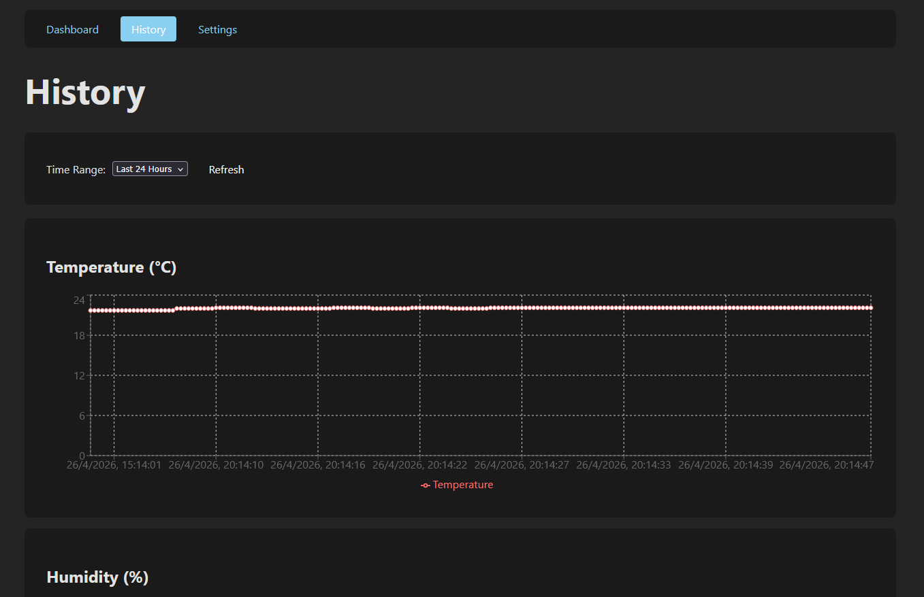
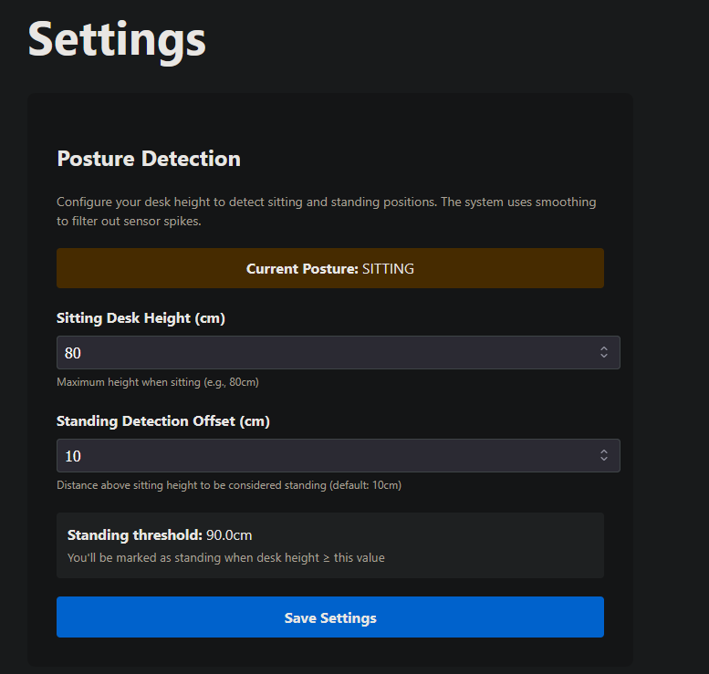
History and Settings
History Page
Settings Page
Sitting height + standing offset → computed threshold
Automatic calibration: record both heights in-situ
Noise band thresholds all configurable
10-second good-posture webcam baseline capture
Ear span and head drop tolerances adjustable
Time-series charts: temperature, humidity, distance, noise.
1h / 6h / 24h / 7d time range. Server-side time-windowed SQL queries with composite indexes on (sensor, ts).
Notes:
HISTORY AND SETTINGS (45s) The History page shows time-series data for all four sensor streams. I had a performance problem early on where the page was fetching all records and filtering them in the browser. Once the database had a few hours of data it became noticeably slow. The fix was moving the time windowing into the SQL query and adding composite indexes on sensor and timestamp. Query time dropped from several seconds to under 100 milliseconds. The Settings page is fully configurable. You set your sitting desk height and the offset above it that triggers standing. There is an automatic calibration flow where you physically sit and stand at your desk and it records both heights and sets the threshold at the midpoint. Noise thresholds are all user-configurable per environment. And for the webcam posture you run a 10-second good-posture calibration and can tune the tolerance values.

Slide 8
Challenges
ESP32-S3 Hardware Fault
3 Posture Detection Attempts
Problem: Bought for onboard camera. Overheated immediately, produced corrupted frames, reset randomly.
Problem: S3 camera failed. Face bounding-box area too sensitive to lighting and auto-exposure.
Fix: Switched to standard ESP32 + host webcam. Better camera quality and more CPU for MediaPipe.
Fix: MediaPipe Pose: 4 landmarks (ears + shoulders). Ear span and head-shoulder gap are physically meaningful.
History Page Performance
Camera Exclusivity
Problem: Fetching all DB records and filtering in browser became slow once hours of data accumulated.
Problem: OpenCV held webcam exclusively. Browser getUserMedia failed while backend worker was running.
Fix: Server-side time-windowed SQL + composite indexes on (sensor, ts). Seconds → under 100ms.
Fix: Pause/Resume: stop backend worker, release camera, then browser preview opens. Reversed on resume.
Thread-Safe WebSocket Broadcast
PostgreSQL Startup Race
Problem: Audio and webcam workers run in threads. Cannot await async broadcast from outside event loop.
Problem: Backend started before Docker PostgreSQL finished initialising — connection refused on cold start.
Fix: Stored event loop at startup. Used asyncio.run_coroutine_threadsafe() from worker callbacks.
Fix: Retry loop in init_db.py: 8 attempts with 5s delay. Waits gracefully for DB to become ready.
Notes:
CHALLENGES (60s) These are the real problems I hit. The ESP32-S3 one was the most disruptive — cost me weeks. The board was faulty, overheating constantly, and I had to redesign the posture detection entirely. Switching to the host webcam with MediaPipe actually produced a better result. Posture detection went through three approaches total. Hardware fault killed the first. Bounding box area was too unreliable for the second. MediaPipe landmarks work well. Camera exclusivity was annoying but the solution is clean. Thread safety for the WebSocket broadcast was subtle — you can not call an async function directly from a background thread in Python. The PostgreSQL startup race was a cold-start Docker problem fixed with a retry loop.

Slide 9
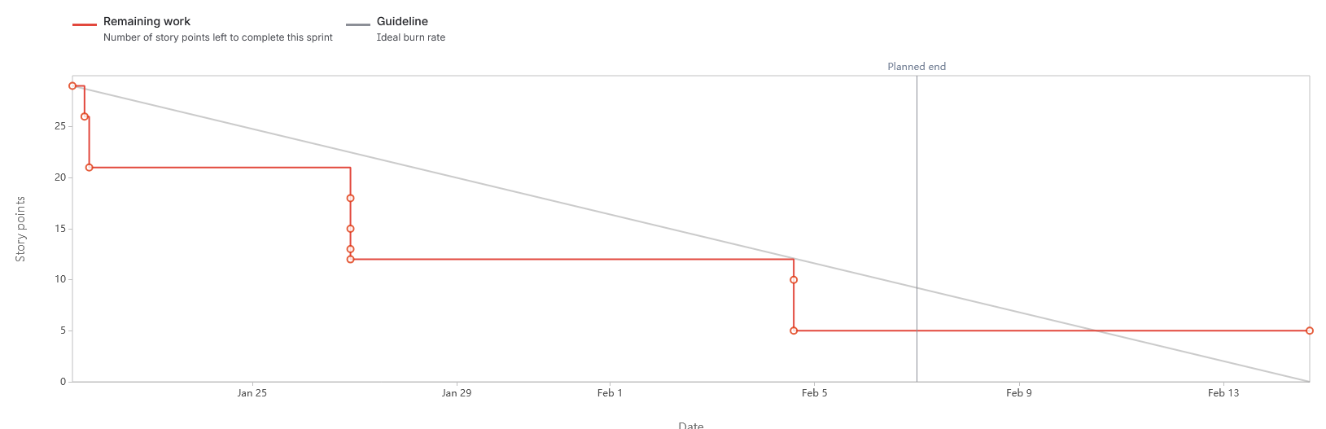
Project Management
Jira Sprint Burndown — Sprint 1 (Jan–Feb 2026)
Agile Approach
Hardware Integration
Backend API + Serial
WebSocket Streaming
Frontend Dashboard
History + Charts
Audio Monitoring
Posture Detection
Settings + Calibration
Documentation
28 story points · slow start while scaffolding · sharp drop 27–29 Jan when serial + WebSocket clicked · 5pts carried
Tools
Jira Sprint planning, backlog, burndown
OneNote Weekly logs all year
GitHub github.com/Edmentos/TheDeskBuddyApp
Notes:
PROJECT MANAGEMENT (30s) Jira throughout with sprints, epics, user stories, and story point estimates. This is the burndown from Sprint 1. Classic pattern: slow start while scaffolding architecture, then a sharp drop when the serial connection and WebSocket integration all clicked at once around the 27th of January. That moment when data first flows end to end from the sensor to the screen — that is the inflection point. I also kept weekly OneNote logs all year which were invaluable when writing the report.

Slide 10
Conclusion and Future Work
What was delivered
Future Work
Live ESP32 sensor dashboard (temp, humidity, distance)
Sitting/standing detection with hysteresis + duration gate
Ambient noise monitoring with 4 configurable bands
MediaPipe webcam slouch detection + calibration
30-second sustained slouch browser notification
PostgreSQL storage with fast indexed queries
History charts with 4 configurable time ranges
Fully configurable Settings page
Docker + start.bat one-command startup
Microsoft Teams integration — LED updates from call status (original motivation)
Package as Tauri native desktop app
RFID badge reader for desk booking
Gamified standing leaderboard (opt-in)
macOS / Linux cross-platform support
Standing reminder notifications
Improved posture detection in varied lighting
Notes:
CONCLUSION (30s) The system works. All four data streams live, dashboard updates in real time, posture detection calibrated and reliable, whole stack from a single start.bat command. The challenges were real but working through them produced a better result. The future work is genuinely exciting — the Teams integration was the original idea and Tauri packaging to make it a proper native app are both natural next steps. Thank you.

Slide 11
Thank You
Edmond Wilkinson · G00414989
BEng Software & Electronic Engineering · ATU Galway · 2025/26
github.com/Edmentos/TheDeskBuddyApp
Notes:
Q&A PREP: - Why PostgreSQL not SQLite? Docker makes it easy, composite indexes work better for EAV queries. - Why not a desktop app? That is in future work as Tauri packaging. Browser frontend is simpler to develop and demo. - How accurate is posture detection? Depends on calibration quality and lighting. 15% tolerance handles normal movement. - What happened with the ESP32-S3? Hardware fault — constant overheating and corrupted frames. Switched to standard ESP32. - Why MediaPipe over a custom CNN? Faster to build, runs on CPU, four-landmark geometry is physically meaningful. - Is audio data private? Only the dB level is stored. The system cannot record or replay anything said.

