Slide 1
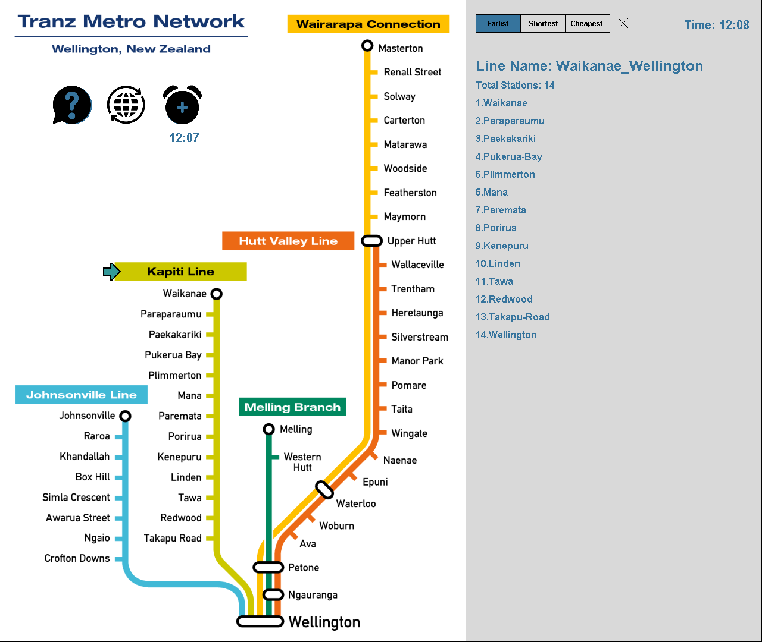
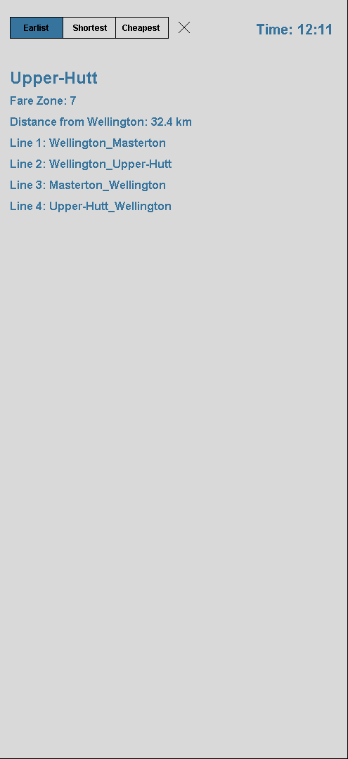
UI Design (Information Enquiry)
Intention Time
-Showing 9:00 by default
All elements will show up, disappear, refresh at the right time.
Intention time can be changed by clicking the alarm icon. The input format has to be “HHmm”
Intention time is set to 9:00 by default for testing purpose, otherwise setting to system time will be more logical.
System time
-will be updated together with the UI refreshing
Enquiry Mode
-Activated by default
Travel preference
-Earliest is chosen by default
-Can be cleared by clicking the cross following behand
Information Area
-Show Line after user clicked a station name (red frame)
-Show station info after user clicked a station name (red frame)
Station Enquiry
Train Line Enquiry
Train Line Info
-Showing after user clicked a train line name (red frame) -The sequence of the stations is set to be in line with the diagram.
Notes:
-Showing system by default.
-can input a intention time by clicking
-the time need to be in the format of “HHmm”

Slide 2
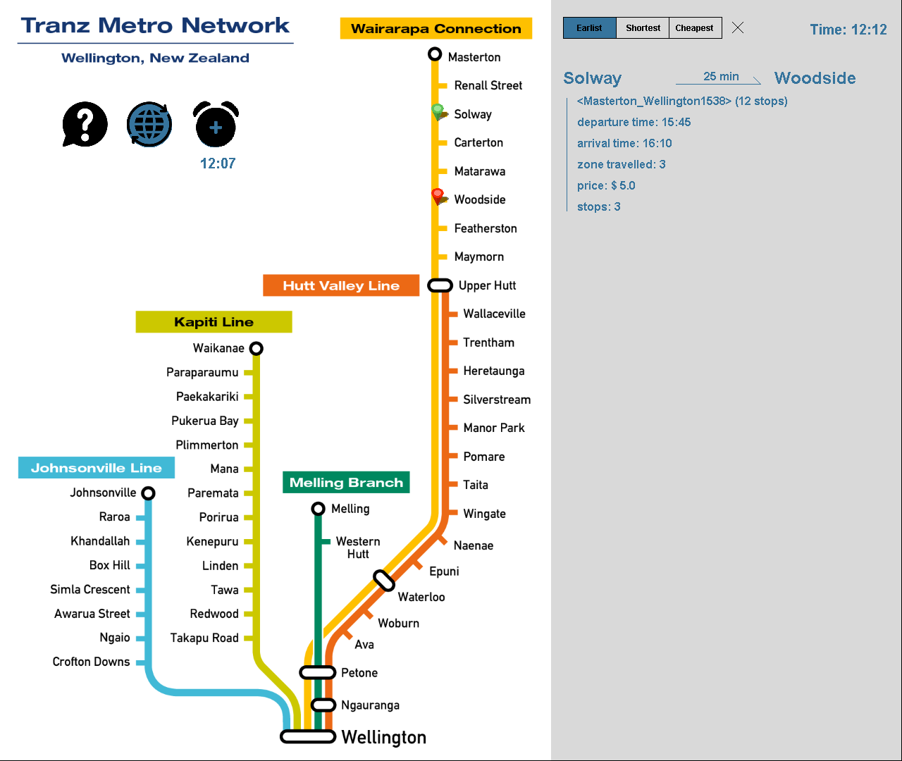
UI Design (Travel Plan)
Green sign: Departure St
Travel Plan Mode
Red sign: Arrival St
Travel information
-The departure time will be based on user input, or system time if no input.

Slide 3
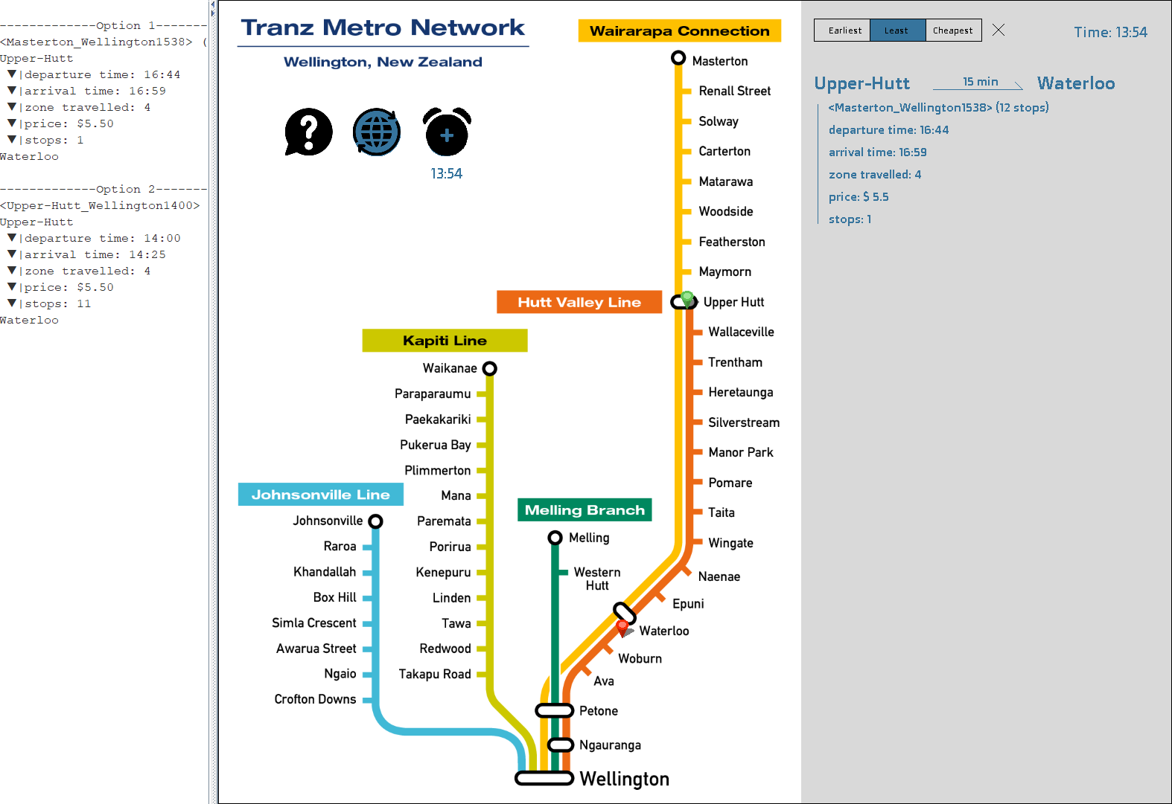
Preferences-Least
Preference setting works if there’s more than 1 option
Preference: Least
-”Least” here means least stops
-Only one best option will be displayed
-The “best” is determined based on user preference

Slide 4
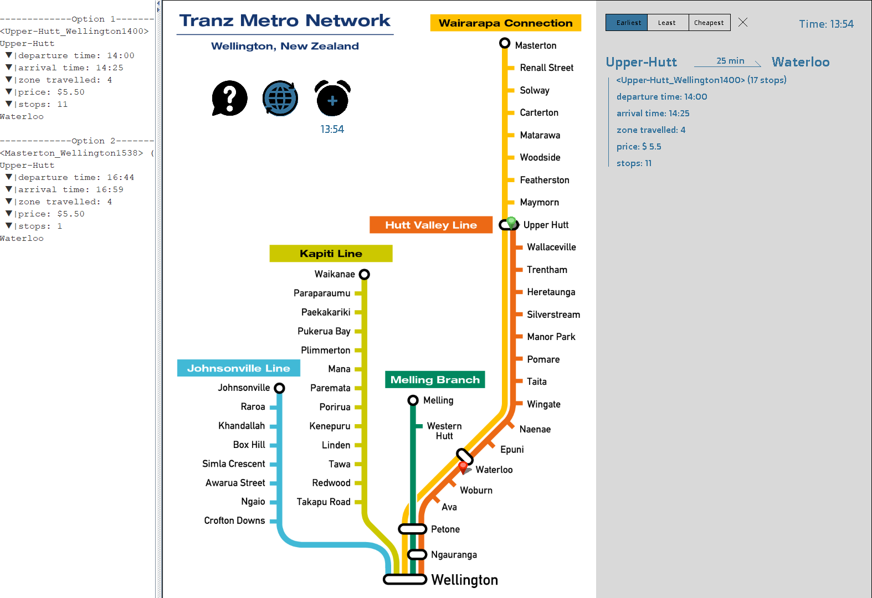
Preferences-Earliest
Preference setting works if there’s more than 1 option
“Cheapest” is functional, but may not be able to test in Wellington’s train system.
Preference: Earliest
-Earliest arrival

Slide 5
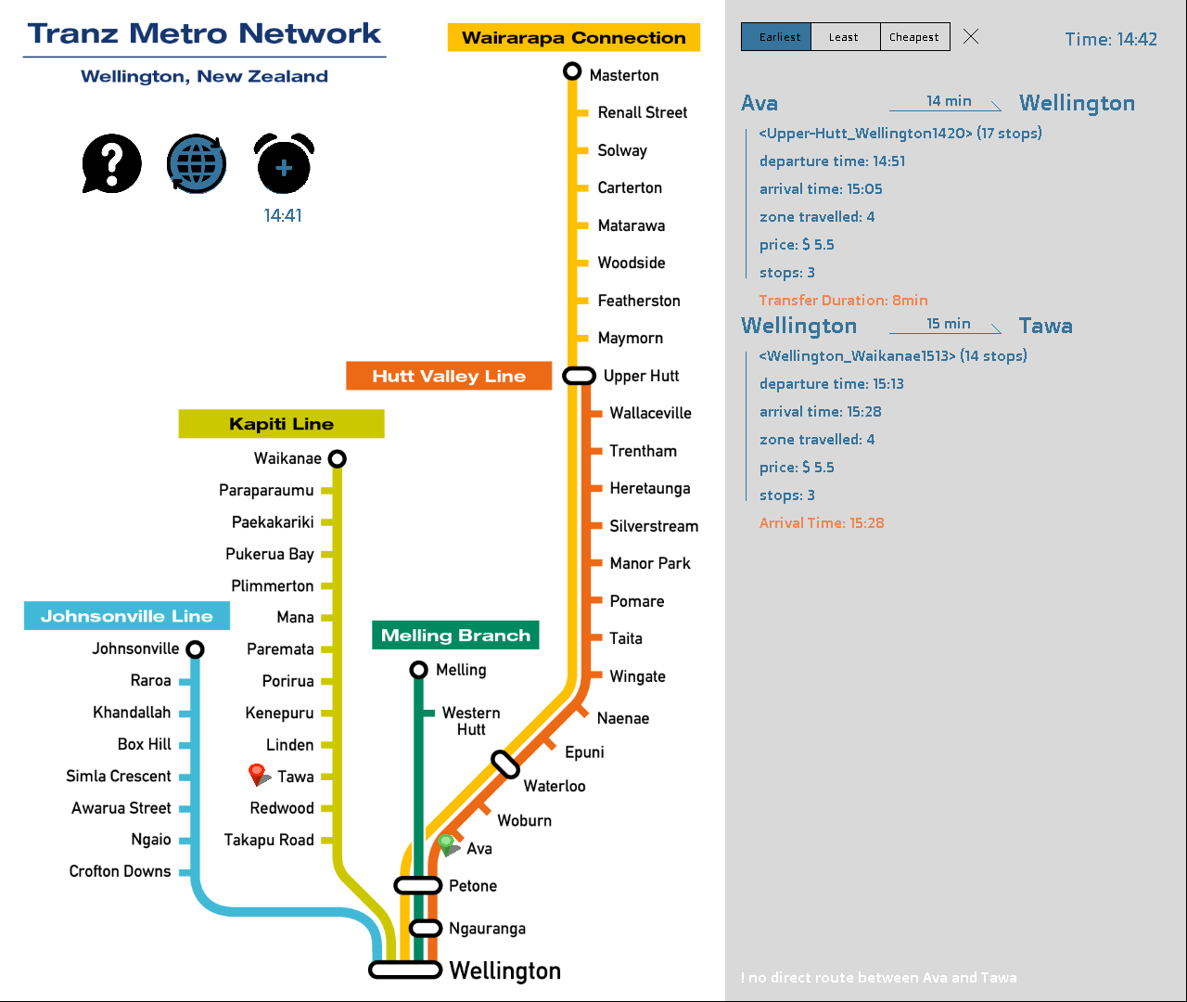
Transfer with only 1 option
These two trains are combined into one travel plan
New information:
-transfer duration
-arrival time/stops/price
New information:
-notification of “no direct route”

Slide 6
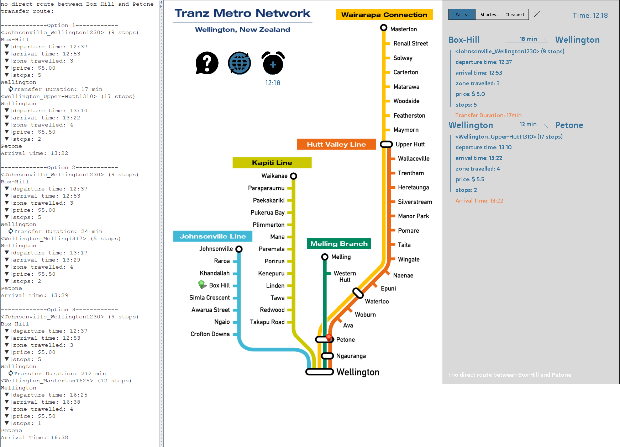


Transfer with multiple options (1)
--More than 1 options either in 1st trip or 2nd trip.
Challenging and Solution:
The departure time of the 2nd trip is based on the arrival time of the 1st trip.
The plan of the 2 trips should be combined to one single option.
All the possible options should be recorded.
The backend will return all 3 options for further processing.
Examples: :
Travel between Box Hill and Petone
Option 1 has earliest arrival, option 3 has least stops, so all of those options will all be kept in the memory.
In UI interface still show the best option based on user preference.
Train Line
Train Line
Options for 1*3:
Trip1+Trip2.A
Trip1+Trip2.B
Trip1+Trip2.C
Options for 3*1:
Trip1.A+ Trip2
Trip1.B+ Trip2
Trip1.C+ Trip2
Train Line A
Train Line B
Train Line C
Train Line A
Train Line B
Train Line C
1*3 scenario
3*1 scenario

Slide 7
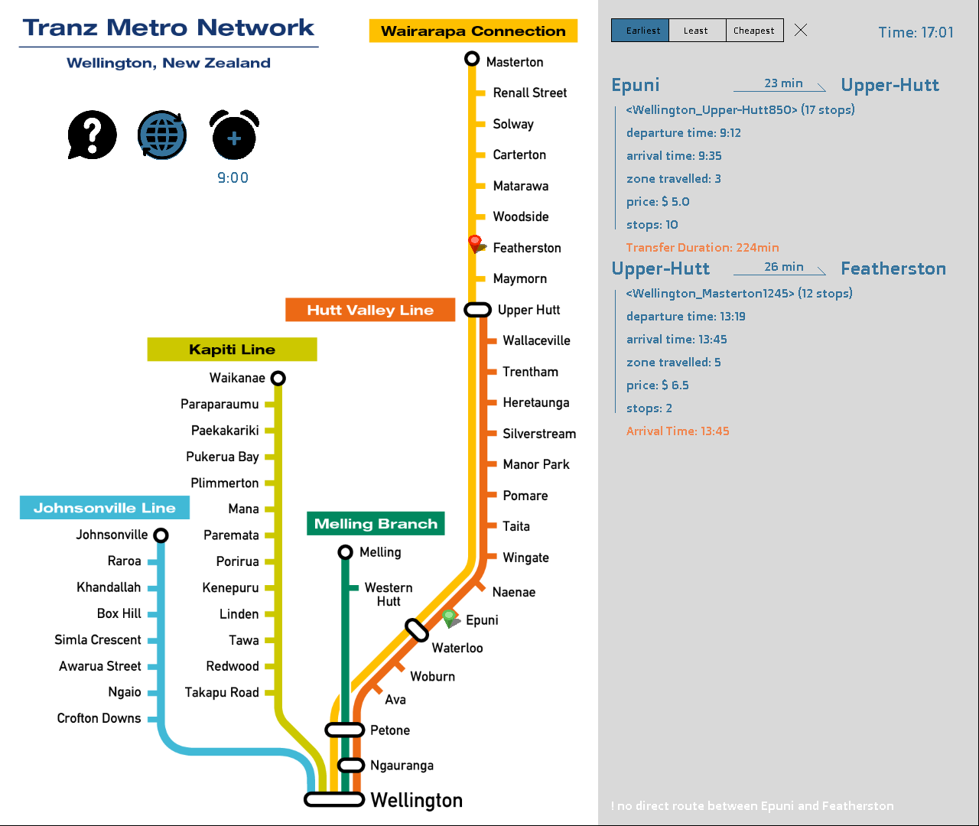
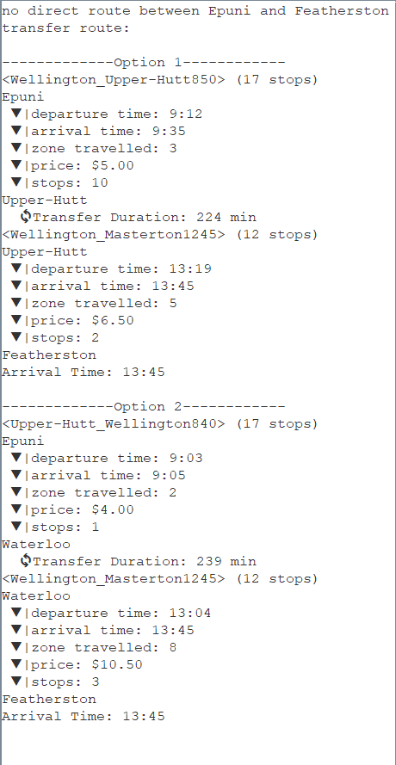
Transfer with multiple options (2)
--U turns.
Dest
Challenging and Solution:
Some U turns are necessary, but some not.
We need to design appropriate algorithm to avoid or filter the unnecessary U turn.
I identify this by the a complex compute using the distance to Wellington, and if any another transfer station exists between start and target transfer station.
Examples: :
Travel from Epuni to Featherston
Transfer from Petone, Ngauranga, and Wellington has been filtered.
Keep one nearest U turn( at Waterloo)
Start
Dest
🔄️
✅
✅
🔄️
Start
🔄️
❌
🔄️

Slide 8
Thank you
More to Discover
by Anmeng Jin
3. Sep. 2023.

