Slide 1
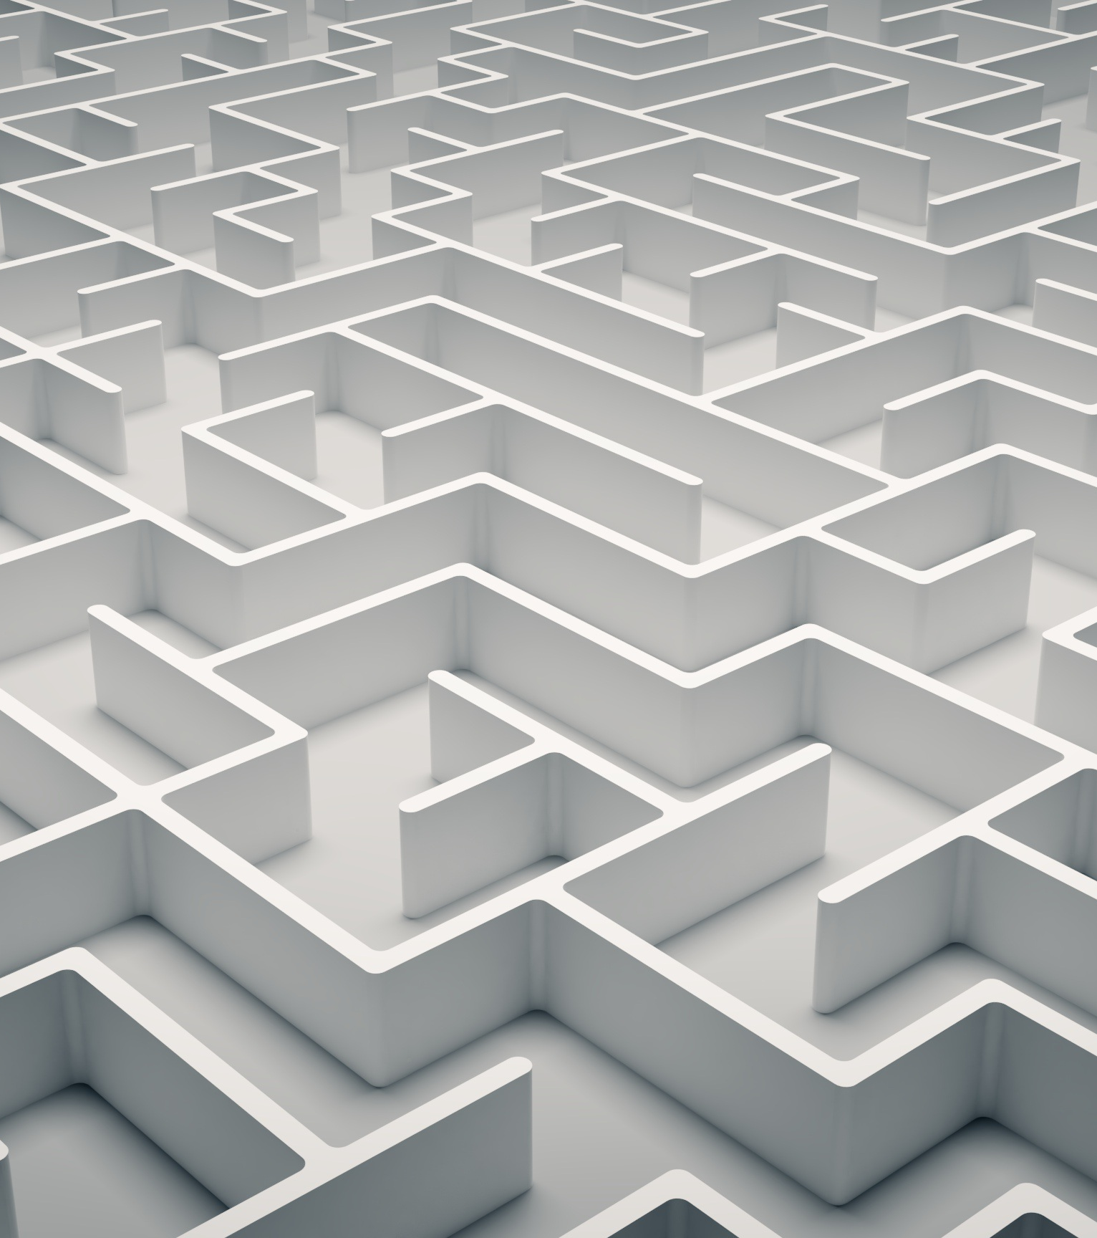
FPGA Controlled Maze Solving Robotic Arm
Inverse kinematics pre-estimated using a multilayer perceptron for faster response times
Solves mazes using Q-learning, able to adapt to new conditions
Potential applications in quality control
Thomas Edmonds – BEng Robotics

