Slide 1
Progress Demonstration

Slide 2
Progress So far
Finalised Plan
Identified an issue with the feedback from the servos damaging the Arduino on the arm and have selected an isolator which will be used to protect the FPGA
Completed H&S report (awaiting review)
Written a rough systemverilog file and testbench for the PWM control

Slide 3
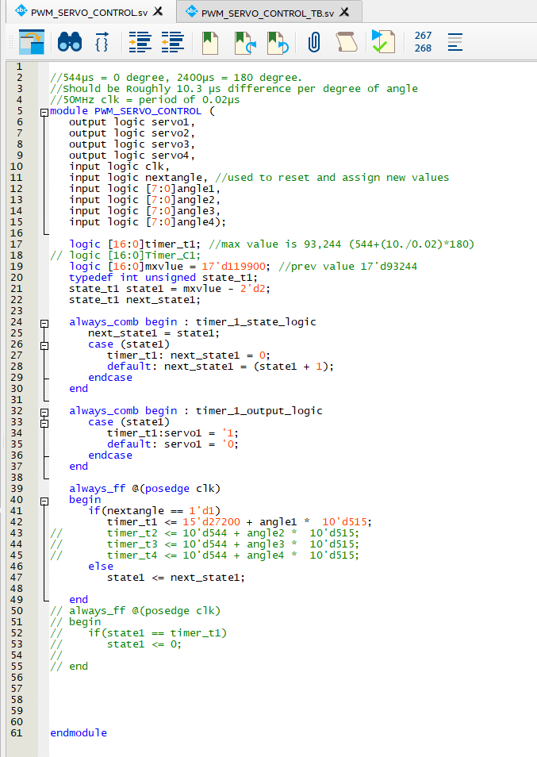
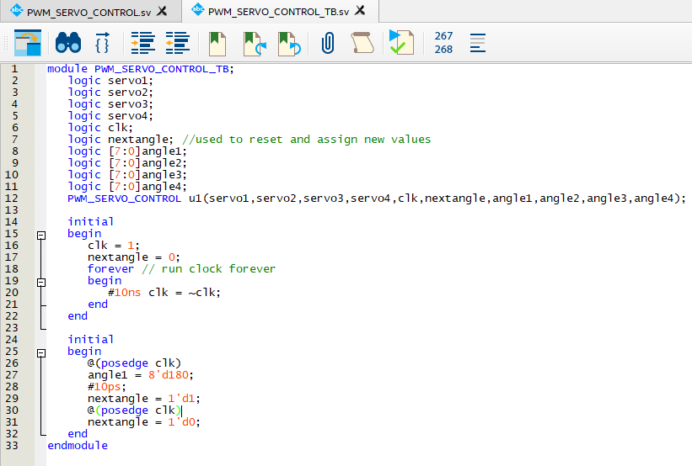

Slide 4
Issues so far
I am behind schedule due to the Arduino overload issue, however I actually see this as a positive as it helped me identify the potential risk before I connected the arm to the FPGA.
Finding a camera module capable of interfacing with the FPGA has proved challenging and as such has been put on hold until more of the key work has been completed and I have a better idea of what I require from it.
As a result of these delays I have also been unable to determine exactly what functionality I need from a microcontroller and so haven’t been able to select and order/borrow one.

Slide 5
What’s next
The next step is to finalise and build the isolation circuit and begin testing FPGA control.
Once this testing is complete progress should speed up considerably as I will have a better understanding of what needs to be done and a framework to build upon

Slide 6
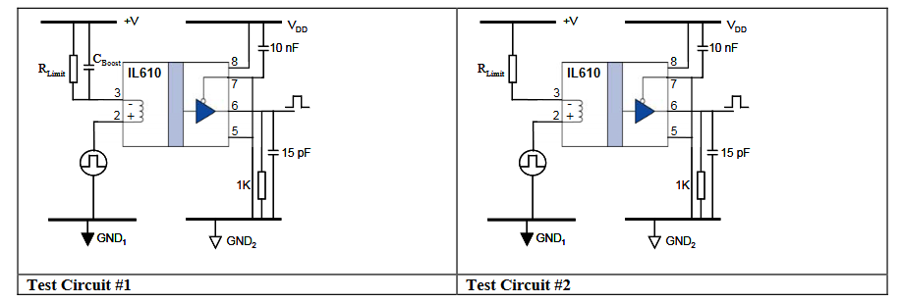
Isolators
I am currently Planning on using 4-6 NVE IL610-2E isolators
Circuit diagram from the Isolator datasheet. The circuit I use should be similar to these.

Slide 7
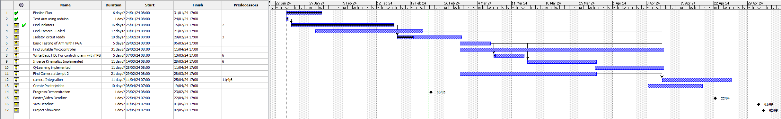
Timescale for the future
Assuming the isolation circuit can be completed by Friday the 29th I expect I’ll be able to complete the first stage deliverable by the 14th of march at the latest.
Once the first stage deliverable is complete, I expect each following deliverable will take roughly two weeks which while a little tight leaves just enough time to finish the project and prepare for the project showcase.
Thankfully as access to the lab should only be needed when technical support is required, I should be able to continue working during the easter break.

