Slide 1
TDD in Python
An introduction to Test-Driven Development

Slide 2
About me
Stephen Semeniuk
Software architect at Intelligent Imaging Systems
Developing software since 1981 (yikes!)
Working with Python since 2002

Slide 3
How does TDD work?
Step 0: write just enough code to have a sense of what you're doing
Step 1: write your unit test
Step 2: watch it fail
Step 3: write your code; when your test passes, you're done
Step 4: refactor (optional)

Slide 4
Write my tests first? That can't be right!
How can I write tests when I don't know what my code is going to do?
  It forces you to think about it, which is a good thing.
  It forces you to write testable code.
Won't that double the amount of code I write?
  Yes, and maybe more.
  You'll be doing it while your head is still in the problem.

Slide 5
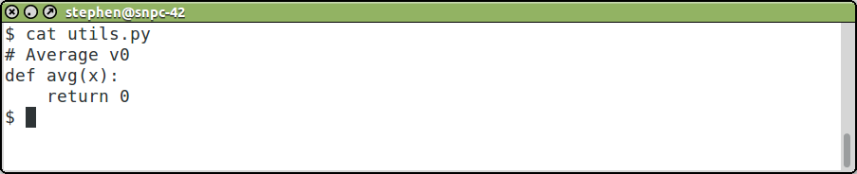
The requisite contrived example
Let's write an average function
Write just enough code so we can start testing

Slide 6
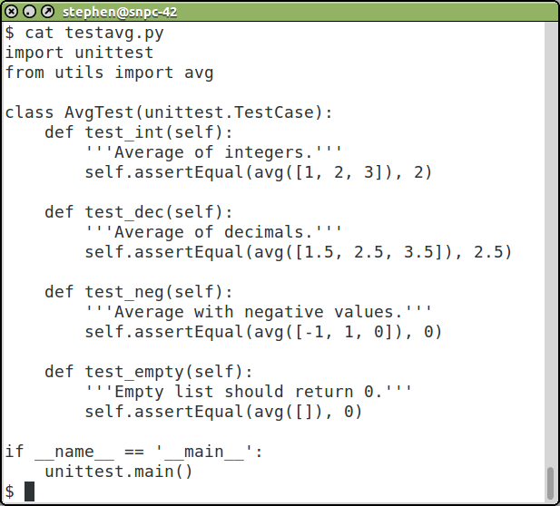
Now we can write some tests

Slide 7
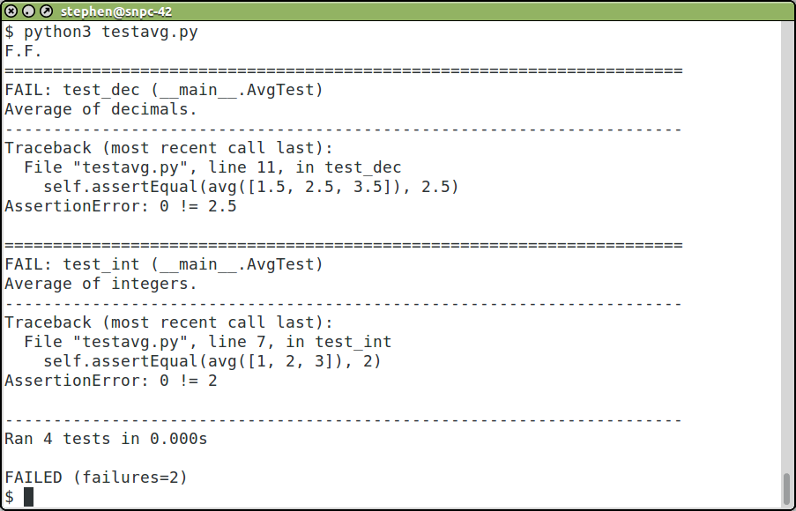
Let's run the tests; we expect some failures

Slide 8
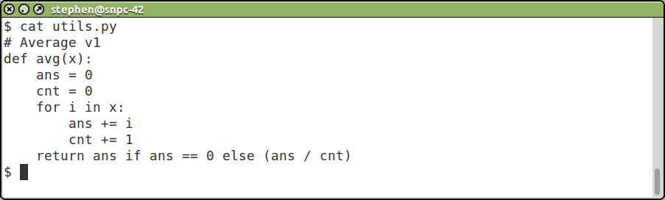
Now we can start coding!

Slide 9
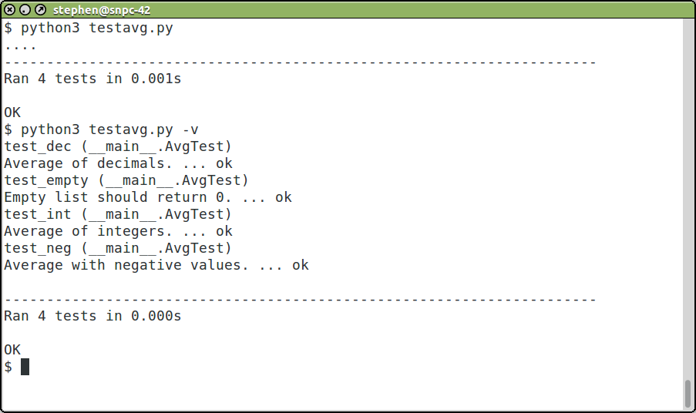
Let's see how we did

Slide 10
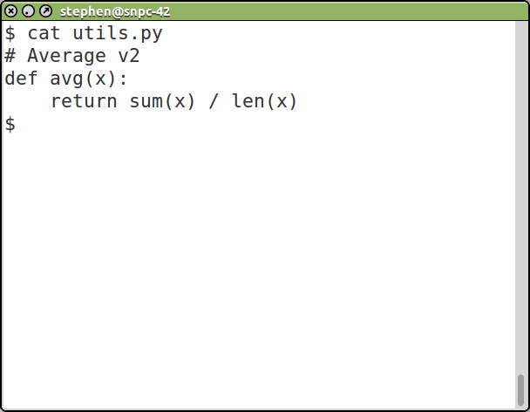
Refactor

Slide 11
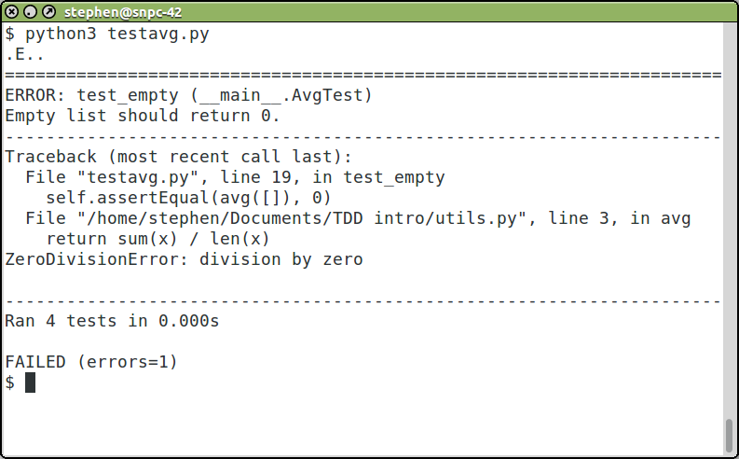
So, how did we do?

Slide 12
That's why we write unit tests
So, what do we do now?
  Fix the code?
  Change the test?
Don't do both!

Slide 13
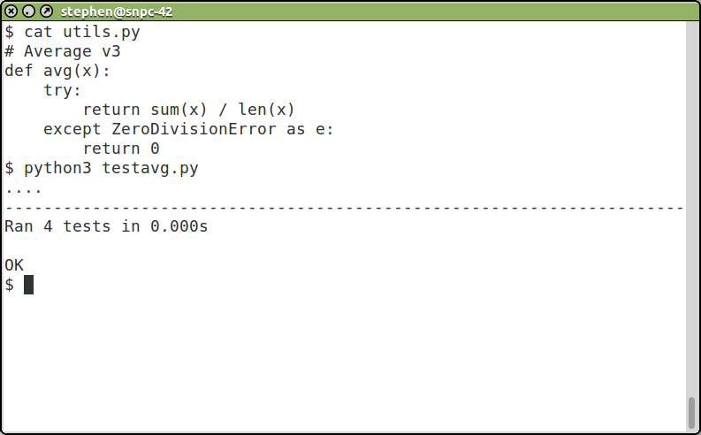
Option A: Fix the code

Slide 14
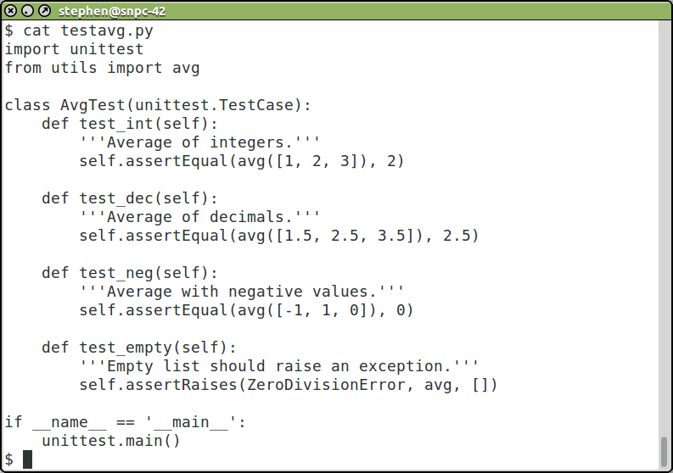
Option B: Fix the test

Slide 15
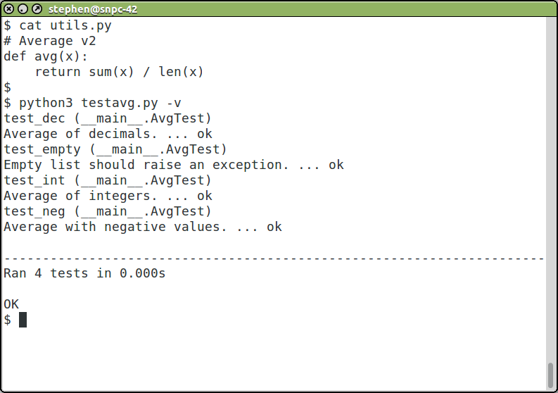
Option B continued...

Slide 16
Resources
Test-driven development by example – Kent Beck
Google: test driven development python
Google: unit testing ROI

