Slide 1


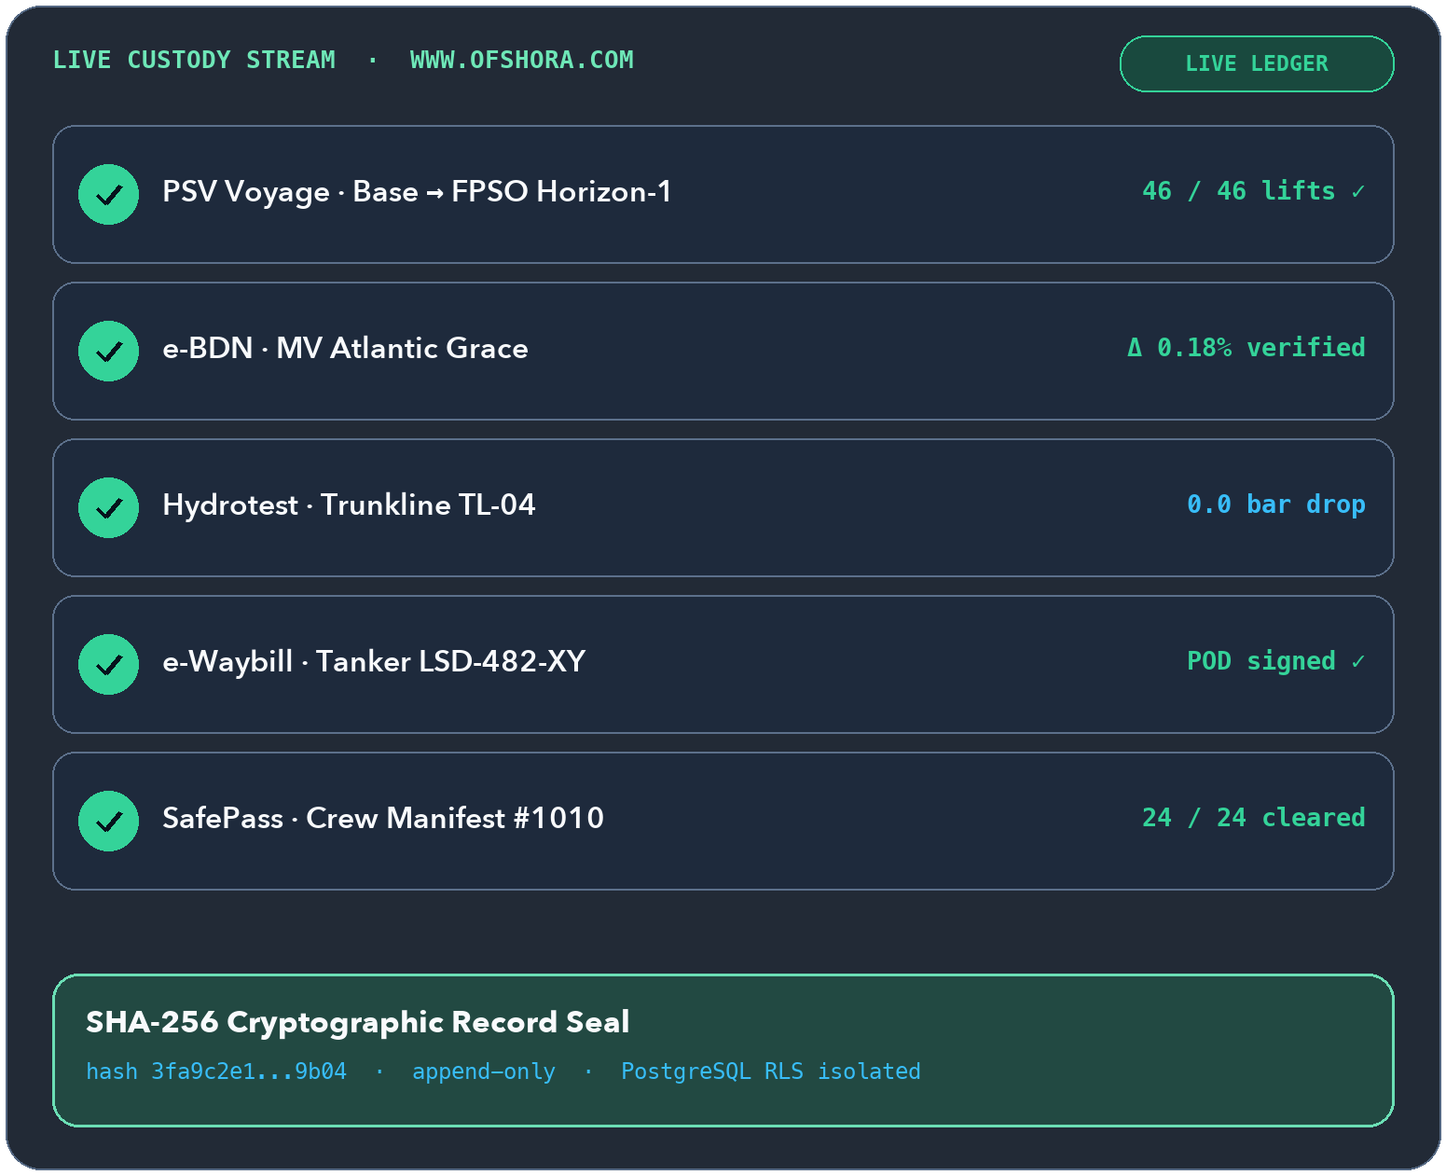
OFFSHORA
ENERGY OS
INTRO · WWW.OFSHORA.COM
www.ofshora.com ↗
OFFSHORA ENERGY OS · WWW.OFSHORA.COM
Every hand-off,
on one sealed ledger.
19
INTEGRATED MODULES
Offline-first · SHA-256 sealed · Dual ₦ / $
The operating system built for offshore and onshore energy contractors—from the supply base quay and bunker barge to the rig deck, pipeline, tank farm, and haulage corridor.
▲ WHY CONTRACTORS SWITCH
One disputed bunker stem, missing waybill, or expired crew ticket can wipe out a month of margin—or disqualify an IOC tender.
✓
Works 100% offline in the field on local SQLite, delta-syncing when VSAT or 4G returns
✓
Cryptographically sealed records across marine, offshore, pipeline, depot, and haulage
✓
Built-in NCDMB NCFCC readiness checks and NOGIC-JQS tender export packs
✓
Dual-currency NGN & USD commercial ledgers with locked FX rate snapshots
◆ West African Offshore & Onshore Corridor
Offshora Energy OS · https://www.ofshora.com
01 / 25
Notes:
SLIDE 01/25 — Offshora Energy OS (www.ofshora.com)
Official Platform: https://www.ofshora.com/
EXECUTIVE HOOK:
Every hand-off, on one sealed ledger.
BUYER PAIN POINT (Why contractors switch):
One disputed bunker stem, missing waybill, or expired crew ticket can wipe out a month of margin—or disqualify an IOC tender.
HEADLINE METRIC:
19 — Integrated modules (Offline-first · SHA-256 sealed · Dual ₦ / $)
KEY CAPABILITIES TO HIGHLIGHT:
• Works 100% offline in the field on local SQLite, delta-syncing when VSAT or 4G returns
• Cryptographically sealed records across marine, offshore, pipeline, depot, and haulage
• Built-in NCDMB NCFCC readiness checks and NOGIC-JQS tender export packs
• Dual-currency NGN & USD commercial ledgers with locked FX rate snapshots

Slide 2

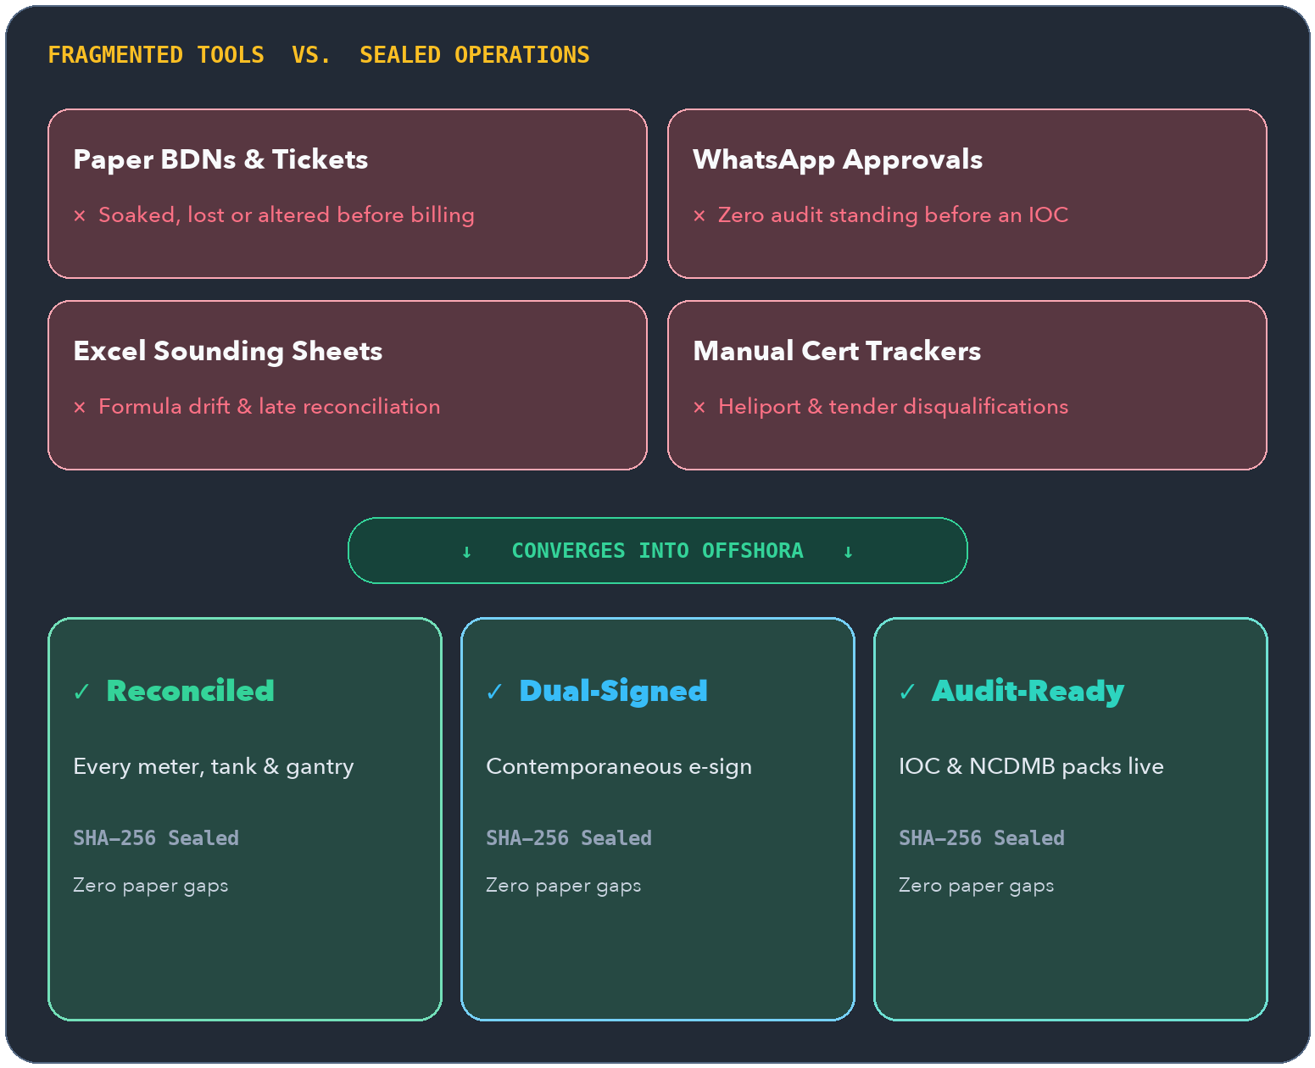
OFFSHORA
ENERGY OS
THE PROBLEM · INDUSTRY PAIN
www.ofshora.com ↗
THE HIDDEN COST OF PAPER, EXCEL & WHATSAPP
Your records are scattered.
Your liability isn't.
$360k+
ANNUAL STEM EXPOSURE
Illustrative 0.5% variance across ten 1,000 MT stems/mo
Multi-service energy firms run bunkering on Monday, haulage on Tuesday, and pipeline or offshore supply all month—using disconnected clipboards, spreadsheets, and chat threads.
▲ WHERE MONEY DISAPPEARS
Unreconciled 0.5%–1.5% fuel shrinkage, unbilled vessel & tool days, month-end depot surprises, and scrambled audit binders before every IOC bid.
✓
Paper BDNs & waybills get altered, soaked, or lost before invoicing
✓
WhatsApp approvals carry zero cryptographic or audit standing before an IOC
✓
Month-end depot reconciliation discovers shortages weeks too late to dispute
✓
Expired crew BOSIET or crane NCEC certificates trigger costly mobilization delays
◆ Field-to-Finance Gap Analysis
Offshora Energy OS · https://www.ofshora.com
02 / 25
Notes:
SLIDE 02/25 — Why Contractors Bleed Margin (Industry Pain)
Official Platform: https://www.ofshora.com/
EXECUTIVE HOOK:
Your records are scattered. Your liability isn't.
BUYER PAIN POINT (Where money disappears):
Unreconciled 0.5%–1.5% fuel shrinkage, unbilled vessel & tool days, month-end depot surprises, and scrambled audit binders before every IOC bid.
HEADLINE METRIC:
$360k+ — Annual stem exposure (Illustrative 0.5% variance across ten 1,000 MT stems/mo)
KEY CAPABILITIES TO HIGHLIGHT:
• Paper BDNs & waybills get altered, soaked, or lost before invoicing
• WhatsApp approvals carry zero cryptographic or audit standing before an IOC
• Month-end depot reconciliation discovers shortages weeks too late to dispute
• Expired crew BOSIET or crane NCEC certificates trigger costly mobilization delays

Slide 3

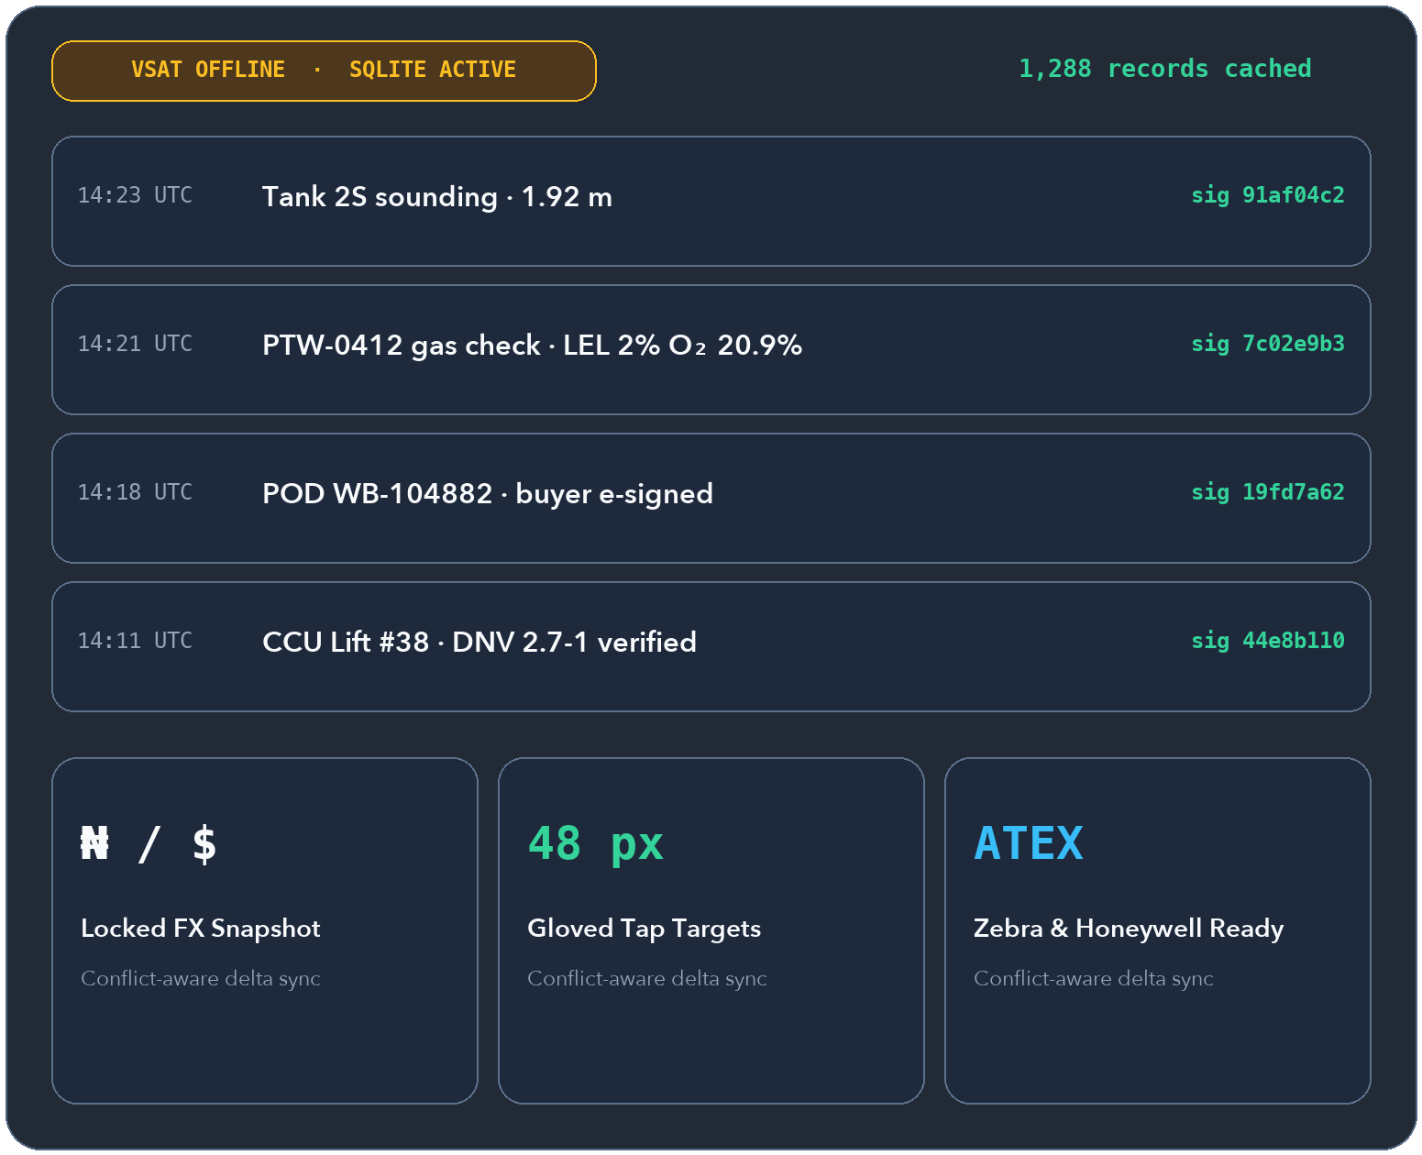
OFFSHORA
ENERGY OS
CORE PLATFORM · CORE OS
www.ofshora.com ↗
INCLUDED IN EVERY OFFSHORA SUBSCRIPTION
No offshore signal?
Zero data lost.
0 ms
OFFLINE CAPTURE LAG
Local SQLite cache + automatic delta sync
Engineered for offshore barges, remote pipeline right-of-ways, and tank farms where connectivity drops constantly.
▲ WHY CLOUD-ONLY SAAS FAILS
Standard web apps freeze when VSAT drops on deck—forcing crews back to paper notes that never get typed in accurately.
✓
Offline-first capture with conflict-aware sync—signed records are never silently overwritten
✓
Append-only audit trail recording actor, tenant, timestamp, and SHA-256 proof
✓
Role-based access gating for MD, Ops GM, Dispatcher, Barge Master, Technician & Driver
✓
Designed for Zebra, Honeywell, and ATEX-rated handhelds with 48px gloved tap targets
◆ Barge · Jetty · Pipeline ROW · Depot
Offshora Energy OS · https://www.ofshora.com
03 / 25
Notes:
SLIDE 03/25 — Offline-First Field Architecture (Core OS)
Official Platform: https://www.ofshora.com/
EXECUTIVE HOOK:
No offshore signal? Zero data lost.
BUYER PAIN POINT (Why cloud-only SaaS fails):
Standard web apps freeze when VSAT drops on deck—forcing crews back to paper notes that never get typed in accurately.
HEADLINE METRIC:
0 ms — Offline capture lag (Local SQLite cache + automatic delta sync)
KEY CAPABILITIES TO HIGHLIGHT:
• Offline-first capture with conflict-aware sync—signed records are never silently overwritten
• Append-only audit trail recording actor, tenant, timestamp, and SHA-256 proof
• Role-based access gating for MD, Ops GM, Dispatcher, Barge Master, Technician & Driver
• Designed for Zebra, Honeywell, and ATEX-rated handhelds with 48px gloved tap targets

Slide 4

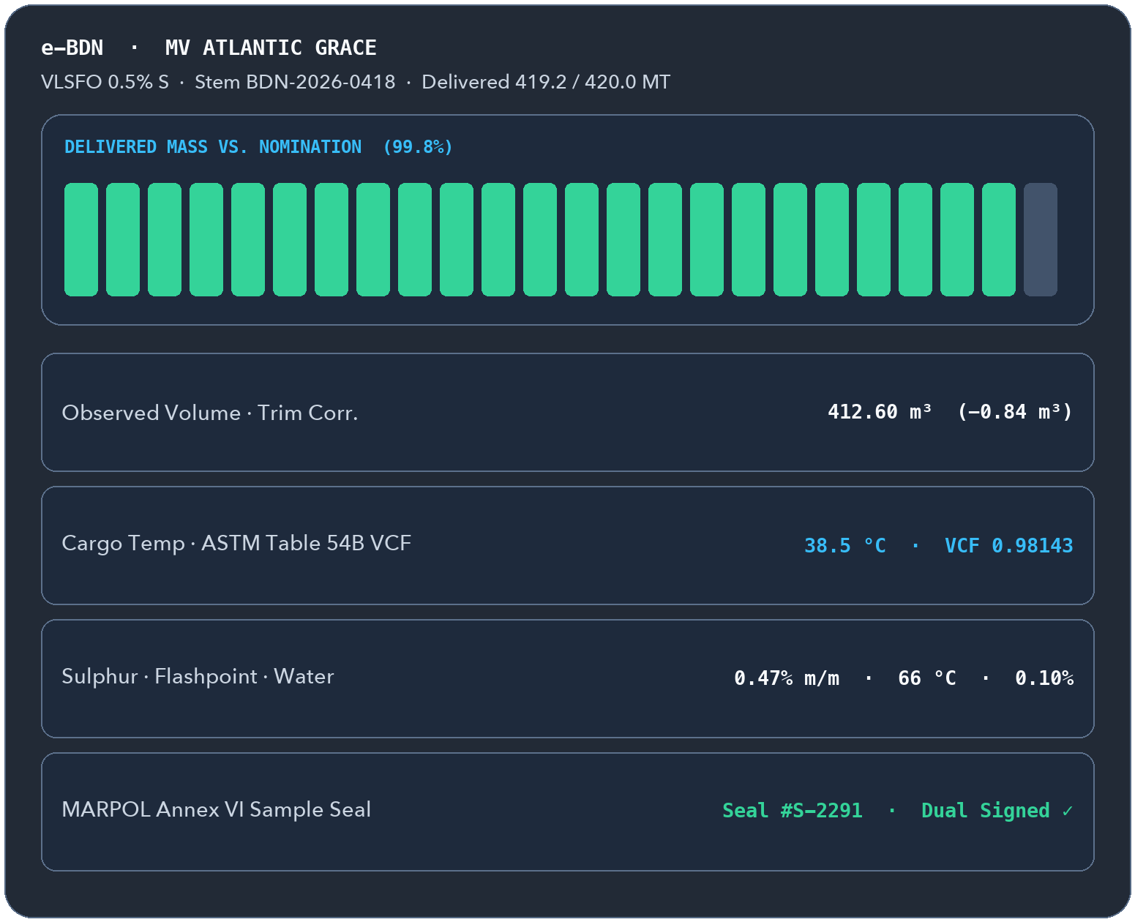
OFFSHORA
ENERGY OS
MODULE 01 · PILOT-READY
www.ofshora.com ↗
MODULE 01 · MARINE FUEL & PORT SERVICES
Every bunker stem reconciled
before the barge casts off.
0.18%
TARGET STEM VARIANCE
ASTM Table 54B & 56 automated on deck
From stem nomination to tank soundings, ASTM D1250 volume/mass conversion, MARPOL sample seals, and dual-signed Electronic Bunker Delivery Notes.
▲ WHY MARINE SUPPLIERS NEED IT
Manual temperature and trim math on a rolling deck leads to short-delivery claims, demurrage standoffs, and unpaid bunker invoices.
✓
Nomination intake, stem confirmation, pricing quote, and commercial hand-off
✓
Fore/aft tank soundings with trim & temperature correction via ASTM Tables 54B / 56
✓
Dual-signed e-BDN (Chief Engineer + Supplier) logging flashpoint, viscosity, sulphur & water
✓
Tamper-evident MARPOL Annex VI sample seal tracking and STS transfer safety checklists
◆ Lagos · Port Harcourt · Onne · Warri Anchorages
Offshora Energy OS · https://www.ofshora.com
04 / 25
Notes:
SLIDE 04/25 — BunkerFlow — Marine Fuel & e-BDN (Pilot-ready)
Official Platform: https://www.ofshora.com/
EXECUTIVE HOOK:
Every bunker stem reconciled before the barge casts off.
BUYER PAIN POINT (Why marine suppliers need it):
Manual temperature and trim math on a rolling deck leads to short-delivery claims, demurrage standoffs, and unpaid bunker invoices.
HEADLINE METRIC:
0.18% — Target stem variance (ASTM Table 54B & 56 automated on deck)
KEY CAPABILITIES TO HIGHLIGHT:
• Nomination intake, stem confirmation, pricing quote, and commercial hand-off
• Fore/aft tank soundings with trim & temperature correction via ASTM Tables 54B / 56
• Dual-signed e-BDN (Chief Engineer + Supplier) logging flashpoint, viscosity, sulphur & water
• Tamper-evident MARPOL Annex VI sample seal tracking and STS transfer safety checklists

Slide 5
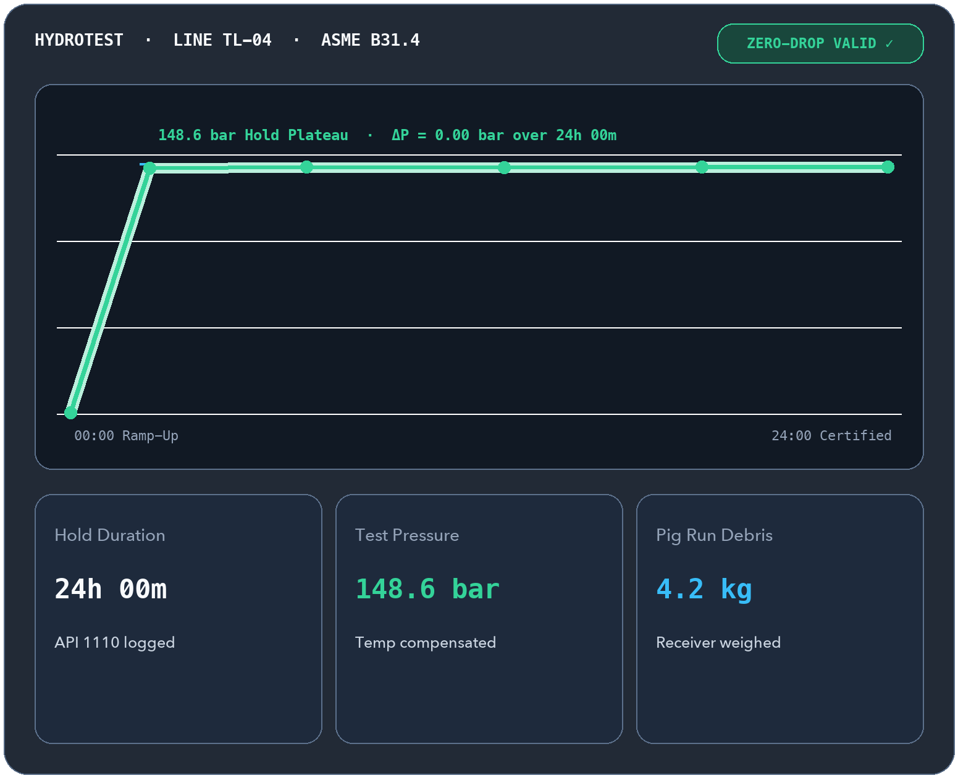
OFFSHORA
ENERGY OS
MODULE 02 · PILOT-READY
www.ofshora.com ↗
MODULE 02 · PIPELINE SERVICES & ASSET INTEGRITY
Every weld, pig run & test
audit-ready for IOCs.
0.0 bar
ZERO-DROP GATE
API 1110 · ASME B31.4 / B31.8 validation
Unifies pigging runs, zero-drop hydrotests, NDT weld registries, ASME B31G remaining-life math, and NACE SP0169 cathodic protection surveys.
▲ WHY PIPELINE EPCS NEED IT
IOCs hold back milestone payments when hydrotest hold charts, weld radiographs, or CP survey logs are missing or inconsistent.
✓
Pigging run lifecycle from launcher pressure and transit velocity to receiver debris weight
✓
Hydrotest pressure vs. temperature curve validation with hold-period completion gates
✓
NDT & corrosion registry with weld IDs, wall thickness, and ASME B31G remaining-life calc
✓
CIPS/DCVG cathodic protection logs, geotagged ROW surveillance & IOC dossier exports
◆ Trunklines · Flowlines · Export Pipelines
Offshora Energy OS · https://www.ofshora.com
05 / 25
Notes:
SLIDE 05/25 — PipeIntegrity — Pigging, Hydrotest & NDT (Pilot-ready)
Official Platform: https://www.ofshora.com/
EXECUTIVE HOOK:
Every weld, pig run & test audit-ready for IOCs.
BUYER PAIN POINT (Why pipeline EPCs need it):
IOCs hold back milestone payments when hydrotest hold charts, weld radiographs, or CP survey logs are missing or inconsistent.
HEADLINE METRIC:
0.0 bar — Zero-drop gate (API 1110 · ASME B31.4 / B31.8 validation)
KEY CAPABILITIES TO HIGHLIGHT:
• Pigging run lifecycle from launcher pressure and transit velocity to receiver debris weight
• Hydrotest pressure vs. temperature curve validation with hold-period completion gates
• NDT & corrosion registry with weld IDs, wall thickness, and ASME B31G remaining-life calc
• CIPS/DCVG cathodic protection logs, geotagged ROW surveillance & IOC dossier exports

Slide 6

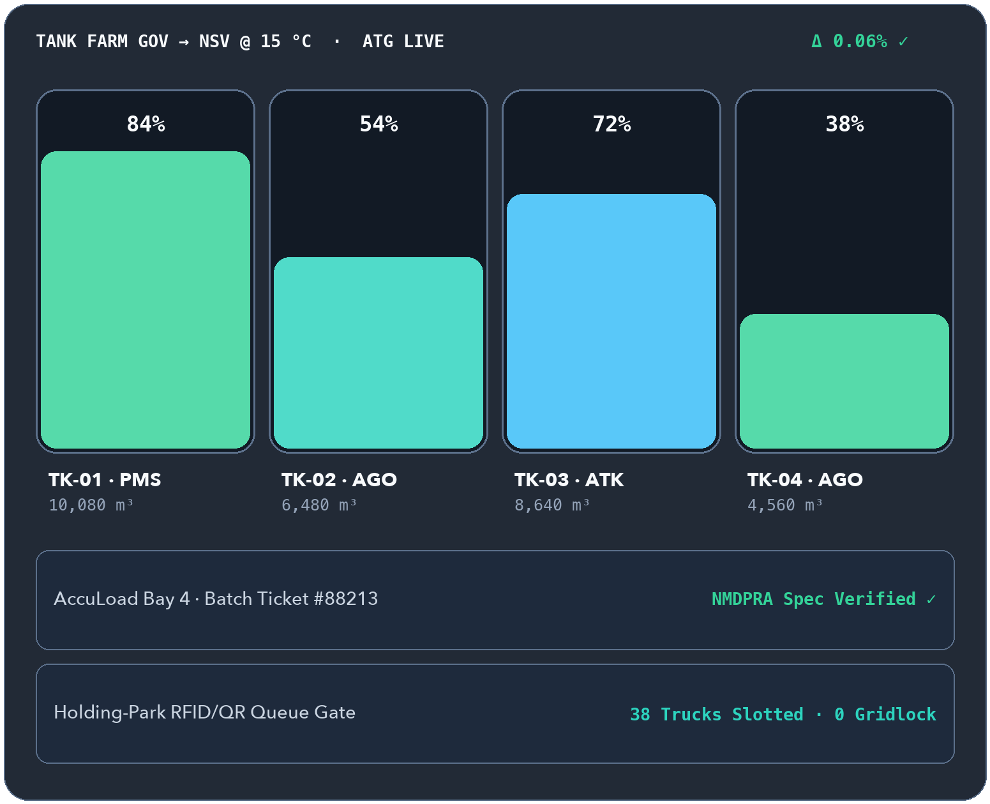
OFFSHORA
ENERGY OS
MODULE 03 · PILOT-READY
www.ofshora.com ↗
MODULE 03 · TERMINAL OFFTAKE & CUSTODY RECONCILIATION
Reconcile your depot
at every single discharge.
<0.5%
VARIANCE THRESHOLD
Continuous ATG vs. gantry batch reconciliation
Connects tank gauging, GOV-to-NSV conversion, gantry batch tickets, batch quality certificates, and standalone holding-park queue control.
▲ WHY DEPOT OPERATORS NEED IT
Waiting until month-end to reconcile tank dips against gantry tickets hides meter drift, evaporation, and unauthorized product losses.
✓
Manual ullage & automated tank gauging (ATG) with GOV → NSV conversion at 15 °C or 20 °C
✓
AccuLoad & Smith Meter gantry ticket reconciliation with instant variance alerts
✓
Batch quality certificates verified against NMDPRA specifications (density, flashpoint, sulphur)
✓
Standalone RFID/QR holding-park queue manager, ready for Lagos State e-Call-Up when API access is confirmed
◆ Tank Farms · Gantries · Lekki-Epe Holding Parks
Offshora Energy OS · https://www.ofshora.com
06 / 25
Notes:
SLIDE 06/25 — RefineryLink — Gantry, Tank Farm & Depot (Pilot-ready)
Official Platform: https://www.ofshora.com/
EXECUTIVE HOOK:
Reconcile your depot at every single discharge.
BUYER PAIN POINT (Why depot operators need it):
Waiting until month-end to reconcile tank dips against gantry tickets hides meter drift, evaporation, and unauthorized product losses.
HEADLINE METRIC:
<0.5% — Variance threshold (Continuous ATG vs. gantry batch reconciliation)
KEY CAPABILITIES TO HIGHLIGHT:
• Manual ullage & automated tank gauging (ATG) with GOV → NSV conversion at 15 °C or 20 °C
• AccuLoad & Smith Meter gantry ticket reconciliation with instant variance alerts
• Batch quality certificates verified against NMDPRA specifications (density, flashpoint, sulphur)
• Standalone RFID/QR holding-park queue manager, ready for Lagos State e-Call-Up when API access is confirmed

Slide 7
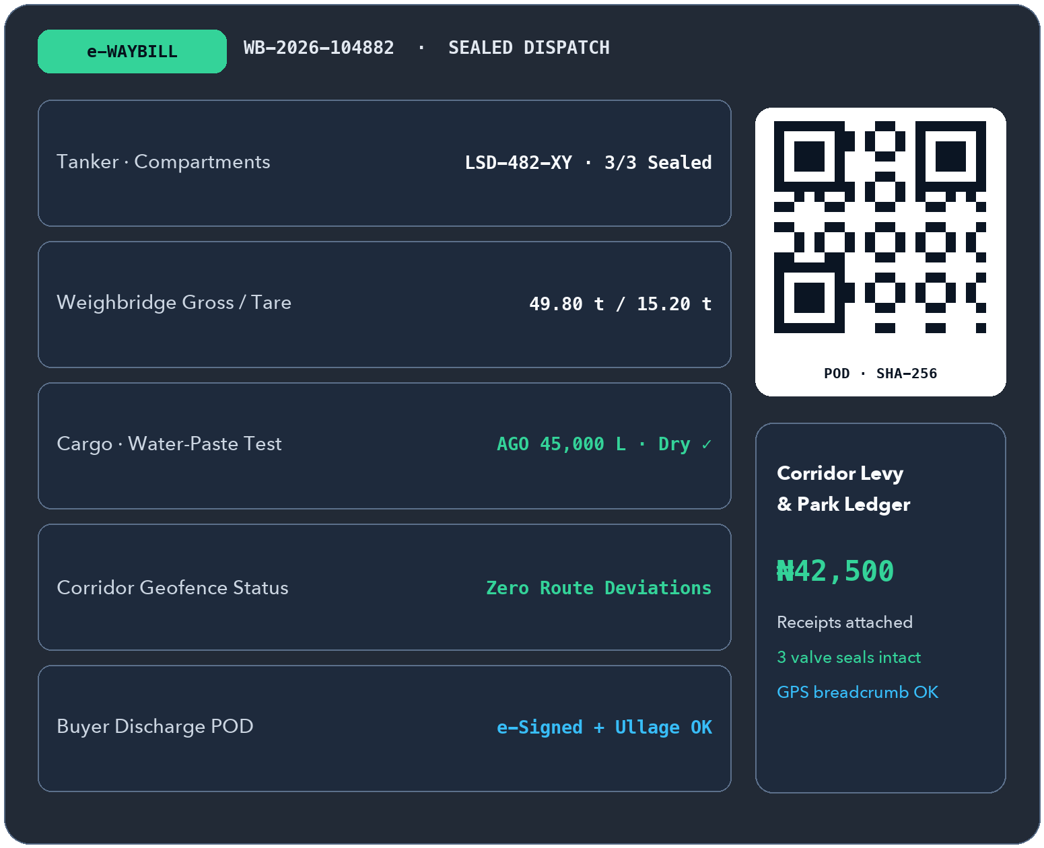
OFFSHORA
ENERGY OS
MODULE 04 · PILOT-READY
www.ofshora.com ↗
MODULE 04 · FLEET DISPATCH, CORRIDOR TRACKING & POD
From weighbridge to buyer,
sealed on one e-Waybill.
3 / 3
COMPARTMENTS SEALED
QR dispatch + buyer e-signature at discharge
Tracks every tanker from tare/gross weigh-in and compartment sealing through corridor geofences to buyer-signed Proof of Delivery.
▲ WHY HAULAGE FLEETS NEED IT
Transit diversion, broken seals, water contamination disputes, and undocumented corridor levies eat straight into per-trip profit.
✓
Weighbridge tare & gross capture generating an encrypted, QR-verifiable digital e-Waybill
✓
Corridor geofence, unauthorized-stop alerts, and compartment valve state tracking
✓
Discharge POD capturing ullage, temperature, water-paste check, and buyer acknowledgement
✓
Per-trip fee & holding-park levy ledger with receipt evidence to settle disputes cleanly
◆ Lekki-Epe · Warri · Port Harcourt · Northern Corridors
Offshora Energy OS · https://www.ofshora.com
07 / 25
Notes:
SLIDE 07/25 — HaulTrac — Bulk Road Haulage & e-Waybill (Pilot-ready)
Official Platform: https://www.ofshora.com/
EXECUTIVE HOOK:
From weighbridge to buyer, sealed on one e-Waybill.
BUYER PAIN POINT (Why haulage fleets need it):
Transit diversion, broken seals, water contamination disputes, and undocumented corridor levies eat straight into per-trip profit.
HEADLINE METRIC:
3 / 3 — Compartments sealed (QR dispatch + buyer e-signature at discharge)
KEY CAPABILITIES TO HIGHLIGHT:
• Weighbridge tare & gross capture generating an encrypted, QR-verifiable digital e-Waybill
• Corridor geofence, unauthorized-stop alerts, and compartment valve state tracking
• Discharge POD capturing ullage, temperature, water-paste check, and buyer acknowledgement
• Per-trip fee & holding-park levy ledger with receipt evidence to settle disputes cleanly

Slide 8
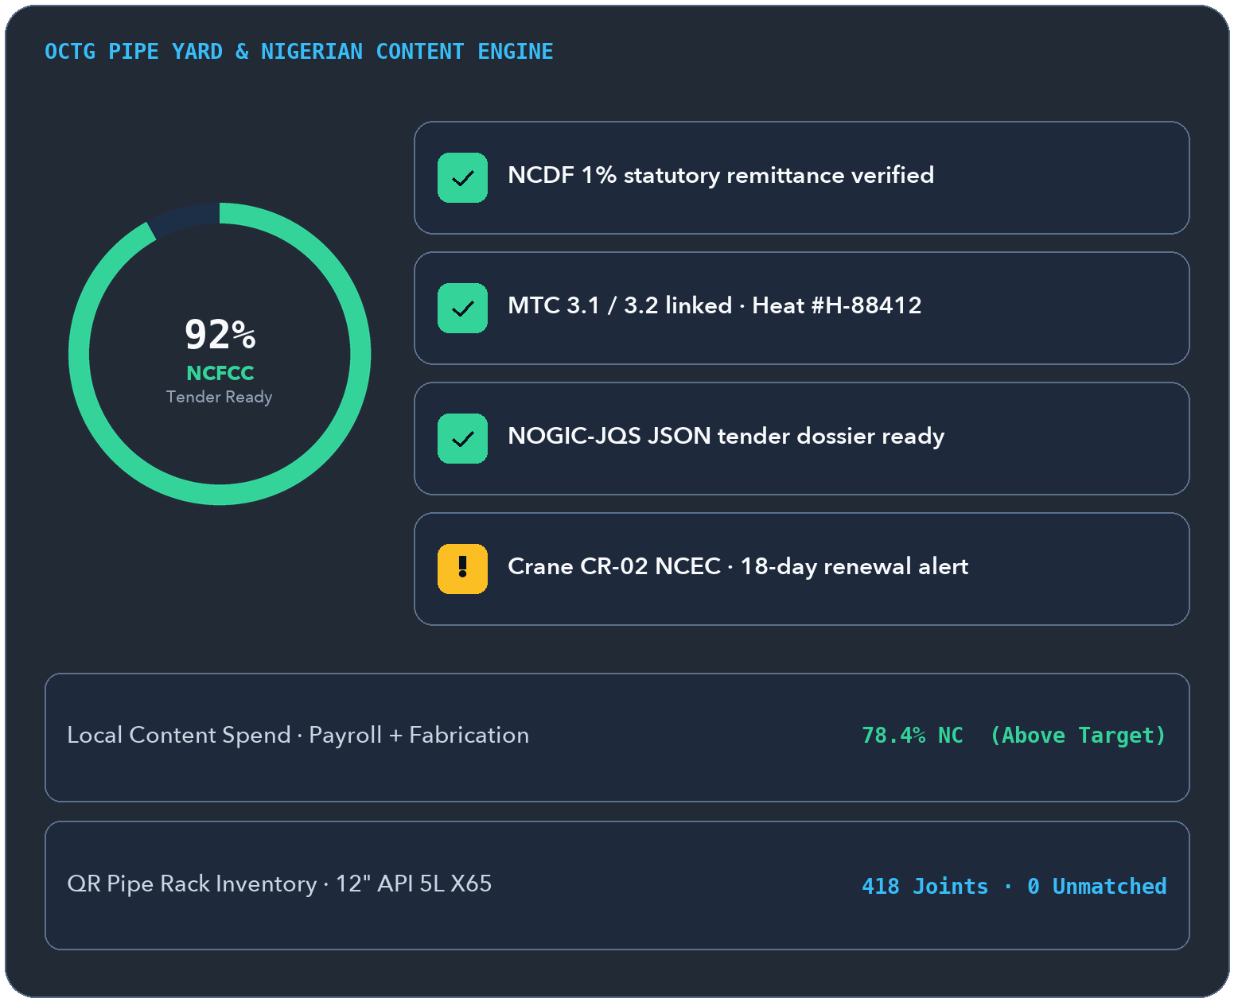
OFFSHORA
ENERGY OS
MODULE 05 · PILOT-READY
www.ofshora.com ↗
MODULE 05 · PIPE YARD CONTROL & NCDMB READINESS
Win more IOC tenders with
instant NCDMB proof.
1-Click
NOGIC-JQS EXPORT
Live NCFCC gap checker + MTC 3.1 / 3.2 traceability
Links WBS material requisitions, QR-tagged pipe-yard heat numbers and MTCs directly to your Nigerian Content spend and NCFCC readiness.
▲ WHY EPC CONTRACTORS NEED IT
Missing Mill Test Certificates in the yard or an expired NCFCC blocks NCEC equipment approvals and disqualifies multi-million-dollar bids.
✓
Pipe-yard inventory by outer diameter, wall thickness, bay/rack, heat number & MTC 3.1/3.2
✓
WBS-coded material requisitions with version-locked approvals and automatic stock decrement
✓
Automated Nigerian Content spend engine across payroll, local fabrication & raw materials
✓
NCFCC readiness checker, NCEC crane/spread tracker, and NOGIC-JQS JSON bid dossier export
◆ Pipe Yards · Fabrication Bases · IOC Tenders
Offshora Energy OS · https://www.ofshora.com
08 / 25
Notes:
SLIDE 08/25 — EPC-Link — OCTG Yard & Nigerian Content (Pilot-ready)
Official Platform: https://www.ofshora.com/
EXECUTIVE HOOK:
Win more IOC tenders with instant NCDMB proof.
BUYER PAIN POINT (Why EPC contractors need it):
Missing Mill Test Certificates in the yard or an expired NCFCC blocks NCEC equipment approvals and disqualifies multi-million-dollar bids.
HEADLINE METRIC:
1-Click — NOGIC-JQS export (Live NCFCC gap checker + MTC 3.1 / 3.2 traceability)
KEY CAPABILITIES TO HIGHLIGHT:
• Pipe-yard inventory by outer diameter, wall thickness, bay/rack, heat number & MTC 3.1/3.2
• WBS-coded material requisitions with version-locked approvals and automatic stock decrement
• Automated Nigerian Content spend engine across payroll, local fabrication & raw materials
• NCFCC readiness checker, NCEC crane/spread tracker, and NOGIC-JQS JSON bid dossier export

Slide 9
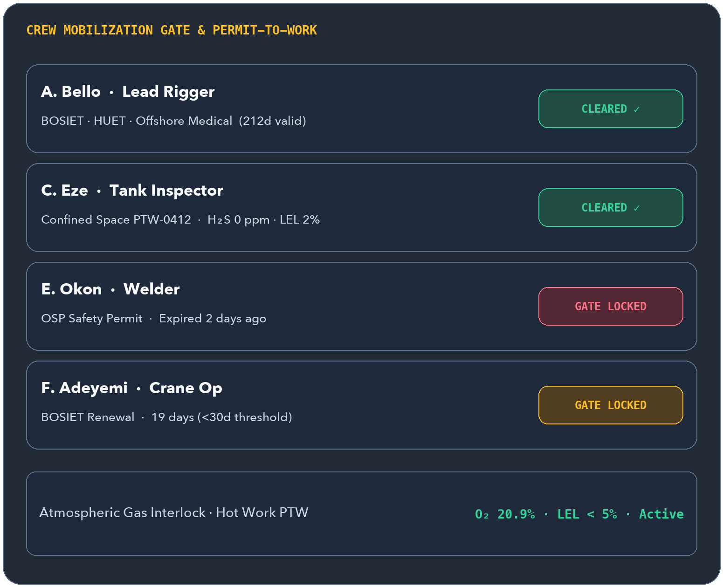
OFFSHORA
ENERGY OS
MODULE 06 · PILOT-READY
www.ofshora.com ↗
MODULE 06 · WORKFORCE CREDENTIALS & PERMIT-TO-WORK
No valid ticket, no boat.
No gas pass, no permit.
30-Day
EXPIRY GATE LOCK
BOSIET · HUET · OSP · STCW · Medical
Hard-gates crew manifests against expiring safety tickets and interlocks high-risk Permits-to-Work with atmospheric gas test thresholds.
▲ WHY HSE & OPS LEADERS NEED IT
Sending a technician to the heliport with an expired BOSIET—or issuing hot-work permits on paper without verified LEL/H₂S checks—risks lives and contracts.
✓
Automated mobilization gate blocking manifest additions when credentials expire within 30 days
✓
Digital Permit-to-Work (hot work, confined space, heights, excavation) with multi-tier sign-off
✓
H₂S, LEL, and O₂ gas-test interlocks that prevent permit activation on failed readings
✓
JSA, toolbox talks, CAPA closure tracking, and 14/14 or 28/28 crew rotation day-rate ledgers
◆ Heliports · Jetties · Offshore Platforms
Offshora Energy OS · https://www.ofshora.com
09 / 25
Notes:
SLIDE 09/25 — SafePass — HSE, Permits & Mobilization Gate (Pilot-ready)
Official Platform: https://www.ofshora.com/
EXECUTIVE HOOK:
No valid ticket, no boat. No gas pass, no permit.
BUYER PAIN POINT (Why HSE & Ops leaders need it):
Sending a technician to the heliport with an expired BOSIET—or issuing hot-work permits on paper without verified LEL/H₂S checks—risks lives and contracts.
HEADLINE METRIC:
30-Day — Expiry gate lock (BOSIET · HUET · OSP · STCW · Medical)
KEY CAPABILITIES TO HIGHLIGHT:
• Automated mobilization gate blocking manifest additions when credentials expire within 30 days
• Digital Permit-to-Work (hot work, confined space, heights, excavation) with multi-tier sign-off
• H₂S, LEL, and O₂ gas-test interlocks that prevent permit activation on failed readings
• JSA, toolbox talks, CAPA closure tracking, and 14/14 or 28/28 crew rotation day-rate ledgers

Slide 10
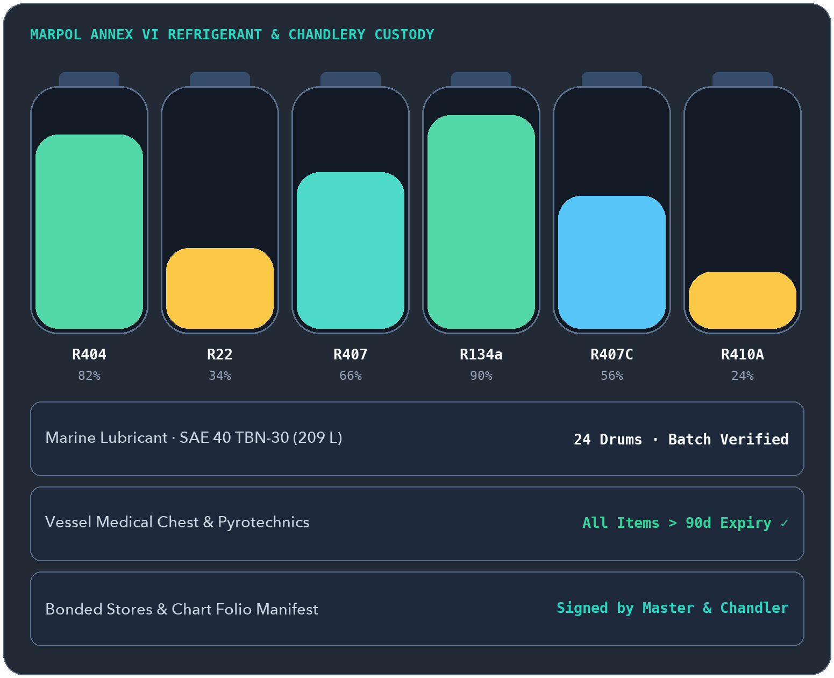
OFFSHORA
ENERGY OS
MODULE 07 · PILOT-READY
www.ofshora.com ↗
MODULE 07 · SHIP CHANDLERY, CONSUMABLES & BONDED STORES
Every drum, spare & cylinder
tracked onto the vessel.
6 Gases
CYLINDER CUSTODY
R404 · R22 · R407 · R134a · R407C · R410A
Controls ship spares, branded marine lubricants, PPE, medical chests, bonded provisions, and MARPOL Annex VI refrigerant gas cylinders.
▲ WHY CHANDLERS & FLEETS NEED IT
Expired medical kits fail port state inspections, lube grades get mixed up, and untracked refrigerant cylinders breach MARPOL logs.
✓
Structured catalogue for engine/deck spares, PPE, life-saving appliances & bonded stores
✓
Branded marine lubricant lookup by viscosity grade, OEM spec, and drum/pack size
✓
Vessel medical supply expiry tracking and nautical chart/publication renewal alerts
✓
MARPOL Annex VI refrigerant cylinder serial tracking, charging logs & signed delivery receipts
◆ Bonded Warehouses · Supply Boats · Fleet Stores
Offshora Energy OS · https://www.ofshora.com
10 / 25
Notes:
SLIDE 10/25 — MarineStores — Spares, Lubes & Refrigerants (Pilot-ready)
Official Platform: https://www.ofshora.com/
EXECUTIVE HOOK:
Every drum, spare & cylinder tracked onto the vessel.
BUYER PAIN POINT (Why chandlers & fleets need it):
Expired medical kits fail port state inspections, lube grades get mixed up, and untracked refrigerant cylinders breach MARPOL logs.
HEADLINE METRIC:
6 Gases — Cylinder custody (R404 · R22 · R407 · R134a · R407C · R410A)
KEY CAPABILITIES TO HIGHLIGHT:
• Structured catalogue for engine/deck spares, PPE, life-saving appliances & bonded stores
• Branded marine lubricant lookup by viscosity grade, OEM spec, and drum/pack size
• Vessel medical supply expiry tracking and nautical chart/publication renewal alerts
• MARPOL Annex VI refrigerant cylinder serial tracking, charging logs & signed delivery receipts

Slide 11

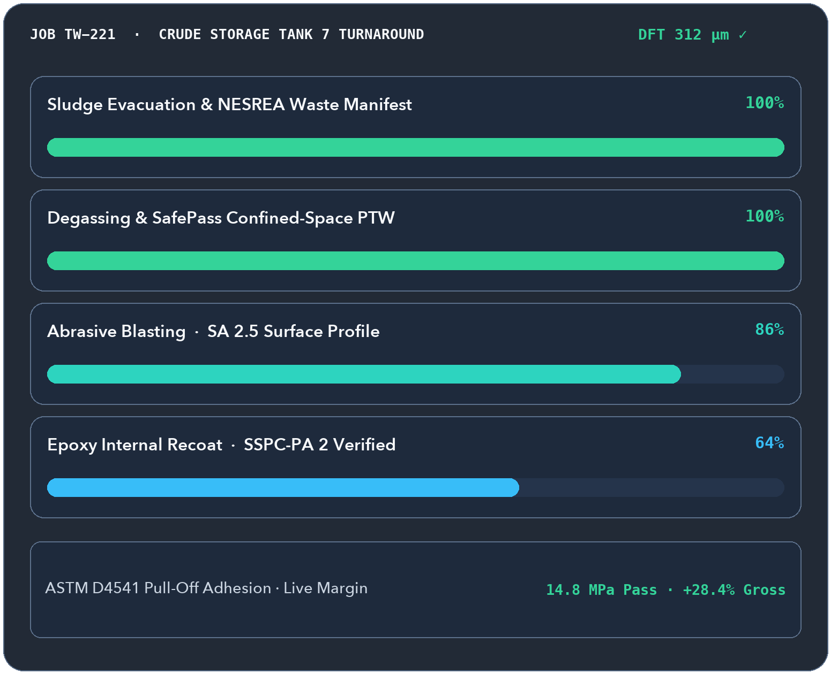
OFFSHORA
ENERGY OS
MODULE 08 · PILOT-READY
www.ofshora.com ↗
MODULE 08 · INDUSTRIAL TANK & FIELD SERVICES
Protect job margins and
confined-space safety.
SA 2.5
BLAST & DFT QA
SSPC-PA 2 DFT + ASTM D4541 pull-off logs
Connects tank evacuation, SA 2.5 abrasive blasting, internal recoating QA, NESREA waste manifests, and live job costing.
▲ WHY TANK CONTRACTORS NEED IT
Tank turnaround jobs overrun abrasive/paint budgets fast—while missing DFT coating proofs or waste manifests delay client sign-off.
✓
Confined-space entry hard-linked to SafePass permits and atmospheric gas clearance
✓
Hazardous sludge evacuation & NESREA chain-of-custody disposal manifest sign-offs
✓
Abrasive blasting, SSPC-PA 2 dry-film thickness (DFT) readings & adhesion test records
✓
Real-time crew man-hours, compressor/equipment utilization, and consumables costing
◆ Storage Tank Farms · Terminals · Field Turnarounds
Offshora Energy OS · https://www.ofshora.com
11 / 25
Notes:
SLIDE 11/25 — TankWorks — Tank Cleaning, Blasting & Recoat (Pilot-ready)
Official Platform: https://www.ofshora.com/
EXECUTIVE HOOK:
Protect job margins and confined-space safety.
BUYER PAIN POINT (Why tank contractors need it):
Tank turnaround jobs overrun abrasive/paint budgets fast—while missing DFT coating proofs or waste manifests delay client sign-off.
HEADLINE METRIC:
SA 2.5 — Blast & DFT QA (SSPC-PA 2 DFT + ASTM D4541 pull-off logs)
KEY CAPABILITIES TO HIGHLIGHT:
• Confined-space entry hard-linked to SafePass permits and atmospheric gas clearance
• Hazardous sludge evacuation & NESREA chain-of-custody disposal manifest sign-offs
• Abrasive blasting, SSPC-PA 2 dry-film thickness (DFT) readings & adhesion test records
• Real-time crew man-hours, compressor/equipment utilization, and consumables costing

Slide 12

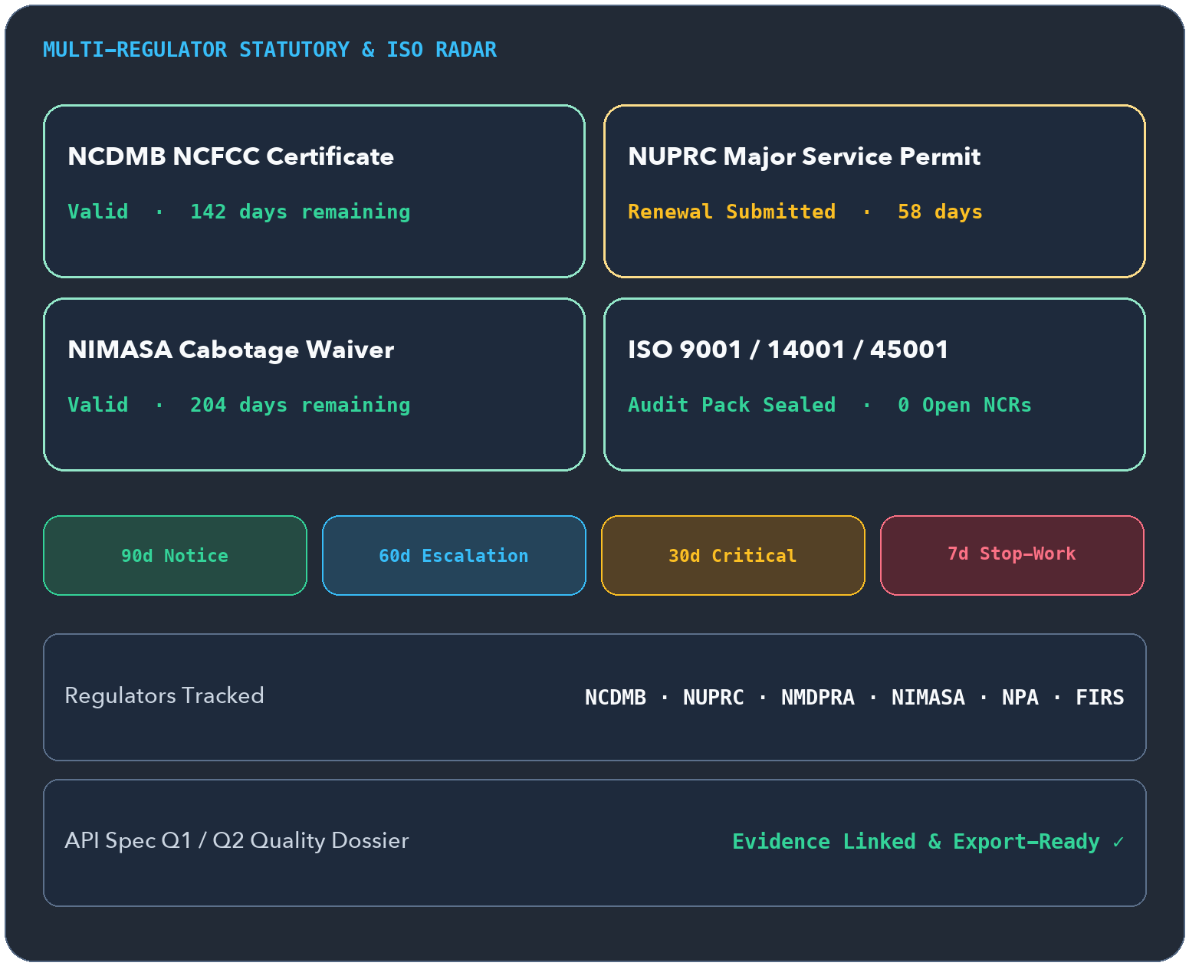
OFFSHORA
ENERGY OS
MODULE 09 · PILOT-READY
www.ofshora.com ↗
MODULE 09 · MULTI-REGULATOR EXPIRY & AUDIT ENGINE
Never lose a contract to
a surprise permit expiry.
90·60·30·7d
ESCALATING ALERTS
NCDMB · NUPRC · NMDPRA · NIMASA · ISO
Puts every statutory licence, vessel endorsement, tax clearance, and ISO non-conformance onto one automated countdown radar.
▲ WHY MDS & COMPLIANCE TEAMS NEED IT
Discovering an expired NUPRC, NIMASA, or NCDMB permit mid-tender—or scrambling days before an ISO surveillance audit—costs millions.
✓
Unified register across NCDMB, NUPRC, NMDPRA, NIMASA, Cabotage, FMEnv, NPA & FIRS
✓
Automated 90/60/30/7-day renewal alerts with critical stop-work risk indicators
✓
Application tracking numbers, submission history, and regulator verification sign-offs
✓
ISO 9001, 14001, 45001 & API Spec Q1/Q2 audit management with NCR closure evidence
◆ Corporate HQ · Compliance & Tender Desk
Offshora Energy OS · https://www.ofshora.com
12 / 25
Notes:
SLIDE 12/25 — Compliance Shield — Statutory & ISO Radar (Pilot-ready)
Official Platform: https://www.ofshora.com/
EXECUTIVE HOOK:
Never lose a contract to a surprise permit expiry.
BUYER PAIN POINT (Why MDs & Compliance teams need it):
Discovering an expired NUPRC, NIMASA, or NCDMB permit mid-tender—or scrambling days before an ISO surveillance audit—costs millions.
HEADLINE METRIC:
90·60·30·7d — Escalating alerts (NCDMB · NUPRC · NMDPRA · NIMASA · ISO)
KEY CAPABILITIES TO HIGHLIGHT:
• Unified register across NCDMB, NUPRC, NMDPRA, NIMASA, Cabotage, FMEnv, NPA & FIRS
• Automated 90/60/30/7-day renewal alerts with critical stop-work risk indicators
• Application tracking numbers, submission history, and regulator verification sign-offs
• ISO 9001, 14001, 45001 & API Spec Q1/Q2 audit management with NCR closure evidence

Slide 13

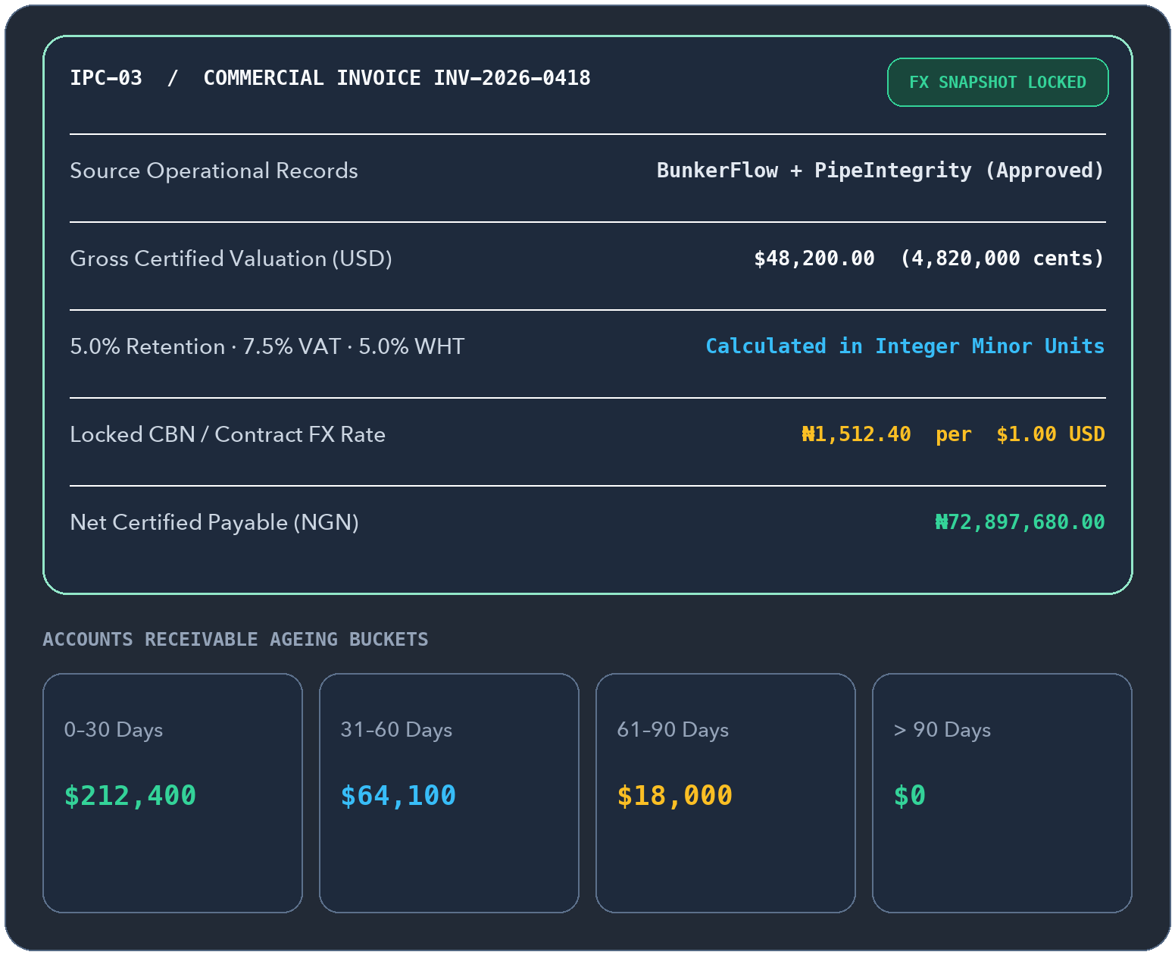
OFFSHORA
ENERGY OS
MODULE 10 · PILOT-READY
www.ofshora.com ↗
MODULE 10 · DUAL-CURRENCY INVOICING, IPCS & AGEING
Turn signed field tickets
into paid invoices faster.
₦ + $
MINOR-UNIT PRECISION
Kobo/Cents ledger + locked FX snapshot
Generates NGN and USD invoices and EPC Interim Payment Certificates directly from approved operational records—with zero FX ambiguity.
▲ WHY CFOS & COMMERCIAL LEADS NEED IT
Re-keying field tickets into spreadsheets delays billing by weeks, while unrecorded Naira/USD exchange rates spark client payment disputes.
✓
Pulls approved billable items straight from BunkerFlow, HaulTrac, TankWorks & PipeIntegrity
✓
Commercial invoices with statutory 7.5% VAT, 5% WHT, and locked FX rate snapshots
✓
EPC Interim Payment Certificates (IPCs) with gross valuation, 5% retention & QS sign-off
✓
Real-time customer statements and 4-bucket AR ageing (0–30, 31–60, 61–90, >90 days)
◆ Commercial & Finance Control
Offshora Energy OS · https://www.ofshora.com
13 / 25
Notes:
SLIDE 13/25 — Billing & Commercial — Field Work to Cash (Pilot-ready)
Official Platform: https://www.ofshora.com/
EXECUTIVE HOOK:
Turn signed field tickets into paid invoices faster.
BUYER PAIN POINT (Why CFOs & Commercial leads need it):
Re-keying field tickets into spreadsheets delays billing by weeks, while unrecorded Naira/USD exchange rates spark client payment disputes.
HEADLINE METRIC:
₦ + $ — Minor-unit precision (Kobo/Cents ledger + locked FX snapshot)
KEY CAPABILITIES TO HIGHLIGHT:
• Pulls approved billable items straight from BunkerFlow, HaulTrac, TankWorks & PipeIntegrity
• Commercial invoices with statutory 7.5% VAT, 5% WHT, and locked FX rate snapshots
• EPC Interim Payment Certificates (IPCs) with gross valuation, 5% retention & QS sign-off
• Real-time customer statements and 4-bucket AR ageing (0–30, 31–60, 61–90, >90 days)

Slide 14

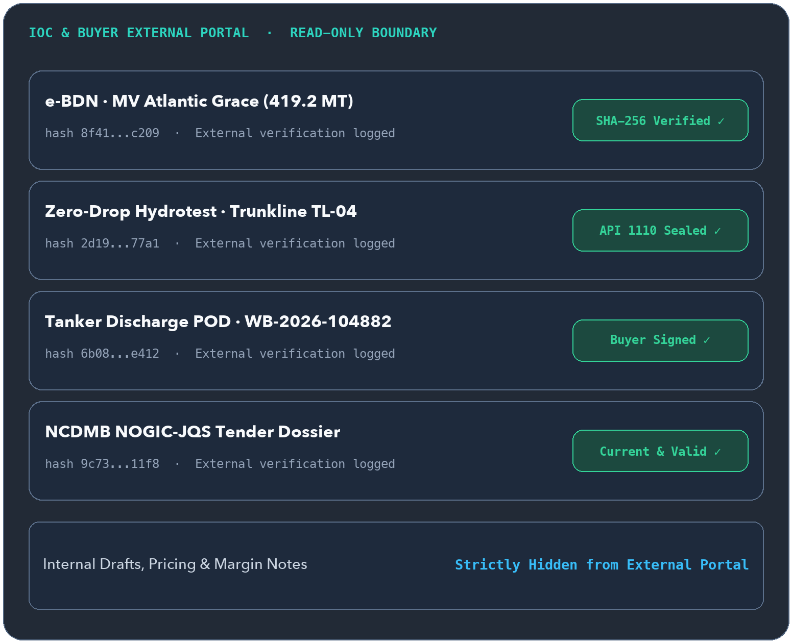
OFFSHORA
ENERGY OS
MODULE 11 · PILOT-READY
www.ofshora.com ↗
MODULE 11 · EXTERNAL READ-ONLY EVIDENCE ROOM
Let your clients verify
every seal themselves.
SHA-256
LIVE SEAL CHECK
Zero access to drafts or internal notes
Gives IOCs, EPC primes, and fleet buyers a tenant-isolated read-only portal to inspect approved BDNs, PODs, hydrotests, and invoices.
▲ WHY IT WINS REPEAT CONTRACTS
Clients hate chasing PDF attachments on email. Giving operators instant cryptographic proof builds trust that competitors can't match.
✓
Strict external customer boundary—clients see only approved records scoped to them
✓
Instant SHA-256 cryptographic seal verification on e-BDNs, PODs, and hydrotest certs
✓
Immutable external access log recording who viewed or downloaded each certificate
✓
Turns transparency into demand-side pull: operators ask their other vendors for Offshora
◆ IOC Operators · EPC Primes · Fleet Buyers
Offshora Energy OS · https://www.ofshora.com
14 / 25
Notes:
SLIDE 14/25 — Client Portal — IOC & Buyer Verification (Pilot-ready)
Official Platform: https://www.ofshora.com/
EXECUTIVE HOOK:
Let your clients verify every seal themselves.
BUYER PAIN POINT (Why it wins repeat contracts):
Clients hate chasing PDF attachments on email. Giving operators instant cryptographic proof builds trust that competitors can't match.
HEADLINE METRIC:
SHA-256 — Live seal check (Zero access to drafts or internal notes)
KEY CAPABILITIES TO HIGHLIGHT:
• Strict external customer boundary—clients see only approved records scoped to them
• Instant SHA-256 cryptographic seal verification on e-BDNs, PODs, and hydrotest certs
• Immutable external access log recording who viewed or downloaded each certificate
• Turns transparency into demand-side pull: operators ask their other vendors for Offshora

Slide 15
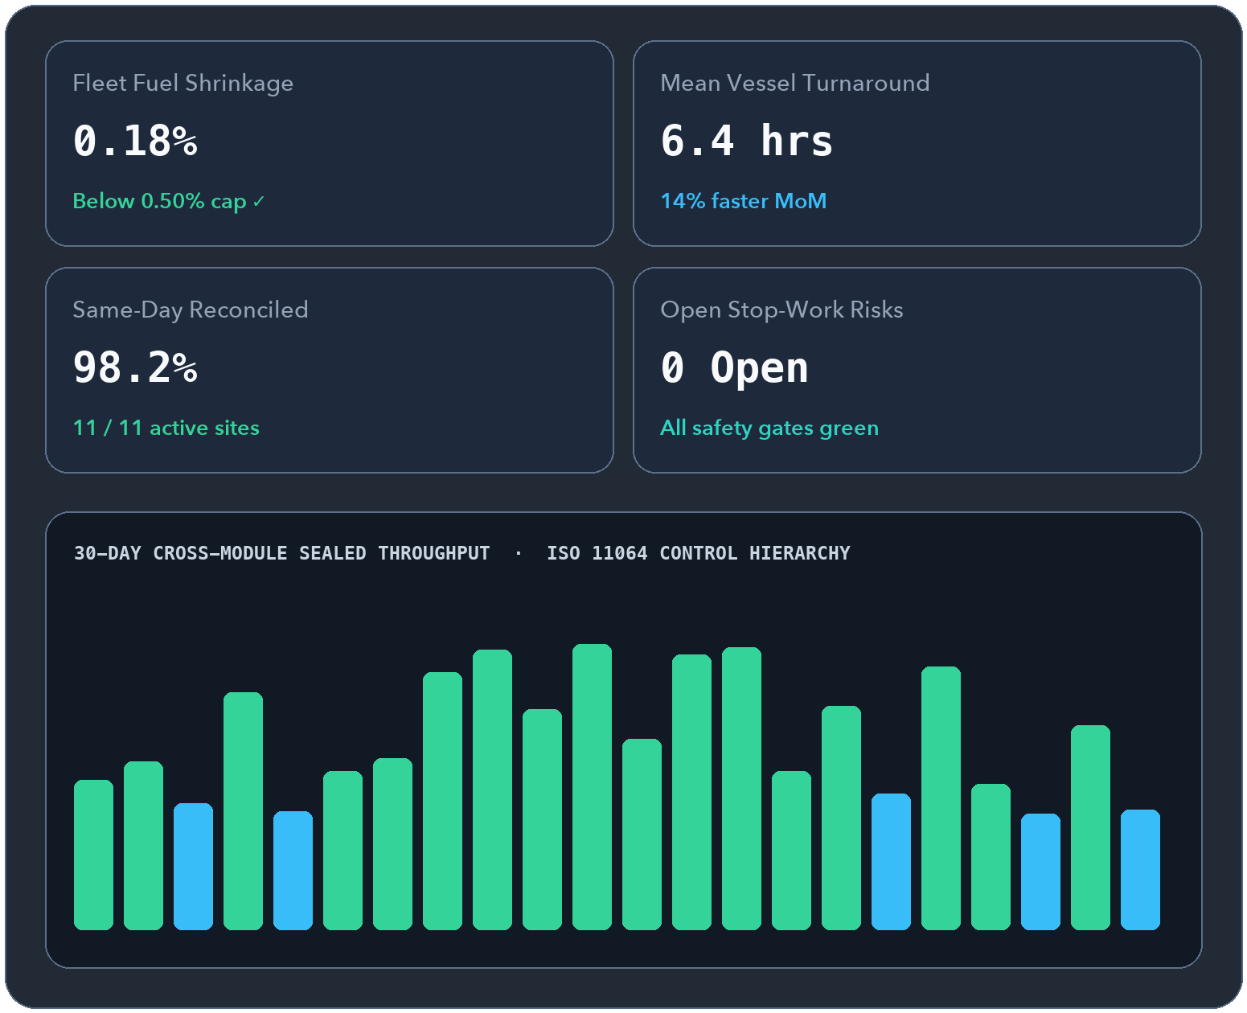
OFFSHORA
ENERGY OS
MODULE 12 · PILOT-READY
www.ofshora.com ↗
MODULE 12 · LIVE CROSS-MODULE KPIS & EXCEPTION FEED
Your entire operation
on one live screen.
98.2%
SAME-DAY RECONCILED
Live exception feed + sealed board exports
Projects live turnaround time, shrinkage %, reconciliation rate, utilization, and statutory risk across every vessel, depot, and yard.
▲ WHY MDS & BOARD DIRECTORS NEED IT
Waiting for Friday PowerPoint packs means you find out about a 0.9% stem variance, failed gas test, or expiring permit after the damage is done.
✓
Live KPIs across all modules filtered by site, date window, and NGN/USD currency
✓
Severity-ranked exception feed (>0.5% variance, failed gas tests, expiring credentials) with ack workflow
✓
One-click executive board briefs, variance ledgers, and SHA-256 sealed audit exports
✓
Control-room visual hierarchy aligned with ISO 11064 operator ergonomics
◆ Managing Director & Control Room View
Offshora Energy OS · https://www.ofshora.com
15 / 25
Notes:
SLIDE 15/25 — Owner Dashboard — Executive Command View (Pilot-ready)
Official Platform: https://www.ofshora.com/
EXECUTIVE HOOK:
Your entire operation on one live screen.
BUYER PAIN POINT (Why MDs & Board Directors need it):
Waiting for Friday PowerPoint packs means you find out about a 0.9% stem variance, failed gas test, or expiring permit after the damage is done.
HEADLINE METRIC:
98.2% — Same-day reconciled (Live exception feed + sealed board exports)
KEY CAPABILITIES TO HIGHLIGHT:
• Live KPIs across all modules filtered by site, date window, and NGN/USD currency
• Severity-ranked exception feed (>0.5% variance, failed gas tests, expiring credentials) with ack workflow
• One-click executive board briefs, variance ledgers, and SHA-256 sealed audit exports
• Control-room visual hierarchy aligned with ISO 11064 operator ergonomics

Slide 16
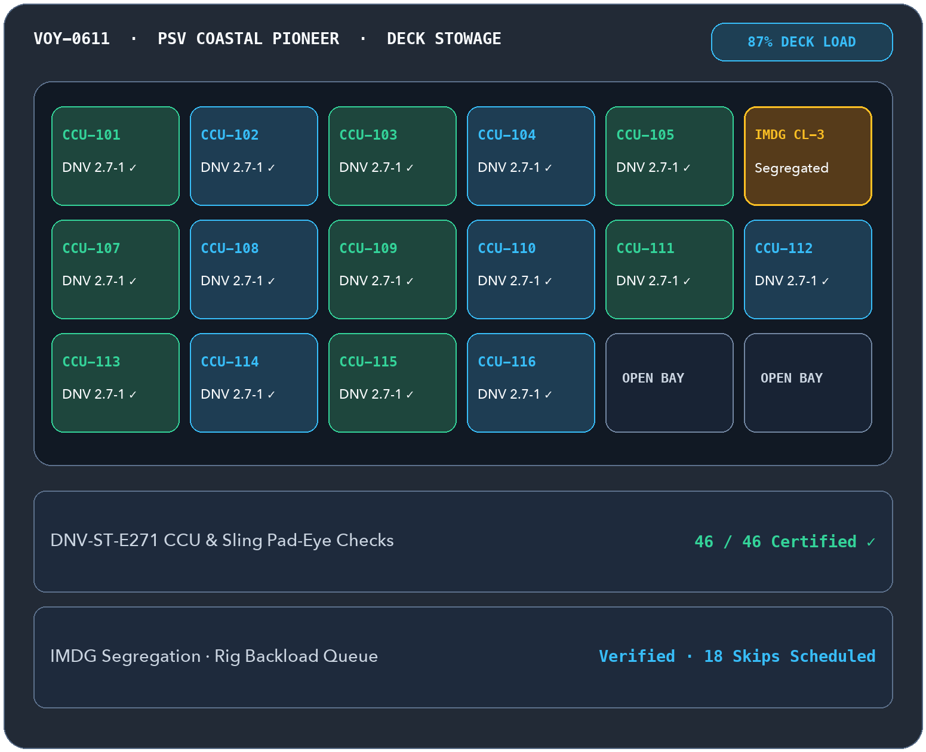
OFFSHORA
ENERGY OS
MODULE 13 · OFFSHORE SUITE
www.ofshora.com ↗
MODULE 13 · QUAYSIDE LOAD-OUT, CCUS & BACKLOAD
Every crane lift to the rig,
and every CCU back ashore.
46 / 46
LIFTS TAGGED & WEIGHED
IMDG segregation + CCU cert lock before sailing
Plans multi-drop PSV voyages, deck stowage, QR/RFID lift manifests, DNV-ST-E271 aligned CCU checks, IMDG segregation, and backload.
▲ WHY SUPPLY BASES & PSVS NEED IT
Containers go missing offshore on daily rental, incompatible dangerous goods get stowed side-by-side, and backload skips arrive undocumented.
✓
Multi-drop PSV voyage & visual deck-load planner across rigs, FPSOs, and platforms
✓
CCU & lifting-set inspection check before load-out (aligned with DNV-ST-E271 / 2.7-1)
✓
IMDG dangerous goods segregation check that flags incompatible classes before stowage
✓
Backload reconciliation tracking returned CCUs, waste skips, and shared-voyage cost splits
◆ Onne · Lekki · Warri Supply Bases → Offshore
Offshora Energy OS · https://www.ofshora.com
16 / 25
Notes:
SLIDE 16/25 — OffshoreLink — Supply Base & PSV Deck Cargo (Offshore Suite)
Official Platform: https://www.ofshora.com/
EXECUTIVE HOOK:
Every crane lift to the rig, and every CCU back ashore.
BUYER PAIN POINT (Why supply bases & PSVs need it):
Containers go missing offshore on daily rental, incompatible dangerous goods get stowed side-by-side, and backload skips arrive undocumented.
HEADLINE METRIC:
46 / 46 — Lifts tagged & weighed (IMDG segregation + CCU cert lock before sailing)
KEY CAPABILITIES TO HIGHLIGHT:
• Multi-drop PSV voyage & visual deck-load planner across rigs, FPSOs, and platforms
• CCU & lifting-set inspection check before load-out (aligned with DNV-ST-E271 / 2.7-1)
• IMDG dangerous goods segregation check that flags incompatible classes before stowage
• Backload reconciliation tracking returned CCUs, waste skips, and shared-voyage cost splits

Slide 17
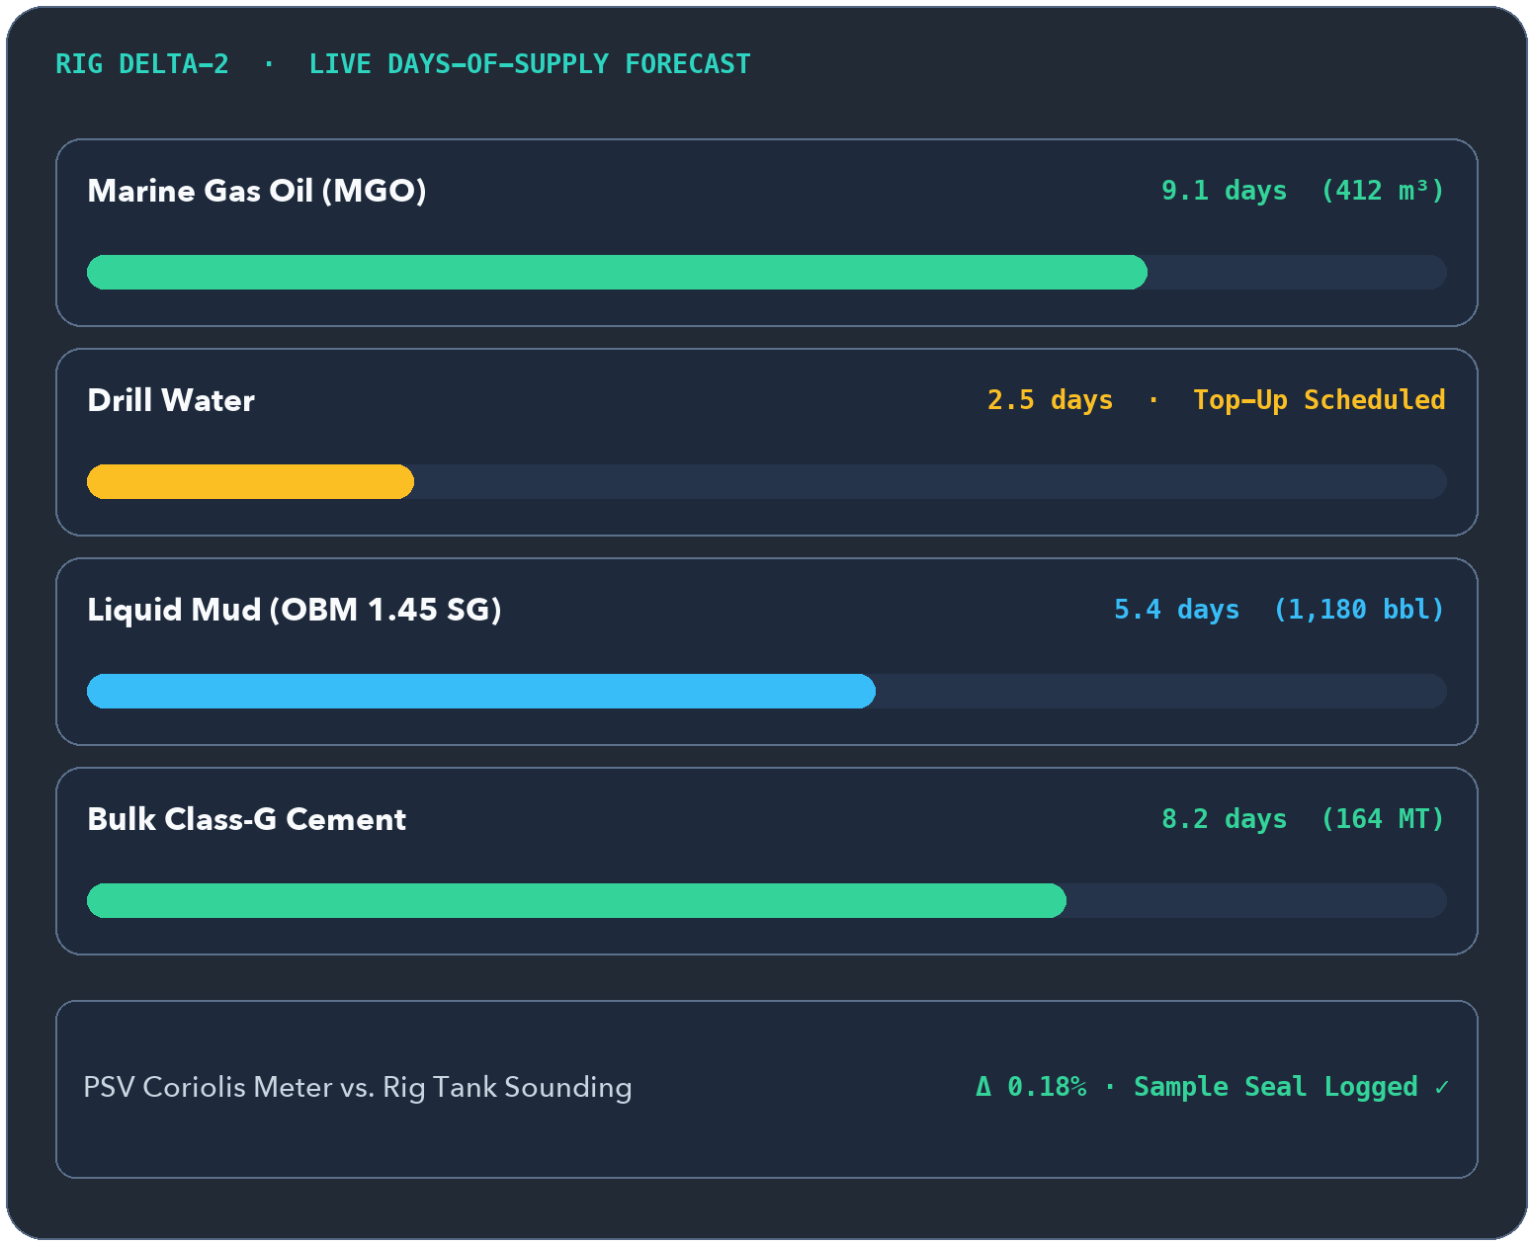
OFFSHORA
ENERGY OS
MODULE 14 · OFFSHORE SUITE
www.ofshora.com ↗
MODULE 14 · BELOW-DECK LIQUID & DRY BULK TRANSFERS
Vessel meter vs. rig tank,
reconciled to the litre.
Δ 0.18%
HOSE TRANSFER CHECK
Live rig days-of-supply forecast per product
Tracks MGO, drill water, potable water, liquid mud (OBM/WBM/SBM), brine, cement, barite, and bentonite—plus rig days-of-supply forecasts.
▲ WHY RIG SUPPLIERS NEED IT
Hose transfers offshore trigger constant disputes between PSV flowmeters and rig tank soundings—while running low on drill water halts drilling.
✓
Delivery tickets for MGO/AGO, drill/potable water, brine, liquid mud & dry bulk tonnages
✓
Instant vessel meter vs. installation sounding reconciliation with variance alerts
✓
Sample seal logging and density @ 15 °C recorded on every offshore fuel transfer
✓
Rig tank inventory & days-of-supply countdown suggesting top-ups on planned PSV runs
◆ PSV Bulk Tanks → Rig & FPSO Manifolds
Offshora Energy OS · https://www.ofshora.com
17 / 25
Notes:
SLIDE 17/25 — RigSupply — Offshore Fuel, Water, Mud & Bulk (Offshore Suite)
Official Platform: https://www.ofshora.com/
EXECUTIVE HOOK:
Vessel meter vs. rig tank, reconciled to the litre.
BUYER PAIN POINT (Why rig suppliers need it):
Hose transfers offshore trigger constant disputes between PSV flowmeters and rig tank soundings—while running low on drill water halts drilling.
HEADLINE METRIC:
Δ 0.18% — Hose transfer check (Live rig days-of-supply forecast per product)
KEY CAPABILITIES TO HIGHLIGHT:
• Delivery tickets for MGO/AGO, drill/potable water, brine, liquid mud & dry bulk tonnages
• Instant vessel meter vs. installation sounding reconciliation with variance alerts
• Sample seal logging and density @ 15 °C recorded on every offshore fuel transfer
• Rig tank inventory & days-of-supply countdown suggesting top-ups on planned PSV runs

Slide 18
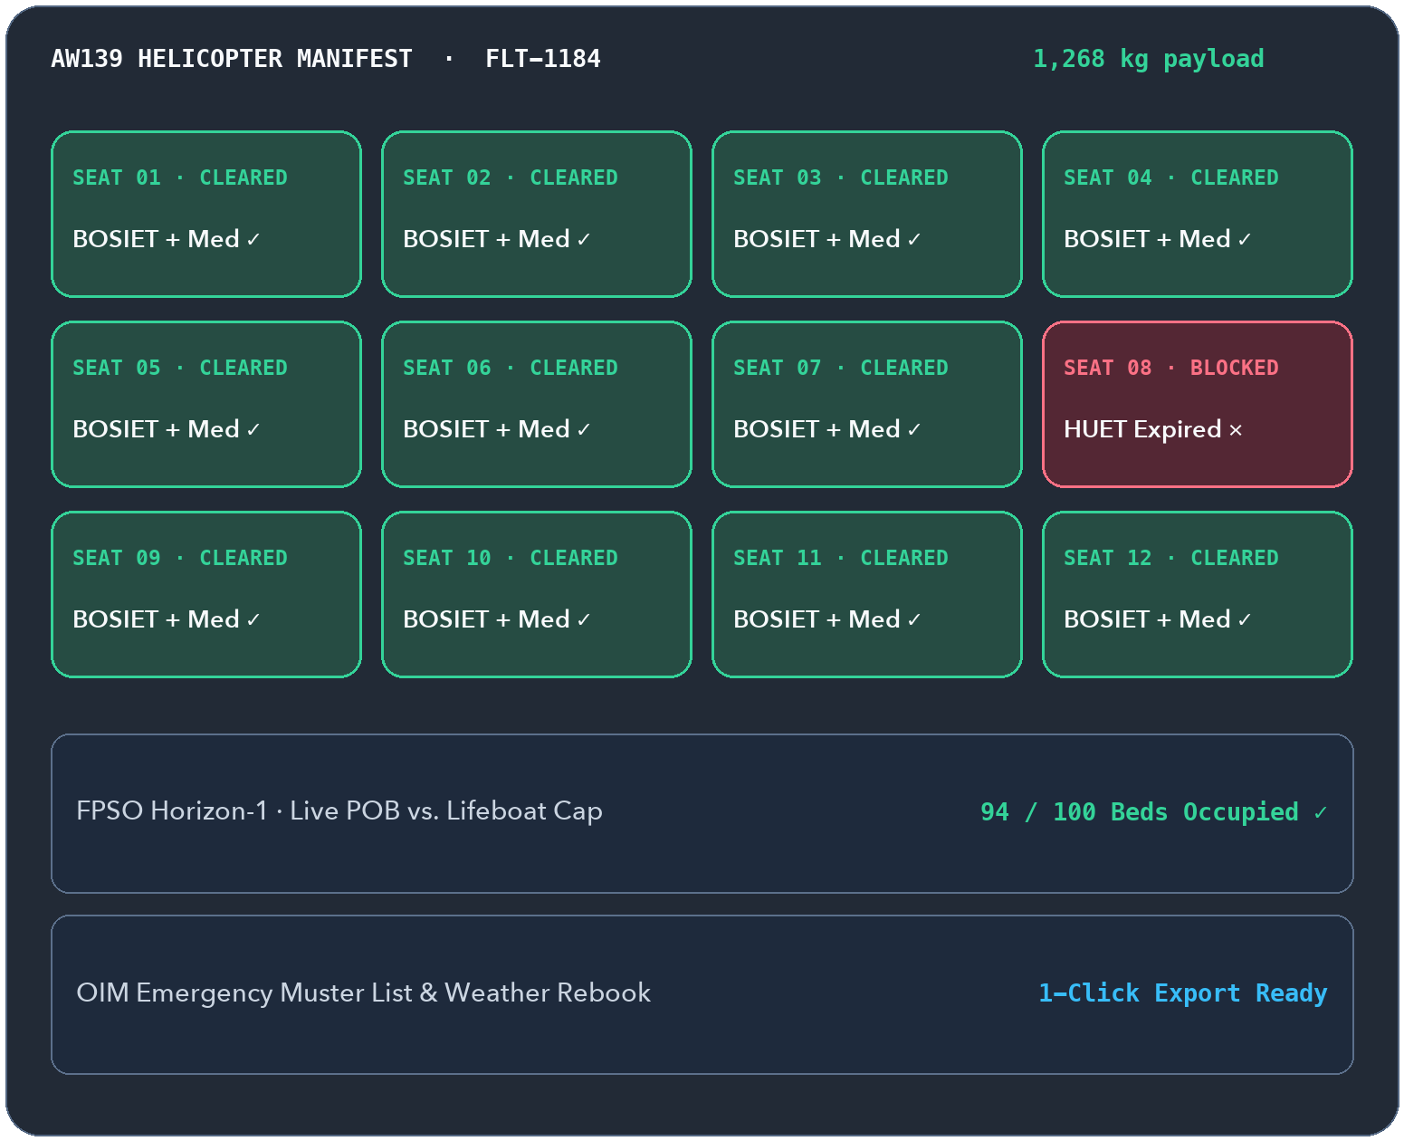
OFFSHORA
ENERGY OS
MODULE 15 · OFFSHORE SUITE
www.ofshora.com ↗
MODULE 15 · AVIATION, MARINE TRANSFERS & LIVE MUSTER
Every seat cleared,
every lifeboat count exact.
94 / 100
LIVE POB VS. BEDS
Auto-gated by SafePass BOSIET / HUET / Medical
Manages helicopter and crew-boat manifests, passenger/baggage weights, weather rebookings, and live Personnel-on-Board (POB) limits.
▲ WHY OFFSHORE LOGISTICS TEAMS NEED IT
Weather cancellations scramble Excel flight lists in minutes, risking bed/lifeboat over-capacity or boarding someone with an expired HUET.
✓
Helicopter & crew-boat seat allocation, standby lists, and check-in payload weights
✓
Automatic boarding block via SafePass if BOSIET, HUET, or medical fitness is expired
✓
Live POB per installation checked against bed and lifeboat capacity limits
✓
One-click weather rebooking and instant OIM emergency muster list export
◆ Heliports · Crew Boat Jetties · Installations
Offshora Energy OS · https://www.ofshora.com
18 / 25
Notes:
SLIDE 18/25 — CrewTransit — Helicopters, Crew Boats & POB (Offshore Suite)
Official Platform: https://www.ofshora.com/
EXECUTIVE HOOK:
Every seat cleared, every lifeboat count exact.
BUYER PAIN POINT (Why offshore logistics teams need it):
Weather cancellations scramble Excel flight lists in minutes, risking bed/lifeboat over-capacity or boarding someone with an expired HUET.
HEADLINE METRIC:
94 / 100 — Live POB vs. beds (Auto-gated by SafePass BOSIET / HUET / Medical)
KEY CAPABILITIES TO HIGHLIGHT:
• Helicopter & crew-boat seat allocation, standby lists, and check-in payload weights
• Automatic boarding block via SafePass if BOSIET, HUET, or medical fitness is expired
• Live POB per installation checked against bed and lifeboat capacity limits
• One-click weather rebooking and instant OIM emergency muster list export

Slide 19
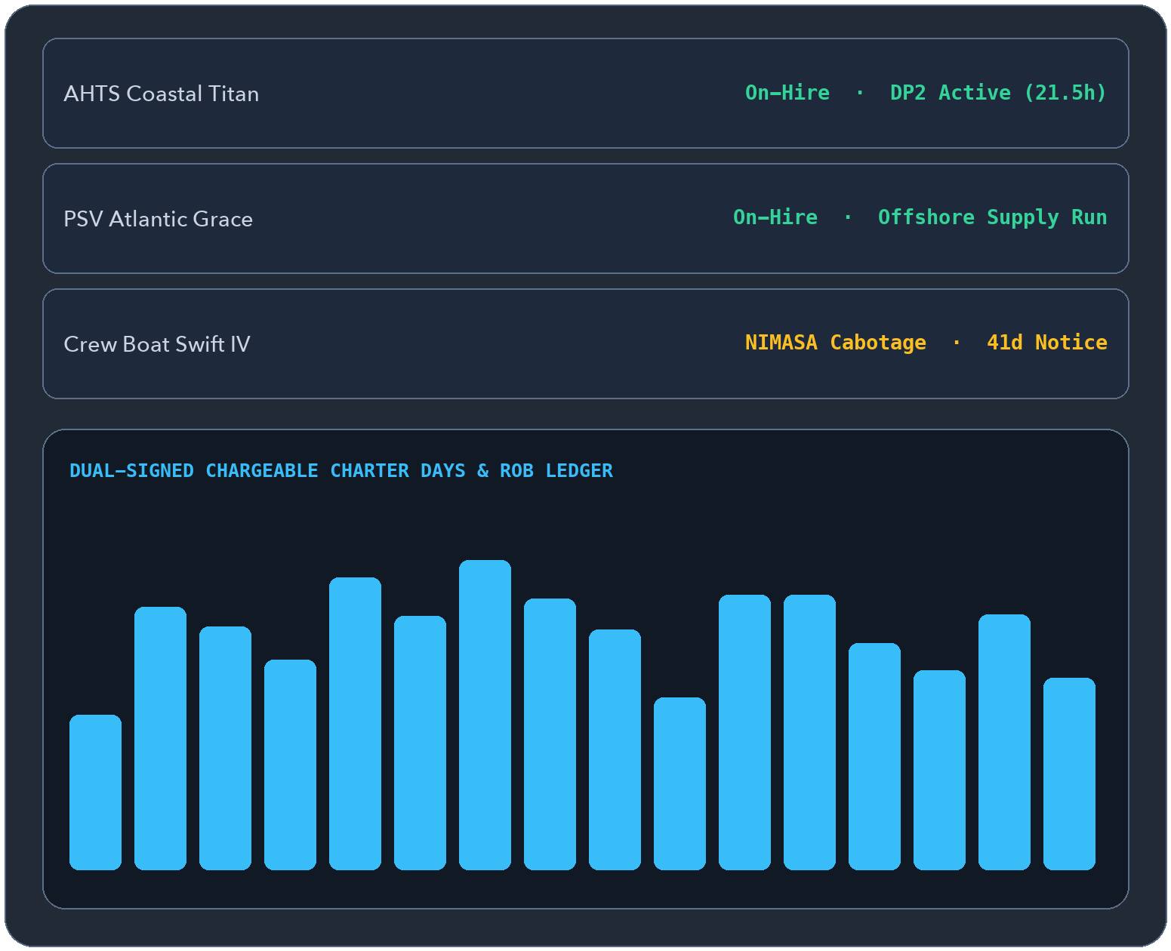
OFFSHORA
ENERGY OS
MODULE 16 · OFFSHORE SUITE
www.ofshora.com ↗
MODULE 16 · ON-HIRE LEDGERS, DPRS & VESSEL COMPLIANCE
Back every charter day
with a dual-signed record.
100%
SIGNED HIRE EVENTS
Class · ISM/ISPS · P&I · Cabotage · OVID/CMID
Covers PSV, AHTS, crew boat, and tug charters—from on-hire/off-hire timestamps and daily DP/ROB reports to NIMASA cabotage and OVID close-out.
▲ WHY OSV OWNERS NEED IT
Charterers dispute chargeable days and fuel ROB when daily vessel reports and off-hire breakdown logs aren't signed contemporaneously.
✓
Charter party register capturing day rates, mob/demob fees, and bunker clauses
✓
Dual-signed on-hire / off-hire ledger with breakdown evidence and chargeable-day math
✓
Daily Vessel Report (DPR): 24h activity log, DP hours, position, fuel & water ROB
✓
Class, flag, P&I, NIMASA cabotage tracking, and OVID/CMID inspection finding close-out
◆ PSV · AHTS · Crew Boat · Anchor Handling Fleets
Offshora Energy OS · https://www.ofshora.com
19 / 25
Notes:
SLIDE 19/25 — VesselOps — OSV Charter, Fleet & Cabotage (Offshore Suite)
Official Platform: https://www.ofshora.com/
EXECUTIVE HOOK:
Back every charter day with a dual-signed record.
BUYER PAIN POINT (Why OSV owners need it):
Charterers dispute chargeable days and fuel ROB when daily vessel reports and off-hire breakdown logs aren't signed contemporaneously.
HEADLINE METRIC:
100% — Signed hire events (Class · ISM/ISPS · P&I · Cabotage · OVID/CMID)
KEY CAPABILITIES TO HIGHLIGHT:
• Charter party register capturing day rates, mob/demob fees, and bunker clauses
• Dual-signed on-hire / off-hire ledger with breakdown evidence and chargeable-day math
• Daily Vessel Report (DPR): 24h activity log, DP hours, position, fuel & water ROB
• Class, flag, P&I, NIMASA cabotage tracking, and OVID/CMID inspection finding close-out

Slide 20
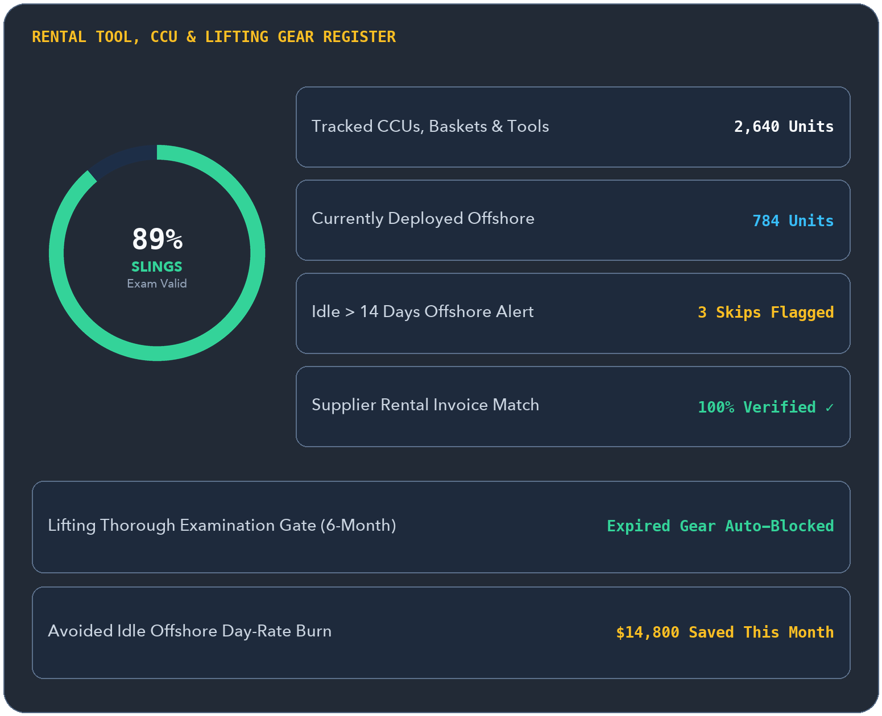
OFFSHORA
ENERGY OS
MODULE 17 · OFFSHORE SUITE
www.ofshora.com ↗
MODULE 17 · ASSET LOCATION, SLING CERTS & RENTAL BURN
Stop paying daily rent on
idle tools forgotten offshore.
$0
UNVERIFIED RENTAL DAYS
QR/RFID location history + sling expiry lock
Tracks every owned and rented CCU, chemical tank, sling, shackle, and downhole tool across base, vessel, and rig with a live rental day counter.
▲ WHY CONTRACTORS & TOOL OWNERS NEED IT
Rented baskets and tools sit idle on rig decks for weeks racking up thousands in unbudgeted day-rates—or fail supplier invoice checks.
✓
Single QR/RFID register for owned & rented CCUs, tote tanks, slings, and specialist tools
✓
Periodic inspection & thorough lifting-gear examination dates blocking expired manifests
✓
Automatic on-rent / off-rent day counter with idle offshore cost-exposure alerts
✓
Reconciles third-party rental supplier invoices directly against tracked ashore dates
◆ Yards · Quaysides · Offshore Decks
Offshora Energy OS · https://www.ofshora.com
20 / 25
Notes:
SLIDE 20/25 — EquipTrack — Rentals, CCUs & Lifting Gear (Offshore Suite)
Official Platform: https://www.ofshora.com/
EXECUTIVE HOOK:
Stop paying daily rent on idle tools forgotten offshore.
BUYER PAIN POINT (Why contractors & tool owners need it):
Rented baskets and tools sit idle on rig decks for weeks racking up thousands in unbudgeted day-rates—or fail supplier invoice checks.
HEADLINE METRIC:
$0 — Unverified rental days (QR/RFID location history + sling expiry lock)
KEY CAPABILITIES TO HIGHLIGHT:
• Single QR/RFID register for owned & rented CCUs, tote tanks, slings, and specialist tools
• Periodic inspection & thorough lifting-gear examination dates blocking expired manifests
• Automatic on-rent / off-rent day counter with idle offshore cost-exposure alerts
• Reconciles third-party rental supplier invoices directly against tracked ashore dates

Slide 21
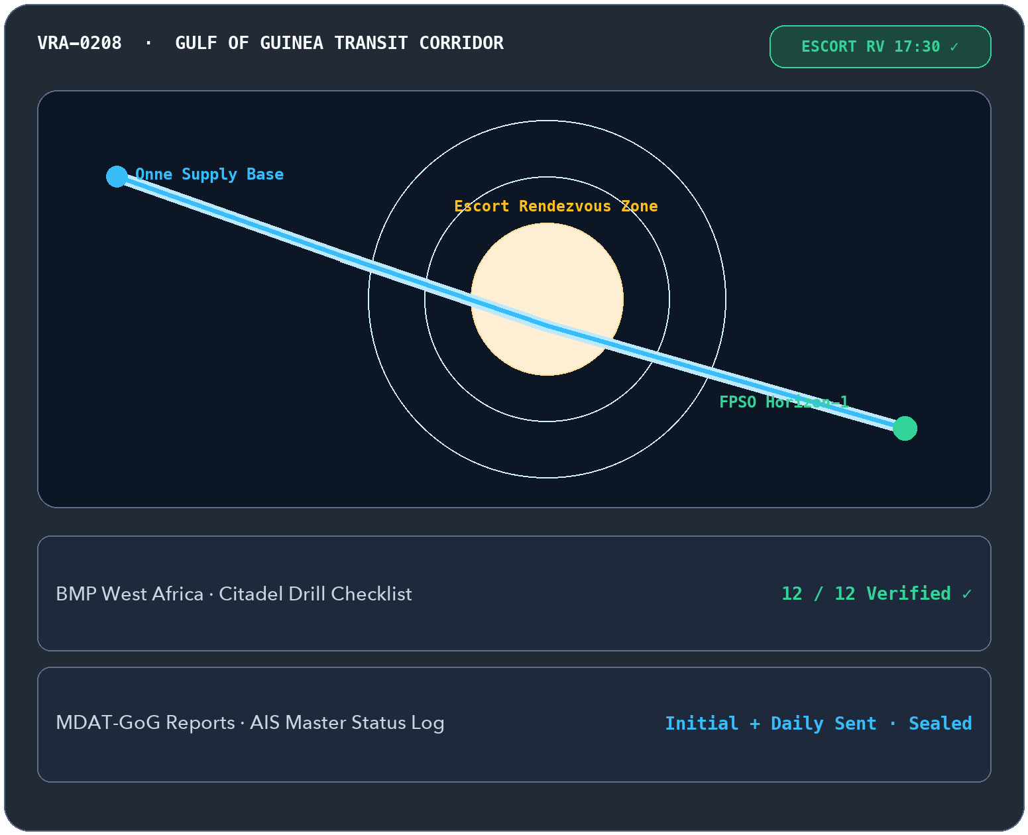
OFFSHORA
ENERGY OS
MODULE 18 · OFFSHORE SUITE
www.ofshora.com ↗
MODULE 18 · TRANSIT RISK, ESCORTS & MDAT-GOG REPORTING
Every transit assessed,
every AIS & MDAT log on file.
12 / 12
BMP WA CHECKLIST
MDAT-GoG Initial · Daily · Final + AIS log
Structured voyage risk assessments, escort rendezvous plans, MDAT-GoG position reports, BMP West Africa checklists, and AIS status logs.
▲ WHY GULF OF GUINEA FLEETS NEED IT
Unlogged AIS state changes risk naval detention, while missed MDAT-GoG reports or undocumented citadel drills fail operator marine assurance.
✓
Route, vessel, and time-of-day Voyage Risk Assessment (VRA) before departure
✓
Security escort coordination recording rendezvous coordinates, comms plan & cost
✓
MDAT-GoG initial, daily, and final report tracker plus citadel drill records
✓
Timestamped AIS status log with master's reason code and offline incident capture
◆ Gulf of Guinea Transit Corridors
Offshora Energy OS · https://www.ofshora.com
21 / 25
Notes:
SLIDE 21/25 — MarineGuard — Gulf of Guinea Voyage Security (Offshore Suite)
Official Platform: https://www.ofshora.com/
EXECUTIVE HOOK:
Every transit assessed, every AIS & MDAT log on file.
BUYER PAIN POINT (Why Gulf of Guinea fleets need it):
Unlogged AIS state changes risk naval detention, while missed MDAT-GoG reports or undocumented citadel drills fail operator marine assurance.
HEADLINE METRIC:
12 / 12 — BMP WA checklist (MDAT-GoG Initial · Daily · Final + AIS log)
KEY CAPABILITIES TO HIGHLIGHT:
• Route, vessel, and time-of-day Voyage Risk Assessment (VRA) before departure
• Security escort coordination recording rendezvous coordinates, comms plan & cost
• MDAT-GoG initial, daily, and final report tracker plus citadel drill records
• Timestamped AIS status log with master's reason code and offline incident capture

Slide 22
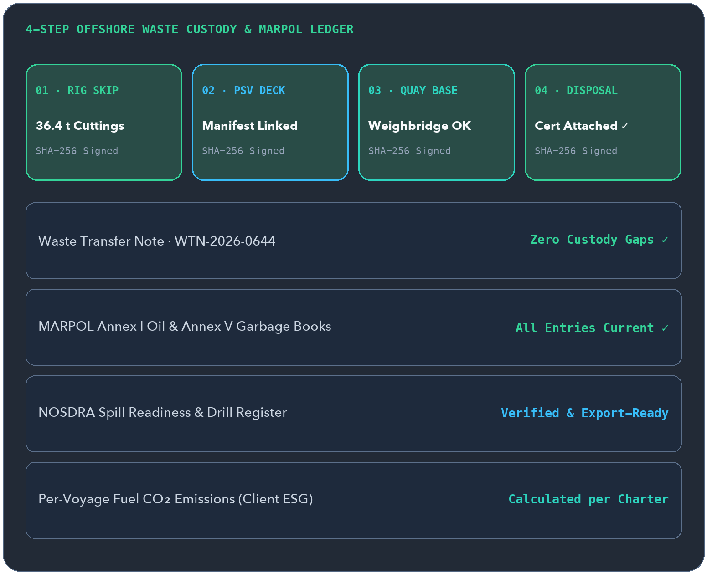
OFFSHORA
ENERGY OS
MODULE 19 · OFFSHORE SUITE
www.ofshora.com ↗
MODULE 19 · WASTE CHAIN OF CUSTODY & VOYAGE EMISSIONS
From rig skip to disposal,
zero custody gaps.
4-Step
WASTE CUSTODY CHAIN
Platform → Vessel → Base → Licensed Disposal
Closes the loop on drill cuttings, oily waste, MARPOL Annex I & V record books, spill readiness, and fuel-based CO₂ reporting for client ESG.
▲ WHY OPERATORS DEMAND IT
One missing waste disposal certificate exposes both contractor and IOC to regulatory fines—and operators now require per-voyage CO₂ metrics.
✓
Waste transfer notes tracking cuttings, slops, and scrap with custody-gap alerts
✓
Digital MARPOL Annex I Oil Record Book and Annex V Garbage Record Book entries
✓
Spill drill readiness logs and structured incident packs for NOSDRA workflows
✓
Fuel-based CO₂ calculations per vessel, voyage, and client ESG report (plus IMO DCS/CII where size applies)
◆ Offshore Installations → Licensed Treatment Facilities
Offshora Energy OS · https://www.ofshora.com
22 / 25
Notes:
SLIDE 22/25 — EnviroLedger — Offshore Waste, MARPOL & ESG (Offshore Suite)
Official Platform: https://www.ofshora.com/
EXECUTIVE HOOK:
From rig skip to disposal, zero custody gaps.
BUYER PAIN POINT (Why operators demand it):
One missing waste disposal certificate exposes both contractor and IOC to regulatory fines—and operators now require per-voyage CO₂ metrics.
HEADLINE METRIC:
4-Step — Waste custody chain (Platform → Vessel → Base → Licensed Disposal)
KEY CAPABILITIES TO HIGHLIGHT:
• Waste transfer notes tracking cuttings, slops, and scrap with custody-gap alerts
• Digital MARPOL Annex I Oil Record Book and Annex V Garbage Record Book entries
• Spill drill readiness logs and structured incident packs for NOSDRA workflows
• Fuel-based CO₂ calculations per vessel, voyage, and client ESG report (plus IMO DCS/CII where size applies)

Slide 23
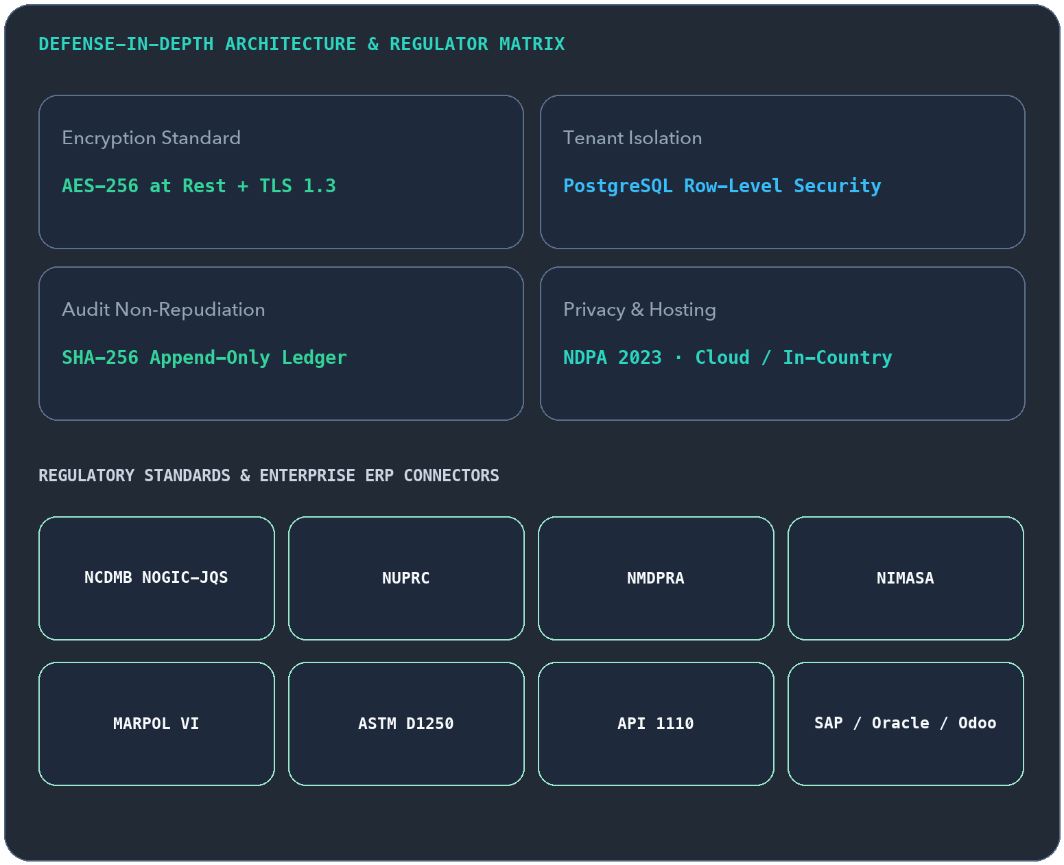
OFFSHORA
ENERGY OS
TRUST & COMPLIANCE · DEFENSE IN DEPTH
www.ofshora.com ↗
BUILT FOR ENTERPRISE AUDITS & DATA SOVEREIGNTY
Evidence you can put
before any IOC auditor.
AES-256
+ TLS 1.3 & RLS
Strict tenant isolation · Append-only history
Multi-tenant isolation, cryptographic record sealing, NDPA 2023 privacy governance, and connector-first ERP coexistence.
▲ WHY IT & LEGAL APPROVE OFFSHORA
Offshora doesn't ask large contractors to rip out SAP, Oracle, or Odoo—it seals field truth and syncs clean financial & compliance packs.
✓
PostgreSQL row-level tenant isolation, server-enforced RBAC, and non-repudiable SHA-256 seals
✓
Mapped to NCDMB, NUPRC, NMDPRA, NIMASA, NPA, MARPOL VI, ASTM D1250 & API 1110
✓
NDPA 2023 personal-data governance with flexible cloud or in-country hosting options
✓
Interface designed to WCAG 2.1 AA and aligned with ISO 11064 control-room ergonomics
◆ Enterprise Security · ERP Connectors · Regulator Ready
Offshora Energy OS · https://www.ofshora.com
23 / 25
Notes:
SLIDE 23/25 — IOC-Grade Security & Multi-Regulator Mapping (Defense in Depth)
Official Platform: https://www.ofshora.com/
EXECUTIVE HOOK:
Evidence you can put before any IOC auditor.
BUYER PAIN POINT (Why IT & Legal approve Offshora):
Offshora doesn't ask large contractors to rip out SAP, Oracle, or Odoo—it seals field truth and syncs clean financial & compliance packs.
HEADLINE METRIC:
AES-256 — + TLS 1.3 & RLS (Strict tenant isolation · Append-only history)
KEY CAPABILITIES TO HIGHLIGHT:
• PostgreSQL row-level tenant isolation, server-enforced RBAC, and non-repudiable SHA-256 seals
• Mapped to NCDMB, NUPRC, NMDPRA, NIMASA, NPA, MARPOL VI, ASTM D1250 & API 1110
• NDPA 2023 personal-data governance with flexible cloud or in-country hosting options
• Interface designed to WCAG 2.1 AA and aligned with ISO 11064 control-room ergonomics

Slide 24
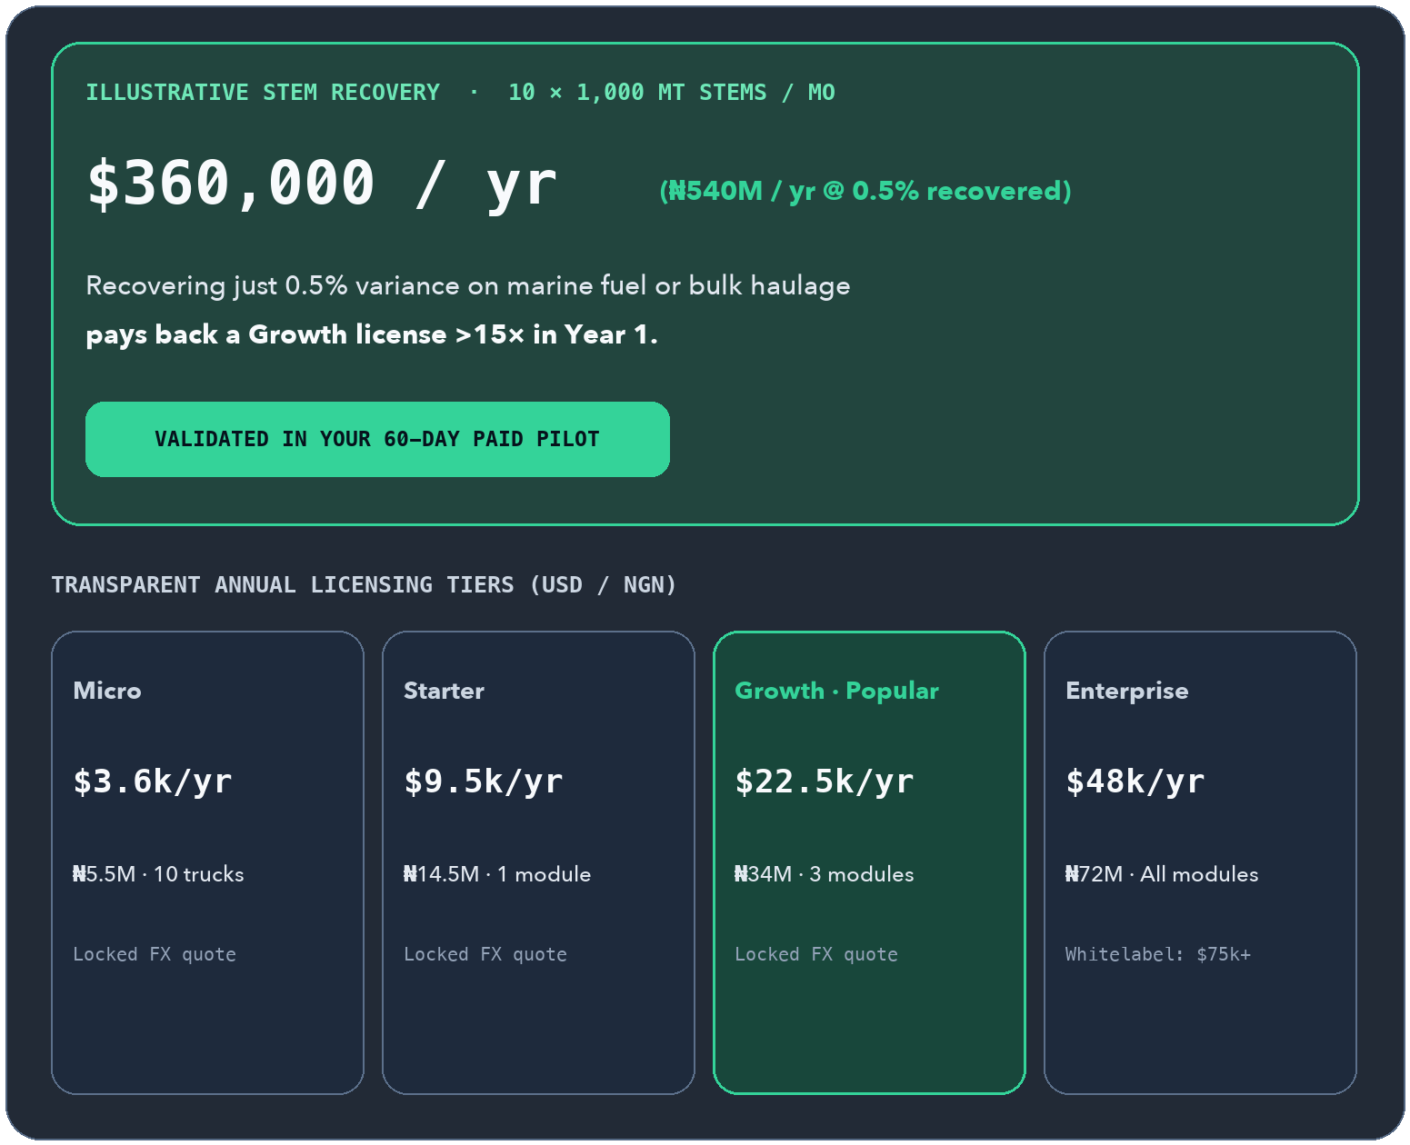
OFFSHORA
ENERGY OS
ROI & PRICING · TRANSPARENT TIERS
www.ofshora.com ↗
INTERACTIVE ROI & MODULAR ANNUAL LICENSING
Start with 10 trucks.
Scale to a private cloud.
10×+
ILLUSTRATIVE ROI
Validated on your own fleet in a 60-day pilot
Recovering just 0.5% variance on marine fuel or haulage trips can dwarf your annual software license—with transparent USD and NGN pricing.
▲ COMMERCIAL FLEXIBILITY
License only the operational modules you run today—from Micro Haulage ($3,600/yr) and Starter ($9,500/yr) up to Enterprise & Single-Tenant Whitelabel.
✓
Micro Haulage ($3.6k / ₦5.5M) · Starter ($9.5k / ₦14.5M) · Growth ($22.5k / ₦34M)
✓
Enterprise ($48k / ₦72M) & Single-Tenant Whitelabel (from $75k / ₦112.5M)
✓
NGN quotes state the locked reference FX rate upfront—zero hidden currency surprises
✓
8% discount on 2-year terms and 12% discount on 3-year prepaid agreements
◆ Indicative Proposal Pricing · USD & NGN
Offshora Energy OS · https://www.ofshora.com
24 / 25
Notes:
SLIDE 24/25 — Pays for Itself on Your First Stems (Transparent Tiers)
Official Platform: https://www.ofshora.com/
EXECUTIVE HOOK:
Start with 10 trucks. Scale to a private cloud.
BUYER PAIN POINT (Commercial flexibility):
License only the operational modules you run today—from Micro Haulage ($3,600/yr) and Starter ($9,500/yr) up to Enterprise & Single-Tenant Whitelabel.
HEADLINE METRIC:
10×+ — Illustrative ROI (Validated on your own fleet in a 60-day pilot)
KEY CAPABILITIES TO HIGHLIGHT:
• Micro Haulage ($3.6k / ₦5.5M) · Starter ($9.5k / ₦14.5M) · Growth ($22.5k / ₦34M)
• Enterprise ($48k / ₦72M) & Single-Tenant Whitelabel (from $75k / ₦112.5M)
• NGN quotes state the locked reference FX rate upfront—zero hidden currency surprises
• 8% discount on 2-year terms and 12% discount on 3-year prepaid agreements

Slide 25
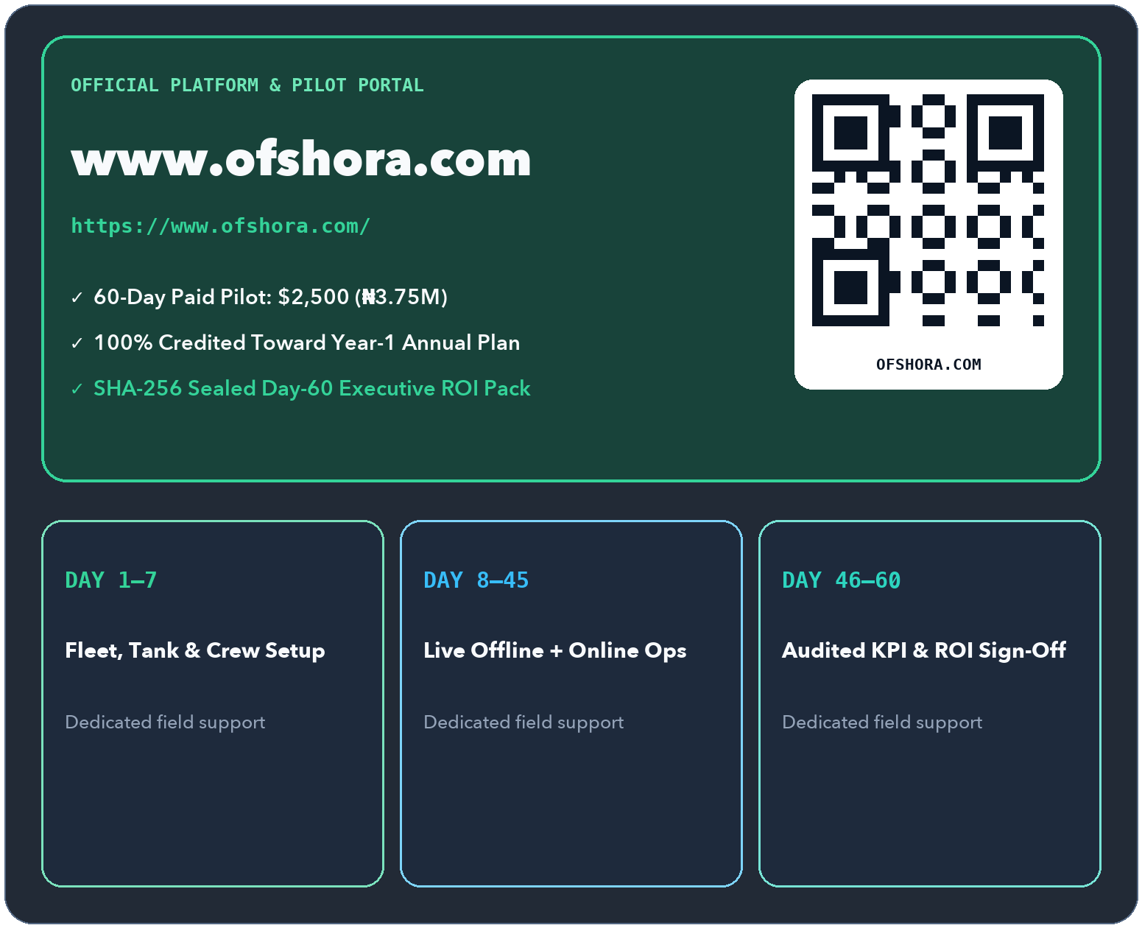
OFFSHORA
ENERGY OS
START NOW · WWW.OFSHORA.COM
www.ofshora.com ↗
ZERO GUESSWORK · AUDITED FIELD PROOF
Pick one module.
Prove the ROI in 60 days.
$2,500
60-DAY PILOT (₦3.75M)
100% credited toward Year-1 subscription
Deploy BunkerFlow, HaulTrac, SafePass, or any Pilot-ready module on your live vessels, trucks, or lines—with 100% of the pilot fee credited when you convert.
▲ HOW WE START TOGETHER
Agree one measurable KPI upfront—shrinkage %, turnaround time, reconciliation speed, or permit compliance—and review audited results at Day 60.
✓
Step 1 — Visit www.ofshora.com and select your highest-urgency operational module
✓
Step 2 — We onboard your fleet, tanks, or crew roster and configure your target KPI
✓
Step 3 — Your field teams run offline & online for 60 days with dedicated onboarding support
✓
Step 4 — Receive a SHA-256 sealed executive ROI report and credit the fee to your annual plan
◆ Lagos · Port Harcourt · Warri · Onne · www.ofshora.com
Offshora Energy OS · https://www.ofshora.com
25 / 25
Notes:
SLIDE 25/25 — Launch Your 60-Day Paid Pilot (www.ofshora.com)
Official Platform: https://www.ofshora.com/
EXECUTIVE HOOK:
Pick one module. Prove the ROI in 60 days.
BUYER PAIN POINT (How we start together):
Agree one measurable KPI upfront—shrinkage %, turnaround time, reconciliation speed, or permit compliance—and review audited results at Day 60.
HEADLINE METRIC:
$2,500 — 60-Day Pilot (₦3.75M) (100% credited toward Year-1 subscription)
KEY CAPABILITIES TO HIGHLIGHT:
• Step 1 — Visit www.ofshora.com and select your highest-urgency operational module
• Step 2 — We onboard your fleet, tanks, or crew roster and configure your target KPI
• Step 3 — Your field teams run offline & online for 60 days with dedicated onboarding support
• Step 4 — Receive a SHA-256 sealed executive ROI report and credit the fee to your annual plan

