Slide 1
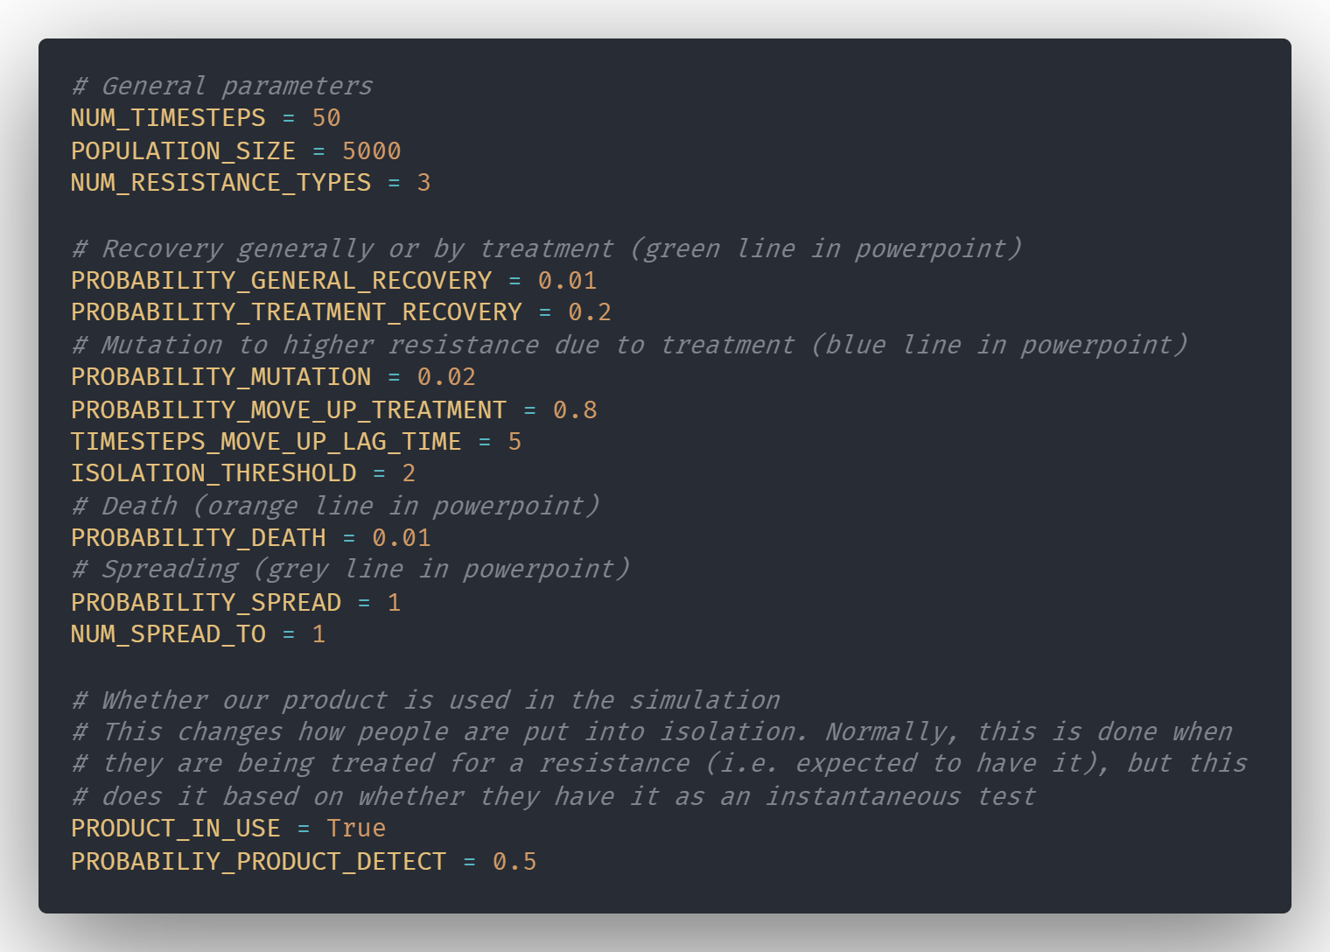
Parameters

Slide 2
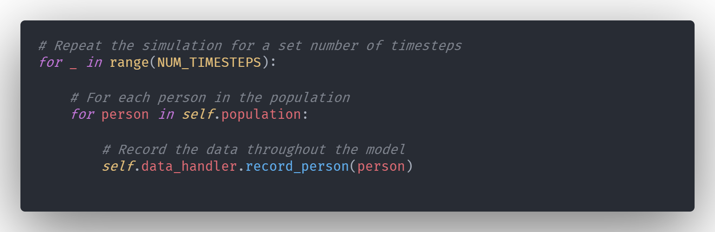
Simulation wrapper

Slide 3
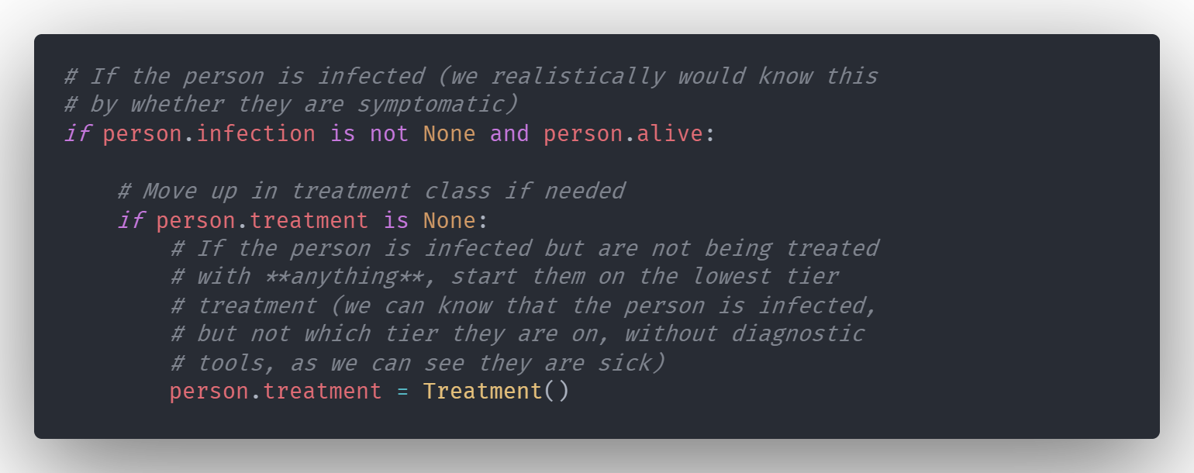
Treatment

Slide 4
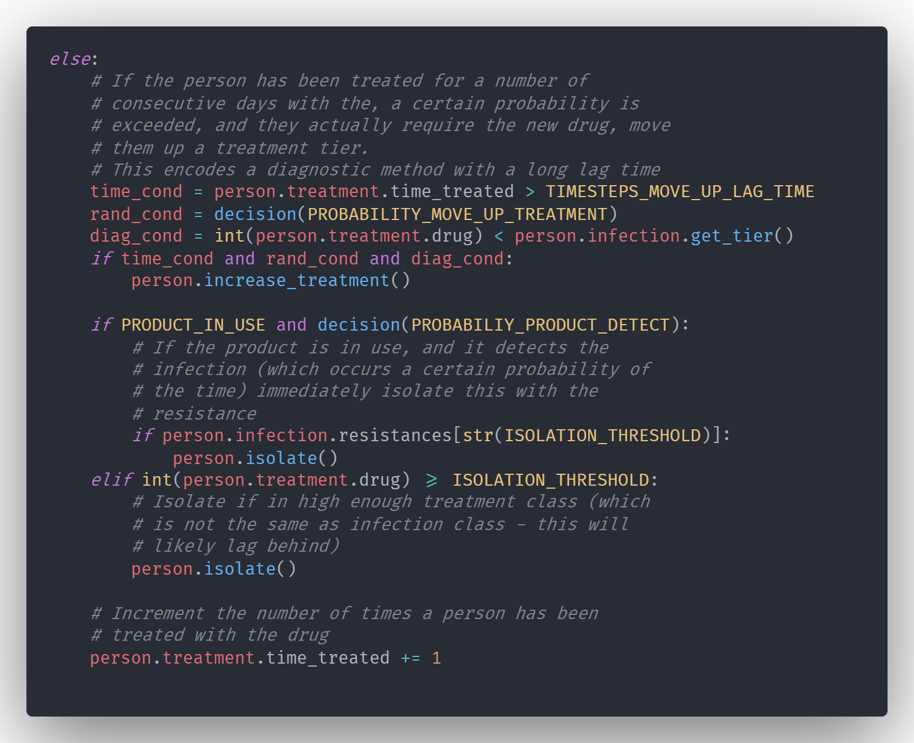
Isolation

Slide 5
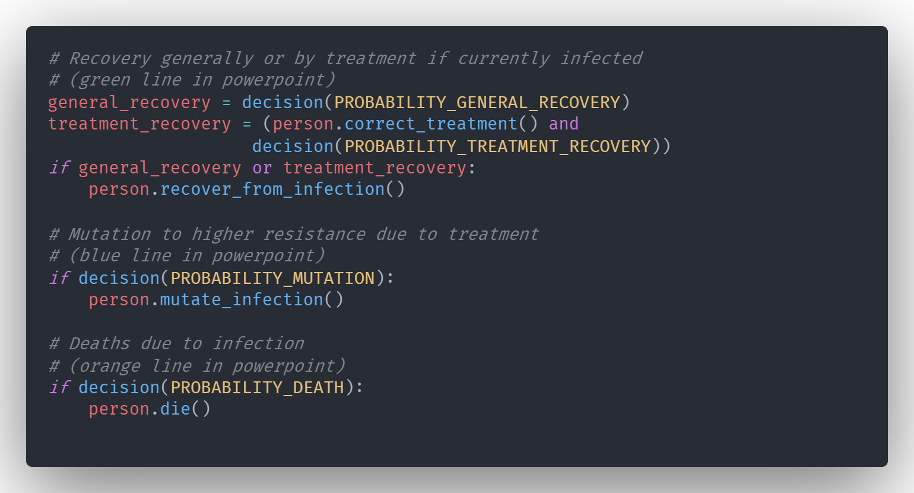
Recovery, mutation, and death

Slide 6
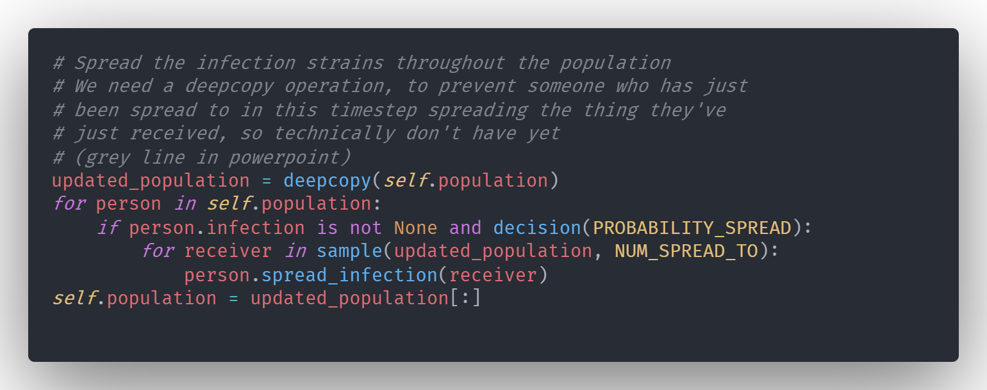
Spread

Slide 7
Types of transition:
Death -
Spread -
Recovery -
Mutation -
No change -
Isolation -
Not infected
No resistance
Resistance #1
Resistance #2
Resistance #3
Immune
Dead

Slide 8
Types of transition:
Death -
Spread -
Recovery -
Mutation -
No change -
Isolation -
Resistance #n-1
Uninfected, or lower resistance
Mutation
Spread
No change
General recovery
Resistance #n
Death
Immunity
Dead
Recovery due to treatment
A patient can be put into isolation, which doesn’t change their state, but stops them spreading/receiving any infections they have.
Without the product, it takes a set lag period, then a random chance each time on top of that, and for the current drug to be insufficient (this models tests with long lag times) to increase the treatment, then when the treatment exceeds a threshold, they will be isolated
With the product, patients are instantly isolated when their infection exceeds the threshold, since our product allows very fast testing – modelled as shorter than one timestep
Mutations in the infection lead to a more resistant strain, which when treated with antibiotic #n+1 becomes the dominant strain, making the patient resistant to antibiotic #n+1
Conditional on patient being treated with antibiotic #n+1 whilst they have an infection (because of tiered approach, this will always be resistant to antibiotic #n)
Resistance #n+1

Slide 9
No treatment
Infected with any resistance
Immune
Not infected
Dead
Treatment #1
Resistance #1
Resistance #2
Resistance #3
Treatment #2
Resistance #2
Resistance #3
Treatment #3
Resistance #3

