Slide 1
Computer modelling of our product

Slide 2
Introduction
What does the model do?
Shows the spread of a disease and the spread of levels of antimicrobial resistance among a population.
Models spread across patients, not sinks, for simplicity – but our product could be used like this in future, just lots of out of scope paperwork
Two modes
With our product in use
Without our product for diagnostic use
What is the purpose of the model?
Demonstrate that our product is beneficial
Gain an understanding of where it is most and least applicable

Slide 3
General overview

Slide 4
General overview
Changes occur in like turns in a board game – granular steps which represent periods of time, such as hours or days
The population is fixed size – no one enters or leaves

Slide 5
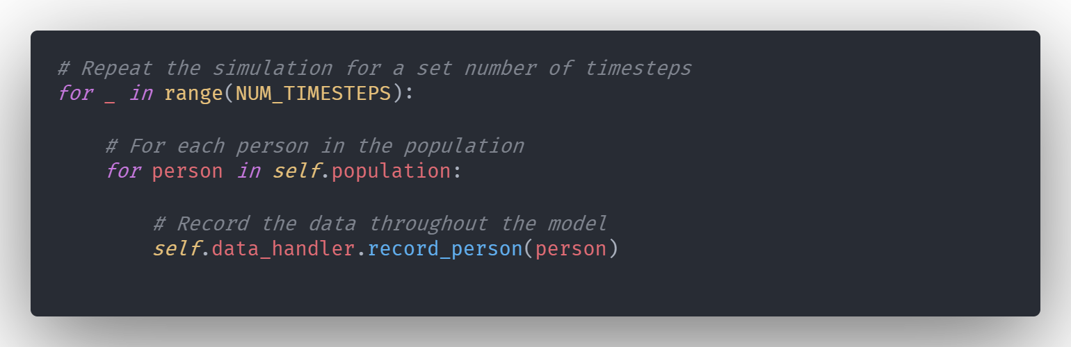

Slide 6
General overview
Changes occur in like turns in a board game – granular steps which represent periods of time, such as hours or days
The population is fixed size – no one enters or leaves
The model is stochastic, meaning it is based on random probabilities, rather than a system of equations
Composed of starting probabilities set at the top as variable parameters
Based on these parameters, people within the population transition between states, such as infected, uninfected, immune, etc.

Slide 7
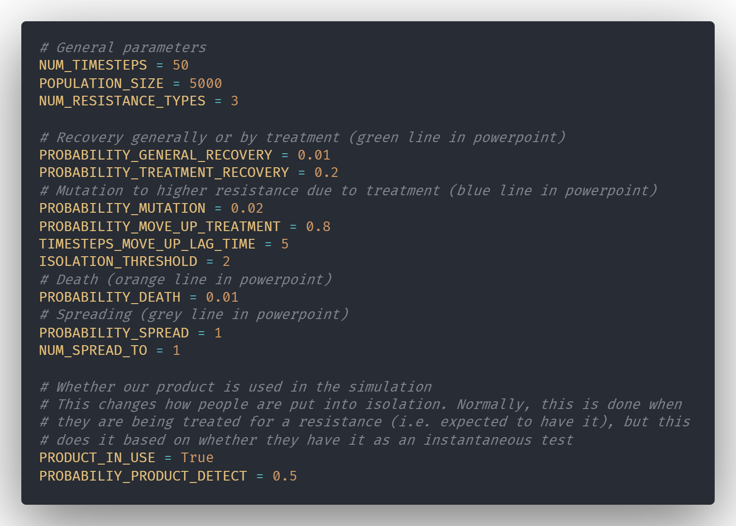

Slide 8
Implementation & features

Slide 9
Disease and people within the model
A disease with a probability of death and a probability of recovery spreads through the population
Patients have a small chance of recovering by themselves, or can be treated with antibiotics, which have a larger chance of curing them
When they have recovered, they become immune to the disease irrespective of resistance
Patients also have a small chance of dying due to the disease
Hence, patients can be uninfected, infected (with resistances), immune, or dead.
Eventually, all individuals will be either uninfected, immune or dead

Slide 10
Types of transition:
Death -
Spread -
Recovery -
Mutation -
No change -
Isolation -
Not infected
No resistance
Resistance #1
Resistance #2
Resistance #3
Immune
Dead

Slide 11
Types of transition:
Death -
Spread -
Recovery -
Mutation -
No change -
Isolation -
Resistance #n-1
Uninfected, or lower resistance
Mutation
Spread
No change
General recovery
Resistance #n
Death
Immunity
Dead
Recovery due to treatment
Isolation
Mutation
Resistance #n+1

Slide 12
Treatment in the model
Antibiotics are used in a specific order, with antibiotic 1 used before 2 and so on
Diseases have a small chance of developing resistance to antibiotics when they are being used on a patient
Once a person becomes infected, treatment starts immediately
Staff do not know if there is any resistance, hence they will start with the lowest level of antibiotics
If the infection is resistant, there will be no greater chance of recovery than for an untreated patient – i.e. the antibiotic won’t work
Every turn the person has not recovered or died, if the person has been treated for a number of consecutive days with the, and a certain probability is exceeded, then they are moved up to a higher antibiotic tier

Slide 13
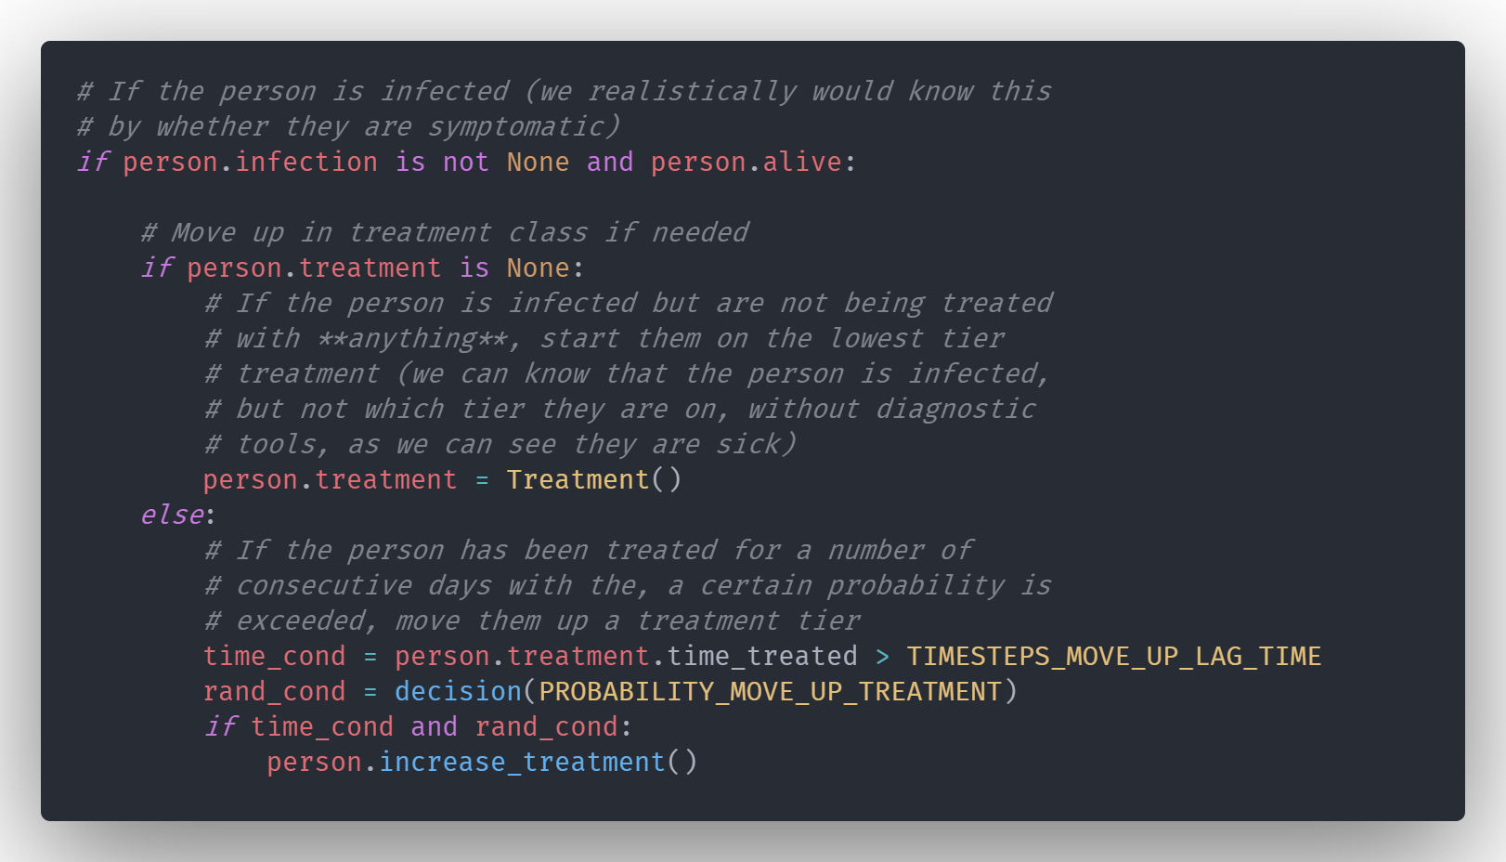

Slide 14
Spread and isolation in the model
Disease can spread from infected patients to uninfected patients, and patients with a less resistant strain
Variable probability of each infected person doing this, and variable number spread to

Slide 15
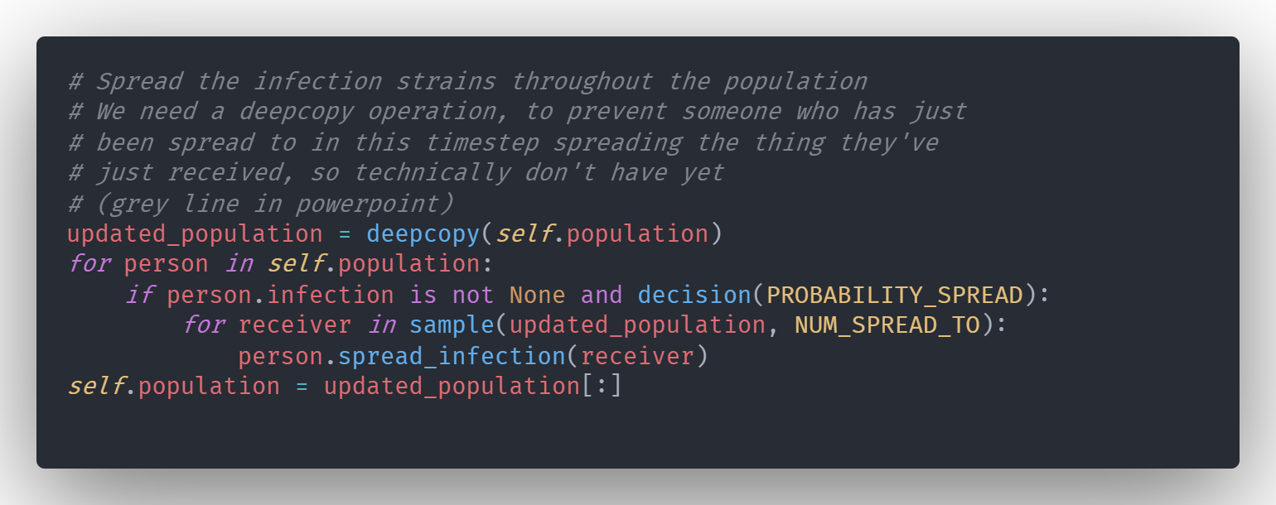

Slide 16
Spread and isolation in the model
Disease can spread from infected patients to uninfected patients, and patients with a less resistant strain, with a certain probability of doing this each timestep
Variable probability of each infected person doing this, and variable number spread to
Patients can be isolated, meaning they cannot spread the disease
Without our product:
A person enters isolation when they reach the highest level of treatment (i.e. it is not related to whether the infection has the highest level of resistance)
With our product:
Isolation is not dependent on treatment level, but whether the highest level of resistance has been detected. If it hasn’t, no isolation. If it has, isolation.

Slide 17
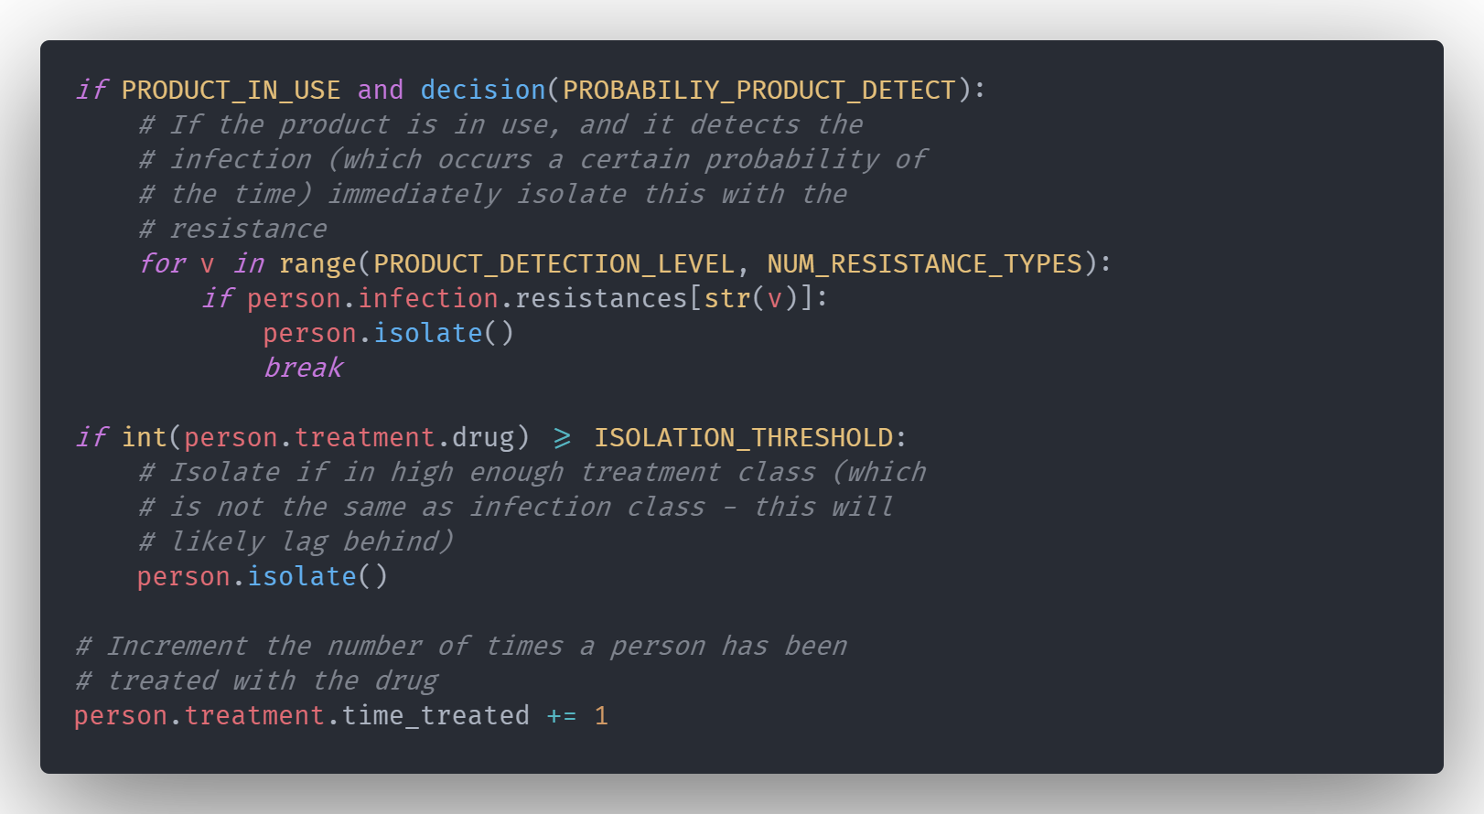

Slide 18
Types of transition:
Death -
Spread -
Recovery -
Mutation -
No change -
Isolation -
Resistance #n-1
Uninfected, or lower resistance
Mutation
Spread
No change
General recovery
Resistance #n
Death
Immunity
Dead
Recovery due to treatment
A patient can be put into isolation, which doesn’t change their state, but stops them spreading/receiving any infections they have.
Without the product, it takes a set lag period, then a random chance each time on top of that, and for the current drug to be insufficient (this models tests with long lag times) to increase the treatment, then when the treatment exceeds a threshold, they will be isolated
With the product, patients are instantly isolated when their infection exceeds the threshold, since our product allows very fast testing – modelled as shorter than one timestep
Mutation
Resistance #n+1

Slide 19
Recovery, mutation, and death
How does resistance increase?
Spread - when a person infects another, the resistance (or lack thereof) will carry over
Mutation - every turn there is a slight chance the disease will increase the level of resistance by one
Hence as patients with no or low resistance are treated more successfully, the share of infected patients with resistance will increase over time
Without our product, the highest level of resistance cannot be detected and will therefore be very slow to treat, as the patient has to go through all stages of treatment. Although it is generally slow to mutate to the highest level, once it does it will spread rapidly throughout the population, killing swathes of people
Each timestep, there is a low probability that a person will die – after which they are essentially removed from the system, with nothing happening to them

Slide 20
Types of transition:
Death -
Spread -
Recovery -
Mutation -
No change -
Isolation -
Resistance #n-1
Uninfected, or lower resistance
Mutation
Spread
No change
General recovery
Resistance #n
Death
Immunity
Dead
Recovery due to treatment
Mutations in the infection lead to a more resistant strain, which when treated with antibiotic #n+1 becomes the dominant strain, making the patient resistant to antibiotic #n+1
Conditional on patient being treated with antibiotic #n+1 whilst they have an infection (because of tiered approach, this will always be resistant to antibiotic #n)
Isolation
Resistance #n+1

Slide 21
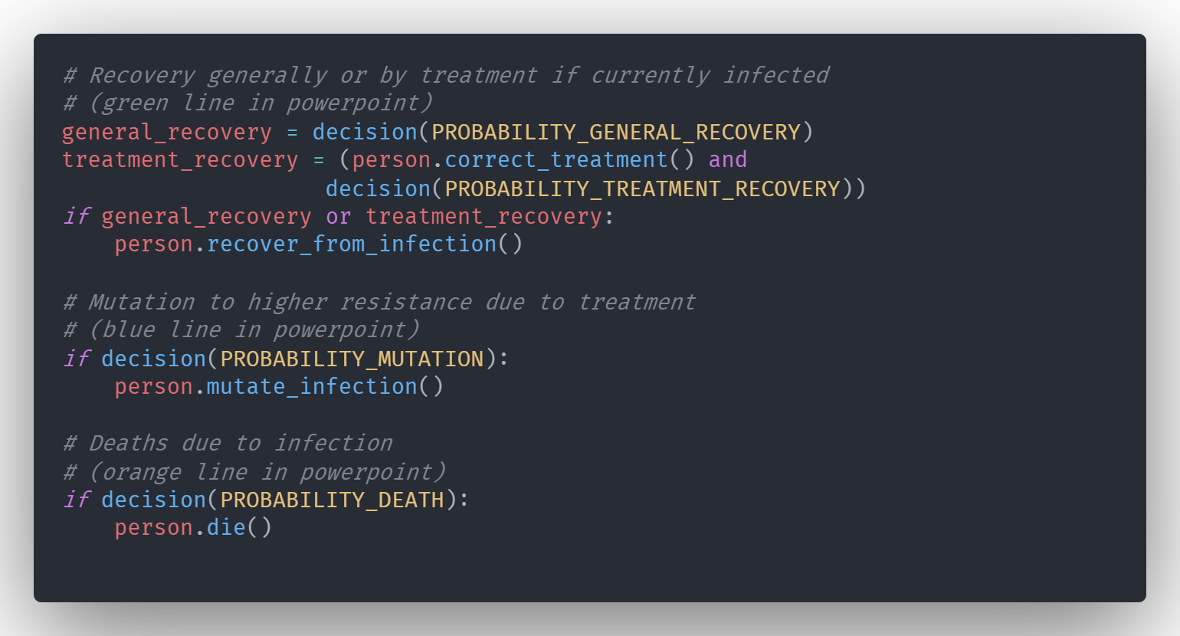

Slide 22
Context and real-world grounding
Axel, fill these in

Slide 23
Why context is important
Without context, the model doesn’t tell us anything about the real world impacts our product may have

Slide 24
Selecting the contextual data set
We selected neo-natal meningitis because…
This specific data set fits our product because…
Explanation of the data set, etc.

Slide 25
Neo-natal meningitis data
Add image of data set
Add citation of paper
Etc.

Slide 26
Parameters extrapolated from the data set
Send me file you changed the parameters on for the data set, and I can make them look nice as with the other code embeds
If you need to, just screenshot it from your editor, but I have a mechanism which will make it look nice, and it shouldn’t be too much effort to send

Slide 27
Results of neo-natal meningitis model
Add a screenshot of graph output of code running here

Slide 28
Conclusions from neo-natal meningitis model
Our product helps because…
Some flaws in our product are…
The data set could be improved by…
Etc.

Slide 29
Discussion of the model
Is the model realistic?
No, very little about it is realistic. It is a model meant to portray how resistance spreads and is combatted.
Is it useful?
Yes, because it provides several helpful insights:
The impact our product will have on the spread of resistance just by quickly detecting who to put into isolation.
Whether higher or lower mortality or transmissibility of a disease increase or decrease the effectiveness.
What other potential improvements are there?
Add special features to make more realistic scenario and results, for example:
Spatial considerations – e.g. modelling multiple wards with movement between them
Asymptomatic transmission

