Slide 1
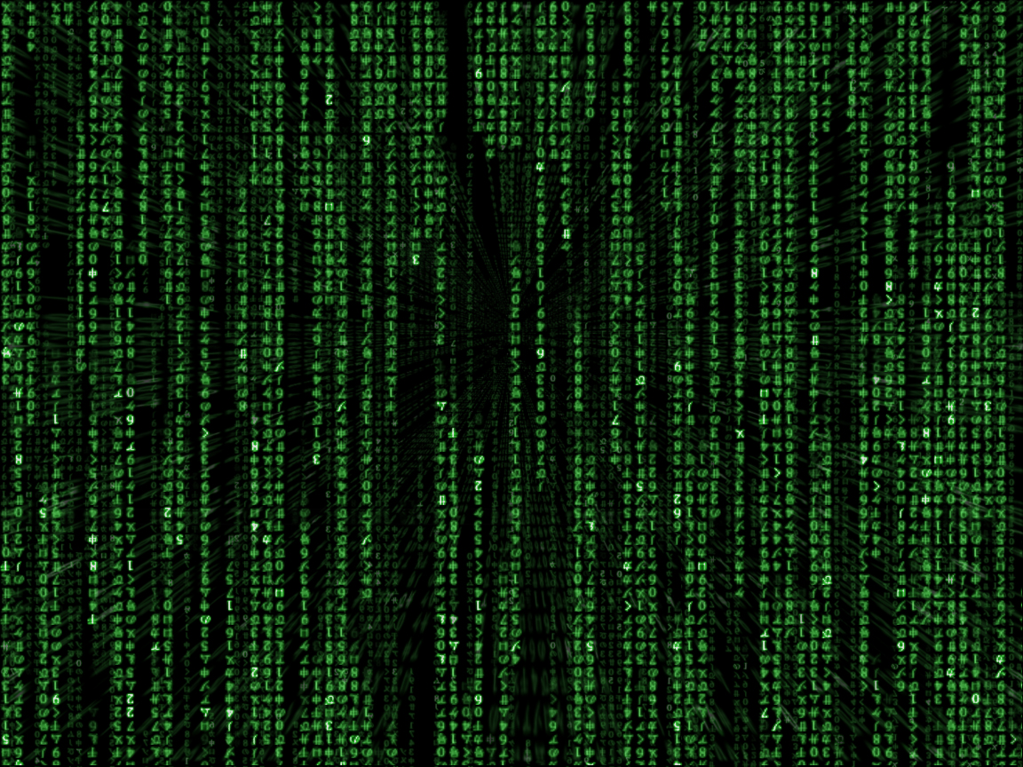
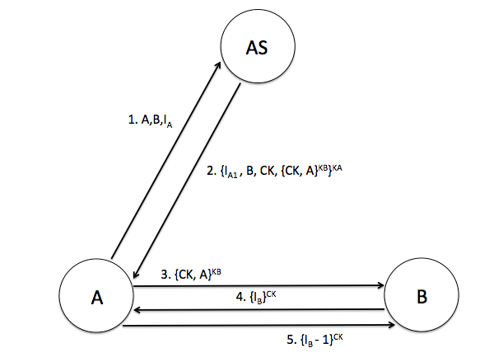
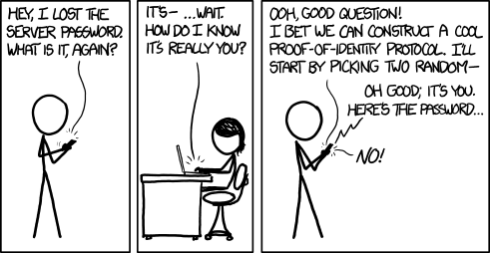
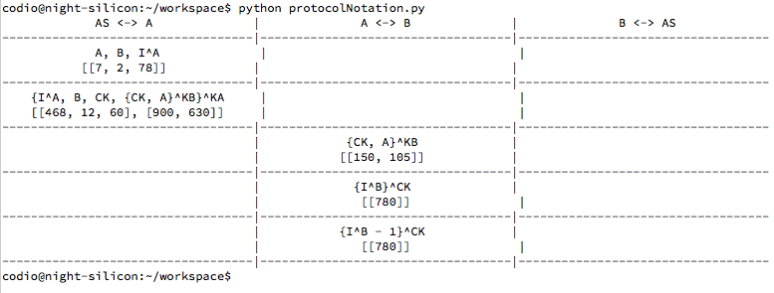
What are computer protocols, how are they verified against attacks, and how is this relevant to people today?
Image attribution:
https://imgs.xkcd.com/comics/identity.png
http://img03.deviantart.net/07ca/a/large/wallpaper/wmovie/swamp.jpg
Edmund Goodman

