Slide 1
What are computer protocols, how are they verified against attacks, and how is this relevant to people today?
Edmund Goodman

Slide 2

What are computer protocols?
A protocol is defined as: a set of rules or procedures for transmitting data between electronic devices (Encyclopedia Britannica).
There are a multitude of varieties of computer protocols
- Transport
- Consensus
- Cryptographic
- Authentication

Slide 3
Example - Authentication protocols - Notation
With protocols, we use notation to denote messages. For example:
A → AS: A, B, I_{A1}
A → B: {CK, A}^{KB}
A → B: {I_{B} - 1}^{CK}

Slide 4
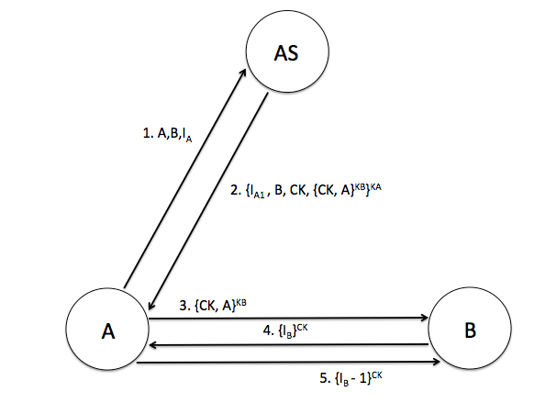
Example - Authentication protocols - Protocols
Needham-Schroeder
protocol:

Slide 5
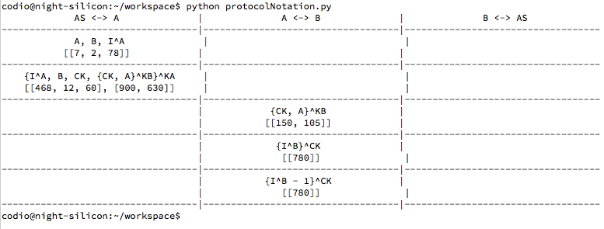
Protocol Emulator Code
I wrote an emulator for computer protocols in Python 2.7

Slide 6
Glossary
-Trust: Whether it is reasonable for a principal to assume something is true
-Tabula rasa: Literally “A blank slate” - a computer that is wiped after use
-WAN/LAN: Wide/Local area network - basis of the internet
-Nonce: Number used only ONCE
-Principal(s): Parties participating in the protocol
-Freshness: Whether or not something has been used before (in the protocol)
-Replay attack: The re-use of an old run of a protocol to impersonate a principal without knowledge of their key, that should be required.

Slide 7
How are they verified against attacks - Techniques
Formality
-Ban logic
-Burrows-Abadi-Needham logic
-Uses special typesetting
-Allows for formalisation and checking of computer protocols
Informality
-Informal principles
-Good practices of design
-Explanation of errors
-How to avoid them

Slide 8

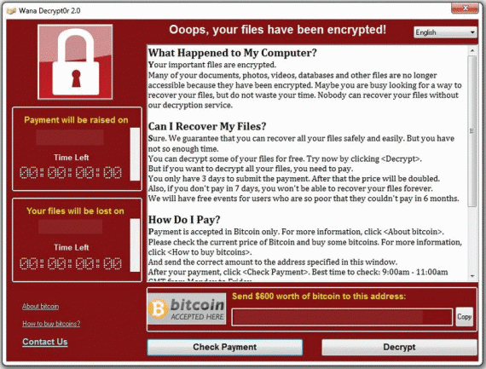
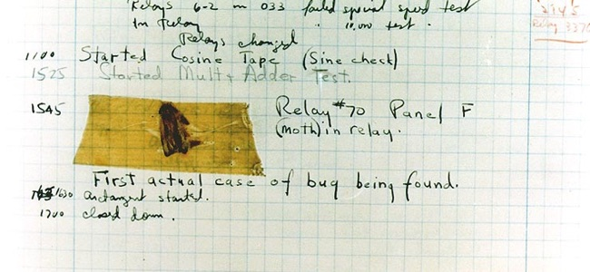
Why is this relevant to us today?

Slide 9


Slide 10

My Research Journey

Slide 11
Any Questions?

Slide 12
Image Attributions
http://2015.igem.org/Team:BABS_UNSW_Australia/Protocols
http://thehackernews.com/2017/02/cloudflare-vulnerability.html
https://www.healthcare-informatics.com/article/cybersecurity/breaking-wanna-decryptor-20-spreads-damage-globally-washington-post-reports
http://www.klynch.com/archives/000025.html
http://store.steampowered.com/app/497350/Conclusion/
https://www.dentalelite.co.uk/dental-practice-sale-journey/

