Slide 1
IS 107 – Business Intelligence
Laboratory Work 4
Forecasting Time-Series Data in Power BI
Edmundo C. Ederio Jr.
Instructor: Joseph A. Vistal
Forecasting

Slide 2
IS 107 – Business Intelligence
P A R T 1
Tourism Data Forecast

Slide 3
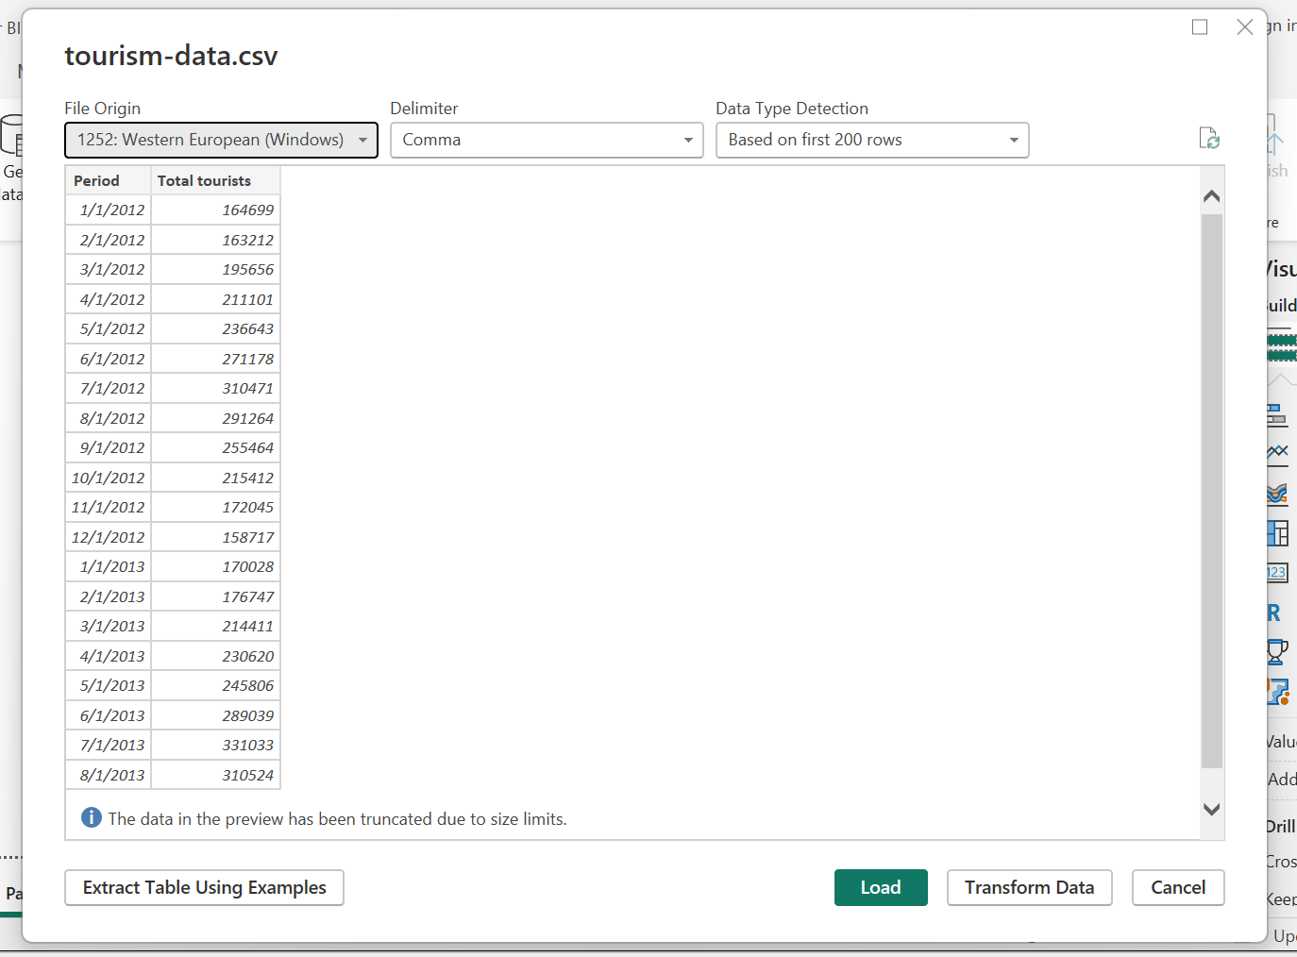
Part 1 – Import | Lab 4
Import Data
Step 1 – Download Dataset
Step 2 – Import into Power BI
Go to the GitHub link and save tourism-data.csv to your computer.
Home → Get Data → Text/CSV → Load tourism-data.csv

Slide 4
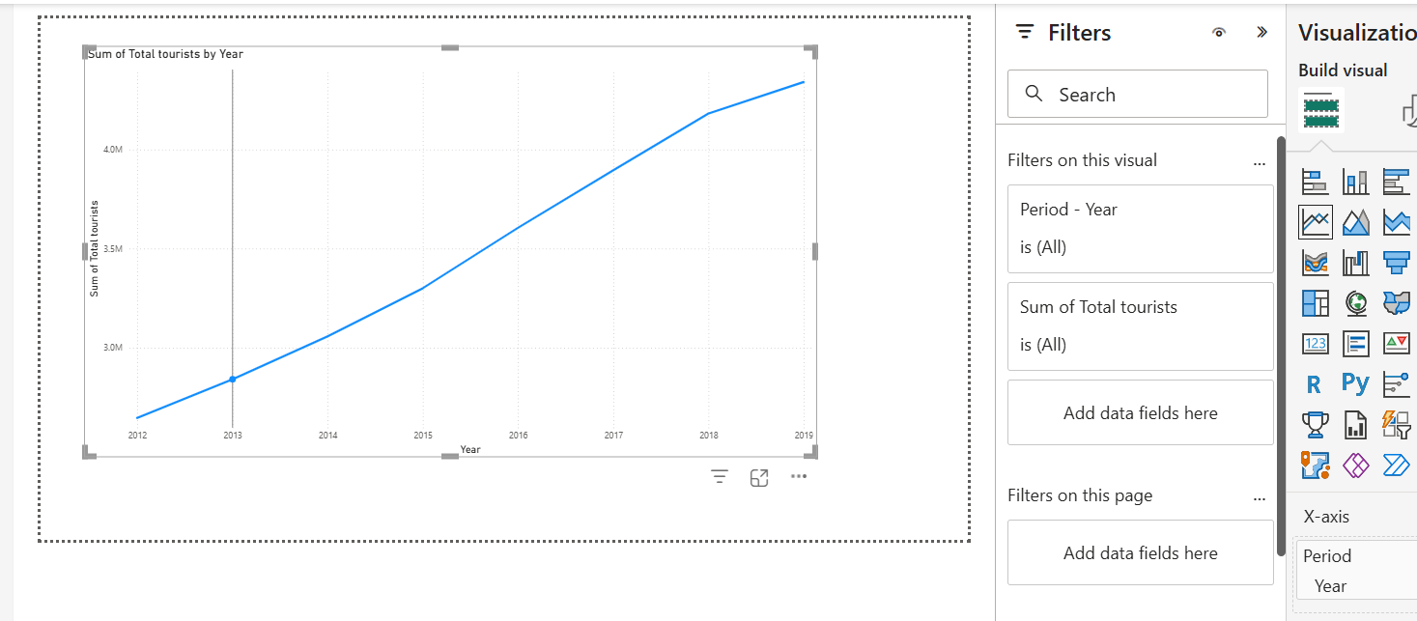
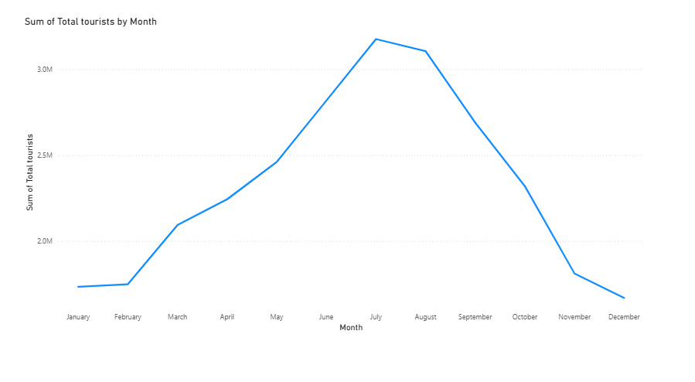
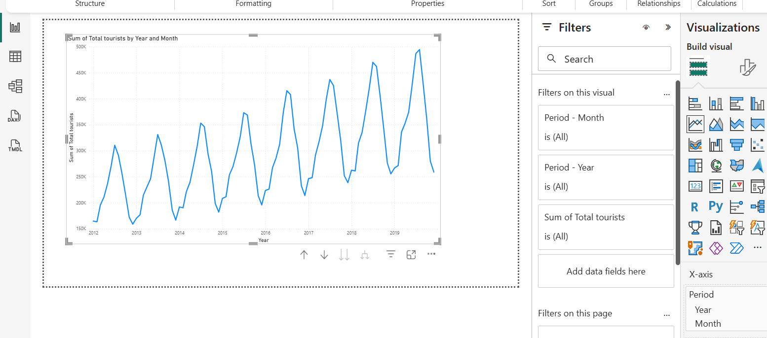
Part 1 – Line Chart | Lab 4
Step 3: Create Line Chart
Year
Month
Year and Month
Step 3 – Create Line Chart
• Drag Period → X-axis
• Drag Total tourists → Y-axis
• Set hierarchy to Year + Month

Slide 5
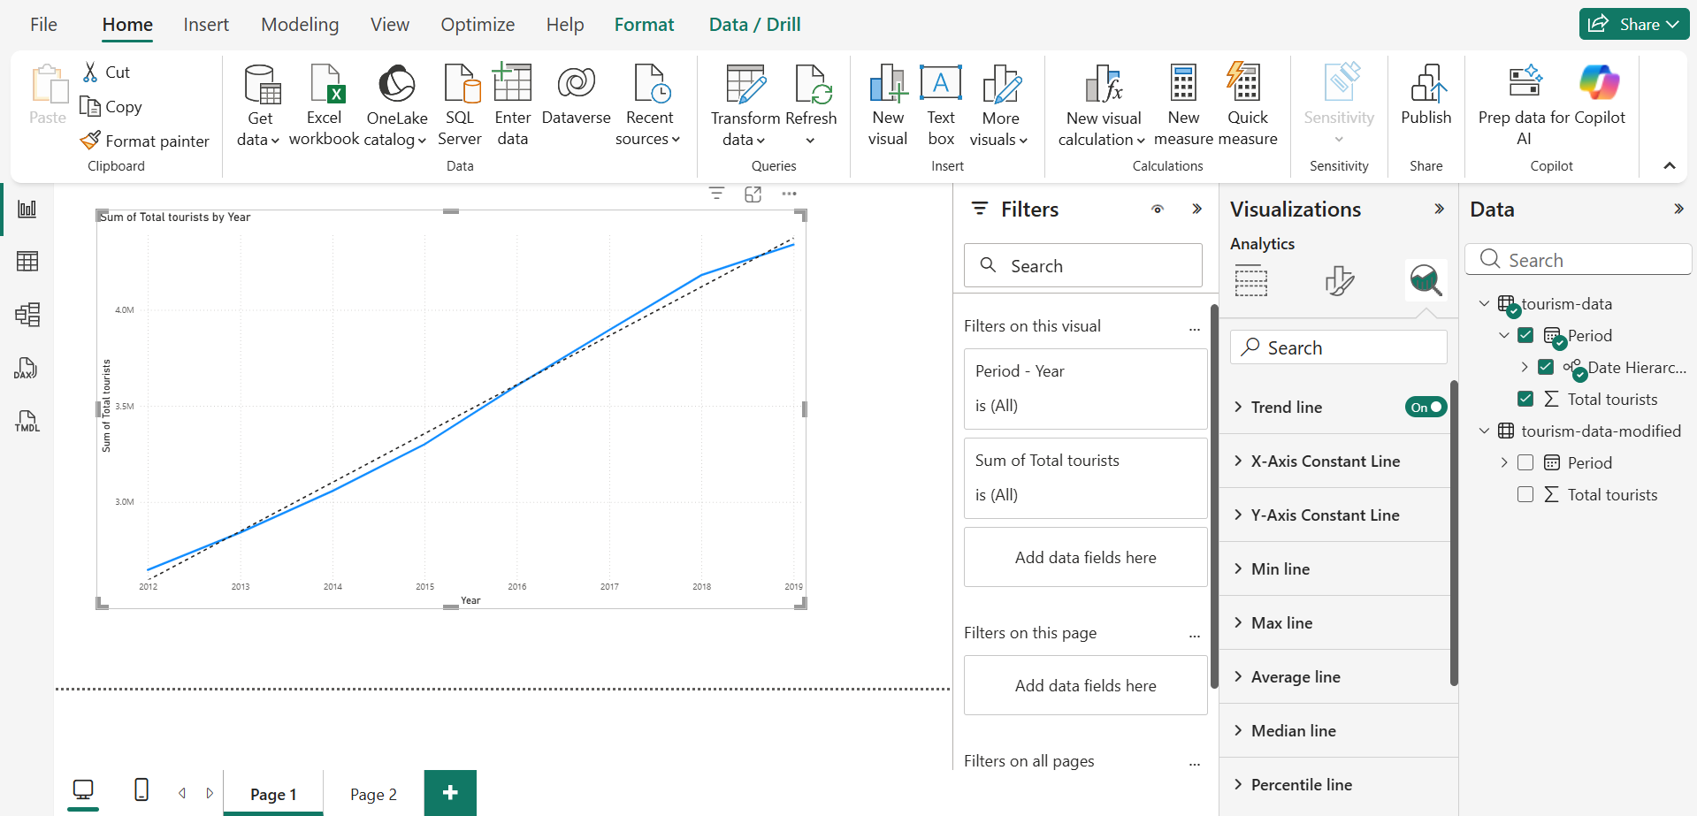
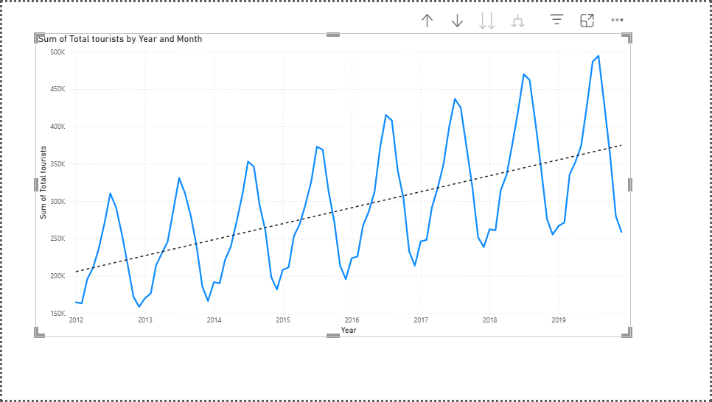
Part 1 – Trend Line| Lab 4
Step 4: Add a Trend Line
Year
Year and Month
Add Trend Line
1. Click the line chart to select it
2. Click the Analytics icon in Visualizations pane
3. Expand 'Trend line'
4. Click + Add

Slide 6
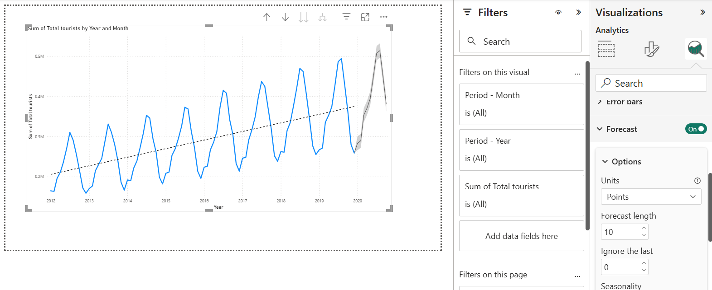
Part 1 – Forecasting| Lab 4
Step 5: Add Forecasting
Add Forecast
Default Forecast
1. Click the Analytics icon in Visualizations pane
3. Expand ‘Forecasting'
4. Click + on
Forecast Length – 12 points
Ignore Last – 0 points
Confidence Interval – 95 %

Slide 7
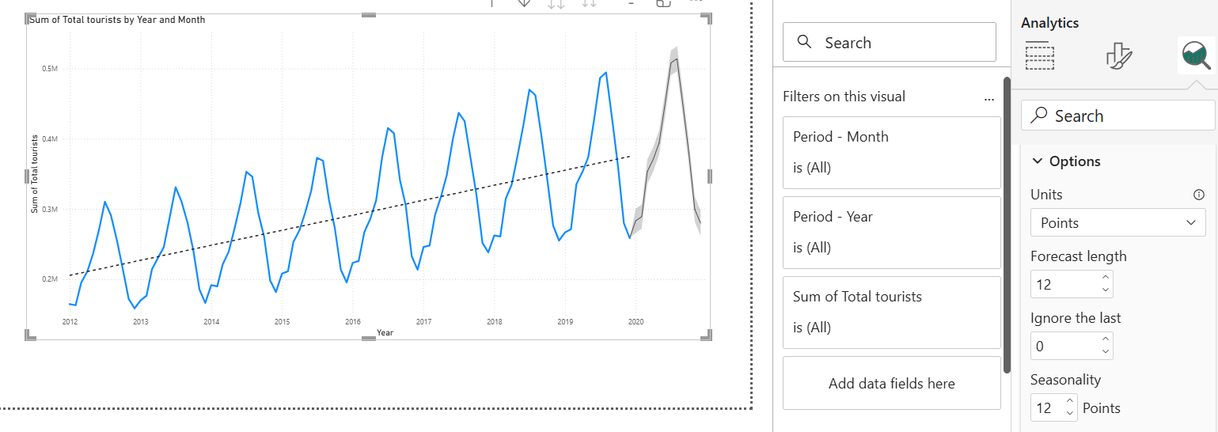
Part 1 – Forecasting| Lab 4
Step 6: Configure Forecasting
Add Forecast
Configure Forecast
1. Click the Analytics icon in Visualizations pane
3. Expand ‘Forecasting'
4. Click + on
Forecast Length – 12 points
Ignore Last – 0 points
Confidence Interval – 95 %
Seasonality – 12 points

Slide 8
Part 1 – Forecasting| Lab 4
Step 7: Analyze the Forecast
Analyzation
Trend Tourism figures rose steadily from around 2.8 million in 2012 to 4.6 million in 2019, indicating consistent annual growth captured by the model.
Seasonality The model shows clear seasonal patterns, with peaks in July–August and declines in January–February each year, confirming a 12-month cycle.
Confidence Interval The narrow shaded band at the 95% confidence interval suggests strong reliability, as consistent historical data leads to stable and dependable forecasts.

Slide 9
IS 107 – Business Intelligence
P A R T 2
Forecasting with Imperfect Data

Slide 10
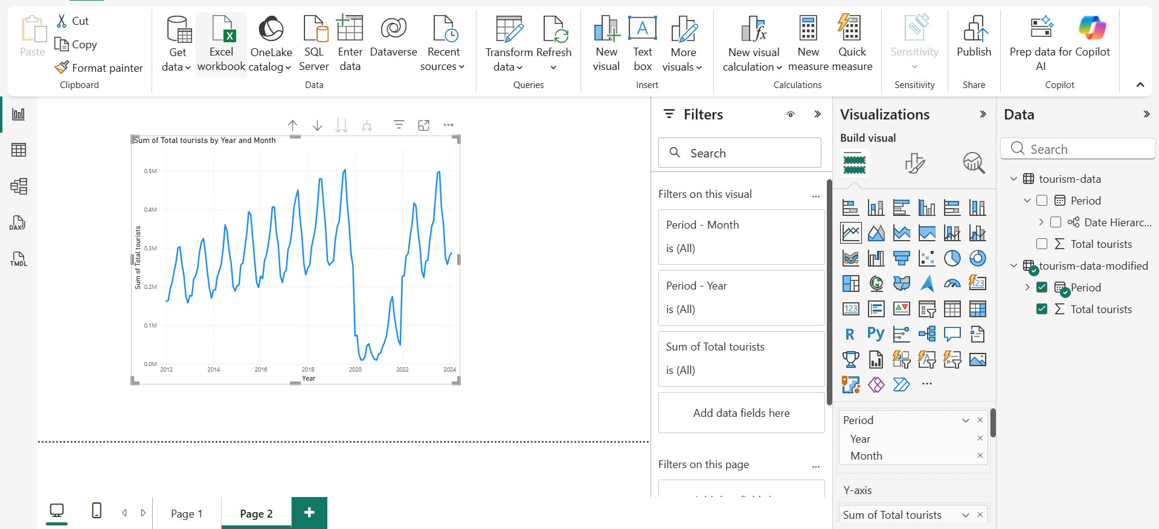
Part 2 – Imperfect Data Overview | Lab 4
Import Data and Create Line Chart
The dataset used is tourism-data-modified.csv, covering the period from January 2012 to February 2024 with a total of 146 records. It includes 50 additional data points beyond the original dataset. A disruption caused by COVID-19 is simulated for the years 2020 to 2021, followed by a recovery trend from 2022 to 2024.
Several phases can be observed in the data. From 2012 to 2019, tourism shows steady growth with regular seasonal patterns. In 2020, there is a sharp decline due to lockdowns. The year 2021 reflects a partial recovery, while the period from 2022 to 2024 shows a strong rebound, returning to pre-pandemic levels.

Slide 11
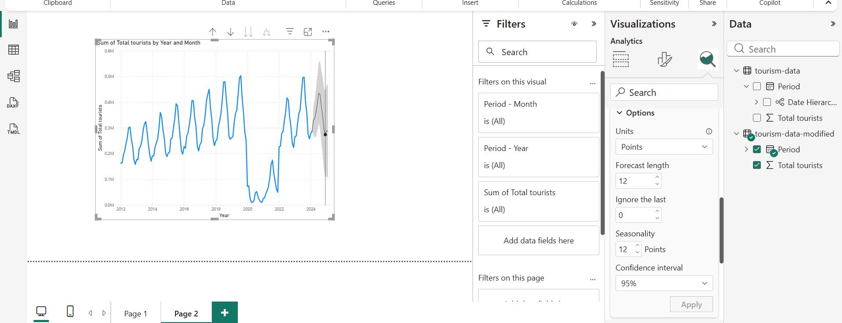
Part 2 – Forecasting| Lab 4
Baseline Forecast (Ignore last = 0, CI = 95%
Configure Forecast
The forecast indicates that the recovery trend is expected to continue. The confidence interval is somewhat wider due to the impact of COVID-19 on the training data. Despite this, the model still projects ongoing seasonal growth.
Forecast Length – 12 points
Ignore Last – 6 points
Confidence Interval – 95 %
Seasonality – 12 points

Slide 12
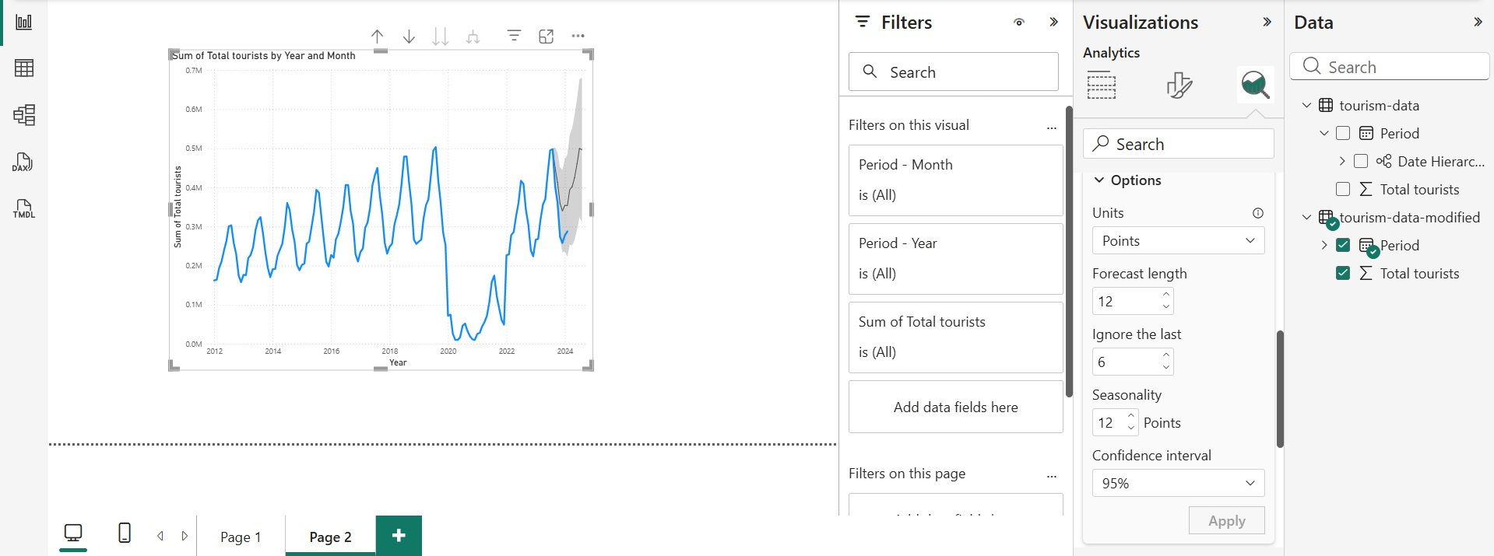
Part 2 – Forecasting| Lab 4
Ignore Last 6 Points (CI = 95%)
Configure Forecast
Excluding the most recent six months causes the forecast to begin earlier. As a result, the confidence interval becomes slightly wider, reflecting increased uncertainty due to having less recent data available for the model.
Forecast Length – 12 points
Ignore Last – 6 points
Confidence Interval – 95 %
Seasonality – 12 points

Slide 13
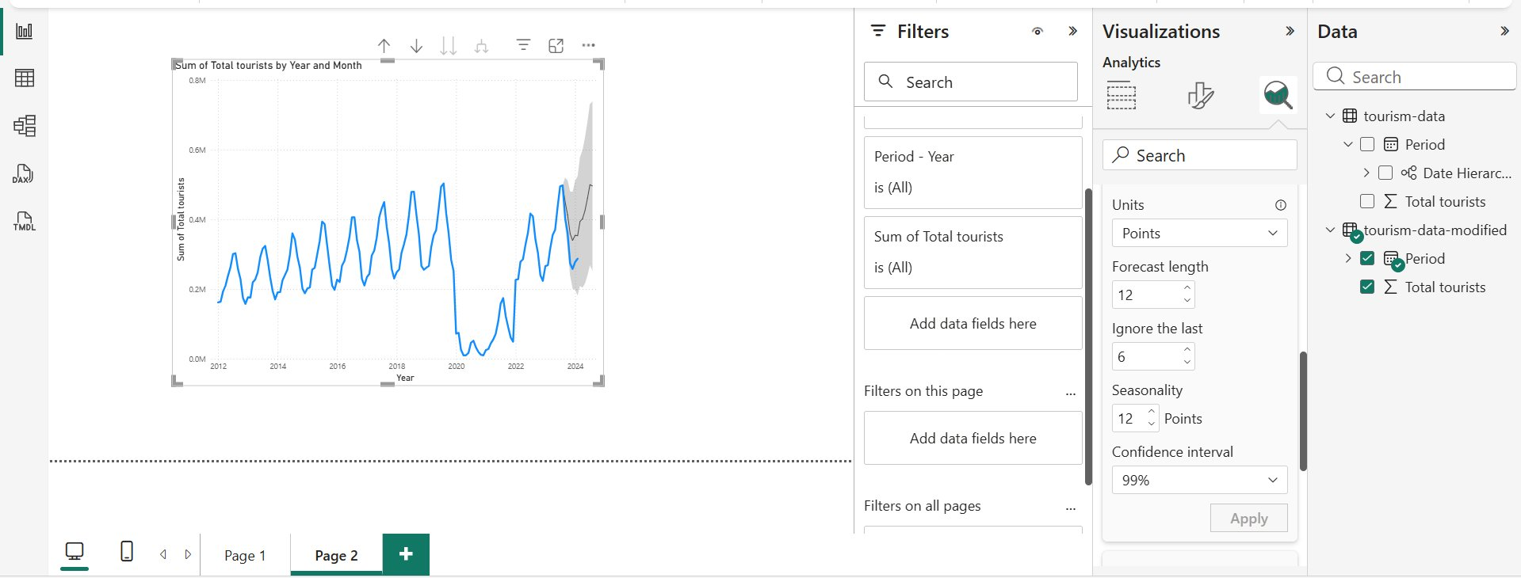
Part 2 – Forecasting| Lab 4
Higher Confidence Interval (CI = 99%)
Configure Forecast
The gray shaded is significantly wider at the 99% confidence interval. Achieving 99% certainty requires the model to cover a larger range of possible values, which reflects increased uncertainty caused by the COVID-related disruption.
Forecast Length – 12 points
Ignore Last – 6 points
Confidence Interval – 99 %
Seasonality – 12 points

Slide 14
ANALYZE & REPORT FINDINGS
The model was unable to anticipate the disruption, as tools like Power BI rely on historical time-series data and cannot predict sudden external shocks such as COVID-19. As a result, the sharp decline during the pandemic was completely unforeseen.
Across all three experiments, the confidence intervals became wider compared to earlier results, indicating increased uncertainty. This reflects how the model adjusted to the instability introduced by the disruption in the training data.
Recovery data from 2022 to 2024 was incorporated into the model, which helped shape a more optimistic outlook. This led to forecasts that project continued growth following the recovery phase.
However, the pandemic period disrupted the usual seasonal patterns. The typical annual cycle was broken, which reduced the model’s confidence in accurately estimating seasonality.

Slide 15
GUIDE QUESTIONS & ANSWERS
What does a narrow confidence interval suggest?
When the CI is narrow, it means the model is highly certain — the past data follows a steady, reliable pattern, so the predicted range stays close together.
How does Ignore Last affect the forecast?
If you set Ignore Last to 6, the model skips the six most recent data points during training. This pushes the forecast back in time and slightly broadens the CI, reflecting the added uncertainty that comes from relying on older data.
How does changing CI from 95% to 99% affect the visual?
The shaded uncertainty band grows wider. A 99% CI requires a larger range to ensure the actual value is captured — this visually signals greater uncertainty compared to 95%.
How useful is Power BI forecasting for this data?
It works very well when the data is clean and consistent. However, when the data has disruptions or irregularities, the CI expands significantly, making the forecast less dependable — and more sophisticated modeling tools may be a better fit in those cases.

Slide 16
CONCLUSION
Strengths: Power BI's forecasting feature is straightforward and requires no programming knowledge. It performs well with clean, seasonal datasets, and its adjustable settings let users fine-tune the model to better fit their data. The confidence interval bands also make it easy to visually understand how reliable a forecast is.
Limitations: The tool struggles when unexpected events occur, as it has no way of anticipating sudden external changes. When disruptions happen, the CI tends to widen considerably, which weakens the forecast's trustworthiness. Additionally, the model is limited to exponential smoothing, meaning more advanced techniques like ARIMA or machine learning models are not available within the tool.
Key Takeaway: Power BI forecasting works best when the underlying data is consistent and stable over time. When the dataset contains significant irregularities — such as those caused by events like the COVID-19 pandemic — the forecast results should not be taken at face value and should be paired with the judgment of someone who understands the broader context of the data.

