Slide 1
LAB
Work
2
End-to-End Data Analytics in Power BI
From Data Cleaning to DAX Insights
Part A
IS 107 – Business Intelligence
Data Cleaning in Power Query
Part B
Submitted by:
Merge & Append Queries
Edmundo C. Ederio Jr
Instructor: Joseph A. Vistal

Slide 2
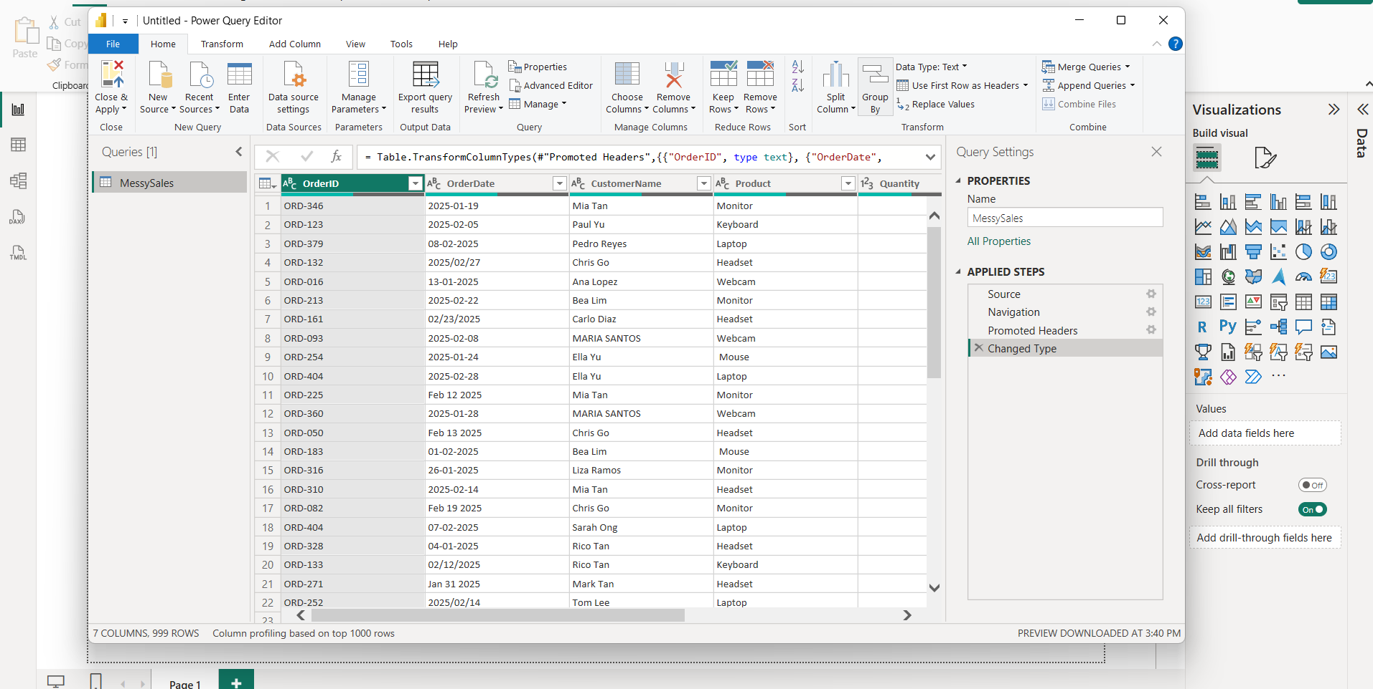
Step 1 – Open Power Query Editor
PART A STEP 1
Click Home → Get Data → Excel Workbook → select file → Transform Data
IS 107 – Business Intelligence | Laboratory Work 2 | Edmundo C. Ederio Jr

Slide 3
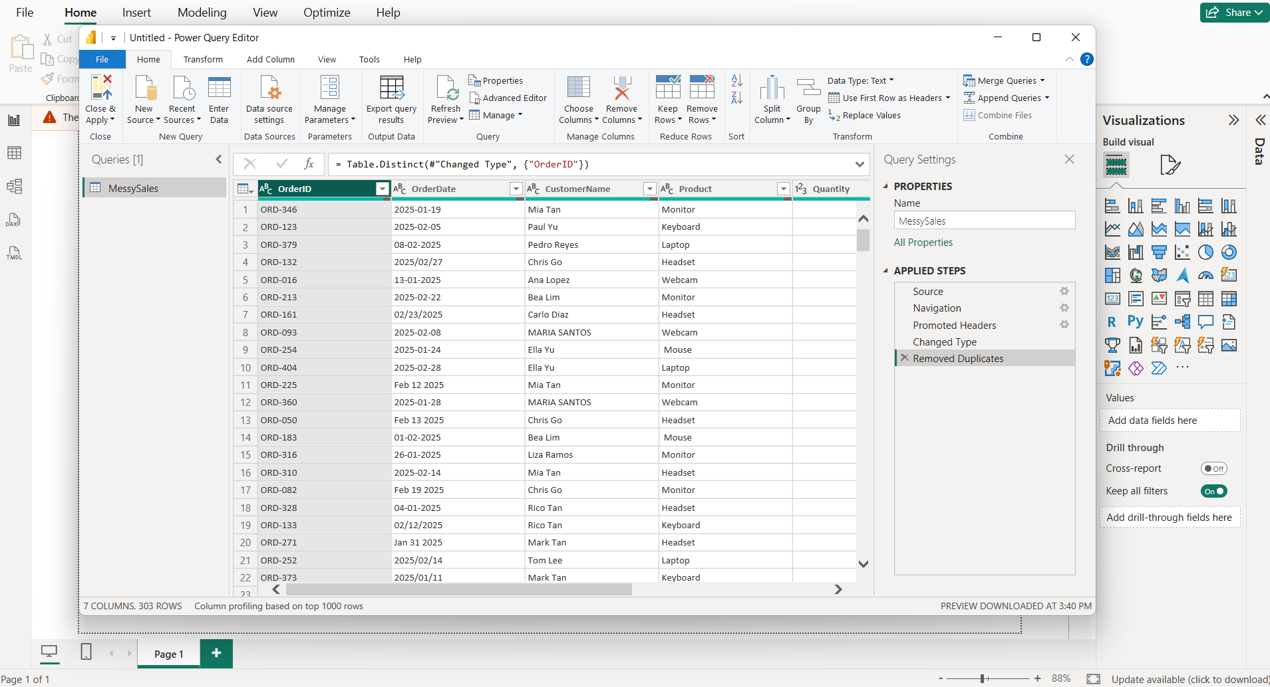
Step 2 – Remove Duplicates
PART A STEP 2
Select OrderID column → Home → Remove Rows → Remove Duplicates
IS 107 – Business Intelligence | Laboratory Work 2 | Edmundo C. Ederio Jr

Slide 4
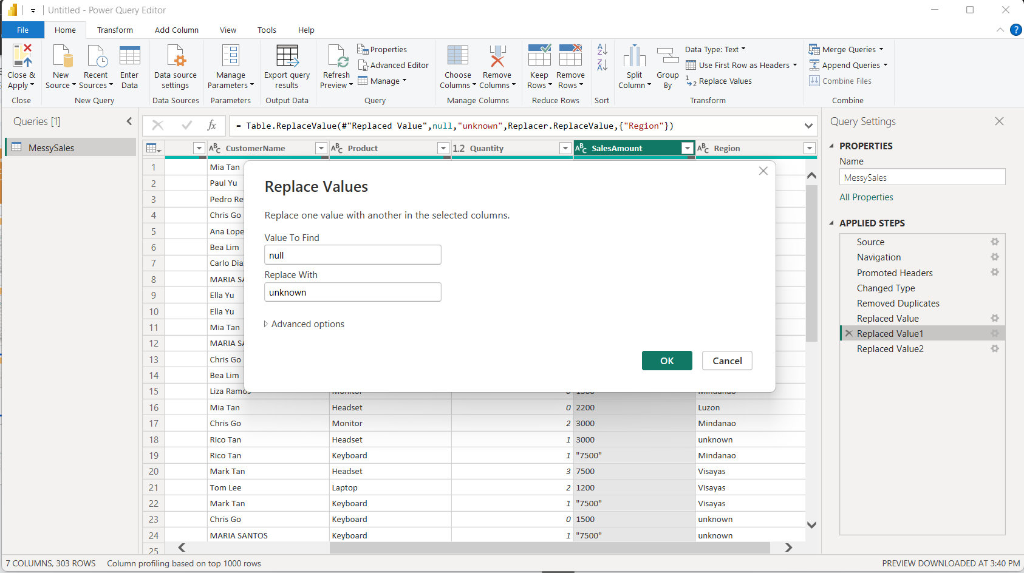
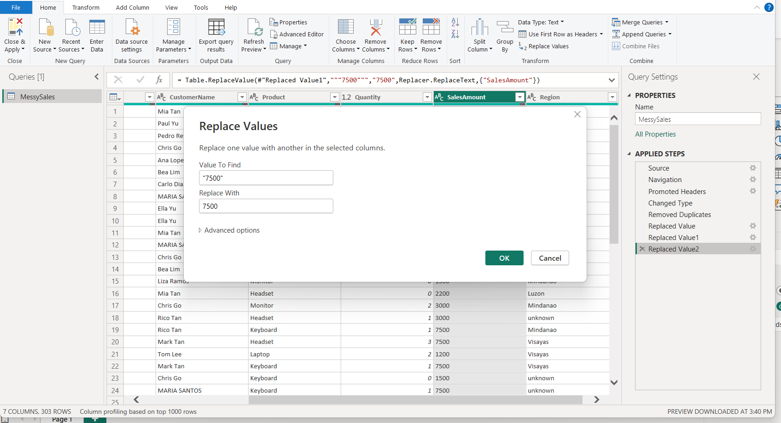
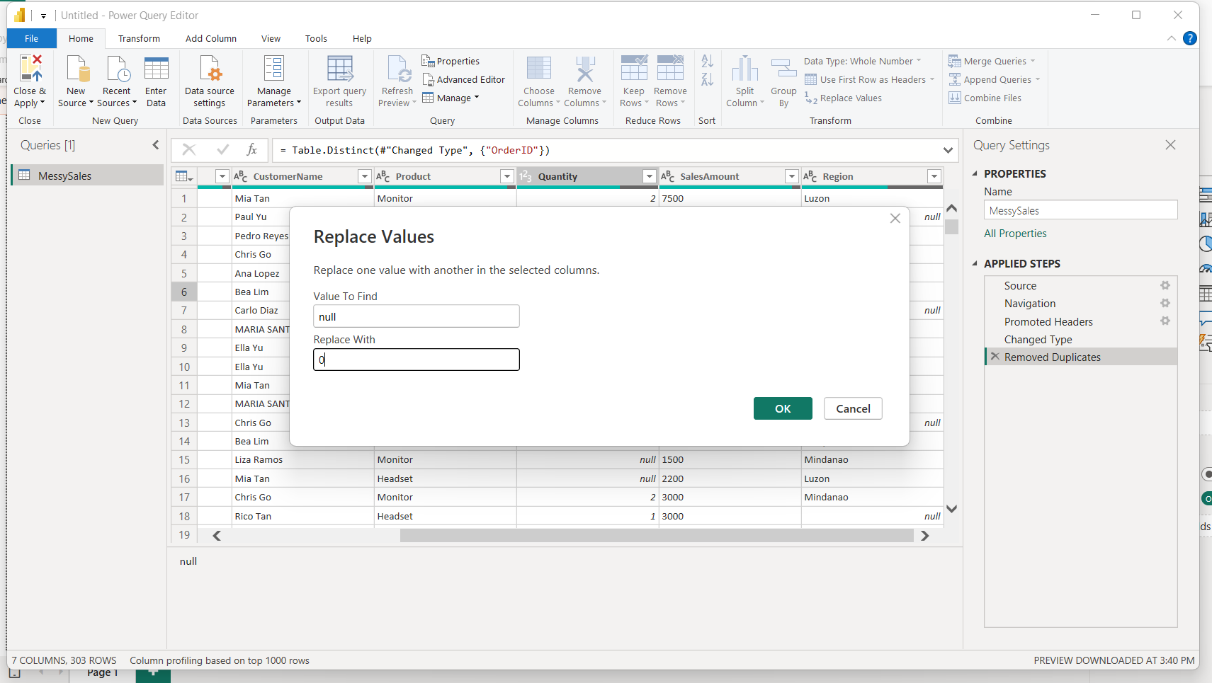
Step 3 – Handle Missing Values
PART A STEP 3
Replace null values in critical columns with 0 or 'unknown'
IS 107 – Business Intelligence | Laboratory Work 2 | Edmundo C. Ederio Jr

Slide 5
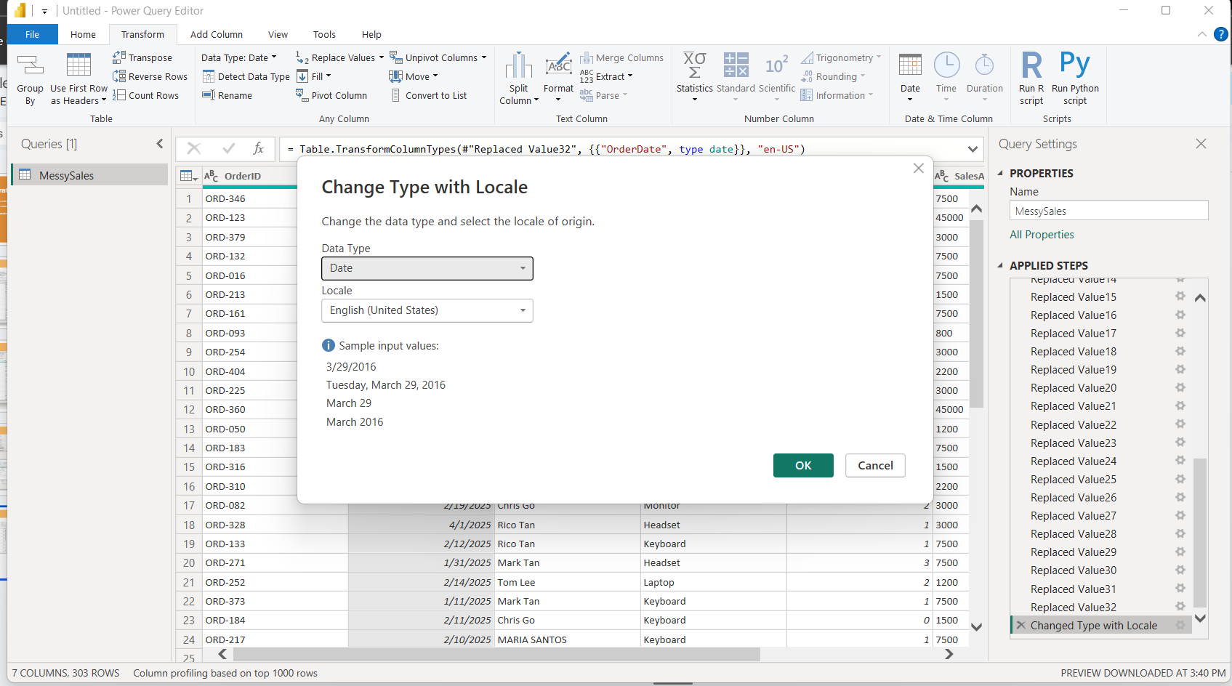
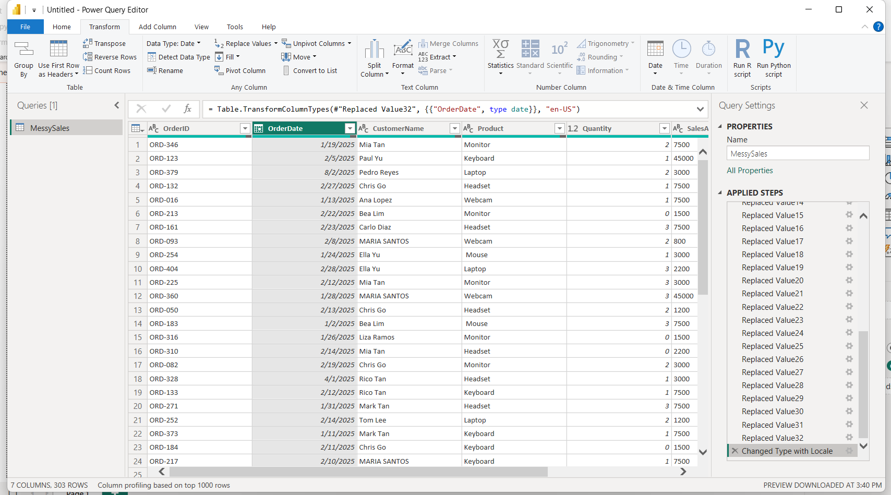
Step 4 – Fix Date Formats & Data Types
PART A STEP 4
Set OrderDate → Date type | Set SalesAmount → Decimal Number
IS 107 – Business Intelligence | Laboratory Work 2 | Edmundo C. Ederio Jr

Slide 6
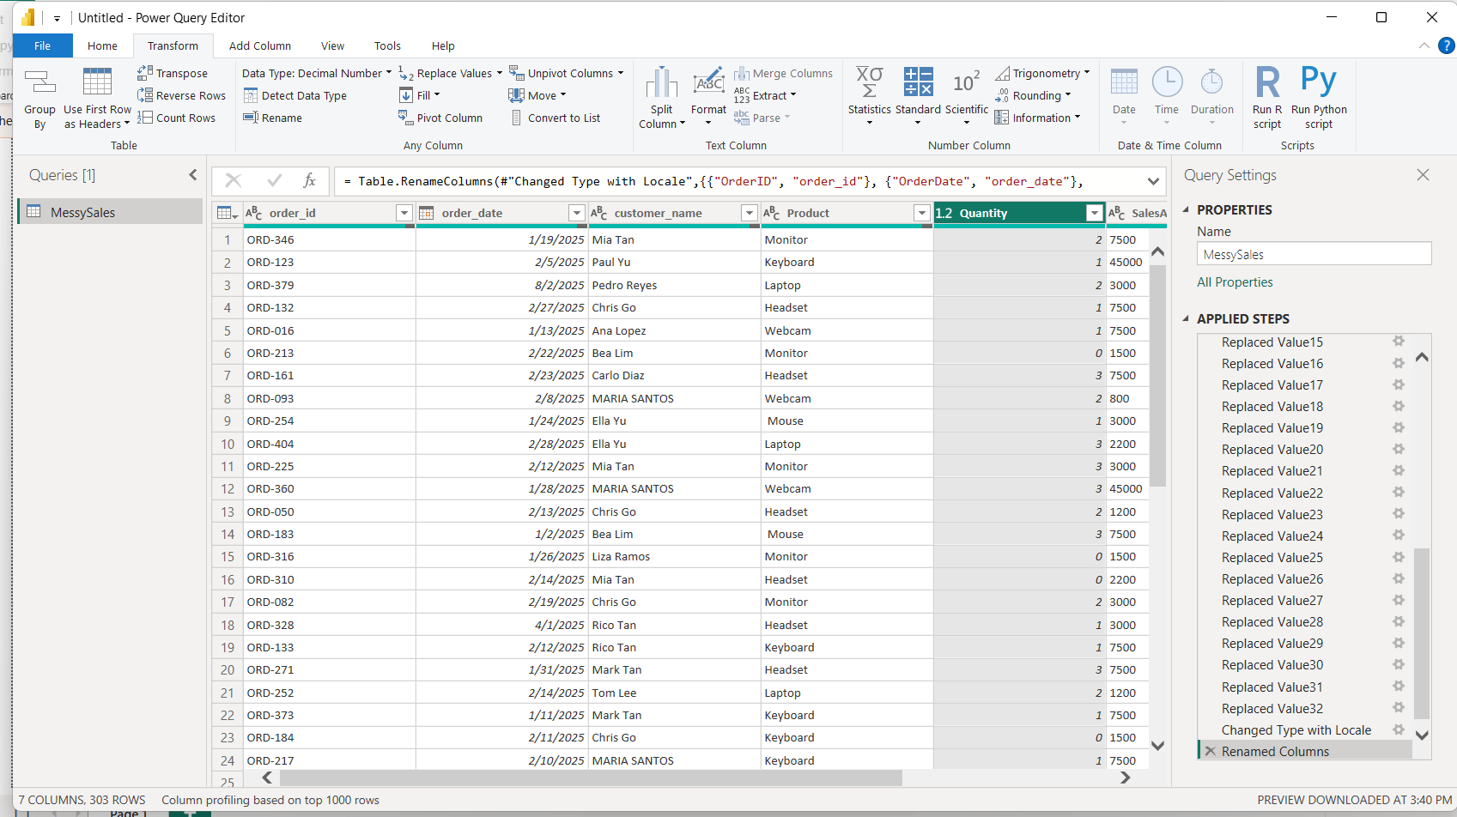
Step 5 – Rename Columns (snake_case)
PART A STEP 5
Right-click each column → Rename → use snake_case (e.g. order_id, sales_amount)
IS 107 – Business Intelligence | Laboratory Work 2 | Edmundo C. Ederio Jr

Slide 7
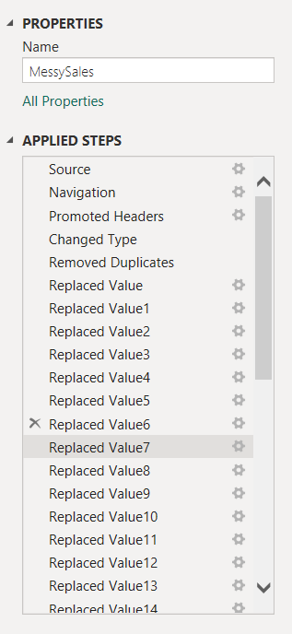
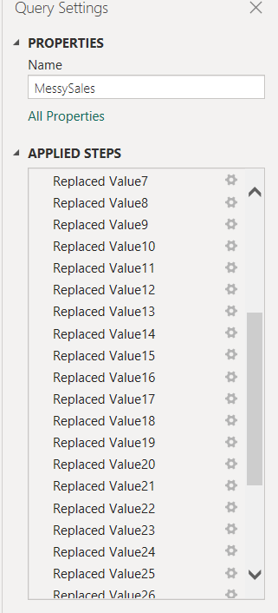
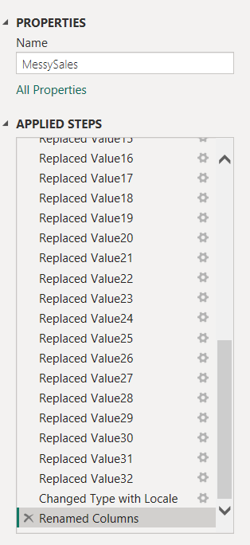
Applied Steps Pane – Full Transformation Pipeline
TRANSFORMATION LOG
Every step recorded as reproducible M code in the Applied Steps pane
M CODE STEPS
1. Source
2. Navigation
3. Promoted Headers
4. Changed Type
5. Removed Duplicates
6. Replaced Value
7. Renamed Columns
IS 107 – Business Intelligence | Laboratory Work 2 | Edmundo C. Ederio Jr

Slide 8
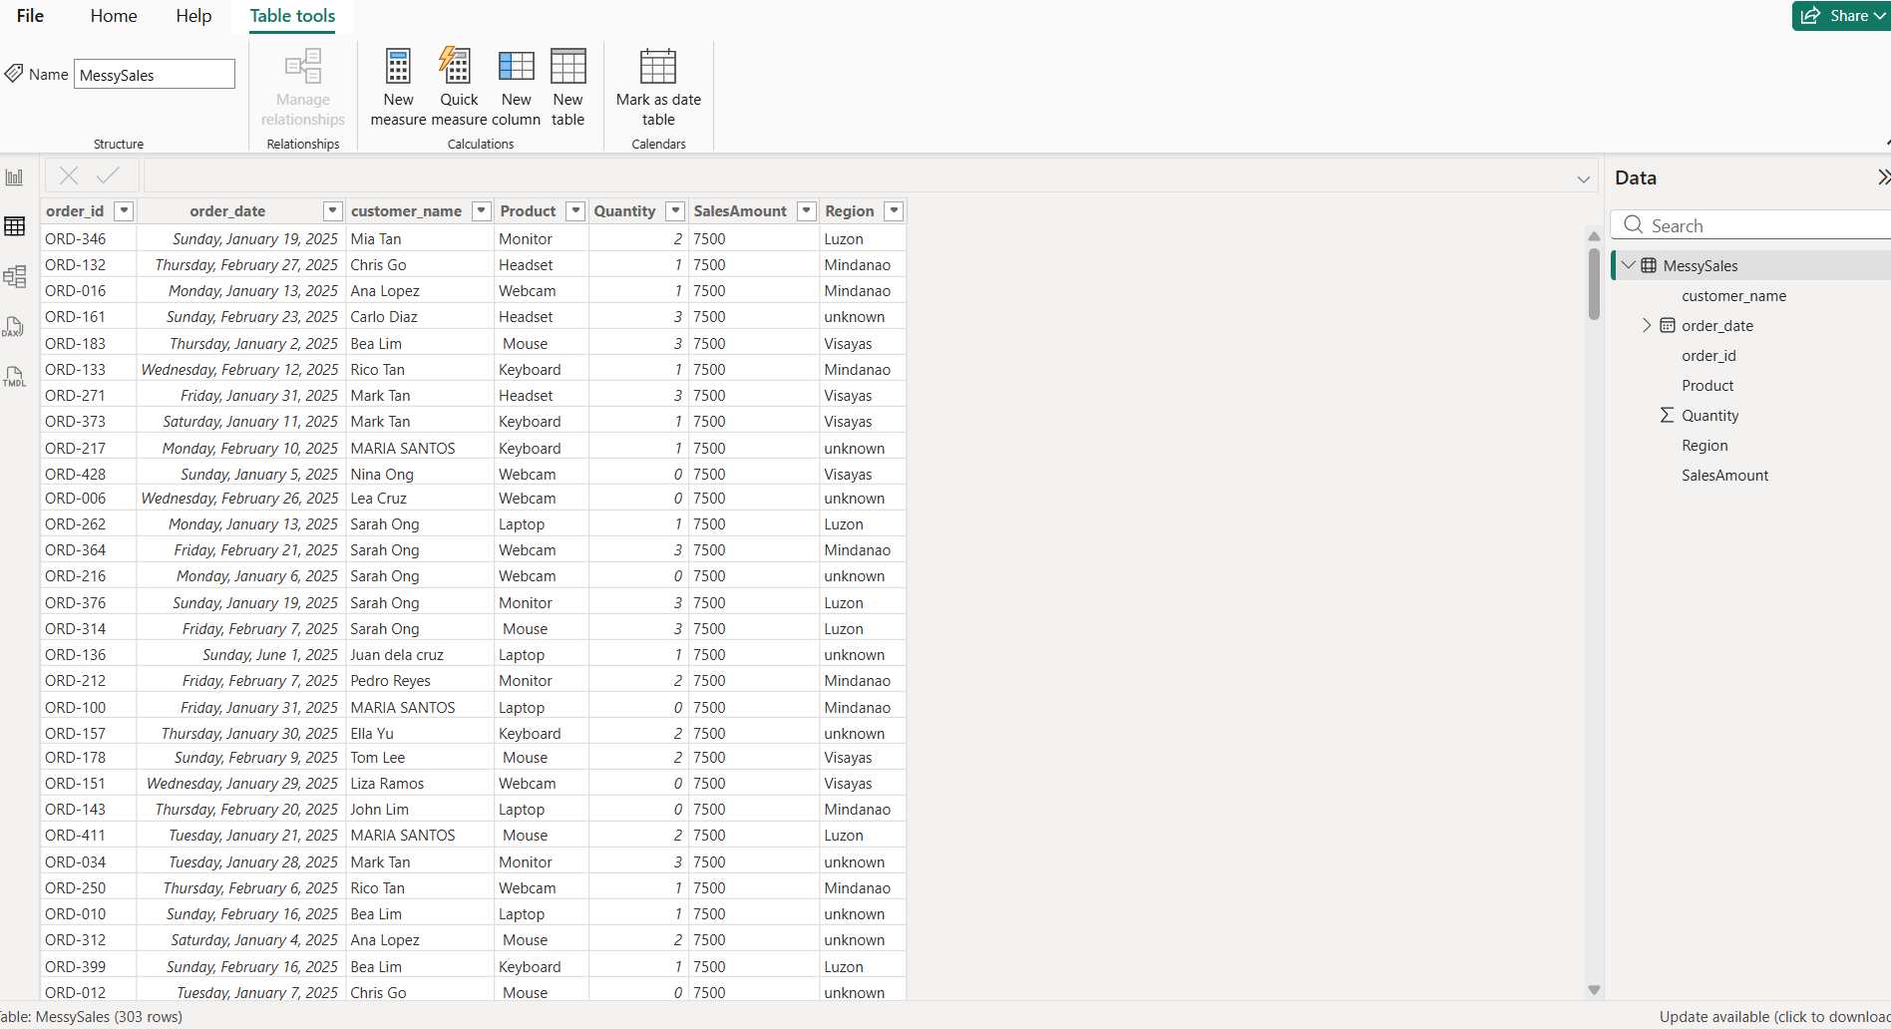
Close & Apply – Load Cleaned Data into Power BI
FINAL STEP
Click Close & Apply to load the cleaned dataset into the Power BI data model
IS 107 – Business Intelligence | Laboratory Work 2 | Edmundo C. Ederio Jr

Slide 9
Guide Questions – Part A: Data Cleaning
1
Why is removing duplicates important?
2
What problems can missing values cause?
Duplicate records quietly inflate your numbers. If an order is logged twice, revenue reports lie. Removing them ensures every transaction is counted once.
A null value can make sales vanish from totals with no error. Filling nulls with 0 or 'unknown' keeps dashboards complete and accurate.
3
How does correct data typing affect calculations?
4
What naming conventions improve readability?
Data types tell Power BI what it can do with a column. Text-typed numbers simply won't add up. Get types right and calculations just work.
snake_case like order_id and total_sales keeps columns consistent. Spaces force brackets in every formula, a small habit that saves big headaches.
IS 107 – Business Intelligence | Laboratory Work 2 | Edmundo C. Ederio Jr

Slide 10
Enhancement Activities – Part A
01
Data Quality Checklist
Think of this as your safety net before any new dataset. No duplicates, no nulls in critical columns, consistent dates, and snake_case column names. Skipping this step is where most reporting errors are born.
02
Dataset Size Before vs. After Cleaning
500 rows came in — only 254 survived. Nearly half the data, 246 rows, was too messy to be useful. Duplicate IDs, nulls, bad dates, and quoted numbers all had to go. What's left is lean and trustworthy.
03
ETL and Power Query
ETL is the journey your data takes before it's ready to report on. Power BI extracts, Power Query transforms, then data loads into the model. Every step records as M code — repeatable and transparent every time.
IS 107 – Business Intelligence | Laboratory Work 2 | Edmundo C. Ederio Jr

Slide 11
PART B
Merge & Append
Queries
Datasets: Customers.csv + Orders.csv | Join Type: Inner Join
IS 107 – Business Intelligence | Edmundo C. Ederio Jr

Slide 12
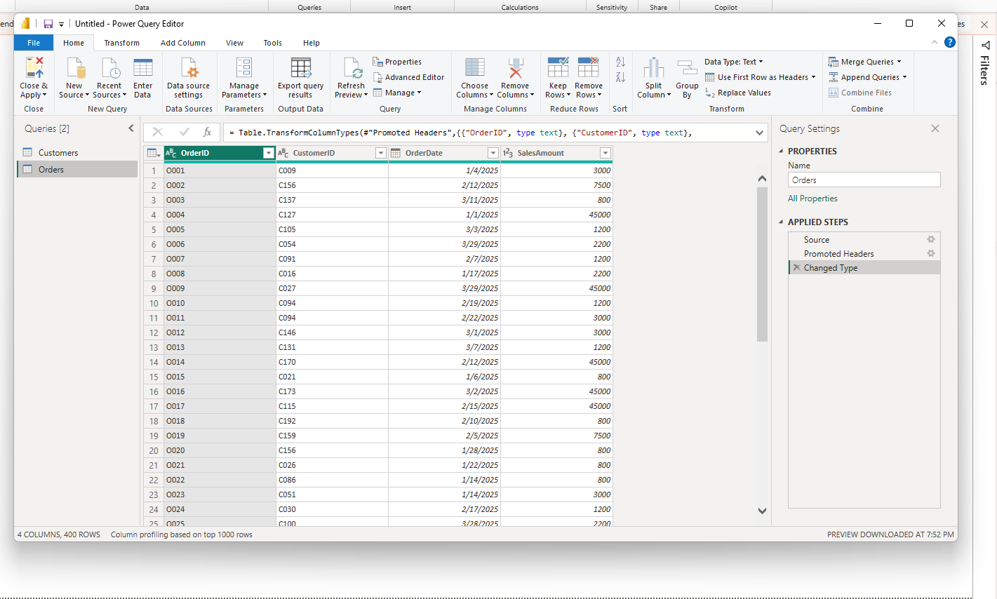
Part B – Step 1: Load Data (Customers.csv & Orders.csv)
PART B STEP 1
Load both CSV files into Power Query as separate queries
IS 107 – Business Intelligence | Laboratory Work 2 | Edmundo C. Ederio Jr

Slide 13
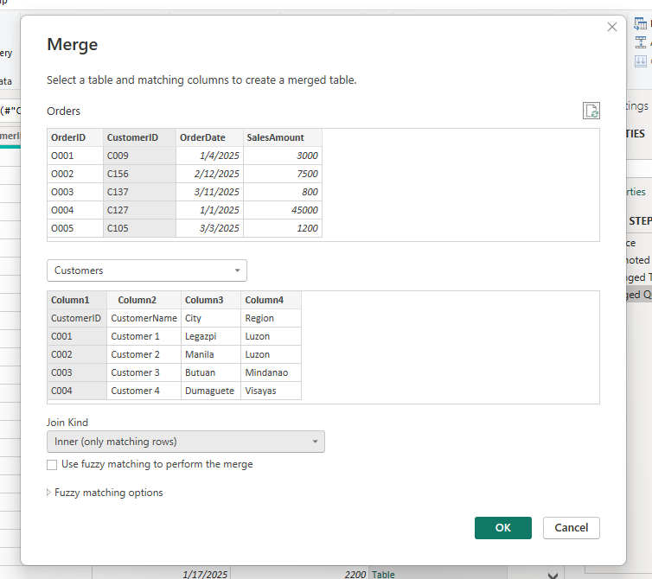
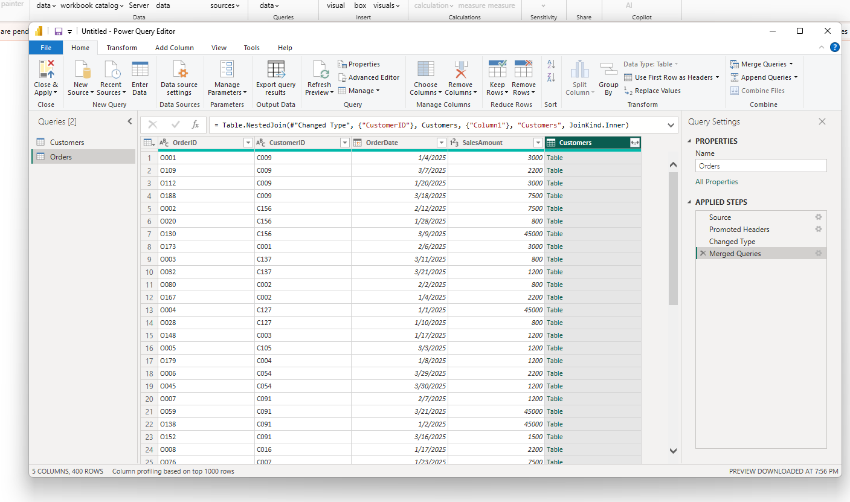
Part B – Step 2: Merge Queries (Inner Join)
PART B STEP 2
Home → Merge Queries → select CustomerID → Inner Join → OK
IS 107 – Business Intelligence | Laboratory Work 2 | Edmundo C. Ederio Jr

Slide 14
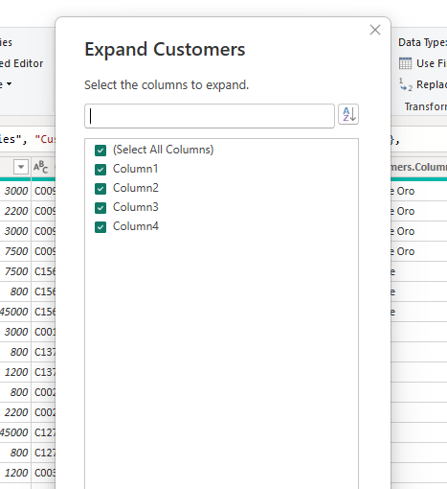
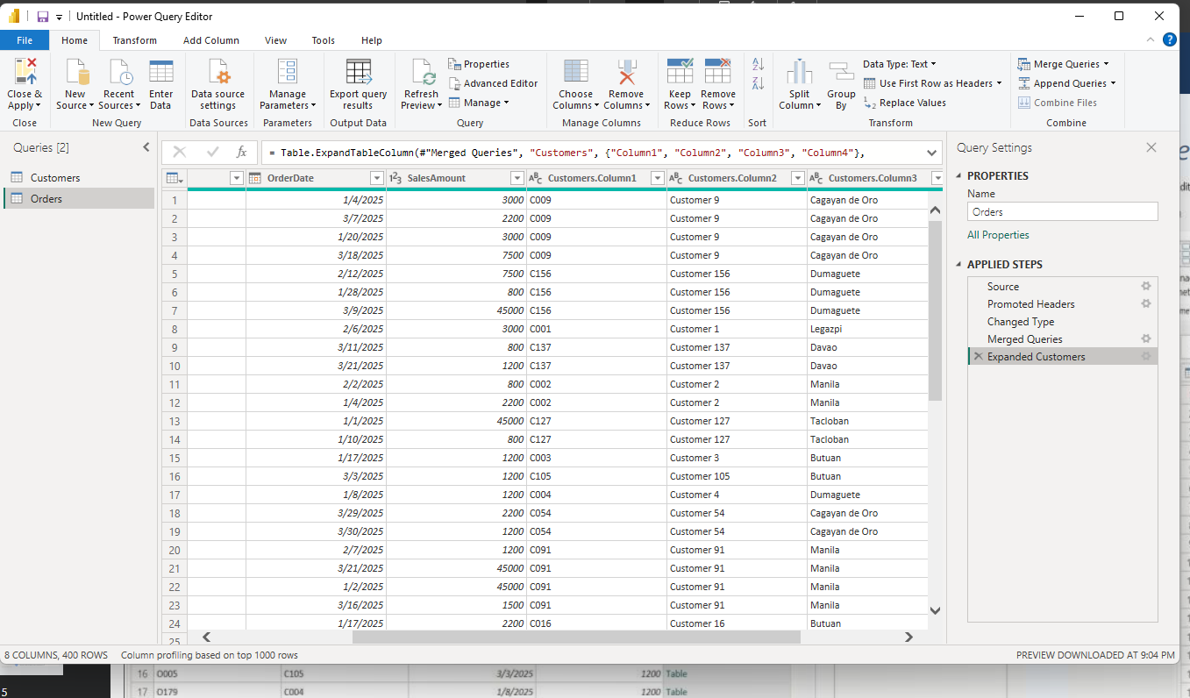
Expand Customer Columns & Final Merged Dataset
PART B STEP 3
Click expand icon on merged column → select CustomerName, City, Region → OK
IS 107 – Business Intelligence | Laboratory Work 2 | Edmundo C. Ederio Jr

Slide 15
Guide Questions – Part B: Merge & Append
1
Difference between Merge and Append?
2
Why use Inner Join instead of Left Join?
Merge joins tables side by side using a key (like SQL JOIN). Append stacks rows when tables share the same structure. Merge = add columns. Append = add rows.
Inner Join keeps only matched records — clean data, no mystery nulls. It kept 400 valid orders and dropped unrecognizable customer IDs. Less noise, more trust.
3
What happens to unmatched records in Inner Join?
4
When is Append better than Merge?
They get dropped — no warning, no error. Any order without a matching CustomerID simply doesn't make it through. That's what makes Inner Join the strictest join type.
When tables are clones of each other. Jan, Feb, March sales files with the same columns? Append stacks them cleanly. Merge is wrong here — no relational key exists.
IS 107 – Business Intelligence | Laboratory Work 2 | Edmundo C. Ederio Jr

Slide 16
Enhancement Activities – Part B
01
Left Join vs Inner Join Comparison
Both Inner and Left Outer Join returned 400 rows here — all 500 orders had matching CustomerIDs. In a different dataset, Left Join would keep unmatched orders showing null for customer details.
Activity 3 – Join Types Reference
INNER JOIN
LEFT JOIN
RIGHT JOIN
FULL OUTER
Only matching rows in BOTH tables
ALL rows from left + matches from right
ALL rows from right + matches from left
ALL rows from both tables
Use when:
Use when:
Use when:
Use when:
Clean, fully-matched data
Keep all orders, even without customer info
All customers, even without orders
Complete combined view of both tables
IS 107 – Business Intelligence | Laboratory Work 2 | Edmundo C. Ederio Jr

