Slide 1
Modelling the Spread of National Protest Movements via Markov Chains
Authors:
Edmund Aduse Poku, Charlie Reeder, Chris Kartsonis,, Chikezie Prosper Onungwa, and Jasper White
Notes:
Chris
Hi - welcome to the final ENGS 27 project presentation of the group ChaEdJasProChris, representing Charlie, Edmund, Jasper, Prosper, and myself.
Our final project involves modelling the spread of national protest movements via Markov Chains
We're really excited to share both our approach and results with you

Slide 2
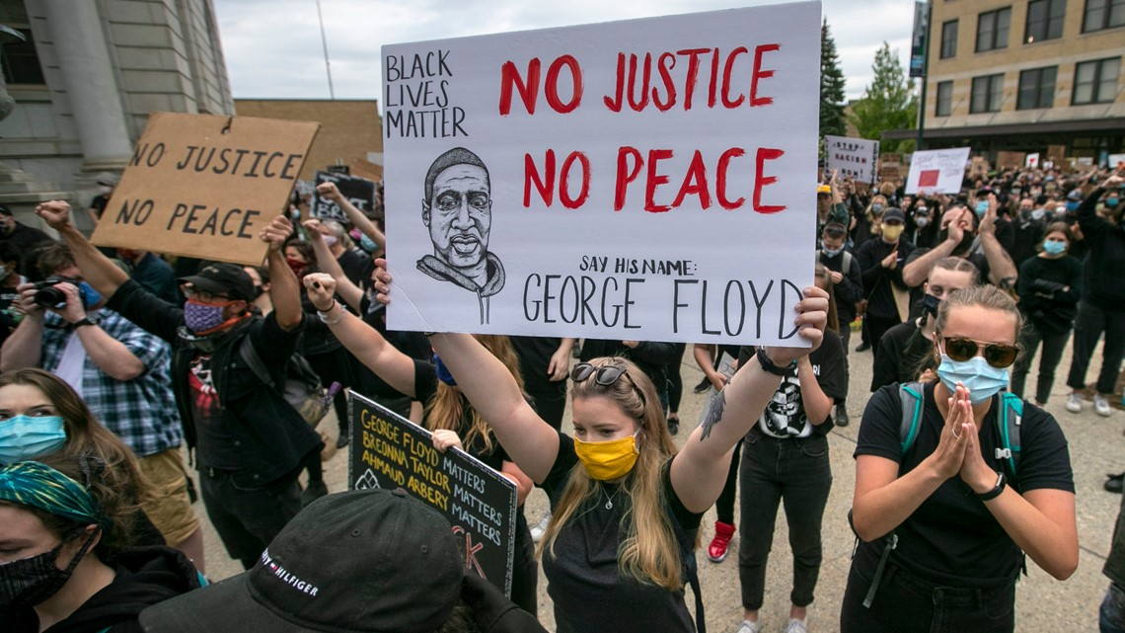
Background & Inspiration
We draw parallels between the spread of fire and protests, as both are influenced by spatial-temporal proximity to prior incidents.
Notes:
Chris
When deciding our project topic, our inspiration was two-fold:
First, we were inspired by the widespread protests earlier this year.
As you may know, protests took the country and the world by storm this past June, in response to George Floyd's murder at the hands of Minneapolis police officers on May 25th, 2020.
Multiple witnesses took videos of the incident, and they quickly spread across the internet.
This immediately sparked protests, first in Minneapolis and soon after across the entire country, associated with the Black Lives Matter movement.
As a quick disclaimer, we are not interested in making a political statement with this project; instead, we are only interested in understanding the reaction of a country to a seminal event, and looked to use Markov Chains to understand protest spread.
The second part of our inspiration was a 2018 paper by Ardianto and Chhetri, two Australian researchers, which was focused on modelling the risk of urban residential fires based on previous fire history in Melbourne, Australia via Markov Chains.
We used a similar approach to that paper, as we drew parallels between the spread of fire and protests, given that both are influenced by spatial-temporal proximity to similar incidents.

Slide 3
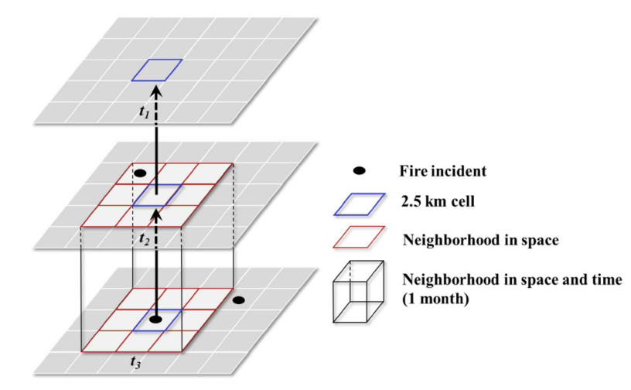
Approach: Overview
Find data (both spatial and temporal) of the protests after George Floyd's murder on May 25, 2020
Source: The Armed Conflict Location & Event Data Project (ACLED) of Bridging Divides Institute at Princeton University
Utilize Ardianto and Chhetri's "neighborhood approach" to develop regions across the United States in establishing Markov matrix
Develop Markov Chain state transition matrix informed by existing data
Visualize protest probability using heat maps
From Ardianto & Chhetri (2018):
Fig. Modeling neighborhood in three-dimensional space and time relationships to determine fire risk
Ardianto, R., Chhetri, P. Modeling Spatial–Temporal Dynamics of Urban Residential Fire Risk Using a Markov Chain Technique. Int J Disaster Risk Sci. 10, 57–73 (2019).
Notes:
Jasper
We employed a Markov Chain, using transition matrices to represent the probability of riots occuring in specific locations after X number of months after George Floyds . States will allow us to parametrize the probability with respect to spatial and temporal coordinates.

Slide 4
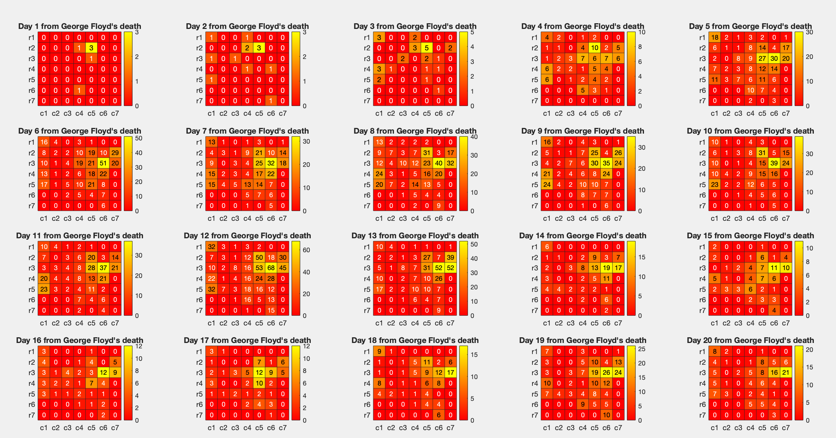
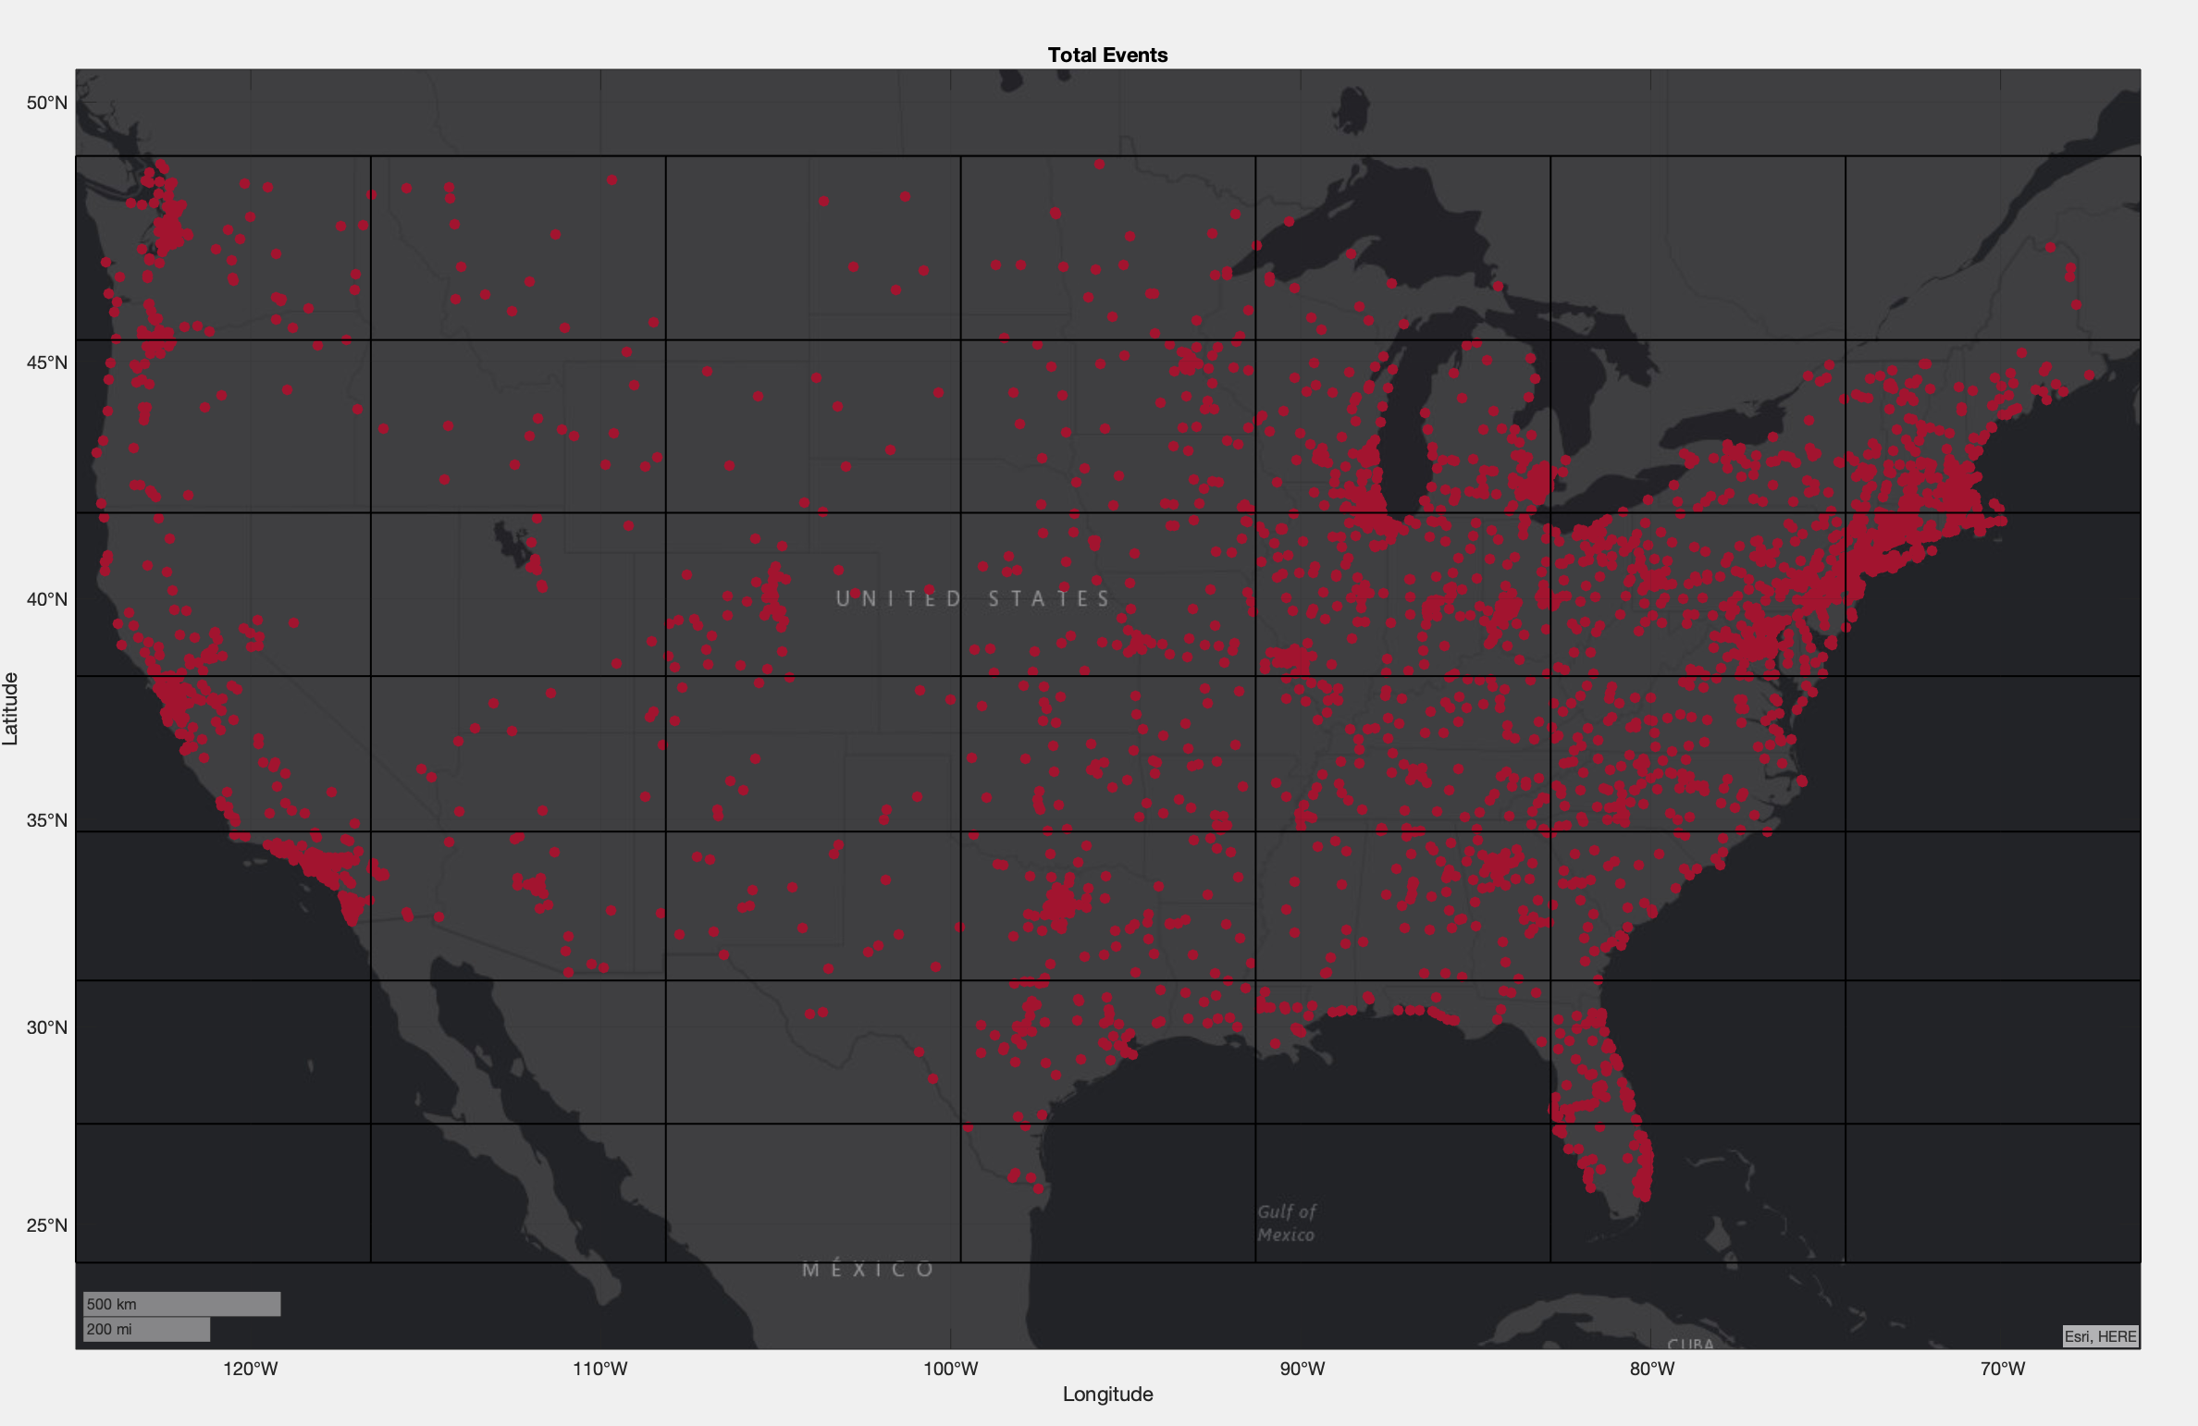
Approach: Informing our Model
The protest data is sorted into histogram bins based on the latitude and longitude coordinates of each event.
Within each bin, we stratified the events by date of occurence.
Our 7x7 square-grid "spatial neighborhood" regions across the US, overlain over map with protest occurrences (red dots)
Note: since contiguous US does not conform to a square, we adjusted our model to ignore the shaded regions (covered by ocean or another country)
Notes:
Charlie
In order to inform our model, we accessed data from the Armed Conflict Location and Event Data Project to collect the geographical coordinates and the dates of protests across the contiguous United States. We sifted through this data to extract events strictly pertaining to the BLM movement, up to 164 days after the murder of George Floyd.
The protest data is sorted into histogram bins based on the latitude and longitude coordinates of each event.
Within each bin, we separated events by day. Pictured to the left, we can see a geospatial heat map visualizing the first 20 of 164 days of protests across the united states. Using these 164 matrices, we are able to develop a model that computes a transition matrix based on the interactions between regions. Before we go into further details, however, we must address the geometry of the contiguous United States. Because it is not a perfect square, we had to adapt our approach. We had to devise an algorithm that would exclude the shaded regions from our computations, since these regions are either outside of the us or are in the ocean. Implementing this algorithm allows us to use a square transition matrix without having the shaded regions contribute noise.

Slide 5
Approach: Transition Matrix
For each region, we built a transition matrix with two states denoting the occurrence of a protest (=1) and the absence of one (=0)
A region’s transition between states is influenced by the states of its geographic neighbors
By making state transitions a spatial dependency, we model factors like information diffusion and local communication networks
Computing each region’s transition matrix per time step lets us model its reaction rate and activism levels
For any region on any day:
Protest Did Not Occur
0
1
Protest Occurred
Notes:
Prosper
What the matrix is comprised of:
The interaction between states (across space and time).
For each one of them we explain how that is built into the transition model.

Slide 6
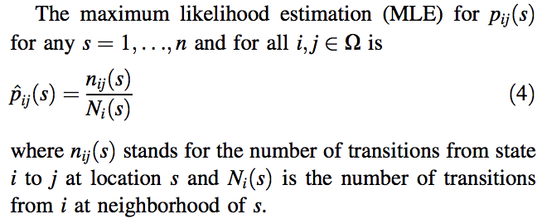
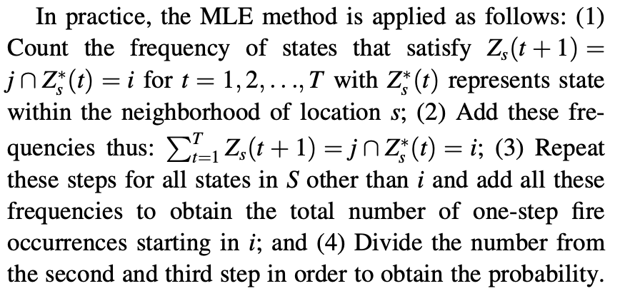
Approach: Maximum Likelihood Estimation (MLE)
From Ardianto & Chhetri (2018):

Slide 7
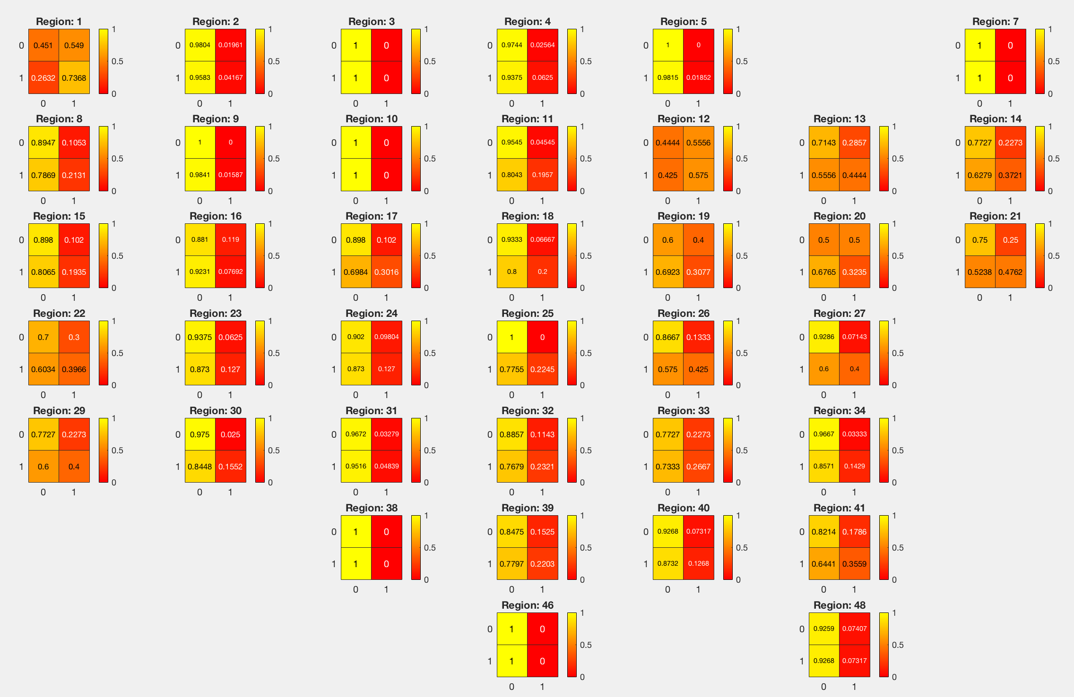
Results & Discussion
Transition Matrix for Each Region in the US
Notes:
Edmund

Slide 8
Next Steps
Create Markov Chain model with three or more states (rather than two) to quantify protest density (e.g. 0, 1, and 2+ protests)
Increasing the resolution of our model
Create 3D representation of probability to capture spatial and temporal elements together
Expansion of model to cover other seminal events that led to national, widespread protesting
Notes:
Jasper

