Slide 1
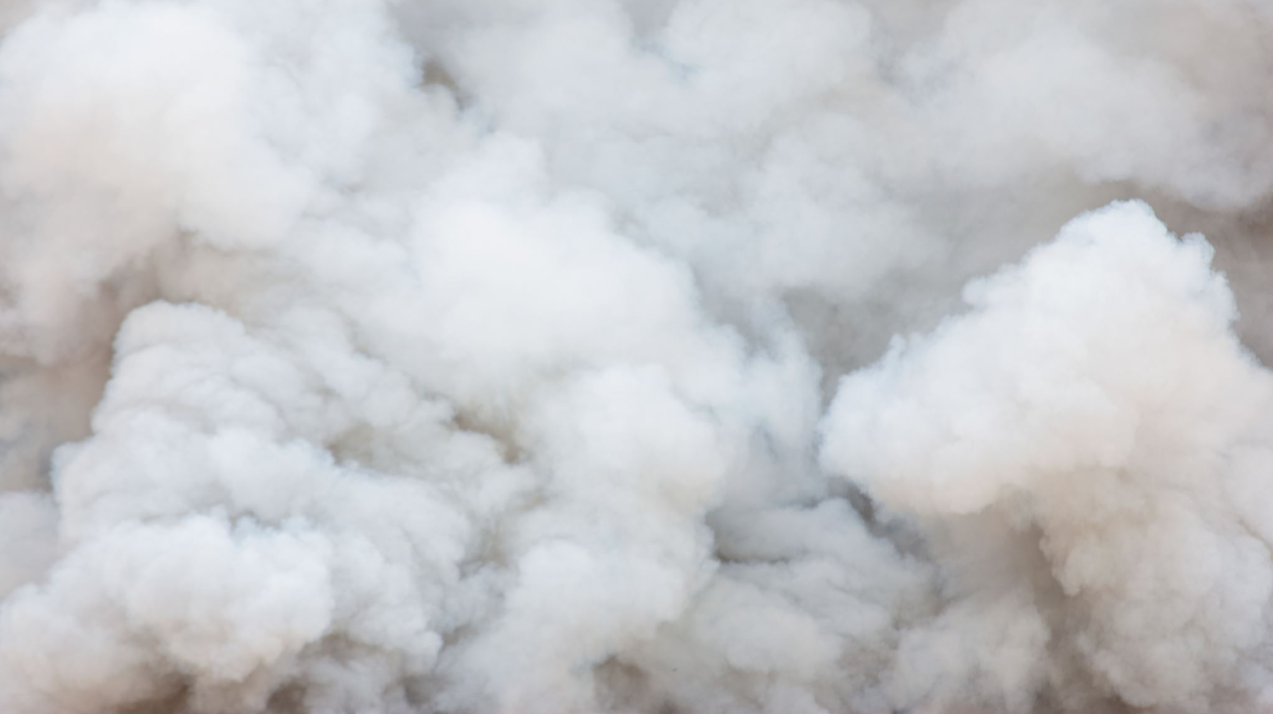
Smoke and Fire Detection in Forest Environment
Protecting Nature and Wildlife

Slide 2
Forest Fires
Unpredictable, catastrophic and destructive events
Affects vegetation and wildlife
500,566 hectares burned in Italy in 2021

Slide 3

Early Fire Detection
Can limit damages
Allows to alert emergency services on time
Difficult even with help of sensors
Remote areas are the most difficult to monitor

Slide 4
Proposed Solutions
System to detect Smoke and Fires from images
Several recording devices contribute to the monitoring (drones, webcams, …)
Non-real-time system (fires evolve more slowly than other events)
CNN and Vision Transformer are employed

Slide 5
Dataset
This dataset consist of sample from two datasets hosted on Kaggle:
Forest Fire
Forest Fire Images
The datasets consist of:
2525 Fire samples
2525 Smoke samples
2525 Normal samples
The dataset is split into:
Train Set -> 6060 samples
Validation Set -> 756 samples
Test Set -> 759 samples

Slide 6
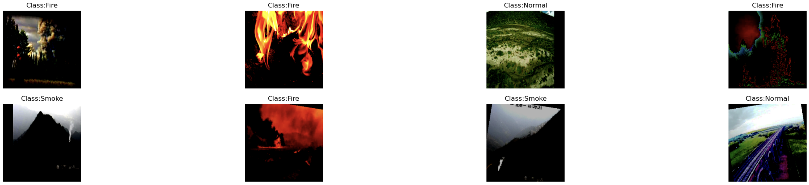
Augmentation Procedure
RandAugment
2 operations
Magnitude 9
same procedure for both approaches

Slide 7
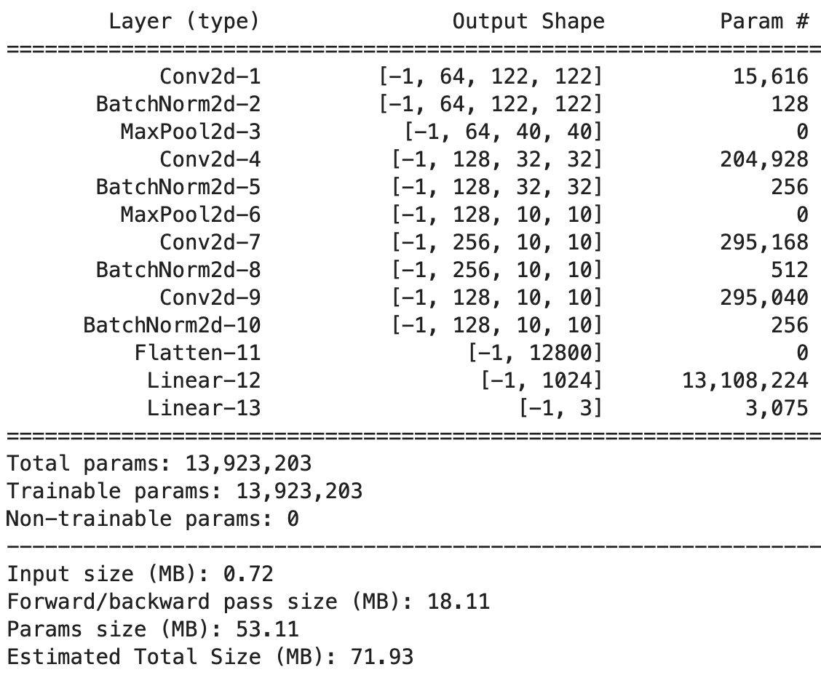
1st. Approach - CNN
Strided Conv.
Dilated Conv.
Batch Normalization
Dropout
SELU activation
Cross-entropy loss
AdamW optimizer
Exponential LR schedule
20 epochs

Slide 8
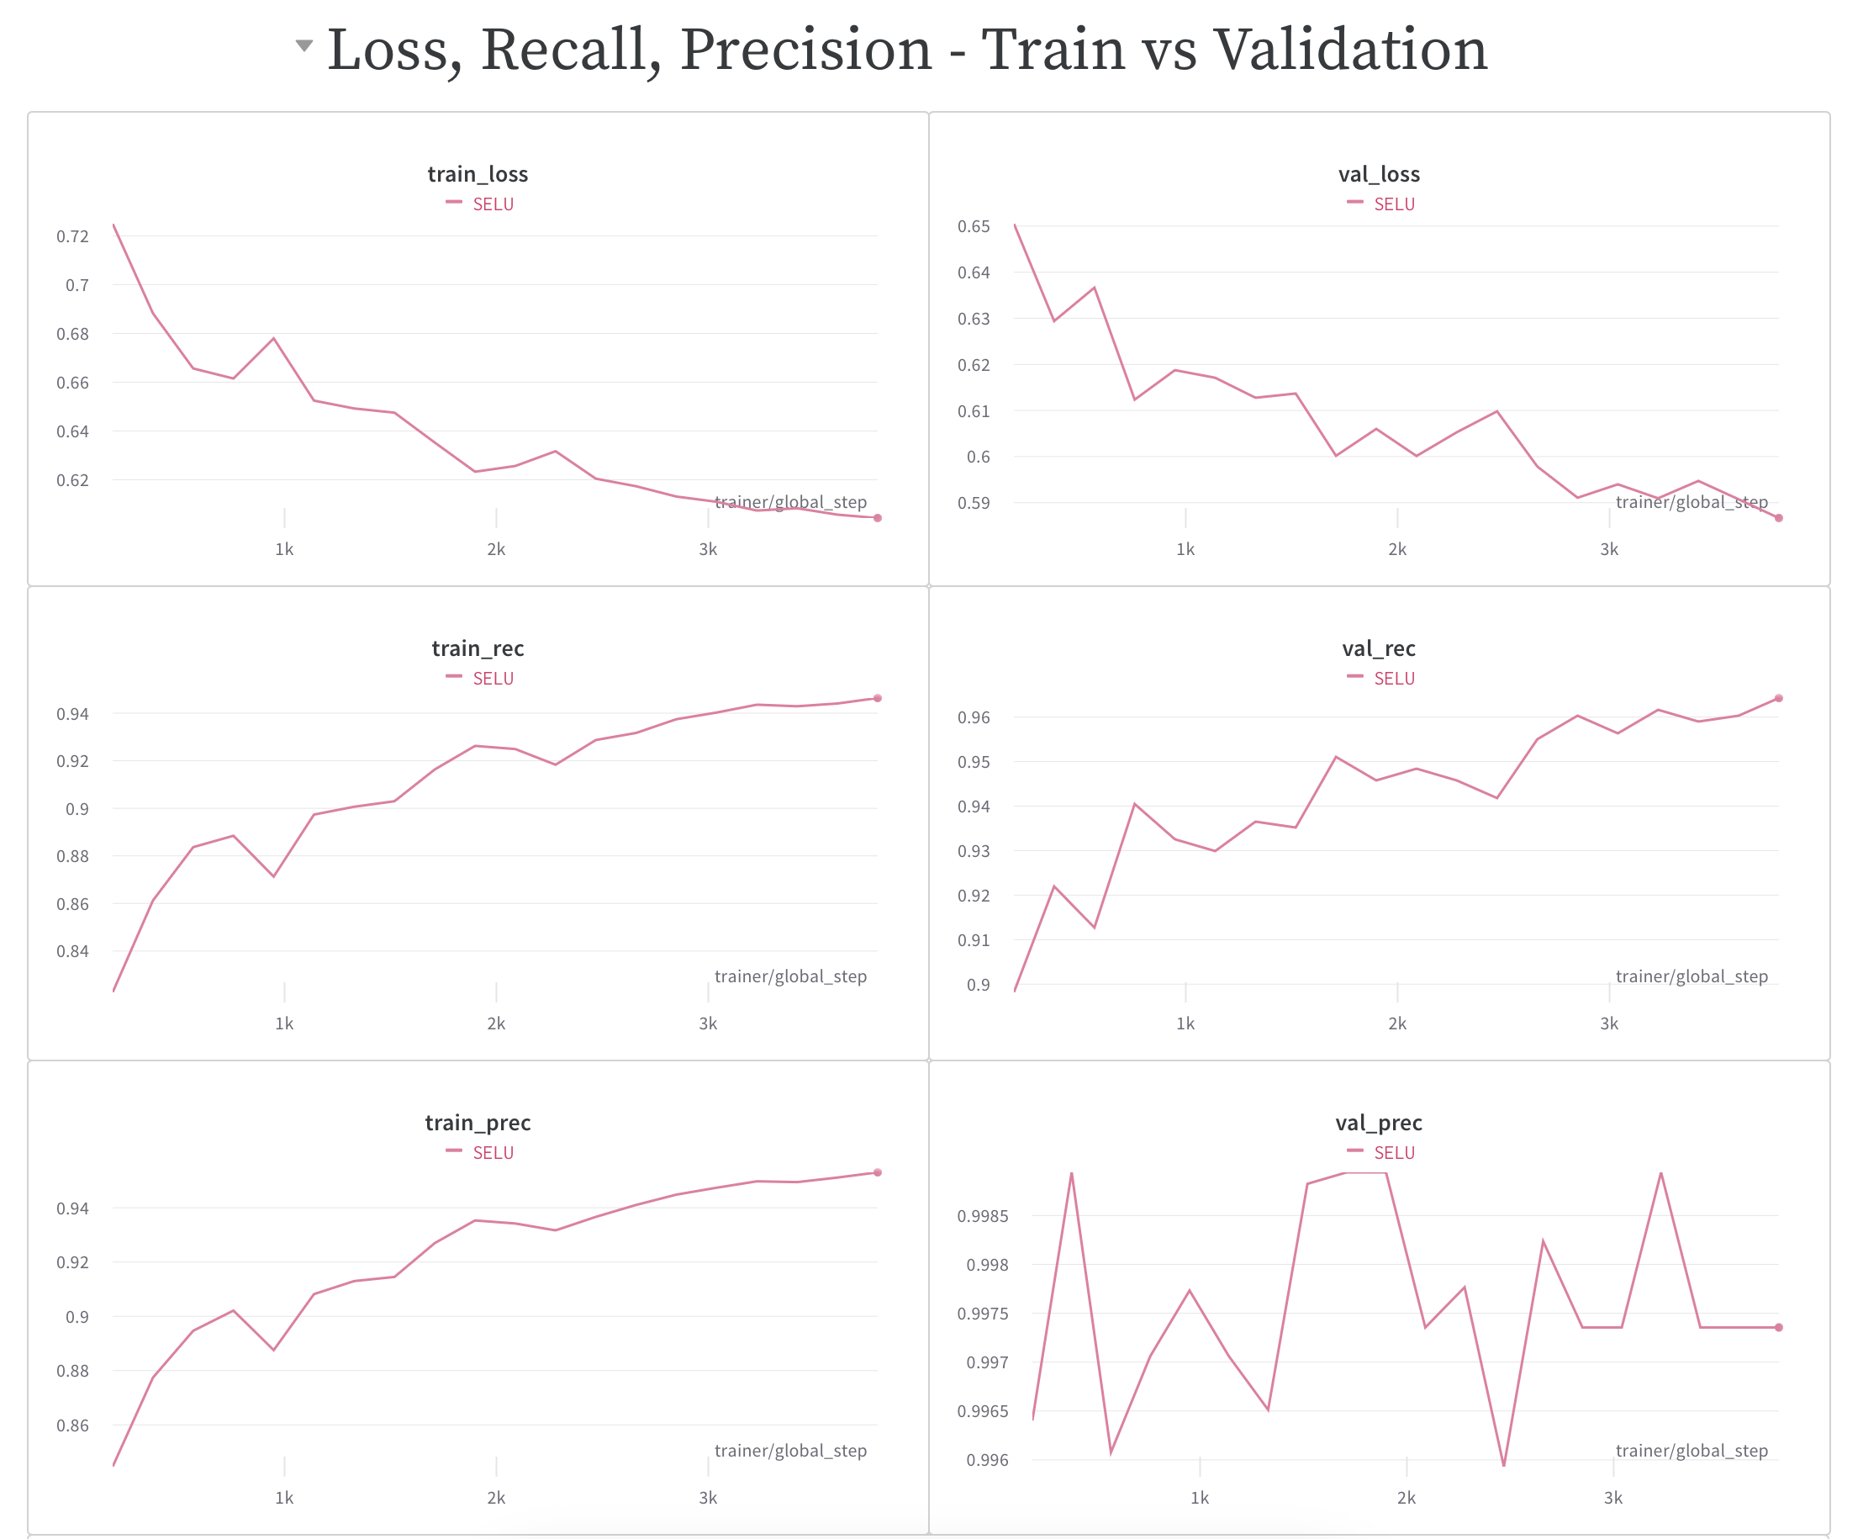
Training and Evaluation
Precision 0.99
Recall 0.97
Still committing errors

Slide 9
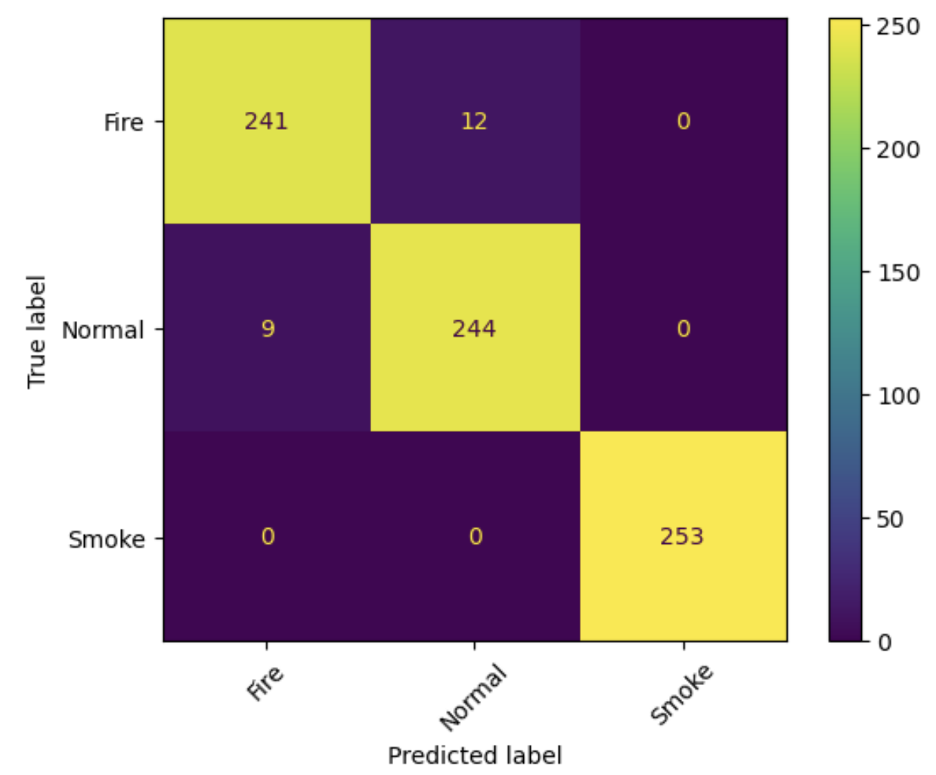
Confusion Matrix
Different cost of misclassification
Reporting a “fire” situation as “normal” is worse than a false alarm

Slide 10
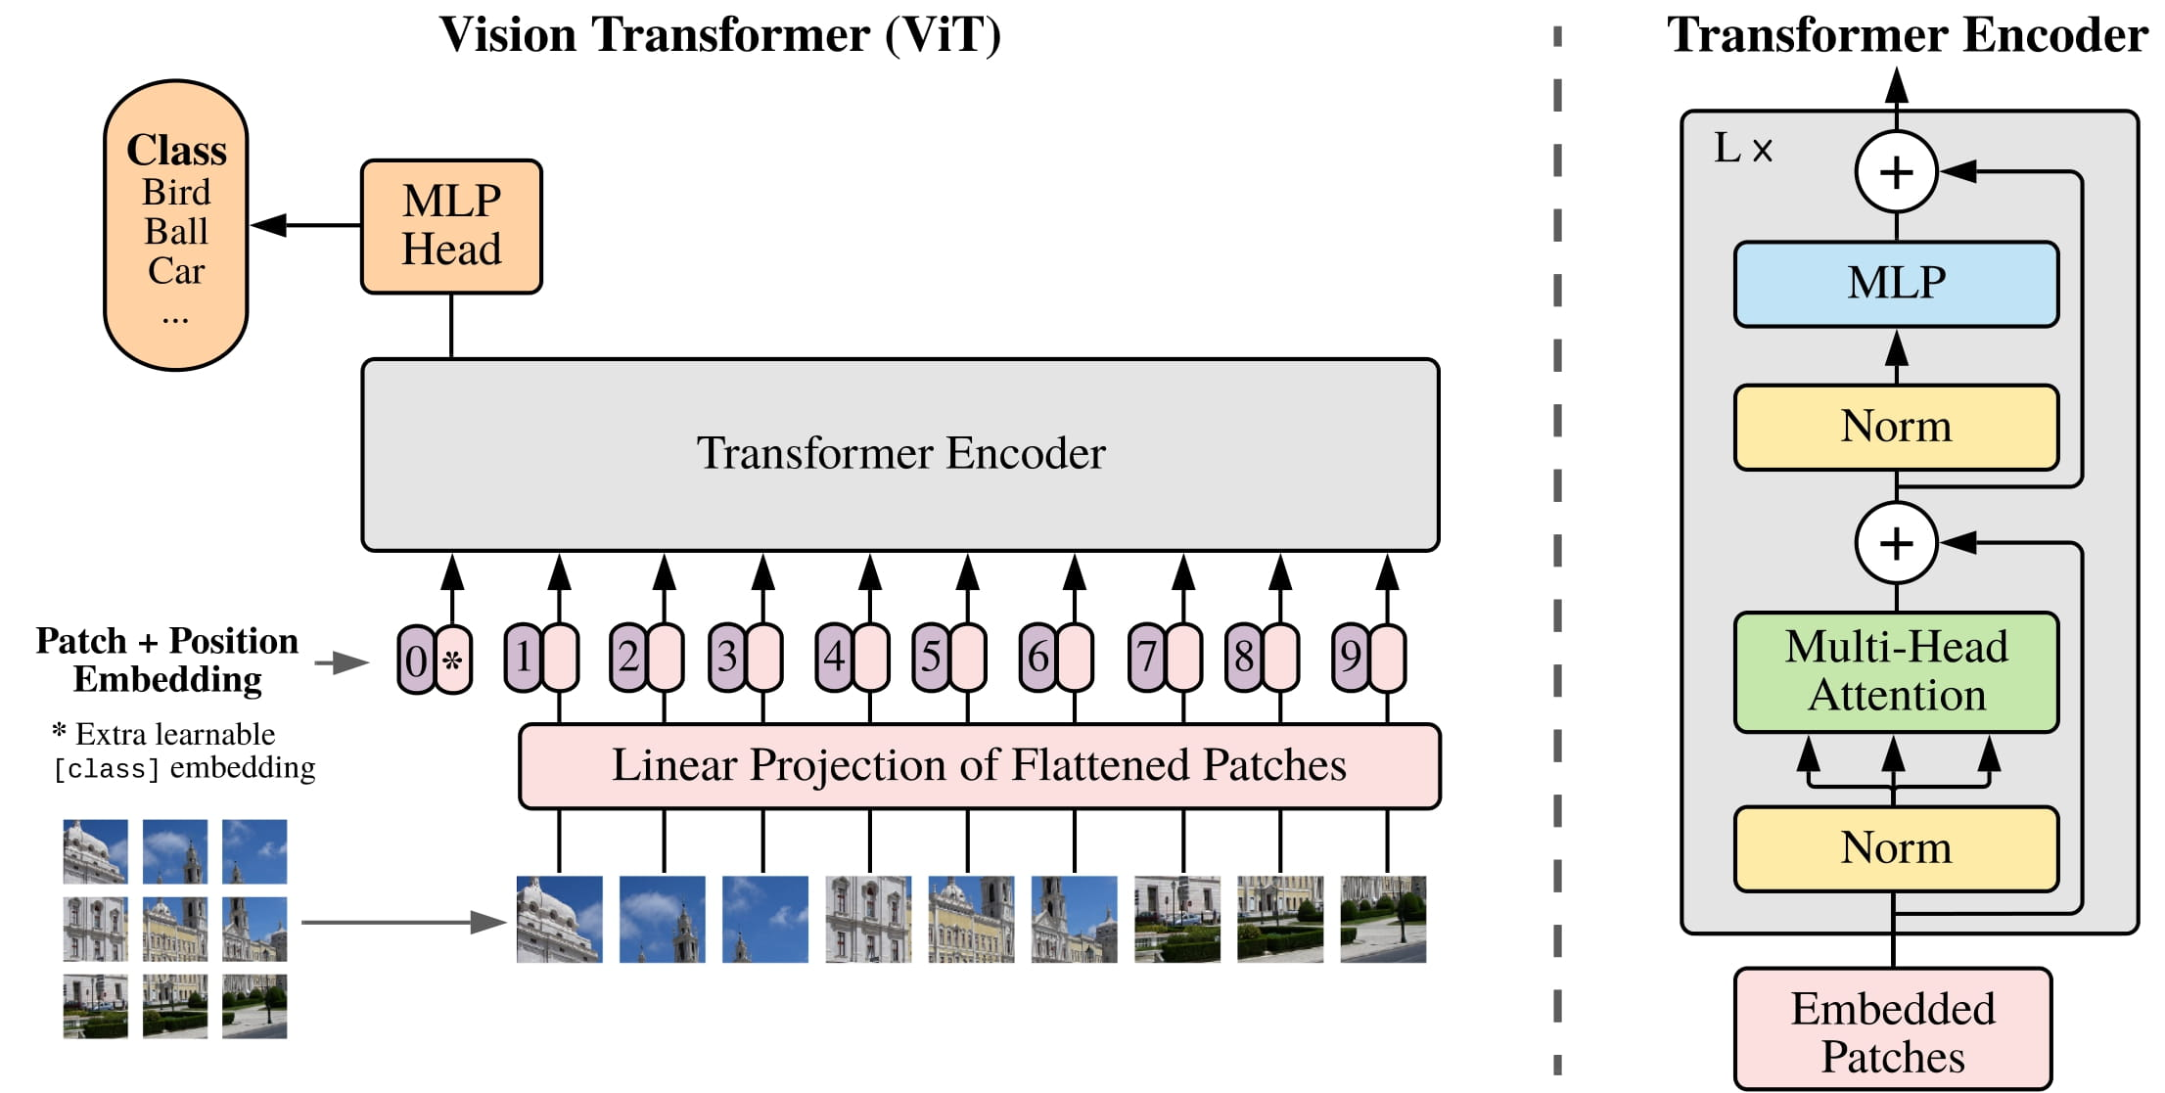
2nd. Approach – Google ViT
Pretrained on ImageNet-21k (14 million images, 21,843 classes)
Resolution 224x224
Warmup 100 steps
AdamW optimizer
Linear LR schedule
10 epochs
Replace CNN with MH Self-attention mechanism
Errata corrige in the report

Slide 11
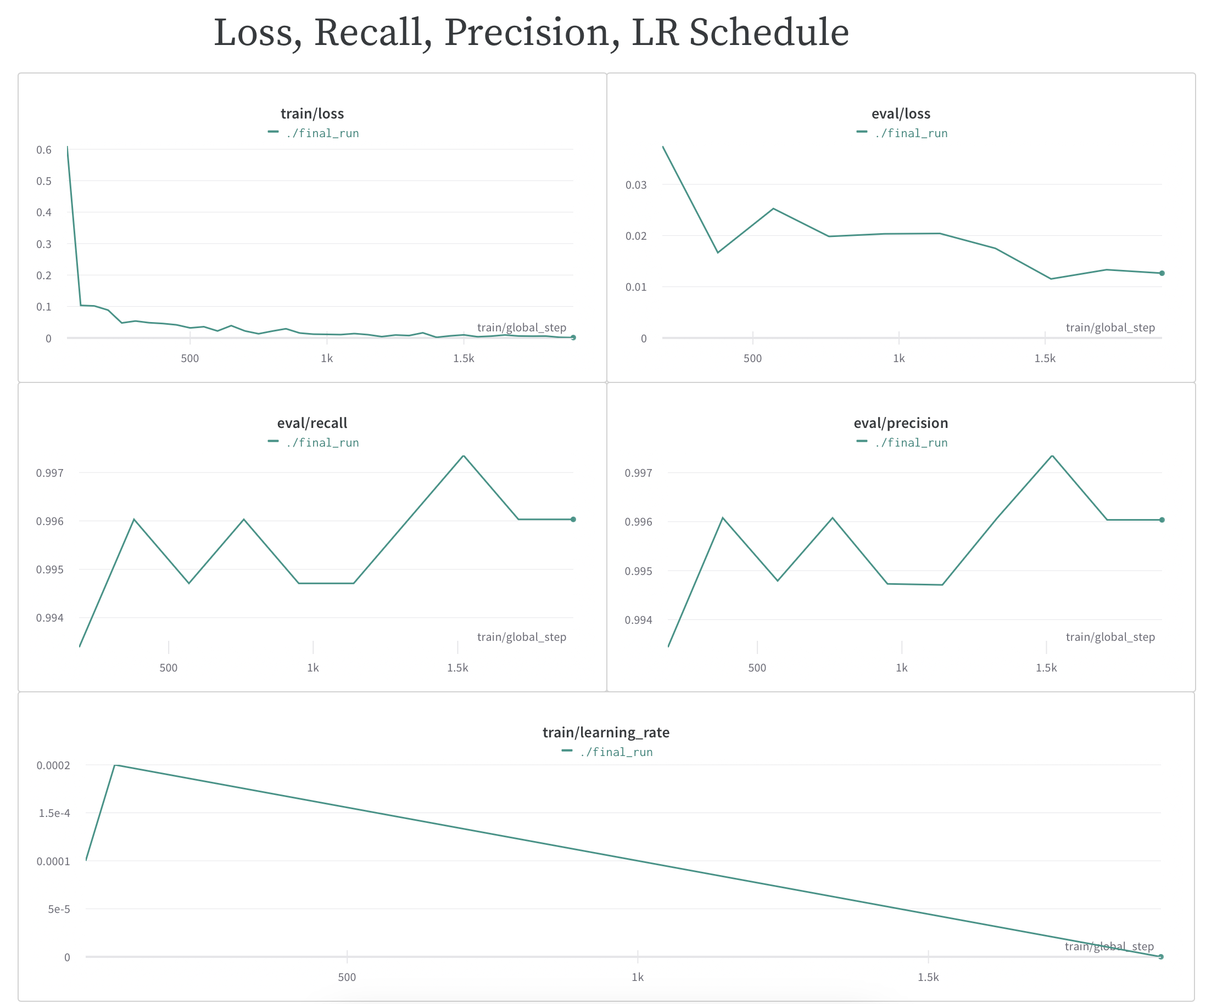
Training and Evaluation
Precision 0.99
Recall 0.99
Only 4 high-cost mistakes

Slide 12
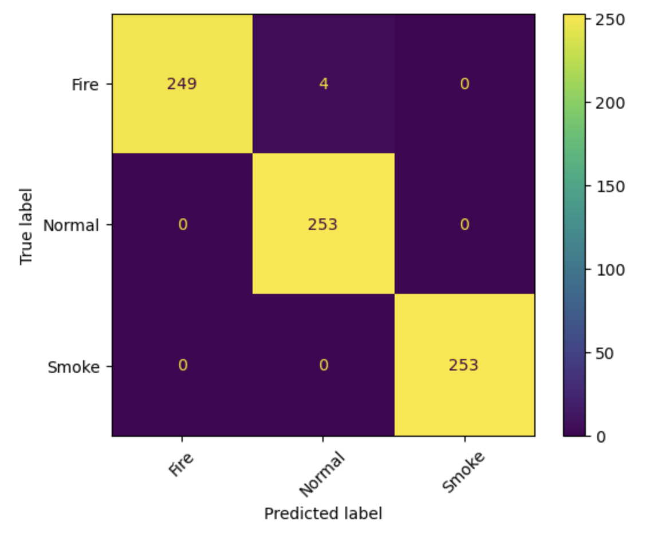
Confusion Matrix
Better results wrt the CNN
Still committing a few errors

Slide 13
Future Work
Train for more epochs
Get more data
Different augmentation
Test different activation functions
Try different schedulers

Slide 14
Demo Web Application
Works with the fine-tuned model
Made with Streamlit
Fast inference time
Available through inference API
Open acces

