Slide 1



Energy:
The City,
The World and
The Forecast
Exploring past and future energy consumption patterns worldwide and in countries with top performing Smart Cities.
POWERED BY
-

Slide 2
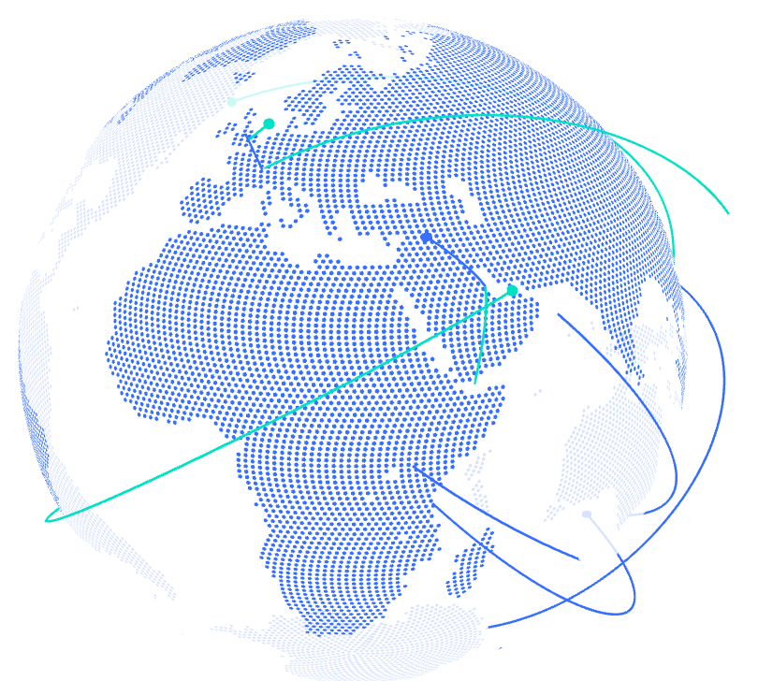
Index
01 Who are we?
02 SCI Data Analysis
03 WEC Data Analysis
04 PJM Data Analysis
05 Forecasting, why?
05 Forecasting models comparison

Slide 3
Who are we?
-

Slide 4

01 Who are we?
Mission
Areas of work
The E-IEA works with governments and industry to shape a secure and sustainable energy future for all
Goal of the project
From the cross-analysis 4 datasets:
World Energy Consumption (WEC),
Smart City Indexes (SCI),
Greenhouse Gases Emissions (GHG),
Hurly Energy Consumption (PJM)
Recommending policies that enhance the reliability and sustainability of energy.
Exploring full spectrum issues including renewables and fossil fuels along with forecasting the energy (electricity) demand in the markets
Trends are identified and converted into insights of business opportunities.

Slide 5
SCI Exploratory Data Analysis

Slide 6
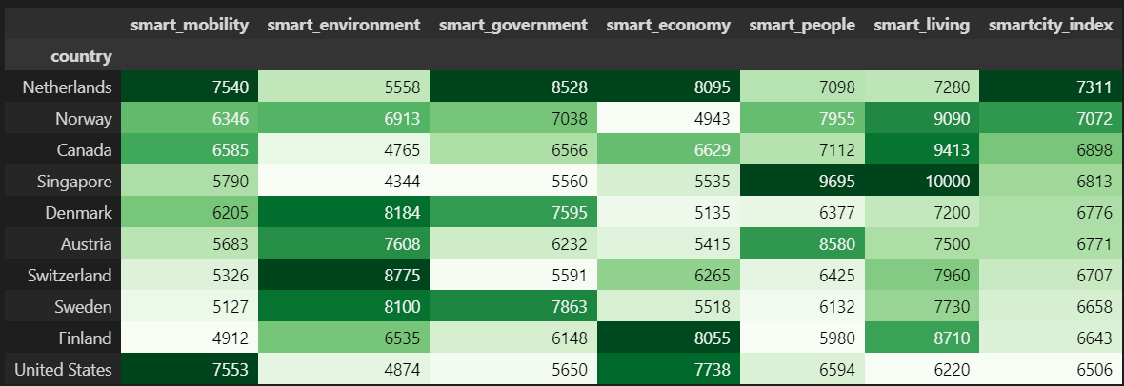
02 SCI Exploratory Data Analysis
The first step it’s always to understand the data. What are the top 10 countries with best SCI?
First of all, a nice definition: “Smart City” describes an urban setting that applies technology to enhance the benefits of urbanization;
The IMD-SUTD Smart City Index (SCI) assesses the perceptions of residents on issues related to structures and technology applications available to them in their city.
Methodology: The SCI is evaluated based on questionnaires over five key areas: Health & Safety, Mobility, Activities, Opportunities for work and school, and Governance which all concurs to define its Index

Slide 7
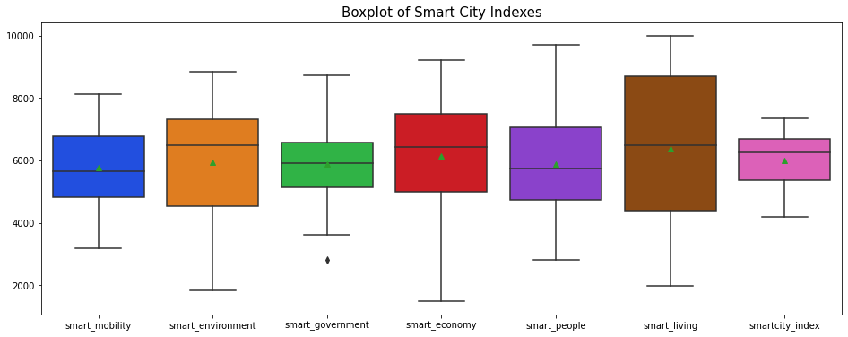
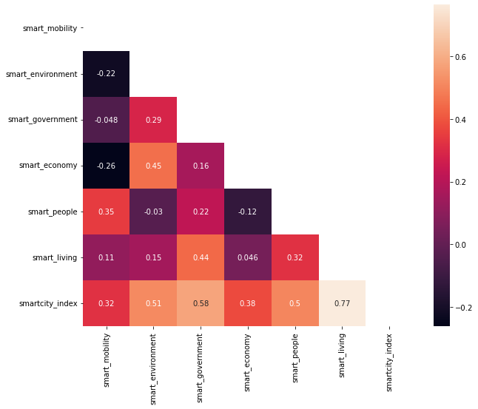
02 SCI Exploratory Data Analysis
How the different indexes behave and which ones give the best contribution?
Insights
Sub-indexes has medium-high correlation between each others.
Although this could be expected due to the fact that quality of life depends on al these factors in an interconnected way, high multicollinearity in the dataset should be further analysed to identify trends: probably the assessment methodology (the questionnaires) should be improved.

Slide 8
WEC Exploratory Data Analysis

Slide 9
02 WEC Exploratory Data Analysis
Understanding the data.
Data on World Energy Consumption provided by Our World in Data:
It is updated regularly with data on energy consumption (primary energy, per capita, and growth rates), energy mix, electricity mix and other relevant metrics.
The dataset can be easily explored if it is categorised into 4 large groups:
Pure energy sources data (Oil, Gas, Nuclear etc.)
Aggregated energy sources data (Renewables, Low-Carbon, etc.)
Per capita energy measures (energy consumption, electricity production;
Identifiers (year, country, population, gross product etc.)

Slide 10
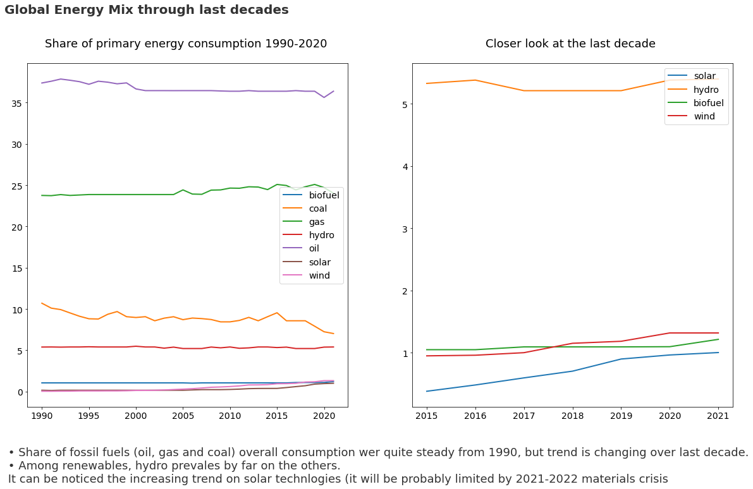
02 WEC Exploratory Data Analysis
Where the world stands now ?

Slide 11
02 WEC Exploratory Data Analysis
Where the world stands now ?

Slide 12
02 Exploratory Data Analysis
Where the world stands now ?

Slide 14
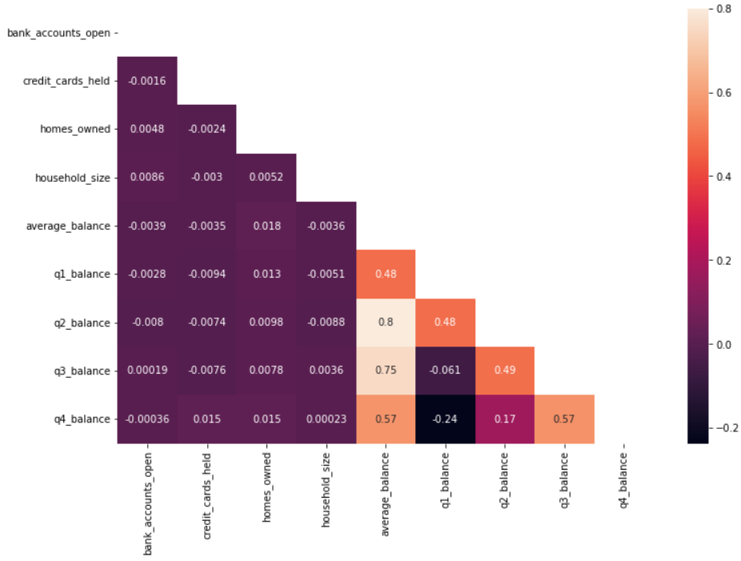
02 Exploratory Data Analysis
Correlation Heatmap

Slide 15
Benchmark

Slide 16
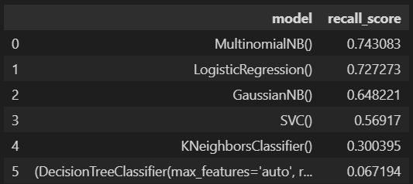
03 Benchmark
How can we measure our model’s performance?
With a high recall on the 'Yes' class, we want to be sure to target all possible customers that will accept the card offer. However after the analysis the 'high' recall gives a low 'precision' on the 'Yes' class. Let's take a look of the recall for these benchmark models:
Initial Benchmarks’ conditions:
- MinMax applied to numerical data
- One Hot Encoder applied to categorical data
- No feature engineer/reduction
- No consideration of Multicollinearity
- Yes to balanced Dataset (high imbalance)
- No outliers dropped
- No parameters tuning on the models

Slide 17
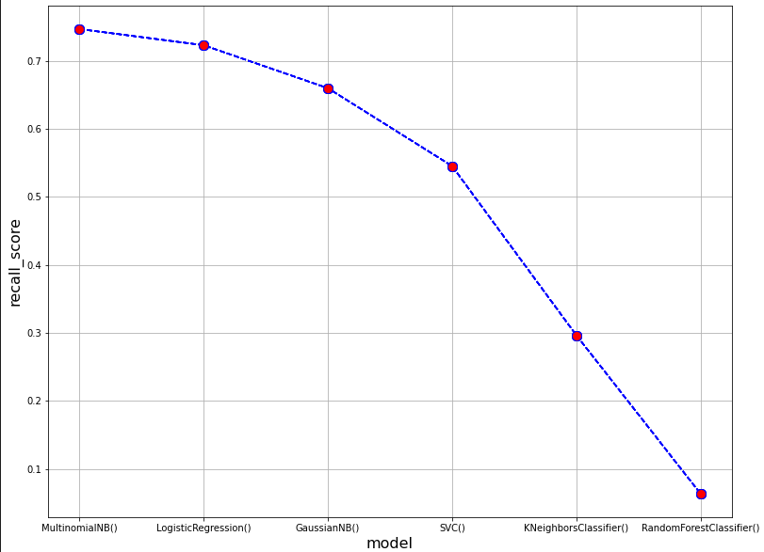
03 Benchmark

Slide 18
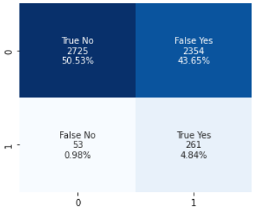
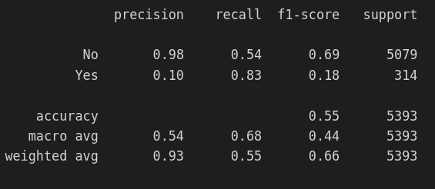
03 Benchmark
Before optimizing we must understand what it is we want to optimize given the high level of imbalance in the dataset:
Specificity
Precision
Recall or Sensitivity
|
Because the goal of the test is to identify everyone who accepted or could accept the offer, the number of false negatives should be low, which requires high recall.

Slide 19
03 Benchmark
In this case Precision tells us what percentage of clients that accepted the offer were correctly identified.
Precision(P) = TP/(TP+FP)
In information retrieval, recall is the fraction of the relevant documents that are successfully retrieved.
Recall(P) (Sensitivity) = TP/(TP+FN)
If the goal of the test is to accurately identify people who rejected the offer then the number of false positives should be very low, which requires a high specificity.
TNR or Specificity = TN/(TN+FP)
Balanced accuracy = (sensitivity + specificity) / 2

Slide 20
Optimizing the model

Slide 21
04 Optimizing the model
Logistic Regression and Naive Bayes (Multinomial):
These models seem to have the best performance on the classification for this reason they will now be optimized in this way:
Scalers
Encoders
Handling Multicollinearity
Outliers
Balancer

Slide 22
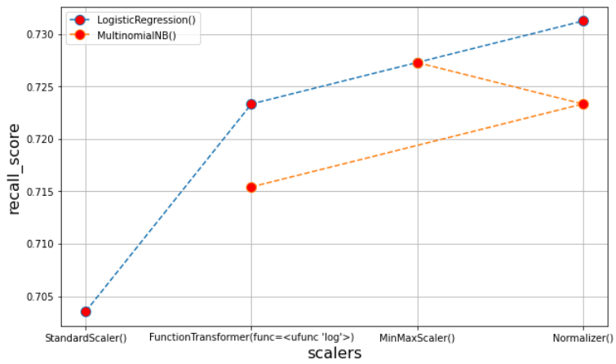
04 Optimizing the model

Slide 23
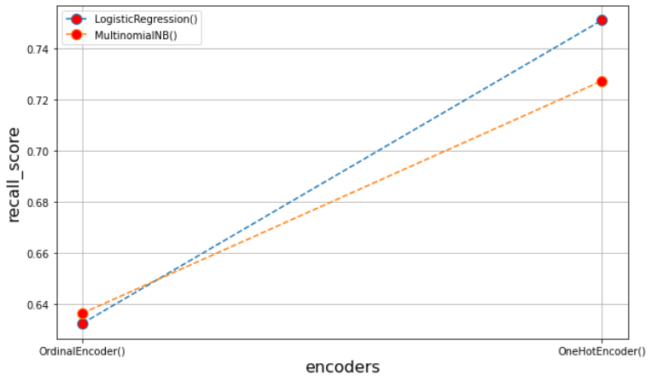
04 Optimizing the model

Slide 24
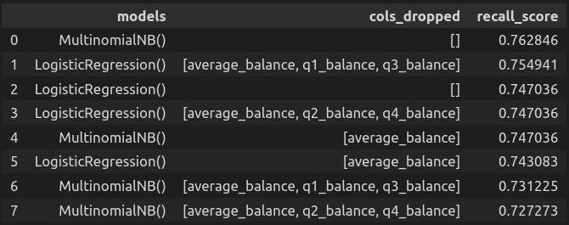
04 Optimizing the model
High multicollinearity

Slide 25
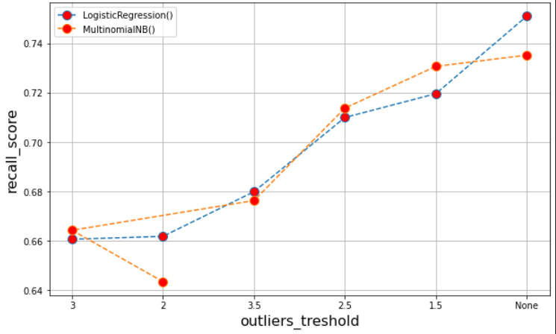
04 Optimizing the model

Slide 26
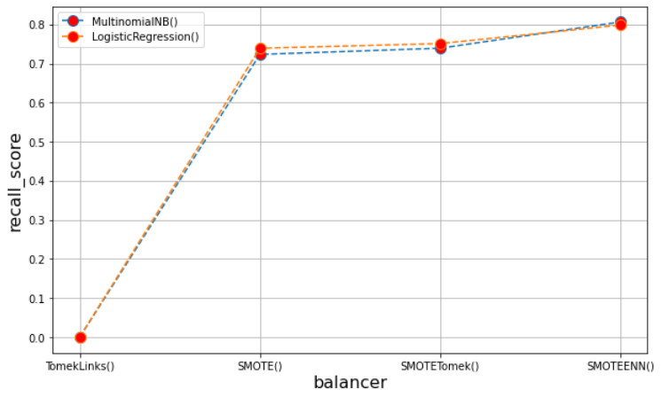
04 Optimizing the model

Slide 27
Final model

Slide 28
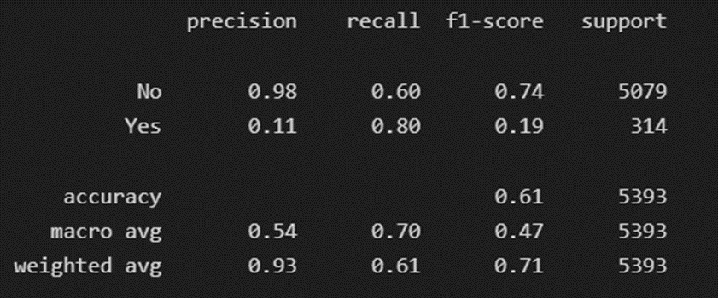
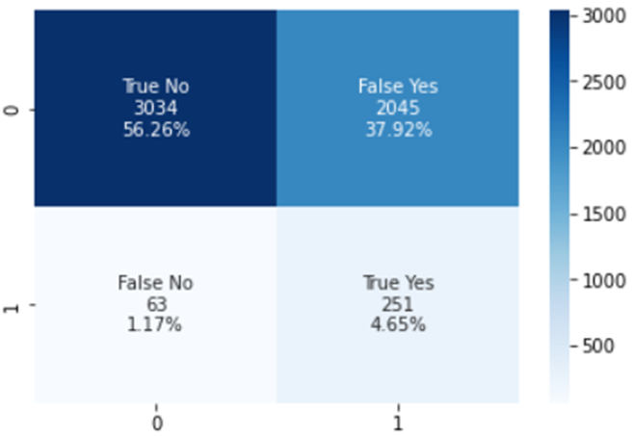
05 Final model
Mathematically optimised model
TPR - FPR is maximized

Slide 29
Results

Slide 30
06 Results
Our final model managed to optimize both the specificity and the recall which allowed to correctly identify customers that will accept the offer and customers that will reject the offer. The balanced accuracy was also maximized which is another indicator of the quality of the model.
Up next we will implement the final model onto a business case and analyze the results

Slide 31
Business Case

Slide 32
07 Business Case
Let’s suppose the management team now give us the following information:
The database contains 1 M of customers.
The cost of sending an mail is 5 $.
The offer acceptance brings to the company 100$
Every true positive means we have encountered the potential customer and he/she will accept offer bringing to the company (+100$ - 5$)
Every true negative mean we have correctly not send an email to a customer that will not accept the offer (0$)
Every false negative mean we have lost an opportunity with a potential customer (-100$)
Every false positive mean we sent an email to a customer that will not accept the offer (-5$)

Slide 33
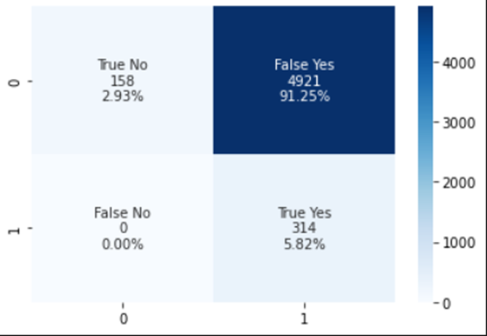
07 Business Case
Business Case Results
Confusion Matrix
Threshold
Max Profit

Slide 34
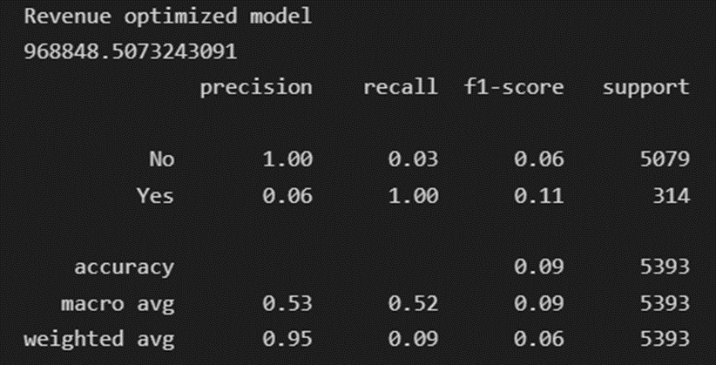
07 Business Case
Model optimised for max revenue
Revenue with no ML model = 679.795 $
Revenue with classification model = 968.848 $
Savings = 289.053 $
+ 42,5% of benefit

Slide 35
Thanks!
Hope you liked it

