Slide 1



Energy:
The City,
The World and
The Forecast
Exploring past and future energy consumption patterns worldwide and in countries with top performing Smart Cities.
POWERED BY
-

Slide 2
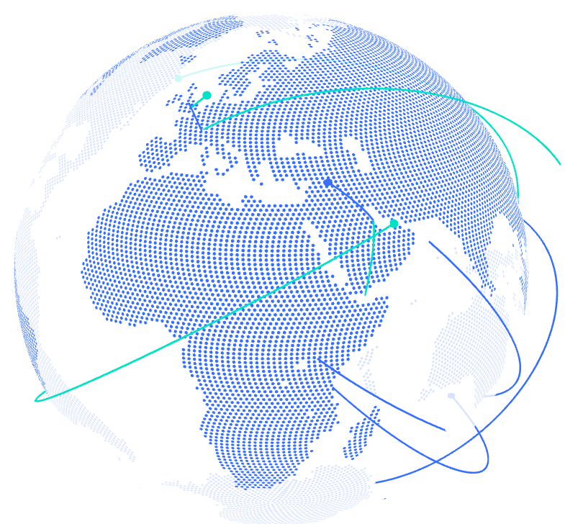
Index
01 Who are we?
02 SCI Data Analysis
03 WEC Data Analysis
04 Forecasting, why?
05 PJM Data Analysis
06 Forecasting models comparison
07 Conclusions

Slide 3
Who are we?
-

Slide 4

01 Who are we?
Mission
Areas of work
The E-IEA works with governments and industry to shape a secure and sustainable energy future for all
Goal of the project
From the cross-analysis 4 datasets:
World Energy Consumption (WEC),
Smart City Indexes (SCI),
Greenhouse Gases Emissions (GHG),
Hurly Energy Consumption (PJM)
Recommending policies that enhance the reliability and sustainability of energy.
Exploring full spectrum issues including renewables and fossil fuels along with forecasting the energy (electricity) demand in the markets;
Trends are identified and converted into insights of business opportunities.

Slide 5
SCI Exploratory Data Analysis

Slide 6
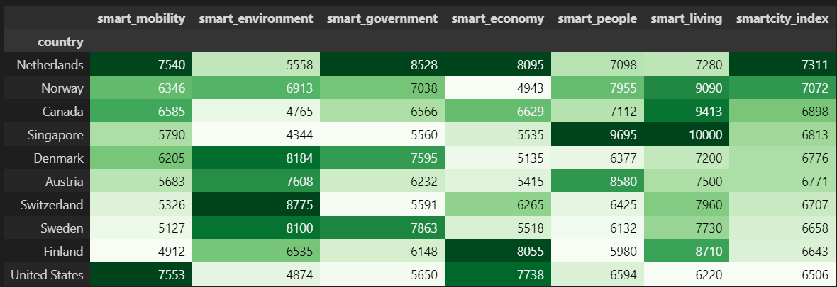
02 SCI Exploratory Data Analysis
The first step it’s always to understand the data. What are the top 10 countries with best SCI?
First of all, a nice definition: “Smart City” describes an urban setting that applies technology to enhance the benefits of urbanization;
The IMD-SUTD Smart City Index (SCI) assesses the perceptions of residents on issues related to structures and technology applications available to them in their city.
Methodology: The SCI is evaluated based on questionnaires over five key areas: Health & Safety, Mobility, Activities, Opportunities for work and school, and Governance which all concurs to define its Index

Slide 7
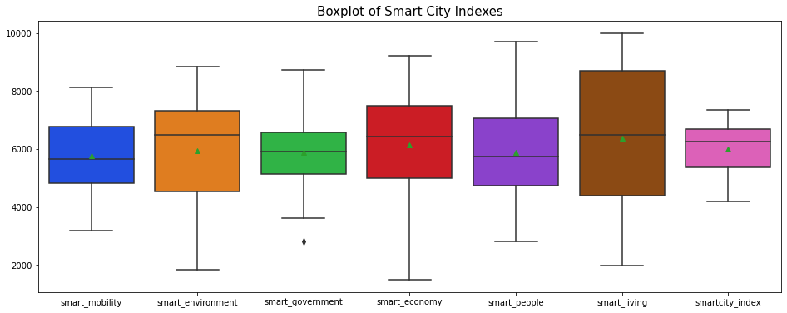
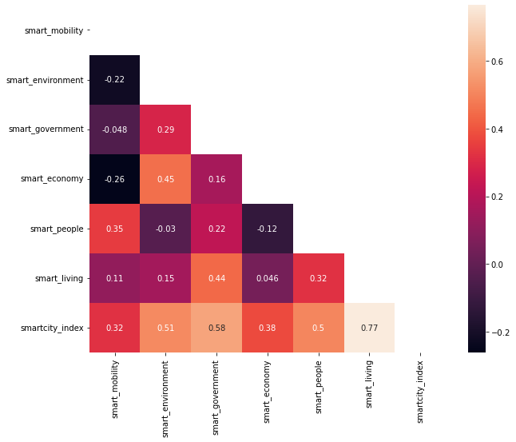
02 SCI Exploratory Data Analysis
How the different indexes behave and which ones give the best contribution?
Insights
Sub-indexes has medium-high correlation between each others.
Although this could be expected due to the fact that quality of life depends on al these factors in an interconnected way, high multicollinearity in the dataset should be further analysed to identify trends: probably the assessment methodology (the questionnaires) should be improved.

Slide 8
WEC Exploratory Data Analysis

Slide 9
03 WEC Exploratory Data Analysis
Understanding the data.
Data on World Energy Consumption provided by Our World in Data:
It is updated regularly with data on energy consumption (primary energy, per capita, and growth rates), energy mix, electricity mix and other relevant metrics.
The dataset can be easily explored if it is categorised into 4 large groups:
Pure energy sources data (Oil, Gas, Nuclear etc.)
Aggregated energy sources data (Renewables, Low-Carbon, etc.)
Per capita energy measures (energy consumption, electricity production;
Identifiers (year, country, population, gross product etc.)

Slide 10
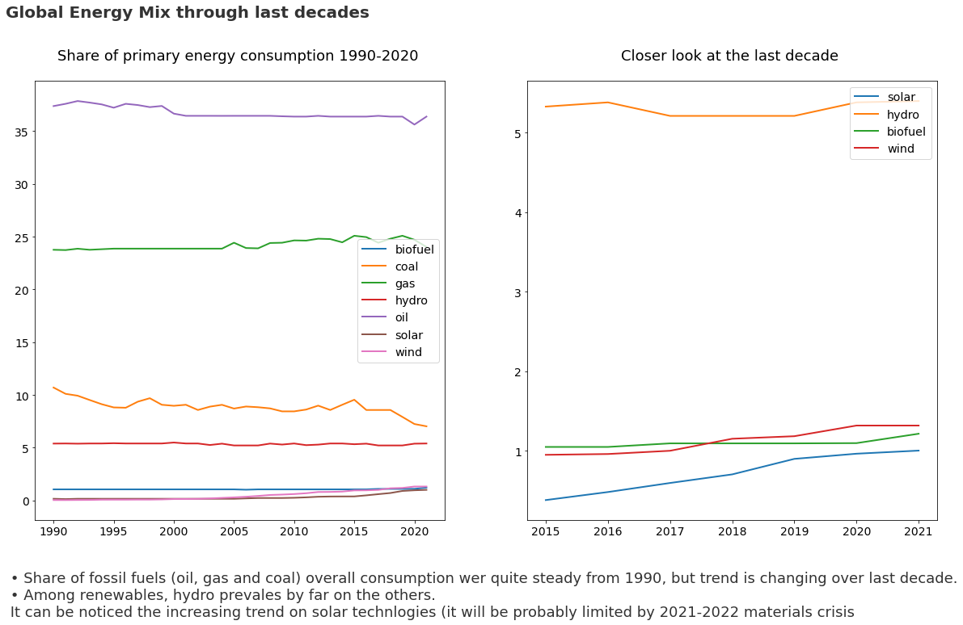
03 WEC Exploratory Data Analysis
Where the world stands now ?

Slide 11
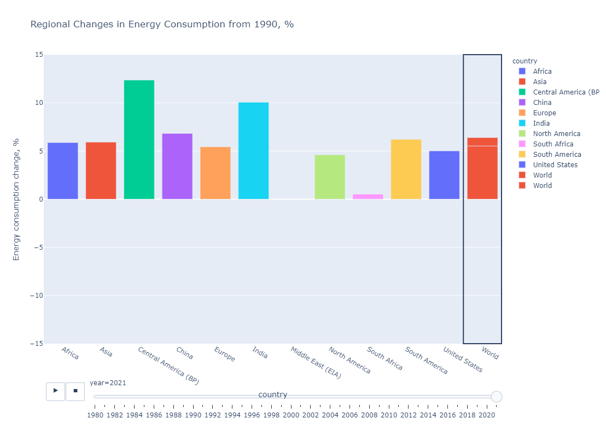
03 WEC Exploratory Data Analysis
Where the world stands now ?
Interact with the plot !

Slide 12
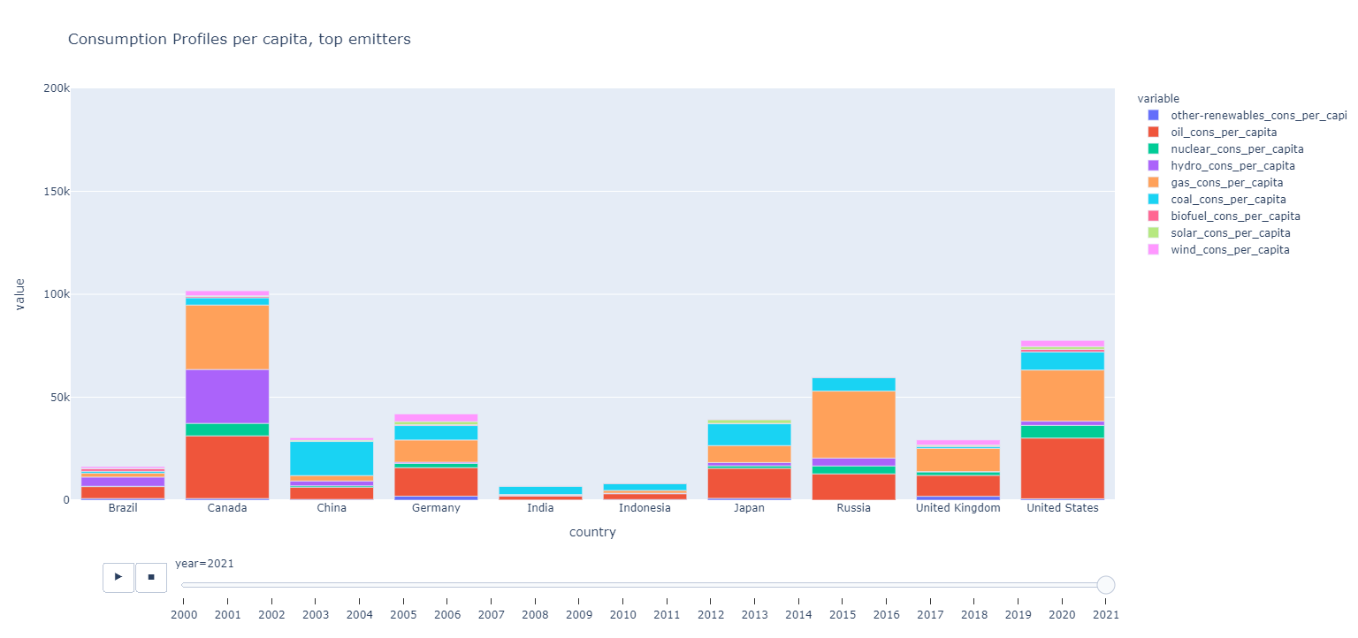
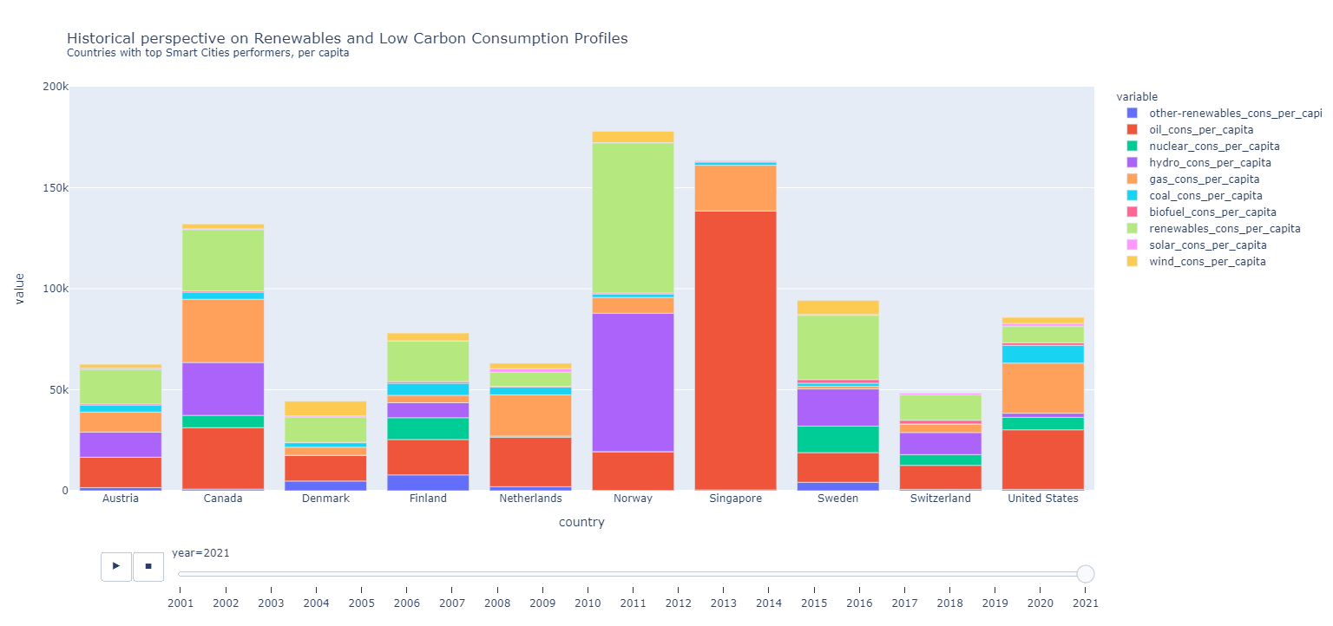
03 WEC & GHG Exploratory Data Analysis
Top 10 GHG emitters vs Top 10 SCI country consumption profiles (per capita)
Interact with the plot !
Interact with the plot !

Slide 13
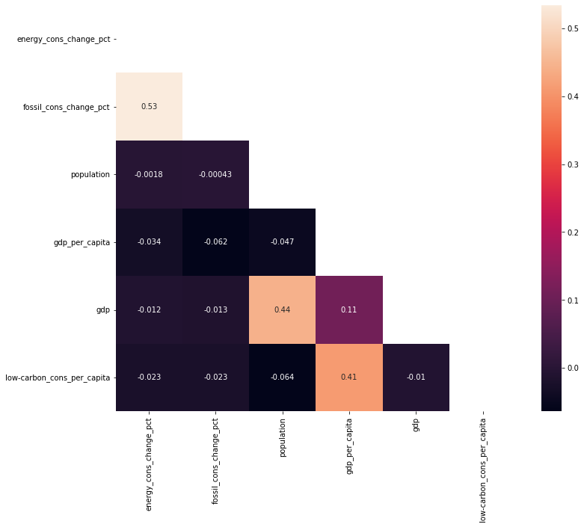
03 WEC & GHG Exploratory Data Analysis
Insights
High correlations between energy consumption increase and fossil energy consumption, meaning again fossil fuels are still an important part of the mix;
High correlation between gdp per capita and the use of low-carbon technologies, richest countries are the ones pushing for innovation.

Slide 14
Energy consumption forecasting

Slide 15

04 Why forecasting?
Market speculation: models help making related critical pricing decisions.
Energy demand forecasting is essential for future Smart Grid operations. (Prosumers optimization)
Plays an important role in the utility companies' decision making for their system planning and operations (Peak Demand).

Slide 16
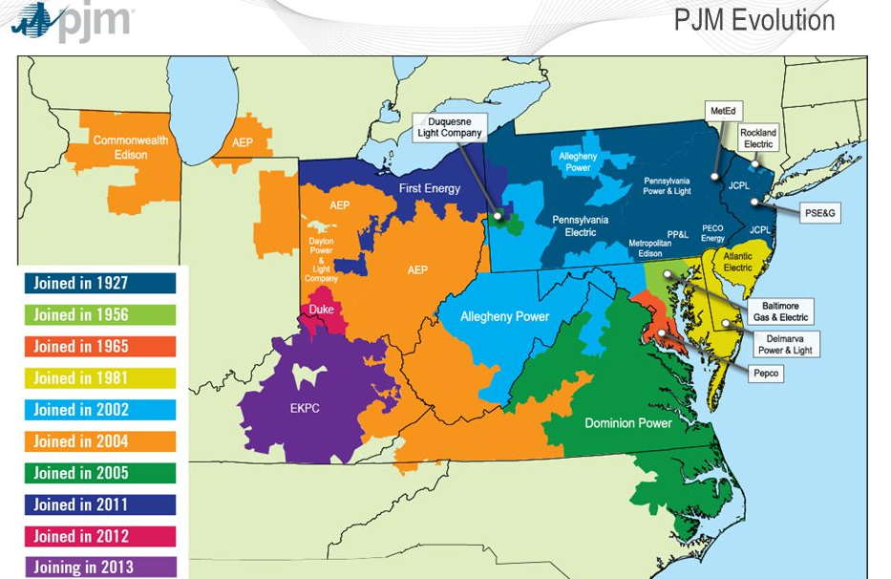
05PJM Data Analysis
Understanding the data.
PJM Interconnection LLC (PJM) is a regional transmission organization (RTO) in the United States.
The hourly power consumption data comes from PJM's website and are in megawatts (MW).

Slide 17
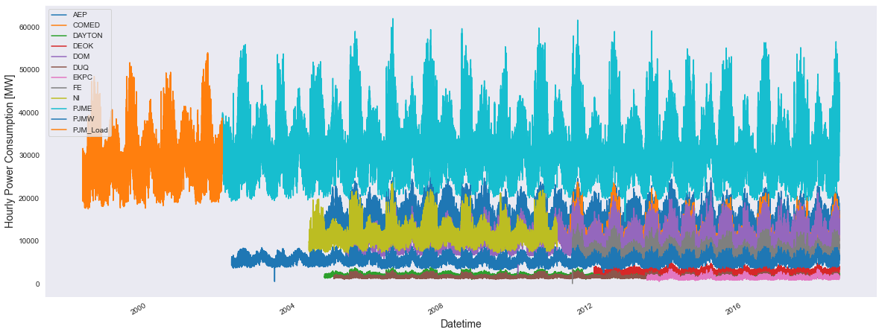
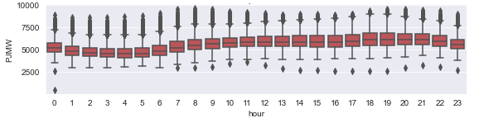
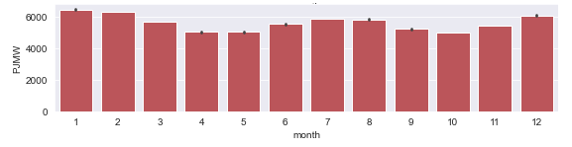
05 PJM Data Analysis
Raw data visualization – Seasonality in the time series

Slide 18
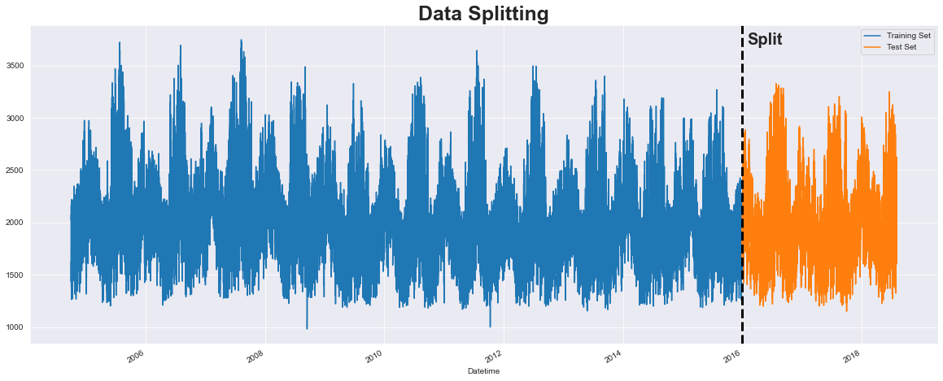
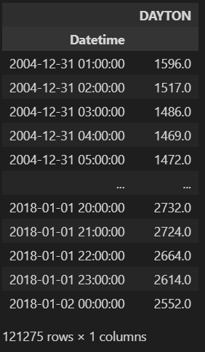
06 Forecasting models comparison
Generating train and test dataset
Mission
The Dayton Area will be chosen for the forecast model because is the area which has less missing data and the entire time span 1998 - 2018.

Slide 19
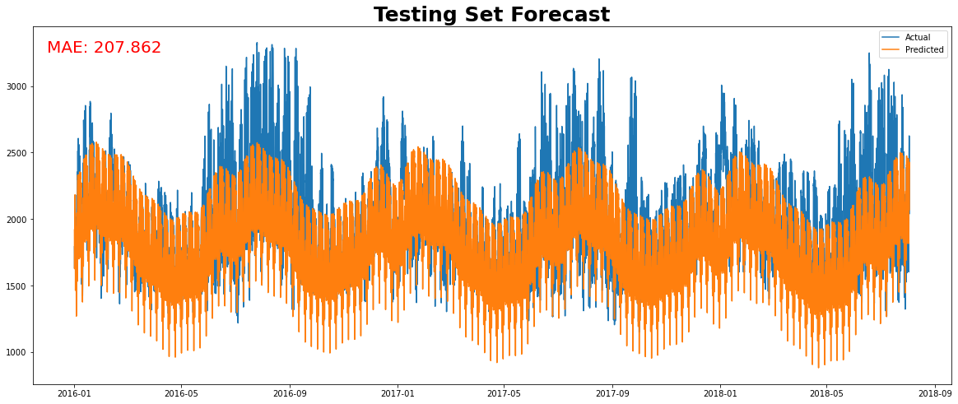
06 Forecasting models comparison
Prophet
Prophet is an open-source library for time series forecasting developed by Facebook.
Time (fitting) ~ 8-9 min

Slide 20
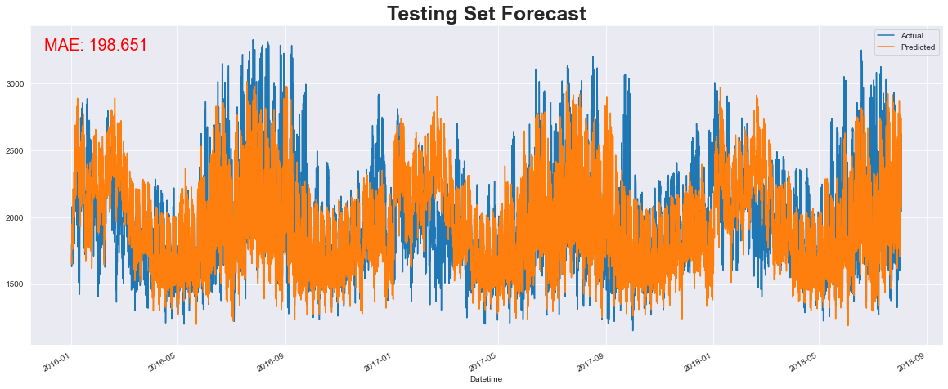
06Forecasting models comparison
XGBoost
XGBoost is short for Extreme Gradient Boosting and is an efficient implementation of the stochastic gradient boosting machine learning algorithm, in other words the “Jack of all trades” in the ML models.
Time (fitting) ~ 30 s

Slide 21
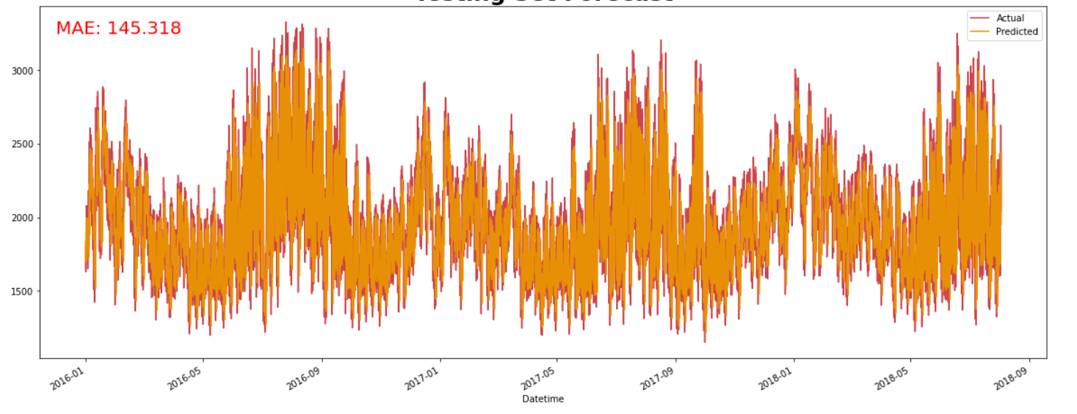
06 Forecasting models comparison
Deep learning -> Sequential model
A Sequential model is appropriate for a plain stack of layers where each layer has exactly one input tensor and one output tensor.
Time (fitting + predicting) ~ 1h

Slide 22
07 Conclusions
Looking at (predicting) the future
Looking at the past
Forecasting is needed for multiple applications and even more if moving towards Smart city / Smart Grids infrastructures
Three models used with following performances:
Fossil fuels (oil, gas and coal) are still the primary energy sources however hydro energy and nuclear are the most popular among renewables/low carbon sources.
Last decade saw a shift to Renewables/Low Carbon energy sources' consumption worldwide and specifically in countries with top performing Smart Cities.
Model | MAE | Time
Prophet | ~ 205 MW | ~ 9 min
Xgboost | ~ 195 MW | ~ 30 s
Deep Learning | ~ 145 MW | ~ 1 h

Slide 23
Thanks!

Slide 24
And to e-iea of course!
-

