Slide 1
Advanced Programming in C++
Library Software using object-oriented programming
Edoardo Lenzi, Patrick Tschuchnig

Slide 2
Delegation
Edoardo
  ORM/ODB, Database functionality, Sqlite3
Patrick
  User Interface, Logic

Slide 3
Functionality
Simple library software including
  User management
    Users can rent books, rents will be attached to a user
  Book management
    Titles, Author, Publisher, Copies available and rented out
  Role management
    Currently unimplemented, but planned for
  Renting functionality

Slide 4
Overview
Used DB: Sqlite3
Object-Related Mapping to provide functionality to other parts of the program (ODB)
ODB generated objects for handling the database connections, Repository pattern
Database Management implemented as Singleton
Command-Line User-Interface
Commands implemented as Factory

Slide 5
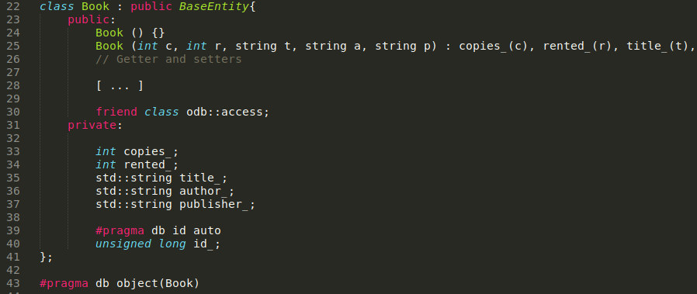
ODB & Sqlite3
Entities:
  Book, User, Role, UserBook
  Provides access to elements of objects

Slide 6
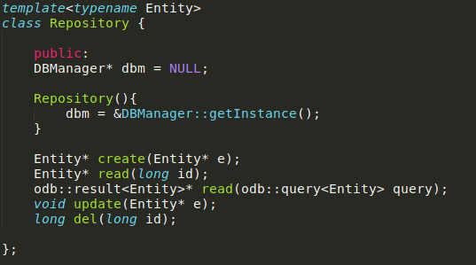
ODB & Sqlite3
Repository to provide functionality of accessing database objects
Reflects command
mechanisms
Create and read
return entities
ID is automatically
assigned by ODB

Slide 7
User Interface
First implementation using ncurses
Later implementation simplified to command line interpreter
Command Structure:
  Four commands: read, create, delete, update
  Multiple Contexts: book, user, role, rent
Command example:
  create book 5 0 Title Author Publisher

Slide 8
Object Oriented Programming
Polymorphism
  Abstract Classes used in the Command Factory (UI.hxx)
Inheritance
  Entities inherit BaseEntity Class (i.e. Book.hxx)
  UICommandXXXX inherits Command class and protected variables (UI.hxx)
Access rights
  Accessor and Mutator methods implemented in any ODB entity as overloaded methods (i.e. Repository.hxx)

Slide 9
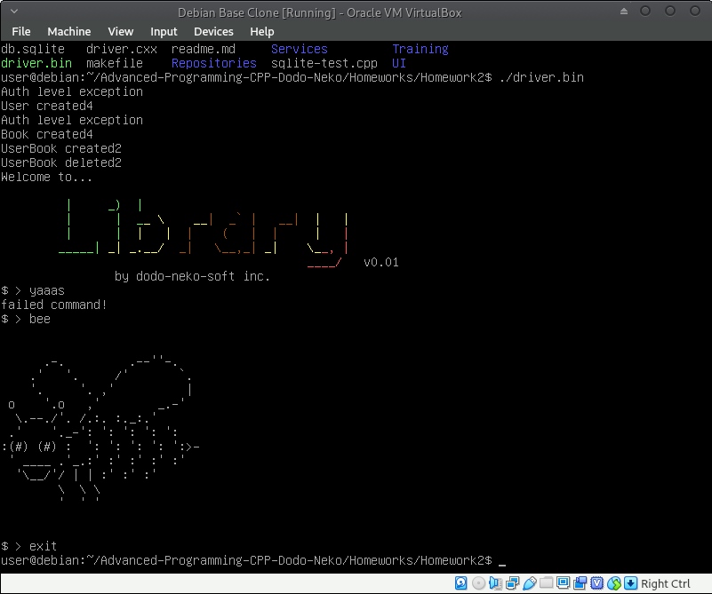
Live Example

Slide 10

Thank
You!

