Slide 1
Advanced Programming in C++
Milestone 1
Edoardo Lenzi, Christian Bauer,
Walter Jensch, Patrick Tschuchnig

Slide 2
Algorithms
Edoardo
  Gaussian Elimination, Dijkstra’s Algorithm
Christian
  Bubblesort, Bucketsort, Insertionsort
Walter
  Sieve of Erathostenes, Quicksort
Patrick
  Matrix Multiplication, Countingsort, Selectionsort

Slide 3
General Implementation Details
All implementations were done with standards
C++11 and C++17
Testsuite with common functions for initialising vectors, matrizes, and testing sorted arrays
  void fill_vector(vector<T> &vec, int from, int to)
  void is_sorted(const vector<T> &vec)
Implemented as a header that is included in the programm (Utils.hpp)

Slide 4
Object Oriented Implementation
The algorithms have been encapsulated as methods of a class contained in a header
The operations are performed on classes that abstract the data (Matrices, Vectors)
  Templates were used for vectors
  Following the encapsulation rules access to the data is restricted via accessor and mutator methods

Slide 5
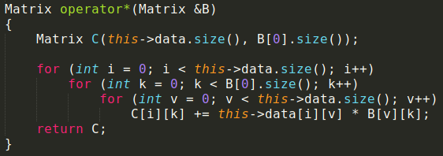
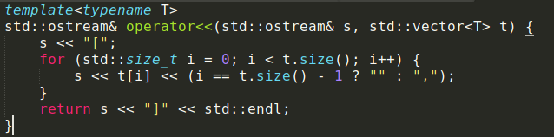
Some specifics...
Overriding operators inside classes for easy access

Slide 6
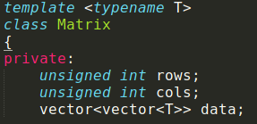
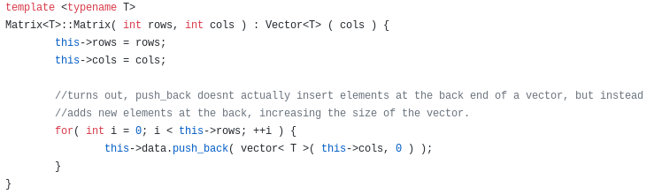
Some specifics...
Use of template syntax to allow type-independent use of vectors and matrices.

Slide 7
Gaussian Elimination
Implementation according to pseudocode from Wikipedia
Fills a Matrix with random values and tries to solve that equation system
The main function gaussianElimination is called once, and has a complexity of O(n³)

Slide 8
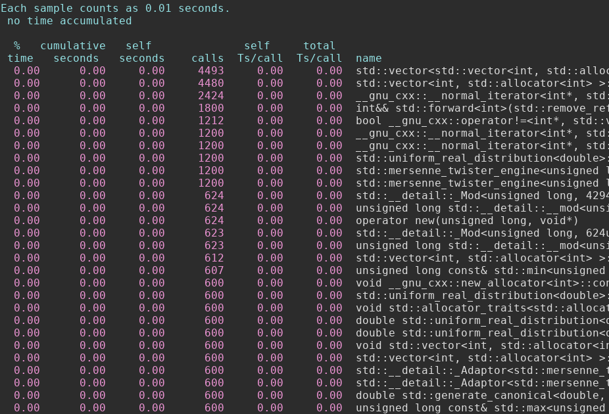
Profiling

Slide 9
Sieve of Erathostenes
Looks at a field of numbers from x to y.
Removes multiples of numbers already looked at (cannot be prime)
The rest will be primes
Main logic in the sieve method of the SieveOfEratosthenes class
Complexity of O(n log log n)

Slide 10
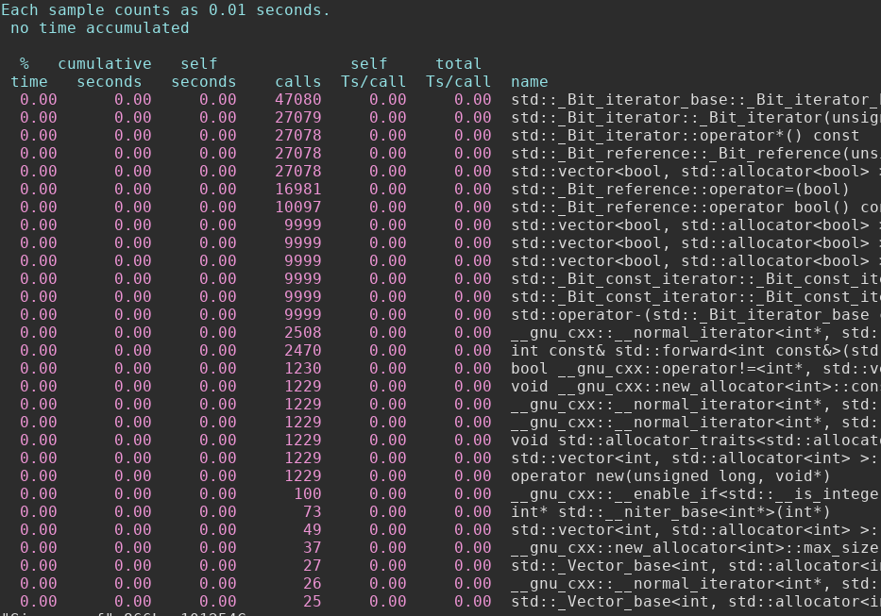

Slide 11
Dijkstra’s Algorithm
Implementation according to pseudocode from Wikipedia
Finds the coverage tree of a graph starting from a certain root given a certain starting point
Main logic in the dijkstra method of the Dijkstra class
Complexity of O(n*m)

Slide 12
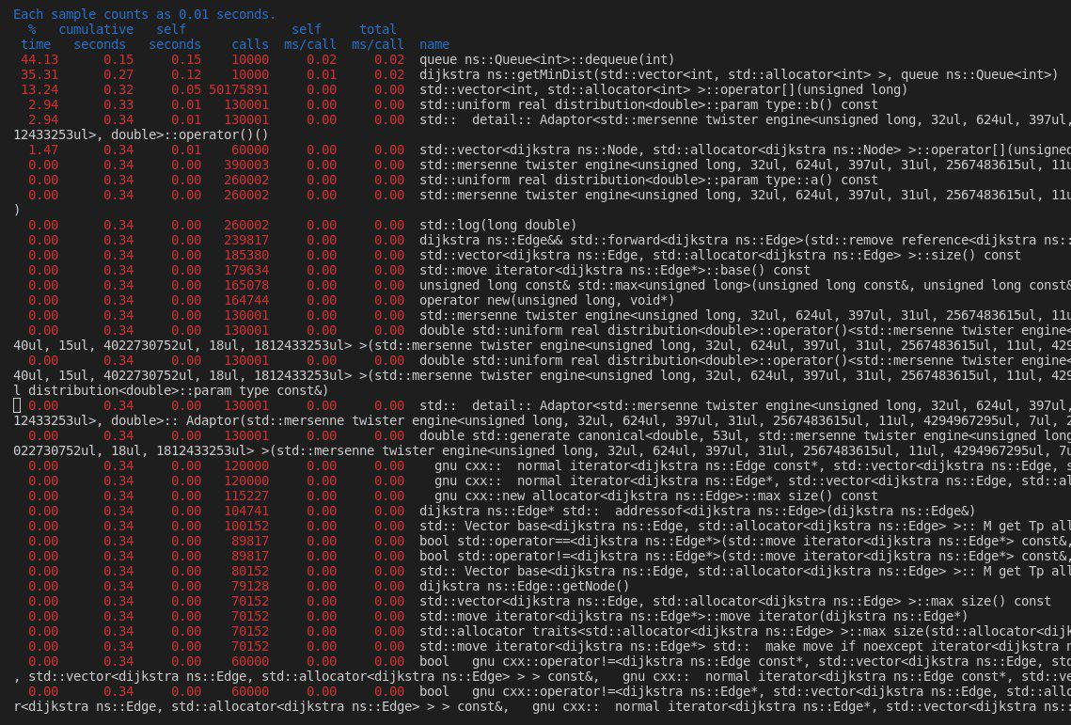

Slide 13
Matrix Multiplication
Standard matrix multiplication implementation
Functionality is implemented in the Matrix class
Overridden * operator method indicates a matrix multiplication
Complexity of O(n³)

Slide 14
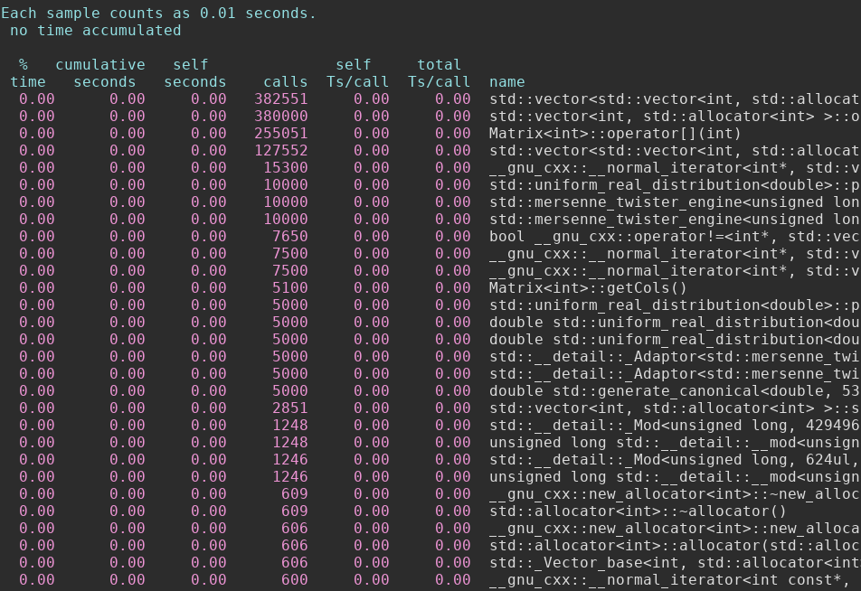

Slide 15
Sorting algorithms
Implementation of the sorting algorithms according to pseudocode from wikipedia
All sorting algorithms have a high problem size
Makes use of the Utils.hpp header for standardised testing
All sorting algorithms sort an instance of vector<T>

Slide 16
Selection Sort
Walks through the whole array of data for every element to find the largest element and swaps them
Slow
Functionality is implemented in a header file that defines a class with a sort() method
Complexity of O(n²)

Slide 17
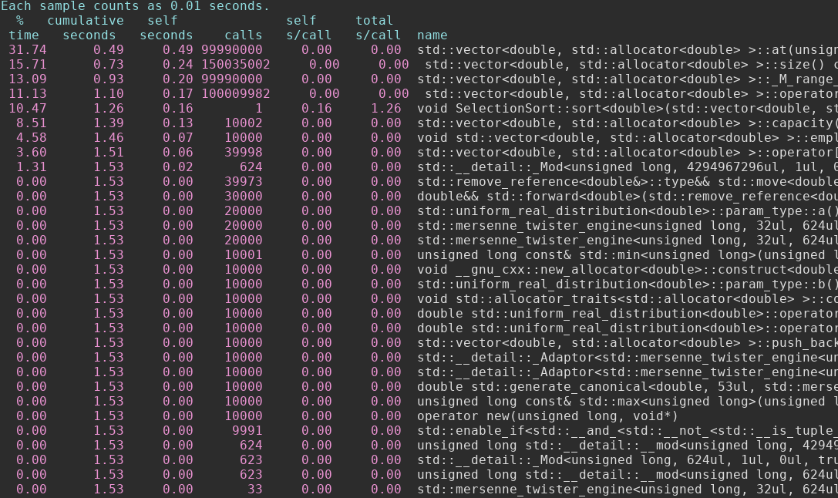

Slide 18
Bubble Sort
Looks through an array with a defined window
Swaps the highest element inside the window to the end
Shifts the window along until the end and repeats the process for the array – 1
Complexity of O(n²)
Functionality is implemented in a header file that defines a class with a sort() method

Slide 19
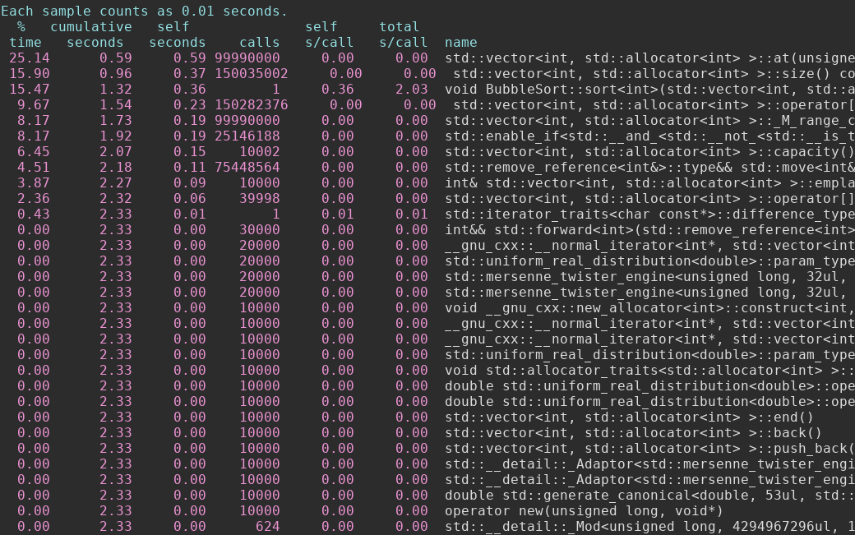

Slide 20
Bucket Sort
Splits the array into smaller arrays
Sorts the smaller arrays by either splitting them to even smaller arrays and repeating, or applying a different sorting algorithm depending on the bucket
Complexity of O(n²)
Functionality is implemented in a header file that defines a class with a sort() method

Slide 21
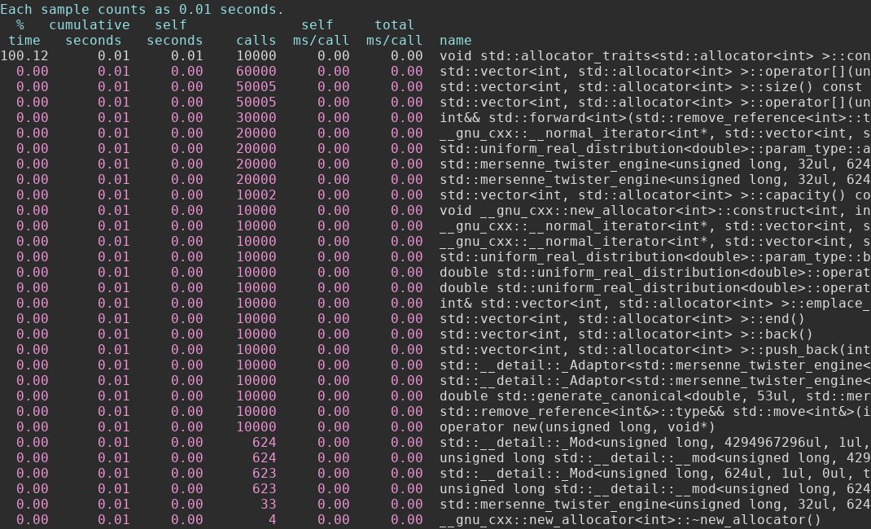

Slide 22
Insertion Sort
Looks through the array from front to back and always shifts the lowest element to the front
Complexity of O(n²)
Functionality is implemented in a header file that defines a class with a sort() method

Slide 23
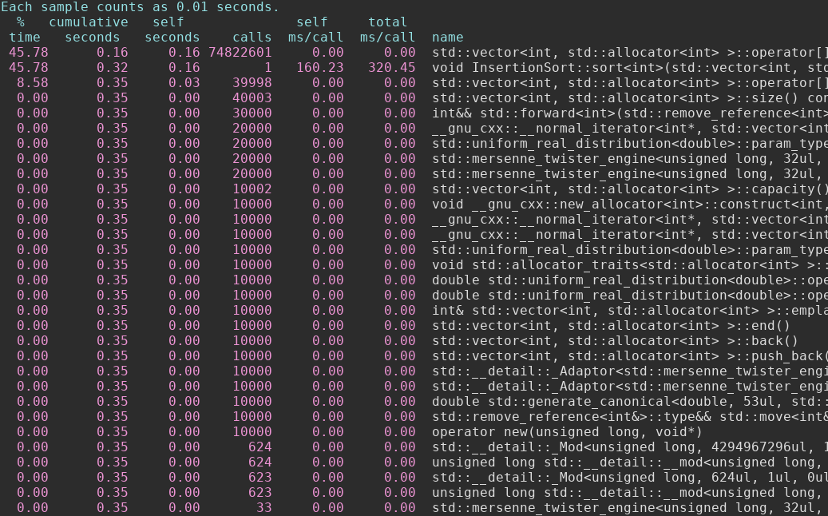

Slide 24
Counting Sort
Creates an array containing how often each unique element is found inside the array (this may be very large)
Creates an output array and then uses the information from the interim array to fill it up
Complexity of O(n log n)
Functionality is implemented in a header file that defines a class with a sort() method

Slide 25
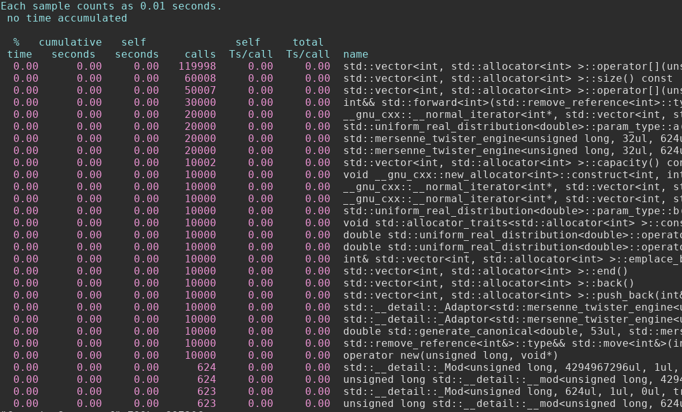

Slide 26
Quick Sort
Splits the array into two smaller sub arrays determined by a randomly chosen pivot element
Sorts those sub arrays individually
Orders the elements around the pivot element
Applies the steps again for each sub array
Complexity of O(n²)
Functionality is implemented in a header file that defines a class with a sort() method

Slide 27
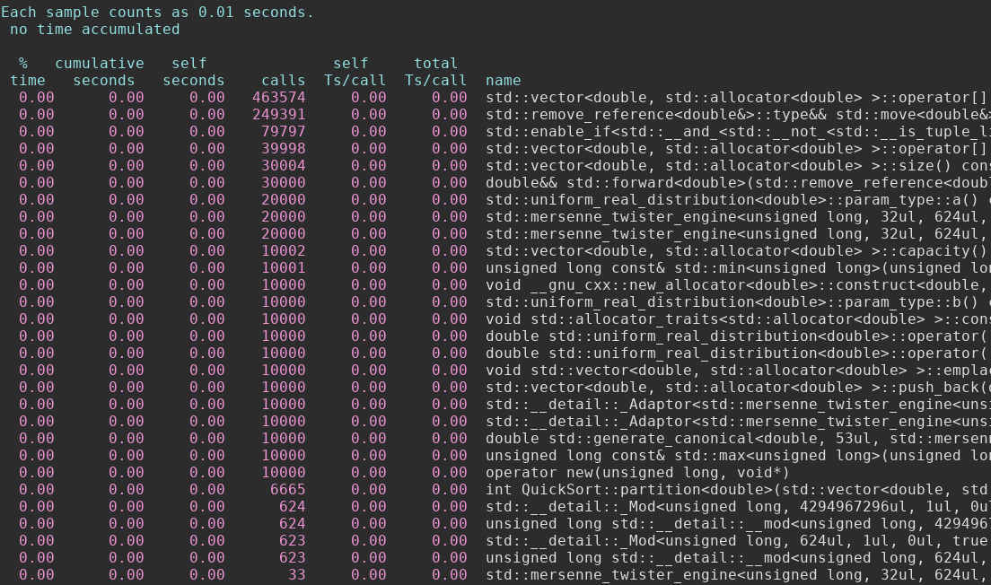

Slide 28

Thank
You!

