Slide 1

Smart Contracts
Security Infrastructures
2nd Seminar
Security and Privacy in Smart Contracts
Presented by Edoardo Lenzi

Slide 2
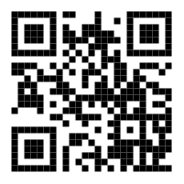
Contents
Slides and code uploaded on GitHub:
github.com/EdoardoLenzi9/Security-Infrastructure-Solidity

Slide 3
Table of Contents
Ethereum
Solidity
3. Vulnerability Taxonomy
4. Debug (Oyente)
Presented by Edoardo Lenzi

Slide 4
1 - Ethereum
Key Concepts
Accounts
Tools:
    MetaMask
Wei conversion
Presented by Edoardo Lenzi 1 / 4

Slide 5
Key Concepts
30 July 2015 - 1st Version of Ethereum
Ether
Smart contracts
Block time of ~15 sec
Test networks
Nodes with full copy of the blockchain
Presented by Edoardo Lenzi 1 / 4

Slide 6
Accounts
Every account has a mnemonic phrase (of 12 words).
“someone prevent chef twin whale cold job barrel item ginger apology bug”
BIP39 menmonic algorithm generates a sequence of accounts from a single mnemonic phrase.
An account has:
                Public key
                Private key
                Address
Presented by Edoardo Lenzi 1 / 4

Slide 7
Accounts
Every account has a mnemonic phrase (of 12 words).
“someone prevent chef twin whale cold job barrel item ginger apology bug”
BIP39 menmonic algorithm generates a sequence of accounts from a single mnemonic phrase.
An account has:
                Public key
                Private key
                Address
Presented by Edoardo Lenzi 1 / 4

Slide 8
Accounts
[ { Account 0
Address: 0xb56fCeB7495…
Public Key: A45DFG4...
Private Key: E34DB7E0… },
{ Account 1
Address: …
Public Key: ...
Private Key: … },
{ Account 2
Address: …
Public Key: ...
Private Key: … },
...
]
Mnemonic phrase
(12 words)
BIP39 algorithm
Presented by Edoardo Lenzi 1 / 4

Slide 9
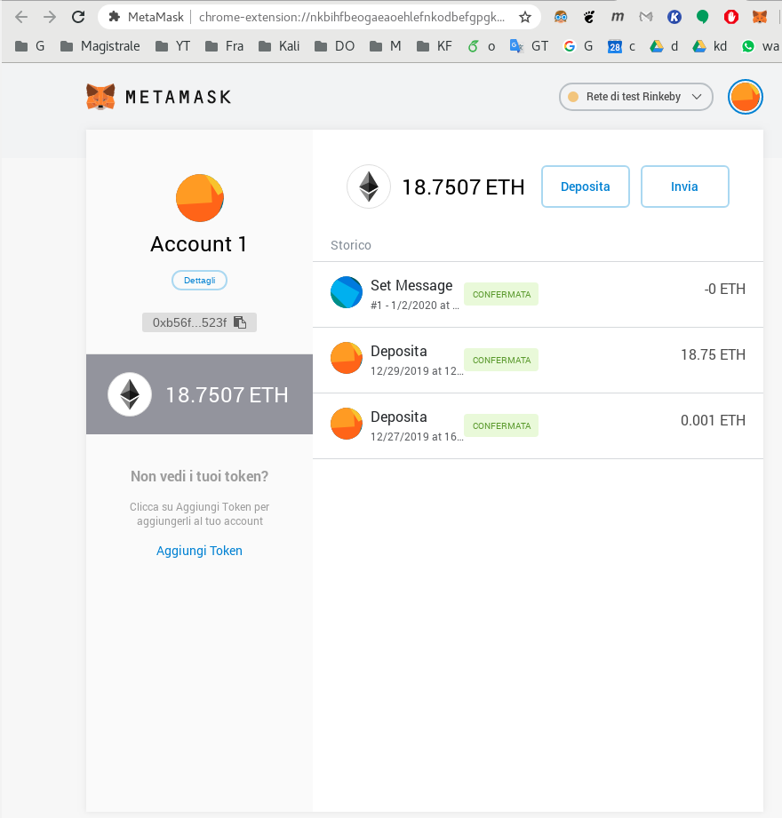
Tools - MetaMask
Presented by Edoardo Lenzi 1 / 4

Slide 10
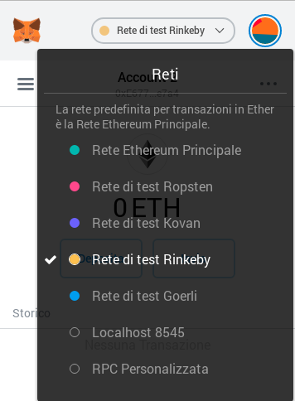
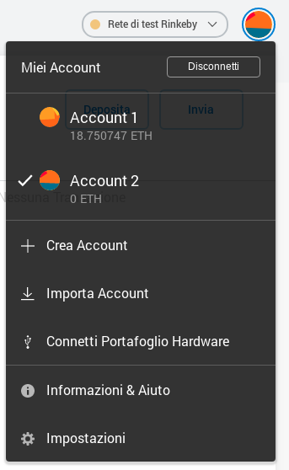
Tools - MetaMask
Presented by Edoardo Lenzi 1 / 4

Slide 11
Tools - MetaMask
A single account is shared
among all the networks
Presented by Edoardo Lenzi 1 / 4

Slide 12
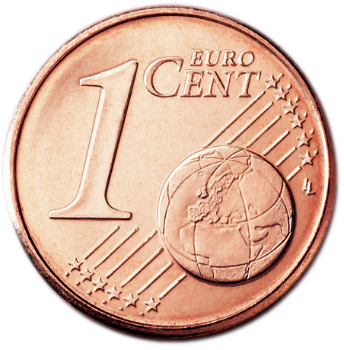
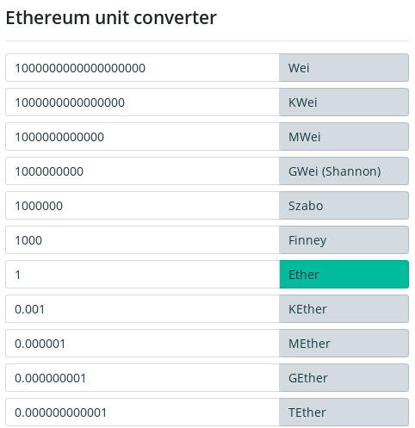
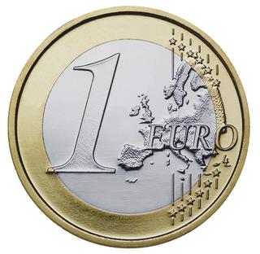
Wei
1 Wei = 10^{-18} Ether
1 Wei is the minimum amount of money (cannot be splitted any more).
Presented by Edoardo Lenzi 1 / 4

Slide 13
2 - Solidity
Tools:
    Remix
    Solc
    Mocha
    Web3
    Providers (Ganache, HDWallet)
Smart Contracts:
    Gas
    Transaction Object
    Functions
        Syntax
        Types
        Storage
        Nature
Presented by Edoardo Lenzi 2 / 4

Slide 14
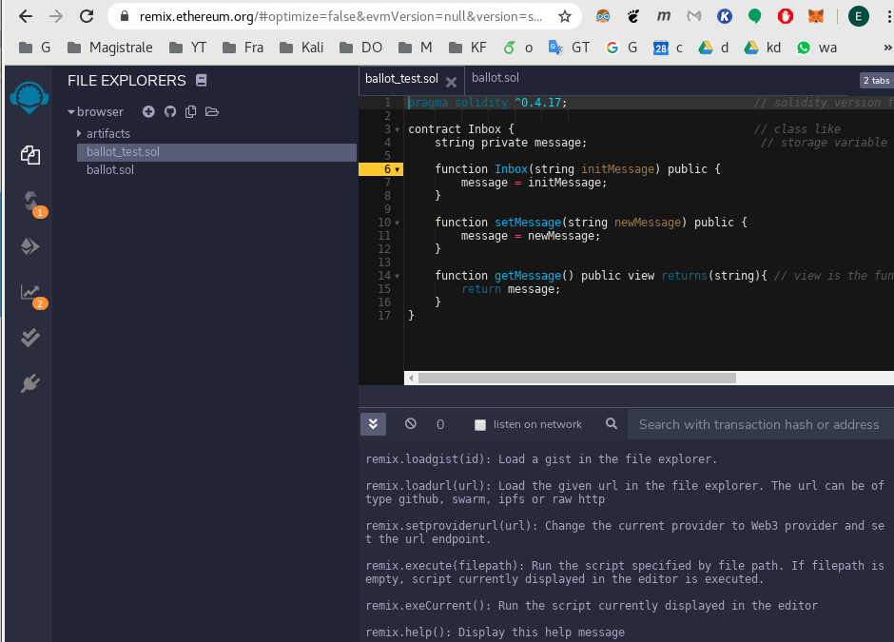
Tools - Remix
Presented by Edoardo Lenzi

Slide 15
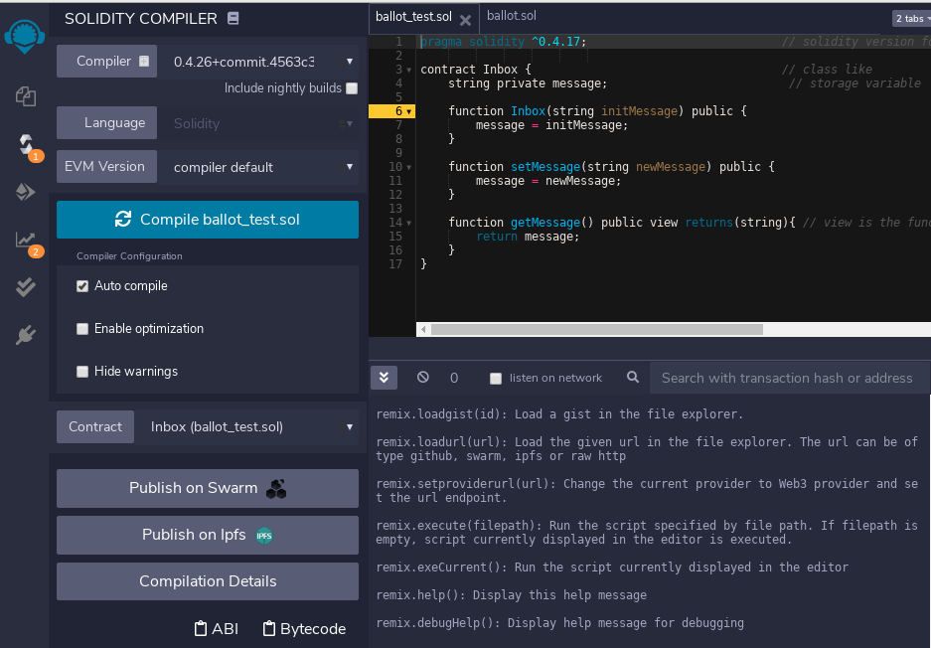
Tools - Remix
Presented by Edoardo Lenzi

Slide 16
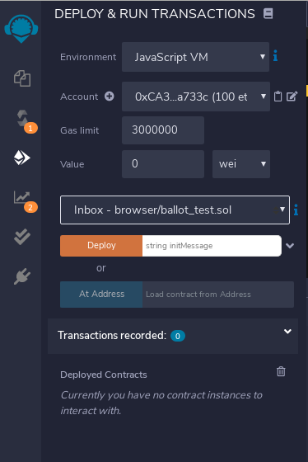
Tools - Remix
Presented by Edoardo Lenzi 2 / 4

Slide 17
Smart Contract
Code (raw machine bytecode)
Balance (amount of eth)
Storage (data persistency)
The source code of a smart contract is written in solidity (.sol file) and compiled with the solidity compiler (solc) into a bytecode executable and an interface (ABI).
Solidity is a strongly typed language similar to JS.
Presented by Edoardo Lenzi 2 / 4

Slide 18
Solc Compiler
bytecode
.sol file
sol compiler
ABI
Presented by Edoardo Lenzi 2 / 4

Slide 19
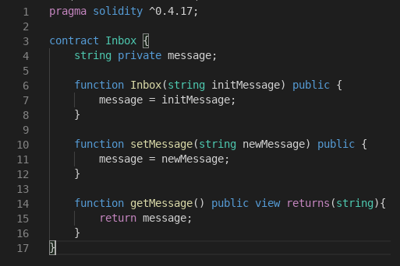
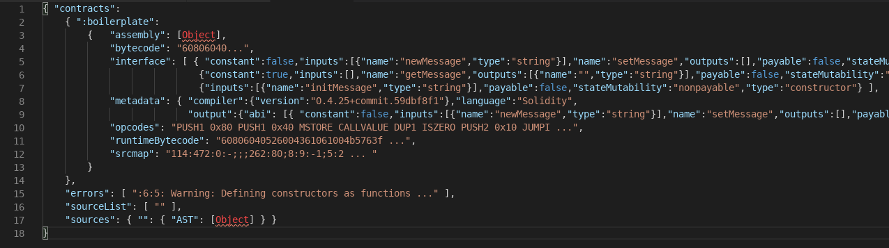
solc compiler

Slide 20
sol compiler

Slide 21
Gas
function doMath(int a, int b){
a + b;
b – a;
a * b;
}
Presented by Edoardo Lenzi 2 / 4

Slide 22
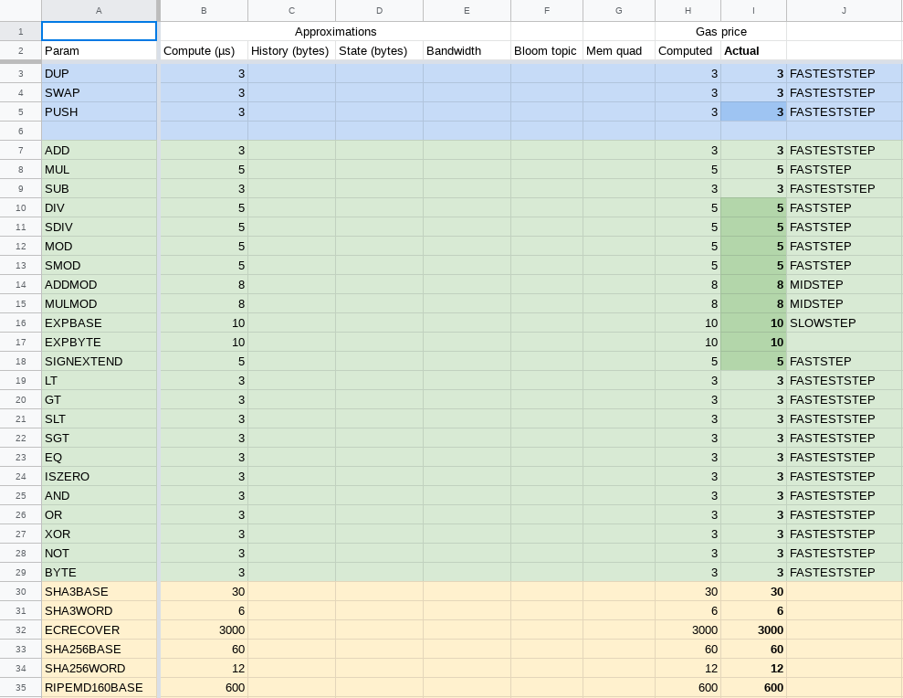
Gas consumption
Presented by Edoardo Lenzi

Slide 23
Gas consumption
Foreach low-level operation there is a correspondent
gas price for the execution.
function doMath(int a, int b){
a + b; // 3 gas
b – a; // 3 gas
a * b; // 5 gas
} // ----------
// 11 gas
Presented by Edoardo Lenzi

Slide 24
Gas consumption
Foreach low-level operation there is a correspondent
gas price for the execution.
function doMath(int a, int b){
a + b; // 3 gas
b – a; // 3 gas
a * b; // 5 gas
} // ----------
// 11 gas
GasPrice is the cost of
a unit of gas in Wei
FunctionCost = GasConsumption * GasPrice
GasConsumption < GasLimit
Presented by Edoardo Lenzi

Slide 25
Gas consumption
Transaction is executed until gas is available, if the gas finish the function throws an exception and transaction is rolled back.
If the gas is enough then the unused gas is returned to the called.
Presented by Edoardo Lenzi 2 / 4

Slide 26
Transaction
nonce: number of transactions sent from a given address
to: target account
value: amount in eth
gasPrice: amount of eth the sender is willing to pay per unit of gas
startGas/gasLimit units of gas that this transaction can consume
v, r, s cryptographic pieces of data that can be used to generate the senders account address.
“v, r, s are generated from the sender's private key to avoid the creation of a fake transaction.”
Presented by Edoardo Lenzi 2 / 4

Slide 27
Functions
Basically there are two “macro-types” of functions:
Idempotent functions (instantaneous, return data)
Non-idempotent functions (alter the contract data/state, needs a transaction and some wei, returns the transaction hash)
Presented by Edoardo Lenzi 2 / 4

Slide 28
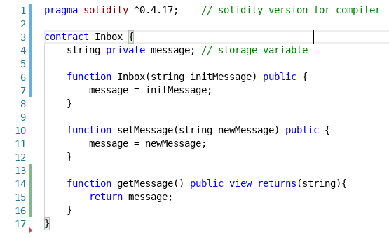
Function Syntax
Function types:
public anyone in the world can call it
private accessible only by the contract
view idempotent function returns data without modifying the state
pure don’t modify or even access the contract data
paybale send money to the contract and call function externally
Presented by Edoardo Lenzi 2 / 4

Slide 29
Function Syntax
Variable storage:
Storage (persistent)
Memory (not persistent)
Presented by Edoardo Lenzi 2 / 4

Slide 30

Function Syntax
Function nature:
Idempontent
Non-idempotent
Non idempotent functions must return the transaction reference (so cannot return any data).
Presented by Edoardo Lenzi 2 / 4

Slide 31
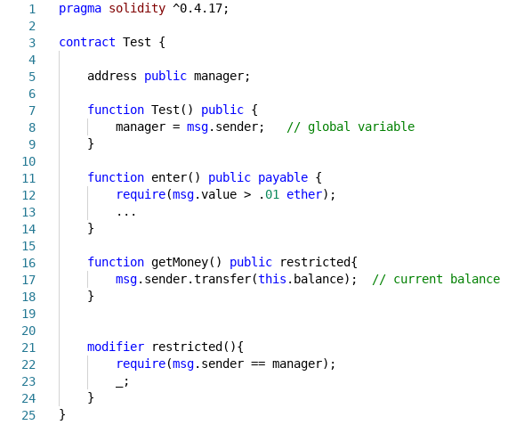
Global variables
Presented by Edoardo Lenzi 2 / 4

Slide 32
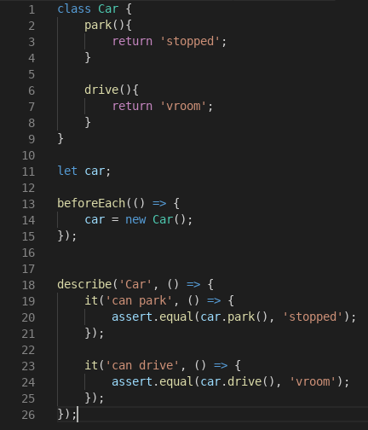
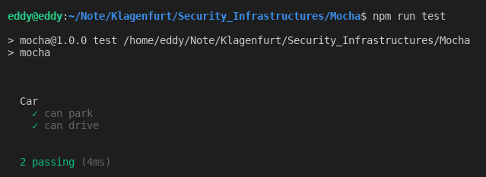
Unit and E2E Tests
Mocha tool
Presented by Edoardo Lenzi 2 / 4

Slide 33
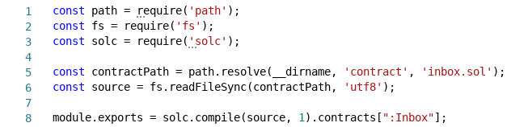
Unit and E2E Tests
Compilation script
Presented by Edoardo Lenzi 2 / 4

Slide 34
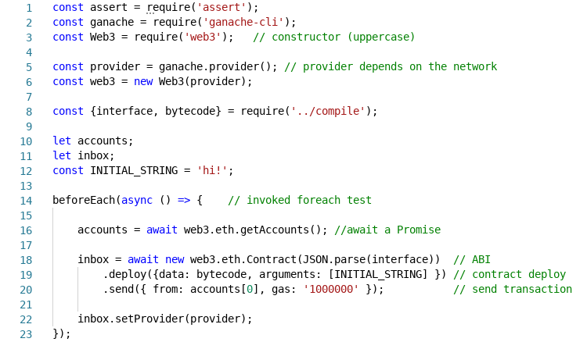
Unit and E2E Tests
Test script (1/2)
Presented by Edoardo Lenzi 2 / 4

Slide 35
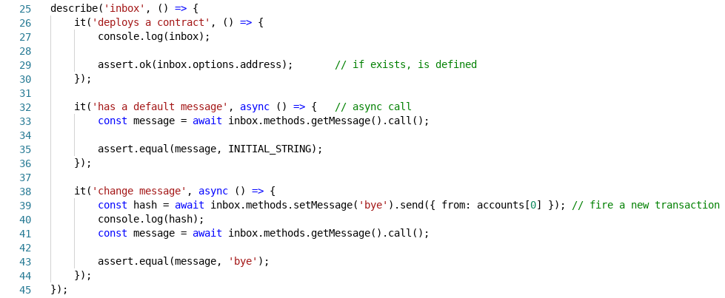
Unit and E2E Tests
Test script (2/2)
Presented by Edoardo Lenzi 2 / 4

Slide 36
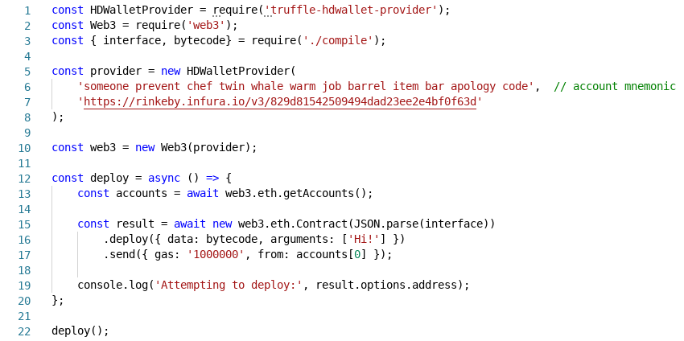
Deploy
Deploy script
Presented by Edoardo Lenzi 2 / 4

Slide 37
3 - Taxonomy
Vulnerabilities
    12 main vulnerabilities
Attacks
    Dao Attack
    King of the Ether Throne
    Multiplayer Games
    Rubixi
    Dynamic libraries
Presented by Edoardo Lenzi 3 / 4

Slide 38
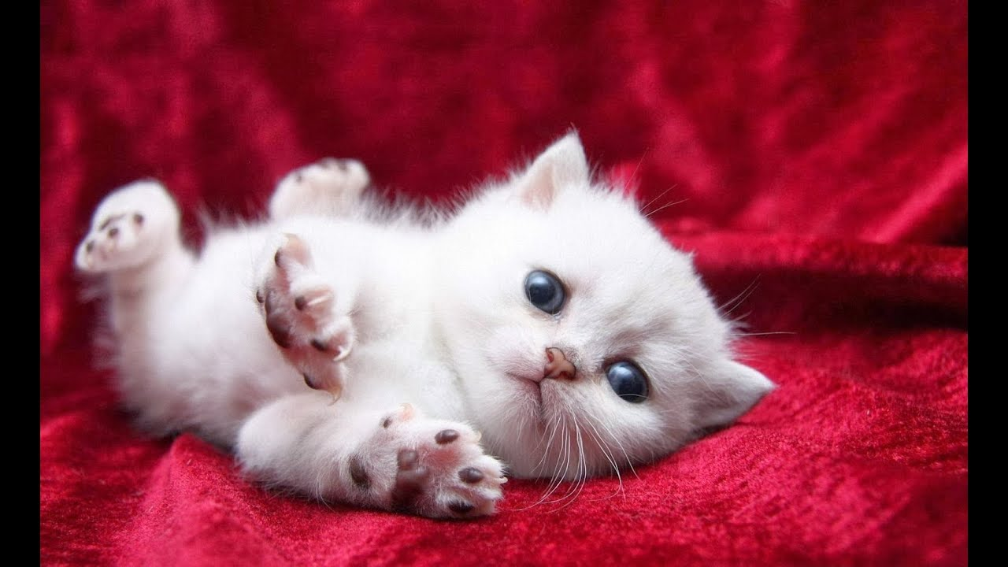
Vulnerabilities
Presented by Edoardo Lenzi 1 / 20

Slide 39
Vulnerabilities
1. Call the unknown
Means that someone calls an non-existing function of a contract triggering the fallback function unexpectedly.
Presented by Edoardo Lenzi 3 / 4

Slide 40
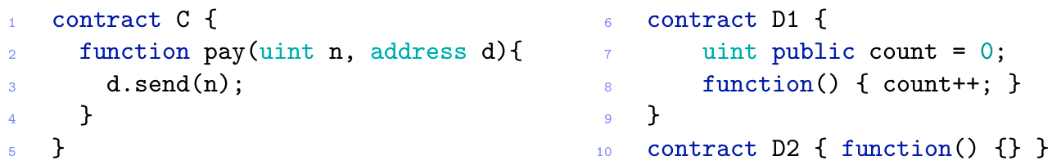
Vulnerabilities
1. Call the unknown
Means that someone calls an non-existing function of a contract triggering the fallback function unexpectedly.
Presented by Edoardo Lenzi 3 / 4

Slide 41
Vulnerabilities
1. Call the unknown
Means that someone calls an non-existing function of a contract triggering the fallback function unexpectedly.
2. Exception disorder
An exception can be unexpectedly raised (outOfGas, callStackLimit, throw command).
Presented by Edoardo Lenzi 3 / 4

Slide 42
Vulnerabilities
1. Call the unknown
Means that someone calls an non-existing function of a contract triggering the fallback function unexpectedly.
2. Exception disorder
An exception can be unexpectedly raised (outOfGas, callStackLimit, throw command).
If you don't check the result of a call, an exception may occur and you will never be aware of that.
Presented by Edoardo Lenzi 3 / 4

Slide 43
Vulnerabilities
1. Call the unknown
Means that someone calls an non-existing function of a contract triggering the fallback function unexpectedly.
2. Exception disorder
An exception can be unexpectedly raised (outOfGas, callStackLimit, throw command).
If you don't check the result of a call, an exception may occur and you will never be aware of that.
28% of contracts do not control the return value of call/send invocations
When an exception is raised the transaction is reverted the caller gets a false return value.
Presented by Edoardo Lenzi 3 / 4

Slide 44
Vulnerabilities
3. Gasless Send
Presented by Edoardo Lenzi 3 / 4

Slide 45
Vulnerabilities
3. Gasless Send
n > 0, d = D1 – Send fail with an out-of-gas exception, because 2300 units of gas are not enough to execute the state-updating D1's fallback.
n > 0, d = D2 - Send succeeds, because 2300 units of gas are enough to execute the empty fallback of D2.
[ n = 0 and d in {D1, D2} – Depends on the compiler version ]
Presented by Edoardo Lenzi 3 / 4

Slide 46
Vulnerabilities
4. Type cast
Compiler takes care of the local types but it doesn't check the interfaces/addresses. Even at run time no exception will be raised
and in case of exceptions the caller can be unaware of the error.
Presented by Edoardo Lenzi 3 / 4

Slide 47
Vulnerabilities
4. Type cast
Compiler takes care of the local types but it doesn't check the interfaces/addresses. Even at run time no exception will be raised
and in case of exceptions the caller can be unaware of the error.
5. Reentrancy (Dao Attack)
The fallback mechanism may allow an attacker to re-enter the caller function multiple times.
In case of exceptions, call doesn't propagate the exception so only the last call will be reverted.
Presented by Edoardo Lenzi 3 / 4

Slide 48
Vulnerabilities
4. Type cast
Compiler takes care of the local types but it doesn't check the interfaces/addresses. Even at run time no exception will be raised
and in case of exceptions the caller can be unaware of the error.
5. Reentrancy (Dao Attack)
The fallback mechanism may allow an attacker to re-enter the caller function multiple times.
In case of exceptions, call doesn't propagate the exception so only the last call will be reverted.
6. Keeping secrets Hawk
private fields aren't directly readable by users/contracts in theory but this doesn't guarantee its secrecy.
Since the blockchain is public everyone can inspect the contents
of the transaction and infer the new value of the field.
Presented by Edoardo Lenzi 3 / 4

Slide 49
Vulnerabilities
7. Immutable Bugs
Once a contract is published on the blockchain it can no longer be altered.
This means that if a contract contains a bug there is no way to patch it.
Presented by Edoardo Lenzi 3 / 4

Slide 50
Vulnerabilities
7. Immutable Bugs
Once a contract is published on the blockchain it can no longer be altered.
This means that if a contract contains a bug there is no way to patch it.
The only exception was the recovery of Dao attack using an hard fork of the blockchain.
“The fork was not agreed by the whole Ethereum community as it contrasted with the “code is law principle”, as a consequence part of the miners refused to fork creating an alternative blockchain.”
Presented by Edoardo Lenzi 3 / 4

Slide 51
Vulnerabilities
8. Ether lost in transfer
If an address is orphan (not associated with any user/contract) the ether sended by mistake is lost forever (there is no way to detect if an address is orphan or not).
Presented by Edoardo Lenzi 3 / 4

Slide 52
Vulnerabilities
8. Ether lost in transfer
If an address is orphan (not associated with any user/contract) the ether sended by mistake is lost forever (there is no way to detect if an address is orphan or not).
9. Stack size limit
Each time a contract invokes another contract the call stack grows by one frame (the maximum size is 1024 frames, any further invocation throws an exception).
Presented by Edoardo Lenzi 3 / 4

Slide 53
Vulnerabilities
8. Ether lost in transfer
If an address is orphan (not associated with any user/contract) the ether sended by mistake is lost forever (there is no way to detect if an address is orphan or not).
9. Stack size limit
Each time a contract invokes another contract the call stack grows by one frame (the maximum size is 1024 frames, any further invocation throws an exception).
If an exception is not properly handled an attacker can try to exploit it!
“After the Dao hard fork the gas price of some EVM instructions changes (in particular for call and delegatecall) and now the maximum reachable depth of the call stack is always less than 1024.”
Presented by Edoardo Lenzi 3 / 4

Slide 54
Vulnerabilities
10. Unpredictable state
The state of a contract is determined by the values of its fields and the balance.
when a user sends a transaction to the network (s)he cannot be sure that the state of the contract remains the same.
Presented by Edoardo Lenzi 3 / 4

Slide 55
Vulnerabilities
10. Unpredictable state
The state of a contract is determined by the values of its fields and the balance.
when a user sends a transaction to the network (s)he cannot be sure that the state of the contract remains the same.
The order of the transactions is managed by the miners
A transaction can be excluded from a block
A fork may occur
Presented by Edoardo Lenzi 3 / 4

Slide 56
Vulnerabilities
10. Unpredictable state
The state of a contract is determined by the values of its fields and the balance.
when a user sends a transaction to the network (s)he cannot be sure that the state of the contract remains the same.
The order of the transactions is managed by the miners
A transaction can be excluded from a block
A fork may occur
11. Time constraints
a time constraint is a condition based on a block timestamp the problem is that
the timestamp control is in the hands of the miners.
Presented by Edoardo Lenzi 3 / 4

Slide 57
Vulnerabilities
12. Generating randomness
EVM bytecode is deterministic, to simulate non-deterministic choices a pseudo-random generator is used.
A common choice for the seed is an hash or a timestamp the problem is that the miners controls transaction timestamps.
Presented by Edoardo Lenzi 3 / 4

Slide 58
Vulnerabilities
12. Generating randomness
EVM bytecode is deterministic, to simulate non-deterministic choices a pseudo-random generator is used.
A common choice for the seed is an hash or a timestamp the problem is that the miners controls transaction timestamps.
An alternative can be a timed commitment protocol where each participant chooses a secret and communicates to the others a digest of it paying a deposit as a guarantee.
At the end the random number is computed combining the secrets;
an attacker can hide his secret but this means loosing the deposit.
Presented by Edoardo Lenzi 3 / 4

Slide 59
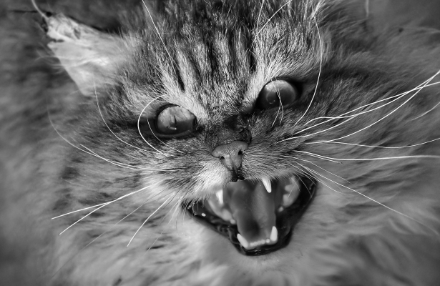
Attacks
Presented by Edoardo Lenzi 1 / 20

Slide 60
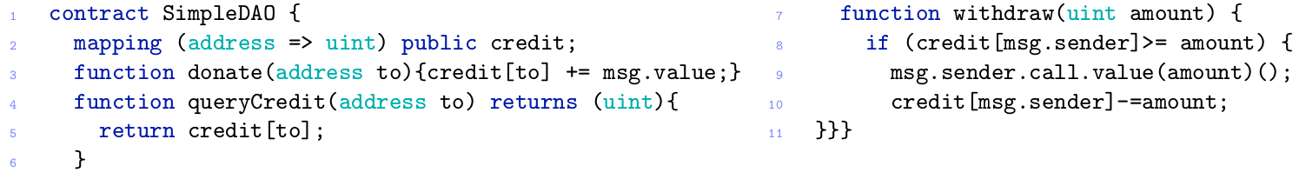
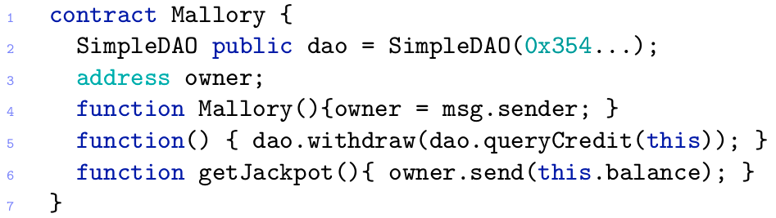
DAO Attack
Presented by Edoardo Lenzi 3 / 4

Slide 61
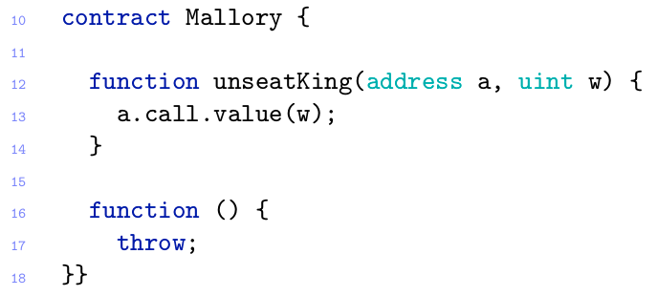
King of the Ether Throne
If u write a fallback function with a throw statement you can stall the game!
Presented by Edoardo Lenzi 3 / 4

Slide 62
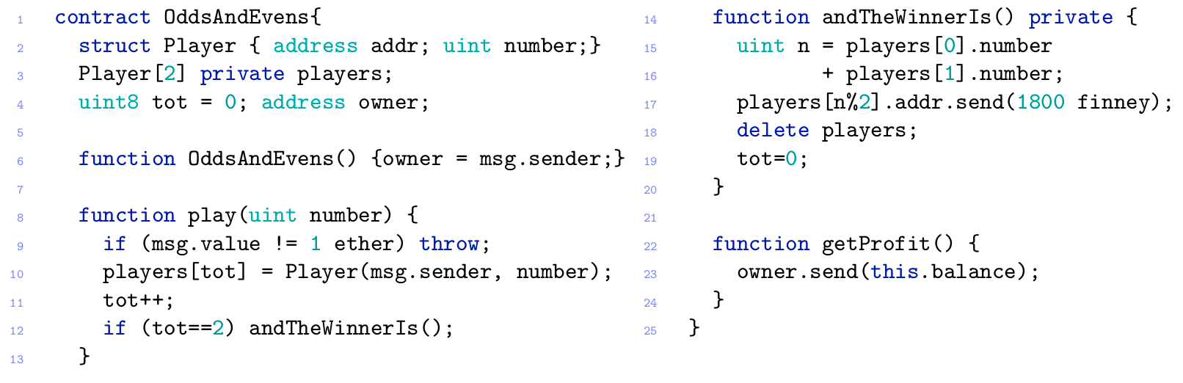
Multi-player games
In a multi-step game the next player can try to infer the value of a private variable.
Presented by Edoardo Lenzi 3 / 4

Slide 63
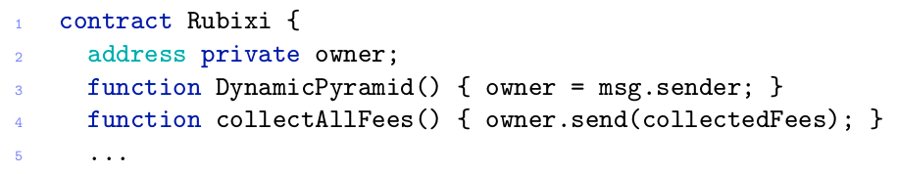
Rubixi
The developer renames the contract but forgets to rename the constructor.
Presented by Edoardo Lenzi 3 / 4

Slide 64
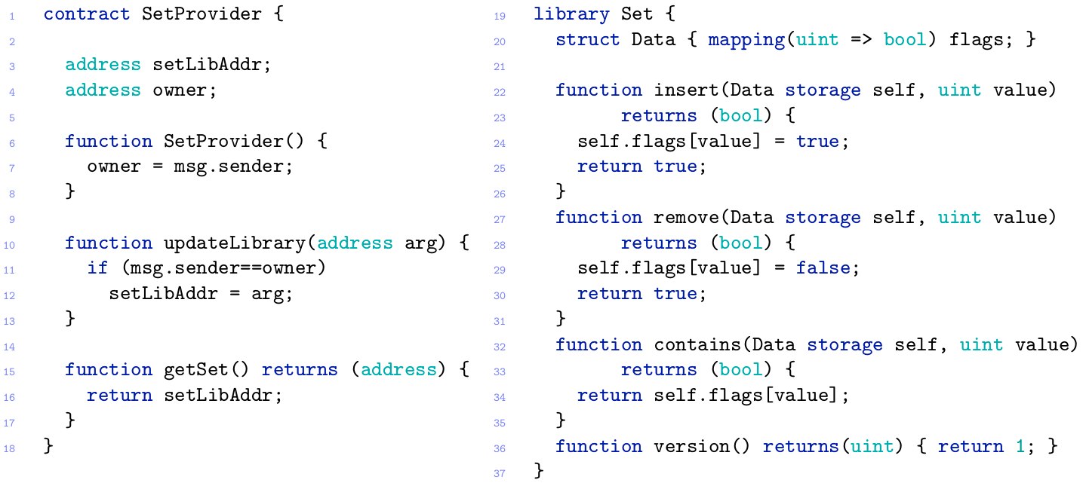
Dynamic Libraries
Dynamic means that the implementation can be replaced at any time.
Presented by Edoardo Lenzi 3 / 4

Slide 65
4 - Debug
Unit tests and E2E tests aren’t enough when you interact with other contracts;
in this case you need some more powerful...
Tool Oyente
Analysis Tool for Smart Contracts
General purpose
Open source
Docker image
Presented by Edoardo Lenzi 4 / 4

Slide 66
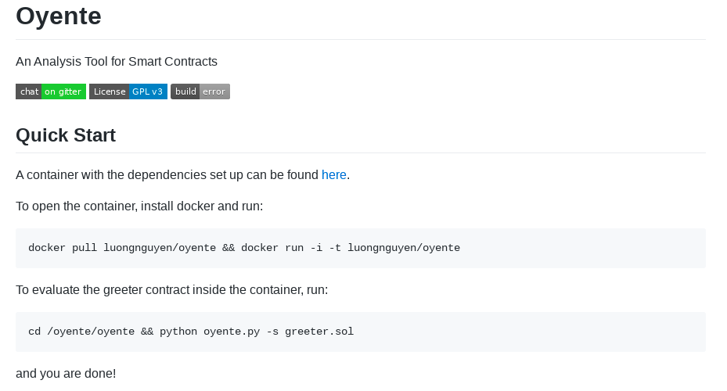
Debug
Unit tests and E2E tests aren’t enough when you interact with other contracts;
in this case you need some more powerful...
Tool Oyente
Analysis Tool for Smart Contracts
General purpose
Open source
Docker image
Presented by Edoardo Lenzi 4 / 4

Slide 67
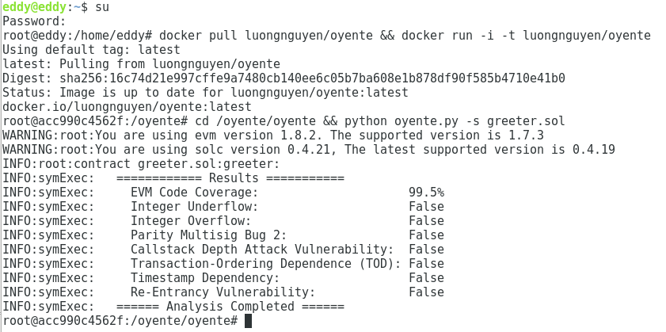
Debug
Presented by Edoardo Lenzi 4 / 4

Slide 68
Thanks for your attention
Sources:
“A survey of attacks on Ethereum smart contracts”
Nicola Atzei, Massimo Bartoletti, and Tiziana Cimoli
University of Cagliari, 2016
"Making Smart Contracts Smarter"
Loi Luu, Duc-Hiep Chu, Hrishi Olickel, Prateek Saxena, Aquinas Hobor
2016
"Blockchains and Smart Contracts for the Internet of Things"
KONSTANTINOS CHRISTIDIS, (Graduate Student Member, IEEE), AND MICHAEL DEVETSIKIOTIS, (Fellow, IEEE)
IEEE 2016
"Hawk: The Blockchain Model of Cryptography and Privacy-Preserving Smart Contracts"
Ahmed Kosba, Andrew Miller, Elaine Shi, Zikai Wen, Charalampos Papamanthou
University of Maryland and Cornell University 2016
“Udemy courses”
https://www.udemy.com/topic/smart-contracts/
Presented by Edoardo Lenzi

Slide 69
Thanks for your attention
Assets credits:
https://www.youtube.com/watch?v=UJ7zfA06E_A
https://yp.scmp.com/blog/98452/13-reasons-why-cats-are-just-plain-evil
https://www.aau.at/
Disclaimer:
The material contained in these text is restricted to students and professors of the course of the Master degree in Computer Science at University of Klagenfurt.
It prohibited any use other than that inherent to the course, and in particular is expressly prohibited its use for any commercial purposes and/or for profit.
Presented by Edoardo Lenzi

