Slide 1
Linux command line and nf-core introduction
Edoardo Piombo

Slide 2
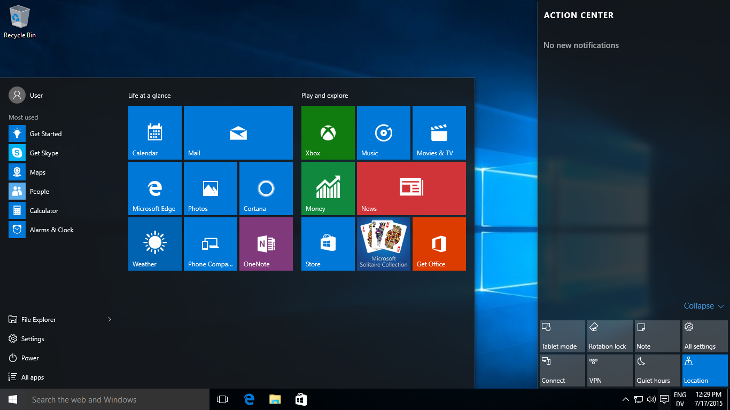
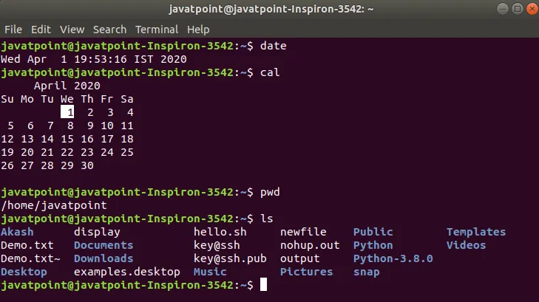
There are different ways of interacting with computers
Graphical user interface (GUI)
Command-line (or text) interface (CLI). Also called shell

Slide 3
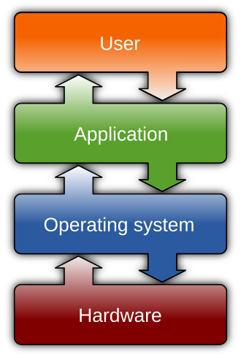
Linux
Operating system (OS)
Microsoft Windows, MacOS, and Linux
Linux – Versatile, open source, free, used on supercomputers.
The most common way to run complex bioinformatic
analyses, on supercomputers or your own pc,
is to use the Bash shell.

Slide 4
What we will do today
Tutorial about the bash shell
Break
Learning about nf-core
Exercise about nf-core

Slide 5
Software carpentry tutorial
Go to this link:
https://swcarpentry.github.io/shell-novice/index.html Follow the instructions, completing these two sections:
1: Introducing the Shell
2: Navigating Files and Directories

Slide 6
What is nf-core?
From their website: A global community effort to collect a curated set of open‑source analysis pipelines built using Nextflow.
When starting a new project requiring bioinformatics analyses, it is not a bad idea to check the nf-core website to see if they have a pipeline prepared to run the analysis of the type of data you have:
https://nf-co.re/

Slide 7
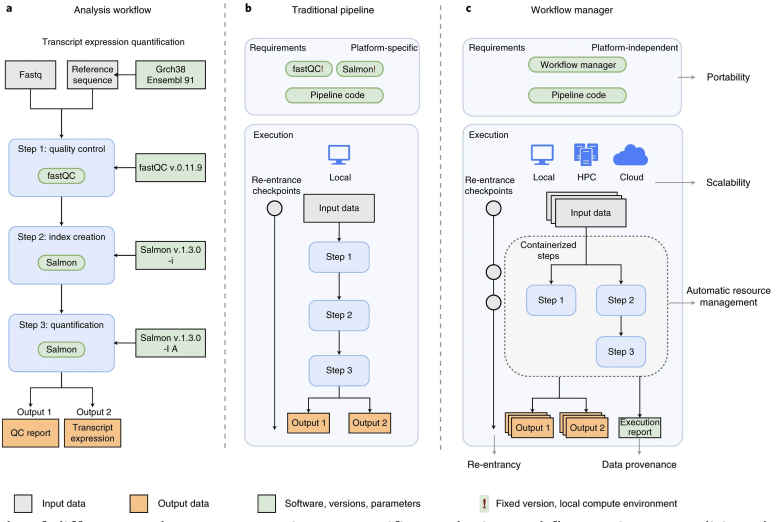
Visually:
Nextflow is the software allowing this
Nf-core is a repository of nextflow pipelines built for different bioinformatics applications
Source:
Wratten, L., Wilm, A. & Göke, J. Reproducible, scalable, and shareable analysis pipelines with bioinformatics workflow managers. Nat Methods 18, 1161–1168 (2021)

Slide 8
Running the rnaseq pipeline
Download my github repository by entering in your shell the following command:
Go to the following link: https://nf-co.re/rnaseq/3.18.0/
Open “launch version 3.18.0” in a new tab
Use the information contained in the Introduction, Usage and Parameters pages to set the mandatory parameters to run the pipeline.
Use “example_sample_sheet.csv” as “input”.
Use “genome_file.fasta” as “fasta”.
Use “genes_coordinates.gff” as “gff”.
Follow the instructions and try to run the pipeline on your laptop using the “-preview” option.
If you feel brave, try to set options to run the pink workflow instead of the default one.

