Slide 1
Requirements Analysis and Specification Document
Piccirillo luca
Zampogna gian luca
Zini edoardo

Slide 2
GOALS
[G1] Allow any kind of user to view the map of the available nearby Cars.
[G2] Allow Visitor user to register to the service.
[G3] Allow Visitor user to log-in and out as a PowerUser.
[G4] Allow PowerUser to check the status of the Car.
[G5] Allow PowerUser to reserve a Car.
[G6] Allow PowerUser to cancel a reservation.
[G7] Allow PowerUser to check the position of the reserved car.
[G8] Allow PowerUser to unlock and enter the Car when inside the specific range.
[G9] Allow PowerUser to get driving directions to his destination.

Slide 3
[G10] Bill the PowerUser for the amount of time spent riding a Car.
[G11] Allow PowerUser to see a list of the closest Special Parking Areas to his destination.
[G12] Allow PowerUser to keep track of the current charged fare.
[G13] Allow PowerUser to check whether he can be eligible for any discount or penalty.
[G14] Allow PowerUser to get a money saving alternative destination.
[G15] Allow the system to lock the Car in a Safe Parking Area at the end of the ride.
[G16] Allow the system to apply penalty or discount according to the given criteria.
[G17] Let the system bill the PowerUser for the total ride fare and issue a payment request for that amount at the end of the ride.

Slide 4
WORLD ASSUMPTIONS
Cars belonging to PowerEnJoy service have a clearly recognizable logo.
Cars are already equipped with onboard infotainment device which is able to provide basic offline navigation services in case of missing Internet connectivity.
All Cars have an interface that is able to provide any kind of data from all sensors available in the car itself.
Availability of the following sensors (or functional equivalents) is assumed: GPS receiver, battery status, core vehicle diagnostic.
Onboard navigation software will not be developed, an existing solution will be integrated.
Predefined Safe Parking Areas are assumed to be under mobile data connectivity service coverage.
Special Parking Areas and exclusive power sockets allocation are pre-determined in such a way that spreading Cars among all the available sockets and filling them all corresponds to the best possible distribution of vehicles.
User’s device used to access the service via mobile app is able to send geolocation data while nearby the reserved Car (i.e. both data connectivity and GPS sensors are functional).

Slide 5
ALLOY
Cars Unlocking [G8]
Assumption: User already booked a car.
Money Saving Options [G14]
Assumption: The closest Special Parking Area is known.
Cars Locking [G15]
Assumption: Car is not moving.

Slide 6
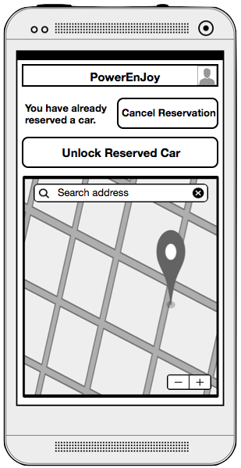
GOAL 8: Allow PowerUser to unlock and enter the Car when inside the specific range.
Requirements
The system must be able to remotely unlock the Car.
The system must be able to compute the distance between the user location and his reserved Car.
The PowerUser must have an input allowing him to send an unlock request.
The system must accept the unlock request issued by the PowerUser if and only if the PowerUser is in the unlock allowance area.
If the unlock request is accepted, the PowerUser must be able to enter the Car.
Domain properties
The PowerUser position is always the same as of its mobile device that runs the PowerUser application.
The PowerUser is considered to be in the unlocking allowance area if the distance to the Car is at most equal to 5 meters.

Slide 7
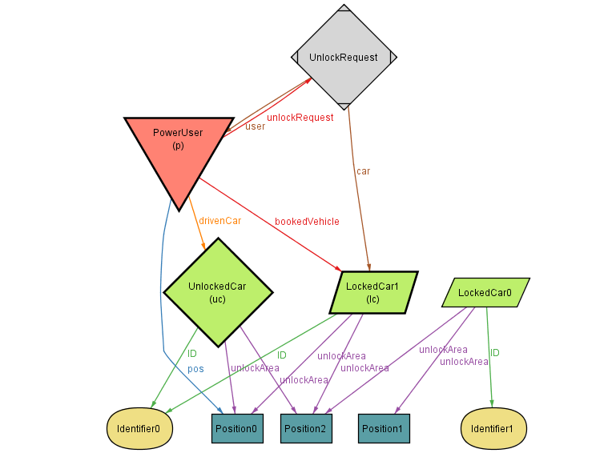

Slide 8
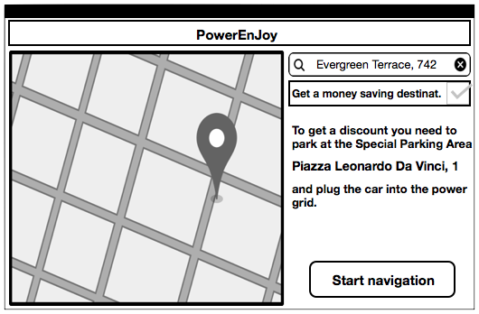
GOAL 14: Allow PowerUser to get a money saving alternative destination.
Requirements
Show the PowerUser the option to get a money saving destination alternative after entering desired destinazione address.
Always show to PowerUser an input to get money saving proposal even ifthere already exists a selected destination.
The destination proposal must correspond to the nearest (w.r.t. PowerUser selected destination) Special Parking Area where there are less than N# Cars attached to the power source.
If the PowerUser accepts the money saving destination proposal, the current selected destination must be updated accordingly.
Domain properties
N# is an integer number defined during setup.
Special Parking Areas provide at least N# power sockets as exclusively available to available to available to PowerEnJoy customers.

Slide 9
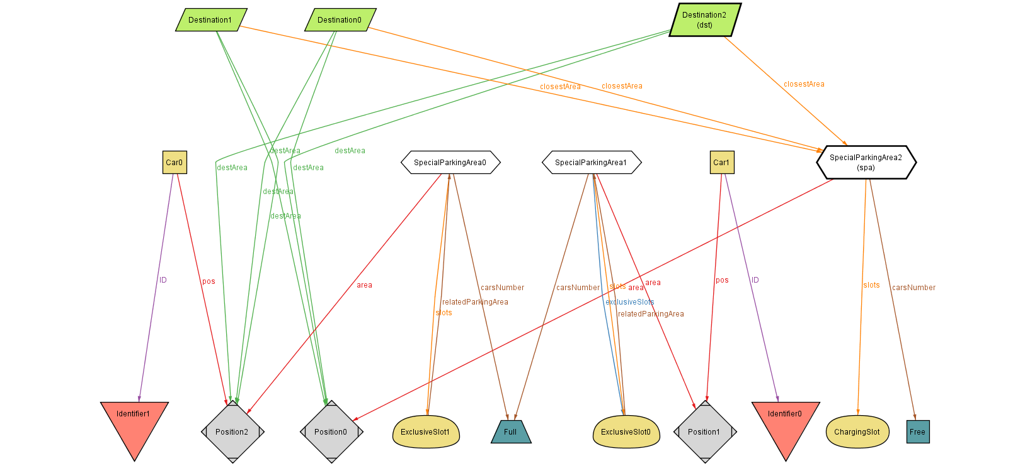

Slide 10
GOAL 15: Allow the system to lock the Car in a Safe Parking Area at the end of the ride.
Requirements
The system must lock the Car if its position belong to the set of Safe Parking Areas, engine is stopped, all doors are closed and S# seconds passed from the last door closure.
Domain properties
S# is a time-span defined during setup.
At least a free parking slot is available for the user among all Safe Parking Areas.

Slide 11
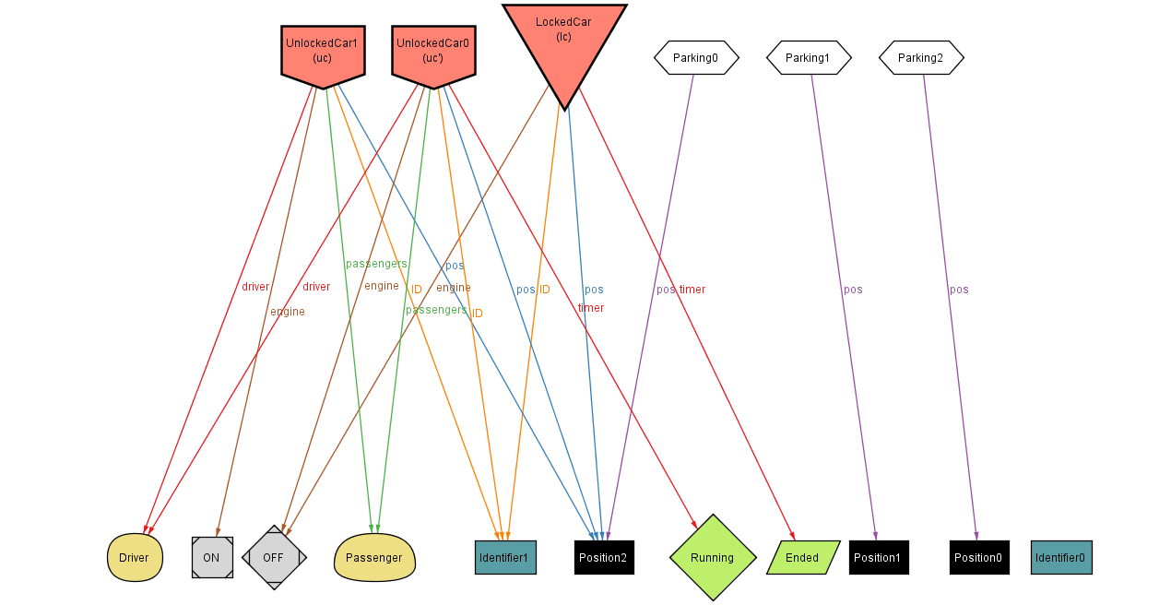

Slide 12
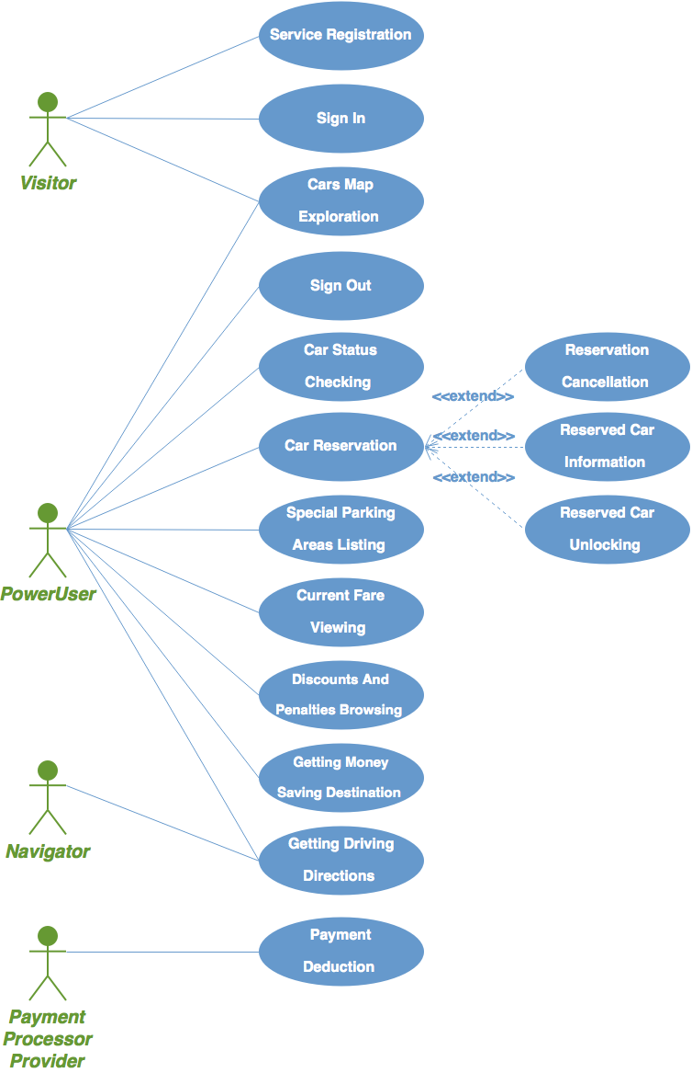
UML – Use Case Diagram

Slide 13
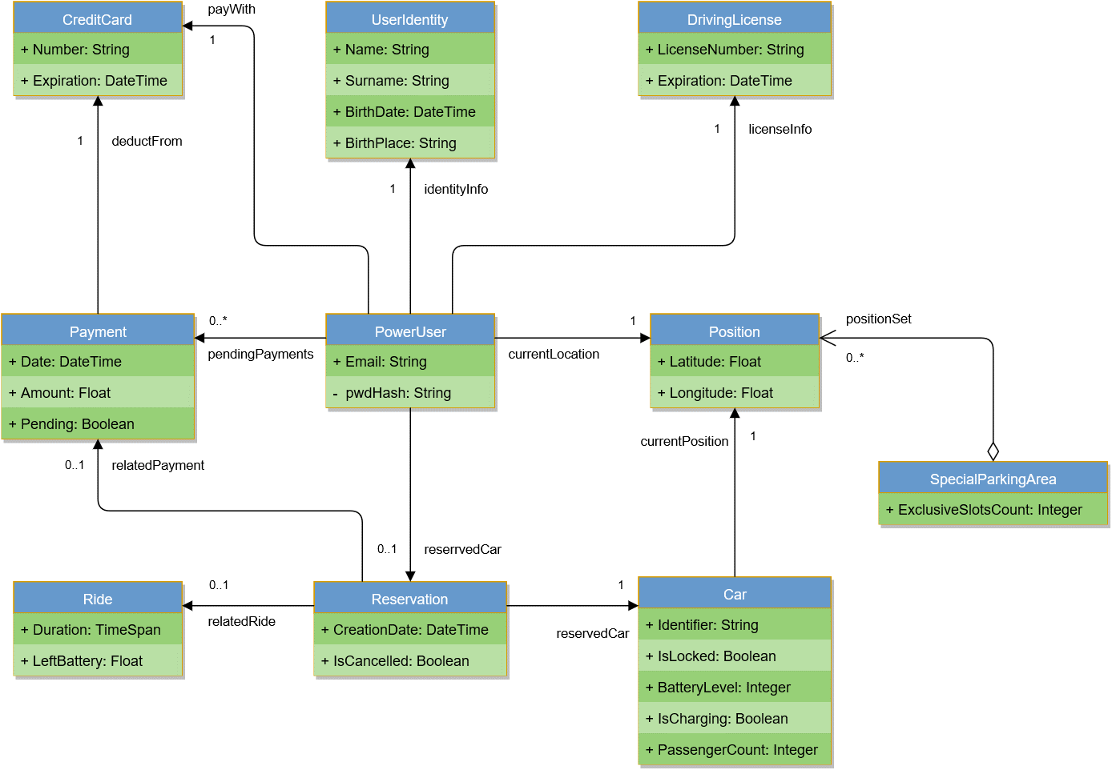
UML – Class Diagram

Slide 14
Thank you for listening!
Questions?

