Slide 1



NAVIGATION
Drawer, Tabs and Sliding Menus (Header && Footer)
PRESENTED BY:
Jacopo Maria Barile
Edoardo Campanella

Slide 2

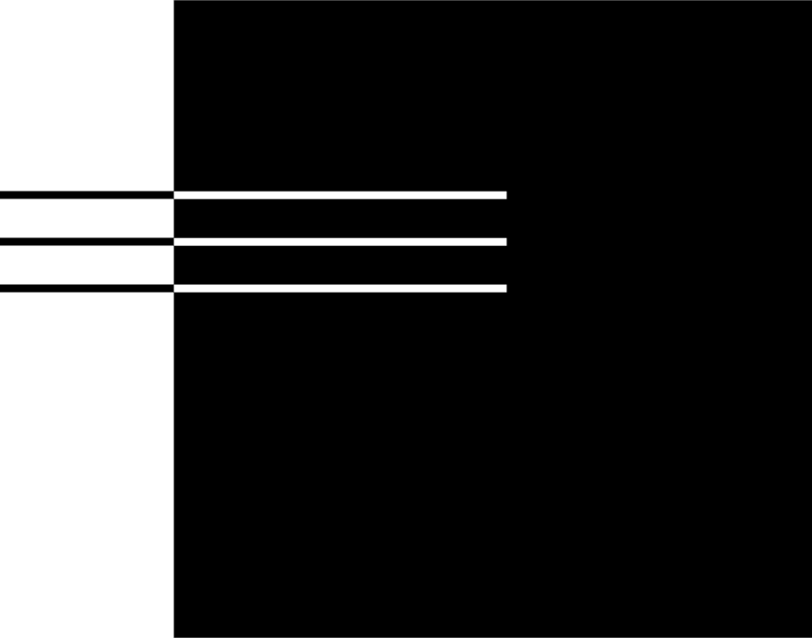
01 | Tabs
02 | Drawers
03 | Sliding Menus (Header && Footer)
04 | Demo Application
05 | Tests - Q&A
06 | Practice Exercises
Agenda

Slide 3

3
Tabs
Organize content into separate sections within the same screen
  Used for navigation within a single screen, allowing users to switch between different content sections.
  Each tab is represented by a Tab composable, which can include text, icons or both.
  Tab contents could be managed with a navHostController to swap entire screen composables based on the selected tab's route.

Slide 4
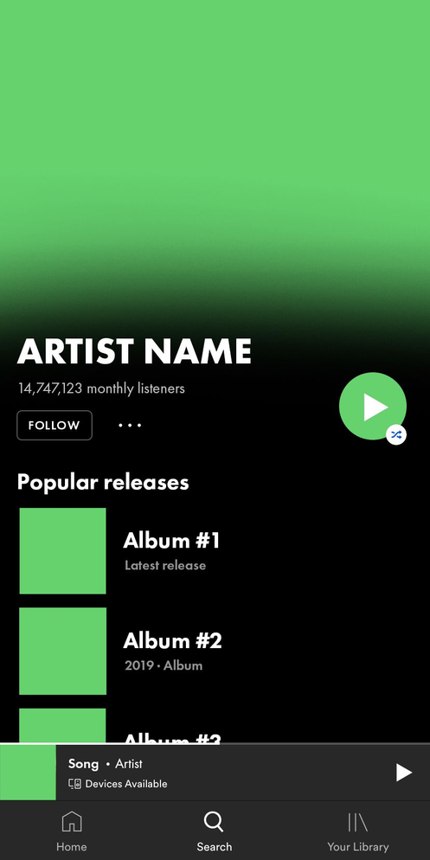
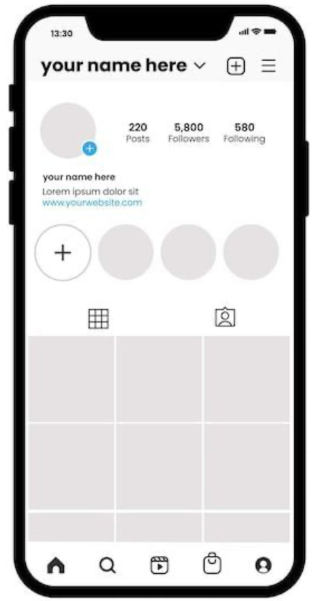
Example
4
Spotify UI Tabs
Instagram UI Tabs

Slide 5
5
Drawers
Sliding panels for navigation and options
  Menu components that allow to navigate inside the app
  Activated by swiping from the side of the screen or by tapping a menu icon
  2 types: Standard Drawers and Modal Drawers
  Several personalization options: scrollable, add icon, add sections, etc

Slide 6
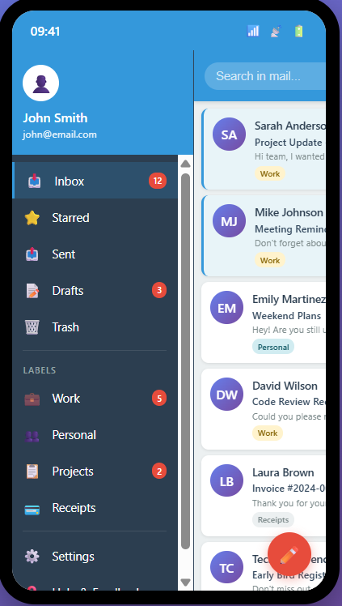
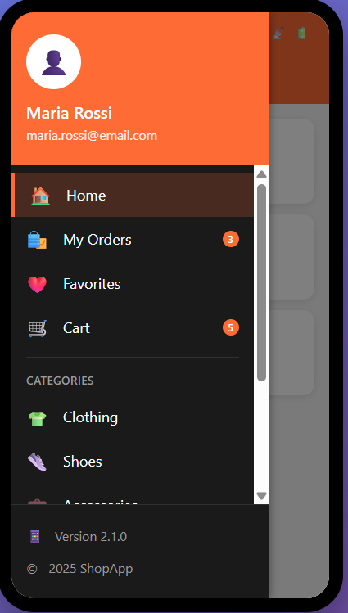
Example
6
Standard Drawer
Modal Drawer

Slide 7
Sliding Menus (Header && Footer)
7
Quick access to top and bottom options
  Header provides page identity and global context (at the top)
  Hosts primary branding, primary navigation and user account access
  Footer provides supporting context and meta-information
(at the bottom)
  Hosts secondary navigation, legal links, policies and support info

Slide 8
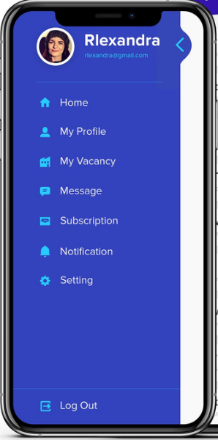
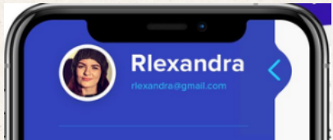
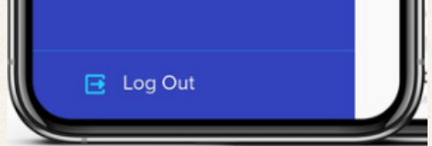
Example
Header
8
Footer

Slide 9
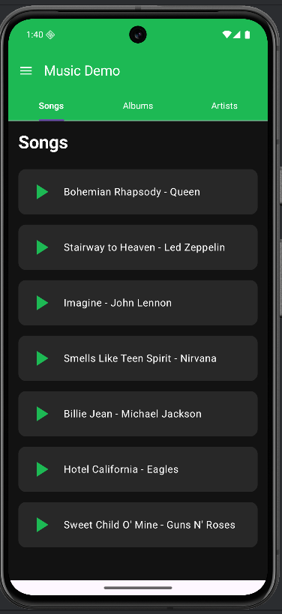
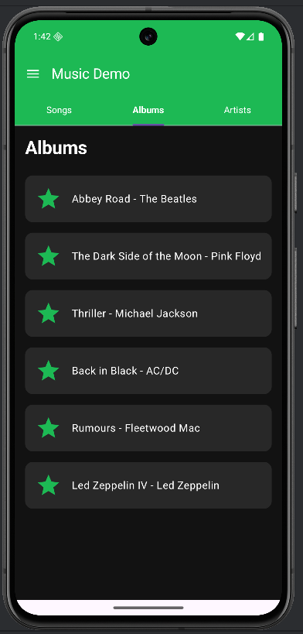
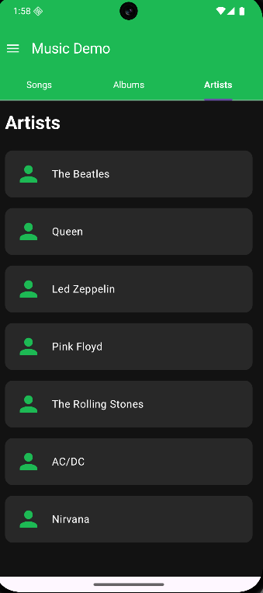
Demo Application-Tabs
9

Slide 10
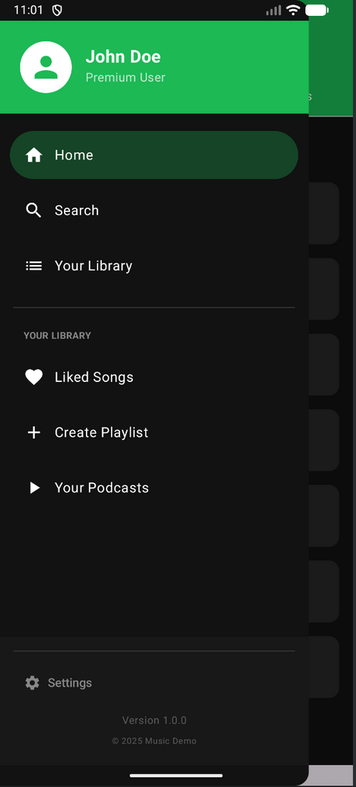

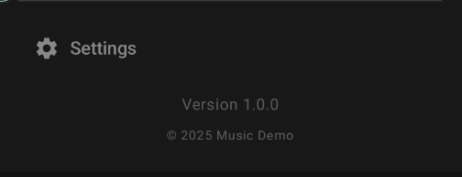
Demo Application-Drawer,Header & Footer
10

Slide 11

Quiz Time - Tabs
11
1. What is the primary purpose of Tabs in a UI?
A) To display ads at the bottom of the screen
B) To organize content into separate, switchable sections on the same screen
C) To open a side navigation panel
D) To show loading indicators
2. Which Jetpack Compose component is commonly used to layout multiple tabs?
A) Column
B) PrimaryTabRow
C) DrawerSheet
D) ScaffoldMask

Slide 12
Quiz Time -Drawer
12
3. A Drawer in Jetpack Compose is mostly used for:
A) Switching keyboard layouts
B) Quick tooltips
C) Navigation to app-wide destinations from a hidden side panel
D) Displaying in-app notifications
4. Which component is used to create a Navigation Drawer in Jetpack Compose?
A) ModalNavigationDrawer
B) DrawerLayout
C) NavigationDrawer
D) Scaffold

Slide 13
Quiz Time - Header & Footer
13
5. What is a Header in UI design?
A) The bottom-most element that contains navigation
B) A visual container displayed before the screen content, often containing titles or actions
C) A panel that slides out from the side
D) A full-screen overlay for alerts
6. Which of the following is a typical use for a Footer in an app?
A) Displaying a loading spinner
B) Showing persistent navigation or legal information
C) Showing user profile pictures
D) Displaying a SnackBar

Slide 14


14
Practice Exercise
  Go to Github link repository (link)
  Complete TODO comments to solve exercises:
Exercise 1: Add Tab "Playlists"
Goal: Repeat the used pattern to learn concepts in practice
Exercise 2: Add Bottom Navigation Bar
Goal: Create a new composable and coordinate multiple UI components

Slide 15
Thank you
for your attention

