Slide 1
App Description File Version 3.0
Twitch
Submission Date | 06/09/2016
App Ver. | 1.0.0 beta
App Developer. | PatrickRorth, Edocsyl

Slide 2
Table of Contents
1. Basic Information
2. Page Description (Guideline)
3. Main Page Description
4. Sub Page Description
5. AD Information
6. Detailed Log-in Information

Slide 3
1. Basic Information
App Title | Twitch
Category | Entertainment
Video Resolution | 1080p
Application Type | Web App
Service Area | The World
Supported Language | English
Sound | BGM Yes, Sound Effects No
Geo-IP Blocking | No
Contents Size | ex) 20 MB
Application URL address (Web Apps Only) | https://s3-eu-west-1.amazonaws.com/twitchtv-lgapp/index.html
AD Type (AD Serving Apps based on LG AD Platform Only) | No Ads
View Title (For webOS TV App Only) | Twitch
App Secondary Description (For webOS TV App Only) | If your app has App Secondary Description at Launcher, please write it down.
Detailed App. Information. | This is an app to watch stream from twitch.tv on an LG Smart TV. This is a third-party application.
Notes 1. Correct and detailed Basic Information required for App QA. 2. Detailed scenario of button or menu’s function required for App QA. 3. Game Apps: If there is sound, detailed description of BGM / Sound Effects, etc. required. 4. Game Apps: Detailed description of “How to Play” required. 5. If you indicate Geo-IP Blocking as “Yes” you must white list the range of IPs required by the QA Team for testing. Please request the range of IPs to white list through the Seller Lounge 1:1 Inquiry. <For webOS TV App> 1.View Title : If your app has View Title at Home UI, write it at this document. 2. App Secondary Description : If your app has App Secondary Description at Launcher, write it at this document.

Slide 4
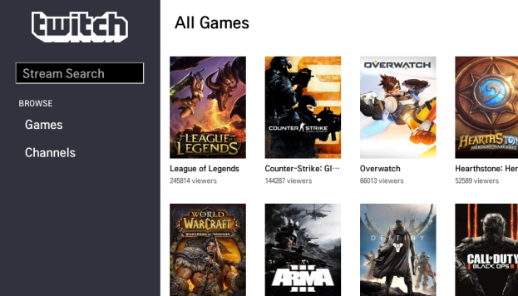
2. Page Description (Guideline)
All Games
Description
1 | Searchbox
2 | Show “All Games”
3 | Show “Channels”
4 | Show the streams of a Specific “Game”
5 | Title of the Current site
5
4
1
2
3
Detailed Information
(Please write the detailed information for the above image here, if needed.
Note: Description of each button’s function and location required for better understanding (Non-English Apps).

Slide 5
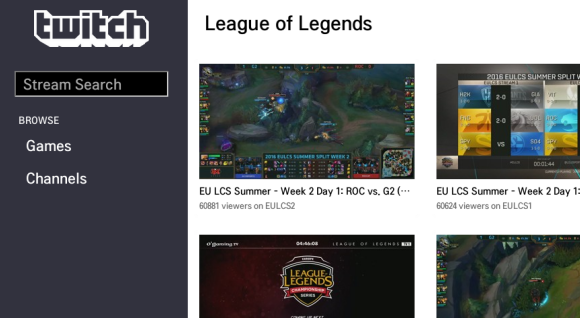
2. Page Description (Guideline)
Game “League of Legend” selecte
Description
1 | Searchbox
2 | Show “All Games”
3 | Show “Channels”
4 | Show The stream
5 | Title of the Current site -> Selected game
5
1
4
2
3
Detailed Information
(Please write the detailed information for the above image here, if needed.
Note: Description of each button’s function and location required for better understanding (Non-English Apps).

Slide 6
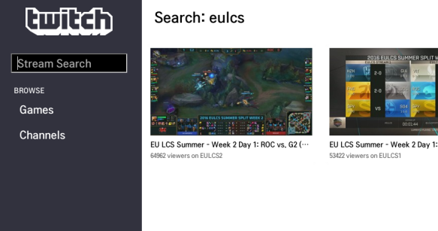
2. Page Description (Guideline)
Search
Description
1 | Searchbox
2 | Show “All Games”
3 | Show “Channels”
4 | Show The stream
5 | Title of the Current site -> Selected game
5
1
4
2
3
Detailed Information
(Please write the detailed information for the above image here, if needed.
Note: Description of each button’s function and location required for better understanding (Non-English Apps).

Slide 7
[Appendix]
If you have anything left to let LG QA team know, please write here. Any detailed references can be welcomed.
1. Everything is ok.

