Slide 1

VehicleMaintenanceSystem (Domain Manufacturing)

Slide 2
Project Info
This system “VehicleMaintenanceSystem” allows providing vehicle for service. If customer got any problem with his vehicle based on guarantee card they are providing services.
The real power of this project lies not in direct selling of products, but in the creation of tighter relationships with customers and delivering of a high level of service and support, which in turn improves organization sales and its goodwill.
A service organization is a business entity that takes care of servicing a customer instrument in the after sales domain.
As the number of customers and size of operations increases, the organization divides the geographical area into service areas and branch locations, to allow Engineers to be more responsive to the customer-needs.

Slide 3
In-Depth Project Description
“VehicleMaintenanceSystem “web application satisfies all the needs of admin, customer, sales manager, and vehicle by providing fast and accurate information about vehicles.
It is very easy to record the information of online sales and purchases in the databases.
The objective of the Vehicle Services is to provide better information for the users of this system for better results for their maintainence in the product details that is sales, purchases and stock.
The VehicleMaintenanceSystem is a software application which avoids more manual hours that need to spend in record keeping and generating reports.
This application keeps the data in a centralized way which is available to all the users simultaneously. It is very easy to manage historical data in database.
No specific training is required for the distributors to use this application. They can easily use the tool that decreases manual hours spending for normal things and hence increases the performance.
The user interface module is classified in to four types Admin, Customer, TransportBranch and Employee.

Slide 4
Module of Project
Administrator(Owner)
ServiceCentre
Employee
Customer

Slide 5
UML use case Design

Slide 6
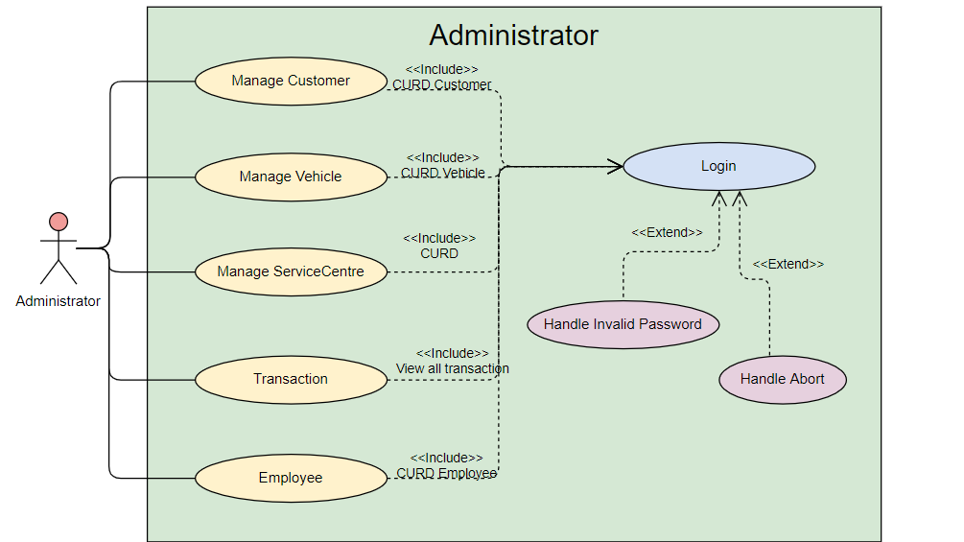

Slide 7
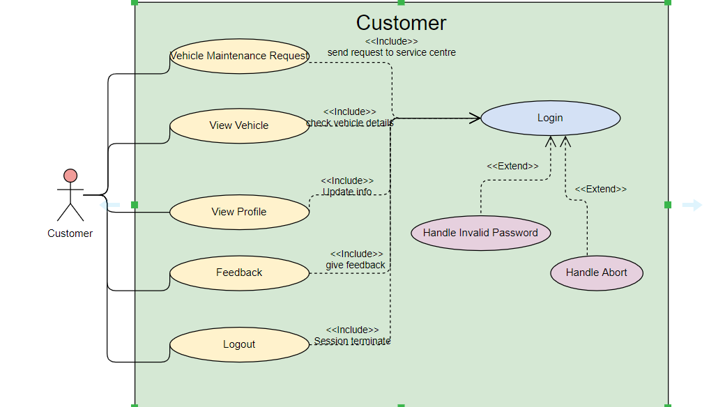

Slide 8
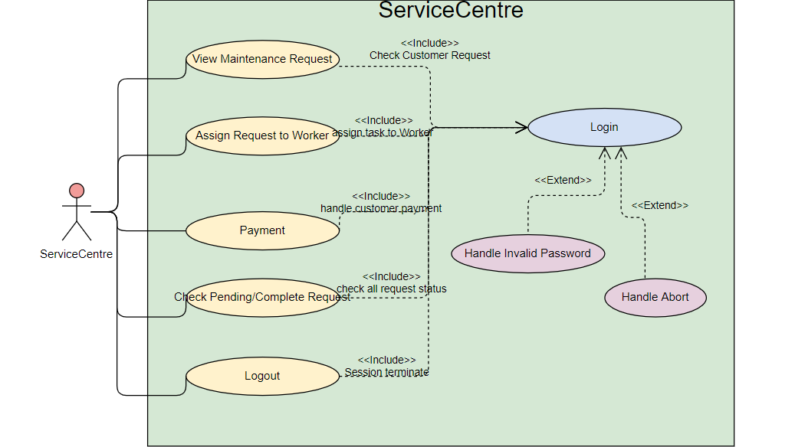

Slide 9
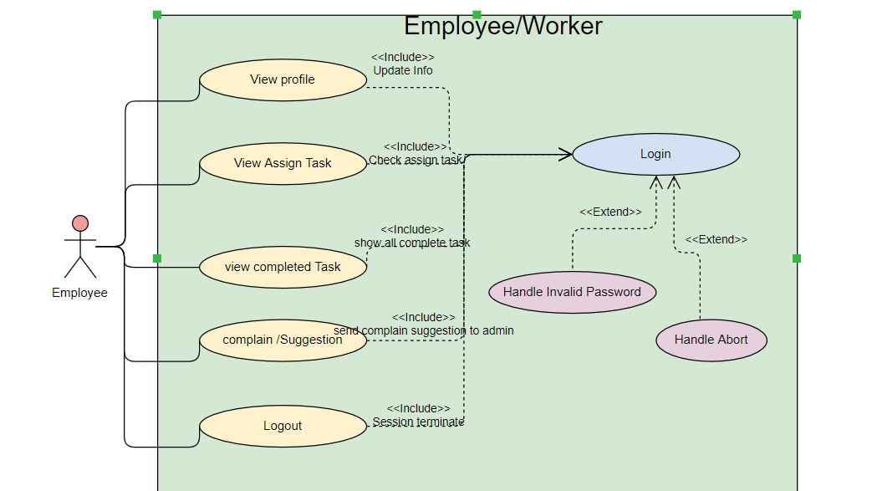

Slide 10
Module Functionality

Slide 11
Administrator
Manage Customer :-Admin will manage customer using CURD operation.
Manage ServiceCentre:- Admin will manage ServiceCentre office using CURD Operations.
Manage Vehicle :- Admin register all vehicle with their service warranty period & do CURD operation.
Manage Employee:- Admin will manage Employee using CURD operation.
Transaction :- Admin will check all income or expense .
Reports

Slide 12
ServiceCentre
View Maintenance request:-ServiceCentre admin will view all incoming customer request on date wise & check validate warranty period .
Assign Request to Worker :-validated request assign request to worker(employee) by ServiceCentre admin .
Payment :- Based on worker repairing sheet (vehicle parts ) generate bill & handle payment.
Check pending/complete request:- Service Centre admin will check all pending complete request if required take action against assign worker if request not done or get complain.

Slide 13
Customer
Vehicle Maintenance request :-Customer will send maintenance request to particular service centre.
ViewVehicle:- Customer view his Vehicle details with warranty period .
View Profile:- can view his/her own profile and modify some information .
Feedback:- can send feedback about assigned worker to his ServiceCentre admin or direct administrator.
Logout

Slide 14
Employee
View Assign Request:-Employee can view assign request & update the status of request with proper repairing sheet which is done in servicing .
View Profile:- can view his/her own profile and modify some information .
ViewcompletedTask:- Employee can view his all completed task & their details too.
complain:- can do complain/suggestion to administrator .
Logout

Slide 15
Technologies

Slide 16
Important API implements
Logging API (Log4j)
Junit Testcase or Mockito (TDD)
Mailing services
Any Third party API like Weather ,News ,Business etc.

