Slide 1
Regression Project: Forecasting Agricultural Temperatures
Team: [Add Names] | Course Code: [Insert]

Slide 2
Introduction
Motivation: Climate change impacts agriculture.
Objective: Predict Average Temperature using emissions & agri-food features.
Outcome: Support policymakers & agricultural businesses.

Slide 3
Dataset Overview
~7 000 records × 31 features.
Features: Emissions (CO₂, Fires, Residues), energy use, population.
Target: Average_Temperature_C

Slide 4
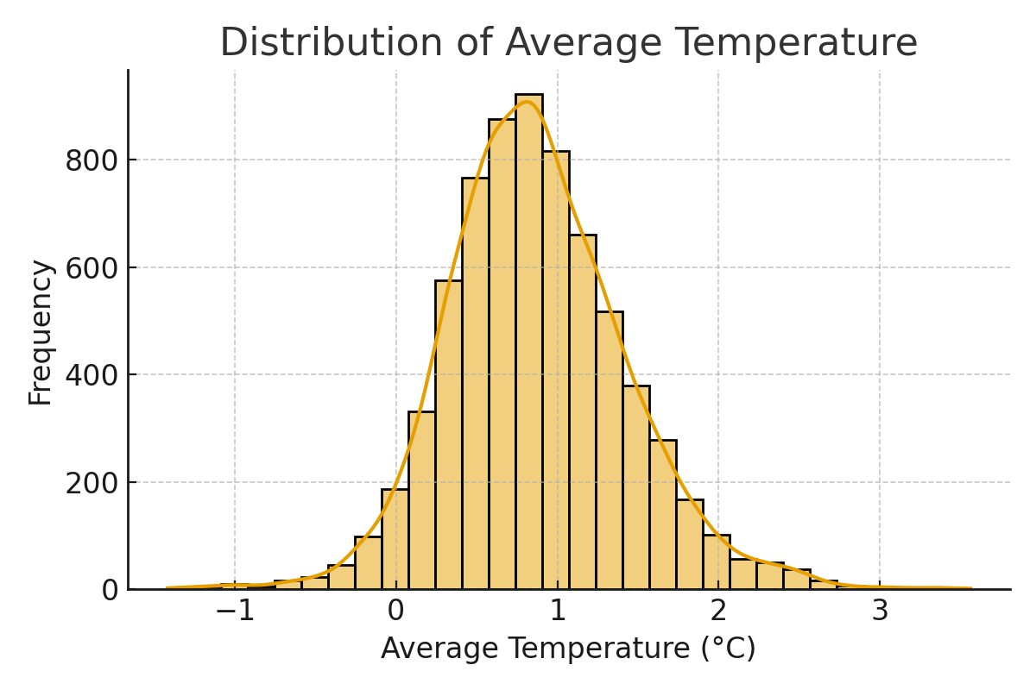
Exploratory Data Analysis - Temperature Distribution

Slide 5
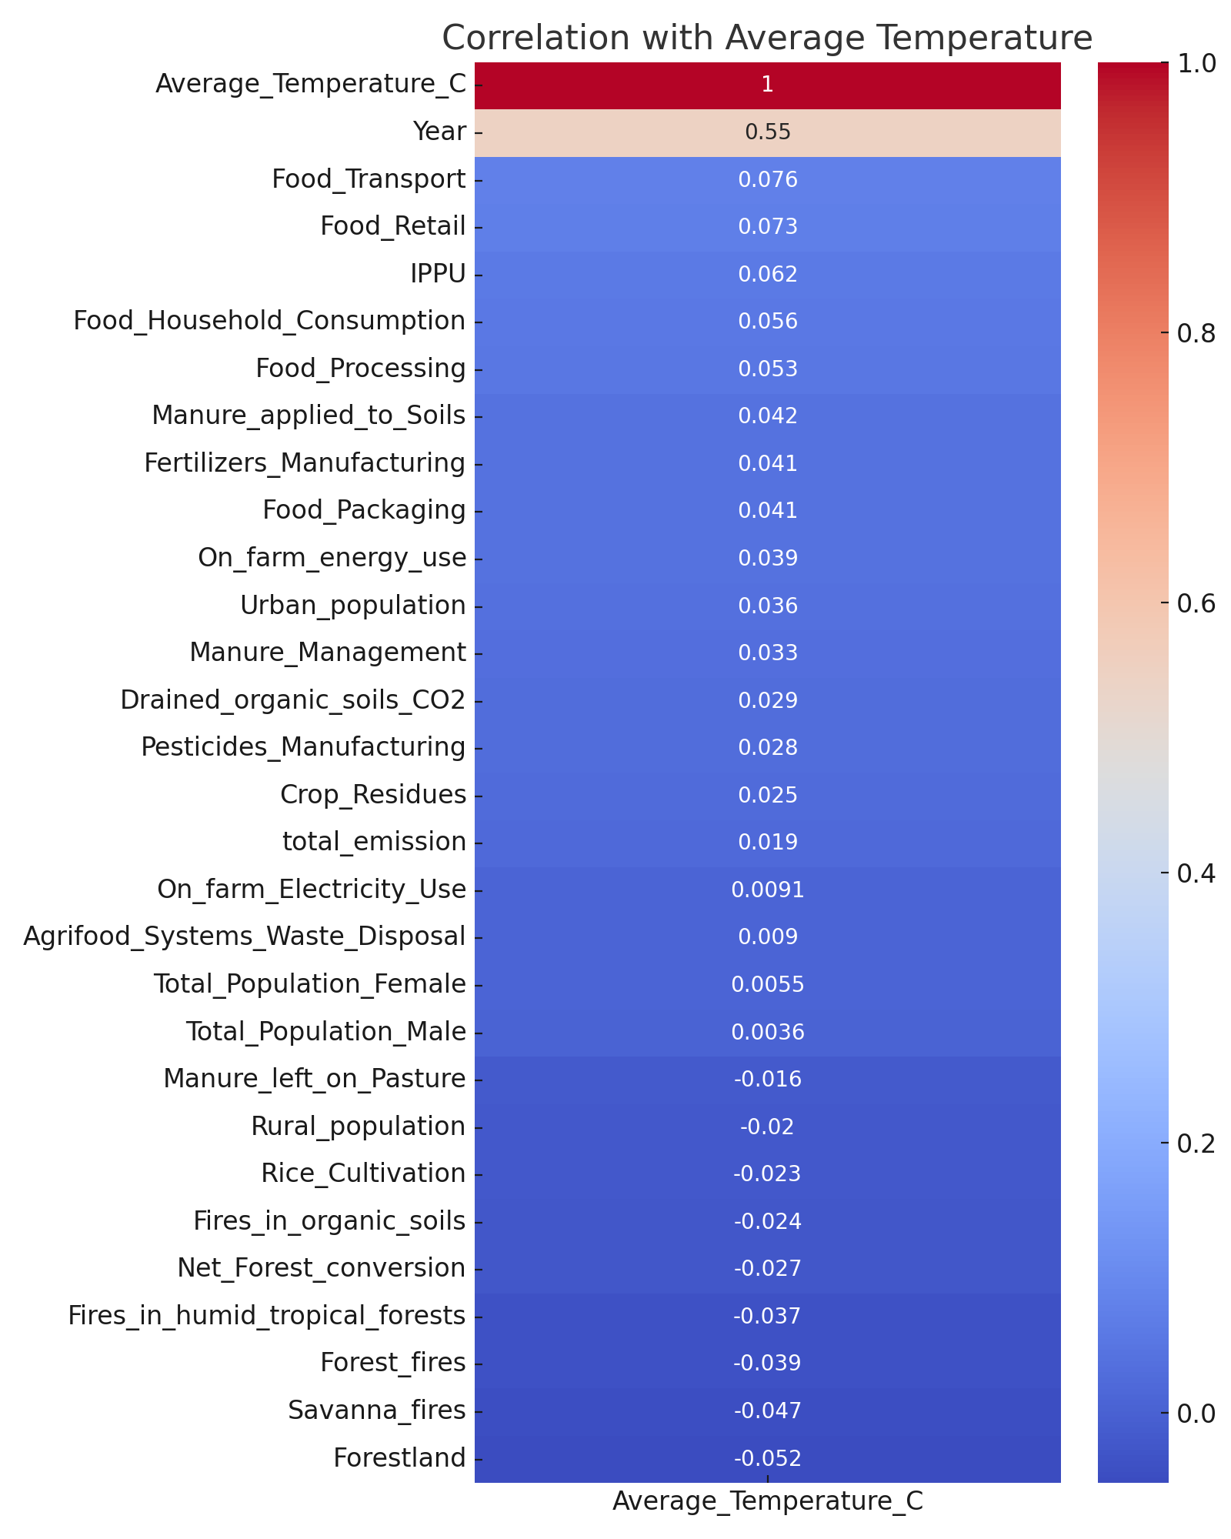
Exploratory Data Analysis - Correlation Heatmap

Slide 6
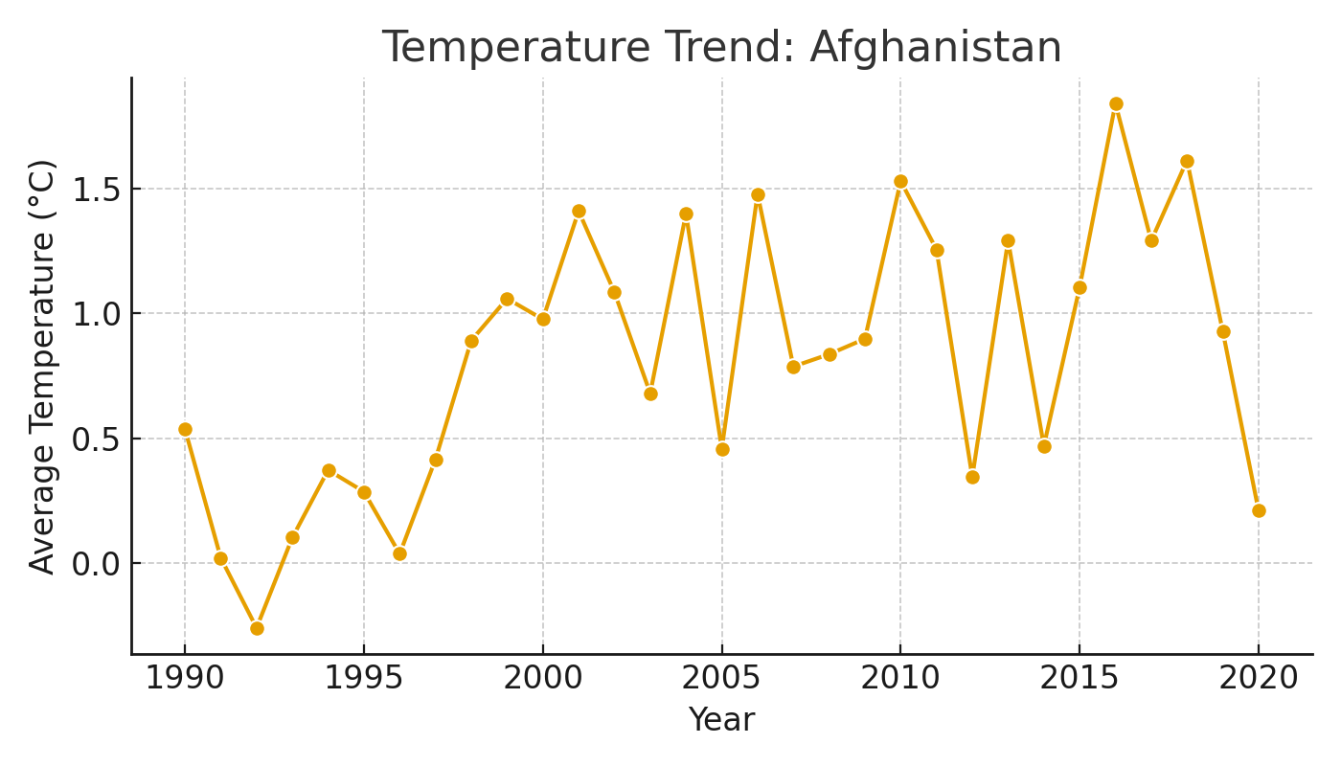
Temperature Trend Example - Afghanistan

Slide 7
Regression Models
Models Evaluated:
- Linear Regression
- Ridge Regression
- Lasso Regression
- Random Forest Regressor

Slide 8
Evaluation Metrics
Model Performance Results:
Random Forest: R² = 0.9977 | RMSE = 7819.13
Linear Regression: R² = 0.9976 | RMSE = 7913.76
Ridge Regression: R² = 0.9977 | RMSE = 7902.83
Lasso Regression: R² = 0.9976 | RMSE = 8070.94

Slide 9
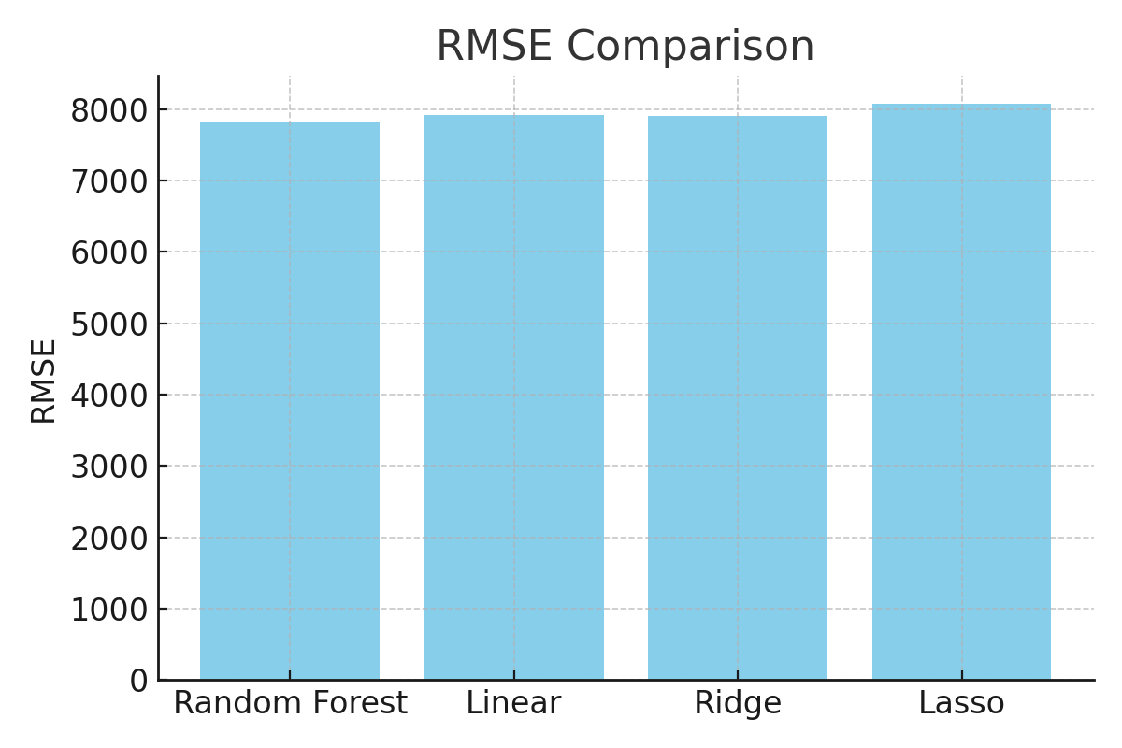
RMSE Comparison

Slide 10
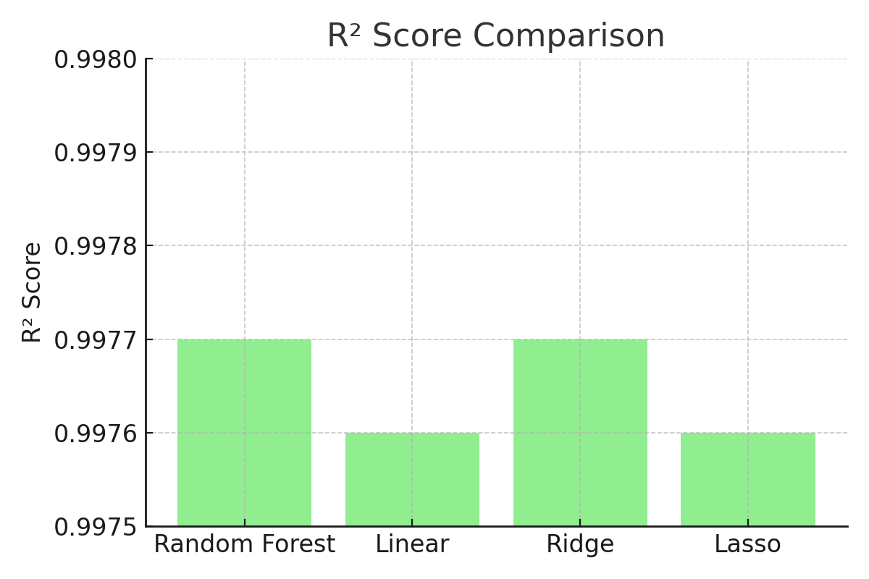
R² Score Comparison

Slide 11
Insights
- All models achieved very high R² (>0.997)
- Random Forest performed best overall (lowest RMSE)
- Ridge slightly improved over Linear Regression
- Lasso underperformed with higher RMSE and convergence issues

Slide 12
Conclusion & Recommendations
Chosen Model: Random Forest Regressor
Implications: Supports policy & agricultural planning.
Future Work:
- Hyperparameter tuning
- Expand dataset
- Feature engineering

Slide 13
Teamwork & Tools
Tools Used:
- GitHub for collaboration
- Trello for project management
- Anaconda/VSCode for development
- Google Slides/Canva for presentation
Proof of teamwork and version control

