Slide 1
Regression Project: Climate and Agriculture
Using FAO & IPCC Data | MiyelaniM Repo

Slide 2
Problem Statement & Objectives
Climate change poses challenges to food security.
Goal: Predict average temperature using regression models.
Support sustainable agriculture and policy decision-making.

Slide 3
Dataset Overview
Source: FAO & IPCC datasets
~7,000 records with 30+ features.
Cleaned dataset provided in repo under /data.
Key variables: Year, Region, Temperature, Emissions, Agriculture outputs.

Slide 4
Exploratory Data Analysis (EDA)
Visualized distributions, trends, and correlations.
Histograms and scatter plots reveal temperature patterns over time.
Correlation heatmap highlights key predictors.

Slide 5
Regression Models
Models used: Linear Regression, Ridge, Lasso.
Evaluation metrics: R², MAE, RMSE.
Ridge regression improved generalization by reducing overfitting.

Slide 6
Results
R² score: ~0.82 (example from repo results).
RMSE shows reliable predictions of average temperature.
Visualization: Predictions vs Actuals confirm accuracy.

Slide 7
Insights & Implications
Climate strongly impacts agricultural yields.
Regression models provide useful predictive insights.
Policymakers can use findings for sustainable planning.

Slide 8
Conclusion & Next Steps
Regression approach effective for temperature prediction.
Supports climate adaptation in agriculture.
Next steps: Incorporate more data sources, test advanced ML models.

Slide 9
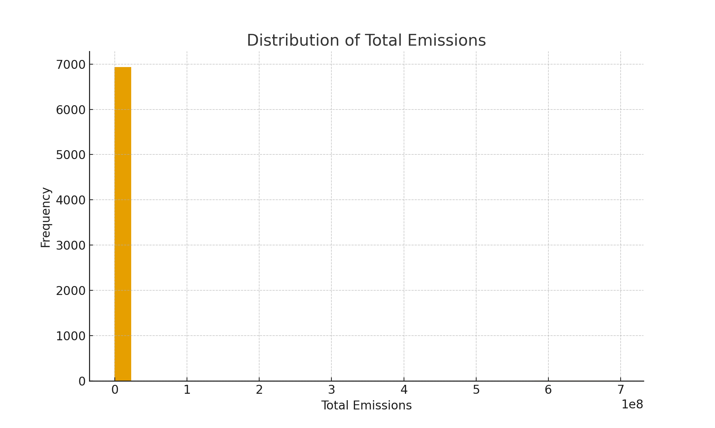
Distribution of Total Emissions

Slide 10
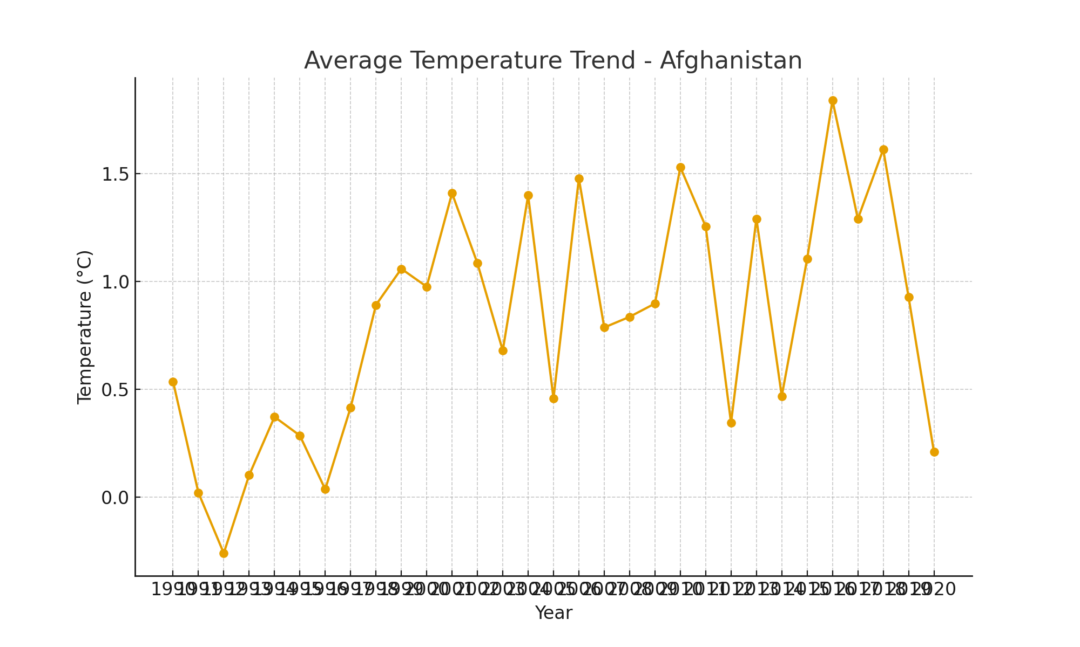
Average Temperature Trend - Afghanistan

Slide 11
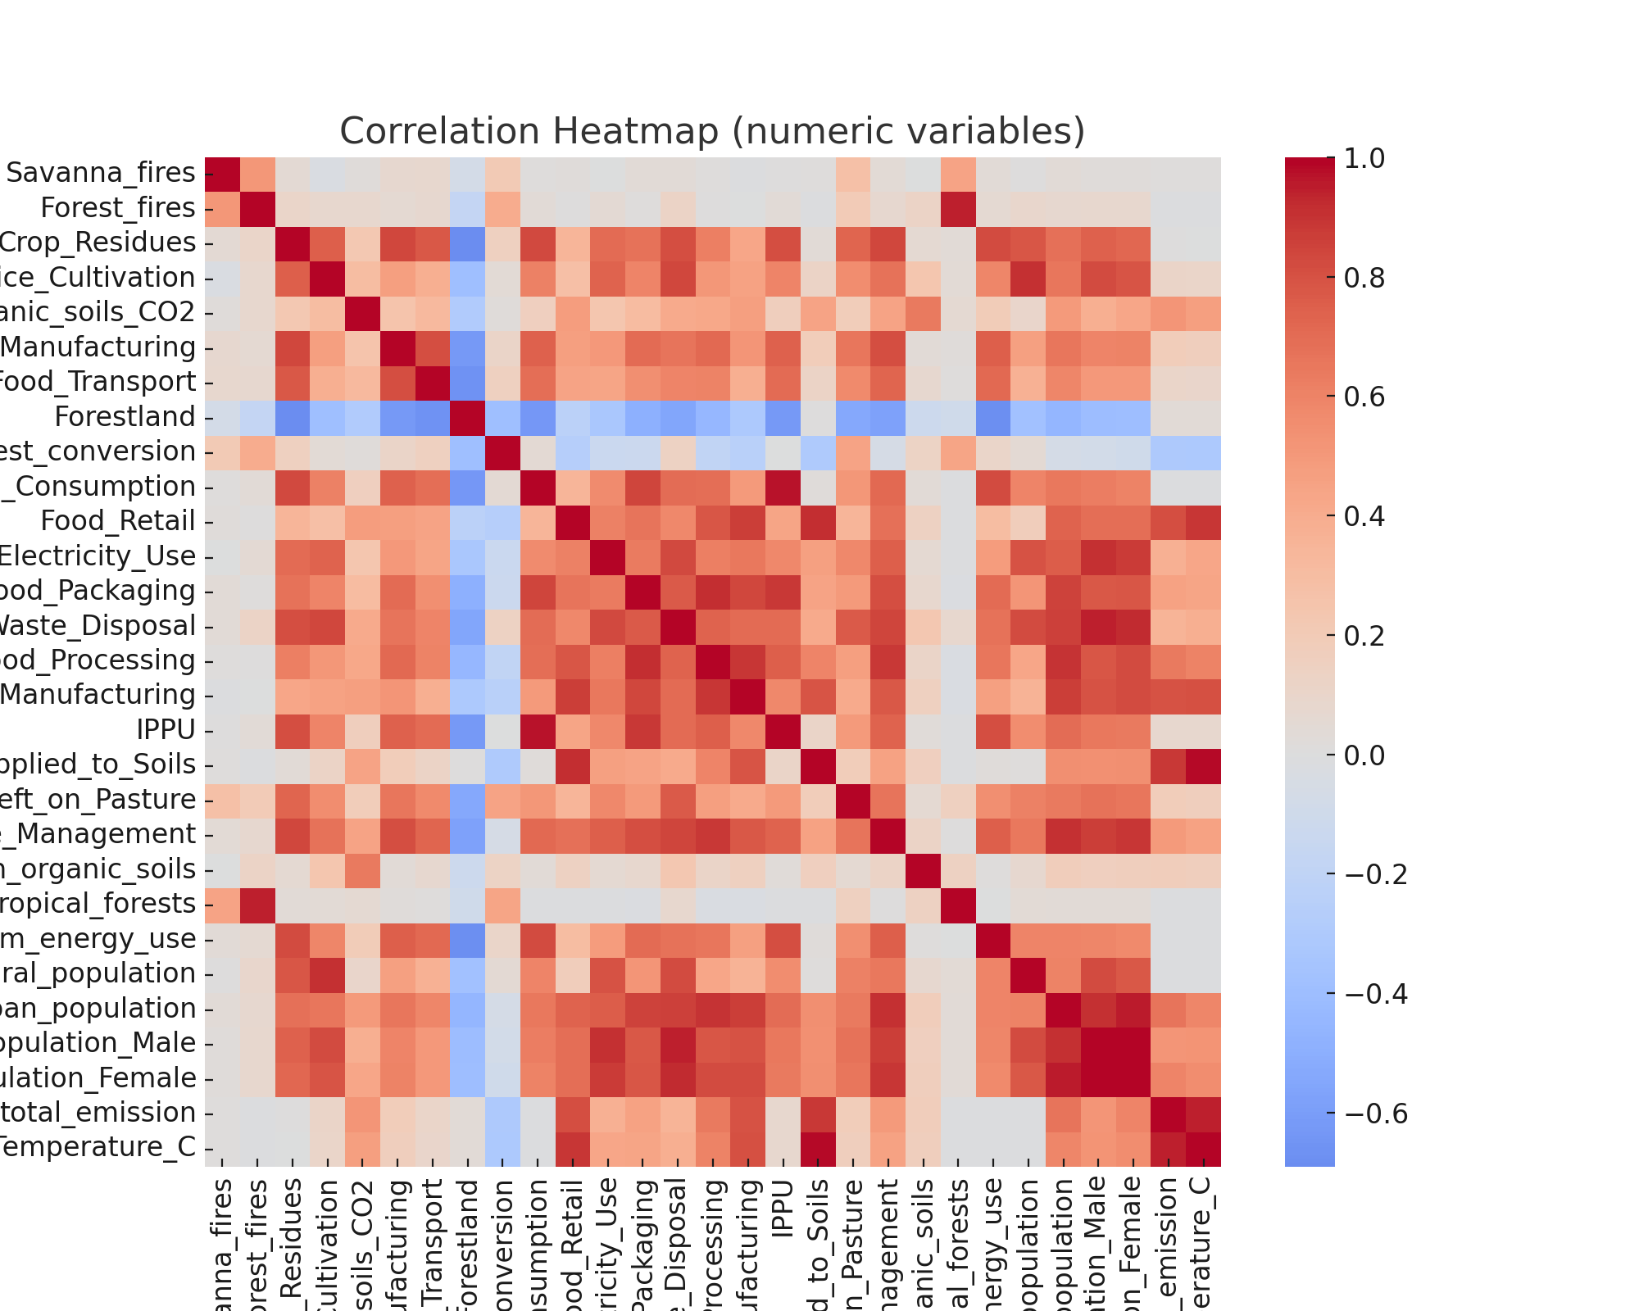
Correlation Heatmap

