Slide 1
Regional Statistical Facts
Americas | As of 2022

Slide 2
Population of Concern & Affected Host Communities in Americas
As of 2022, a total of 19,919,000 Individuals
3.5%
Refugees
26.8%
Other people in need of international protection
13.8%
Asylum seekers
35.5%
20.4%
Internally displaced persons
Others of concern to UNHCR
Source: UNHCR.org/refugee-statistics

Slide 3
Share of Refugees within Americas
As of 2022, about 2.6% of that global population category are hosted in the
region
25,975,000
in Rest of the World
Source: UNHCR.org/refugee-statistics

Slide 4
Share of Asylum seekers within Americas
As of 2022, about 56.0% of that global population category are hosted in the
region
2,749,000
2,161,000
in Americas
in Rest of the World
Source: UNHCR.org/refugee-statistics

Slide 5
Share of Other people in need of international protection within Americas
As of 2022, about 100.0% of that global population category are hosted in the
region
5,342,000
in Americas
Source: UNHCR.org/refugee-statistics

Slide 6
Share of Internally displaced persons within Americas
As of 2022, about 12.1% of that global population category are hosted in the
region
51,287,000
7,065,000
in Rest of the World
in Americas
Source: UNHCR.org/refugee-statistics

Slide 7
Share of Stateless Persons within Americas
As of 2022, about 0.1% of that global population category are hosted in the
region
4,341,000
in Rest of the World
Source: UNHCR.org/refugee-statistics

Slide 8
Americas: People of Concern | 2017-2022
20M
20M
17M
17M
16M
15M
13M
10M
10M
5M
0
2017
2018
2019
2020
2021
2022
Source: UNHCR.org/refugee-statistics

Slide 9
Americas: Population type per year
Number of people (thousand)
Asylum seekers
Internally displaced persons
Other people in need of international protection
Others of concern to UNHCR
Refugees
Stateless Persons
20M
17M
17M
16M
13M
10M
2017
2018
2019
2020
2021
2022
Source: UNHCR.org/refugee-statistics

Slide 10
Main Host Countries for Refugees | 2022 in Americas
Number of people for top 5 countries in the region
United States of America
348K
2.2%
Mexico
85K
15.4%
Brazil
64K
2.2%
Ecuador
59K
4.4%
Canada
57K
-56.1%
Source: UNHCR.org/refugee-statistics

Slide 11
Main Host Countries for Asylum seekers | 2022 in Americas
Number of people for top 5 countries in the region
United States of America
1M
11%
Peru
537K
0%
Costa Rica
205K
34.1%
Brazil
204K
2.2%
Mexico
180K
14.3%
Source: UNHCR.org/refugee-statistics

Slide 12
Biggest Decrease of Population
5 Biggest change in Refugee Population, Americas 2017 - 2022
2017
2022
Venezuela
Canada
Belize
Nicaragua
Cuba
0
50K
100K
150K
Source: UNHCR.org/refugee-statistics

Slide 13
Where did Refugee Population increased in Americas?
Biggest increase in Refugee Population, 2012 - 2022
Colombia
United States of America
Peru
Brazil
Chile
0
500K
1M
2M
2M
2M
Source: UNHCR.org/refugee-statistics

Slide 14
Recognized Refugee Status Decisions | 2022, in Americas
For top 10 Countries of Asylum
For top 10 Countries of Origin
USA
Venezuela
Canada
Honduras
Mexico
El Salvador
Brazil
Colombia
Ecuador
Guatemala
Costa Rica
Nicaragua
Peru
Haiti
Guatemala
Mexico
Uruguay
Cuba
Trinidad and Tobago
Ecuador
0
5K
10K
15K
20K
0
2K
4K
6K
Source: UNHCR.org/refugee-statistics

Slide 15
Complementary Protection Decisions | 2022, in Americas
For top 5 Countries of Asylum
For top 5 Countries of Origin
Mexico
Venezuela
Belize
Haiti
Canada
El Salvador
Brazil
Colombia
Argentina
Peru
0
100
200
300
400
500
0
2K
5K
8K
Source: UNHCR.org/refugee-statistics

Slide 16
Total Decision (independently of the outcome) | 2022, in Americas
For top 10 Countries of Asylum
For top 10 Countries of Origin
USA
Venezuela
Mexico
Honduras
Canada
El Salvador
Brazil
Nicaragua
Costa Rica
Guatemala
Colombia
Colombia
Uruguay
Haiti
Ecuador
Mexico
Panama
Cuba
Chile
Ecuador
0
30K
60K
90K
0
10K
20K
30K
40K
Source: UNHCR.org/refugee-statistics

Slide 17
Refugee Recognition Rate | 2022, in Americas
For top 10 Countries of Asylum
For top 10 Countries of Origin
Venezuela (Bolivarian Republic of)
Saint Lucia
Cuba
Grenada
Cayman Islands
Barbados
Ecuador
Bahamas
Trinidad and Tobago
Antigua and Barbuda
Guyana
Jamaica
Canada
Guyana
Peru
Honduras
Dominican Republic
Colombia
Mexico
French Guiana
0%
25%
50%
75%
100%
0%
10%
20%
30%
40%
50%
Source: UNHCR.org/refugee-statistics

Slide 18
Total Recognition Rate | 2022, in Americas
For top 10 Countries of Asylum
For top 10 Countries of Origin
Venezuela (Bolivarian Republic of)
Saint Lucia
Cuba
Grenada
Cayman Islands
Barbados
Ecuador
Bahamas
Trinidad and Tobago
Venezuela
Guyana
French Guiana
Canada
Antigua and Barbuda
Peru
Jamaica
Dominican Republic
Guyana
Mexico
Panama
0%
25%
50%
75%
100%
0%
10%
20%
30%
40%
50%
Source: UNHCR.org/refugee-statistics

Slide 19
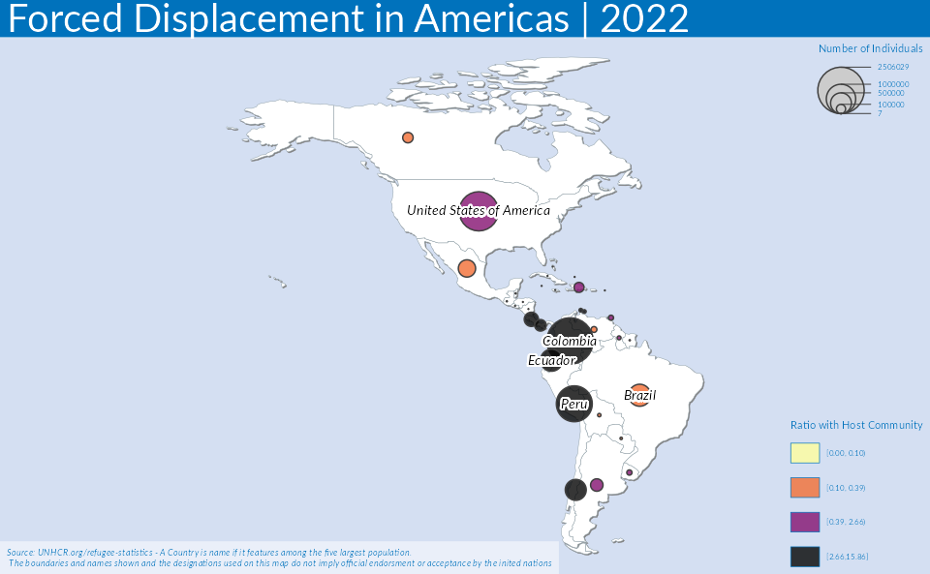
TRUE

Slide 20
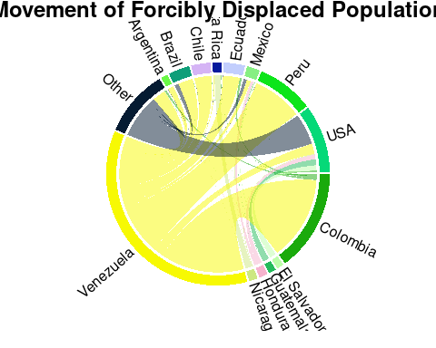
TRUE

Slide 21
Number of refugees, asylum seekers & displaced across
borders by country of origin inAmericas
Top 10 Countries, as a proportion of the national population of that country of
origin (SDG indicator 10.7.4)
Venezuela
18.7%
Nicaragua
3.4%
El Salvador
3.1%
Honduras
2.3%
Haiti
1.5%
Guatemala
1.1%
Cuba
1.0%
Colombia
0.4%
Bahamas
0.4%
Dominica
0.3%
0.0%
5.0%
10.0%
15.0%
Source: UNHCR.org/refugee-statistics. Total count of population who have
been recognized as refugees as a proportion of the total population of their
country of origin, expressed per 100,000 population. Refugees refers to persons
recognized by the Government and/or UNHCR, or those in a refugee-like situation.
Population refers to total resident population in a given country in a given
year.

Slide 22
Solution for Displacement in Americas
Evolution in the past 10 years
25K
20K
15K
10K
5K
Naturalisation
Resettlement arrivals
0
Refugee returns
2012
2017
2022
Source: UNHCR.org/refugee-statistics

