Slide 1
State of the art
F. Bergerot, L. Dupont, V. Everest, T. Paun
20/03/2023
1

Slide 2
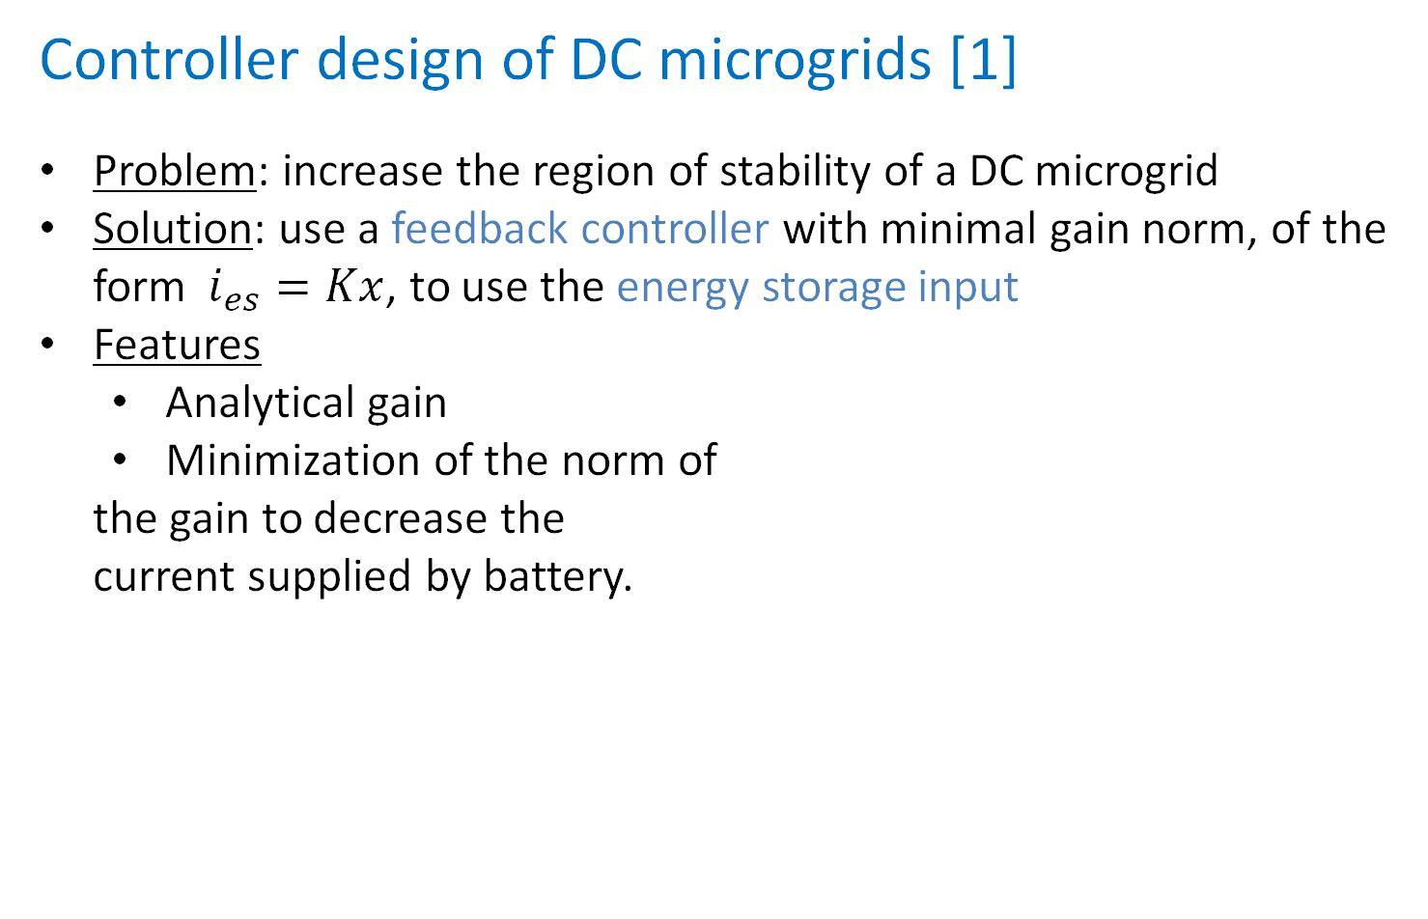
Controller design of DC microgrids [1]
Problem: increase the region of stability of a DC microgrid
Solution: use a feedback controller with minimal gain norm, of the form$i_{es}=Kx$, to use the energy storage input
Features
Analytical gain
Minimization of the norm of
the gain to decrease the
current supplied by battery.
Théorique
Pratique
Detailed dc microgrid of more electric aircraft, navy ships… with a robust controller
[1] L. Herrera, W. Zhang and J. Wang, "Stability Analysis and Controller Design of DC Microgrids With Constant Power Loads," in IEEE Transactions on Smart Grid, vol. 8, no. 2, pp. 881-888, March 2017, doi: 10.1109/TSG.2015.2457909.

Slide 3
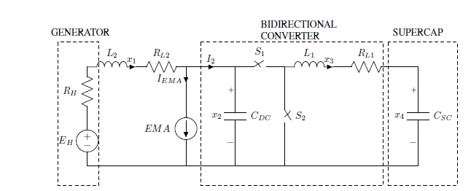
Supercapacitor stability for More Electric
Aircraft application [2]
Problem: Some instability can occur
Solution: Using a bidirectional converter to regulate the power flow between the power generator and a supercapacitor.
Features
soothing action on generator current
Stability of the open-loop
Théorique
Pratique
Bidirectional converter with supercapacitor schematic
[2] A. Russo and A. Cavallo, "Supercapacitor stability and control for More Electric Aircraft application," 2020 European Control Conference (ECC), St. Petersburg, Russia, 2020, pp. 1909-1914, doi: 10.23919/ECC51009.2020.9143927

Slide 4
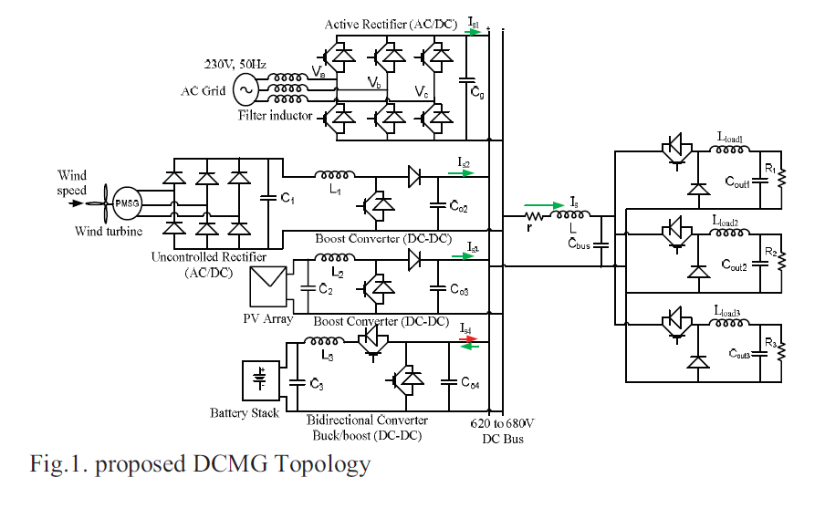
Control and Stability Analysis of DC Micro-
grids with Constant Power Loads and Source
Disturbances [3]
Problem: DC buses' stability can be deteriorated by the multiples CPL and DG disturbance
Solution: droop control (a variation of a control loop, using the measured voltage and current to compute the voltage/current of reference)
Features:
The method also accounts for
batteries and the sources linked
to the microgrid
Decentralized control scheme
Théorique
Pratique
[3] G. Ensermu and A. Bhattacharya, "Control and Stability Analysis of DC Micro-grids with Constant Power Loads and Source Disturbances," 2018 IEEE International Conference on Power Electronics, Drives and Energy Systems (PEDES), Chennai, India, 2018, pp. 1-6, doi: 10.1109/PEDES.2018.8707605.

Slide 5
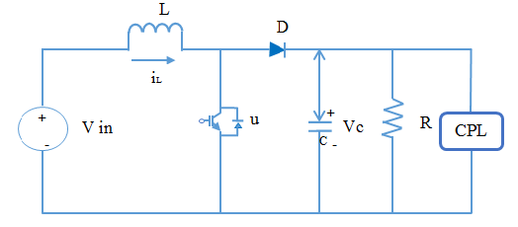
Stabilization of DC / DC Converter with
Constant Power Load using Exact Feedback Linearization Method [4]
Problem: the objective is to guarantee the stabilization of a DC microgrid with a boost converter associated to a CPL
Solution: studying the system, taking u as an input and using backstepping and sliding mode control
Features:
is applied to a boost converter
Guarantees stability of the
system
Théorique
Pratique
[4] M. Dehghani, M. Ghiasi, M. GhasemiGarpachi, T. Niknam, A. Kavousi-Fard and H. Shirazi, "Stabilization of DC/DC Converter with Constant Power Load using Exact Feedback Linearization Method based on Backstepping Sliding Mode Control and Nonlinear Disturbance Observer," 2021 12th Power Electronics, Drive Systems, and Technologies Conference (PEDSTC), Tabriz, Iran, 2021, pp. 1-6, doi: 10.1109/PEDSTC52094.2021.9405916.

Slide 6
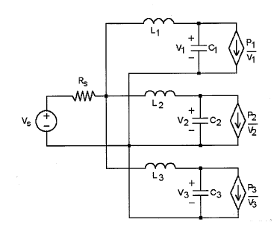
Stability issues associated with a Navy shipboard DC zonal electric distribution system [5]
Problem: In ships, DC Zonal electric distribution presents stability issues due to the interconnection of non-linear power converters.
Solution: Placing a constraint on the source resistance to have a steady-state operating. Create a criterion on input impedance to guarantee system stability.
Features
Avoiding unwanted sustained
oscillation in the network.
Théorique
Pratique
Model of Networked High-Bandwidth Converters
[5] J. G. Ciezki and R. W. Ashton, "Selection and stability issues associated with a navy shipboard DC zonal electric distribution system," in IEEE Transactions on Power Delivery, vol. 15, no. 2, pp. 665-669, April 2000, doi: 10.1109/61.853002.

Slide 7
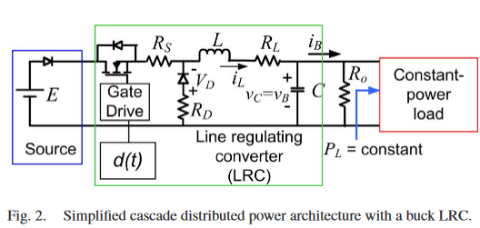
Dynamic Behavior and Stabilization of DC Microgrids With Instantaneous Constant Power Loads [6]
Problem: Constant power load induce destabilizing effect on micro grids
Solution: PID-type controllers or Boundary controllers (switch of LRC semi-conductor)
Features:
Does not impact efficiency of the system
Extreme robustness
Théorique
Pratique
[6] A. Kwasinski and C. N. Onwuchekwa, "Dynamic Behavior and Stabilization of DC Microgrids With Instantaneous Constant-Power Loads," in IEEE Transactions on Power Electronics, vol. 26, no. 3, pp. 822-834, March 2011, doi: 10.1109/TPEL.2010.2091285.

Slide 8
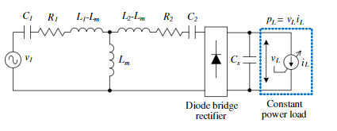
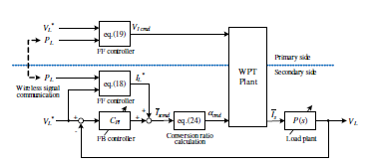
Load voltage control for wireless in-wheel
motor [7]
Problem: The system without control is unstable (too complex)
Solution: Controller method
Features: use 2 types of operation modes of the secondary converter (in the wheel part): diode bridge rectifier, to control the transmitting power. Using several controller to be sure that the constant power load is respected.
Théorique
Pratique
Feedforward controller and two degrees of freedoom controller used to control the power
Circuit model
[7] D. Gunji, T. Imura and H. Fujimoto, "Stability analysis of constant power load and load voltage control method for Wireless In-Wheel Motor," 2015 9th International Conference on Power Electronics and ECCE Asia (ICPE-ECCE Asia), Seoul, Korea (South), 2015, pp. 1944-1949, doi: 10.1109/ICPE.2015.7168044.

Slide 9
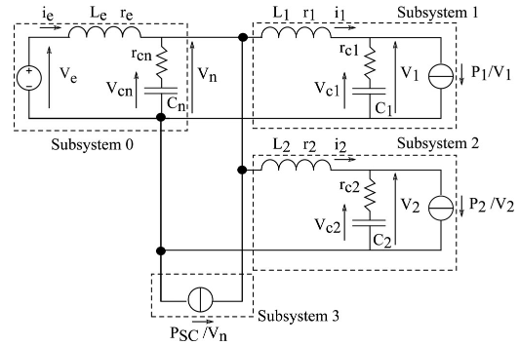
General Active Global Stabilization of
Multiloads DC-power network [8]
Problem: Induce stability on DC micro grids such as the ones used on electric aircraft
Solution: Feedback loops and multilevel controllers
Features:
Too many sensors
Centralized methods
Théorique
Pratique
[8] P. Magne, B. Nahid-Mobarakeh and S. Pierfederici, "General Active Global Stabilization of Multiloads DC-Power Networks," in IEEE Transactions on Power Electronics, vol. 27, no. 4, pp. 1788-1798, April 2012, doi: 10.1109/TPEL.2011.2168426.

Slide 10
Thank you!

Slide 11
References
[1] L. Herrera, W. Zhang and J. Wang, "Stability Analysis and Controller Design of DC Microgrids With Constant Power Loads," in IEEE Transactions on Smart Grid, vol. 8, no. 2, pp. 881-888, March 2017, doi: 10.1109/TSG.2015.2457909.
[2] A. Russo and A. Cavallo, "Supercapacitor stability and control for More Electric Aircraft application," 2020 European Control Conference (ECC), St. Petersburg, Russia, 2020, pp. 1909-1914, doi: 10.23919/ECC51009.2020.9143927
[3] G. Ensermu and A. Bhattacharya, "Control and Stability Analysis of DC Micro-grids with Constant Power Loads and Source Disturbances," 2018 IEEE International Conference on Power Electronics, Drives and Energy Systems (PEDES), Chennai, India, 2018, pp. 1-6, doi: 10.1109/PEDES.2018.8707605.
[4] M. Dehghani, M. Ghiasi, M. GhasemiGarpachi, T. Niknam, A. Kavousi-Fard and H. Shirazi, "Stabilization of DC/DC Converter with Constant Power Load using Exact Feedback Linearization Method based on Backstepping Sliding Mode Control and Nonlinear Disturbance Observer," 2021 12th Power Electronics, Drive Systems, and Technologies Conference (PEDSTC), Tabriz, Iran, 2021, pp. 1-6, doi: 10.1109/PEDSTC52094.2021.9405916.
[5] J. G. Ciezki and R. W. Ashton, "Selection and stability issues associated with a navy shipboard DC zonal electric distribution system," in IEEE Transactions on Power Delivery, vol. 15, no. 2, pp. 665-669, April 2000, doi: 10.1109/61.853002. [6] A. Kwasinski and C. N. Onwuchekwa, "Dynamic Behavior and Stabilization of DC Microgrids With Instantaneous Constant-Power Loads," in IEEE Transactions on Power Electronics, vol. 26, no. 3, pp. 822-834, March 2011, doi: 10.1109/TPEL.2010.2091285. [7] D. Gunji, T. Imura and H. Fujimoto, "Stability analysis of constant power load and load voltage control method for Wireless In-Wheel Motor," 2015 9th International Conference on Power Electronics and ECCE Asia (ICPE-ECCE Asia), Seoul, Korea (South), 2015, pp. 1944-1949, doi: 10.1109/ICPE.2015.7168044. [8] P. Magne, B. Nahid-Mobarakeh and S. Pierfederici, "General Active Global Stabilization of Multiloads DC-Power Networks," in IEEE Transactions on Power Electronics, vol. 27, no. 4, pp. 1788-1798, April 2012, doi: 10.1109/TPEL.2011.2168426. P. Magne, B. Nahid-Mobarakeh and S. Pierfederici, "General Active Global Stabilization of Multiloads DC-Power Networks," in , vol. 27, no. 4, pp. 1788-1798, April 2012, doi: 10.1109/TPEL.2011.2168426.

