Slide 1
Optimization of an aeronautic propulsion system
F. Bergerot, L. Dupont, V. Everest, T. Paun
^{31/03/2023}
1

Slide 2
Content
Context and system presentation
Superconducting filter
Optimization of the filter
2

Slide 3
Context and system presentation
3

Slide 4

MEA: More Electric Aircraft​​
​
Aims at replacing hydraulics, pneumatics or thermics motors and rotors by electric means.​
​
Stakes:​
Lowering greenhouse gases emission
Lowering operating and exploiting costs
Safe and confortable aircrafts
Issues:
Stability issues
[2] A. Russo and A. Cavallo, "Supercapacitor stability and control for More Electric Aircraft application," 2020 European Control Conference (ECC), St. Petersburg, Russia, 2020, pp. 1909-1914, doi: 10.23919/ECC51009.2020.9143927
4

Slide 5
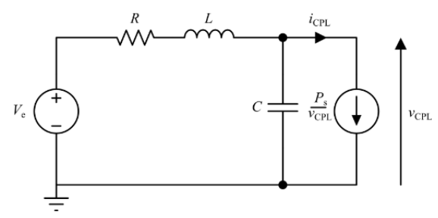
Toward an RLC system with a CPL​​
​
DC microgrids are commonly found in the power systems of aircrafts. They are controlled to maintain constant voltage, current and power and they can be simplified as constant power load (CPL).
Stakes:​
Stability of the system is unsure
[1] L. Herrera, W. Zhang and J. Wang, "Stability Analysis and Controller Design of DC Microgrids With Constant Power Loads," in IEEE Transactions on Smart Grid, vol. 8, no. 2, pp. 881-888, March 2017, doi: 10.1109/TSG.2015.2457909.
[3] G. Ensermu and A. Bhattacharya, "Control and Stability Analysis of DC Micro-grids with Constant Power Loads and Source Disturbances," 2018 IEEE International Conference on Power Electronics, Drives and Energy Systems (PEDES), Chennai, India, 2018, pp. 1-6, doi: 10.1109/PEDES.2018.8707605.
5

Slide 6
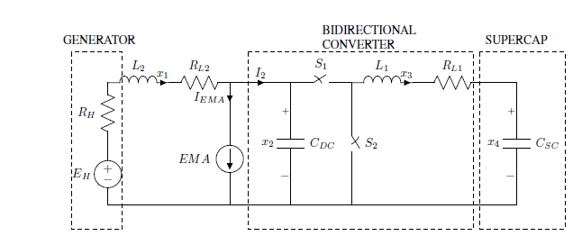
Passive solution
Supercapacitor stability for more electric aircraft application
Problem: Some instability can occur
Solution: Using a bidirectional converter to regulate the power flow between the power generator and a supercapacitor.
Features
soothing action on generator current
Stability of the open-loop
Theoretical
Practical
Bidirectional converter with supercapacitor schematic
[2] A. Russo and A. Cavallo, "Supercapacitor stability and control for More Electric Aircraft application," 2020 European Control Conference (ECC), St. Petersburg, Russia, 2020, pp. 1909-1914, doi: 10.23919/ECC51009.2020.9143927

Slide 7
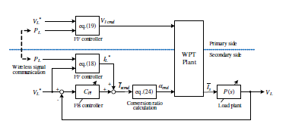
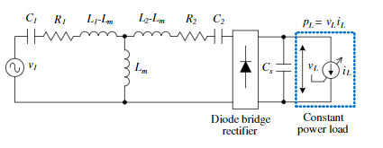
Active solution
Load voltage control for wireless in-wheel motor
Problem: The system without control is unstable
Solution: Controller method
Features: use 2 types of operation modes of the secondary converter (in the wheel part): diode bridge rectifier, to control the transmitting power + feedforward controller + 2 freedom controllers
Theoretical
Practical
[7] D. Gunji, T. Imura and H. Fujimoto, "Stability analysis of constant power load and load voltage control method for Wireless In-Wheel Motor," 2015 9th International Conference on Power Electronics and ECCE Asia (ICPE-ECCE Asia), Seoul, Korea (South), 2015, pp. 1944-1949, doi: 10.1109/ICPE.2015.7168044.

Slide 8
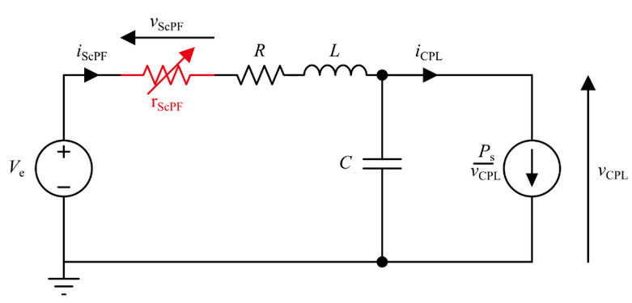
Other solution​​
​
Add a superconducting filter in the circuit to avoid instabilities
8

Slide 9
II. Superconducting filter
9

Slide 10

Stability condition for a DC circuit under constant power load
Stable if
$$P_{s}≤\frac{RC}{L}V_{e}^{2}$$
10

Slide 11
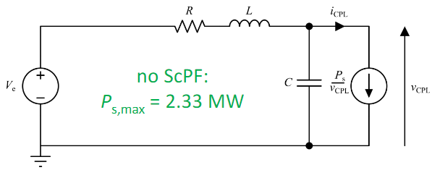
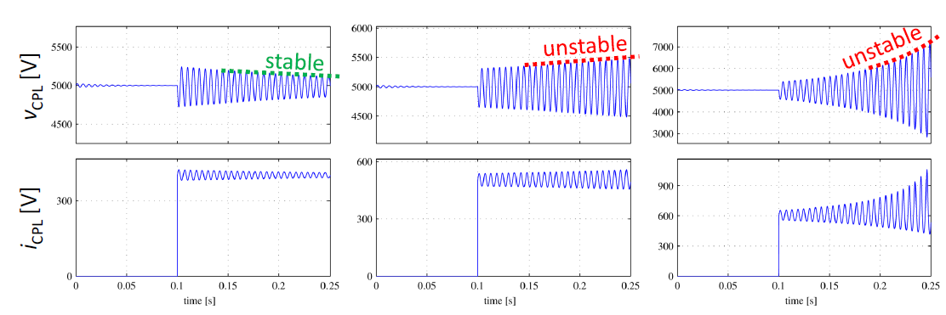
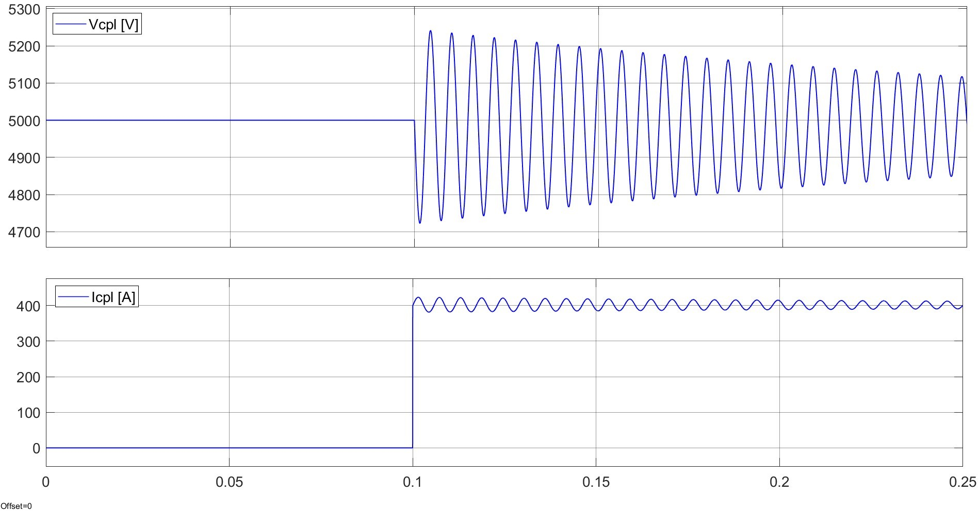
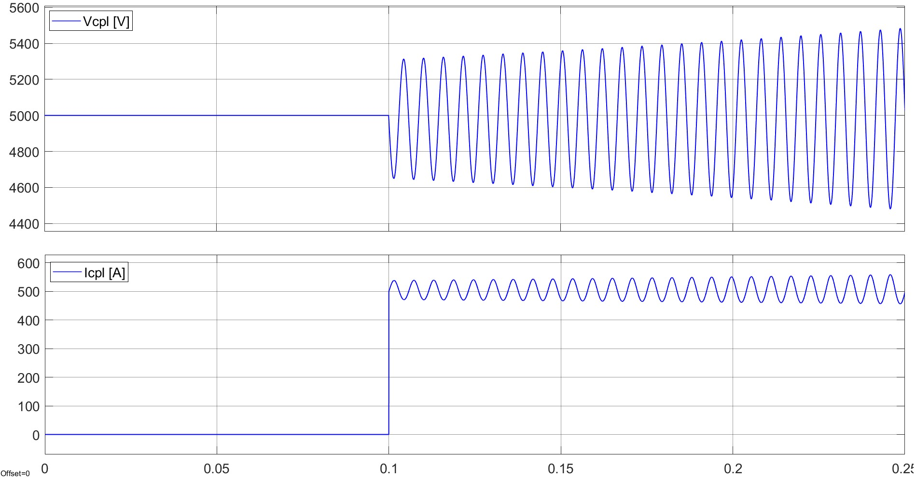
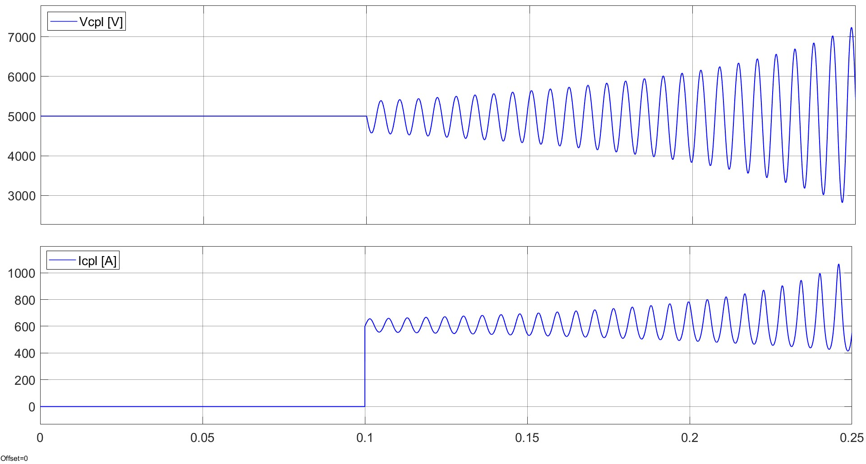

Numerical stability
$$P_{s, max}=\frac{RC}{L}V_{e}^{2}$$
Ps = 2 MW : stable Ps = 2.5MW : Unstable Ps = 3MW : Unstable
[A]
11

Slide 12

Stability condition for a DC circuit under constant power load with superconductor
Stable if: $P_{s}≤\frac{(R+r_{supra}\left(I\right))C}{L}V_{e}^{2}$
12

Slide 13
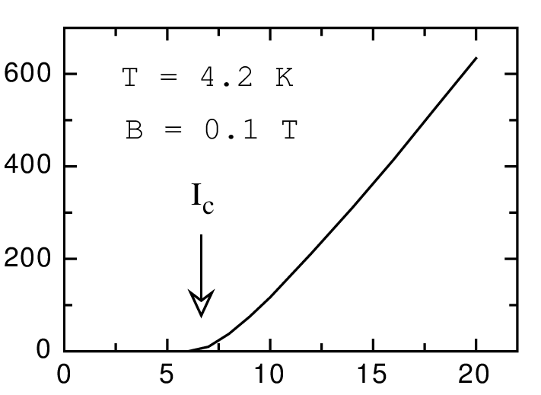

Avantages of the superconductor
$$P_{s}≤\frac{(R+r_{supra}\left(I\right))C}{L}V_{e}^{2}$$
Caracteristic UI of the
superconductor:
Become resistant at a
certain current
13

Slide 14
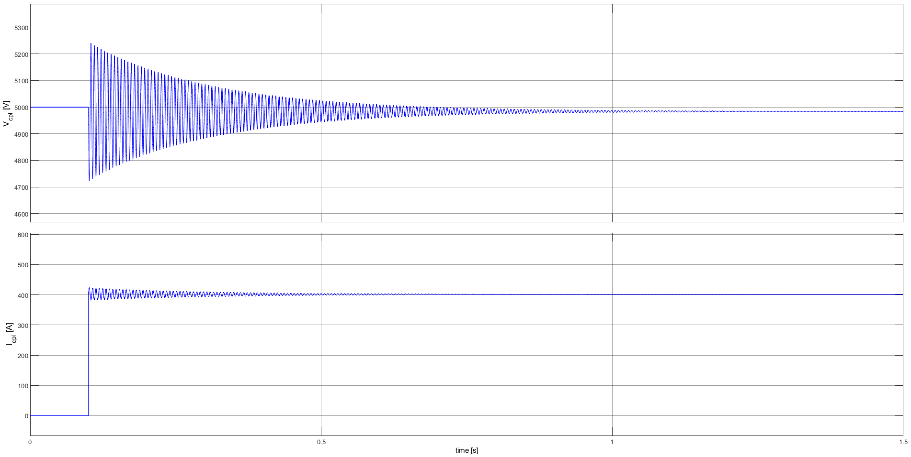
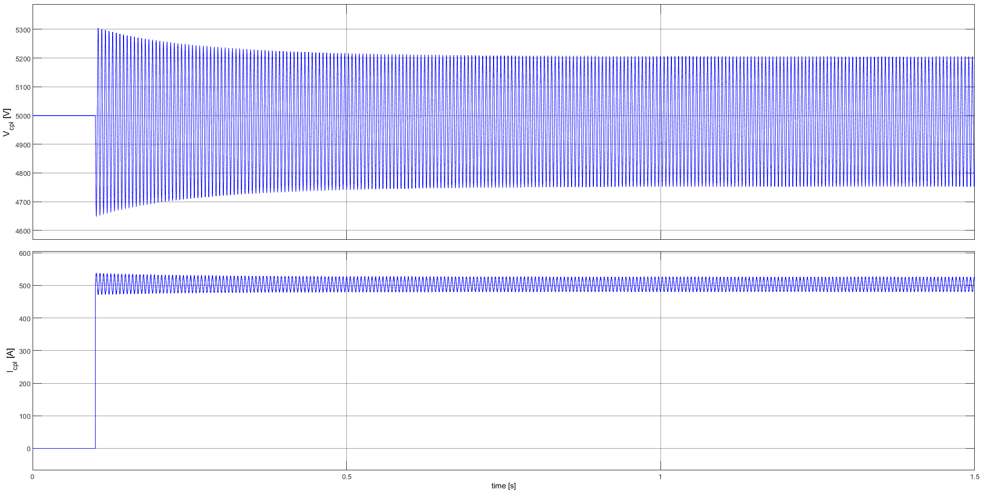
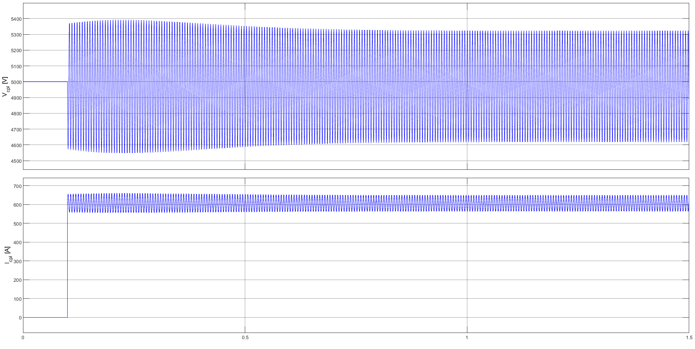

Numerical stability
$$P_{s, max}=\frac{(R+r_{supra}(I))C}{L}V_{e}^{2}$$
Ps = 2 MW : stable Ps = 2.5MW : Stable Ps = 3MW : Stable
=> Stability for all power
[A]
14

Slide 15
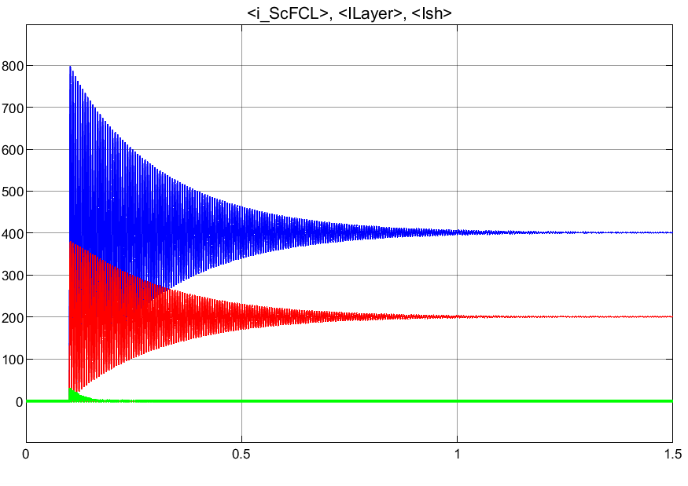
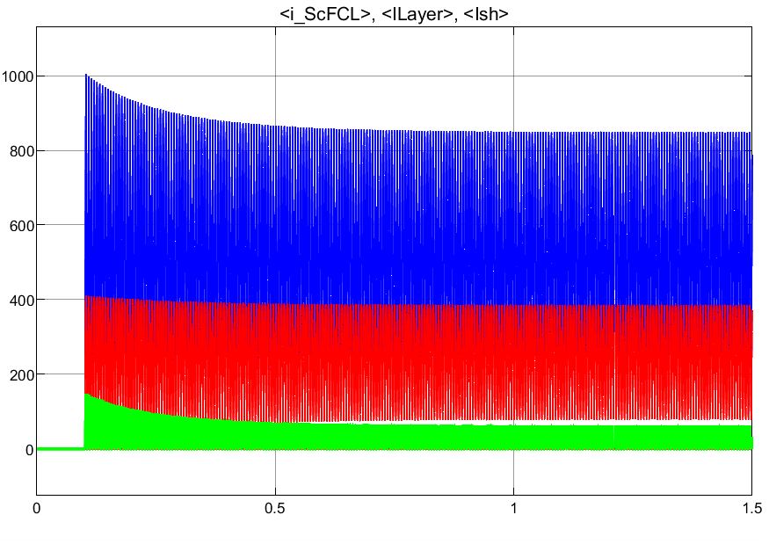
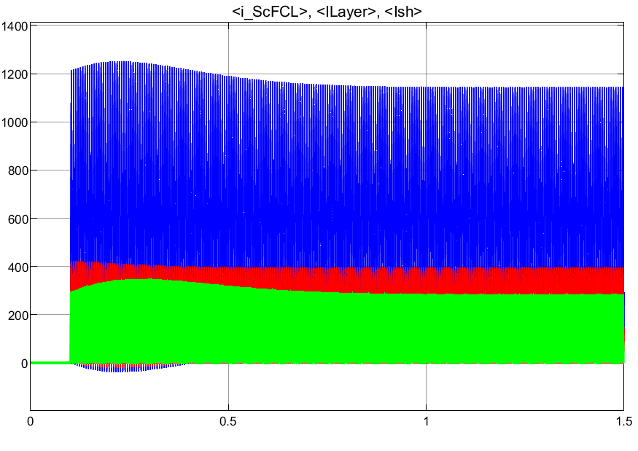
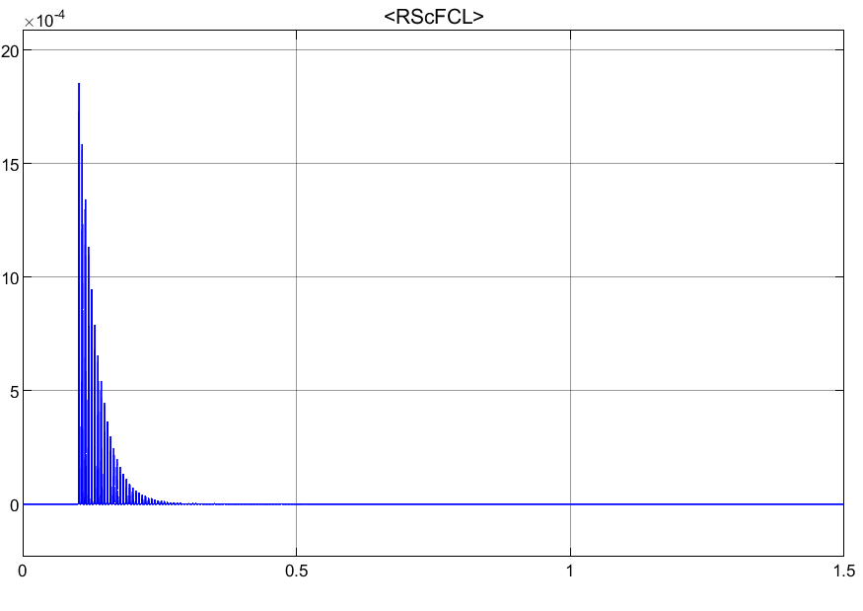
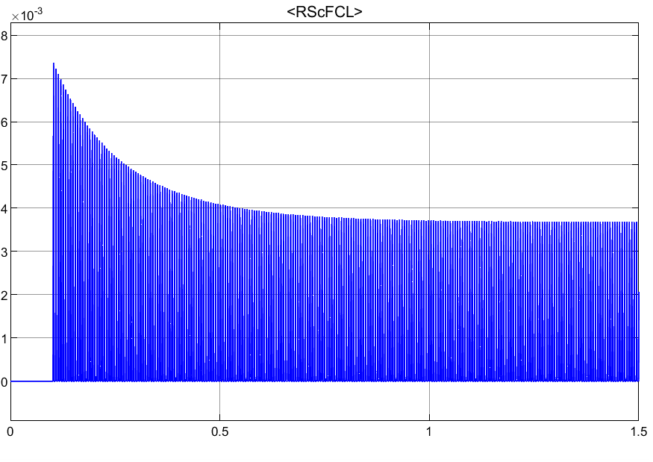
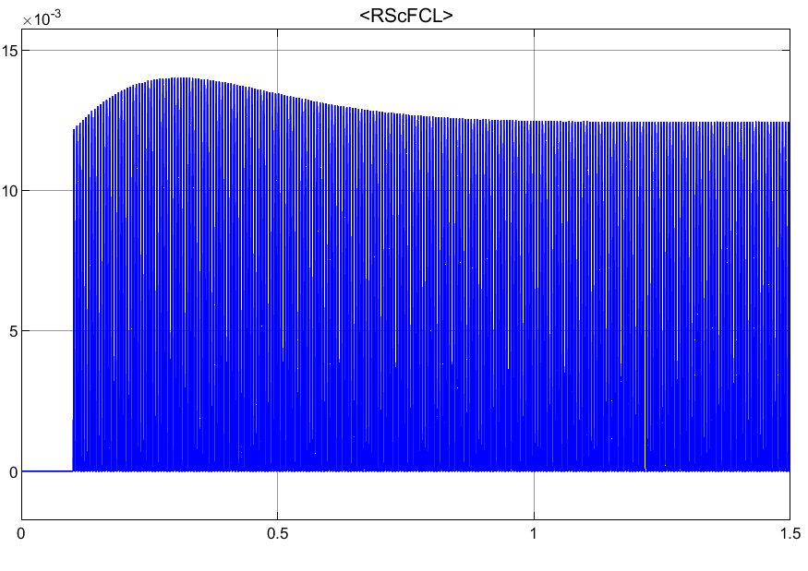
ScPF behavior (simulated with Matlab)
Ps = 2 MW : stable Ps = 2.5 MW : stable Ps = 3 MW : stable
iScPF [A]
rScPF [Ω]
15

Slide 16
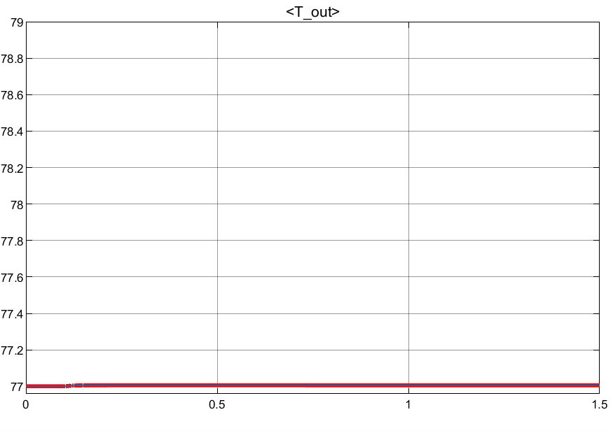
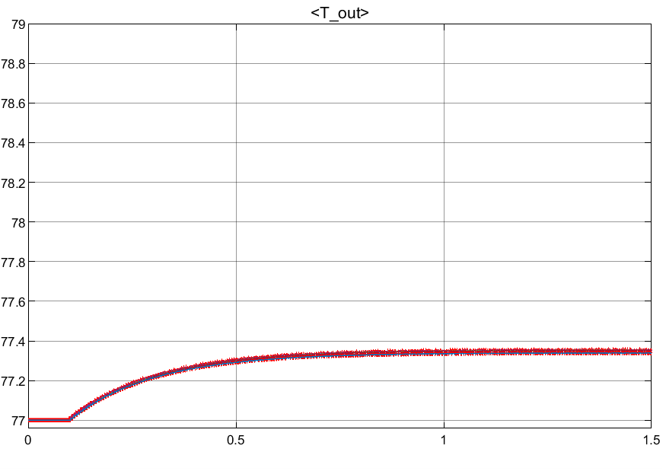
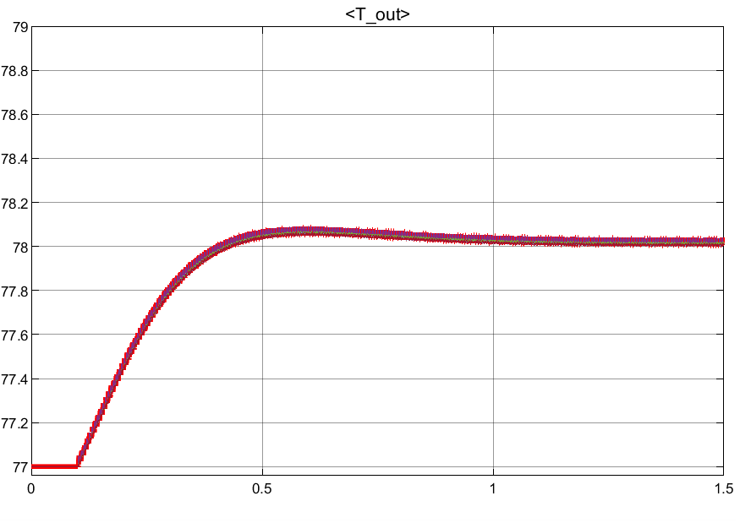
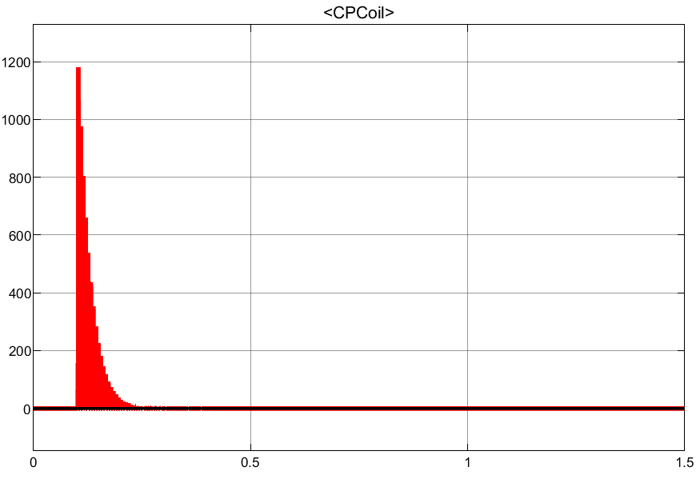
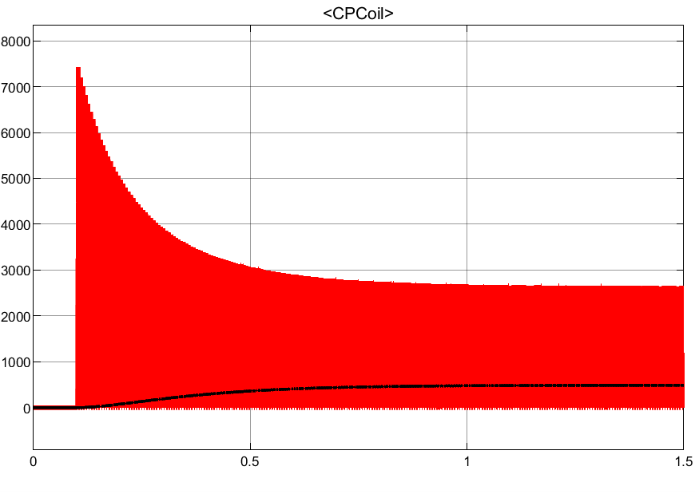
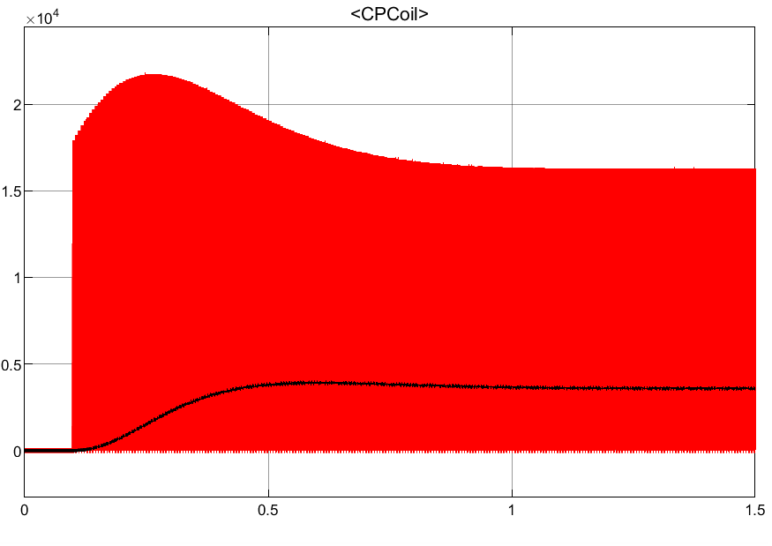

ScPF behavior (simulated with Matlab)
Ps = 2 MW : stable Ps = 2.5 MW : stable Ps = 3 MW : stable
TSC [K]
$Power_{super }$, CPcoil [W]
16

Slide 17
III. Filter’s optimization
17

Slide 18
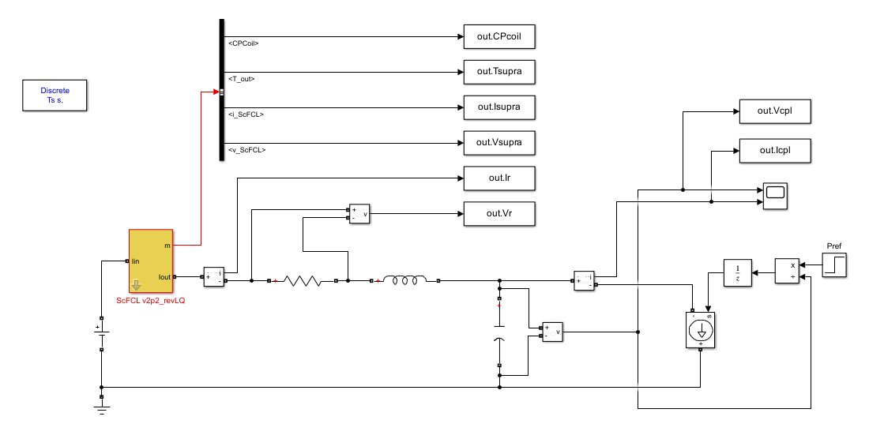
Coupling between MOPSO and Simulink
Initialization
Model
Constraint checking
Pareto front
Evaluation of the solution
Simulink
18

Slide 19

Constraints
Stability for P = 2.33 MW
Parameters
30 particles, 100 iterations
Optimization according to R and -L
Goal: check the coupling
- No concrete physical interpretation
Variables
$R∈[{30⋅10}^{−3};{50⋅10}^{−3}]$[$Ω$]
$L∈[{0.2⋅10}^{−3};{0.8⋅10}^{−3}]$[H]
Objectives
$$\min\left\{\begin{aligned}R \\ −L\end{aligned}\right.$$
19

Slide 20
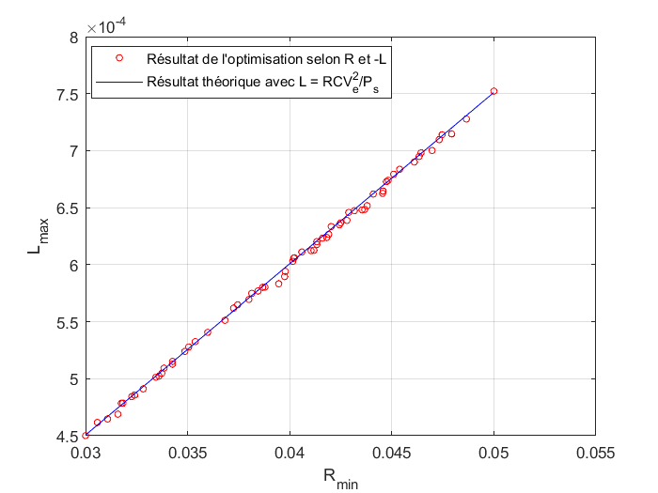

Optimization according to R et -L
$$P_{s}≤\frac{RC}{L}V_{e}^{2}$$
=> Coupling between Matlab and Simulink : Ok for the test
Unfeasible domain
Feasible domain
20

Slide 21
III. 1. Optimization Cost_copper / Cost_super
21

Slide 22
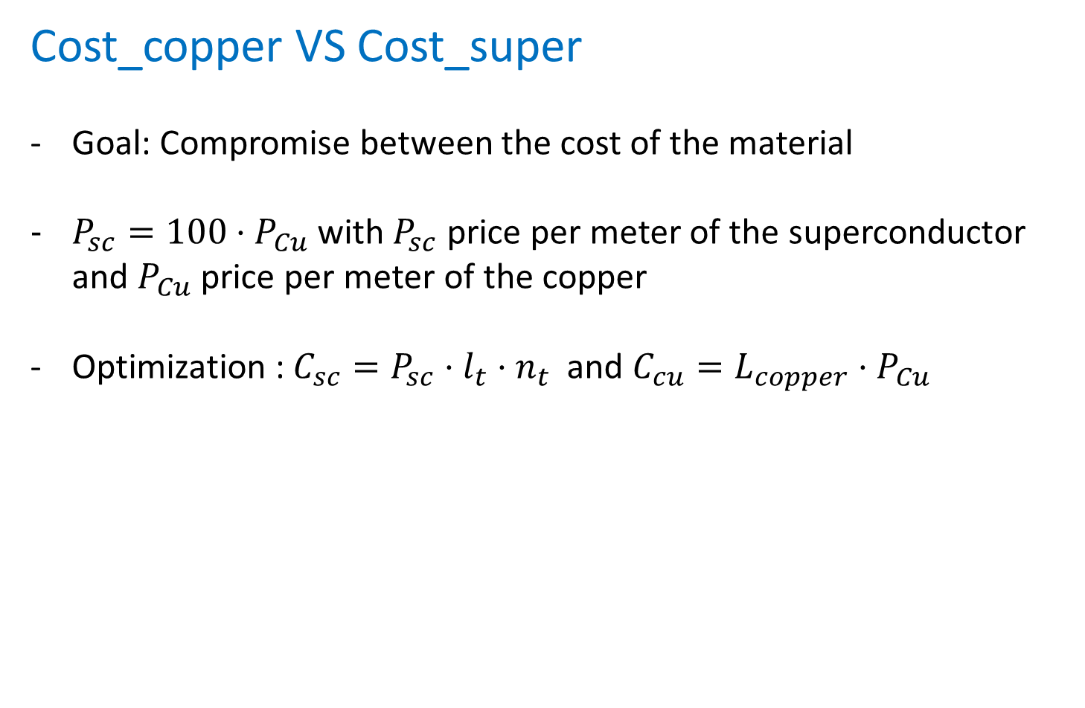


Cost_copper VS Cost_super
Goal: Compromise between the cost of the material
$P_{sc}=100⋅P_{Cu}$ with $P_{sc}$ price per meter of the superconductor and $P_{Cu}$ price per meter of the copper
Optimization : $C_{sc}=P_{sc}⋅l_{t}⋅n_{t}$ and $C_{cu}=L_{copper}⋅P_{Cu}$
Rsh (length = $L_{copper}$)
Ic
$n_{t}$superconductor (length = $l_{t}$)
22

Slide 23



L_copper
$L_{copper}=\frac{R_{sh}S}{ρ}$
with S the section of the wire and $ρ$ the resistivity of the copper
$S=\frac{n_{t}I_{c}}{J}$
with $J=2$ A/mm² and $I_{c}=300$ A (maximum current into the superconductor)
Rsh (length = $L_{copper}$)
Ic
$n_{t}$superconductor (length = $l_{t}$)
23

Slide 24

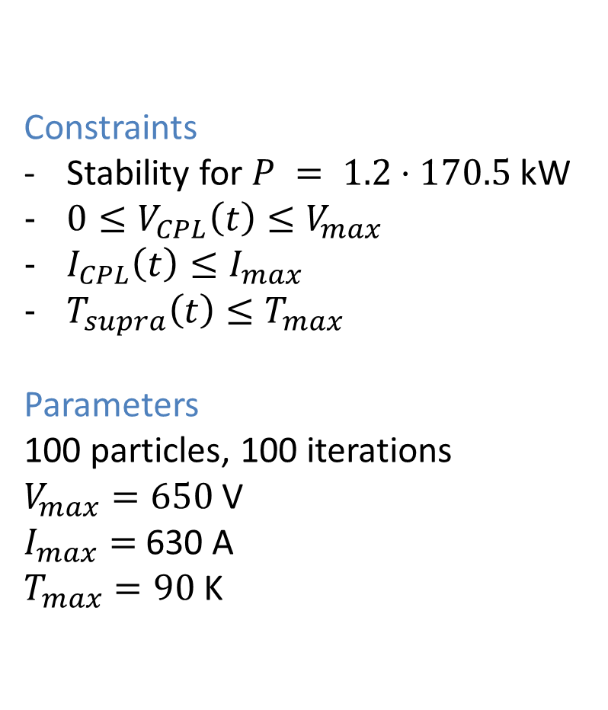
Constraints
Stability for $P = 1.2⋅170.5$kW
$0≤V_{CPL}\left(t\right)≤V_{max}$
$I_{CPL}\left(t\right)≤I_{max}$
$T_{supra}\left(t\right)≤T_{max}$
Parameters
100 particles, 100 iterations
$V_{max}=650$V
$I_{max}=$ 630 A
$T_{max}=90$ K
Optimization according to $C_{cu}$ and $C_{sc}$
Variables
$$n_{t}∈⟦1;3⟧$$
$L_{t}∈[1;100]$[m]
$R_{sh}∈\left[{0.1⋅10}^{−3};1\right]$[$Ω$]
Objectives
$$\min\left\{\begin{aligned}C_{sc} \\ C_{cu}\end{aligned}\right.$$
24

Slide 25

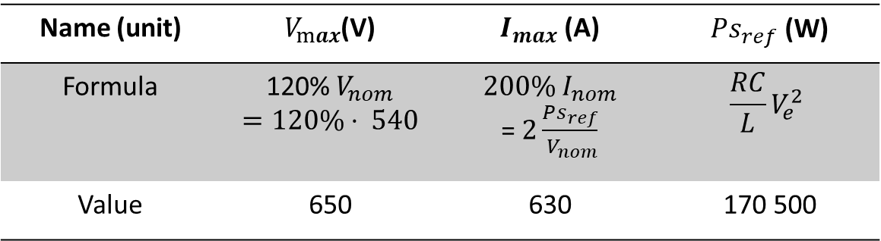
$$0≤V_{CPL}\left(t\right)≤V_{max}$$
$$I_{CPL}\left(t\right)≤I_{max}$$
Parameters
Name (unit) | $V_{max}$(V) | $I_{max}$ (A) | $Ps_{ref}$ (W)
Formula | 120% $V_{nom}$ $$=120\%⋅ 540$$ | $$200\% I_{nom}$$ = $2\frac{Ps_{ref}}{{ V}_{nom}}$ | $$\frac{RC}{L}V_{e}^{2}$$
Value | 650 | 630 | 170 500
25

Slide 26
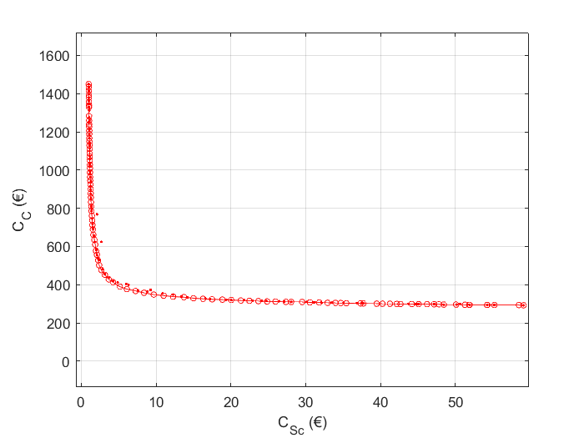
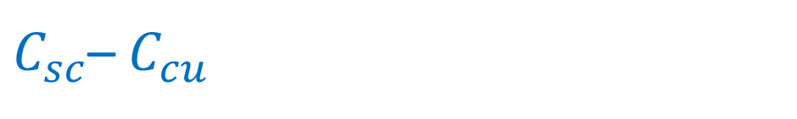
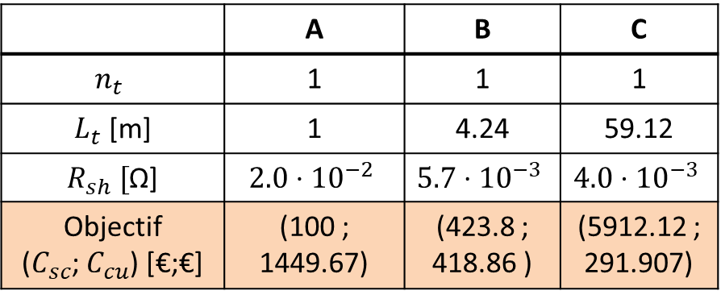
$C_{sc}$– $C_{cu}$
 | A | B | C
$$n_{t}$$ | 1 | 1 | 1
$L_{t}$ [m] | 1 | 4.24 | 59.12
$R_{sh} [$Ω] | $$2.0⋅{10}^{−2}$$ | $$5.7⋅{10}^{−3}$$ | $$4.0⋅{10}^{−3}$$
Objectif ($C_{sc}$; $C_{cu}$) [€;€] | (100 ; 1449.67) | (423.8 ; 418.86 ) | (5912.12 ; 291.907)
A
B
C
26

Slide 27
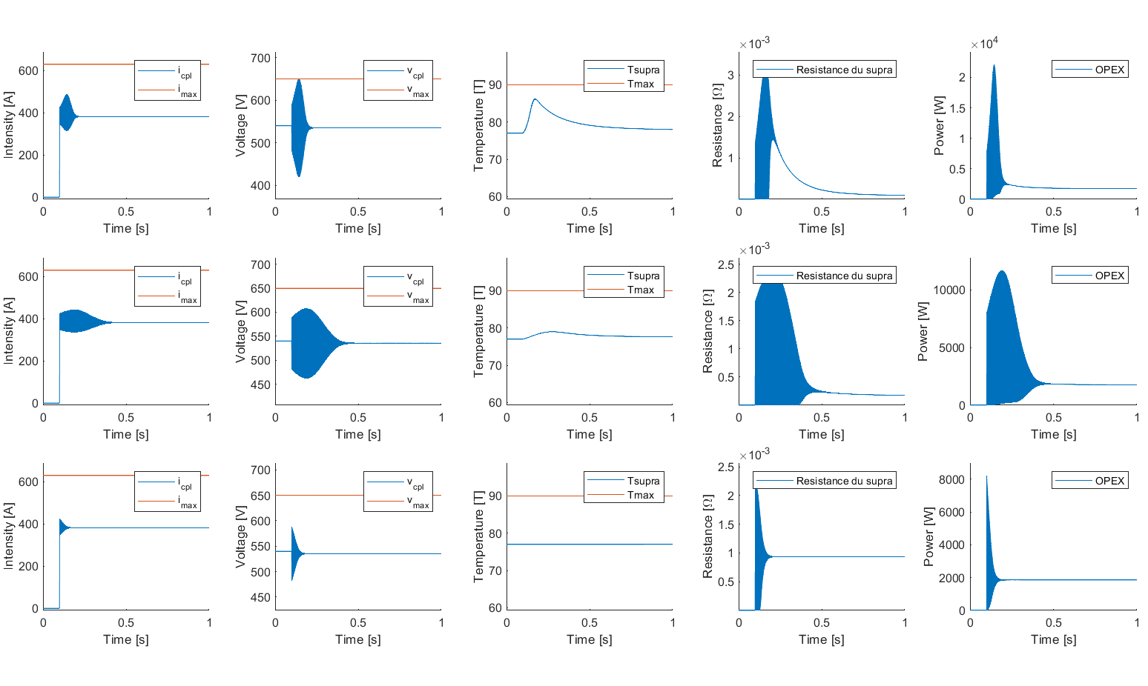
A
C
Particular points
B
Point A
Point B
Point C
27

Slide 28

III. 2. Optimization CAPEX / $Power_{CPL}$
28

Slide 29
Interests to increase the power of the CPL
A break of one reactor: how many power can we have with another one?
Pressurisation problem, climatisation
During the landing and the take-off: more power needed in the plane
=> How the CAPEX influence the overpower allowed?
29

Slide 30



CAPEX
CAPEX = Capital expenditure
Formula
$$CAPEX=C_{sc}+C_{cu}$$
Hypothesis
$P_{sc}=100⋅P_{c}$
$L_{copper}=\frac{R_{sh}S}{ρ}$
$S=\frac{n_{t}I_{c}}{J}$
Rsh (length = $L_{copper}$)
Ic
$n_{t}$superconductor (length = $l_{t}$)
30

Slide 31

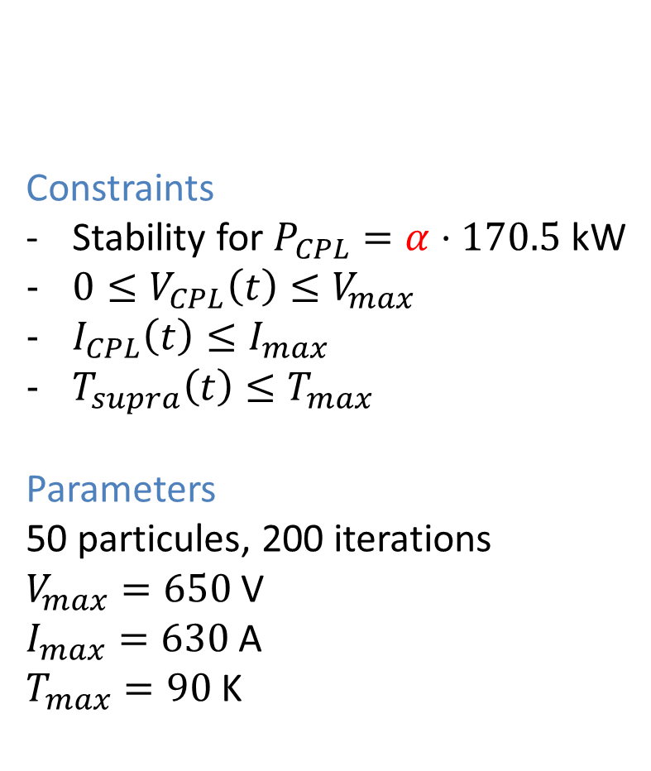
Constraints
Stability for $P_{CPL}=α⋅170.5$ kW
$0≤V_{CPL}\left(t\right)≤V_{max}$
$I_{CPL}\left(t\right)≤I_{max}$
$T_{supra}\left(t\right)≤T_{max}$
Parameters
50 particules, 200 iterations
$V_{max}=650$ V
$I_{max}=630$A
$T_{max}=90$K
Optimization according to CAPEX and power of the constant power load
Variables
$$n_{t}∈⟦1;3⟧$$
$L_{t}∈[1;100]$[m]
$R_{sh}∈\left[0.1⋅{10}^{−3};1\right]$[$Ω$]
$$α∈[1;2.5]$$
Objectives
$$\min\left\{\begin{aligned}−α \\ CAPEX\end{aligned}\right.$$
31

Slide 32
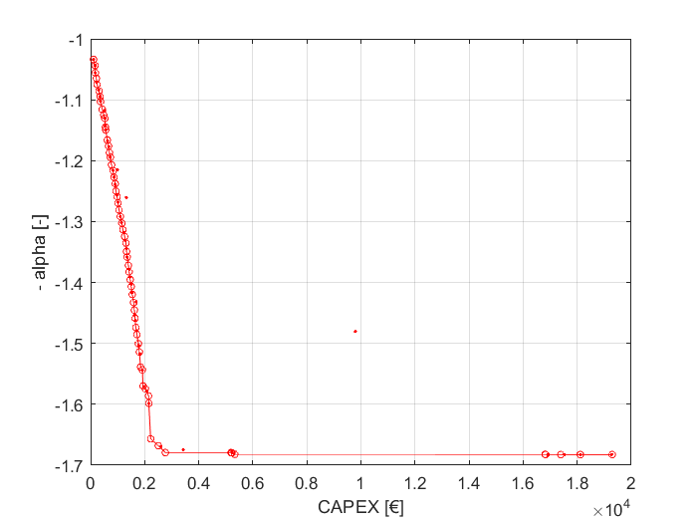


CAPEX – $−α$
 | A | B | C
$$R_{sh} [Ω]$$ | $$1.0⋅{10}^{−4}$$ | $$2.0⋅{10}^{−2}$$ | $$1.1⋅{10}^{−1}$$
$L_{t} [$m] | $$1$$ | $$10.3$$ | $$56.2$$
$$n_{t}$$ | $$1$$ | $$1$$ | $$2$$
$alpha$ | $$1.03$$ | $$1.67$$ | $$1.68$$
Objectif ($−α$; $CAPEX$) [-;€] | (-1.03 ; 107.29) | (-1.67 ; 2502.45 ) | (-1.68 ; 19276)
A
B
C
32

Slide 33

A
Particular points
B
C
Point A
Point B
Point C
33

Slide 34
III. 3. Optimization CAPEX / OPEX
34

Slide 35


Life-cycle approach
• $CAPEX=$ Capital cost
• $OPEX=$ Operation and maintenance cost
• Goal: Have an overview of the cost of the system during its full life-cycle and find a compromise between the cost of maintenance and the cost of investment
35

Slide 36

OPEX
Formula
$$OPEX=CP_{coil}+V_{ScPF}⋅I_{ScPF}+V_{R}⋅I_{R}$$
Hypothesis
Mean value of the sum
CPcoil: power use by the cooling system
36

Slide 37


CAPEX
Formula
$$CAPEX=C_{sc}+C_{cu}$$
Hypothesis
$P_{sc}=100⋅P_{c}$
$C_{sc}=l_{t}n_{t}P_{sc}W_{sc}$
Rsh (length = $L_{copper}$)
Ic
$n_{t}$superconductor (length = $l_{t}$, width = $W_{sc}$)
37

Slide 38



Constraints
Stability for $P = 1.2⋅170.5$ kW
$0≤V_{CPL}\left(t\right)≤V_{max}$
$I_{CPL}\left(t\right)≤I_{max}$
$T_{supra}\left(t\right)≤T_{max}$
Parameters
40 particles, 180 iterations
$V_{max}=650$ V
$I_{max}=$ 630 A
$T_{max}=$ 90 K
Optimization according to CAPEX and OPEX
Variables
$$n_{t}∈⟦1;3⟧$$
$L_{t}∈[1;100]$[m]
$R_{sh}∈\left[{0.1⋅10}^{−3};1\right]$[$Ω$]
Superconductor type :
Objectives
$$\min\left\{\begin{aligned}OPEX \\ CAPEX\end{aligned}\right.$$
$$I_{c}$$ | 75 | 112.5 | 150 | 225 | 300 | 450
$$W_{sc}$$ | 2 | 3 | 4 | 6 | 12 | 12
38

Slide 39


 | A | B | B’ | C
$$R_{sh} [Ω]$$ | $$2.3⋅{10}^{−3}$$ | $$1.0⋅{10}^{−2}$$ | $$1.6⋅{10}^{−2}$$ | $$5.9⋅{10}^{−1}$$
$L_{t} [$m] | $$1$$ | $$3$$ | 26 | 22.3
$$n_{t}$$ | $$1$$ | $$3$$ | 3 | 3
$(Ic;W_{sc})$ [A; mm] | $$(75;2)$$ | $$(75;2)$$ | (112.5; 3) | (112.5; 3)
Objectif ($OPEX$; $CAPEX$) [W;€] | (1997;59.6) | (1677;949) | (1625; 3349) | (1617 ; 49905)
CAPEX - OPEX
A
B
B’
C
39

Slide 40

A
Particular points
B
C
Point A
Point B
Point C
40

Slide 41
IV. Conclusion
41

Slide 42

Conclusion
5 parameters to optimize through 3 optimization problems different
- $Cost_{copper}$
- $Cost_{superconductor}$
- $α$: load power
- CAPEX
- OPEX
42

Slide 43
Thank you !
43

Slide 44
References
[1] L. Herrera, W. Zhang and J. Wang, "Stability Analysis and Controller Design of DC Microgrids With Constant Power Loads," in IEEE Transactions on Smart Grid, vol. 8, no. 2, pp. 881-888, March 2017, doi: 10.1109/TSG.2015.2457909.
[2] A. Russo and A. Cavallo, "Supercapacitor stability and control for More Electric Aircraft application," 2020 European Control Conference (ECC), St. Petersburg, Russia, 2020, pp. 1909-1914, doi: 10.23919/ECC51009.2020.9143927
[3] G. Ensermu and A. Bhattacharya, "Control and Stability Analysis of DC Micro-grids with Constant Power Loads and Source Disturbances," 2018 IEEE International Conference on Power Electronics, Drives and Energy Systems (PEDES), Chennai, India, 2018, pp. 1-6, doi: 10.1109/PEDES.2018.8707605.
[4] M. Dehghani, M. Ghiasi, M. GhasemiGarpachi, T. Niknam, A. Kavousi-Fard and H. Shirazi, "Stabilization of DC/DC Converter with Constant Power Load using Exact Feedback Linearization Method based on Backstepping Sliding Mode Control and Nonlinear Disturbance Observer," 2021 12th Power Electronics, Drive Systems, and Technologies Conference (PEDSTC), Tabriz, Iran, 2021, pp. 1-6, doi: 10.1109/PEDSTC52094.2021.9405916.
[5] J. G. Ciezki and R. W. Ashton, "Selection and stability issues associated with a navy shipboard DC zonal electric distribution system," in IEEE Transactions on Power Delivery, vol. 15, no. 2, pp. 665-669, April 2000, doi: 10.1109/61.853002. [6] A. Kwasinski and C. N. Onwuchekwa, "Dynamic Behavior and Stabilization of DC Microgrids With Instantaneous Constant-Power Loads," in IEEE Transactions on Power Electronics, vol. 26, no. 3, pp. 822-834, March 2011, doi: 10.1109/TPEL.2010.2091285. [7] D. Gunji, T. Imura and H. Fujimoto, "Stability analysis of constant power load and load voltage control method for Wireless In-Wheel Motor," 2015 9th International Conference on Power Electronics and ECCE Asia (ICPE-ECCE Asia), Seoul, Korea (South), 2015, pp. 1944-1949, doi: 10.1109/ICPE.2015.7168044. [8] P. Magne, B. Nahid-Mobarakeh and S. Pierfederici, "General Active Global Stabilization of Multiloads DC-Power Networks," in IEEE Transactions on Power Electronics, vol. 27, no. 4, pp. 1788-1798, April 2012, doi: 10.1109/TPEL.2011.2168426. P. Magne, B. Nahid-Mobarakeh and S. Pierfederici, "General Active Global Stabilization of Multiloads DC-Power Networks," in , vol. 27, no. 4, pp. 1788-1798, April 2012, doi: 10.1109/TPEL.2011.2168426.
44

Slide 45
III. 3. Optimization CAPEX / OPEX with only one type of superconductor
45

Slide 46



CAPEX
Formula
$$CAPEX=C_{sc}+C_{cu}$$
Hypothesis
$P_{sc}=100⋅P_{c}$
$L_{copper}=\frac{R_{sh}S}{ρ}$
$S=\frac{n_{t}I_{c}}{J}$
Rsh (length = $L_{copper}$)
Ic
$n_{t}$superconductor (length = $l_{t}$)
46

Slide 47
OPEX
Formula
$$OPEX=CP_{coil}+V_{ScPF}⋅I_{ScPF}+V_{R}⋅I_{R}$$
Hypothesis
Mean value of the sum
CPcoil: power use by the cooling system
47

Slide 48


Constraints
Stability for $P = 1,2×170,5$ kW
$0≤V_{CPL}\left(t\right)≤V_{max}$
$I_{CPL}\left(t\right)≤I_{max}$
$T_{supra}\left(t\right)≤T_{max}$
Parameters
30 particles, 150 iterations
$V_{max}=650$V
$I_{max}=$ 630 A
$T_{max}=90$ K
Optimization according to CAPEX and OPEX
Variables
$$n_{t}∈⟦1;3⟧$$
$L_{t}∈[1;100]$[m]
$R_{sh}∈\left[{0.1⋅10}^{−3};1\right]$[$Ω$]
Objectives
$$\min\left\{\begin{aligned}OPEX \\ CAPEX\end{aligned}\right.$$
48

Slide 49


CAPEX - OPEX
A
 | A | B | C
$$R_{sh} [Ω]$$ | $$6.7⋅{10}^{−3}$$ | $$2.2⋅{10}^{−2}$$ | $$7.4⋅{10}^{−1}$$
$L_{t}[$m] | 2.6 | 2.6 | 2.0
$$n_{t}$$ | 1 | 1 | 1
Objectif ($CAPEX$; $OPEX$) [€;W] | (745.87 ; 2138.98) | (1887.9 ; 1660.65 ) | (54510.5 ; 1657.71)
B
C
49

Slide 50

A
Particular points
B
C
Point A
Point B
Point C
50

