Slide 1
Considering the superconductor in the circuit
Thomas B., Henri A., Oussama H., Benoît L. Bilal Z.

Slide 2
Ahead of a certain power demand, the system becomes unstable
Would the implementation of a superconductive resistor solve this issue?

Slide 3
Content
Results without superconductor
Results with superconductor
Conclusion

Slide 4
I. Results without superconductor

Slide 5
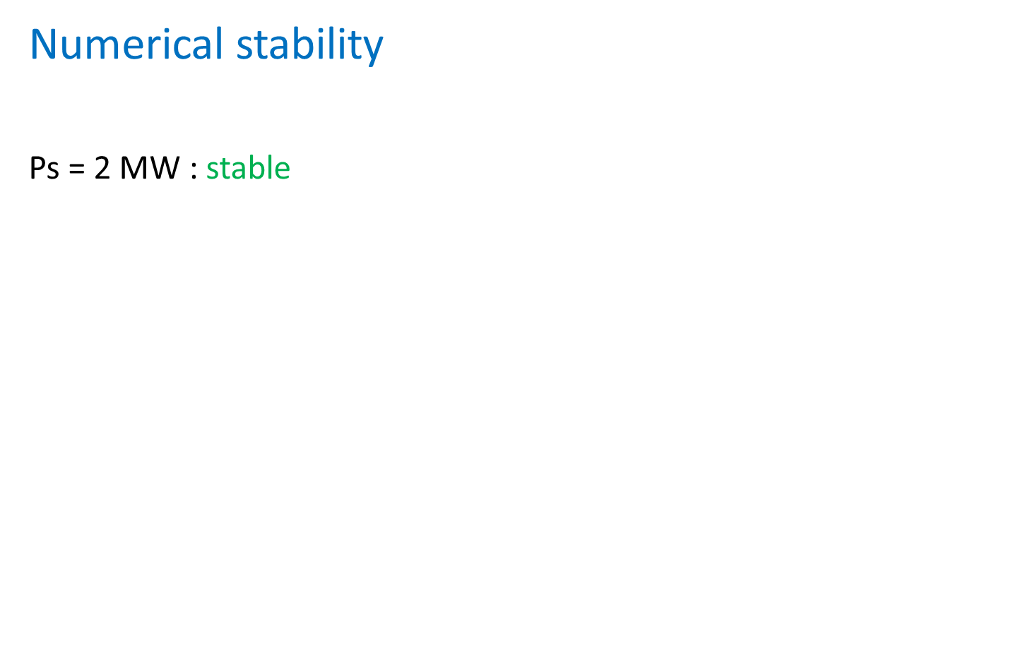
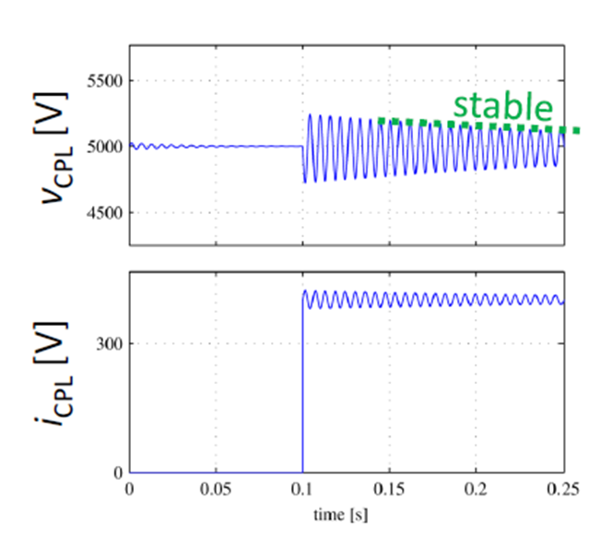
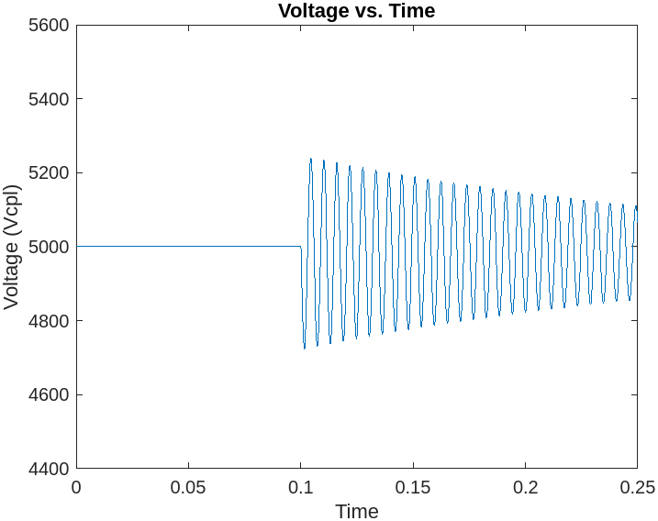
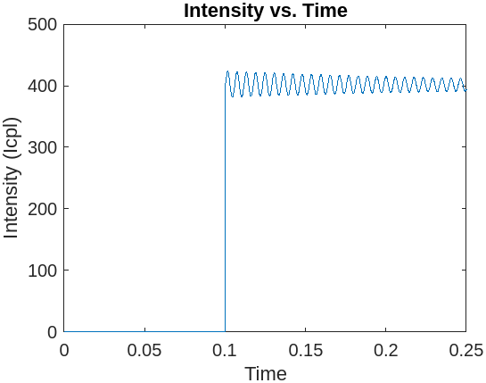
[x] in 10 pt (for references at the bottom of the slide)

Slide 6
II. Instability mitigation

Slide 7
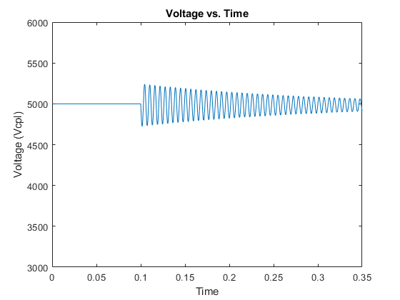
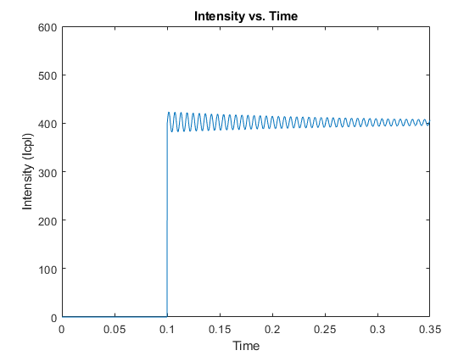
Resolution of the issue
Adding a superconductive resistor solves the instability issue while causing no losses
As expected, when the load is lower than the threshold load (here 2MW), the system tends to stabilize

Slide 8
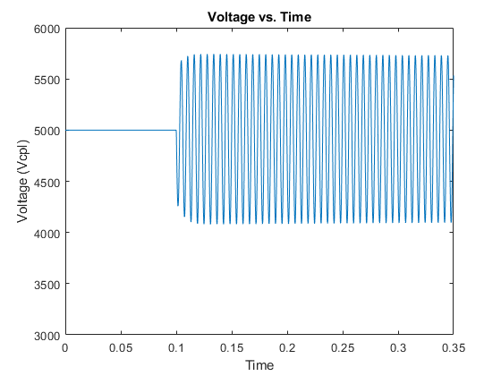
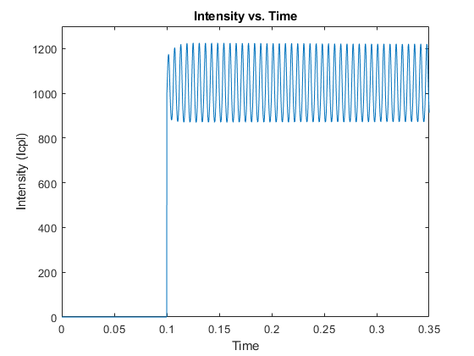
But with the superconductor added, even load much higher than the expected threshold do not diverge (here the load is 5MW)

Slide 9
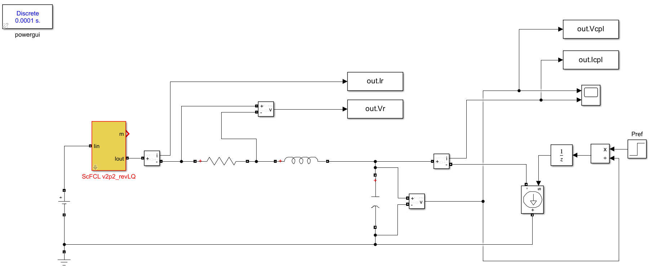
Estimation of the Parameters found in : Feasibility Study of a Superconducting Power Filter for HVDC grids by Loïc Queval, Olivier Despouys, Frederic Trillaud, Bruno Douine
Here is the circuit used:

Slide 10
III. Conclusion

Slide 11
Conclusion
High loads cause instability in the system
A higher resistance would dampen it but would also cause huge losses
A superconductive resistance takes the best of both worlds

Slide 12
Merci !

Slide 13
References
[1] | P.C. Krause, O. Wasynczuk, S.D. Sudhoff, Analysis of electric machinery and drive systems, IEEE Press, 2002.
[2] | L. Quéval, H. Ohsaki, "Nonlinear abc-model for electrical machines using N-D lookup tables," IEEE Transactions on Energy Conversion, vol. 30, no. 1, pp. 316-322, March 2015.
[3] | L. Quéval, A. Coty, L. Vido, B. Multon, "Photovoltaic motors review, comparison and switched reluctance motor prototype," 10th International Conference on Ecological Vehicles and Renewable Energies (EVER2015), Monaco, April 2015.
[4] | L. Quéval, "Modeling and simulation of grid-connected superconducting wind turbine generators," PhD thesis, The University of Tokyo, Tokyo, Japan, 2013.
[5] | "COMSOL Multiphysics version 4.3a" [Online]. Available: www.comsol.com.

