Slide 1
Optimization of an aeronautic propulsion system
Thomas B., Henri A., Oussama H., Benoît l., Bilal Z.
^{29/03/2023}
1

Slide 2
Content
Context
Filter modelisation
Superconducting filter optimisation
Conclusion
2

Slide 3
Context
3

Slide 4
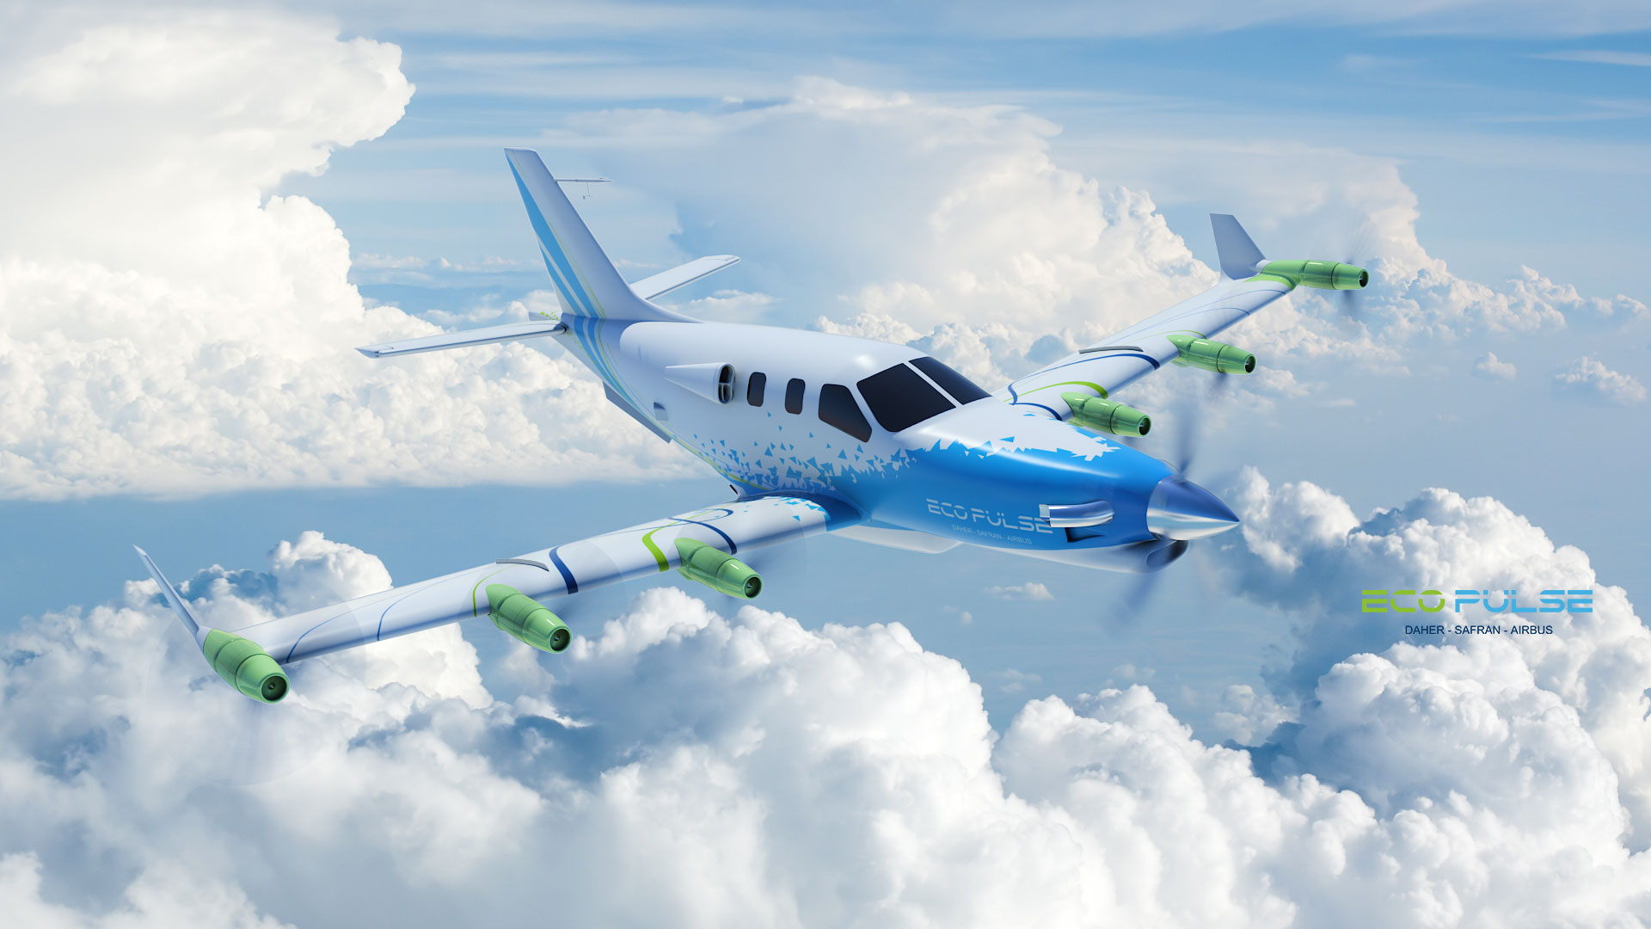
The EcoPulse hybrid airplane, developped Daher, Safran and Airbus. Credit : daher.com
4

Slide 5
II. Filter Modelisation
5

Slide 6
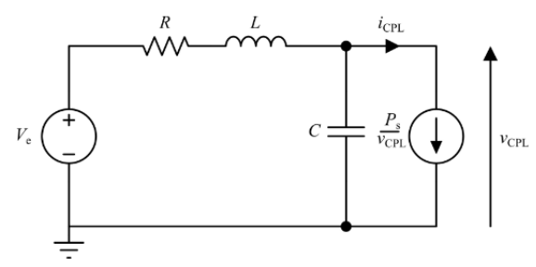

Stability condition for a DC circuit under constant power load
Stable if
$$P_{s}≤\frac{RC}{L}V_{e}^{2}$$
6

Slide 7
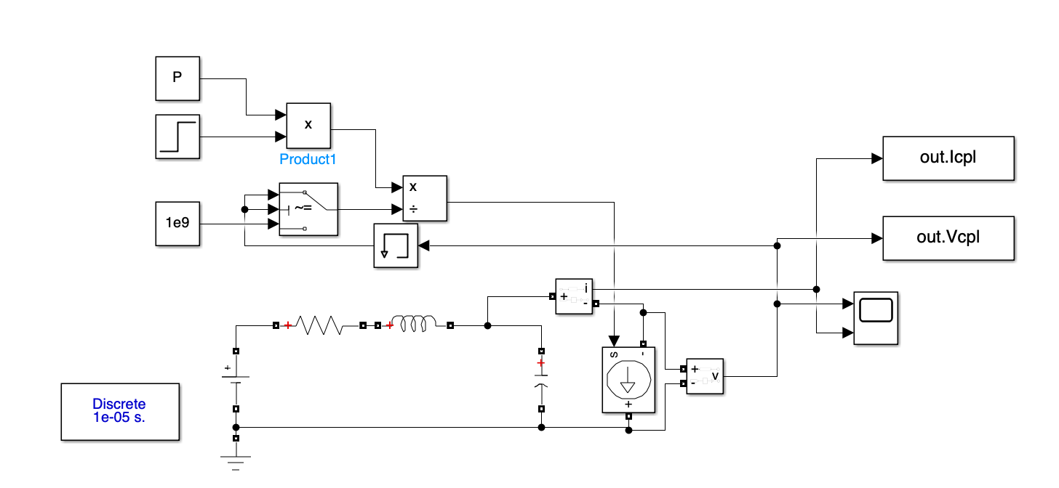
Stability condition for a DC circuit under constant power load
7

Slide 8
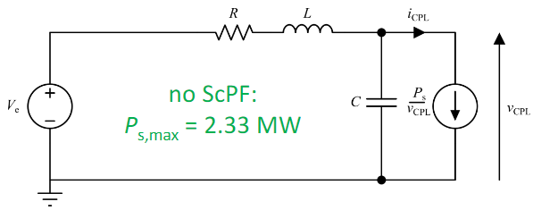
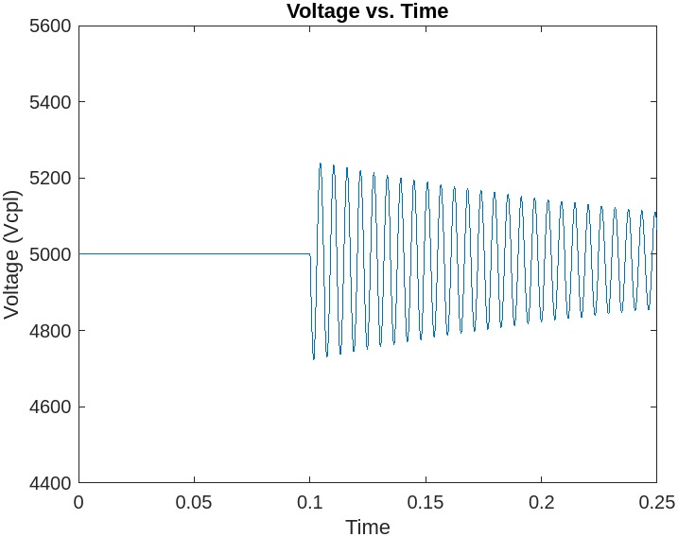
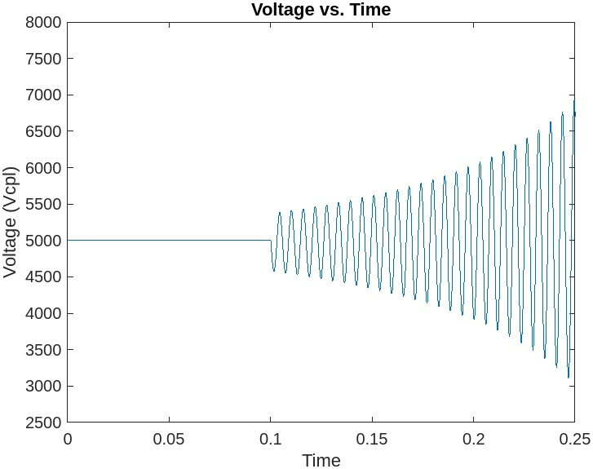
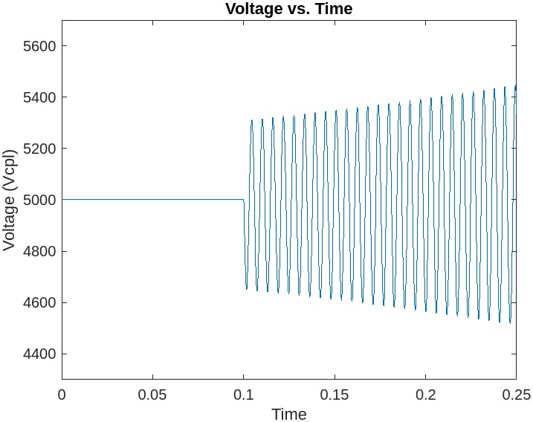
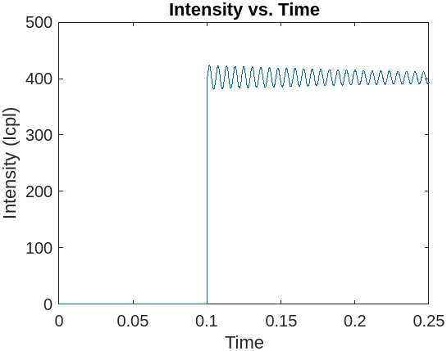
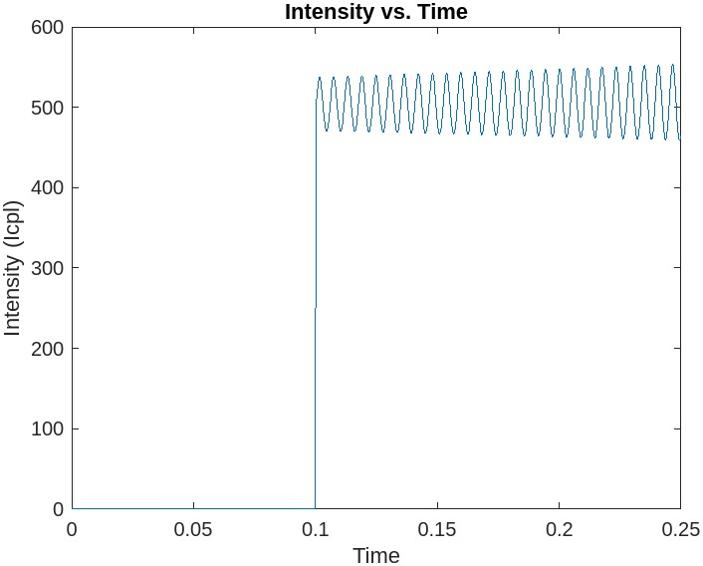
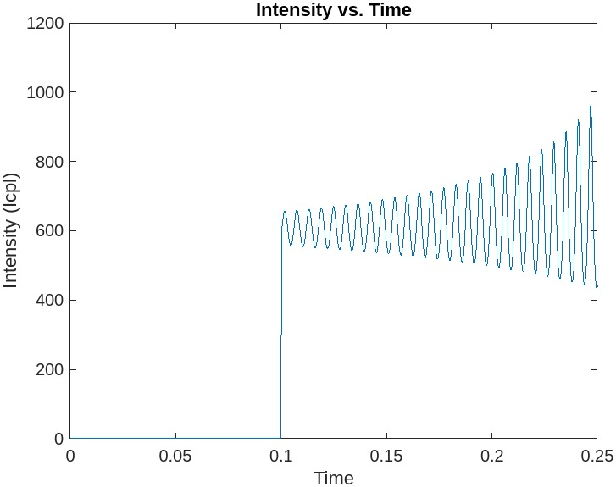

Numerical stability
$$P_{s, max}=\frac{RC}{L}V_{e}^{2}$$
Ps = 2 MW : stable Ps = 2.5MW : Unstable Ps = 3MW : Unstable
8

Slide 9
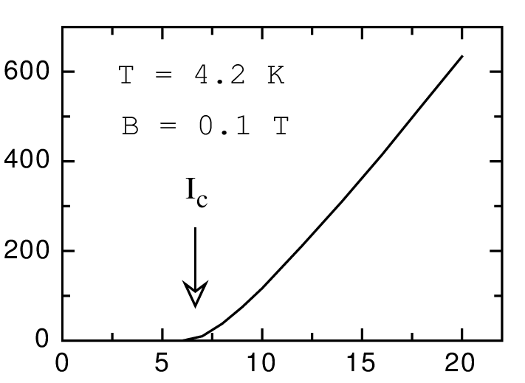
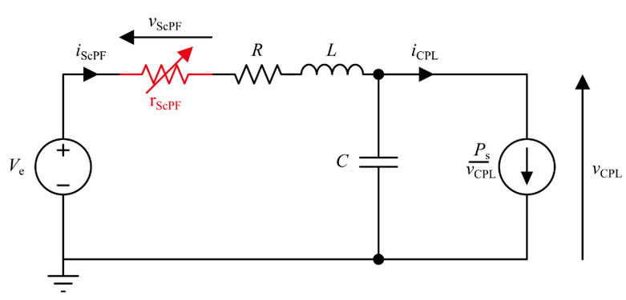


Stability condition for a DC circuit under constant power load with superconductor
Stable if: $P_{s}≤\frac{(R+r_{supra}\left(I\right))C}{L}V_{e}^{2}$
Rsh
$n_{t}$superconductor (length = $L_{t}$)
9

Slide 10
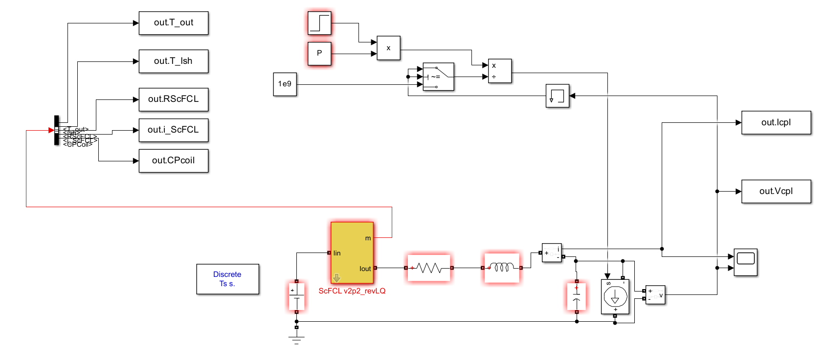
Stability condition for a DC circuit under constant power load
Stable if
$$P_{s}≤\frac{RC}{L}V_{e}^{2}$$
10

Slide 11
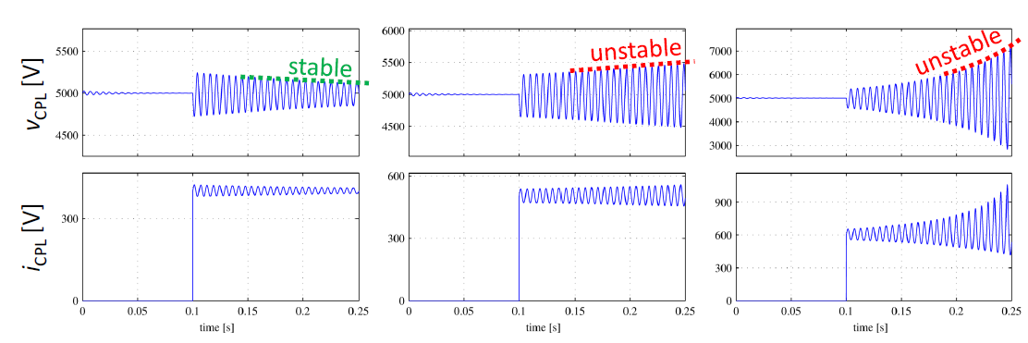
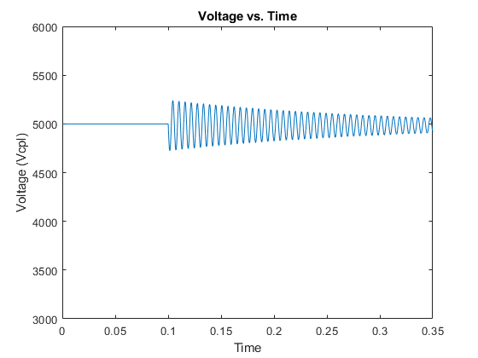
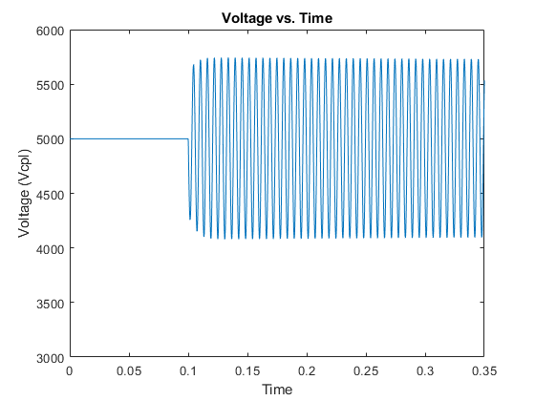
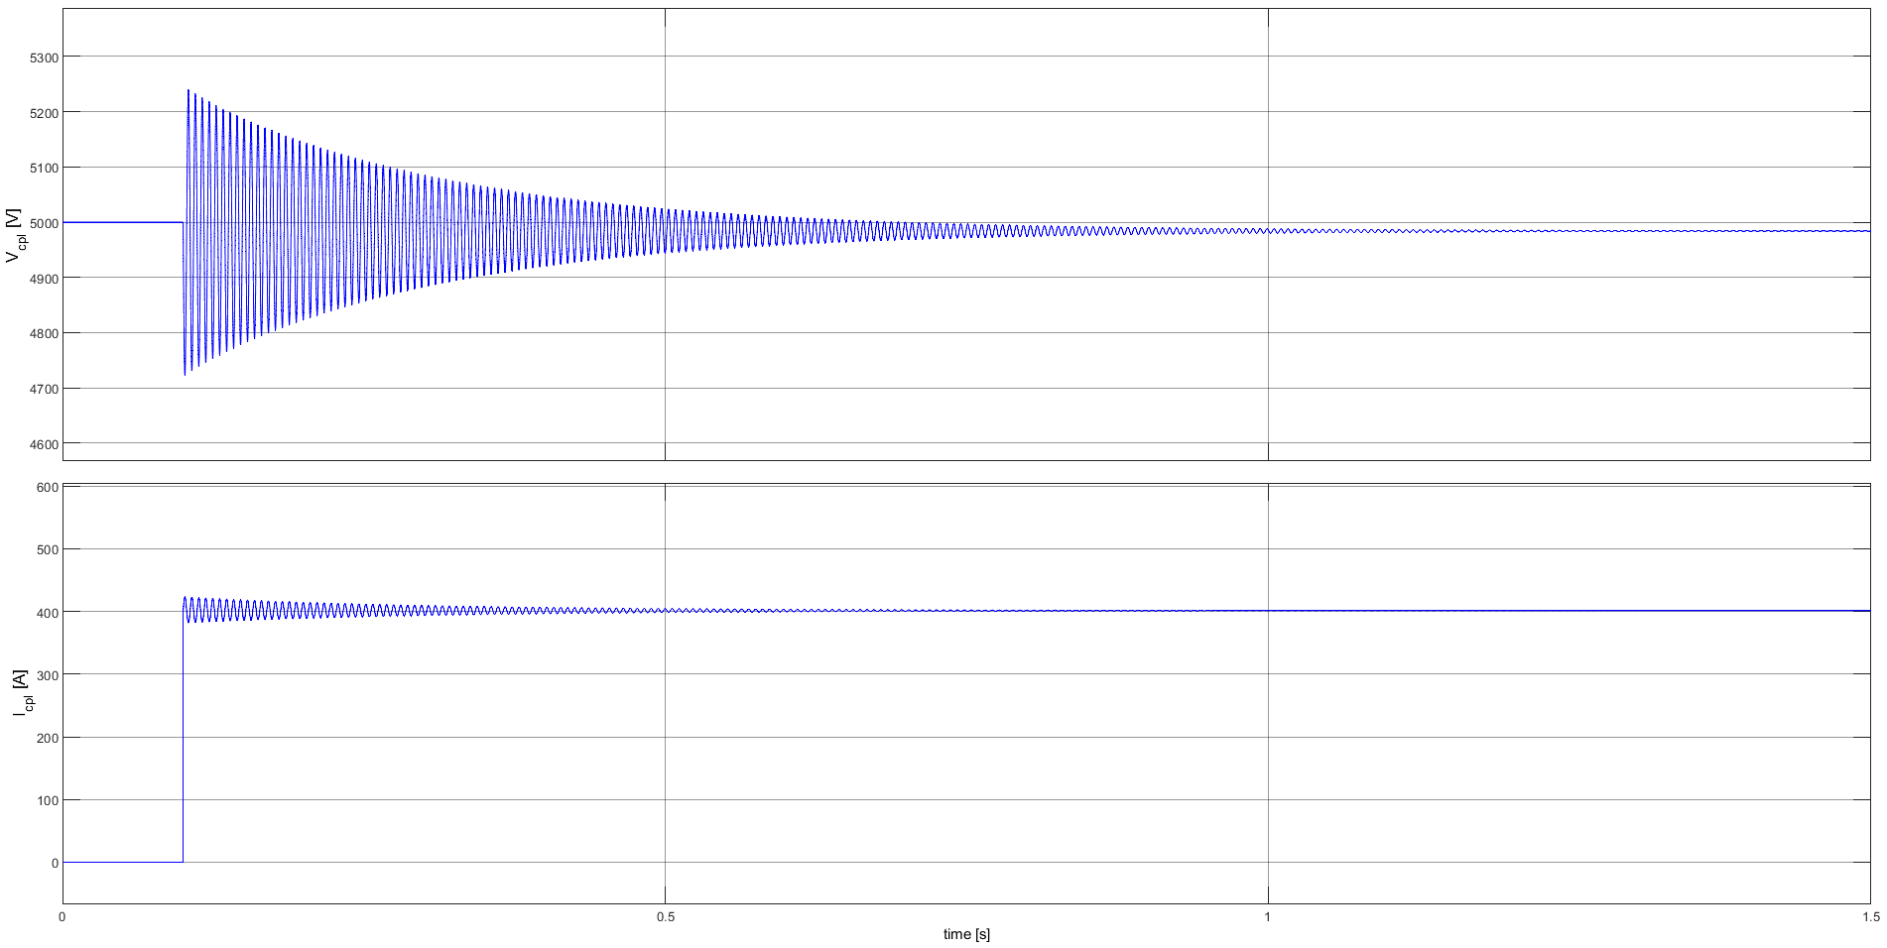
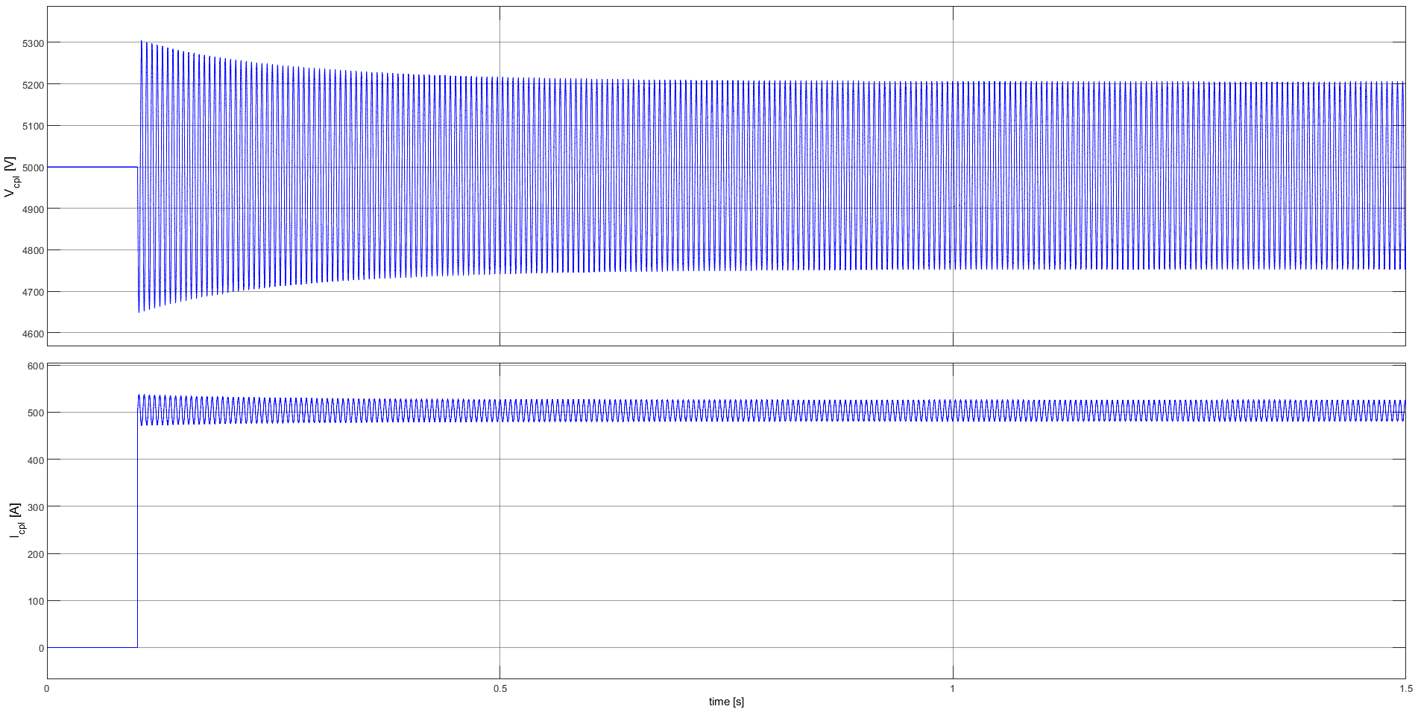
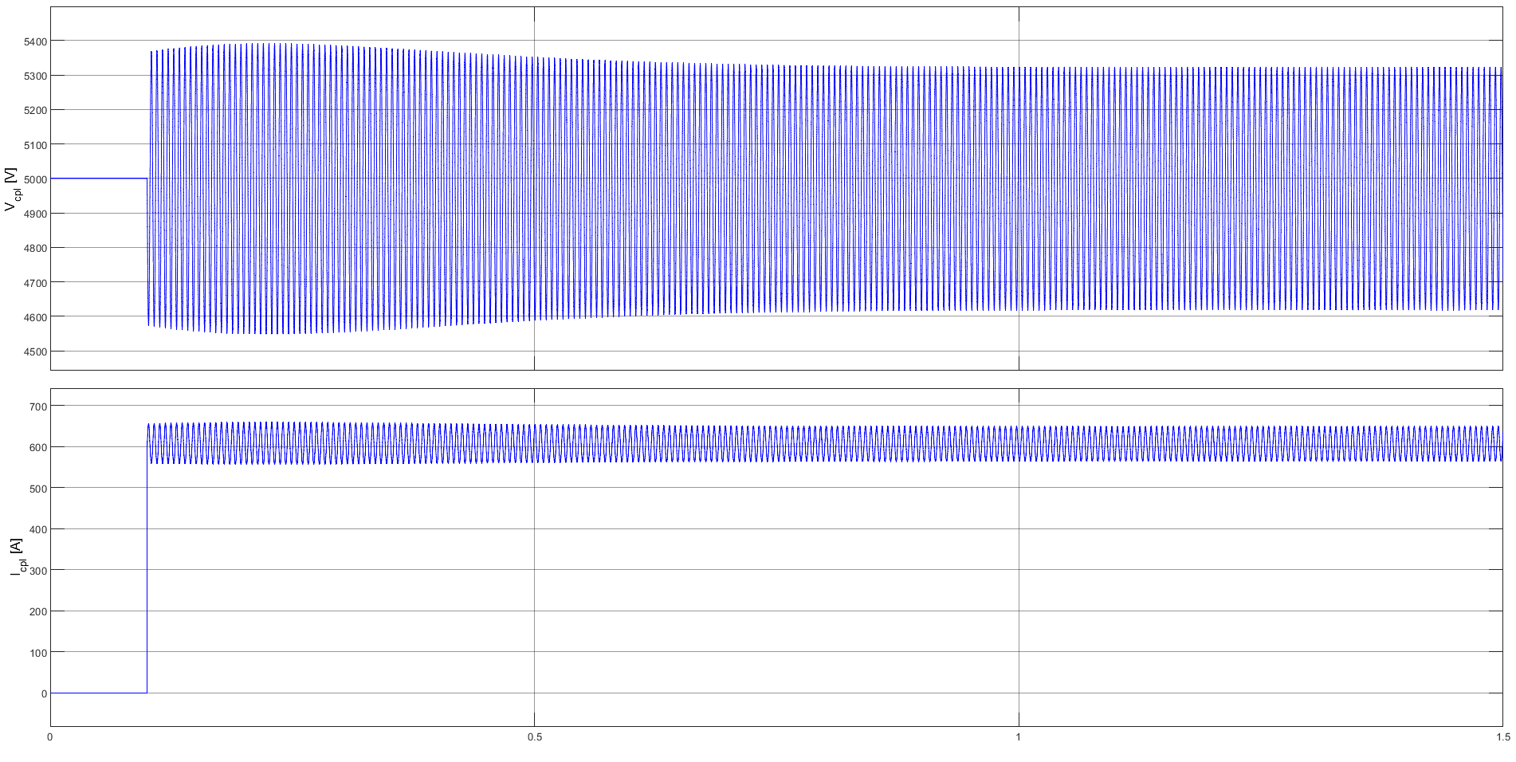
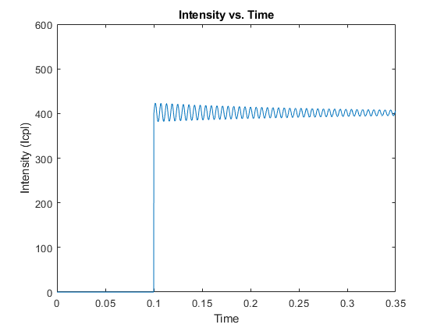
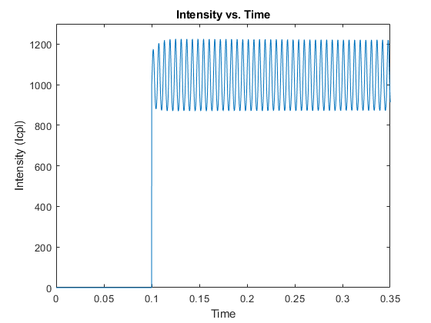
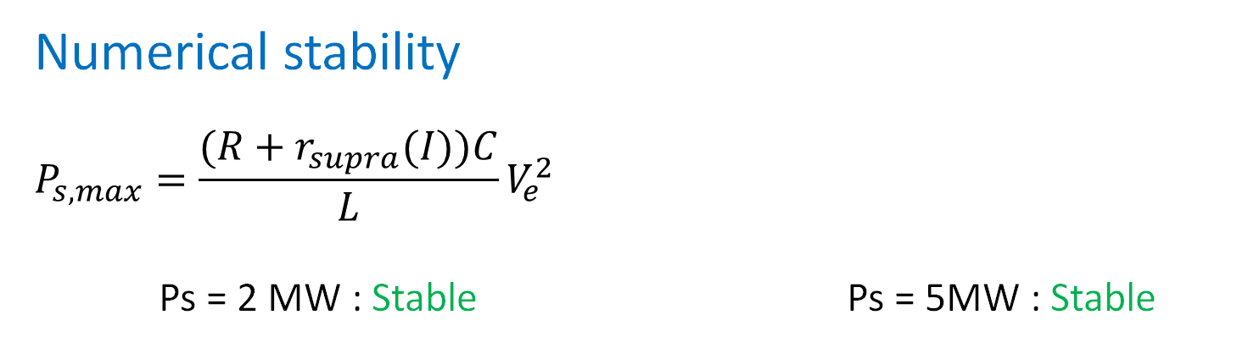
Numerical stability
$$P_{s, max}=\frac{(R+r_{supra}(I))C}{L}V_{e}^{2}$$
Ps = 2 MW : Stable Ps = 5MW : Stable
We have stability for all power loads
[A]
11

Slide 12
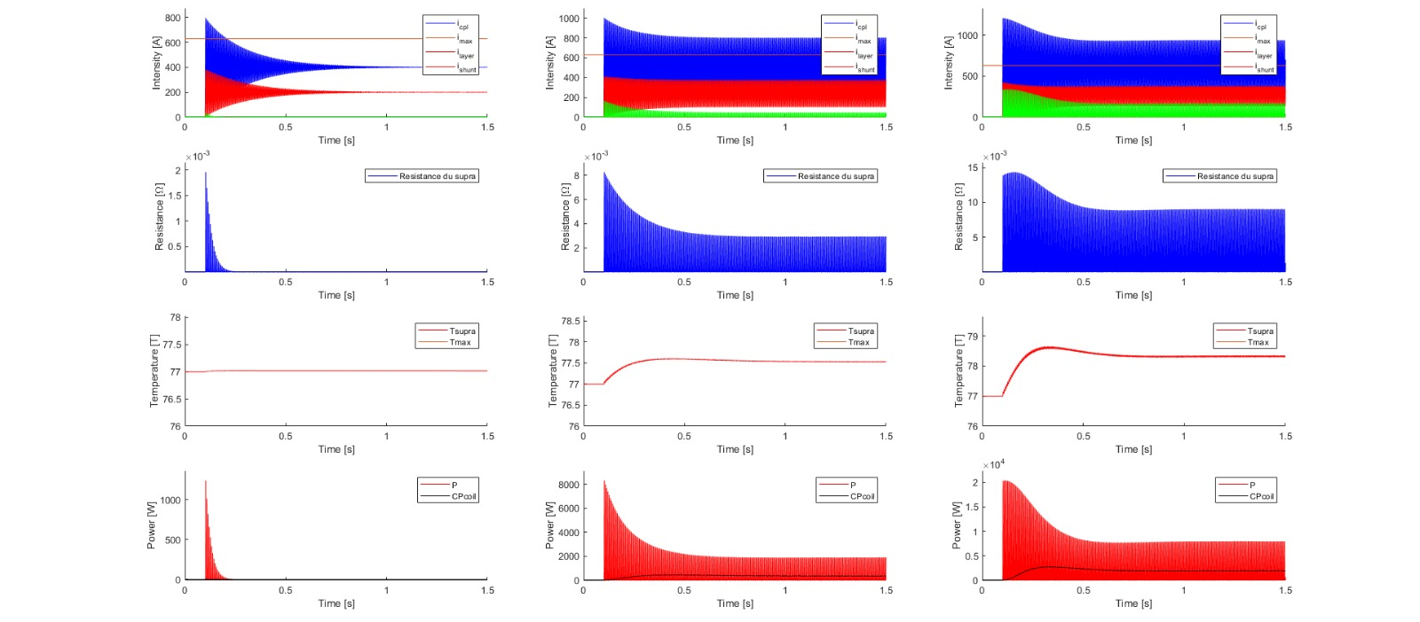
ScPF behavior (simulated with Matlab)
Ps = 2 MW : stable Ps = 2.5 MW : stable Ps = 3 MW : stable
12

Slide 13
III. Filter optimization
13

Slide 14
III. 1. Verification of the stability criteria and Simulink/MOPSO interaction
14

Slide 15
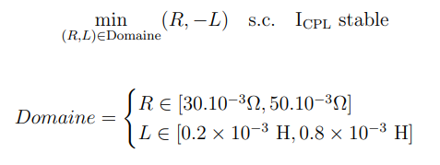
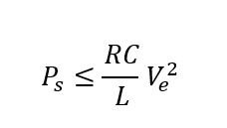
Problem 1
Goal: Check the coupling between the optimisation algorithm and the Simulink model
V
15

Slide 16
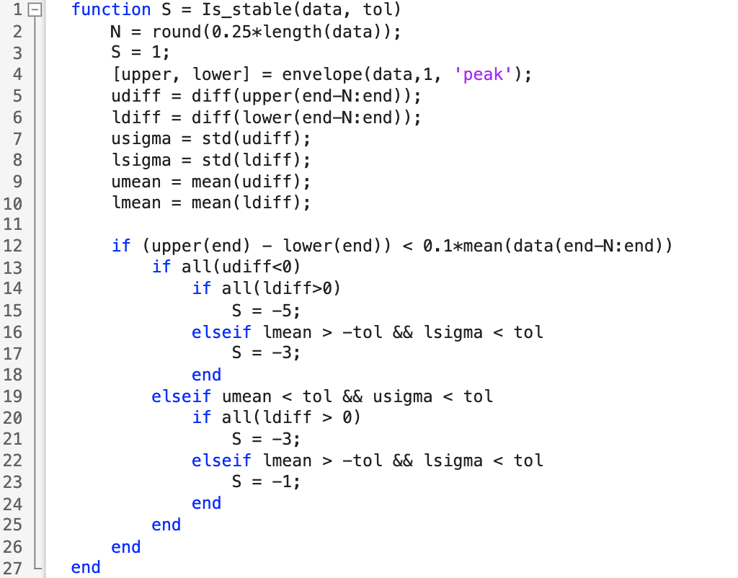
Stability function:
16

Slide 17
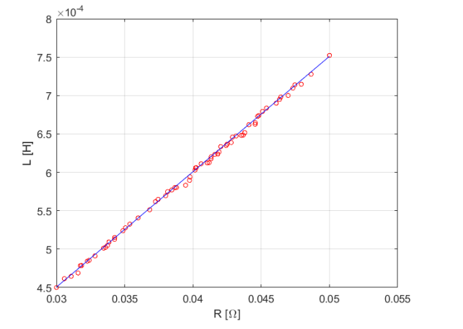

Optimization according to R and -L
$$P_{s}≤\frac{RC}{L}V_{e}^{2}$$
=> Coupling between Matlab and Simulink : Ok for the test
17

Slide 18
III. 2. Verification of normal MOPSO operation with a constraint compliance problem
18

Slide 19
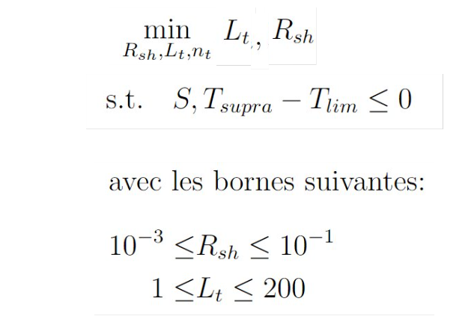
Problem 2
19

Slide 20
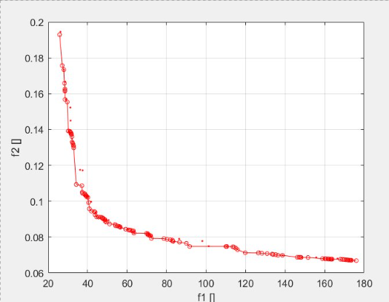
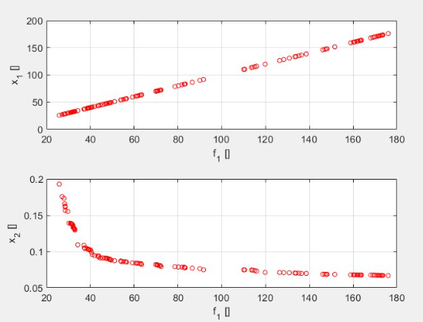
Results :
We do obtain the expected results
C
A
B
20

Slide 21
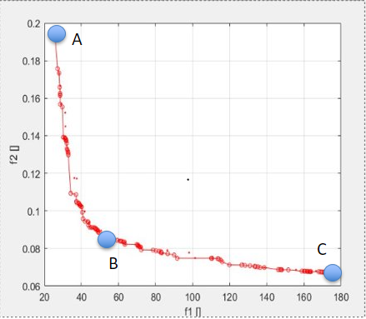
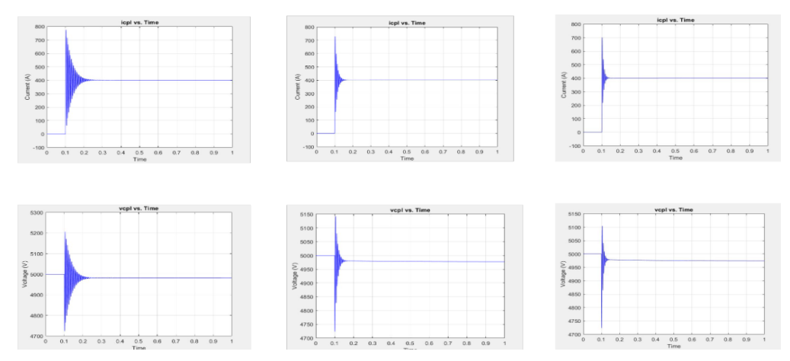
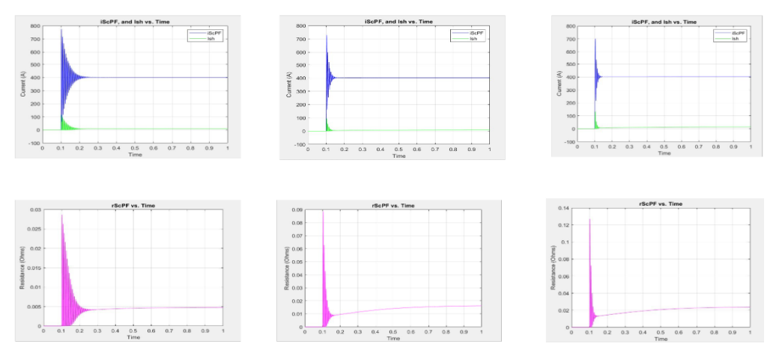
A B C

Slide 22
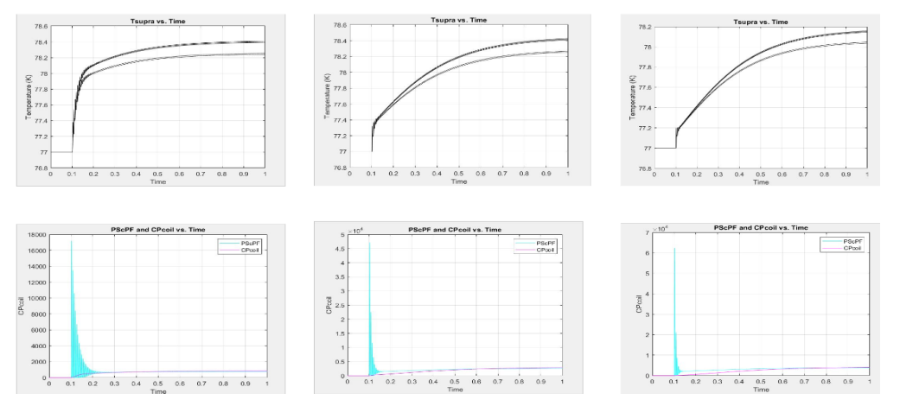
A B C

Slide 23
III. 3. Optimization CAPEX / OPEX
23

Slide 24
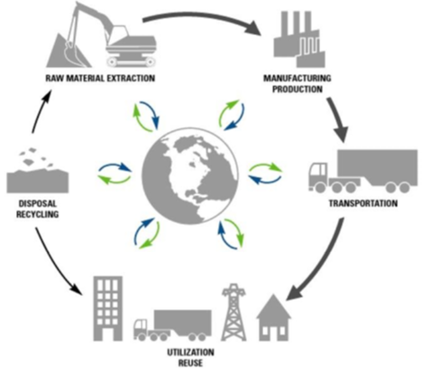
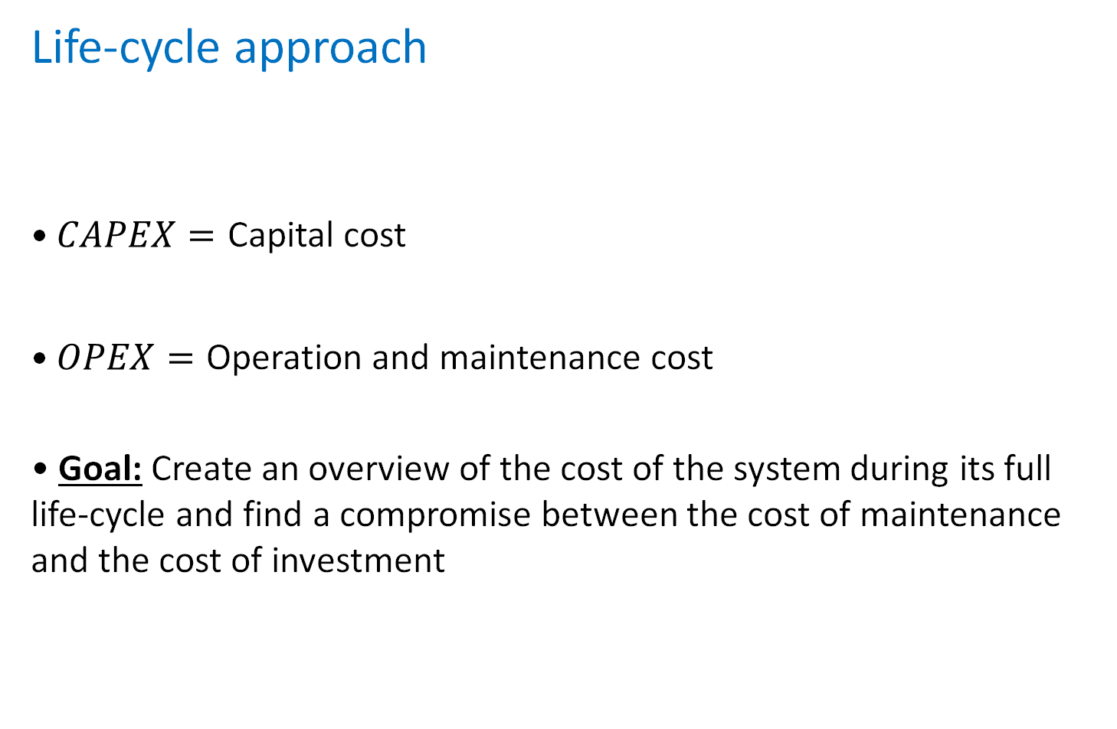
Life-cycle approach
• $CAPEX=$ Capital cost
• $OPEX=$ Operation and maintenance cost
• Goal: Create an overview of the cost of the system during its full life-cycle and find a compromise between the cost of maintenance and the cost of investment
24

Slide 25
OPEX
Formula
CP_{coil} is the cooling power required to keep the superconductor from overheating
η is the efficiency of the cooling cycle (~7.14%)
R_{ScFCL} is the equivalent resistance of the superconductor
I_{ScFCL} is the current traversing the superconductor
25

Slide 26

CAPEX
Formula
L_{tot} = L_{t} • n_{t} : total length of superconductive material
P_{YBCO} : cost (per m) of superconductive material
V_{Cu} : volume of copper in the heat shunt
m_{Cu} : density of copper
P_{Cu} : cost (per kg) of copper
º
Rsh
$n_{t}$superconductor (length = $L_{t}$)
26

Slide 27


CAPEX
Formula for V_{Cu}
ρ : resistivity of copper
J : allowed current density
º
27

Slide 28
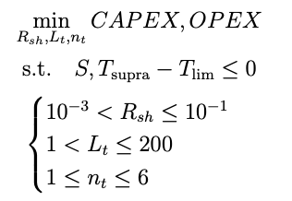
Optimization according to CAPEX and OPEX
28

Slide 29
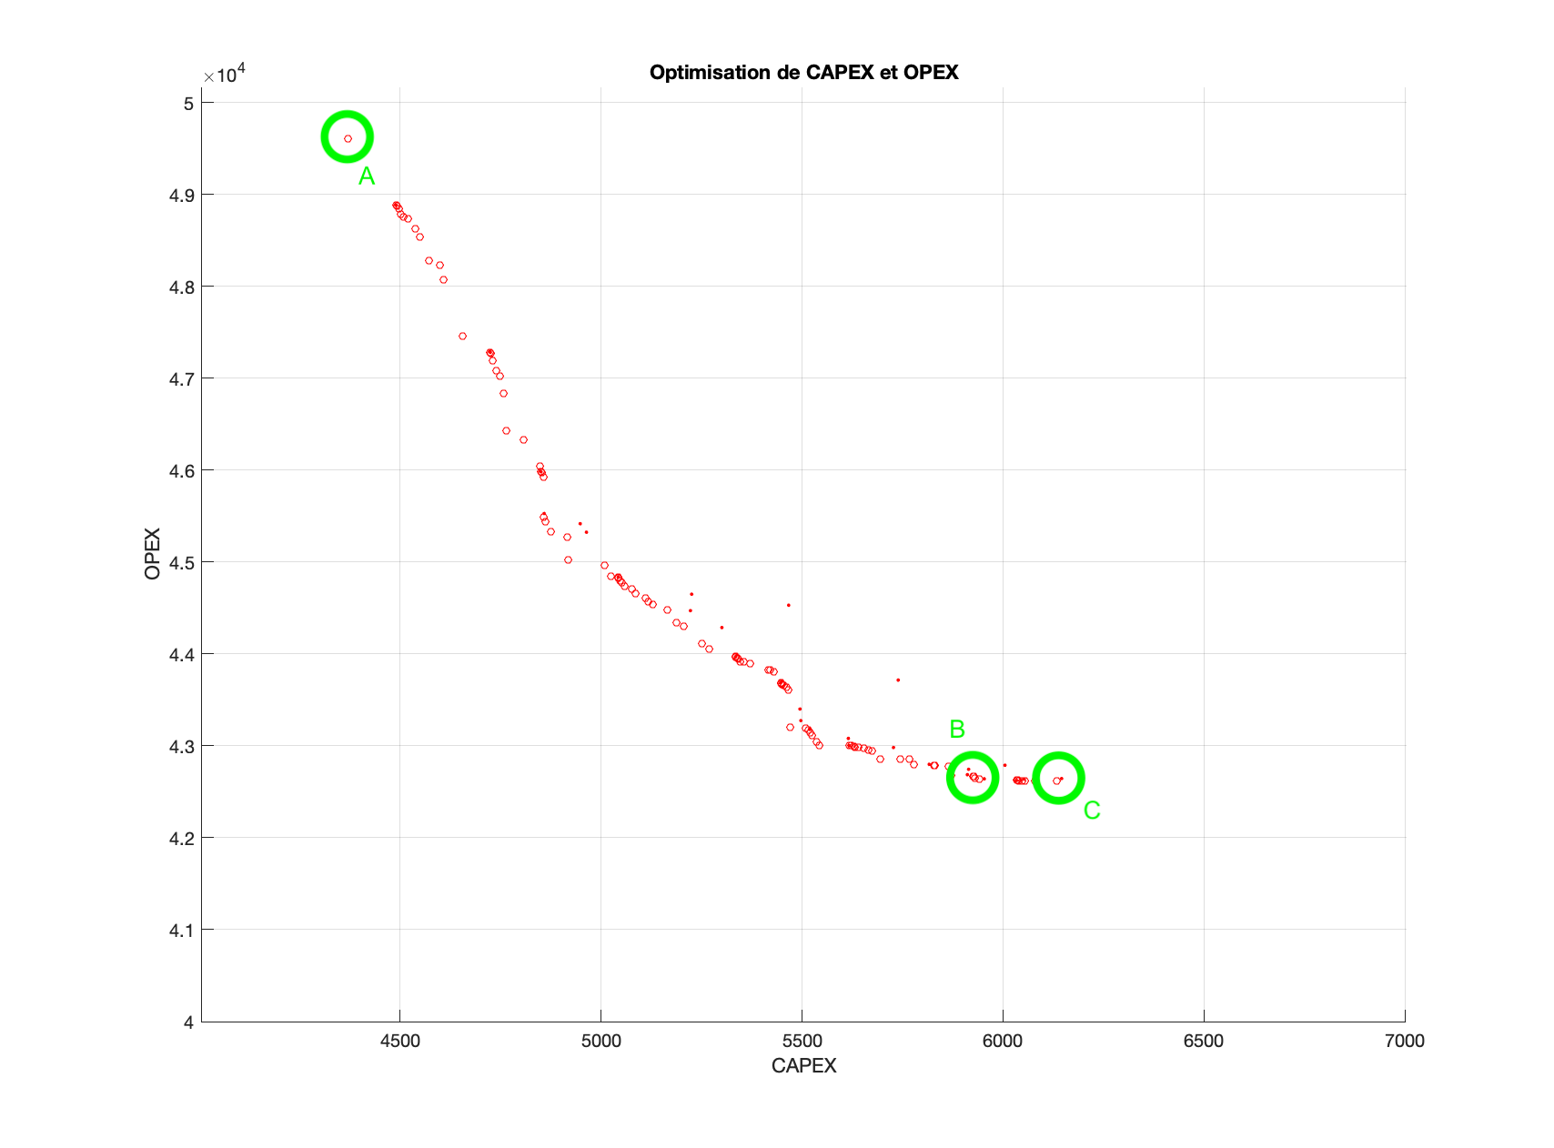
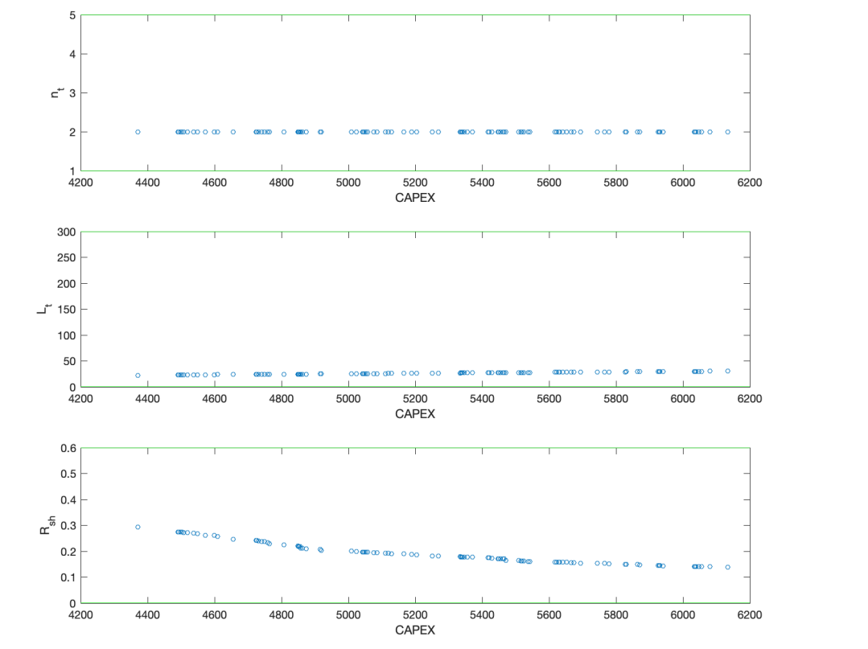
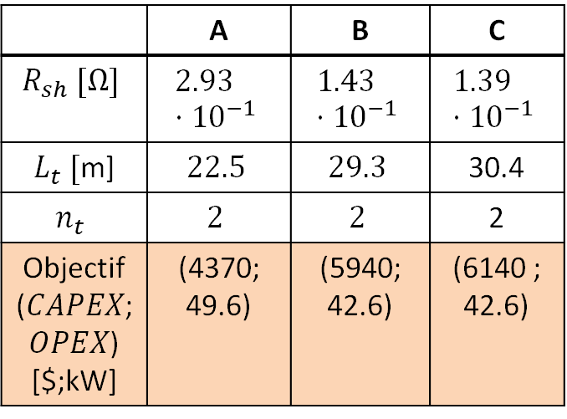
 | A | B | C
$$R_{sh} [Ω]$$ | $$2.93⋅{10}^{−1}$$ | $$1.43⋅{10}^{−1}$$ | $$1.39⋅{10}^{−1}$$
$L_{t} [$m] | $$22.5$$ | $$29.3$$ | 30.4
$$n_{t}$$ | $$2$$ | $$2$$ | 2
Objectif ($CAPEX$; $OPEX$) [$;kW] | (4370; 49.6) | (5940; 42.6) | (6140 ; 42.6)
CAPEX - OPEX
29

Slide 30
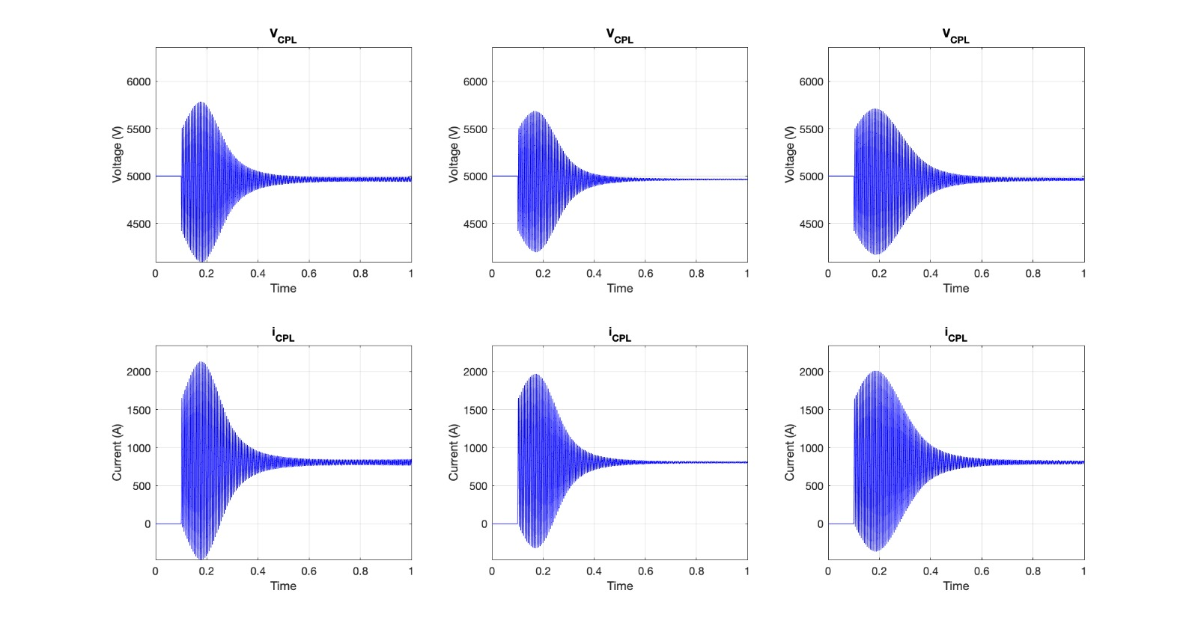
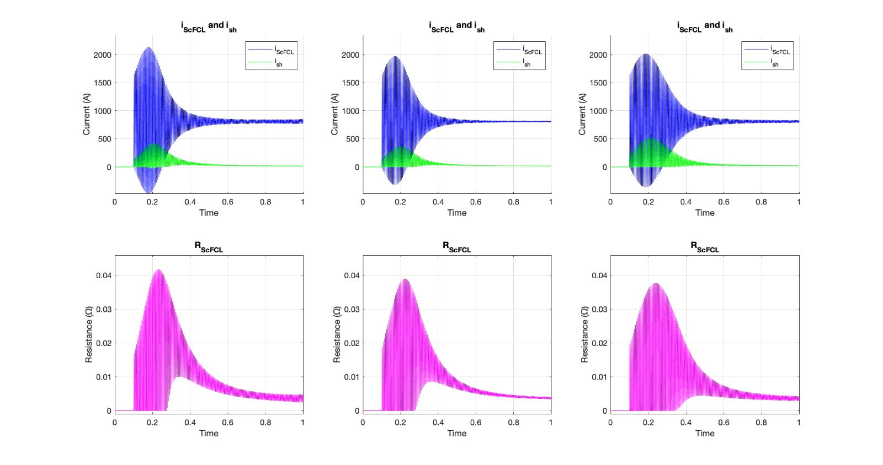
30

Slide 31
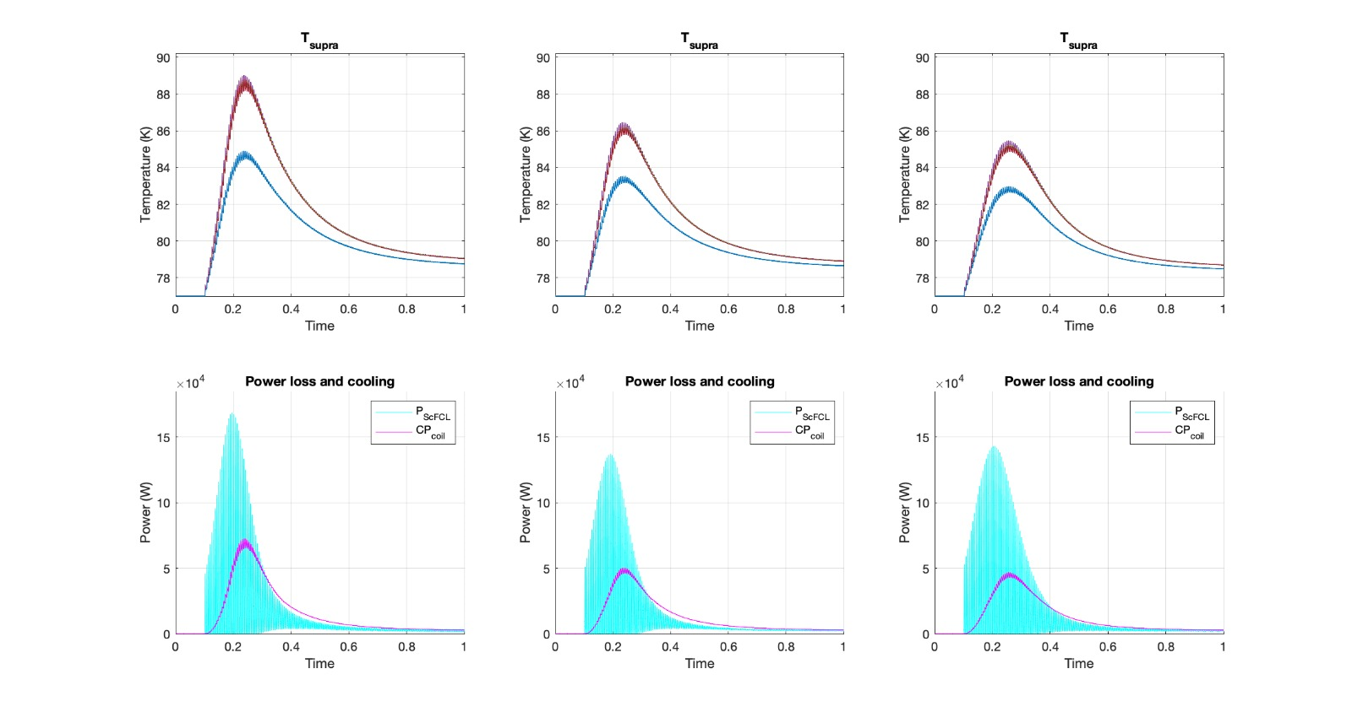
31

Slide 32
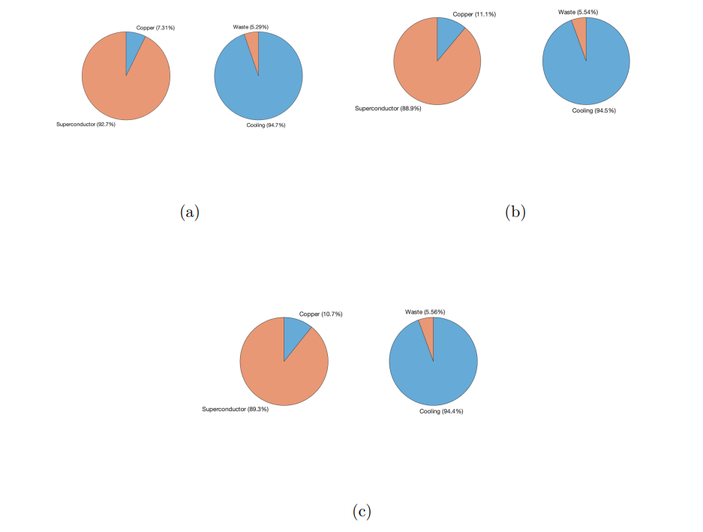
32

Slide 33
IV. Conclusion
33

Slide 34
The modeling part of this project has confirmed the effectiveness of a superconducting resistor to enable DC power grid stability.
After obtaining all the optimization results, a discussion with the client should be initiated in order to determine which point of the Pareto front to choose. Several aspects must be considered, among which the initial, operation, and environmental costs.
34

Slide 35
Thank you !
35

Slide 36
References
[1] L. Herrera, W. Zhang and J. Wang, "Stability Analysis and Controller Design of DC Microgrids With Constant Power Loads," in IEEE Transactions on Smart Grid, vol. 8, no. 2, pp. 881-888, March 2017, doi: 10.1109/TSG.2015.2457909.
[2] A. Russo and A. Cavallo, "Supercapacitor stability and control for More Electric Aircraft application," 2020 European Control Conference (ECC), St. Petersburg, Russia, 2020, pp. 1909-1914, doi: 10.23919/ECC51009.2020.9143927
[3] G. Ensermu and A. Bhattacharya, "Control and Stability Analysis of DC Micro-grids with Constant Power Loads and Source Disturbances," 2018 IEEE International Conference on Power Electronics, Drives and Energy Systems (PEDES), Chennai, India, 2018, pp. 1-6, doi: 10.1109/PEDES.2018.8707605.
[4] M. Dehghani, M. Ghiasi, M. GhasemiGarpachi, T. Niknam, A. Kavousi-Fard and H. Shirazi, "Stabilization of DC/DC Converter with Constant Power Load using Exact Feedback Linearization Method based on Backstepping Sliding Mode Control and Nonlinear Disturbance Observer," 2021 12th Power Electronics, Drive Systems, and Technologies Conference (PEDSTC), Tabriz, Iran, 2021, pp. 1-6, doi: 10.1109/PEDSTC52094.2021.9405916.
[5] J. G. Ciezki and R. W. Ashton, "Selection and stability issues associated with a navy shipboard DC zonal electric distribution system," in IEEE Transactions on Power Delivery, vol. 15, no. 2, pp. 665-669, April 2000, doi: 10.1109/61.853002. [6] A. Kwasinski and C. N. Onwuchekwa, "Dynamic Behavior and Stabilization of DC Microgrids With Instantaneous Constant-Power Loads," in IEEE Transactions on Power Electronics, vol. 26, no. 3, pp. 822-834, March 2011, doi: 10.1109/TPEL.2010.2091285. [7] D. Gunji, T. Imura and H. Fujimoto, "Stability analysis of constant power load and load voltage control method for Wireless In-Wheel Motor," 2015 9th International Conference on Power Electronics and ECCE Asia (ICPE-ECCE Asia), Seoul, Korea (South), 2015, pp. 1944-1949, doi: 10.1109/ICPE.2015.7168044. [8] P. Magne, B. Nahid-Mobarakeh and S. Pierfederici, "General Active Global Stabilization of Multiloads DC-Power Networks," in IEEE Transactions on Power Electronics, vol. 27, no. 4, pp. 1788-1798, April 2012, doi: 10.1109/TPEL.2011.2168426. P. Magne, B. Nahid-Mobarakeh and S. Pierfederici, "General Active Global Stabilization of Multiloads DC-Power Networks," in , vol. 27, no. 4, pp. 1788-1798, April 2012, doi: 10.1109/TPEL.2011.2168426.
36

