Slide 1
IMDB MOVIE TREND ANALYSIS NAME: Mohammad Edrees Nassimi COURSE TITLE: DATA SCIENCE AND VISUALIZATION SCHOOL: DATE: JULY 27, 2025

Slide 2
OBJECTIVES
Analyze movie trends using IMDB ratings, runtime, and genres
Identify clusters and genre-based rating patterns.

Slide 3
DATASET METADATA
Number of entries: 1000
Features: Poster_Link, Series_Title, Released_Year, Certificate, Runtime, Genre, IMDB_Rating, Overview, Meta_score, Director, Star1, Star2, Star3, Star4, No_of_Votes, Gross
IMDB Rating stats: summary IMDB_Rating 0 count 1000 1 mean 7.949300000000012 2 stddev 0.2754912074920139 3 min 7.6 4 max 9.3
Runtime stats: summary Runtime 0 count 1000 1 mean None 2 stddev None 3 min 100 min 4 max 99 min
Gross stats: summary Gross 0 count 831 1 mean 272456.8181818182 2 stddev 315488.7617525601 3 min 1,000,045 4 max Orlando Bloom

Slide 4
SUMMARY
Clustering revealed three movie groups: short high-rated (e.g., 12 Angry Men), medium-length popular (e.g., The Dark Knight), and long epics (e.g., The Godfather).
Genre analysis showed Animation, Drama, War films lead with highest average ratings, suggesting complex narratives boost scores.

Slide 5
Brief explanation about the tools I used for the project
Used Spark for data loading, cleaning, and KMeans clustering.
Python with Matplotlib/Seaborn for visualizations.
Cleaned runtime/gross with regexp_replace, aggregated genres with groupBy, and saved results to CSV.

Slide 6
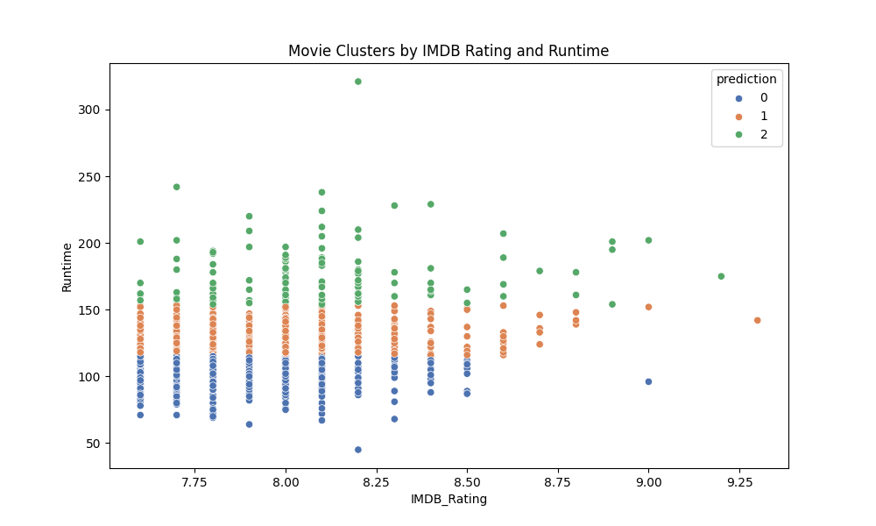
Plots

Slide 7
