Slide 1

DSA
Week 13
AVL Trees
Data Structures and Algorithms (DSA)
Diploma in IT, CSF
Year 2 (2024/25), Semester 4
Last Update: 18 Dec 2024

Slide 2
Topics
1. Efficiency of Binary Search Tree
2. AVL Trees
Rotations
single rotations
double rotations

Slide 3
References
1. Data Abstraction and Problem Solving with C++ 5th Edition
☞ chapter 10 (Trees)

Slide 4
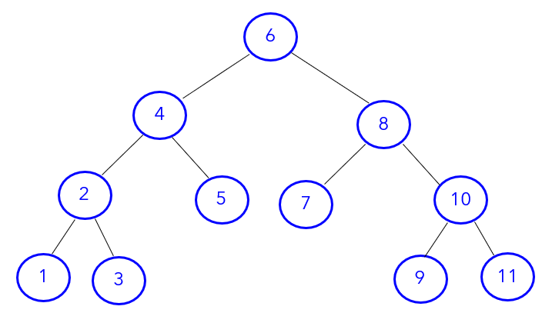
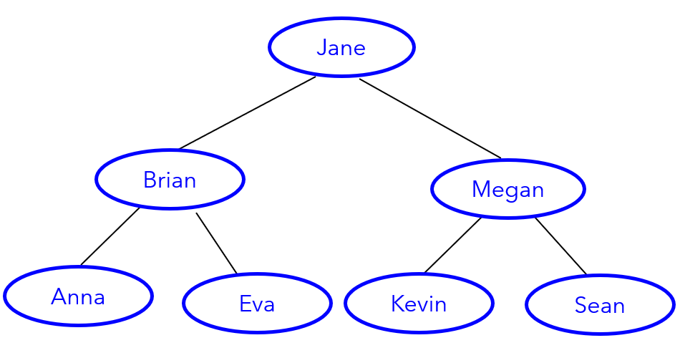
1. Efficiency of Binary Search Tree
A binary search tree is a binary tree that is ordered
i.e For each node in the binary search tree
☞ data in node's left subtree < data in the node
☞ data in node's right subtree > data in the node

Slide 5
Efficiency of Binary Search Tree
Typical operations of a Binary Search Tree
- search
- insert
- delete
All the operations require a search that begins at the root
Number of comparisons is directly proportional to the height
☞ worst case (balanced) = O (log₂ n)
worst case (unbalanced) = O (n)
where n = number of nodes in the binary search tree
Important that a binary search tree is balanced

Slide 6
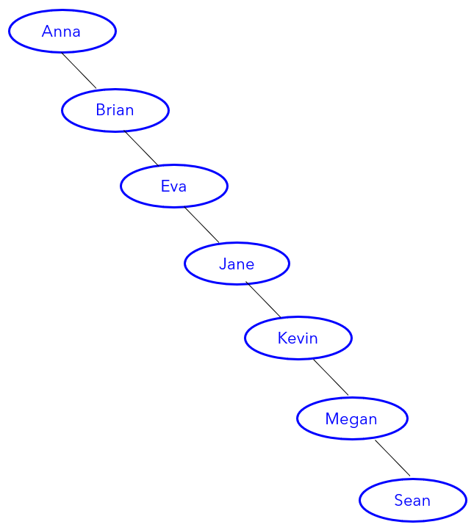
Importance of Balancing
BST-1 (balanced)
BST-2 (unbalanced)
How many comparisons are required to search for Megan in BST-1?
How many comparisons are required to search for Megan in BST-2?

Slide 7
Importance of Balancing
n | Balanced BST O(log₂ n) | Unbalanced BST O(n)
1 | 1 | 1
2 | 2 | 2
8 | 3 | 8
16 | 4 | 16
32 | 5 | 32
. | . | .
. | . | .
1000 | 10 | 1000
1000,000 | 20 | 1000,000
1000,000,000 | 30 | 1000,000,000

Slide 8
Balanced Binary Search Tree
a binary search tree is balanced if the heights of any node’s two subtrees differ by at most 1.
abs( getHeight(t->left) – getHeight(t->right) ) <= 1
the height of a balanced binary search tree is
h = log₂ (n + 1)
worst case number of comparisons = O(log₂ n)
a balanced binary search tree may become unbalanced after an insert or remove operation
How to ensure a binary search tree is ALWAYS balanced?

Slide 9
2. AVL Trees
AVL tree
is a binary search tree
is always balanced
will re-balance itself whenever it becomes unbalanced e.g. after an insert or remove operation
☞ number of comparisons (worst case) = O (log₂ n)
* named after its two inventors Adelson-Velskii, Landis

Slide 10
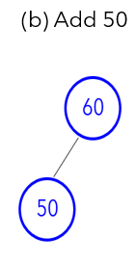
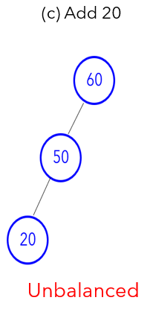
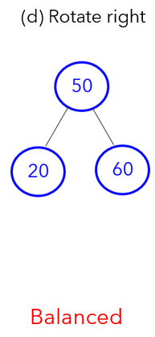

AVL Trees - Example
(a)
An AVL tree re-balance itself by “rotating” the nodes

Slide 11
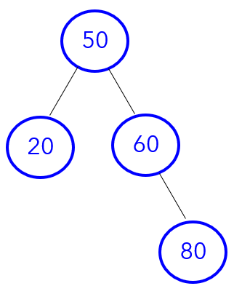
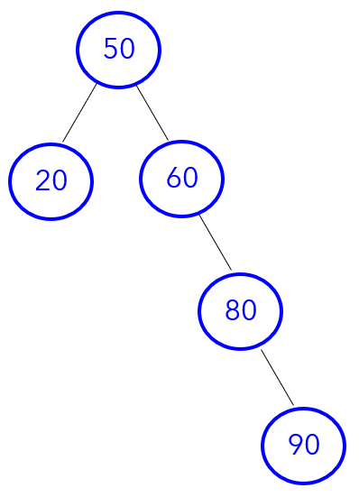
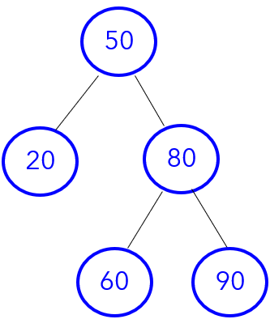
AVL Trees - Example
(a) Add 80
(b) Add 90
(c) Rotate left
Balanced
Unbalanced
Balanced

Slide 12
3. Rotations
Types of Rotations
Single rotations
Left rotation
Right rotation
Double rotations
Left-Right rotation
Right-Left rotation

Slide 13
Determining the TYPE of rotations
IF tree is right heavy
{
IF tree's right subtree is NOT left heavy
Perform Left rotation
ELSE
Perform Right-Left rotation
}
ELSE
IF tree is left heavy
{
IF tree's left subtree is NOT right heavy
Perform Right rotation
ELSE
Perform Left-Right rotation
}
.

Slide 14
Single Rotations (Left Rotation)
LEFT ROTATION
- tree is right heavy AND
- tree's right subtree is NOT left heavy
e.g.
50 50
20 60 20 80
80 60 90
90
.
N
N

Slide 15
Left Rotation - Algorithm
Left Rotation : Algorithm
BinaryNode rotateLeft(BinaryNode nodeN) | Left Rotation
Set nodeC = right child of nodeN Set nodeN’s right child to nodeC’s left child Set nodeC’s left child to nodeN return nodeC | C = N->right N->right = C->left C->left = N return C

Slide 16
Left Rotation - Example
50
20 60
80
90
.
After inserting 50, 20, 60, 80, 90, the
tree become unbalanced at Node 60
Need to perform LEFT ROTATION
- tree is right heavy AND
- tree's right subtree is NOT left heavy

Slide 17
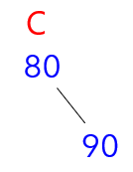
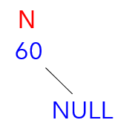
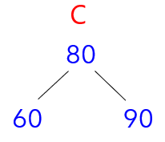
Left Rotation - Example
50
20 60
80
90
.
Rotate Left
C = N->right
N->right = C->left
C->left = N
Return nodeC
N

Slide 18
Left Rotation - Example
50
20 60
80
90
50
20 80
60 90
N
C
rotateLeft(60)

Slide 19
Single Rotations (Right Rotation)
RIGHT ROTATION
- tree is left heavy AND
- tree's left subtree is NOT right heavy
e.g.
50
30 60
10 40
20
30
10 50
20 40 60
rotateRight(50)

Slide 20
Right Rotation - Algorithm
Right Rotation : Algorithm
BinaryNode rotateRightt(BinaryNode nodeN) | Right Rotation
Set nodeC = left child of nodeN Set nodeN’s left child to nodeC’s right child Set nodeC’s right child to nodeN return nodeC | C = N->left N->left = C->right C->right = N return C

Slide 21
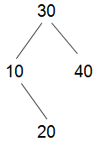

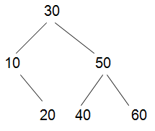
Right Rotation - Example
Rotate Right
C = N->left
N->left = C->right
C->right = N
Return nodeC
50
30 60
10 40
20
N
C
N
C

Slide 22
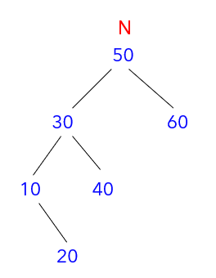
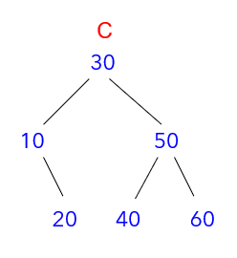
Right Rotation - Example
rotateRight

Slide 23
Double Rotations
IF tree is right heavy
{
IF tree's right subtree is left heavy
Perform Right-Left rotation
}
ELSE
IF tree is left heavy
{
IF tree's left subtree is right heavy
Perform Left-Right rotation
}

Slide 24
Right-Left Rotation - Algorithm
Right-Left Rotation : Algorithm
BinaryNode rotateRightLeft(BinaryNode nodeN)
Set nodeC = right child of nodeN Set nodeN’s right child to node returned by rotateRight(nodeC) return rotateLeft(nodeN)

Slide 25
Right-Left Rotation - Example
RIGHT-LEFT ROTATION
- tree is right heavy AND
- tree's right subtree is left heavy
e.g.
50
20 80
60 90
70
Set nodeC = right child of nodeN
Set nodeN’s right child to node returned by rotateRight(nodeC)
return rotateLeft(nodeN)

Slide 26
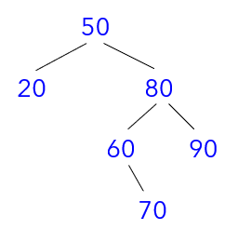
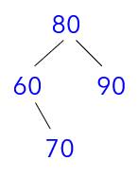
Right-Left Rotation - Example
Set nodeC = right child of nodeN

Slide 27
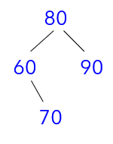
Right-Left Rotation - Example
2. Set nodeN’s right child to node returned by rotateRight(80)
Rotate Right (80)
C = N->left
N->left = C->right
C->right = N
Return nodeC
C
60
70
N
80
70 90
C
60
80
70 90

Slide 28
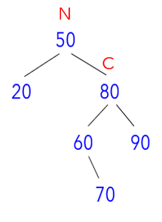
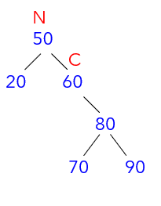
Right-Left Rotation - Example
2. Set nodeN’s right child to node returned by rotateRight(nodeC)

Slide 29
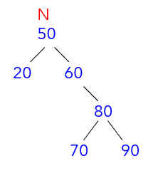
Right-Left Rotation - Example
3. rotateLeft(50)
Rotate Left (50)
C = N->right
N->right = C->left
C->left = N
Return nodeC
C
60
80
70 90
N
50
20
C
60
50 80
20 70 90

Slide 30
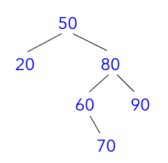
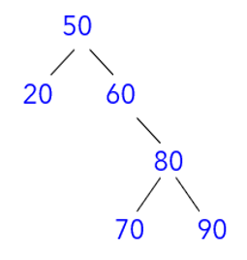
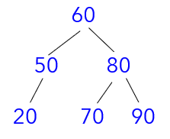
Right-Left Rotation - Example
rotateRight(80)
rotateLeft(50)

Slide 31
Left-Right Rotation - Algorithm
Left-Right Rotation : Algorithm
BinaryNode rotateLeftRight(BinaryNode nodeN)
Set nodeC = left child of nodeN Set nodeN’s left child to node returned by rotateLeft(nodeC) return rotateRight(nodeN)

Slide 32
Left-Right Rotation - Example
LEFT-RIGHT ROTATION
- tree is left heavy AND
tree's left subtree is right heavy
e.g.
50
20 70
10 40
30
40
20 50
10 30 70
Can you show the intermediate trees at each stage of rotation?

Slide 33
Summary
Efficiency of Binary Search Tree
AVLTrees
Rotations
Single rotations
Double rotations

Slide 34
Appendix 1 - AVL Rotations
IF tree is right heavy { IF tree's right subtree is NOT left heavy Perform Left rotation ELSE Perform Right-Left rotation } | LEFT ROTATION C = N->right N->right = C->left C->left = N Return C
IF tree is left heavy { IF tree's left subtree is NOT right heavy Perform Right rotation ELSE Perform Left-Right rotation } | RIGHT ROTATION C = N->left N->left = C->right C->right = N Return C

