Slide 1

DSA
Week 4
Stacks
Data Structures and Algorithms (DSA)
Prescribed Module/Elective
Diploma in CSF, IT
Year 2 (2023/24), Semester 3

Slide 2
Topics
Introduction of the ADT stack
Implementation of the ADT stack
Application of the ADT stack

Slide 3
References
1. Data Abstraction and Problem Solving with C++ 5th Edition
☞ chapter 6

Slide 4

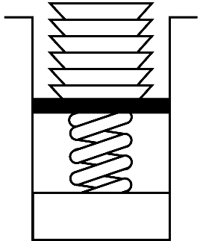
1. Stack ADT
A stack is another form of data structure for organizing data.
Important property: LIFO (Last-in First-Out)
Last item placed on the stack will be removed first.
e.g. stack of plates, bangles in a hand, etc
Notes:
A stack is a data structure that organizes the data such that the last item in would be the first item out.
This is similar to a stack of plates in a canteen like the one shown above, where we can only remove the top plate. The first plate that was inserted is at the bottom and will be the last to be removed.
A stack is like when we wear many bangles on our hand. We can put on the bangles one by one on our hand only from the fingers end. While taking off the bangles, the last bangle we wear is the first bangle we can remove. This is the only way we can wear and remove the bangles, from one end.
Bangle image accessed from:
https://www.google.com/url?sa=i&url=https%3A%2F%2Fwww.dreamstime.com%2Fillustration%2Fbracelets.html&psig=AOvVaw2o0WTKfHtTsutLhrbUEZtK&ust=1602579356060000&source=images&cd=vfe&ved=0CAIQjRxqFwoTCIC8oL_XruwCFQAAAAAdAAAAABAD

Slide 5
Stack ADT
Stack ADT
is a collection of items
only item at top of stack is visible and can be retrieved.
new items can only be added to top of stack
items can only be removed from top of stack
Notes:
A stack data structure is a list with some restriction on the list's operations. It can only perform operations from one end, called the top. New items can only be inserted in the top position and items can only be removed from the top position.

Slide 6
2. Implementing Stack ADT
Steps
Identify and list the operations for Stack ADT
list of operations required for Stack ADT
Specify the Stack ADT interface
☞ function prototypes of the operations for Stack ADT (Stack.h)
Implement the Stack operations
☞ implementation of the operations for Stack ADT (Stack.cpp)
Notes:
We apply the following steps to implement a Stack ADT.
Identify and list the operations for the Stack ADT.
Specify the interface i.e. the function prototypes of the operations required. These will be placed in the stack.h file.
Implement the Stack operations in the stack.cpp file.

Slide 7
Step 1 : Identify and list the operations for Stack ADT
The purpose of this step is to identify and list the operations required for the ADT.
Operations (for Stack ADT)
create an empty stack add an item to the top of stack (push) remove an item from top of stack (pop) retrieve/ look at item at top of stack (peek or getTop) check whether the stack is empty destroy the stack
Notes:
First, to identify and list the operations for the stack ADT.
We need the following operations:
Create an empty stack
Push – to add an item to the top of the stack
Pop – to remove an item from the top of the stack
Peek or getTop – to look at an item at the top of the stack (without removing it)
isEmpty – to check whether the stack is empty
Destroy – to remove the stack from the runtime memory

Slide 8
Step 2 : Specify the Stack ADT (Stack.h)
The purpose of this step is to specify the function prototypes/headers of each of the operations clearly
Specification of Stack ADT
Stack() push(ItemType item):bool pop():bool getTop(ItemType &item):void isEmpty():bool ~Stack() //for pointers-based implementation
Notes:
Step 2 is to specify the stack.h file. This is to translate the operations in the previous slide into function prototypes or headers.
So we have:
Stack() – the constructor
push(ItemType item): boolean – which will push an item of type ItemType into the stack and returns true if successful or false if unsuccessful (because the stack is full).
pop(): boolean – to remove an item from the stack. It returns true if successful or false if unsuccessful (because the stack is empty).
getTop(ItemType &item): void – which will get a copy of the top item in the stack. This item is placed in the parameter item. Note the & sign means that the value will be passed back to the calling function.
isEmpty(): boolean – this function checks whether the stack is empty and returns true, if it is and false, otherwise.
~Stack() – is the destructor and only implemented if the stack is implemented using pointers.

Slide 9
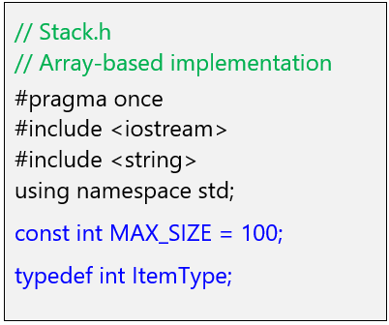
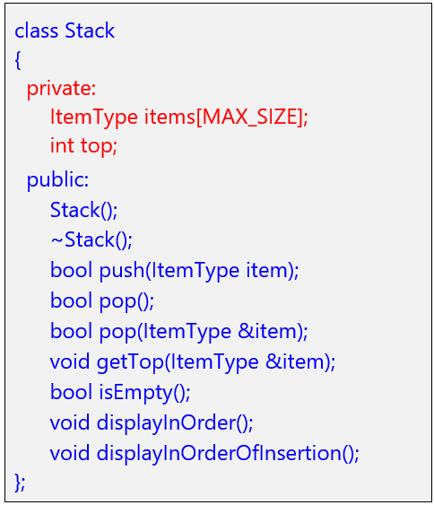
Specification of Stack ADT(Array-based) - stack.h
Notes:
Here we see the stack.h file contents.
Note that we declare the max size of the stack to be 100.
So the array items has MAX_SIZE elements of type ItemType. The ItemType is int.
Besides the functions mentioned in the previous slide, we also have 2 other functions:
displayInOrder() – which will display the stack in the order of its contents.
And
displayInOrderOfInsertion() – which will display the stack contents in the order of insertion.
So if a, b, c, d are inserted into the stack,
displayInOrder() will display d, c, b, a.
But
displayInOrderOfInsertion() will display a, b, c, d.

Slide 10
Array-based Implementation of Stack ADT
Note
Top of stack corresponds to the last occupied entry in array
pushing & popping data can only be done at top
pushing & popping data is fast (access top via index : O(1) )
number of items can be stored is limited
may waste storage (array may not be fully utilized)
MAX_SIZE -1
top = ?
…
k - 1
itemk
…
3
item4
2
item3
1
item2
0
item1
Array indices
Notes:
Let us look at an array implementation of a stack.
A variable, top, is used to keep track of the top of the stack.
So, if item1 is pushed into the stack, it will be placed at index 0.
Item2 is next pushed in, and so it will be placed at index 1.
Item3 will then pushed and placed at index 2.
So, after k items have been pushed into the stack, the value of the top of the stack is k-1 – which is the last occupied entry in the array.
Note that the number of items to be stored is limited by the size of the array.
However, if the array is not fully used, this will result in memory wastage, esp. if a large array has been declared.
When items are removed, the value of top will be decreased at each pop(). There is no need to physically remove the items, as the value of top would determine how may items are in the stack.
When top has value -1, the stack is considered empty.

Slide 11
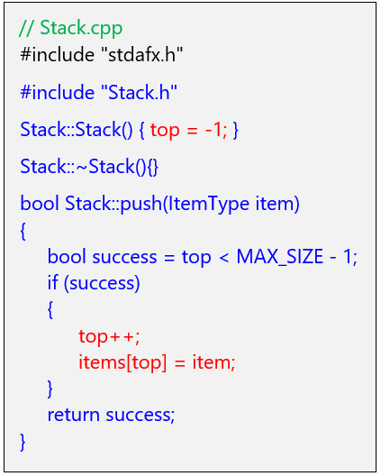
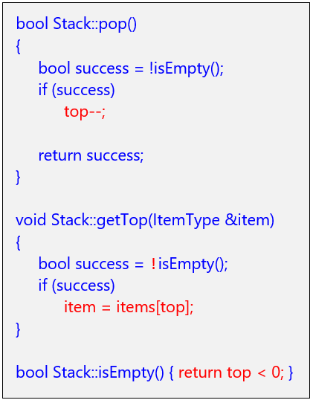
Implementing the operations (Array-based) – stack.cpp
Notes:
Lastly, we implement the functions in the stack.h file.
For the constructor, the top of the stack is set to -1 in the constructor to signify that the stack is empty.
No need to write any code for the destructor, as this is not a pointer implementation.
The push() function first checks if the stack is not full. If this is true, then item is added to the next position at the top.
For the pop() function, it first checks if the stack is not empty. If this is true, then decrease the top variable by 1. There is no need to physically remove an item.
The getTop() function first checks if the stack is not empty. If this is true, then it stores the value of items[top] into the item variable – which will be returned to the calling function, as stated with an & in the parameter.
The isEmpty() function checks if the stack is empty. It is true when top is -1 i.e. < 0 and false otherwise.

Slide 12
Pointer-based Implementation of Stack ADT
topNode
Pointers can be used to
link data to form a stack,
as shown on the right.
Riz
item
Node
next
Likewise, need to have a inner structure known as a Node that has 2 parts:
- item (to store the data item)
- next (to store the address of next node)
Sam
item
Node
next
…
topNode
Overall Stack ADT needs:
- a pointer topNode to point to the node at top most position (initially point to NULL)
Mic
item
Node
next

Slide 13
Pointer-based Implementation of Stack ADT
topNode
Note
TopNode points to top node of stack(NB: as opposed to last item in array implementation)
pushing & popping data can only be done at top
pushing & popping data involves manipulation of linkages including topNode (fast : O(1))
Stack can dynamically grow and shrink
Additional memory need to store the linkages
Riz
item
Node
next
Sam
item
Node
next
…
Mic
item
Node
next

Slide 14
Node Structure
Recall format for declaring the node structure in C++ is:
struct Node
{
ItemType item; // to store the data item
Node *next; // pointer to point to next node
};
item
next

Slide 15
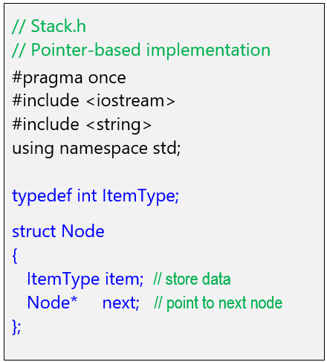
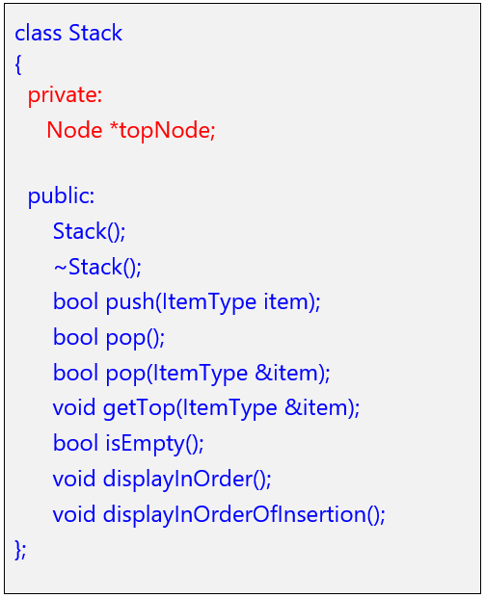
Specification of Stack ADT(Pointer-based) - Stack.h

Slide 16
Pushing an item on top of the Stack
To push a new item to the top of the List, you need to :
☞ create a new node to store the item
☞ make the new node’s next pointer point to the top node
☞ Make the topNode pointer point to new node
topNode
2
newNode
Annie
1
Mary
John

Slide 17
Algorithm : push an item on top of the Stack
boolean push(ItemType item)
Create a new node Store the item to the node Initialize the next pointer to null set new node’s next pointer to point to node pointed to by topNode set topNode (pointer) to point to new node Return true

Slide 18
Pop an item from top of the Stack
To pop item from top of the Stack, you need to :
☞ Use a temp pointer to point to top node
☞ Make the topNode point to the next node in stack
☞ Make removed node’s next pointer point to NULL and deallocate memory from removed node
2
topNode
temp
1
Annie
3
John

Slide 19
Algorithm : pop item from top of the stack
boolean pop()
If stack is not empty set temp (pointer) point to the top node make topNode(pointer) point to the next node in stack make removed node’s next (pointer) point to NULL deallocate memory from removed node

Slide 20
Algorithm : retrieving an item at top of the Stack
ItemType getTop()
If stack is not empty return the item contained in the top node

Slide 21
Applications of Stack
Language Processing
Balancing of symbols
Expression conversion (infix to postfix, postfix to prefix, etc)
Reversing
“undo” mechanism in text editors
Reversing a string
Backtracking
Find way through a maze
Find path from one point to another point
Notes:
Language Processing
A compiler’s syntax check for matching brackets is implemented using a stack.
Expressions can be represented in prefix, postfix or infix notations and conversion from one form to another may be accomplished using a stack. More on prefix, postfix and infix when we cover the topic on Trees.
Reversing
When you want to undo something in a text editor like MS Word, we need to keep all text changes in a stack.
Reversing a string. Each character is pushed into a stack. Then pop each character from the stack.
Backtracking
Consider a simple example of finding the correct path in a maze. There are a series of points from the starting point to the destination. There are several paths. If we find that we reach a dead end in a path, we need to return to the previous point to try a different way. Stacks will be useful here where each point in the path is pushed into the stack.
This concept is similarly used in Google maps, when you specify a start point and a destination, Google will try to find a path to the destination. If a wrong path is selected (where we get further away from the destination), there is a need to backtrack to a previous point to continue the quest to find the right path to the destination.

Slide 22
3. Application of Stack ADT – Balanced Parentheses
Scenario:
☞ Given a list of brackets: round ( ), square [ ] , curly { }, etc.
☞ Can we make use of stack to identify if they are balanced
e.g. {[()]}, {[)]}, {{[])}}
☞ The pseudocodes are defined as:
Algorithm checkDelimiterBalance (expression) ← main algorithm
Algorithm isPairOfDelimiters (char open, char close) ← supporting function
Download pseudocode from Brightspace

Slide 23
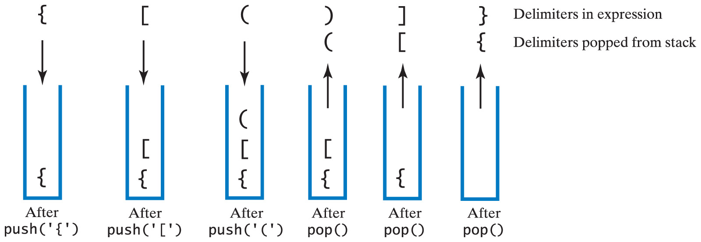
3. Application of Stack ADT – Balanced Parentheses
Checking for Balanced Delimiters ( ) , [ ], { }
Example of balanced delimiters: { [ ( ) ] }
Carrano, Data Structures and Abstractions with Java, Second Edition, (c) 2007 Pearson Education, Inc. All rights reserved. 0-13-237045-X
Notes:
Let’s check this set of delimiters. As you can see, they are balanced.
Remember, the algorithm is to push open brackets into the stack and pop closed brackets from the stack.
The first character is '{', an open curly bracket, we push it into the stack.
The next character is '[', an open square bracket, so we push it into the stack.
The next character is '(', an open round bracket, so we push it into the stack.
The third character is ')', a closed round bracket, so we pop a character from the stack to see if it is a match to this closed round bracket. The character popped is '(', an open round bracket which does match the closed round bracket. So we carry on.
The next character is ']', a closed square bracket, so we pop a character from the stack to see if it is a match to this closed square bracket. The character popped is '[', an open square bracket which does match the closed square bracket. So we carry on.
The next character is '}', a closed curly bracket, so we pop a character from the stack to see if it is a match to this closed square bracket. The character popped is '}', a closed curly bracket which does match the closed curly bracket. So we carry on.
But there are no more characters and the stack is also empty.
Therefore we conclude that the delimiters are balanced.

Slide 24
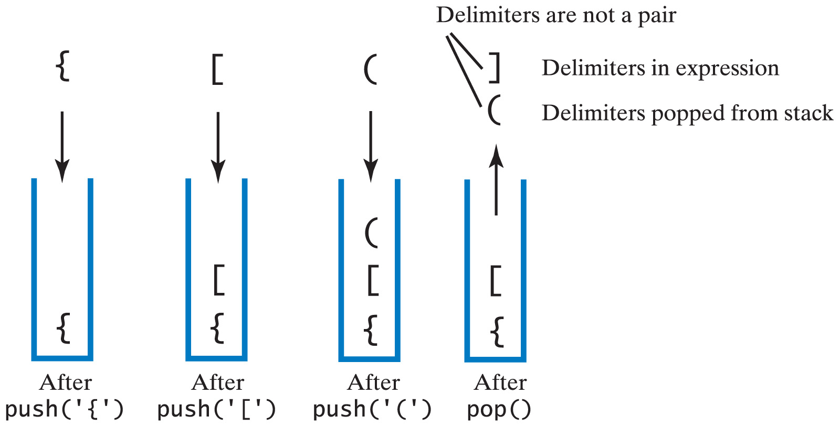
3. Application of Stack ADT – Balanced Parentheses
Example of unbalanced delimiters {[(])} :
Carrano, Data Structures and Abstractions with Java, Second Edition, (c) 2007 Pearson Education, Inc. All rights reserved. 0-13-237045-X0
Notes:
This slide has animation. Play the slide to see the animation.
Here is how we check for unbalanced delimiters using a stack.
The algorithm is to push open brackets into the stack and pop closed brackets from the stack.
The first character, is '{' and since it is an open curly bracket, we push it into the stack.
The next character is '[', an open square bracket, so we push it into the stack.
The third character is '(', an open round bracket, so we push it into the stack.
The next character is ']', a closed square bracket, so we pop a character from the stack to see if it is a match to this closed square bracket. The character popped is '(', an open round bracket which does not match the closed square bracket. Hence we conclude that the delimiters are unbalanced.

Slide 25
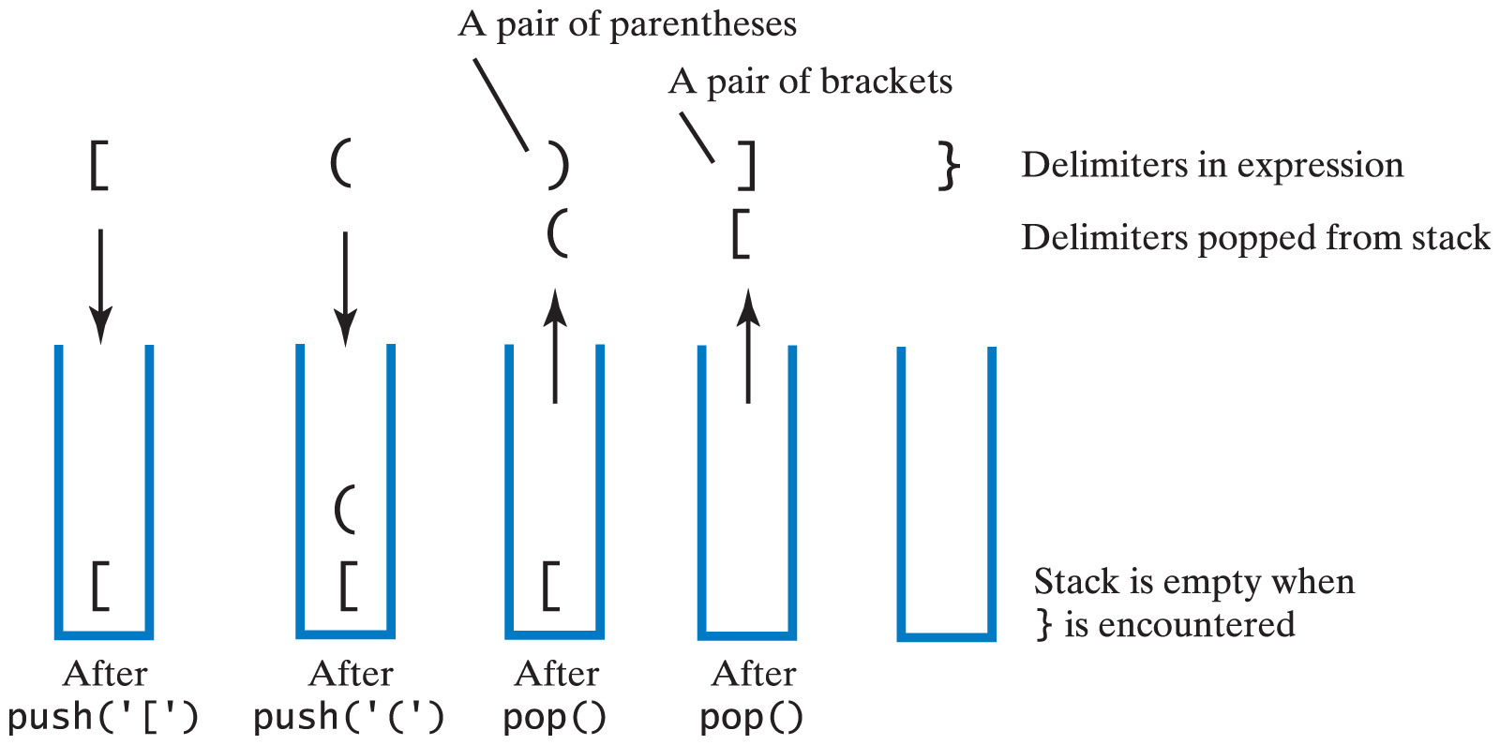
3. Application of Stack ADT – Balanced Parentheses
Example of unbalanced delimiters [()]} :
Carrano, Data Structures and Abstractions with Java, Second Edition, (c) 2007 Pearson Education, Inc. All rights reserved. 0-13-237045-X0
Notes:
This slide has animation. Play the slide to see the animation.
Let’s try with this set of delimiters.
Remember, the algorithm is to push open brackets into the stack and pop closed brackets from the stack.
The first character is '[', an open square bracket, we push it into the stack.
The next character is '(', an open round bracket, so we push it into the stack.
The third character is ')', a closed round bracket, so we pop a character from the stack to see if it is a match to this closed round bracket. The character popped is '(', an open round bracket which does match the closed round bracket. So we carry on.
The next character is ']', a closed square bracket, so we pop a character from the stack to see if it is a match to this closed square bracket. The character popped is '[', an open square bracket which does match the closed square bracket. So we carry on.
The next character is '}', a closed curly bracket. But the stack is empty. Therefore we conclude that the delimiters are unbalanced.

Slide 26
3. Application of Stack ADT – website history
Track visited URLs in a web browser
Implement a back button
Make the current URL always available.
Notes:
Now let's solve a basic problem. Let's say we want to keep track of the websites we have visited in a web browser. The simple purpose of this could be to implement the back button we all know. We're also interested in keeping the current web address always available through a function. So let's see how the stack ADT can help.

Slide 27
Algorithm : website history
main()
declare back_stack and temp while temp is not "exit" display menu with option 1 visit URL, option 2 back get input temp if temp is "1" get URL and store in temp push temp into back_stack if temp is "2" display "going back…." pop back_stack display current url
Notes:
A website history for implementing a back button is a typical example of the behavior of a stack.
Here is the algorithm
We will use a stack of strings which we'll call back_stack.
Next we have a temp variable where the user will enter the web address. In the while loop we present a menu with two options. One is visit URL to enter a web address and the second option is back as to simulate that the user has pressed the back button. So after we take in the user input, we evaluate it to see if the user entered exit. If so, we finish this program.
If the user enters 1, we get the url and push it into the back_stack.
If the user enters 2, we pop the stack
The current url is displayed which is at the top of the back_stack, before starting the loop again.
Now let's think how the back button works. When you visit a URL, this address gets stored in the stack and when you visit a next address, this next address is also store there and so on. But when you hit back button, you go back to the last address you visited and so this is just the behavior of a stack.
Thus what we need to do is after we enter a URL is just to push that string into the back_stack.
For option 2, we put a message that we are going back. And next we need to actually get rid of the top of the stack and so we will do that by popping the back_stack.

Slide 28
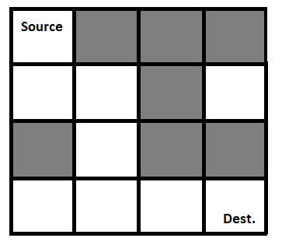
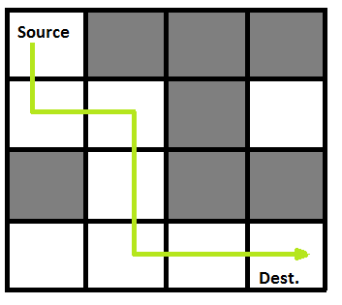
3. Application of Stack ADT – maze traversal
Maze given
Can move up, down, left, right until goal
Notes:
Consider a simple example of finding the correct path in a maze. There are a series of points, from the starting point to the destination. We start from one point. To reach the final destination, there are several paths. Suppose we choose a random path. After following a certain path, we realise that the path we have chosen is wrong. So we need to find a way by which we can return to the beginning of that path. This can be done with the use of stacks. With the help of stacks, we remember the point where we have reached. This is done by pushing that point into the stack. In case we end up on the wrong path, we can pop the last point from the stack and thus return to the last point and continue our quest to find the right path. This is called backtracking.

Slide 29
3. Application of Stack ADT – maze traversal
Representation of Maze as 2D array:
original maze maze path
. | # | # | #
. | . | # | .
# | . | # | #
. | . | . | .
v | # | # | #
v | v | # | .
# | v | # | #
v | v
start
end
Requires backtracking
Notes:
The maze can be represented as a 2d array. The array on the left shows the walls in the maze represented by ‘#’ in the cell and the open space represented by ‘.’. In finding the path from start to end, we need to mark the cell visited with ‘v’ as well as push this cell into the stack. The next cell to visit would be the neighbor cell which has a ‘.’ . If there are no more neighbor cells that has a ‘.’ and the end cell is not yet reached, it means we need to backtrack. To backtrack, pop the cell from the stack. This gives the previous cell visited.

Slide 30
Algorithm : Maze traversal 1
main()
declare and initialize the maze array make a copy of the maze, call it visited initialize the start and end cells mark the start cell as ‘v’ in both maze and visited arrays Push the start cell into the stack
Notes:
declare and initialize the maze array – this array shows the path travelled.
make a copy of the maze, call it visited – this array keeps track of the cells that were visited.
initialize the start and end cells
mark the start cell as ‘v’ in both maze and visited arrays
Push the start cell into the stack

Slide 31
Algorithm : Maze traversal 2
main()
while stack is not empty pop a cell from the stack and make it the current cell if the current cell has neighours which have not been visited push the current cell into the stack choose one of the unvisited neighbours if this is the end cell // reached destination break out of loop mark the chosen cell ‘v’ in maze and visited arrays push the chosen cell into the stack else // backtrack mark the current cell ‘.’ in the maze // restore value display the maze

Slide 32
Sample Maze
# | # | # | # | # | # | # | # | # | # | # | #
# | . | . | . | # | . | . | . | . | . | . | #
. | . | # | . | # | . | # | # | # | # | . | #
# | # | # | . | # | . | . | . | . | # | . | #
# | . | . | . | . | # | # | # | . | # | . | .
# | # | # | # | . | # | . | # | . | # | . | #
# | . | . | # | . | # | . | # | . | # | . | #
# | # | . | # | . | # | . | # | . | # | . | #
# | . | . | . | . | . | . | . | . | # | . | #
# | # | # | # | # | # | . | # | # | # | . | #
# | . | . | . | . | . | . | . | . | . | . | #
# | # | # | # | # | # | # | # | # | # | # | #
start
end
Needs functions: hasNeighbour(maze, cell),
display(maze)
Notes:
Try out the algorithm using this maze.
When writing the program, you will need to have a function to display the maze and a function to check if there are neighbours.
The hasNeighbour() function will check the maze for a neighbor in the given cell and returns the neighboring cell, if any.

Slide 33
Some points to note
1. Again, format for specifying the ADT operations may vary
e.g.
getTop(int index):ItemType // format 1
push(ItemType item):boolean // format 1
getTop(ItemType &item):void // format 2
push(ItemType &item):void // format 2
2. In C++, a node, if removed, should be returned to the
system(or memory deallocated) using the keyword delete
e.g.
delete removedNode;

Slide 34
Summary
Introduction of the ADT stack
Implementation of the ADT stack
Application of the ADT stack

