Slide 1
Redemption
Created By:
Alexander Kofi, James Blue, Ratul Banerjee, Joseph Butterworth, Joseph Creek, Jack Collier, Jack Glaister

Slide 2
Table of Content
What is Redemption ?
Key Features of Redemption
Implementation
Demonstration of Redemption
Why you should by Redemption

Slide 3
What
is Redemption?
RPG Text-Based Adventure Game
Sick person trying to leave behind a legacy about himself

Slide 4
Features
Character Creation System
Combat System
Karma System
Inventory
Randomly selected Event
Randomly selected Enemies
Randomly selected Room
Mini game system
Big Bad Boss at end
Notes:
Explain how each system work and why we decide to put that system
Character Creation System(Ratul)
Name and Gender
Combat System (Joe)
Attack
Heal
Run
Karma System(Jamie)
Good
Bad
Inventory (Joseph)
Food
Weapons
Armor
Randomly selected Event(Kofi)
Randomly selected Enemies (Edrik)
Randomly selected Room(Jack Glyaster)
Mini game system (Jack Collier)
Big Bad Boss at end

Slide 5
Implementation

Slide 6
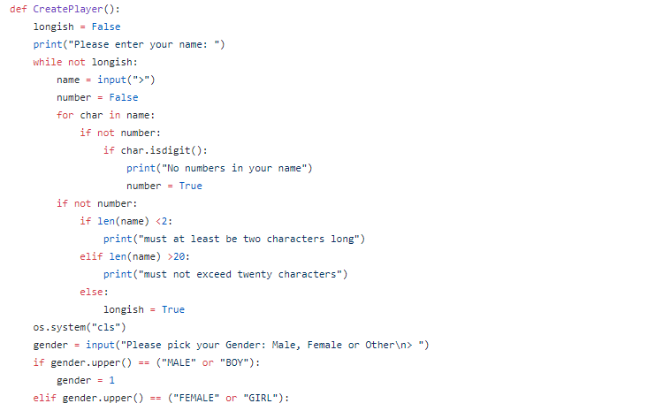
Character Creation System
Notes:
CCS here, is the element that gives an identity to the user. Takes input, checks if it doesnt’ have numbers, checks if its longer than 2 characters, checks if its shorter than 20 characters, outputs it. Gets input for gender, chooses 1 for male, 2 for female, 3 for other.

Slide 7
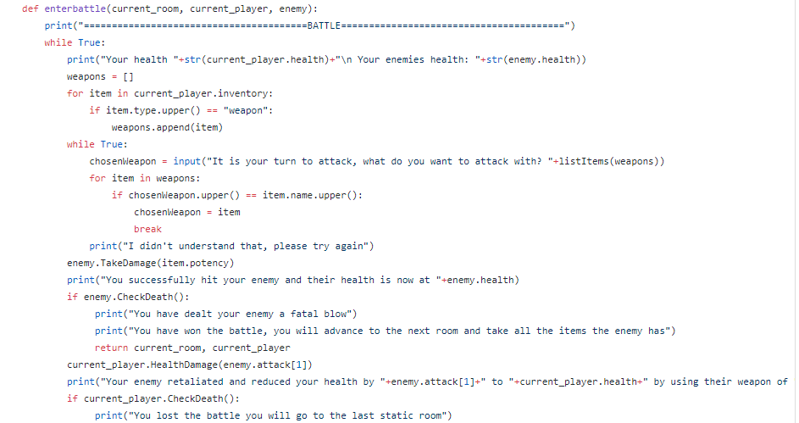
Combat System

Slide 8
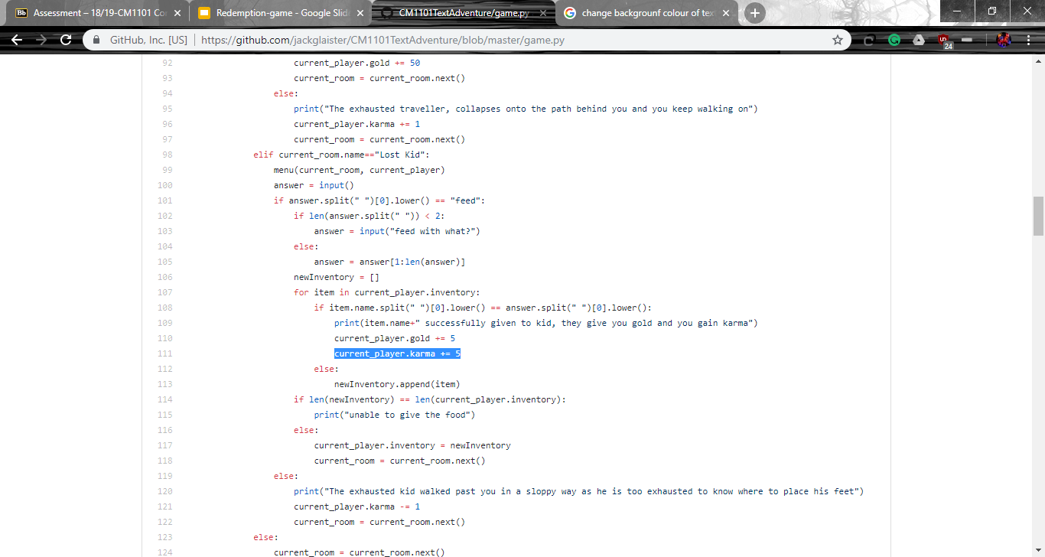
Karma System

Slide 9
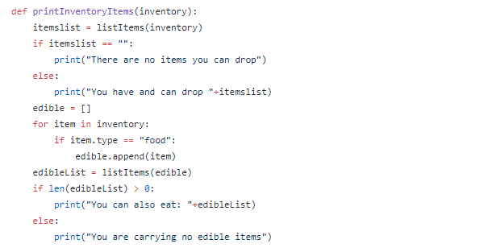
Inventory System

Slide 10
Randomly Selected Event
RandRooms = [
room("Lost Kid"," A kid is blocking the path in front of you, he appears to be hungry. Do you feed him or leave him? ",0,[],[]),
room("Merchant's Son"," The merchant's on steps into your path with a clueless look on his face. Do you give him directions or leave him? ",0,[],[]),
room("Wild Animal"," A wild animal is blocking your path, trying to shield its cubs from you. Do you force the animal out of your way or walk around it? ",0,[],[]),
room("Tired Traveller"," A wary traveller crosses your path, looking exhausted. Do you give him food and directions or laugh at him as you walk past? ",0,[],[]),
room("Bandit attack","A bandit is blocking your path ahead, they haven't yet spotted you but one movement could cost your life. Tread carefully.",0,[],[]),
room("Lost Kid"," A kid is blocking the path in front of you, he appears to be hungry. Do you feed him or leave him? ",0,[],[]),
room("Merchant's Son"," The merchant's on steps into your path with a clueless look on his face. Do you give him directions? ",0,[],[])
]
Notes:
What I did/ what are randomly selected events I designed and implemented the random events for our game. Random events are what their name suggests, events that randomly appear.
What the code means ( The code on screen essentially shows what is in the the variable ‘RandRoom’, an example is the lost kid room. When a user encounters the ‘Lost Kid’ room they will see the following text *point to the correct description*.
The Zero indicates the room number, the first square brackets indicates the number of items, and the second set of square brackets indicate the number of exits. - the number will depend on where the player is in the game.

Slide 11
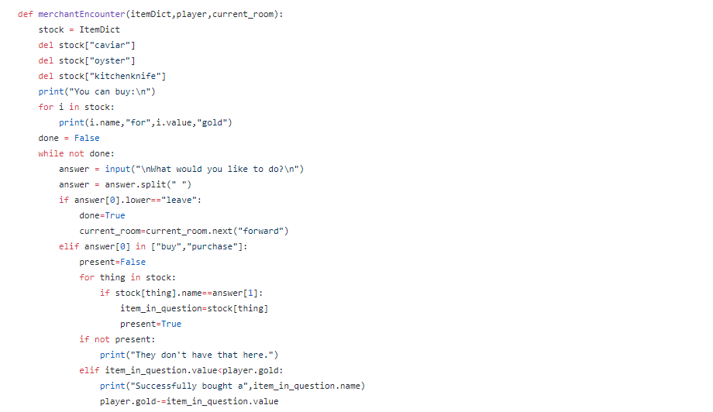
Merchant Encounter

Slide 12
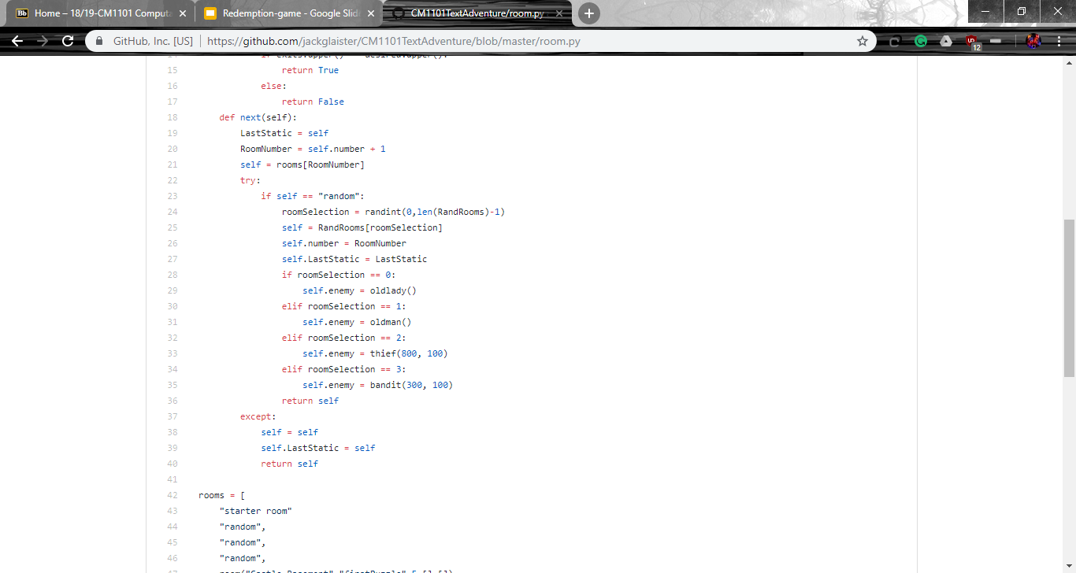
Randomly selected Room

Slide 13
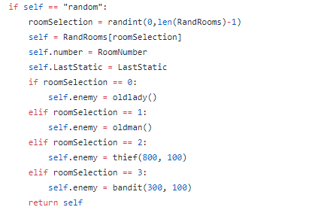
Randomly selected Enemies

Slide 14
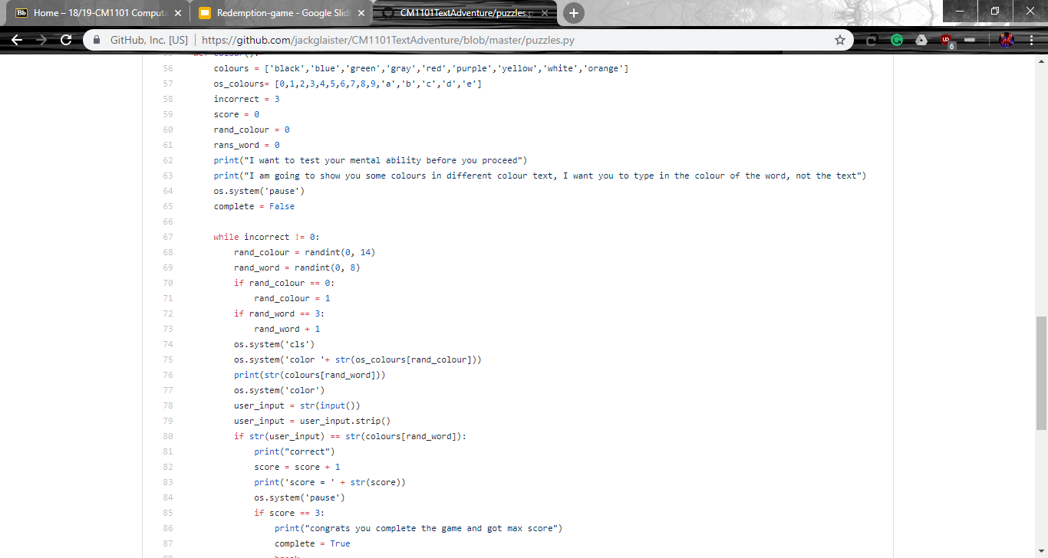
Mini Game System

Slide 15
But one day, everything changes

Slide 16
So, what is the new version of redemption?
Incredibly fun
Intense role playing game
The character goal is to put all the items in the correct room

Slide 17
Features that Redemption Currently have
Inventory
Karma System

Slide 18
Demonstration

Slide 19
Why You Should Buy the Game
Incredibly fun
10/10 - Darcy (dog)
Intense role playing game
It has a compelling story
Amazing replayability
Amazing mini-games inside a game
It uses the most powerful graphical processing unit; your IMAGINATION!
Andddddd…….why not?

Slide 20
Thank You for listening to our pitch

