Slide 1
Pitch Deck
Team LinTech
ITE 351
Instructor: Ma’am Ma. Grace Carpizo

Slide 2
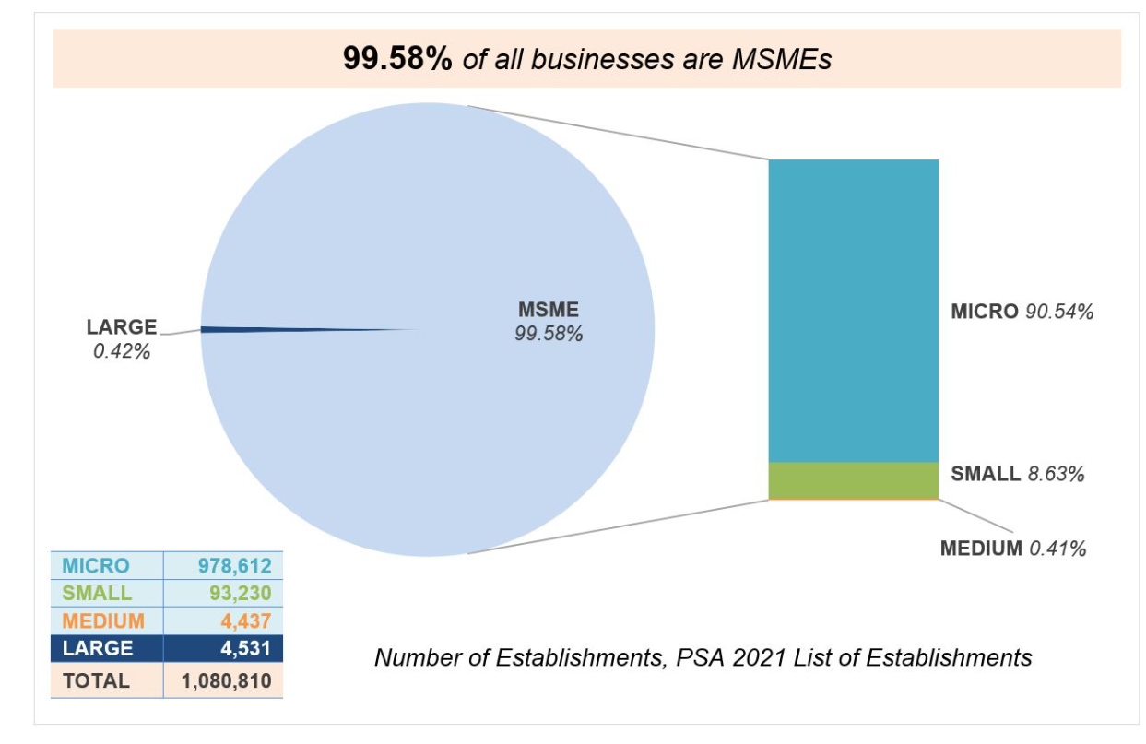
Introduction
MSMEs closing and bankruptcy rates are still going high.

Slide 3
Problem
Business owners are struggling to market their businesses.

Slide 4
Solution
Media Marketing

Slide 5
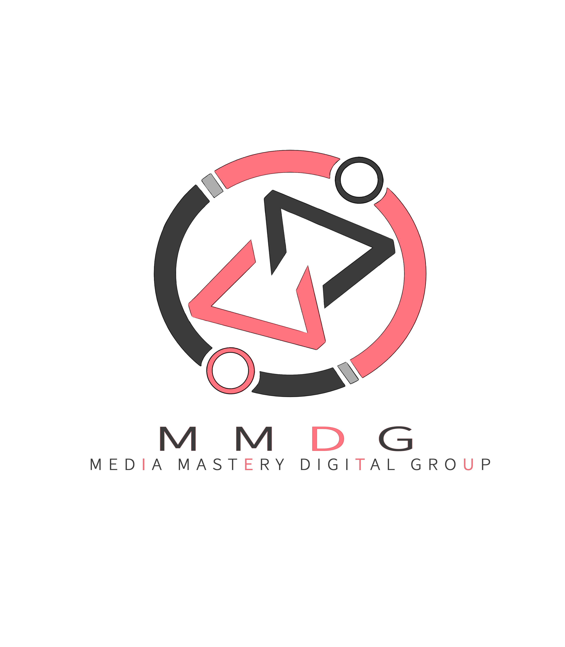
The Business
Business Form
General Partnership.
MMDG offers:
Commercial video (animated or recorded)
Product photography
Drawing (digital or any canvas)
Banner or tarpaulin designing
Logo Making
Social media platforms making and admin
T-shirts designing
Sticker designing
Other media art (digital or canvas)
Company Description
Within this global economy, small and medium-scale businesses need the right information and the right contacts for access and success. Media Mastery Digital Group offers all elements of entertainment in your product or service.

Slide 6
SWOT analysis
Strengths
Weaknesses
Opportunities
Threats
Skilled Employees
Providing Excellent Customer Service
Employees are Adaptive
Personnel with Technical Expertise
Limited spending
Less Popularity
Businesses (product or service) New or Old
Rise for the Needs of our Products
Social Media Era
Events and Occasions
Competitors
Natural Disasters

Slide 7



The Management Team/Employees
Alice Doe
Tim Jimmy
Ben Bones
You can speak a bit about this person here
You can speak a bit about this person here
You can speak a bit about this person here

Slide 8
Sample Pricing
Logo Making
Commercial Video (Recorded)
Product Photography
₱100- ₱ 1,500
Per-Image (₱20 to ₱200, depending on the quality and difficulty to take the shot)
Depends on the duration and elements of the video:
10 seconds commercial video (approx.₱500 – ₱1000) 20 seconds commercial video (approx. ₱1,200 – ₱2,500)
Depends on customization request
₱100- ₱ 1,000
10 seconds commercial video (approx.₱500 – ₱1000) 20 seconds commercial video (approx. ₱1,200 – ₱2,500)
Revision request

Slide 9
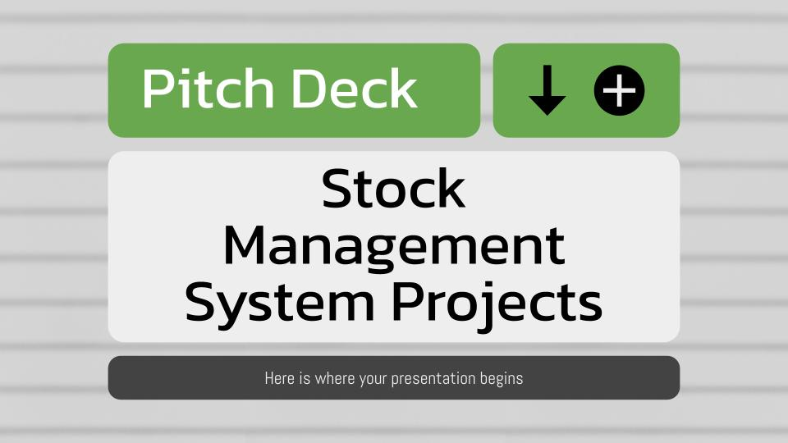
Product demo
You can replace the image on the screen with your own work. Just right-click on it and select “Replace image”

Slide 10
Raising Capital
Bootstrapping
Personal Funds
Family

Slide 11
Conclusion
MMDG is simple but profitable.
The MMDG management team is complete and equipped for the services that we offered.
MMDG target customers are everywhere.

