Slide 1
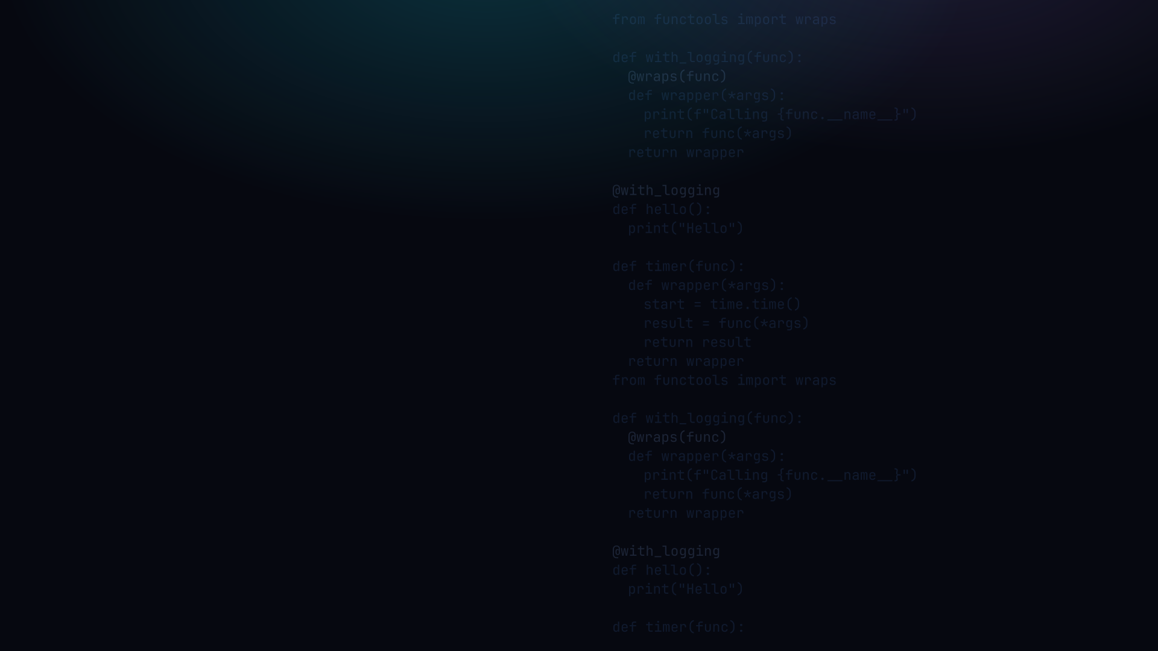

PYTHON PROGRAMMING 2
Decorators
Add behaviour to a function without changing it, and the @pie syntax that makes it clean.
Edward Reynolds · StayAhead Training, 2026

Slide 2








CHAPTER 5 · DECORATORS
What we'll cover
Introduction
A Simple Decorator
What decoration means, and why it matters
Take a func, wrap it, return the wrapper
Pie Syntax
Handling Arguments
@ as shorthand for name = deco(name)
*args and **kwargs in the wrapper
Handling Return Values
Configurable Decorators
Capturing and forwarding the result
Decorator factories: @deco(arg)
Real-world Use Cases
Logging, timing, auth, Flask, stdlib
Contents · 01

Slide 3
INTRODUCTION
What decoration means
• To decorate a function is to add functionality to it without changing it
• The functional equivalent of OO proxying
• It involves monkey patching
• Should not be used to fundamentally alter behaviour
• Commonplace in frameworks, e.g. Flask
Introduction · 02

Slide 4
A SIMPLE DECORATOR
Take, wrap, return
A decorator is a higher-order function that returns a modified version of the given function:
with_logging.py
1 def with_logging(func):
2
3 def modified_func():
4 print("Calling", func.__name__)
5 return func()
6
7 return modified_func
The added
functionality
A Simple Decorator · 03

Slide 5

YOUR TURN
A simple decorator
Setup: create decorators.py and decorators_test.py. Define decorators in the first; test them in the second.
1 · Write a decorator called with_logging that prints "Calling <name>" before calling the decorated function. Apply it to a simple function and call it.
2 · Code a decorator that logs to audit.log the date, time, the target function's name, and the arguments passed to it each time it is called.
Repo: stayahead-training/python-2-exercises · content/decorators.md
Your turn · 04

Slide 6
PIE SYNTAX
@ is shorthand for name = deco(name)
The pie syntax is preferred to explicitly monkey patching the function:
pie_syntax.py
SAME AS
@with_logging
def hello():
print("Hello")
hello()
# output:
# Calling hello
# Hello
@with_logging def hello(): ... is exactly hello = with_logging(hello)
Pie Syntax · 05

Slide 7
HANDLING ARGUMENTS
*args and **kwargs in the wrapper
Use *args, **kwargs so the wrapper forwards any call signature:
with_logging.py
1 def with_logging(func):
2 def modified_func(*args, **kwargs):
3 print("Calling", func.__name__)
4 for arg in args:
5 print("-", arg)
6 return func(*args, **kwargs)
7 return modified_func
collect in,
unpack out,
any signature
Handling Arguments · 06

Slide 8
YOUR TURN
Handling arguments
3 · Code a decorator that rounds the target function's return value to the nearest integer (use the built-in round function).
4 · Code a decorator that raises an Exception if the arguments passed to the target function are not numbers (either int or float).
Repo: stayahead-training/python-2-exercises · content/decorators.md
Your turn · 07

Slide 9
HANDLING RETURN VALUES
Capture, inspect, or transform the result
Assign func(*args, **kwargs) to a variable to inspect or transform the result before returning it:
round_result.py
1 def round_result(func):
2 def wrapper(*args, **kwargs):
3 result = func(*args, **kwargs)
4 return round(result)
5 return wrapper
6
7 @round_result
8 def average(a, b):
9 return (a + b) / 2
result = capture,
then transform
before returning
Handling Return Values · 08

Slide 10
CONFIGURABLE DECORATORS
Decorator factories: @deco(arg)
Wrap the decorator in an outer function that takes the config. The outer call returns the decorator:
audit_logger.py
1 def audit_logger(log_path):
2 def decorator(func):
3 def wrapper(*args, **kwargs):
4 # write to log_path ...
5 return func(*args, **kwargs)
6 return wrapper
7 return decorator
8
9 @audit_logger("orders.log")
10 def save_order(order_id):
11 ...
@deco(arg) calls
the factory first,
then decorates
Configurable Decorators · 09

Slide 11
YOUR TURN
Configurable decorators
5 · Modify the decorator you coded for task 2 such that the path of the log file may be passed as an argument to the decorator.
6 · What is a cross-cutting concern?
Repo: stayahead-training/python-2-exercises · content/decorators.md
Your turn · 10

Slide 12
REAL-WORLD USE CASES
Where you will meet decorators every day
• Flask routes: @app.route('/users') maps a URL to a function
• Auth and access control: @login_required guards a view
• Caching: @functools.lru_cache memoises pure functions
• Class helpers: @property, @staticmethod, @classmethod
• Test fixtures: pytest's @pytest.fixture and @pytest.mark.*
Real-world Use Cases · 11

Slide 13
YOUR TURN
Real-world use cases
7 · What should you not use decorators for?
USE decorators for cross-cutting concerns:
logging, timing, caching, auth, validation
DO NOT use them to change core behaviour:
altering return values, hiding business logic
Repo: stayahead-training/python-2-exercises · content/decorators.md
Your turn · 12

Slide 14

Recap & questions
• A decorator wraps a function, adds behaviour without changing it
• @deco is exactly name = deco(name)
• *args, **kwargs in the wrapper, works on any function
• Capture the result to inspect or transform it, always return it
• Factories add a config layer: @deco(arg) == deco(arg)(func)

