Slide 1
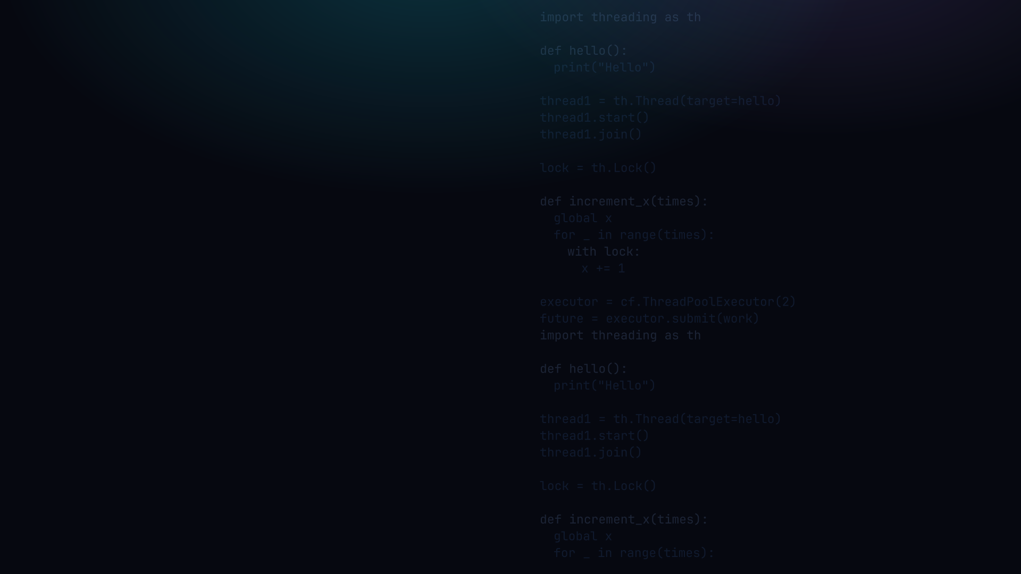

PYTHON PROGRAMMING 2
Threading
Spawning threads, sharing data safely, and the truth about the GIL.
Edward Reynolds · StayAhead Training, 2026

Slide 2






CHAPTER 6 · THREADING
What we'll cover
Creating threads
Scheduling
Spawn · subclass · __call__ · daemon · passing data
Order of execution · many threads · sleep · join
Coordinating and results
Memory and safety
Obtaining a result · executors
Stack and heap · race conditions · locks · deadlock
Use cases
I/O-bound work · the GIL · multiprocessing
Contents · 01

Slide 3
INTRODUCTION
What is a thread?
• A thread is the smallest unit of execution scheduled by the OS
• Think of it like a worker executing your code in the processor
• A process is a program in execution, made of one or more threads
• In theory a multi-threaded program can do two or more things at once
Introduction · 02

Slide 4

YOUR TURN
Introduction
Repo: stayahead-training/python-2-exercises · content/threading.md
1 · How does a thread differ from a process?
Your turn · 03

Slide 5
SPAWNING A THREAD
Target an existing function
Instantiate the Thread class, then call its start method:
spawn_target.py
import threading as th
def hello():
print("Hello")
# target an existing function...
thread1 = th.Thread(target=hello)
thread1.start()
Spawning a Thread · 04

Slide 6
YOUR TURN
Spawning a Thread
2 · Create hoo_ha_function.py. Code a function that writes its argument to stdout 10 times.
Spawn two threads: the first with argument "hoo" and the second with "ha". Run the script and note any interleaving.
If no interleaving is visible, increase the repeat count. How do you account for the variability?
Your turn · 05

Slide 7
SUBCLASSING THREAD
Or subclass Thread and override run
spawn_subclass.py
import threading as th
class MyThreadable(th.Thread):
def run(self):
print("Hello")
thread1 = MyThreadable()
thread1.start()
DON'T call run()
directly, use start()
Subclassing Thread · 06

Slide 8
IMPLEMENTING __CALL__
Make any callable object run on a thread
Pass any callable as target. A class with __call__ is callable:
callable_thread.py
import threading as th
class Worker:
def __call__(self):
print("Working...")
worker = Worker()
t = th.Thread(target=worker)
t.start()
Implementing __call__ · 07

Slide 9
YOUR TURN
Subclassing Thread
3 · Create hoo_ha_class.py. Repeat task 2 using a class that inherits from Thread.
Your turn · 08

Slide 10
DAEMON THREADS
Threads that die with the program
A daemon thread stops automatically when the program exits:
daemon.py
import threading as th
thread1 = th.Thread(target=some_func, daemon=True)
thread1.start()
• A non-daemon thread keeps the program alive until it finishes
• A daemon thread is killed when the main program exits, good for background tasks
Daemon Threads · 09

Slide 11
YOUR TURN
Daemon Threads
4 · What is a daemon thread?
Your turn · 10

Slide 12
PASSING DATA TO THREADS
Two styles: args= or __init__
function style (args=)
subclass style (__init__)
def mean(nums):
print(sum(nums)/len(nums))
th.Thread(target=mean,
args=[nums]).start()
class MeanThread(th.Thread):
def __init__(self, nums):
super().__init__()
self.nums = nums
def run(self):
print(sum(self.nums)/
len(self.nums))
• Function style: 'args' is a list unpacked into the function's parameters.
• Subclass style: data arrives in '__init__', stored on self, used in run().
Passing Data to Threads · 11

Slide 13
ORDER OF EXECUTION
Threads do not run in a guaranteed order
The OS scheduler decides WHEN each thread runs. You cannot predict the order:
order.py
import threading as th
def say(msg):
print(msg)
th.Thread(target=say, args=["first"]).start()
th.Thread(target=say, args=["second"]).start()
# may print: first, second OR second, first
Order of Execution · 12

Slide 14
SPAWNING MANY THREADS
Create and start them in a loop
many_threads.py
import threading as th
def work(n):
print("task", n)
threads = [
th.Thread(target=work, args=[i])
for i in range(5)
]
for t in threads: t.start()
for t in threads: t.join()
Spawning Many Threads · 13

Slide 15
PUTTING A THREAD TO SLEEP
time.sleep() pauses the running thread
pausing.py
import threading as th
import time
def hello_after_delay():
time.sleep(1) # sleep for 1 sec.
print("Hello")
thread1 = th.Thread(target=hello_after_delay)
thread1.start()
Pausing a thread · 14

Slide 16
WAITING FOR A THREAD TO FINISH
Call its join method
Force one thread to wait for another to finish with join:
joining.py
import threading as th
...
thread1 = th.Thread(target=some_func)
thread1.start()
# force the main thread to wait
thread1.join()
Waiting for a Thread to Finish · 15

Slide 17
OBTAINING A RESULT FROM A THREAD
Store it on an attribute, join, then read
result_attr.py
• threads have no return value.
• Best: store on self, read after join().
• Alternative: write to a 'global' variable (set 'global name' inside the function), then join() before reading.
class MeanThread(th.Thread):
def __init__(self, nums):
super().__init__()
self.nums = nums
def run(self):
self.mean = sum(self.nums)/
len(self.nums)
t = MeanThread([5,13,7,9])
t.start()
t.join()
print(t.mean)
always join() before
you read the result
Obtaining a Result from a Thread · 16

Slide 18
USING AN EXECUTOR
A pool that manages threads for you
executor.py
import concurrent.futures as cf
def mean(nums):
return sum(nums) / len(nums)
executor = cf.ThreadPoolExecutor(2)
future1 = executor.submit(mean, some_nums)
print(future1.result())
executor.shutdown()
result() blocks until the task is complete
Using an Executor · 17

Slide 19
STACK AND HEAP MEMORY
One heap, one danger
• Stack: one per thread. Holds local variables, private to that thread.
• Heap: ONE, shared by all threads. Holds objects.
• Consequence: shared mutable objects on the heap are where race conditions live.
Thread 1 Stack
Thread 2 Stack
function1()
function1()
local_var1
local_var1
local_var2
local_var2
Heap (shared by all threads)
obj1
obj2
obj3
Stack and Heap Memory · 18

Slide 20
RACE CONDITIONS
When shared data goes wrong
• Where two or more threads race to execute a critical section of code
• The result differs depending on the order in which the threads run
• Two types: read-modify-write & check-then-act
• Occur only when objects are shared between threads
Race Conditions · 19

Slide 21
RACE CONDITIONS
Why: read-modify-write is not atomic
x += 1 compiles to four steps. A thread can be paused between any two:
Time
Thread 1
Thread 2
x += 1 as bytecode
LOAD x = 57
LOAD_NAME (x)
LOAD_INT (1)
BINARY_OP (+=)
STORE_NAME (x)
LOAD x = 57
BINARY_OP = 58
BINARY_OP = 58
STORE x = 58
STORE x = 58 (lost!)
Race Conditions · 20

Slide 22
THREAD SYNCHRONISATION
A Lock protects the critical section
Ensure only one thread runs the critical section at a time:
locking.py
lock = th.Lock()
def increment_x(times):
global x
for _ in range(times):
lock.acquire()
x += 1
lock.release()
Cleaner:
with lock:
x += 1
Thread Synchronisation · 21

Slide 23
DEADLOCK
When every thread is waiting forever
Two threads each hold a lock the other needs, so both wait forever:
deadlock.py
lock_a = th.Lock() lock_b = th.Lock()
def task_one():
with lock_a: # acquires A
with lock_b: # then tries B
print("task one")
def task_two():
with lock_b: # acquires B
with lock_a: # then tries A
print("task two")
• Fix: always acquire locks in the same order in every thread
Deadlock · 22

Slide 24

THREADING USE CASES
The honest truth about Python threads
• The GIL prevents more than one thread executing at once
• Threads can, however, wait simultaneously
• Great for IO-intensive work (network, disk, waiting)
• For CPU-intensive work, consider multiprocessing instead
• Since Python 3.13-3.14 the GIL can be switched off (free-threaded builds)
Threading Use Cases · 23

Slide 25
YOUR TURN
Exercises: Threading
Head to the Threading exercises and work through them.
Repo: stayahead-training/python-2-exercises · content/threading.md
Exercises · 24

Slide 26

Recap & questions
• start / join, spawn a thread, wait for it; pass data via args or __init__
• Shared data races, x += 1 isn't atomic; a Lock protects the critical section
• The GIL, threads help IO-bound work; use multiprocessing for CPU-bound

