Slide 1
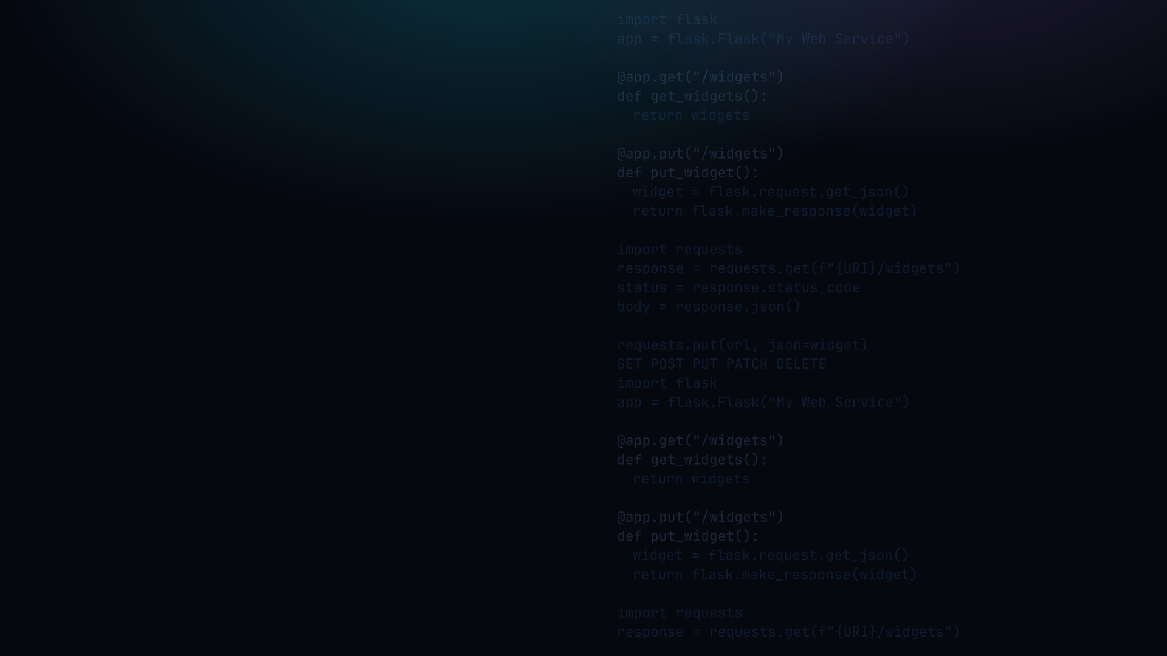

PYTHON PROGRAMMING 2
Web Services
REST APIs, HTTP methods, and talking between programs with Flask & requests.
Edward Reynolds · StayAhead Training, 2026

Slide 2



CHAPTER 7 · WEB SERVICES
What we will cover
REST Services
REST Clients
Flask · routes · path vars · methods · auth · deploy
requests · headers · params · body · timeouts · errors
Installing Flask
Installing requests
A simple REST service
Making requests
Path variables
Headers and query params
HTTP methods
The request body
The request / The response
Timeouts
Auth and deployment
Errors and exceptions
Contents · 01

Slide 3
INTRODUCTION
What is a web service?
• A program whose functions may be invoked remotely over the web
• It enables communication between disparate programs
• Types: RPC, CORBA, SOAP, REST
• REST (Representational State Transfer) now dominates
*Technically REST is an architectural
style, not a type of web service
Web Services · 02

Slide 4
REST SERVICES
Installing Flask
• You could build one with stdlib, e.g. http.server
• Third-party libs are preferred: Django, FastAPI, Flask
• Each is a framework: a program that is extended by your code
• We will use Flask because it is lightweight and simple
terminal
$ pip3 install flask
REST Services · 03

Slide 5
REST SERVICES
A simple REST service
service.py
1 import flask
2
3 app = flask.Flask("My Web Service")
4
5 @app.get("/widgets")
6 def get_widgets():
7 # TODO fetch widgets
8 return widgets
9
10 if __name__ == "__main__":
11 app.run(debug=True)
GET /widgets is mapped
to the get_widgets function
run() starts a server
listening on port 5000
REST Services · 04

Slide 6
REST SERVICES
Path variables
service.py
...
@app.get("/widgets/<int:id>")
def get_widget(id: int):
# TODO fetch widget with id
return widget
...
GET /widgets/51 is mapped to
get_widget, with the parameter
id set to 51
REST Services · 05

Slide 7
REST SERVICES
HTTP methods
Method
Description
GET
Read the resource. Safe and idempotent. No body sent.
POST
Create a new resource. NOT idempotent.
PUT
Replace the whole resource at a known URL. Idempotent.
PATCH
Partial update: change only the fields you send. Idempotent.
DELETE
Remove the resource. Idempotent.
CRUD mapping: POST = Create, GET = Read, PUT/PATCH = Update, DELETE = Delete. Idempotent: GET, PUT, PATCH, DELETE. Not idempotent: POST.
REST Services · 06

Slide 8
REST SERVICES
The request
service.py
1 @app.put("/widgets")
2 def put_widget():
3 widget = flask.request.get_json()
4 # TODO write the widget to disk
5 ...
• flask.request is Flask's context object for the current incoming request
• get_json() parses the JSON body into a Python dict
• Other useful attributes: request.args (query params), request.headers
REST Services · 07

Slide 9
REST SERVICES
The response
service.py
1 @app.put("/widgets")
2 def put_widget():
3 widget = flask.request.get_json()
4 response = flask.make_response(widget)
5 response.status = 201
6 return response
Build a response with
custom status code
201 = CREATED
200 = OK (default)
REST Services · 08

Slide 10
REST SERVICES
Authentication and authorisation
• REST is stateless: the server keeps no session, so each request must carry its own credentials
• Credentials travel in the Authorization request header on every call
• Common scheme: Bearer token (JWT or opaque string)
• Server checks the token in the route (or a decorator)
service.py
token = flask.request.headers.get("Authorization")
if not token:
return {"error": "unauthorised"}, 401
REST Services · 09

Slide 11
REST SERVICES
Deployment
• Flask's built-in app.run() is for development only: not safe, single-threaded
• Production: run Flask behind a WSGI server, e.g. Gunicorn or uWSGI
• Typical stack: Nginx (proxy) -> Gunicorn (WSGI) -> Flask app
• Cloud options: Heroku, AWS Elastic Beanstalk, Azure App Service, Render
terminal
$ pip3 install gunicorn
$ gunicorn service:app
REST Services · 10

Slide 12

YOUR TURN
REST Services
Setup: download movie_service.py from the exercises repo (link below). Open it in your editor.
1 · How does a web service differ from a web app?
2 · How is an HTTP request mapped to a function/method?
3 · Add endpoints to the movie service: GET by ID, POST, DELETE, and a filtered GET using query params
4 · The service handles requests in separate threads. What problems might that cause as written?
5 · What error handling, if any, should be added to the service?
Repo: stayahead-training/python-2-exercises · content/web-services.md
Your turn · 11

Slide 13
REST CLIENTS
Installing the requests module
• You could build a client with stdlib, e.g. urllib.request
• Third-party library preferred: requests ('HTTP for humans')
• Clean, readable, with sensible defaults
terminal
$ pip3 install requests
REST Clients · 12

Slide 14
REST CLIENTS
Making requests
client.py
1 import requests
2
3 response = requests.get(f"{URI}/widgets")
4
5 status_code = response.status_code
6 headers = response.headers # a dict
7 body = response.json() # assuming JSON
REST Clients · 13

Slide 15
REST CLIENTS
Headers and query parameters
headers: client.py
params: client.py
response = requests.get(
f"{URI}/widgets",
headers={
"Accept": "application/json",
"Authorization": creds
}
)
response = requests.get(
f"{URI}/movies",
params={
"genre": "Comedy"
}
)
Accept = format you want; Authorization = who you are.
/movies?genre=Comedy (built by requests)
REST Clients · 14

Slide 16
REST CLIENTS
The request body
client.py
1 movie = {"id": 3, "title": "Clueless"}
2
3 response = requests.post(
4 f"{URI}/movies",
5 json=movie # serialises + sets Content-Type
6 )
json=movie serialises the dict to JSON and sets Content-Type: application/json. This is the data the server reads with get_json().
REST Clients · 15

Slide 17
REST CLIENTS
Timeouts
client.py
response = requests.get(
f"{URI}/movies",
timeout=5 # seconds
)
• Without a timeout, requests can hang forever if the server is slow or unreachable
• timeout=5 waits up to 5 s for a connection AND response
• timeout=(connect, read) sets them separately, e.g. timeout=(2, 10)
• Timeout raises requests.exceptions.Timeout
REST Clients · 16

Slide 18
REST CLIENTS
Errors and exceptions
client.py
1 try:
2 response = requests.get(url, timeout=5)
3 response.raise_for_status() # 4xx/5xx -> exception
4 data = response.json()
5 except requests.exceptions.Timeout:
6 print("Timed out")
7 except requests.exceptions.ConnectionError:
8 print("Cannot connect")
9 except requests.exceptions.HTTPError as e:
10 print("HTTP error", e)
REST Clients · 17

Slide 19
YOUR TURN
REST Clients
Setup: download movie_client.py from the repo. Run your movie service in one terminal, the client in another.
6 · Complete the movie client to match the endpoints you added to the service in task 3
7 · How does basic authentication work?
Repo: stayahead-training/python-2-exercises · content/web-services.md
Your turn · 18

Slide 20

Recap & questions
• A web service is called remotely; REST dominates
• URI is the noun, HTTP method is the verb; JSON is the data
• Build with Flask, consume with requests, both halves of the loop

