Slide 1
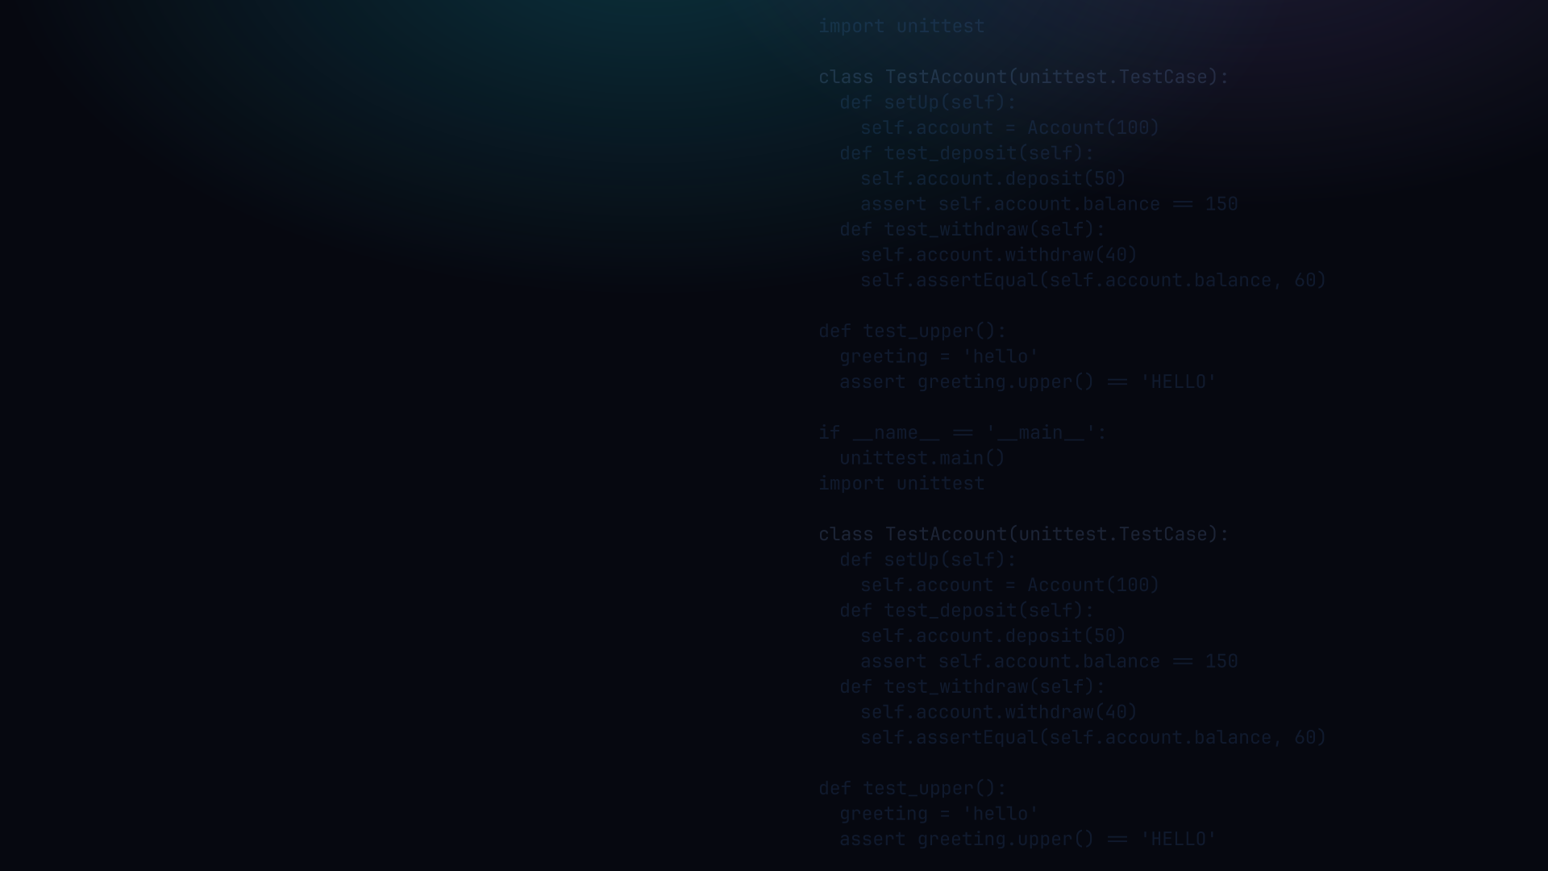

PYTHON PROGRAMMING 2
Unit Testing
Terminology, frameworks, assertions, fixtures, stubs and mocks, and running tests from the command line.
Edward Reynolds . StayAhead Training, 2026

Slide 2







CHAPTER 8 . UNIT TESTING
What we'll cover
Introduction
A Simple Unit Test
Terminology, frameworks, guidelines
TestCase subclass, the 3A pattern
Assert Methods
Test Fixtures
assertEqual, assertRaises, and more
setUp, tearDown, setUpClass
Stubs
Mocks
Hand-written stand-ins for isolation
unittest.mock: Mock and patch
Command Line Test Execution
python -m unittest, discovery, -v
Contents . 01

Slide 3
INTRODUCTION
Terminology
Term
Definition
Unit
The smallest testable part of an application (a function or method)
Test case
A group of related tests, usually a class or module
SUT
System under test: the module or class currently being tested
Test double
A fake object used in place of one of the SUT's real dependencies
Fixture
The environment in which the test runs: the SUT's prepared dependencies
Setup
The process of constructing the fixture before each test
Unit test
A function or method that exercises the unit and passes or fails
Assertion
A statement that decides whether the test passes or fails
Teardown
The process of destroying the fixture after each test
Runner
A script that invokes all tests in a test case or suite
Introduction . 02

Slide 4

INTRODUCTION
Unit testing frameworks
unittest: part of the Python standard library, no install needed
pytest: popular third-party tool, plain assert with richer output
A framework gives you:
A way to group and name tests
Automatic test discovery (files and functions matching test_*)
A runner that reports pass, fail and error with a summary
Built-in setup and teardown hooks
Introduction . 03

Slide 5
INTRODUCTION
Guidelines
Apply the 3A pattern: Arrange, Act, Assert
Avoid test interdependence: each test must stand on its own
Keep it simple: do not abstract away the Arrange step
Arrangement pain is a code smell. Hard-to-arrange code is badly designed
Add your tests to the build. If a test fails, the build fails
One test, one thing. If the name has 'and', split it
Name tests so the failure line alone says what broke
Deterministic: no random data, no live network calls
Isolate the SUT from its dependencies using test doubles
No logic inside a test: no ifs, loops or exception handling
Introduction . 04

Slide 6
A SIMPLE UNIT TEST
The 3A pattern in a TestCase
Arrange
Act
Assert
Prepare arguments, set the SUT's starting state
Exercise the SUT: call the function or method
Verify the outcome
account_test.py
1 class TestAccount(unittest.TestCase):
2 def test_deposit_increases_balance(self):
3 account = Account(100) # arrange
4 account.deposit(50) # act
5 self.assertEqual(account.balance, 150) # assert
A Simple Unit Test . 05

Slide 7
ASSERT METHODS
The unittest assert* family
Method
What it checks
assertEqual(a, b)
Assert a == b
assertNotEqual(a, b)
Assert a != b
assertTrue(x)
Assert bool(x) is True
assertFalse(x)
Assert bool(x) is False
assertIn(a, b)
Assert a in b
assertNotIn(a, b)
Assert a not in b
assertRaises(exc, fn, ...)
Assert fn(...) raises exc
assertAlmostEqual(a, b)
Assert a and b are close (float-safe)
assertIsNone(x)
Assert x is None
assertIsNotNone(x)
Assert x is not None
assertRaises as context manager: with self.assertRaises(ValueError): <act> -- test passes only when the exception is raised.
Assert Methods . 06

Slide 8

YOUR TURN
Unit testing basics
Setup: download assorted.py from the repo. Create assorted_test.py alongside it.
1 What is the purpose of unit testing?
2 What are the three A's?
Repo: stayahead-training/python-2-exercises . content/unit-testing.md
Your turn . 07

Slide 9
TEST FIXTURES
setUp and tearDown
setUp runs before EACH test: build the shared fixture fresh
tearDown runs after EACH test: release resources
setUpClass / tearDownClass: run once per class for expensive shared state
account_test.py
1 class TestAccount(unittest.TestCase):
2 def setUp(self): # runs before EACH test
3 self.account = Account(100)
4 def tearDown(self): # runs after EACH test
5 self.account = None
6 def test_deposit_increases_balance(self):
7 self.account.deposit(50)
8 self.assertEqual(self.account.balance, 150)
9 def test_withdraw_reduces_balance(self):
10 self.account.withdraw(30)
11 self.assertEqual(self.account.balance, 70)
Test Fixtures . 08

Slide 10
STUBS
A hand-written stand-in for isolation
A stub is a fake object that returns canned data in place of a real dependency
Inject it into the SUT via the constructor: dependency injection
Stub vs mock: a stub just supplies data. A mock also records calls for later assertion
order_test.py
1 class StubPaymentGateway: # hand-written stub
2 def charge(self, amount):
3 return "ok" # canned return value
4
5 class TestOrder(unittest.TestCase):
6 def test_checkout_total_charged(self):
7 gateway = StubPaymentGateway() # arrange
8 order = Order(gateway, items=["book"])
9 result = order.checkout() # act
10 self.assertEqual(result, "ok") # assert
Stubs . 09

Slide 11
MOCKS
Mock and verifying calls
A mock supplies canned data AND records every call made to it
Mock / MagicMock: use for a collaborator passed in as an argument
assert_called_once_with: verify the call happened, once, with the right argument
order_test.py
1 from unittest.mock import MagicMock
2
3 class TestOrder(unittest.TestCase):
4 def test_checkout_charges_correct_amount(self):
5 gateway = MagicMock() # arrange
6 gateway.charge.return_value = "ok"
7 order = Order(gateway, items=["book"], price=15)
8
9 order.checkout() # act
10
11 gateway.charge.assert_called_once_with(15) # assert
Mocks . 10

Slide 12
MOCKS
@patch: replacing a name the SUT looks up
@patch: temporarily replace an object the SUT looks up by name
Patch target: where the name is used, not where it is defined
notifier_test.py
1 from unittest.mock import patch
2
3 class TestNotifier(unittest.TestCase):
4
5 @patch("notifier.send_email") # patch WHERE used
6 def test_welcome_email_sent(self, mock_send):
7 notifier = Notifier() # arrange
8
9 notifier.welcome("alice") # act
10
11 mock_send.assert_called_once_with(
12 "alice@example.com", "Welcome!" # assert
13 )
Mocks . 11

Slide 13
YOUR TURN
Stubs, mocks and isolation
3 Differentiate between a stub and a mock
4 Why does unittest require classes that inherit from TestCase?
5 Open assorted.py. Code tests for mean, get_next_number, get_greeting and total_amount_repayable.
Isolate each test from its dependencies. Cover happy and sad paths.
Repo: stayahead-training/python-2-exercises . content/unit-testing.md
Your turn . 12

Slide 14
COMMAND LINE TEST EXECUTION
python -m unittest
terminal
# discover and run all tests in the current directory
$ python -m unittest discover
$ python -m unittest discover -v # verbose
$ python -m unittest account_test # one module
$ python -m unittest account_test.TestAccount # one class
# terse output (dot=pass, F=fail, E=error)
..F.E. Ran 5 tests in 0.012s FAILED (failures=1, errors=1)
# verbose output (-v)
test_deposit ... ok
test_withdraw ... FAIL
test_transfer ... ERROR
FAIL = assertion failed (wrong answer). ERROR = unexpected exception (crash in test or SUT). Both need fixing.
Command Line Test Execution . 13

Slide 15

Recap & questions
Arrange, Act, Assert: the shape of every good test
Fixtures: setUp builds the shared context fresh before each test
Stubs supply data; mocks also verify how the SUT called its dependency
python -m unittest discover -v: run everything, verbosely

