Slide 1
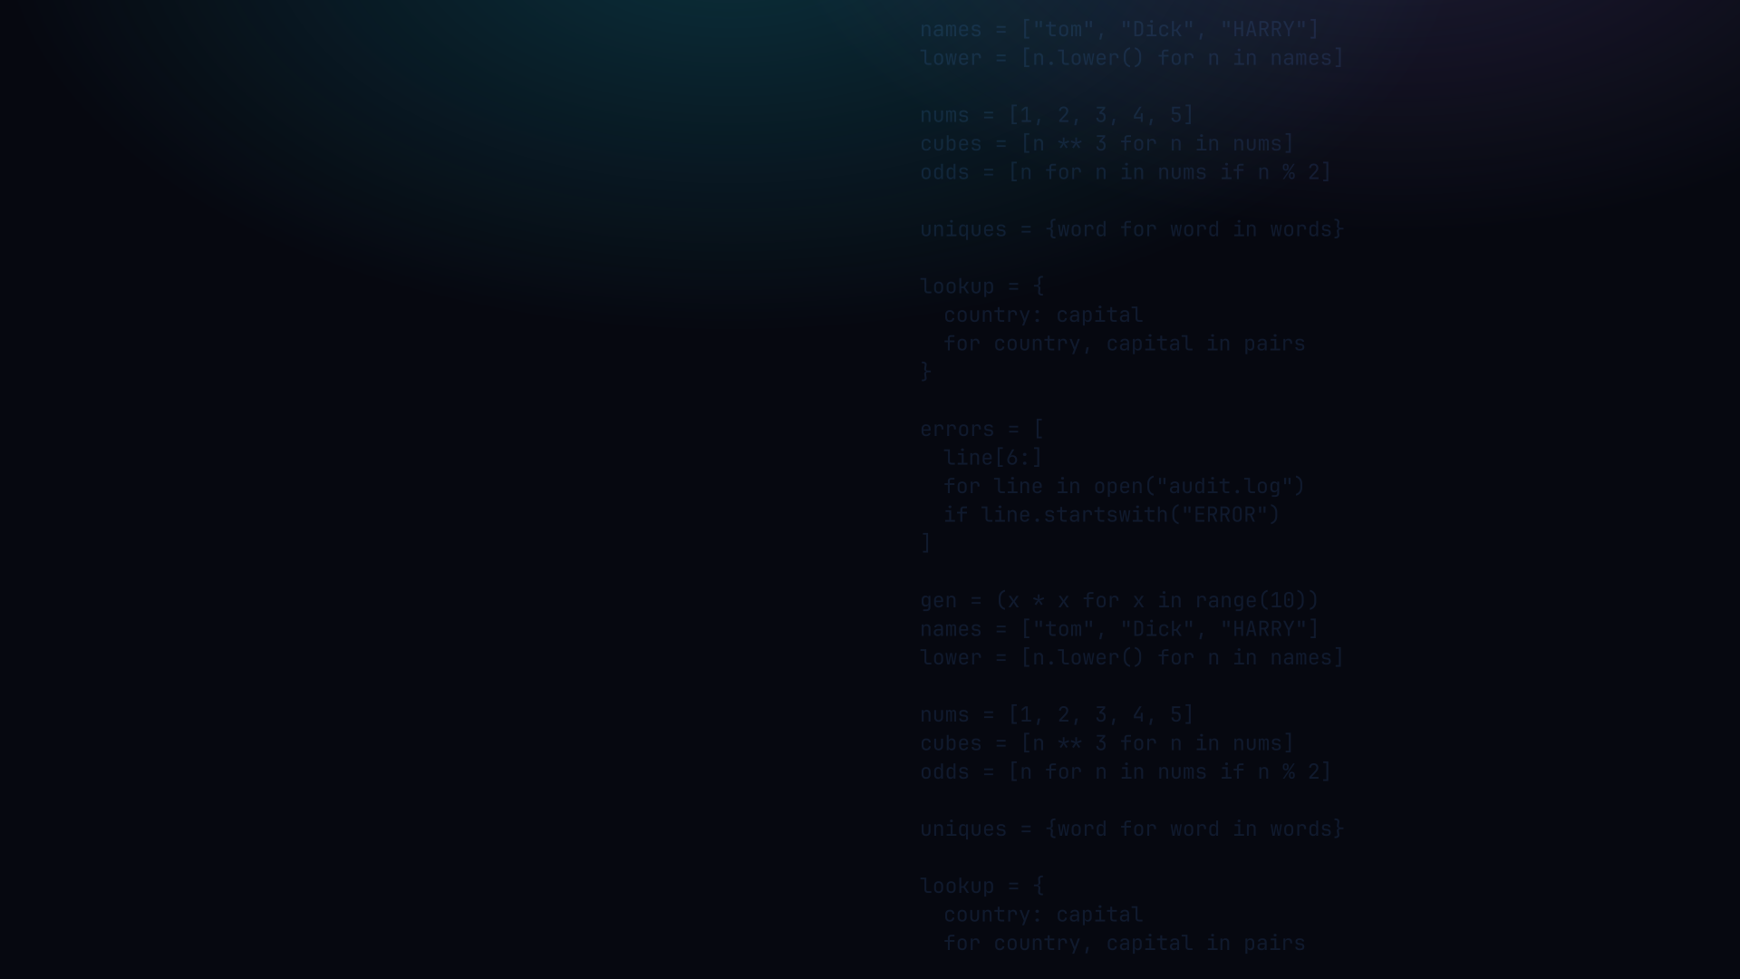

PYTHON PROGRAMMING 2
Comprehensions
Transform a list, set or dict in one declarative line, map, filter, combine.
Edward Reynolds · StayAhead Training, 2026

Slide 2








CHAPTER 3 · COMPREHENSION
What we'll cover
Introduction
List Comprehension
A concise expression that builds a collection
Anatomy · conditions · spanning · sources
Set Comprehension
Dictionary Comprehension
{ expr for ... } · dedupes automatically
{ key: value for ... } · the zip function
Nesting
Flattening
A comprehension inside a comprehension
Flatten a nested list with two for clauses
Generator Expressions
( expr for ... ) · lazy, one-shot, low memory
Contents · 01

Slide 3
INTRODUCTION
What a comprehension is
A comprehension is a concise expression that builds a new list / set / dict from an iterable:
for_loop.py
→
comprehension.py
lower_names = []
for name in names:
lower_names.append(
name.lower())
lower_names = [
name.lower()
for name in names
]
• Same result, every name is mapped to a new value
• Concise, efficient, and declarative. It reads like an SQL query
Introduction · 02

Slide 4
LIST COMPREHENSION
The basic form: anatomy of a comprehension
All the logic lives inside the square brackets, two parts:
basic_form.py
lower_names = [name.lower() for name in names]
the value added to the new container
the for loop over the source
• Square brackets [ ] → a list. The for loop has no colon and no indented body. The expression IS the body.
List Comprehension · 03

Slide 5
LIST COMPREHENSION
Conditional statements: filter, or choose a value
An if at the end filters; an a if cond else b expression chooses a value:
conditions.py
nums = [1, 2, 3, 4, 5]
# filter, keep only odd numbers
odds = [n for n in nums if n % 2]
# odds ===> [1, 3, 5]
# choose a value, label each number
labels = ["odd" if n % 2 else "even" for n in nums]
# labels ===> ['odd','even','odd','even','odd']
List Comprehension · 04

Slide 6
LIST COMPREHENSION
Spanning lines for readability
For readability, put each of the three parts on its own line:
spanning.py
The brackets let it span lines freely. Or, some devs prefer very short names:
short_names = [
name
for name in names
if len(name) < 5
]
short.py
short = [
n for n in names
if len(n) < 5
]
List Comprehension · 05

Slide 7
LIST COMPREHENSION
Sources of data: any iterable works
The source can be a range, list, string, any iterable, iterator, or generator:
sources.py
squares = [n * n for n in range(5)]
# squares ===> [0, 1, 4, 9, 16]
caps = [c.upper() for c in "abc"]
# caps ===> ['A', 'B', 'C']
errors = [
line[6:]
for line in open("audit.log")
if line.startswith("ERROR")
]
List Comprehension · 06

Slide 8
LIST COMPREHENSION
Two or more sources: each extra for nests
Each extra for loop is nested inside the previous, every combination (all pairs):
two_sources.py
• Reads top-to-bottom as outer-then-inner, like stacked loops
• 3 x 2 = 6 results: every price with every discount
prices = [100, 200, 300]
discounts = [5, 10]
discounted = [
price - (price * discount / 100)
for price in prices
for discount in discounts
]
# ===> [95, 90, 190, 180, 285, 270]
List Comprehension · 07

Slide 9

YOUR TURN
List comprehensions
Setup: create comprehension.py and copy in the books list (10 dicts). Full data in the repo.
one book, for shape
Transform the books list to produce each of these:
{'id': 1, 'title': 'The Gruffalo',
'author': 'Donaldson',
'genre': 'Childrens',
'ratings': [4, 5, 5]}
• titles only
• childrens books only
• titles of childrens books only
• educational and military/war books only
• title and author of classics only
• books with average rating greater than 4
• title and author of childrens books with avg rating > 4
Repo: stayahead-training/python-2-exercises · content/comprehension.md
Your turn · 08

Slide 10
SET COMPREHENSION
Curly braces, no colon, and it dedupes
Use curly braces with a single expression, the result is a set (duplicates removed):
set_comp.py
words = ["hi", "HI", "Hi", "bye"]
uniques = {word.lower() for word in words}
# uniques ===> {'hi', 'bye'}
• Curly braces { } with no colon → a set; the same braces with a colon → a dict (next).
Set Comprehension · 09

Slide 11
DICTIONARY COMPREHENSION
Curly braces with a key: value expression
Use curly braces and a key: value expression:
dict_comp.py
nums = [1, 2, 3]
squares = {
n: n * n
for n in nums
}
# squares ===> {1: 1, 2: 4, 3: 9}
• The key before the colon, the value after, both can be any expression.
Dictionary Comprehension · 10

Slide 12
DICTIONARY COMPREHENSION
The zip function: pair two lists into a dict
zip pairs items from two lists by position, perfect inside a dict comprehension:
zip_dict.py
countries = ["France", "Germany", "Spain"]
capitals = ["Paris", "Berlin", "Madrid"]
lookup = {
country: capital
for country, capital in zip(countries, capitals)
}
# {"France": "Paris", "Germany": "Berlin", ...}
zip yields tuples:
('France','Paris')
... unpacked into
country, capital
Dictionary Comprehension · 11

Slide 13
YOUR TURN
Multiple sources & zip
3 · Predict the output. What does result contain?
predict.py
4 · Refactor it to produce:
[('a', 1), ('b', 2), ('c', 3)]
letters = ['a', 'b', 'c']
numbers = [1, 2, 3]
result = [(l, n) for l in letters
for n in numbers]
5 · Using the authors list (first_name / last_name dicts), transform books so each book's
author key references a dict of the author's first and last names.
Your turn · 12

Slide 14
NESTING
A comprehension inside a comprehension
Put a comprehension in the expression slot to build a grid (a list of lists):
nesting.py
grid = [
[row * col for col in range(3)]
for row in range(3)
]
# ===> [[0, 0, 0],
# [0, 1, 2],
# [0, 2, 4]]
• Inner comprehension builds one row; the outer for repeats it for each row.
Nesting · 13

Slide 15
FLATTENING
Collapse a nested list with two for clauses
Two for clauses in a row flatten a list of lists into a single list:
flatten.py
grid = [[1, 2], [3, 4], [5, 6]]
flat = [
value
for row in grid
for value in row
]
# flat ===> [1, 2, 3, 4, 5, 6]
• Same order as nested loops: for each row, then for each value in that row.
Flattening · 14

Slide 16
YOUR TURN
Sets & flattening
6 · Copy the recipes list (each recipe has a name and an ingredients list)
and transform it into a SET of all ingredients.
one recipe, for shape
two for clauses
flatten AND dedupe
{'name': 'spag bowl',
'ingredients': ['pasta', 'bolognese sauce']}
Your turn · 15

Slide 17
GENERATOR EXPRESSIONS
Like a list comp, but lazy
Swap brackets for parentheses, values are produced lazily, one at a time:
genexp.py
gen = (n * n for n in range(1000000))
# nothing computed yet, no big list in memory
total = sum(gen) # consumed on demand
# one-shot: gen is now exhausted
• Lazy, computes each value only when asked; low memory (no full list built)
• One-shot, once iterated it's exhausted; great for piping into sum / max / any
Generator Expressions · 16

Slide 18
YOUR TURN
Reflect
7 · What is a generator expression, and how does it differ from a list comprehension?
GENERATOR EXPRESSION ( ... )
LIST COMPREHENSION [ ... ]
• Lazy iterator, items one at a time
• Tiny memory, great for large / streamed data
• One-shot: no len(), no indexing
• Builds the whole list up front
• Reusable, supports len() and indexing
• Holds everything in memory
Your turn · 17

Slide 19

Recap & questions
• value · for · condition, the parts inside the brackets
• [ ] list · { } set · { k: v } dict · ( ) generator, same anatomy
• Nest, flatten, zip, combine and reshape; genexps stay lazy

