Slide 1
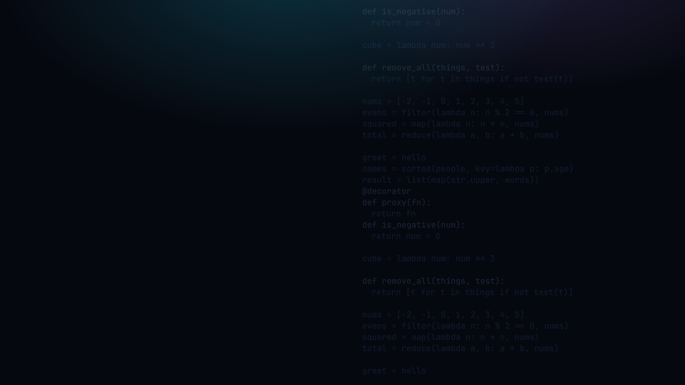
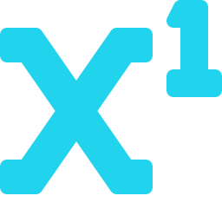
PYTHON PROGRAMMING 2
Functional Programming
Pure functions, functions as objects, higher-order functions and lambdas.
Edward Reynolds · StayAhead Training, 2026

Slide 2







CHAPTER 4 · FUNCTIONAL PROGRAMMING
What we'll cover
Introduction
Pure Functions
Paradigms, characteristics, the FP mindset
Same input, same output, no side-effects
Functions as Objects
Higher-Order Functions
First-class values, aliasing, monkey patching
Interchangeable logic, HOF patterns
Lambda Expressions
map, filter and reduce
Anonymous inline functions
Built-in HOFs for transform, keep, fold
Mutability
Mutable vs immutable, the id function
Contents · 01

Slide 3


INTRODUCTION
Procedural, object-oriented, functional
Procedural
Object-oriented
Functional
Mixed
Built mainly from procedures, a named group of instructions that does not return a value.
Built mainly from objects, related state and behaviour (attributes and methods).
Built mainly from functions, instructions that produce output from the given input.
A program that exploits one or more of the other approaches together.
Introduction · 02

Slide 4
INTRODUCTION
What functional programming favours
Functional programming favours:
• Functions over procedures and objects
• Transformations over modifications
• Immutable data over mutable data
Aside: the original slide showed a gumball machine, a Transformer and pi. Which image does not fit functional programming?
Introduction · 03

Slide 5
PURE FUNCTIONS
Same input, same output, no side-effects
• Produces y given x, with no side-effects
• Must not read or write globals or external systems
• Easy to test, no fixture, no dependencies
• No real program is entirely pure. Purity is a goal, not a law
Pure functions · 04

Slide 6
PURE FUNCTIONS
Pure vs impure, in code
PURE
IMPURE
pure.py
impure.py
def circumference(radius):
import math
return 2 * math.pi * radius
def date_from_today(days):
import datetime as dt
return dt.date.today()
+ dt.timedelta(days=days)
Why is this
function impure?
The impure one reads today's date, an external system. Same input, different output on different days.
Pure functions · 05

Slide 7

YOUR TURN
Pure functions
Setup: create functions.py and functions_test.py. Define functions in the first, test them in the second.
1 · Create two files, one named functions.py and the other named functions_test.py
2 · Code a pure function that strips all duplicates from a list of numbers
Repo: stayahead-training/python-2-exercises content/functional-programming.md
Your turn · 06

Slide 8
FUNCTIONS AS OBJECTS
In Python, a function is an object
A function has a type, just like everything else in Python:
functions_are_objects.py
def hello():
print("Hello")
type_of_hello = type(hello)
# type_of_hello ===> <class 'function'>
Notice hello, no parentheses. We pass the function itself, not its result.
Functions as objects · 07

Slide 9
FUNCTIONS AS OBJECTS
Two names, one function object
aliasing.py
Python Memory
def hello():
print("Hello")
greet = hello
greet()
# output: Hello
hello
print("Hello")
greet
Functions as objects · 08

Slide 10
FUNCTIONS AS OBJECTS
A name can be repointed to a new function
reassign.py
Python Memory
def hello():
print("Hello")
def salut():
print("Salut")
hello = salut
print("Hello")
hello
print("Salut")
salut
hello now runs salut's code. The original print("Hello") is orphaned.
Functions as objects · 09

Slide 11

MONKEY PATCHING
Changing behaviour at runtime
• Changing the behaviour of a program at runtime
• Reassigning a function / method / class / module
• The previous slide was an example of monkey patching
• Good use cases: decorators; mocking dependencies when testing
• Bad use cases: pretty much anything else!
Monkey patching · 10

Slide 12
YOUR TURN
Functions as objects
3 · Code an alias for the print function named out
4 · Monkey patch the random function in the random module so that it always returns 0.5
5 · Can one add attributes and methods to a function?
Repo: stayahead-training/python-2-exercises content/functional-programming.md
Your turn · 11

Slide 13
HIGHER-ORDER FUNCTIONS
The problem: duplicated logic
This works. But how much would we copy to also remove primes?
remove_negatives.py
1 def remove_all_negatives(nums):
2 index = 0
3 while index < len(nums):
4 num = nums[index]
5 if num < 0:
6 nums.remove(num)
7 index += 1
Only ONE line is
specific to negatives
Higher-order functions · 12

Slide 14
HIGHER-ORDER FUNCTIONS
Functions that take or return functions
• A higher-order function (HOF) accepts and/or returns a function
• Provide interchangeable logic, like inheritance in OOP
• Provide for proxying existing functions, see decorators
• Closures are higher-order functions
Higher-order functions · 13

Slide 15
HIGHER-ORDER FUNCTIONS
remove_all, rewritten as a HOF
Pass the test in as a function. remove_all no longer cares what we remove:
remove_all.py
1 def remove_all(things, test):
2 index = 0
3 while index < len(things):
4 thing = things[index]
5 if test(thing):
6 things.remove(thing)
7 index += 1
test is a function:
takes a thing,
returns a bool
Higher-order functions · 14

Slide 16
HIGHER-ORDER FUNCTIONS
Interchangeable logic, no duplication
interchangeable.py
def is_negative(num):
return num < 0
def is_odd(num):
return num % 2
nums = [-2, -1, 0, 1, 2, 3]
remove_all(nums, is_negative)
remove_all(nums, is_odd)
One function, many behaviours. We pass the function by name, no parentheses.
Higher-order functions · 15

Slide 17
LAMBDAS
Small, anonymous functions
• A lambda is an anonymous function
• A lambda must:
- be defined with the lambda keyword
- comprise one line of code only (the expression)
- not include return. It is assumed
Lambdas · 16

Slide 18
LAMBDAS: BASIC FORM
Anatomy of a lambda
The parameter list -
no round brackets
is_negative = lambda num: num < 0
Typically the lambda
won't be assigned a name
The expression
Lambdas · 17

Slide 19
LAMBDAS: SIMPLE EXAMPLES
A number cuber and a slugifier
lambda_examples.py
cube = lambda num: num ** 3
result = cube(2)
# result ===> 8
snake_case = lambda s: s.strip().lower().replace(" ", "_")
result = snake_case(" Hello world ")
# result ===> "hello_world"
Even chained method calls fit, as long as it's a single expression.
Lambdas · 18

Slide 20
LAMBDAS
Interchangeable logic, inline
No more tiny named functions. Pass the test as a lambda:
remove_with_lambda.py
nums = [-2, -1, 0, 1, 2, 3, 4, 5]
remove_all(nums, lambda num: num < 0)
remove_all(nums, lambda num: num % 2)
# nums ===> [0, 2, 4]
The behaviour lives right at the call site, concise and readable.
Lambdas · 19

Slide 21
YOUR TURN
Higher-order functions and lambdas
6 · Code a higher-order function that accepts a filename and a function. Apply the function to each line of the file
7 · In functions_test.py call the function from task 6 passing a lambda to write each line to the screen
8 · The add_to_basket (below) is tightly coupled to take_from_inventory. What might one do about this?
add_to_basket (task 8)
def add_to_basket(basket, product, qty):
take_from_inventory(product, qty)
if product in basket:
basket[product] += qty
else: basket[product] = qty
Repo: stayahead-training/python-2-exercises content/functional-programming.md
Your turn · 20

Slide 22
MAP, FILTER AND REDUCE
The map function
map(func, iterable) applies func to every item and returns a lazy map object.
map_demo.py
words = ["hello", "world", "python"]
# map with a built-in method reference
upper = list(map(str.upper, words))
# upper ===> ['HELLO', 'WORLD', 'PYTHON']
# map with a lambda
lengths = list(map(lambda w: len(w), words))
# lengths ===> [5, 5, 6]
• Wrap in list() to see the results; map is lazy (iterator)
• Comprehension equivalent: [w.upper() for w in words]
map, filter and reduce · 21

Slide 23
MAP, FILTER AND REDUCE
The filter function
filter(predicate, iterable) keeps items where the predicate is truthy. Also lazy.
filter_demo.py
nums = [0, 1, 2, 3, 4, 5]
# keep odd numbers
odds = list(filter(lambda n: n % 2, nums))
# odds ===> [1, 3, 5]
# filter(None, ...) drops falsy values
items = [0, "hi", "", None, 42]
truthy = list(filter(None, items))
# truthy ===> ["hi", 42]
map, filter and reduce · 22

Slide 24
MAP, FILTER AND REDUCE
The reduce function
from functools import reduce -- folds a sequence down to ONE value.
reduce_demo.py
from functools import reduce
nums = [1, 2, 3, 4, 5]
# sum: 1+2=3, 3+3=6, 6+4=10, 10+5=15
total = reduce(lambda a, b: a + b, nums)
# total ===> 15
# with an initial value (prepended before the fold)
total2 = reduce(lambda a, b: a + b, nums, 100)
# total2 ===> 115
• For sums or products, sum() / math.prod() or a plain loop is usually clearer
map, filter and reduce · 23

Slide 25
MUTABILITY
Mutable and immutable types
• Mutable objects can be changed after creation: list, dict, set
• Immutable objects cannot: int, float, str, tuple, bool, frozenset
• Functional style prefers immutable data: no accidental mutation
• Shared mutable references are a common source of bugs
mutability.py
# immutable: reassignment makes a NEW object
x = 5
x = 6 # x now points at a fresh int
# mutable: append changes the SAME object
nums = [1, 2]
nums.append(3) # mutates in place
Mutability · 24

Slide 26
MUTABILITY
The id function
id(obj) returns the object's identity (its address in CPython). 'is' compares identity; '==' compares value.
id_demo.py
x = 5
print(id(x)) # e.g. 4399012144
x = 6
print(id(x)) # different address, new int
nums = [1, 2]
alias = nums # both names, one object
print(alias is nums) # True, same id
nums.append(3) # mutates in place
print(alias) # [1, 2, 3], alias sees it too
• Small-int / string interning: Python may reuse the same object for common values
Mutability · 25

Slide 27
YOUR TURN
Mutability
9 · What does it mean to say an object is immutable?
10 · Objects of which of the core Python data types are immutable?
Repo: stayahead-training/python-2-exercises content/functional-programming.md
Your turn · 26

Slide 28

Recap & questions
• Pure functions, same input, same output, no side-effects
• Functions are objects, pass them, alias them, repoint them
• Higher-order functions and lambdas, interchangeable logic, inline
• map, filter and reduce, functional tools in the standard library
• Mutability, mutable vs immutable types, id()

