Slide 1
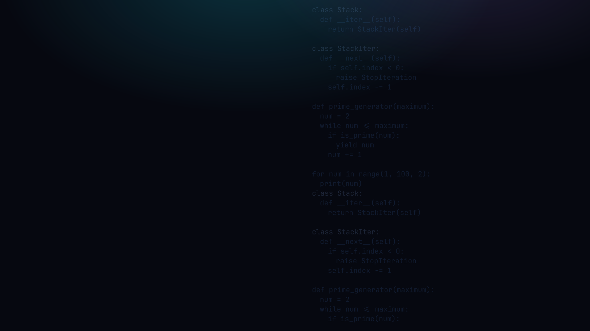

PYTHON PROGRAMMING 2
Iterators & Generators
The protocol behind every for loop, __iter__ / __next__, and yield, the lazy shortcut.
Edward Reynolds · StayAhead Training, 2026

Slide 2





CHAPTER 2 · ITERATORS & GENERATORS
What we'll cover
Iterable
Iterator
The target of a for loop · has __iter__
Produces values on demand · __next__
A Custom Iterable
Generators
Your own __iter__ / __next__ classes
yield: an iterator with no class
Generator Use Cases
Laziness · range & open built-ins
Contents · 01

Slide 3
ITERABLE
The target of a for loop
The target of a for loop is an iterable, e.g.:
iterable.py
• An iterable implements __iter__
• list, tuple, str, dict, set
• ... are all iterable
for char in "iterable":
print(char)
Iterable · 02

Slide 4
ITERATOR
Produces values on demand: the protocol
• An iterator produces values on demand, one at a time
• It implements __next__; an iterable's __iter__ returns one
• When values run out it raises StopIteration
iter_next.py
it = iter("ab")
# -> "ab".__iter__()
x = next(it)
# -> it.__next__()
• iter() gets an iterator from an iterable
• next() gets the next item from an iterator
Iterator · 03

Slide 5
ITERATOR
What a for loop really does inside
WHAT YOU WRITE
WHAT PYTHON DOES
for_loop.py
while_loop.py
for char in "iterable":
print(char)
it = iter("iterable")
while True:
try:
char = next(it)
print(char)
except StopIteration:
break
A for loop is just a while loop over next() that stops on StopIteration.
Iterator · 04

Slide 6

YOUR TURN
Iterator basics
Setup: create iterators.py and iterators_test.py. Code in the first, try it in the second.
1 · Differentiate iterable vs iterator (which dunder?)
2 · Name the built-ins for (a) iterator-from-iterable, (b) next item
3 · Rewrite a for loop as its iter / next / StopIteration form
Your turn · 05

Slide 7
A CUSTOM ITERABLE
The iterable class: __iter__
stack.py
1 class Stack:
2 def __init__(self):
3 self.values = []
4
5 def push(self, value):
6 self.values.append(value)
7
8 def __iter__(self):
9 return StackIter(self)
__iter__ returns
a fresh iterator
A Custom Iterable · 06

Slide 8
A CUSTOM ITERABLE
The iterator class: __next__ + StopIteration
stack_iter.py
1 class StackIter:
2 def __init__(self, stack):
3 self.stack = stack
4 self.index = len(stack.values) - 1
5
6 def __next__(self):
7 if self.index < 0: raise StopIteration
8 value = self.stack.values[self.index]
9 self.index -= 1
10 return value
A Custom Iterable · 07

Slide 9
YOUR TURN
Custom iterable
4 · Write an iterable Fibonacci class that yields the sequence up to a maximum
Give it __iter__ and __next__, just like the Stack / StackIter pair
iterators_test.py
stop once the
next value > max
for n in Fibonacci(max=20):
print(n)
# 0 1 1 2 3 5 8 13
Your turn · 08

Slide 10
GENERATORS
A shortcut to an iterator
• A generator is a function with one or more yield statements. Calling it returns an iterator
• Each yield pauses the function and hands back a value
• The next call resumes where you left off, local state kept for free
• An iterator without coding any classes. Far less code
Generators · 09

Slide 11
GENERATORS
yield in action: resuming where you left off
simple_generator.py
def simple_generator():
yield 1
yield 2
yield 3
# the function is called only once!
for num in simple_generator():
print(num)
each yield pauses,
then resumes on next()
Generators · 10

Slide 12
YOUR TURN
Generators
5 · Write a generator that yields multiples of 6 up to a max
6 · Which built-in makes that generator redundant? (hint: range step)
iterators.py
yield, do not return
a whole list
def multiples_of_6(mx):
...
yield n
Your turn · 11

Slide 13
GENERATOR USE CASES
Why bother? Process every prime up to N
1 · HARD-CODED LIST
2 · COMPUTE IN A LOOP
3 · A GENERATOR
primes_list.py
primes_loop.py
prime_generator.py
primes = [2, 3, 5, 7, ...]
for p in primes:
...
# 2 million? can't.
n = 2
while n <= 20:
if is_prime(n): ...
n += 1 # tangled
def primes(mx):
n = 2
while n <= mx:
if is_prime(n):
yield n
List doesn't scale → loop scales but tangles find & use → generator is lazy, parameterised, reusable.
Use Cases · 12

Slide 14
GENERATOR USE CASES
You already use these: range & open
range: a lazy sequence
open: a lazy file
range_demo.py
open_demo.py
# generated on demand
for n in range(1, 100, 2):
print(n)
# read in chunks if needed
f = open("big.txt")
for line in f:
print(line)
range(start, stop, step), holds nothing in memory
a 10 GB file never loads at once
Both are lazy iterables, the same idea as prime_generator: compute / read only what's needed, when it's needed.
Use Cases · 13

Slide 15
YOUR TURN
Reflect
7 · Weigh the pros & cons of iterators / generators vs a plain list
WHEN A GENERATOR WINS
WHEN A LIST WINS
• Lazy, memory-light, even huge / infinite
• One-pass streaming (logs, files, feeds)
• Tiny code, no iterator class
• Re-iterate freely, generators are single-use
• Indexing & len(), generators have neither
• Small, reused data you hold anyway
Repo: stayahead-training/python-2-exercises · content/iterators-and-generators.md
Your turn · 14

Slide 16

Recap & questions
• Iterable has __iter__; iterator has __next__, one returns the other
• A for loop is iter() + next() + StopIteration under the hood
• Generators: yield gives you an iterator, no class, lazy & memory-light

