Slide 1
CAP4770 Final Project
Corbin Lane
EDWIN J SOTO LOPEZ

Slide 2


Credit Card Fraud Detection Using Machine Learning
Problem Statement: Credit card fraud
Research Objective: to develop a model that can accurately identify fraudulent credit card transactions
Data Source: Credit Card Fraud Detection Dataset (creditcard.csv)

Slide 3
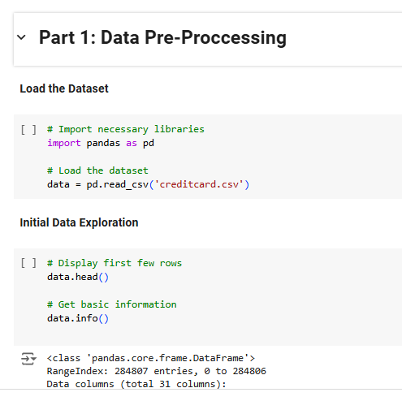
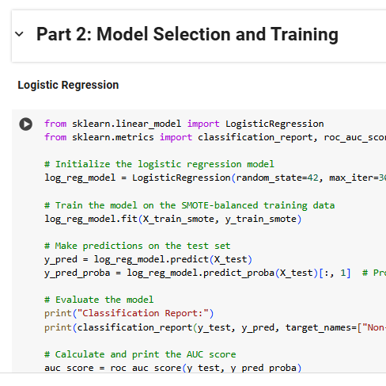
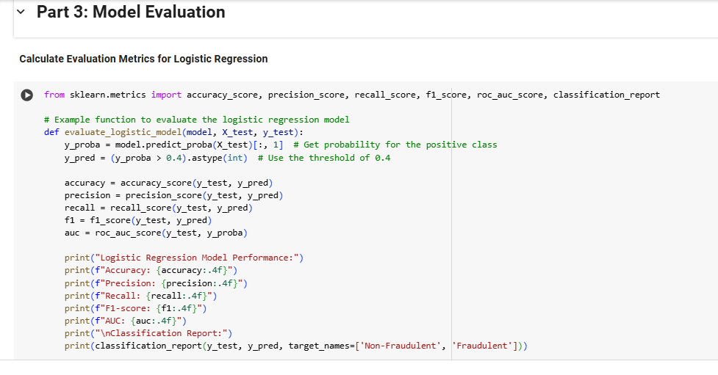
Methodology Overview
1: Data Preprocessing
2: Model Selection and Training
3. Model Evaluation

Slide 4
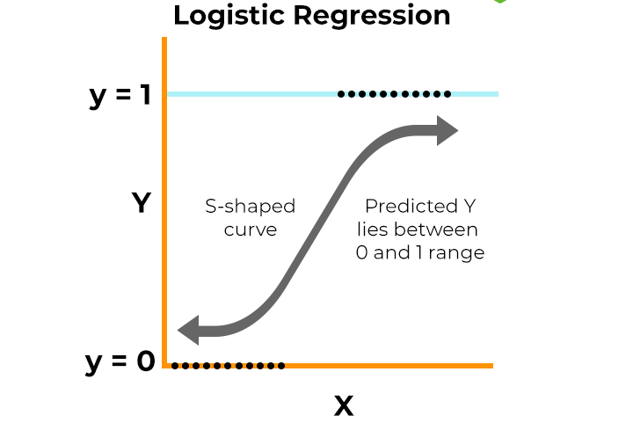

Models Used
Logistical Regression
Random Forest

Slide 5
Why Logistic Regression?
1. Simple and easy to interpret results.
2. Effectively models linear relationships.
3. Provides probabilistic predictions for fraud likelihood.

Slide 6
Strengths of Logistic Regression
1. Robust to noise and multicollinearity.
2. Suitable for imbalanced datasets with proper techniques.
3. Minimal computational requirements.

Slide 7
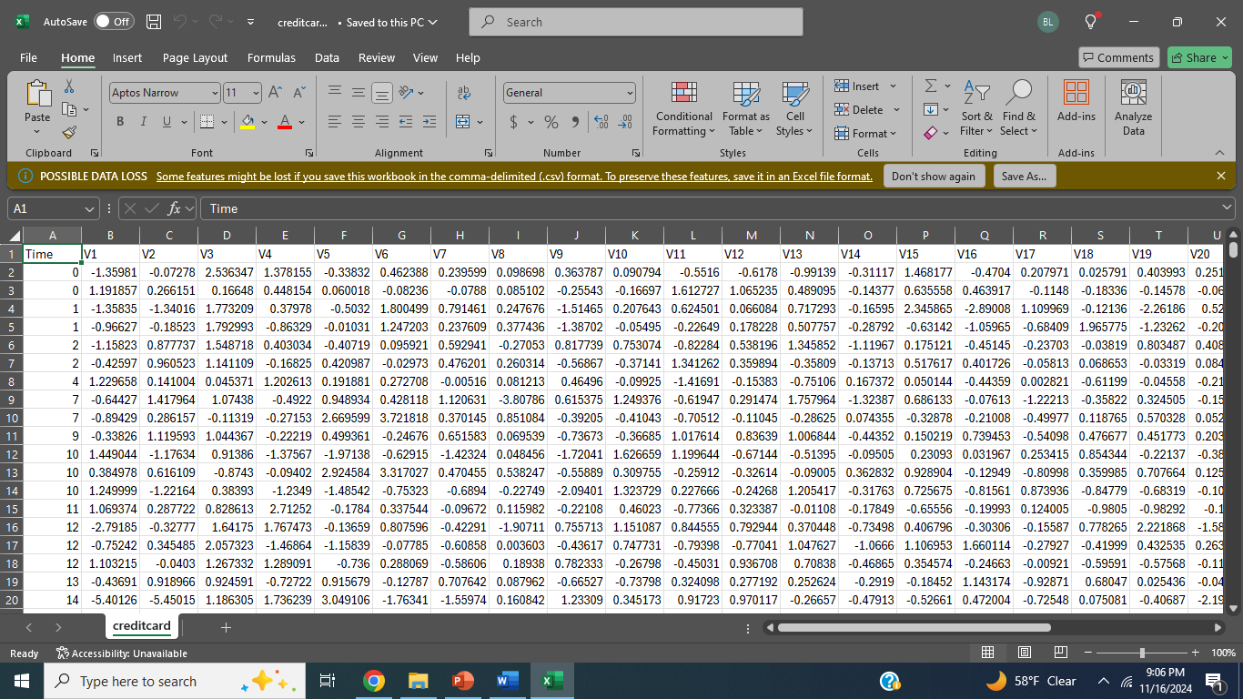
Strengths of Random Forest
1. High accuracy.
2. Resistant to overfitting.
3. Versatile across various types of data.

Slide 8
Model Comparison: Logistic Regression vs. Random Forest
1. Model Complexity.
Logistic Regression: A relatively simple linear model
Example: Predicting the likelihood of a customer churning.
Random Forest: A complex ensemble model.
Example: Detecting fraudulent transactions.
2. Random Forest outperforms with complex, non-linear patterns.
3. Both models complement each other based on dataset properties.

Slide 9

Handling Imbalanced Data
1. SMOTE for balancing training data.
2. Weight adjustments for Logistic Regression.
3. Class balancing in Random Forest.

Slide 10
Evaluation Metrics Overview
Precision to minimize false positives.
Recall to ensure all fraud cases are detected.
AUC for overall model effectiveness.

Slide 11
Key Lessons Learned
The Importance of Pre-processing.
Model selection will always require trade offs.
Balancing Performance Metrics is Challenging.
Deployment Requires More than Just a Good Model.

Slide 12
Conclusion
To summarize, while Logistic Regression has higher precision, the Random Forest model strikes a better balance between identifying fraudulent transactions and avoiding false positives, making it the stronger overall choice for fraud detection in this case.

Slide 13
Works Cited
Tan, P.-N., Steinbach, M., Karpatne, A., & Kumar, V. (2019). Introduction to data mining (Global edition.). Pearson.
Chowdhury, D., Hovda, S., & Lund, B. (2023). Analysis of cuttings concentration experimental data using exploratory data analysis. Geoenergy Science and Engineering, 221, 111254-. https://doi.org/10.1016/j.petrol.2022.111254
Hong, H., Pourghasemi, H. R., & Pourtaghi, Z. S. (2016). Landslide susceptibility assessment in Lianhua County (China): A comparison between a random forest data mining technique and bivariate and multivariate statistical models. Geomorphology, 259, 105–118. https://doi.org/10.1016/j.geomorph.2016.02.012
Ziegler, A., & König, I. R. (2014). Mining data with random forests: current options for real-world applications. Wiley Interdisciplinary Reviews. Data Mining and Knowledge Discovery, 4(1), 55–63. https://doi.org/10.1002/widm.1114
What is Logistic Regression? - Logistic Regression Model Explained - AWS. (n.d.). Amazon Web Services, Inc. https://aws.amazon.com/what-is/logistic-regression/
Stojiljković, M. (2023, June 26). Logistic Regression in Python. https://realpython.com/logistic-regression-python/
W3Schools.com. (n.d.). https://www.w3schools.com/python/python_ml_logistic_regression.asp

