Slide 1
NativeScript Extensibility
Go beyond the basics
Sebastian Witalec

Slide 2

Now presenting – Sebastian Witalec
Developer Advocate for Telerik
NativeScript Champion
Working with the Dev community in London:
International Developers
Software Architecture & Mentorship
NativeScript Insiders London
Notes:
A little bit about me
My name is Sebastian Witalec.
I work as a Technical Evangelist for Telerik. And I am a member of the NativeScript team.
I am engaged with various Dev communities in London, such as the International Developers group, Software Architecture & Mentorship Group and the NativeScript Insiders London group.
<Before the next slide>
Today I am going to talk about:
My background is primarily in Data Quality solutions, think software that handles data of questionable quality and makes something meaningful with it.
My challenges were around the performance of the data processing workflows. I didn’t have to care about the visual part of the solution. If we told the users to use IE 6 to access the dashboard, then that is what they would use. Except we didn’t ☺
I’ve recently transitioned into mobile development and that really put me out of my comfort zone. I have a newfound respect for the UX and I had to learn how to solve a completely different set of challenges.
<Before the next slide>
This is enough about me.
Here are the things that I am going to talk about

Slide 3
What is Extensibility
“In software engineering, extensibility is a system design principle where the implementation takes future growth into consideration.
It is a systemic measure of the ability to extend a system and the level of effort required to implement the extension.”
Wikipedia: http://en.wikipedia.org/wiki/Extensibility

Slide 4
NativeScript World
JavaScript
Native
External JavaScript Libraries
Platform API
Custom UI Components
External Native Libraries
#1
#2
#3
#4

Slide 5
#1 External JS Libraries - basics
No browser
so
No browser dependant libraries
YES:
moment.js
underscore.js
so
NO:
jQuery.js
d3.js

Slide 6
#1 External JS Libraries
Copy
Require
Use

Slide 7
#1 External JS Libraries (Moment.js)
DEMO

Slide 8
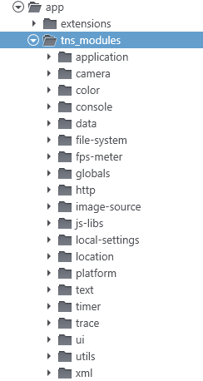
NS Modules
Notes:
NativeScript comes equipped with a rich set of Modules,
which allow us to take advantage of the platform specific functionality,
without the need to know how to implement them on each platform.

Slide 9
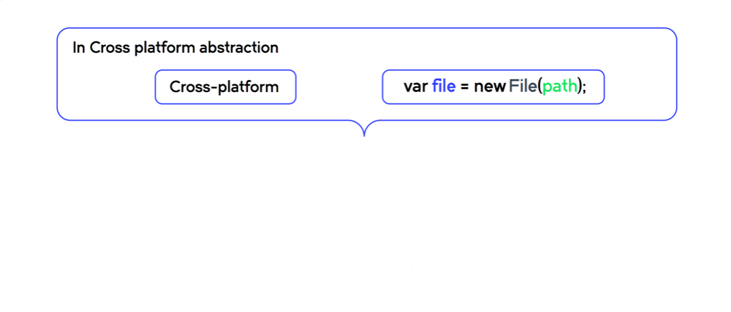
NS Modules

Slide 10
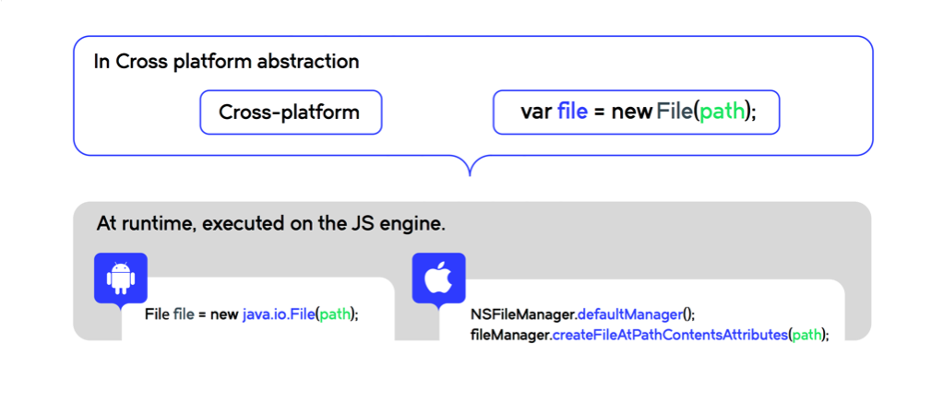
NS Modules

Slide 11
Building NS Modules
name-common.js
name.adroid.js
name.ios.js
Shared:
Platform Specific:
Notes:
In order to build a module it is important to understand the structure.
A module implementation is divided into:
Shared code: that is common across all platforms
Platform specific: where we use JavaScript to access the Native API

Slide 12
Building NS Modules At runtime
name-common.js
name.js
Shared:
Platform Specific:
Notes:
In order to build a module it is important to understand the structure.
A module implementation is divided into:
Shared code: that is common across all platforms
Platform specific: where we use JavaScript to access the Native API

Slide 13

#2 Building NS Modules Flashlight
Notes:
To show you how:
I am going take you through the steps required to build a flashlight module

Slide 14
#2 Flashlight android code http://developer.android.com/reference/android/hardware/Camera.html
var camera = android.hardware.Camera.open();
var p = camera.getParameters();
function on() {
p.setFlashMode( "torch" );
camera.setParameters( p );
camera.startPreview();
};
function off() {
p.setFlashMode( "off" );
camera.setParameters( p );
camera.stopPreview();
};
Notes:
In order to access flashlight on Android we need to:
Obtain an instance of Native Camera with open().
Get existing (default) settings with getParameters().
Once that is ready we can then setTheFlash ON and OFF.

Slide 15
#2 Flashlight iOS code https://developer.apple.com /library/prerelease/ios/documentation/AVFoundation/Reference/AVCaptureDevice_Class/
var device = AVCaptureDevice.defaultDeviceWithMediaType( AVMediaTypeVideo );
function on() {
device.lockForConfiguration( null );
device.torchMode = AVCaptureTorchMode.AVCaptureTorchModeOn;
device.flashMode = AVCaptureFlashMode.AVCaptureFlashModeOn;
device.unlockForConfiguration();
};
function off() {
device.lockForConfiguration( null );
device.torchMode = AVCaptureTorchMode.AVCaptureTorchModeOff;
device.flashMode = AVCaptureFlashMode.AVCaptureFlashModeOff;
device.unlockForConfiguration();
};

Slide 16
#2 Flashlight: functions
Toggle
IsOn
On
Off

Slide 17
#2 Flashlight: functions
On
Off
Toggle
IsOn

Slide 18
#2 Building NS Module based on native API Flashlight Module
flashlight.ios.js
Shared:
flashlight-common.js
Platform Specific:
flashlight.android.js

Slide 19
#2 NS Modules based on native API (Flashlight)
DEMO

Slide 20
#2 Publish it as NPM Module
Register an account
npm adduser
Initialise your module
npm init
Publish your module
npm publish
Install
npm install <module name>
(adds package.json)

Slide 21
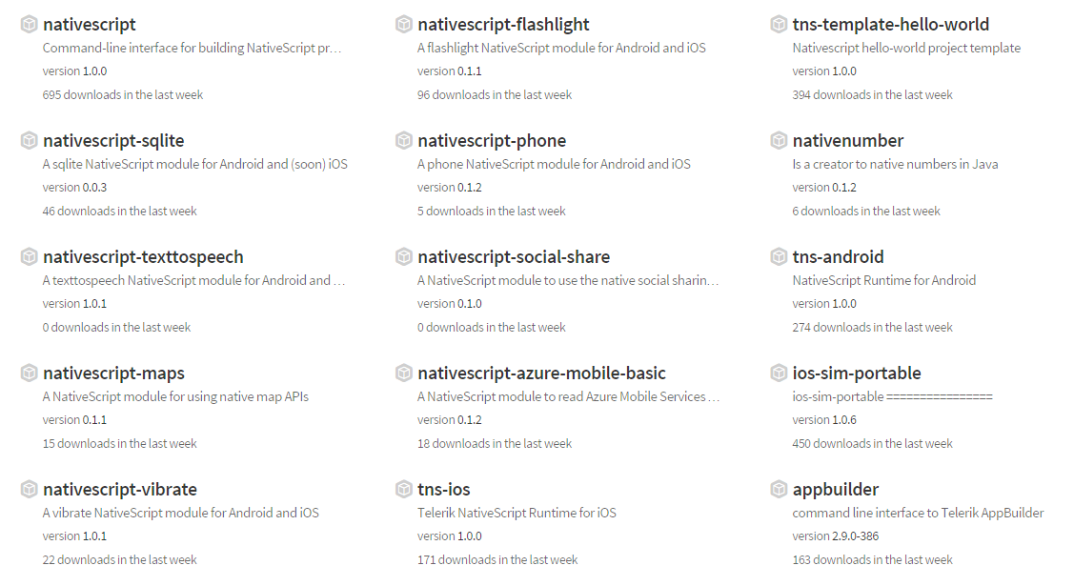
#2 Existing NativeScript modules www.npmjs.com/search?q=nativescript

Slide 22
#3 Custom UI Controls/Templates
Made of:
Component view [XML]
Component code [JavaScript]
Notes:
Create view component.xml
Create code-behind component.js

Slide 23
#3 Custom UI Controls LoginComponent
Username: [_________]
Password: [_________]
loginComponent.xml
<StackLayout>
<Label text="Username:" />
<TextField text="{{username}}" width="100"/>
<Label text="Password: "/>
<TextField text="{{password}}" secure="true" width="100"/>
<Button text="Log in" tap="onLogIn" />
</StackLayout>
loginComponent.js
exports.onLogIn = function(args) {
//Do something here
}
Log In

Slide 24
#3 Custom UI Controls LoginComponent
Username: [_________]
Password: [_________]
loginComponent.xml
<StackLayout>
<Label text="Username:" />
<TextField text="{{username}}" width="100"/>
<Label text="Password: "/>
<TextField text="{{password}}" secure="true" width="100"/>
<Button text="Log in" tap="onLogIn" />
</StackLayout>
loginComponent.js
exports.onLogIn = function(args) {
//Do something here
}
Parent
Binding-Context
Log In
Module Code

Slide 25
#3 Using Custom Controls
<Page>
<StackLayout>
<Label text="Custom Component" />
<StackLayout>
</Page>

Slide 26
#3 Using Custom Controls
<Page xmlns:myPrefix=" ">
<StackLayout>
<Label text="Custom Component" />
<StackLayout>
</Page>

Slide 27
#3 Using Custom Controls
<Page xmlns:myPrefix="path-to-controls-folder">
<StackLayout>
<Label text="Custom Component" />
<StackLayout>
</Page>

Slide 28
#3 Using Custom Controls
<Page xmlns:myPrefix="path-to-controls-folder">
<StackLayout>
<Label text="Custom Component" />
<myPrefix: />
<StackLayout>
</Page>

Slide 29
#3 Using Custom Controls
<Page xmlns:myPrefix="path-to-controls-folder">
<StackLayout>
<Label text="Custom Component" />
<myPrefix:ComponentName />
<StackLayout>
</Page>

Slide 30
#3 Using Custom Controls Login Example
<Page xmlns:myComponents="extensions/login-module">
<StackLayout>
<Label text="Custom Component" />
<myComponents:loginComponent />
<StackLayout>
</Page>

Slide 31
#3 Custom UI Control
DEMO

Slide 32

The session contains
examples in TypeScript
Proceed with caution

Slide 33

#3 Extended UI Controls
Inherit from existing components
export class myCustom extends Component
Create something bigger
and hopefully better
Notes:
Allows nesting (if base class is a container)
Custom properties
Full MVVM binding on custom properties

Slide 34
#3 Extended UI Controls: Custom Properties
Component
set electrodeType(value: string) {
this._electrodeType = value;
}
XML
<myControl:MyComponent electrodeType="copper" />

Slide 35
#3 Extended UI Controls: Custom Properties with Binding
Component
this.powerTextField = new textFieldModule.TextField();
var bindingOptions = {
sourceProperty: "power",
targetProperty: "text",
twoWay: true
};
this.powerTextField.bind(bindingOptions, this);
XML
<myControl:MyComponent power="{{frankStrength}}" />

Slide 36
#3 Extended UI Controls Nesting
XML
<myControl:MyComponent>
<Label text="Frank is your friend"/>
<Button text="Click Me" tap="wakeUpFrank" />
</ myControl:MyComponent>

Slide 37
#3 Extended UI Controls (LabelText)
DEMO

Slide 38
#4 Using Native 3rd party library
Import
Use
Build UI Module

Slide 39
#4 Using Native 3rd party library: Import
Create Project
tns create [app name]
Add required platforms
tns platform add [android/ios]
Add libraries
tns library add [android/ios] [URL]
Build
tns build [android/ios]

Slide 40
#4 Using Native 3rd party library: Build UI Module
Extend NS View Component
Expose 3rd party component
Implement NS default functions
Properties
Functions
Create
Add/Remove To Visual Tree

Slide 41

#4 Using Native 3rd party library: SideDrawer example

Slide 42
#4 Using Native 3rd party library: SideDrawer example
- SlideContent
- SlideContentWidth
- SlideMenu
- OpenSlideContent()
- CloseSlideContent()
Functions
Properties

Slide 43
#4 Using Native 3rd party library: Use SideDrawer
SURPRISE SURPRISE
<Page xmlns:myPrefix=“extensions/SideDrawer" />
<StackLayout>
<Label text=“Side Drawer below" />
<myPrefix:SideDrawer />
<StackLayout>
</Page>

Slide 44
#4 Using Native 3rd party library (SideDrawer)
DEMO

Slide 45
Questions?
?

Slide 46
Questions?
?
Thank you!
http://bit.ly/next-witalec

Slide 47
Feedback
http://bit.ly/next-witalec

Slide 48
#1 External JS Libraries
var moment = require("./extensions/moment");
var formattedDate = moment().format('MMMM Do YYYY');
//May 4th 2015
var day = moment().format('dddd');
//Monday

