Slide 1
Building Amroo with NS
You mean cross platform apps can actually work?
Miro

Slide 2
NativeScript
Why NS?
What’s in it for me/my team?
Where’s the catch?
Notes:
1. PERFORMANCE 2. One code base 3. Easy to learn 4. Simple setup
5. Extensibility

Slide 3

Winning!

Slide 4
AmWhat?

Slide 5
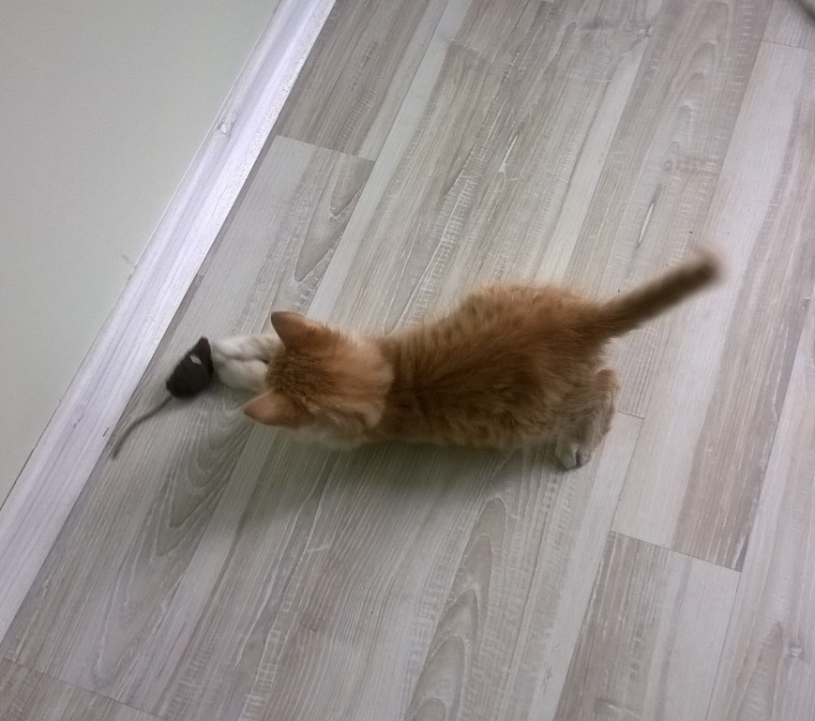
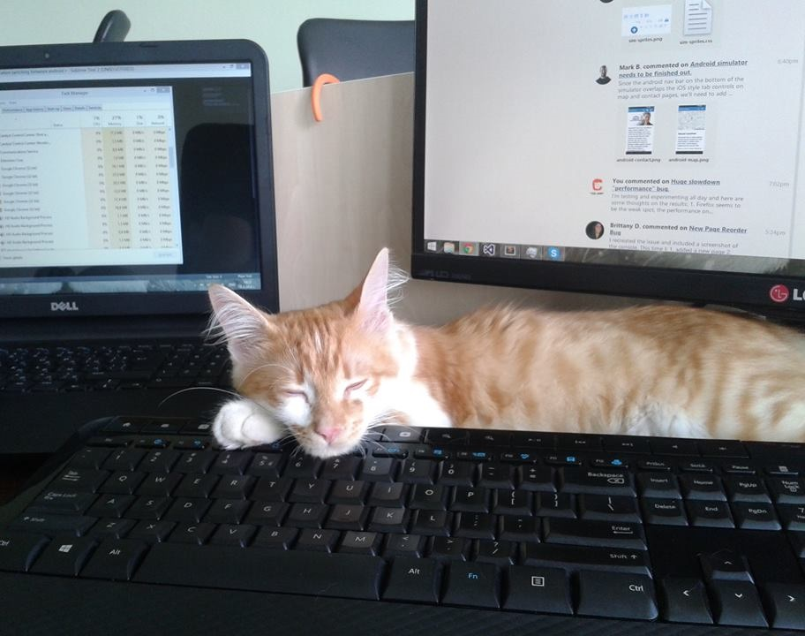
Pixel

Slide 6
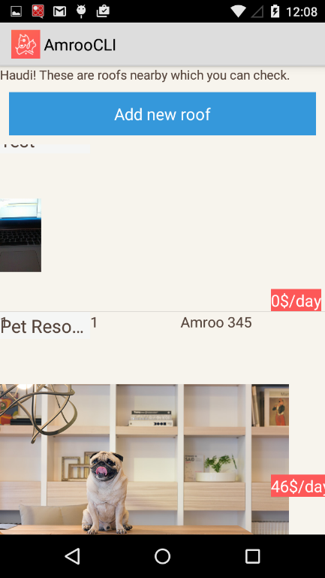
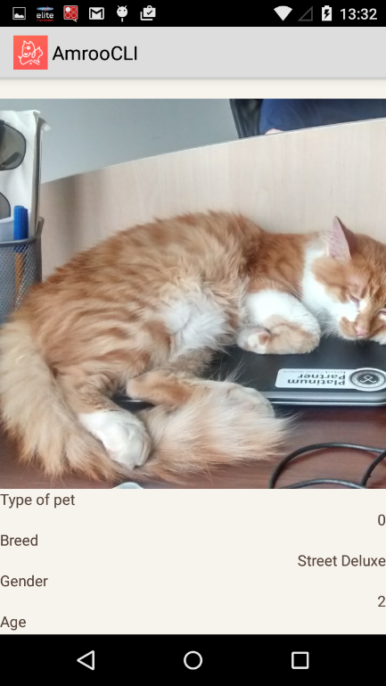
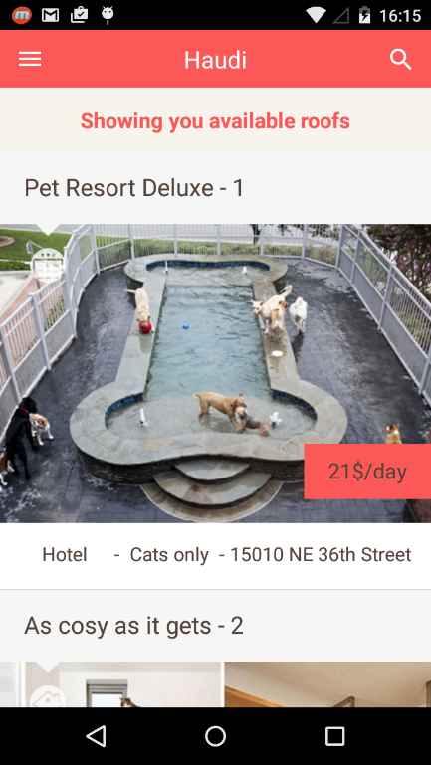
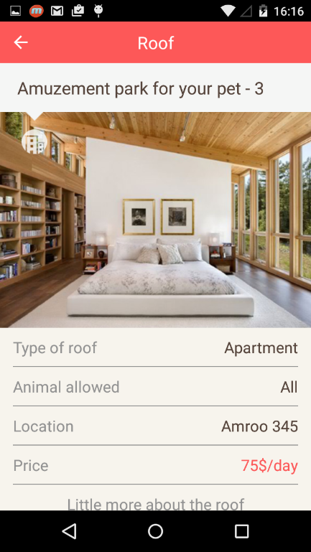
Demo

Slide 7
Tips & Tricks
Learn TypeScript!
Apply MVVM
Issue and info: https://github.com/NativeScript/NativeScript/issues
No need for documentation - tns_modules
https://www.npmjs.com/search?q=nativescript

Slide 9
Stay Cool!
Wanna know more or just say ‘Hi!’ miro@thecoolapps.com Rate(or hate) this session – bit.ly/next-valchev
Repo - https://github.com/MiroValchev/amroo-tnext Script of the talk will be available on these places: http://www.thecoolapps.com/blog/
https://www.facebook.com/CoolAppsBG https://medium.com/@WeirdDreaming

