Slide 1
Building Mobile Apps with Visual Studio
Michael Crump | @mbcrump | michaelcrump.net

Slide 2
Building Mobile Apps in Visual Studio meant this…

Slide 3
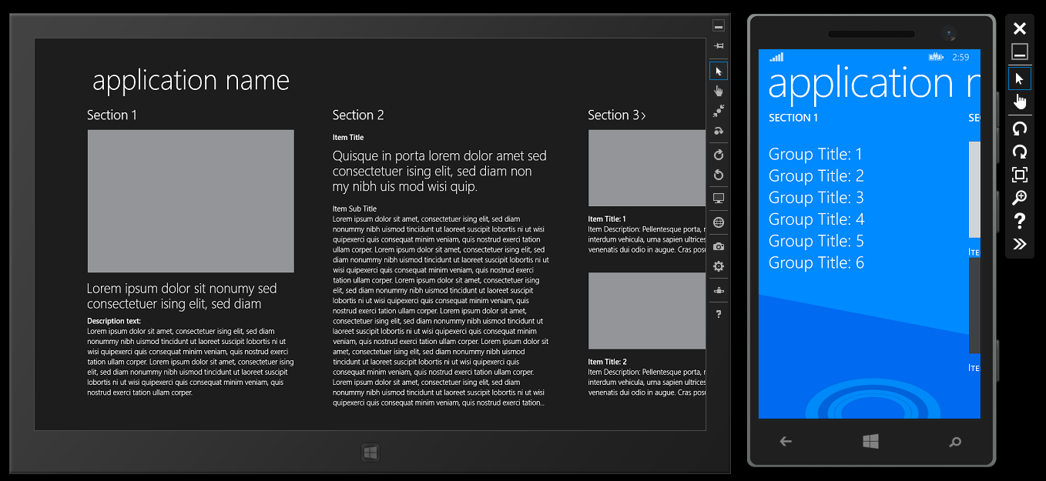

Slide 4



But What About the Other Major Players?
Just Kidding!

Slide 5


Slide 6
This Leads us to Several Questions
What are my best options for developing mobile apps using Visual Studio?
Can I develop for iOS without a Mac?
How can I develop for iOS or Android without learning Objective-C, Swift or Java?
How can I develop for all three using Visual Studio?

Slide 7

This Leads us to Several Options
Mobile Web
Hybrid Apps
Native Apps
Cross-Platform Native Apps

Slide 8
Mobile Web - Pros
Multiple Platforms – even BlackBerry! ☺
Use HTML5, JS, CSS3
Development cost is usually low
You can reuse your user interface and core logic
You don’t have to get approval from any app store

Slide 9
Mobile Web - Cons
Limited APIs
Limited Graphics
Limited to the Capabilities of the Mobile Browser
No Store Discoverability

Slide 10
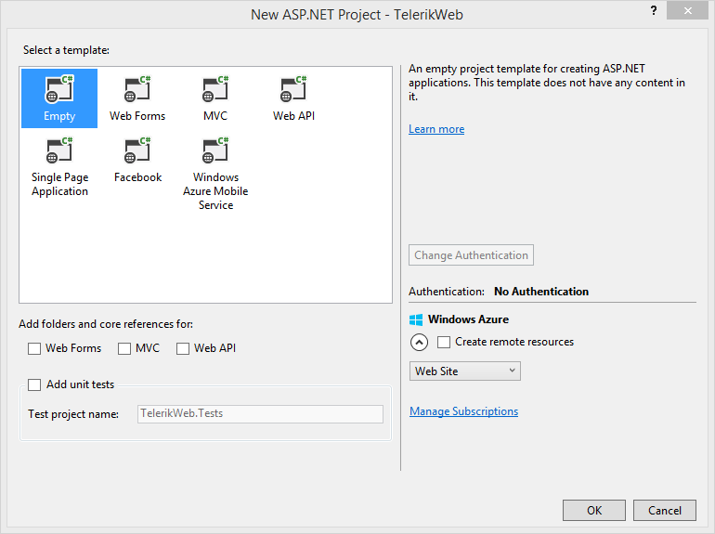
Mobile Web – Responsive Web Design

Slide 11
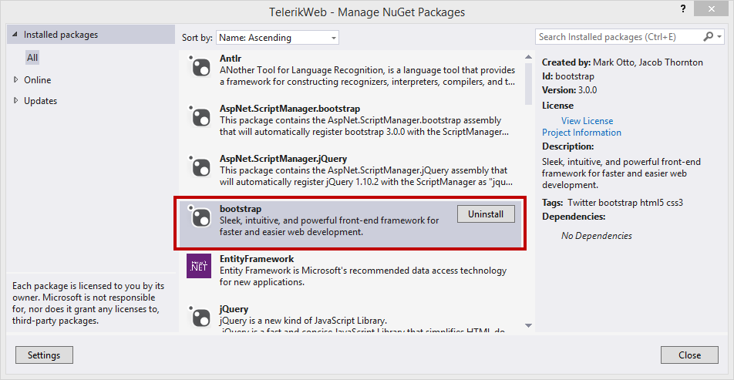
Mobile Web – Responsive Web Design

Slide 12
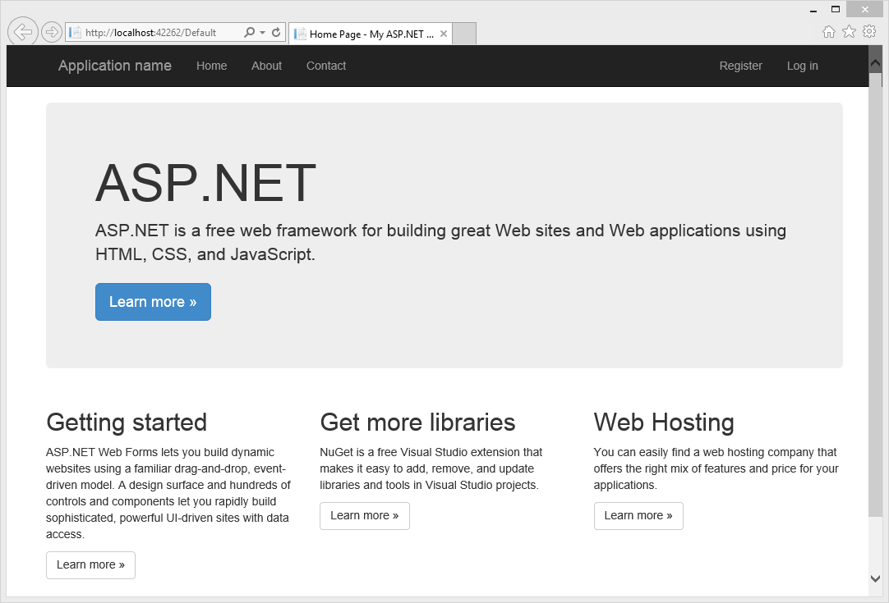
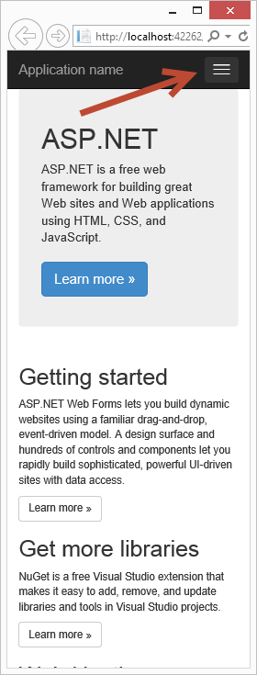
Mobile Web – Responsive Design

Slide 13
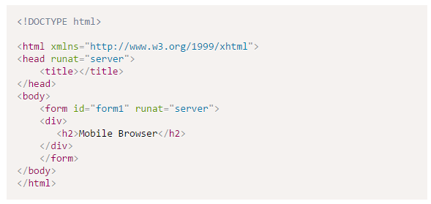
Mobile Web – Mobile Optimized Web Pages

Slide 14
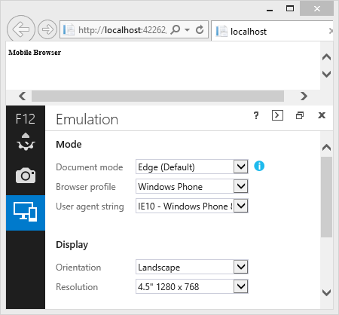
Mobile Web – Mobile Optimized Web Pages

Slide 15
Hybrid App - Pros
Multiple Platforms
Use HTML5, JS, CSS3
Development cost is usually low
You can reuse your user interface and core logic
Store Discoverability

Slide 16
Hybrid App - Cons
Performance*
Native APIs – what is provided by Cordova and Plug-ins built by the community
Moderate Graphics

Slide 17
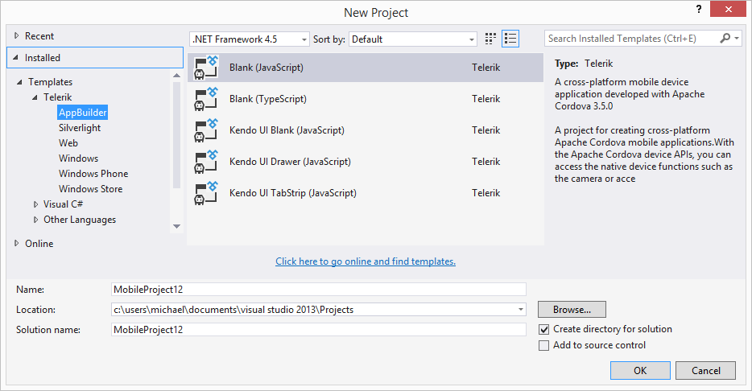
Hybrid Apps w/ Telerik AppBuilder

Slide 18
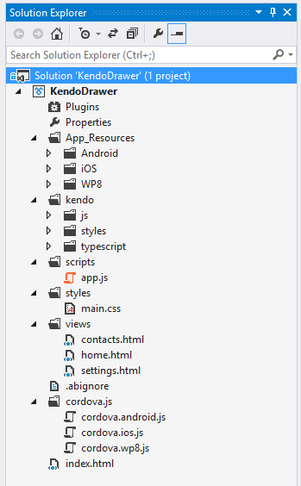
Hybrid Apps w/ Telerik AppBuilder

Slide 19
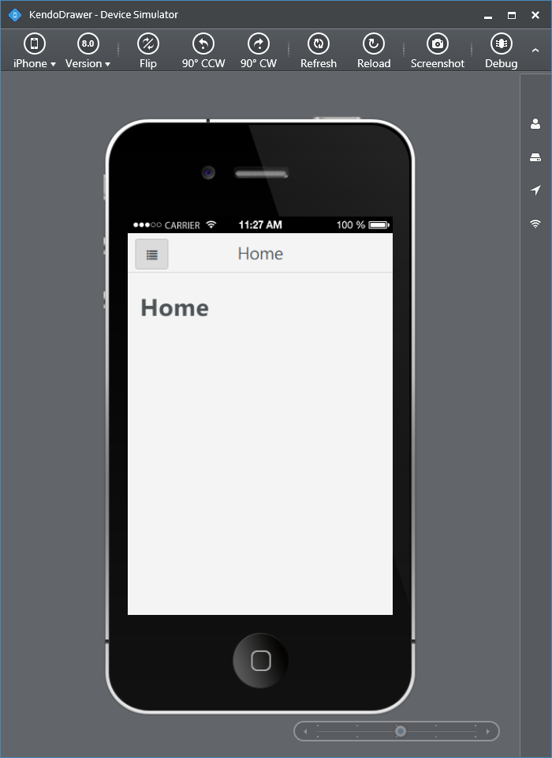
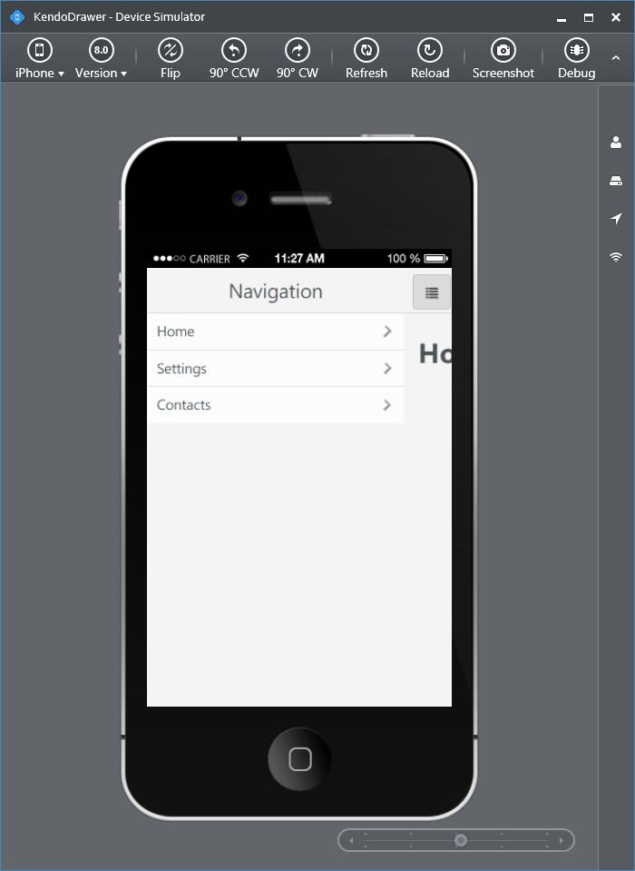
Hybrid Apps w/ Telerik AppBuilder (Built-in Simulator)

Slide 20
Demo – Hybrid

Slide 21
Native App - Pros
Access to all Native APIs
Advanced Graphics
Speed
App Store Distribution

Slide 22
Native App - Cons
Single Platform
High Development Cost

Slide 23
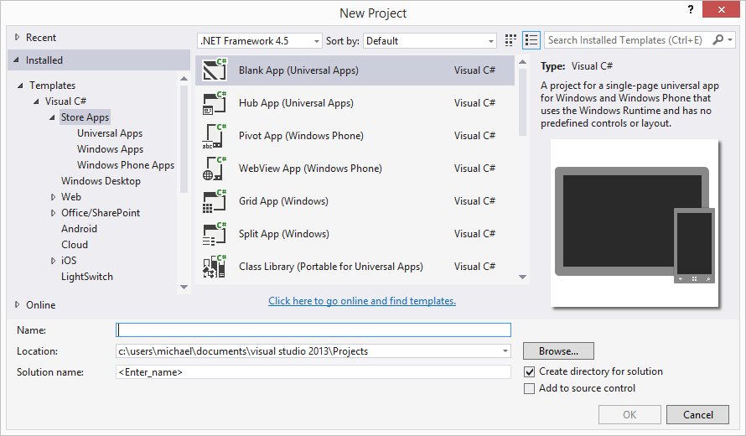
Native Apps supported by Microsoft

Slide 24
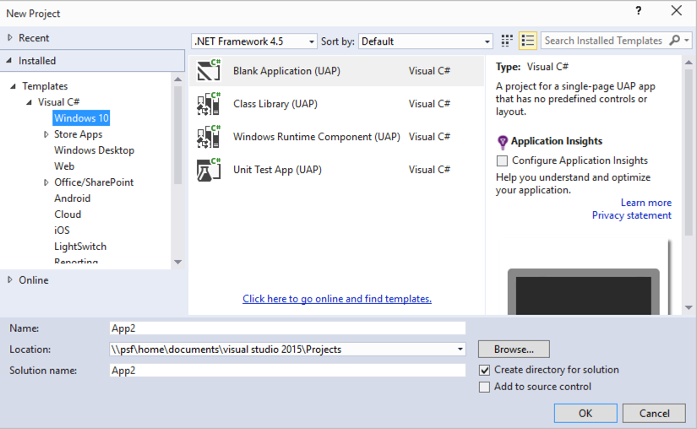
Native Apps – Universal App Platform

Slide 25
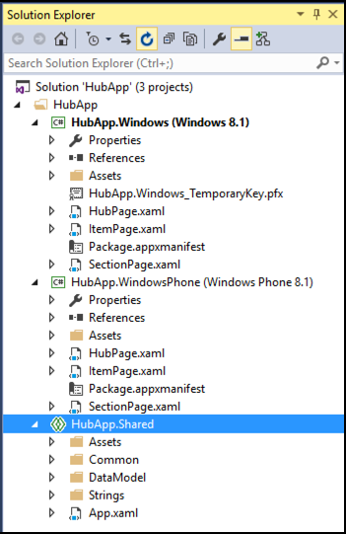
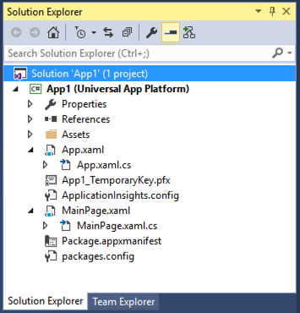
Native Apps supported by Microsoft

Slide 26
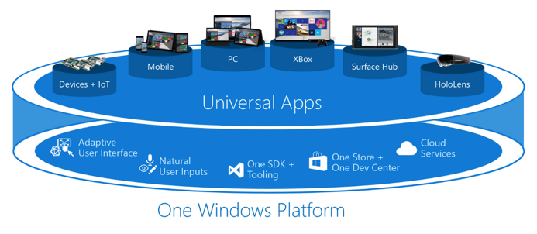

Slide 27
Cross-Platform Native Apps
Write in one language and it translates your code into apps that run across platforms.

Slide 28

NativeScript (nativescript.org)

Slide 29
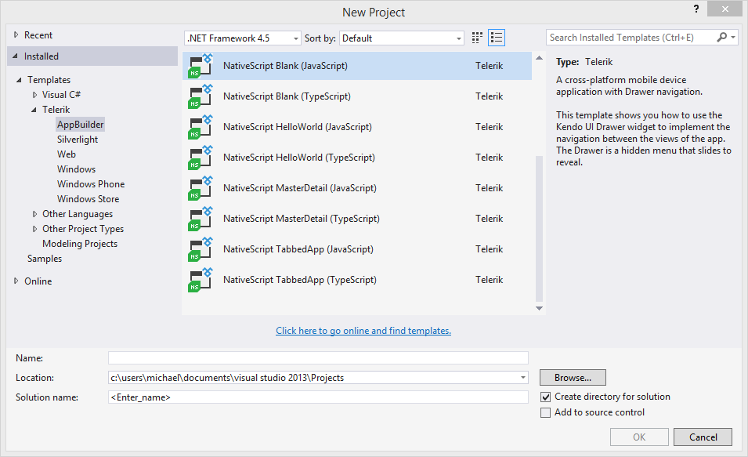
Native Apps with NativeScript

Slide 30
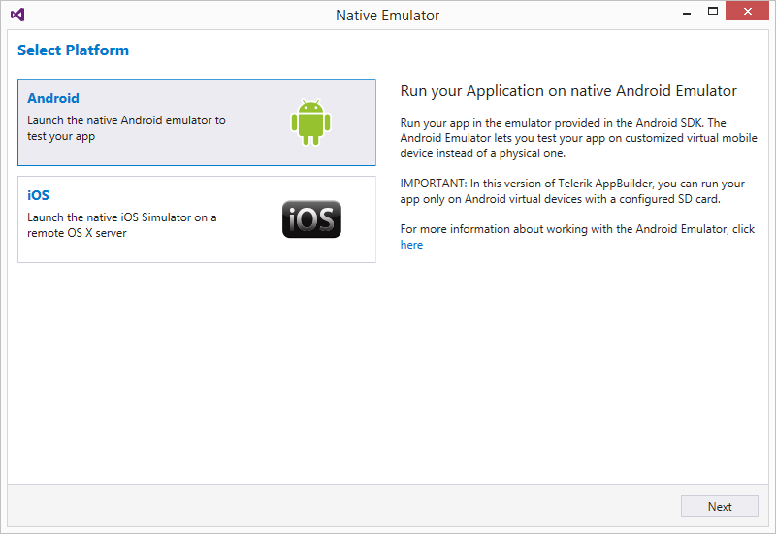
NativeScript

Slide 31
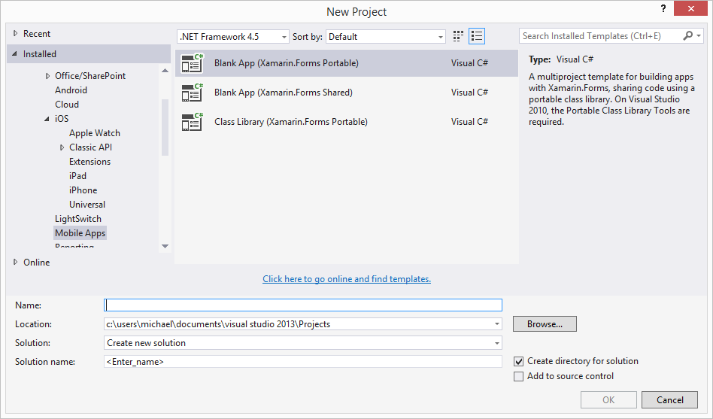
Native Apps with Xamarin

Slide 32
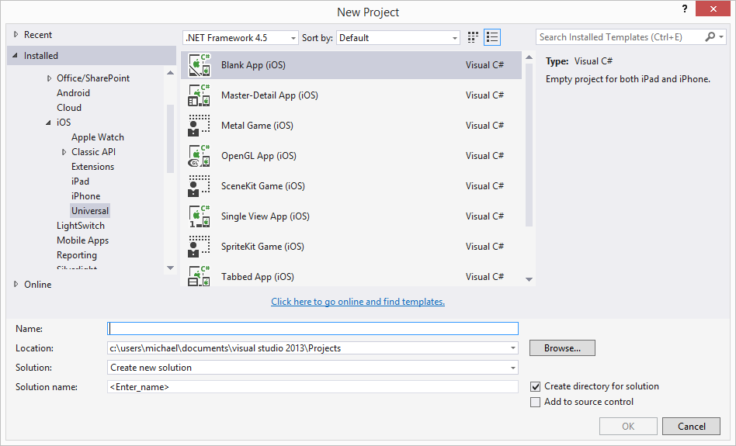
Native Apps with Xamarin - iOS

Slide 33
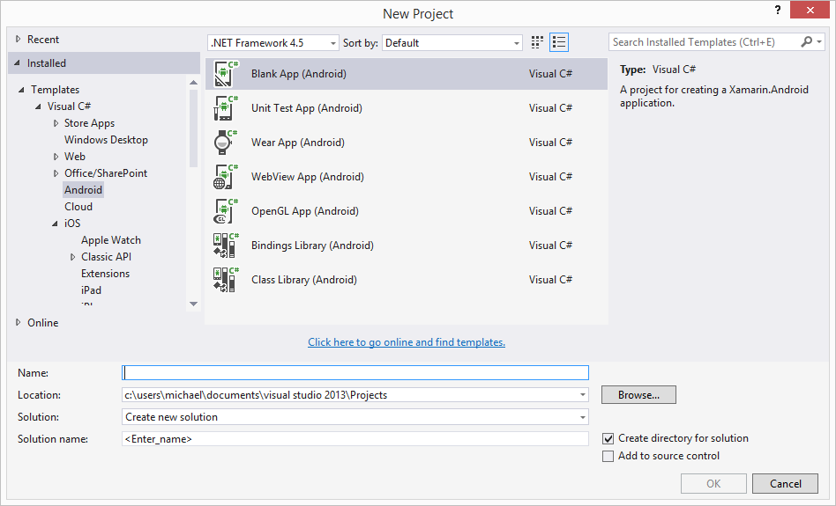
Native Apps with Xamarin - Android

Slide 34
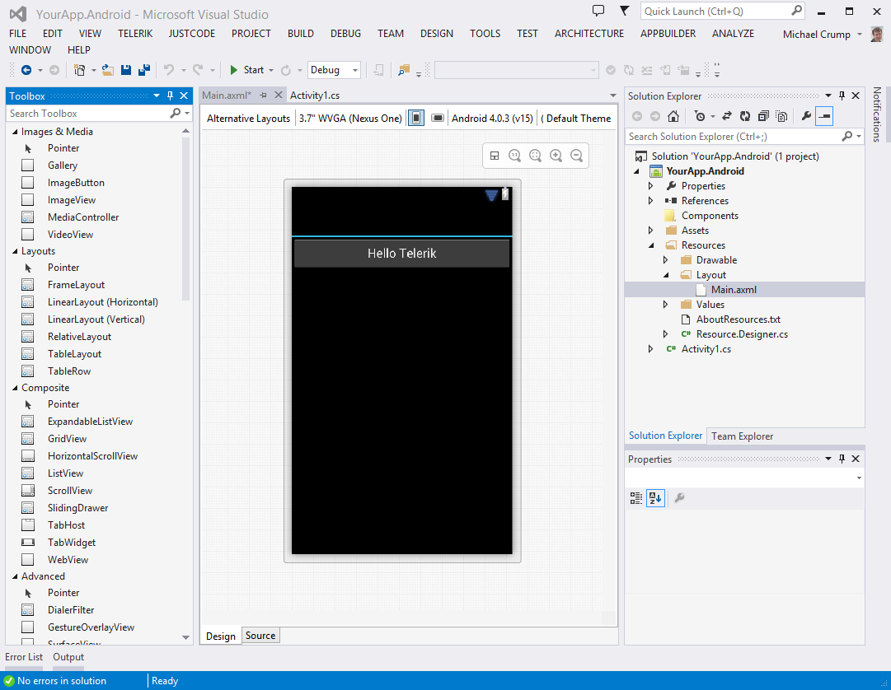
Native Apps with Xamarin - Android

Slide 35
Demo – Xamarin

Slide 36
Wrap-Up
What are you trying to accomplish?
Do you need a high performing app?
Do you need store discoverability?
These are just a few questions that your team should discuss before moving forward.
Choose the right technology for your team.
Strong web teams can jump straight into Mobile Web, Hybrid or NativeScript.
C# Skillset can be reused by Xamarin or MS based apps.

Slide 37
Thanks! Q&A Time
Slides/Code: https://github.com/mbcrump/CordovaCameraApp
https://github.com/mbcrump/XamarinChart
Session Survey: http://bit.ly/next-crump-2

